Slide 1
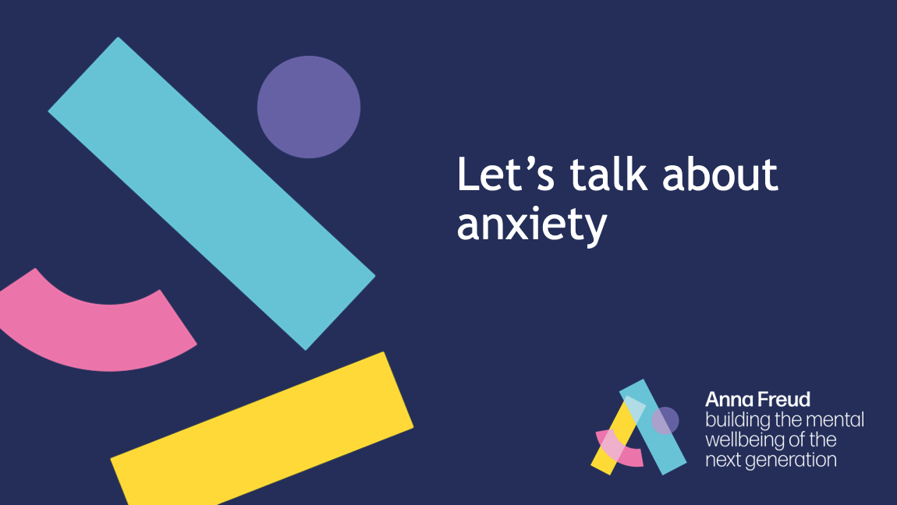
Notes:
Draw students’ attention to ‘unease’, ‘fear’ and ‘worry’. Ask for some other examples of feelings related to anxiety.
Ask students for a couple of further examples of when someone might feel anxious. How might it affect someone?
Explain that these responses are normal – and that there are some skills and techniques we can learn and practise to help manage anxious feelings.

Slide 2
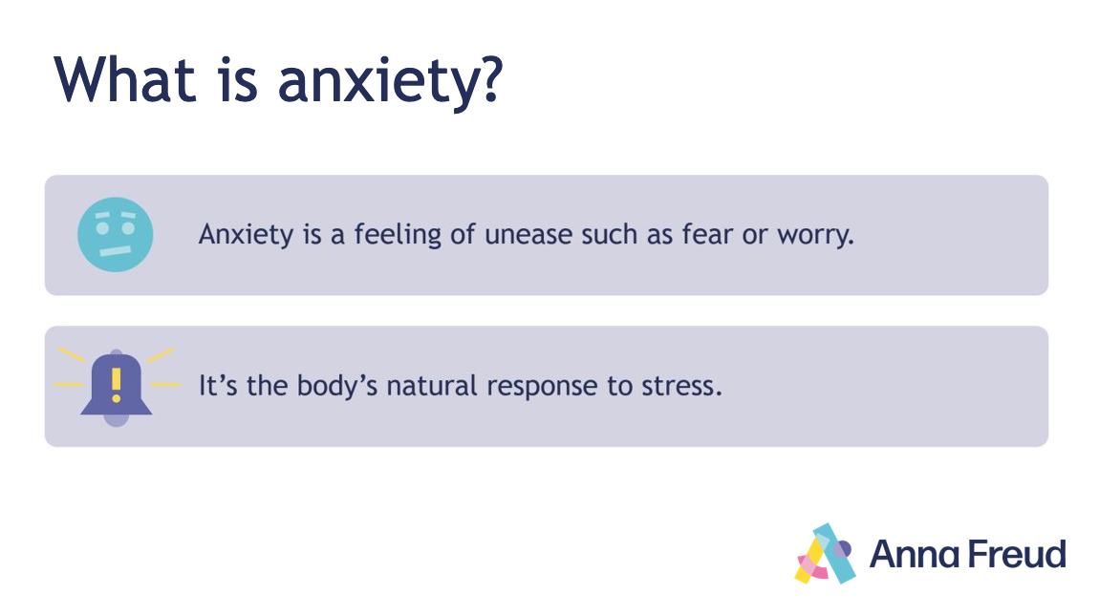
Notes:
Draw students’ attention to ‘unease’, ‘fear’ and ‘worry’. Ask for some other examples of feelings related to anxiety.
Ask students for a couple of further examples of when someone might feel anxious. How might it affect someone?
Explain that these responses are normal – and that there are some skills and techniques we can learn and practise to help manage anxious feelings.

Slide 3
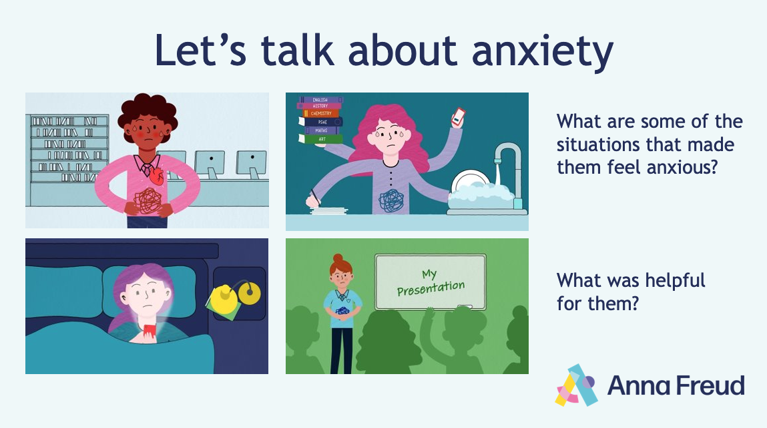

Notes:
Animation link: https://www.youtube.com/watch?v=dknTQktH5Z0
Alternative link: https://vimeo.com/825490584/15cc14f9bc
Introduce the Let’s talk about anxiety animation.
Ask students to look out for the characters on the slide, and to think about the following as they watch:
What are some of the situations that made them feel anxious?
How did it affect them?
What things were helpful for them?
After you have watched the animation, ask for hands up, and gather students’ responses to the questions, referring to the characters on the slides.
Encourage them to make comparisons between the different characters, situations and ways of responding.
Ask students to suggest their own examples of how someone might cope with anxious feelings.
At the end of the discussion, ask students to take a moment to reflect on when they might use any of the strategies covered in the animation.

Slide 4
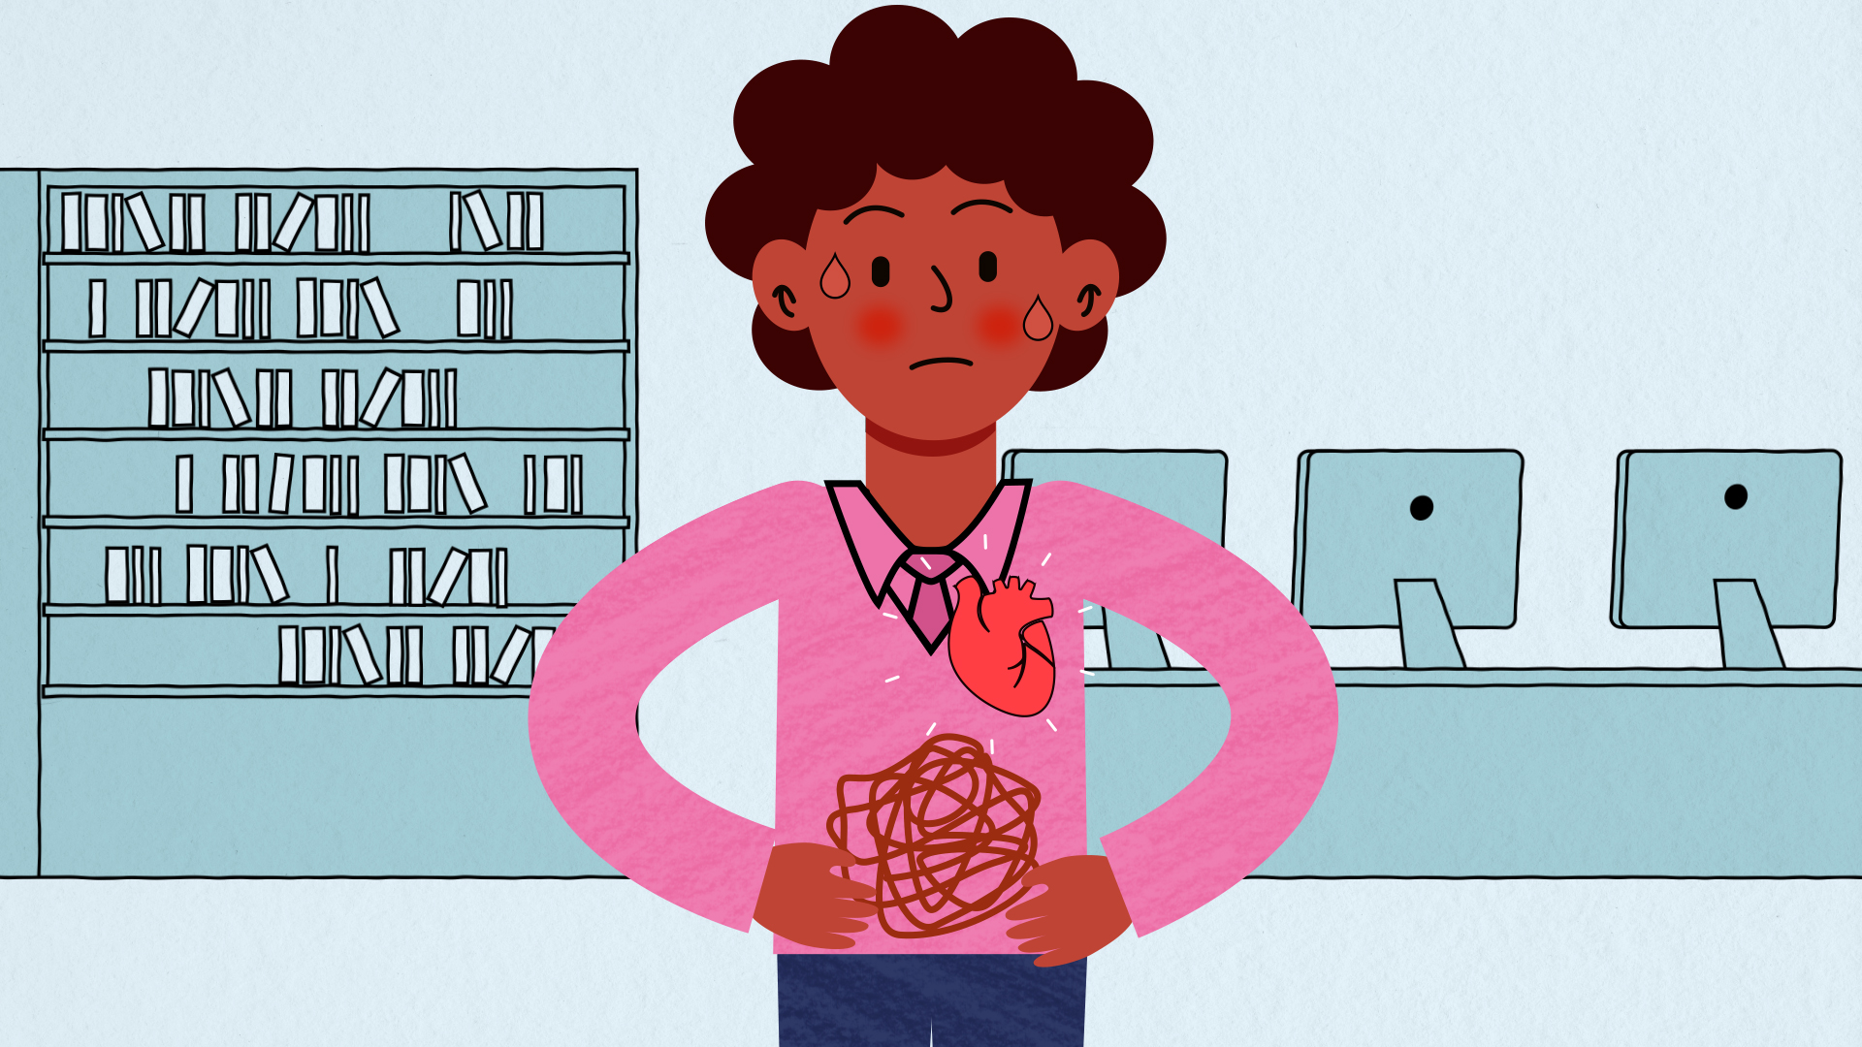
Notes:
What did we find out about how anxiety can affect our bodies? (e.g., sweating, heart racing, butterflies in stomach, feeling dizzy, fidgety, etc.)
How might it affect our thoughts, feelings and actions? (e.g., negative thoughts, acting impulsively, avoiding difficult situations).

Slide 5
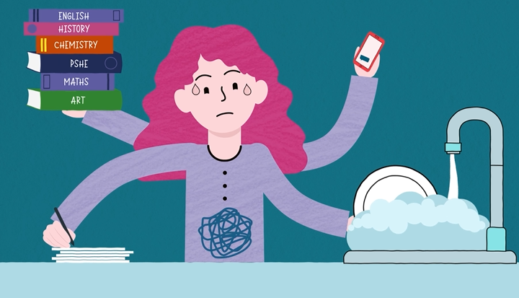
Notes:
What kinds of thoughts might be going through this character’s mind? (e.g., “I don’t have enough time”; “I’m going to fail my exam”; “My mum will be mad if I don’t finish my chores and do my homework”).
What could they try to manage better? (e.g., ask for help; create a schedule; stick to a routine; make time for self-care).

Slide 6
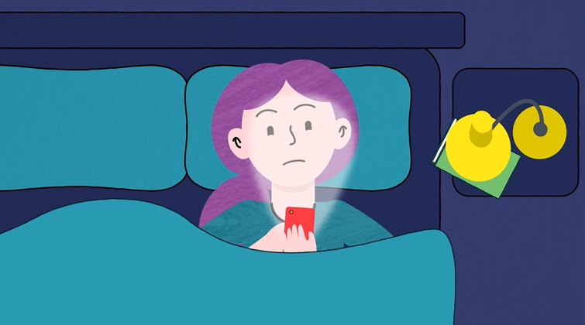
Notes:
What might this character be looking at on their phone? How might this affect them?
What could a healthy evening routine look like for them? (e.g., stop using phone 30 mins before bed; set phone to ‘night mode’; try not to use laptop and phone in bed; have a regular bedtime; listen to relaxing music, read, etc. to wind down).

Slide 7
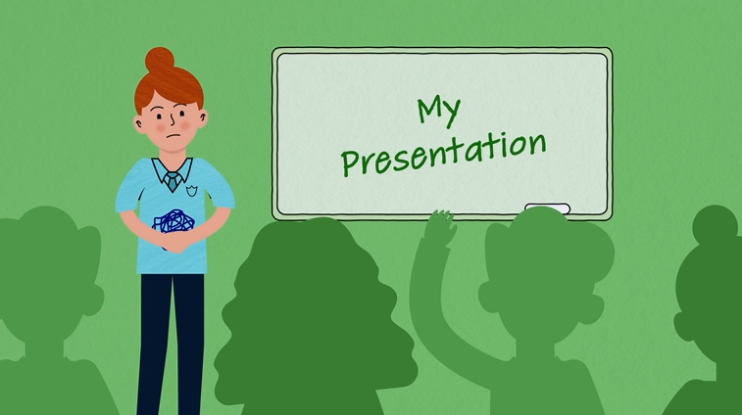
Notes:
What might this character be thinking or imagining? (e.g., “I don’t know what I’m talking about”; “I’m not ready”; “Everyone will laugh at me”; “I’ll go red”).
Explain that one thing they might try is ‘positive self-talk'. This is when we talk to ourselves in a kinder and more helpful way. (e.g., rather than thinking “There’s no way I can do this,” we might think “I’ve done it before, I’ll try my best”).
How could this character use positive self-talk to ‘talk back’ to her anxious thoughts?

Slide 8
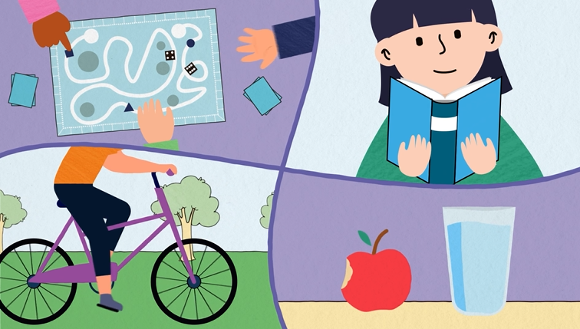
Notes:
What are some other skills and coping strategies that we can work on to help manage anxious feelings?

Slide 9

Further support
Here’s where you can find further support if you need it:
Speak to your teacher
-
-
-
-
Notes:
This slide is editable. Fill this slide with information about where students can find further support in your setting.
Close the assembly by emphasising that anxiety is a normal emotion, and that it’s important to try and find out what works for you.
Remind students that if they’re worried, they should speak to a trusted adult, and possibly seek specialist help (e.g., speak to your GP).
Remind students about the support available at school. Make yourself available to any students who want to speak further.

