Slide 1
Would you like to help raise awareness of dementia?
Help reduce stigma
Help support people to live well with dementia
Help to promote the positive messages around dementia

Slide 2
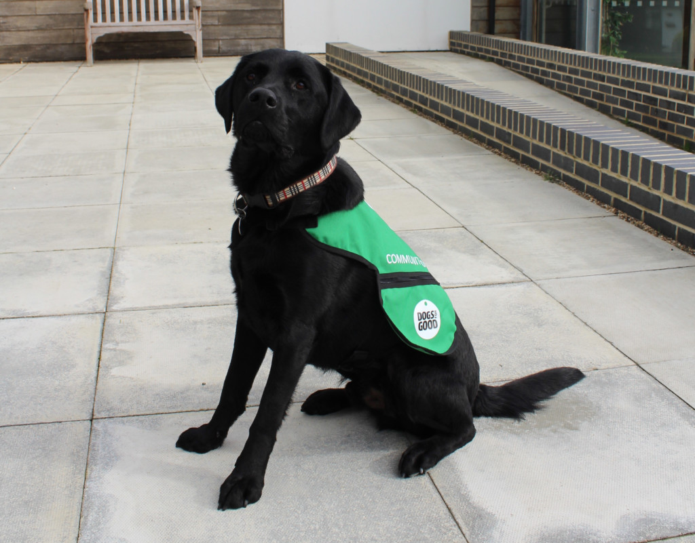
This is a Community Dementia Dog
We are now working on the benefits of Dementia Dogs in Gloucestershire and we need your help...

Slide 3
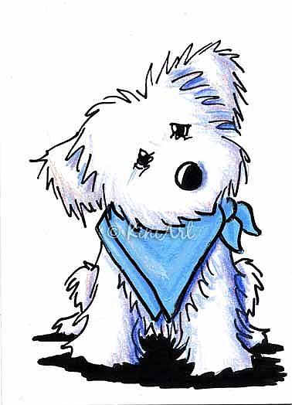
He needs YOU to design him a bright new bandana which he can wear when working!

Slide 4
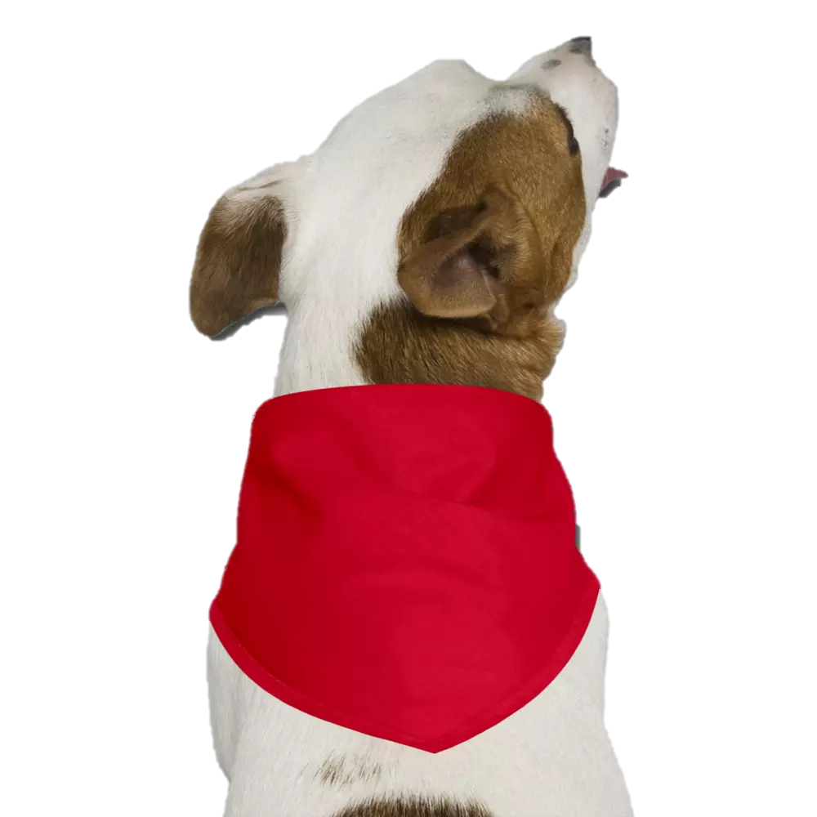
Think about the following:
Reducing stigma and raising positive attitude about dementia
How dementia is not a natural part of aging
How it is possible to live well with dementia
How we can all support people living with dementia
Colour and contrast to support the changing brain of those living with dementia

Slide 5
What we need you to do…
Design a dog bandana on the template provided
Submit your entry either electronically, or in hard copy, by Friday 5th April
The winner will have their bandana printed and produced to wear
Winners will be chosen from each of the Key Stages 2, 3 and 4. They will be announced on Friday 3rd May 2019
Entries will be judged by Margaret Willcox, Director of Adult Social Care, Gloucestershire County Council

Slide 6
Good Luck and Thank You!

