Slide 1
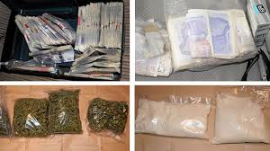
Drug Gangs

Slide 2
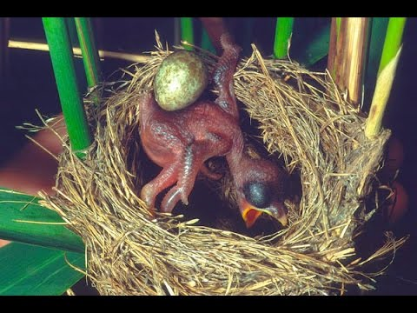
The Cuckoo….
What do you know about the Cuckoo?
The bird that invades nests, takes over the nest from a more vulnerable bird, leaving the bird helpless.
2. What does this have to do with drugs and gangs?

Slide 3
Urban Dictionary…
Cuckooing
(verb) A crime where a drug dealer befriends a weak, old or otherwise vulnerable person, then takes over their home and uses it as a drug house.
"Cuckooing is a new type of crime which involves a drug dealer befriending a vulnerable individual who lives on their own. Like a cuckoo, the dealer moves in, takes over the property, and turns it into a drugs' den."

Slide 4
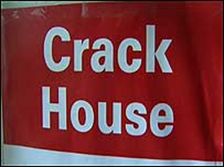
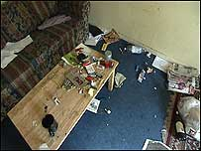
Who might these drug gangs target?
People with mental health problems
Disabled
Young people
Lonely
Drug addicts
People in debt
Vulnerable people

Slide 5
Why might these people feel unable to go to the police?
Fear
Addicts themselves
2. Whole else does this Cuckooing impact?
Neighbours
Neighbourhood

Slide 6
For four months, a tenant of a landlord was preyed upon in his flat in Ipswich.
The man has mental health problems and his vulnerability made him an easy target.
"He was having to go back to a flat that was basically full of people dealing drugs," said the Landlord
"On a couple of occasions the police actually did do raids on the flat and a dozen or so people were in the flat, none of whom were really proper friends of his.
Eventually the man was re-housed.

Slide 7
What happens then…. It is likely the dealers have simply found a new victim's home to control.
A senior social worker said he has seen the problem increase over the past two years.
"It's a growing problem and for families it's absolutely devastating," he said.
"We've had one girl, four foot nothing, she's sitting at home with her two toddlers. She's an ex-user trying to stay clean.
"An old friend has knocked on the door and said, 'Can I come in and use the phone?' She has said, 'Course you can', and two huge guys have come in with her and taken over the flat for two weeks."

Slide 8
There are also signs of cuckooing that you can look out for:
It usually takes place in a multi-occupancy or social housing property
There may be an increase in the number of comings and goings, including people you haven't seen before
There might be new vehicles outside the property
A possible increase in anti-social behaviour in and around the property
It can happen anywhere…..
http://www.bbc.co.uk/news/uk-england-gloucestershire-39954345

Slide 9
Many of these gangs are made up of the very young
How might these drug gangs trap young people?
By exploiting and grooming!
2. How might they achieve this?
Giving them drugs
Giving them Alcohol
Presents
Making them feel important
Fast cars to ride around in
Flashing money

Slide 10
An ITV News investigation has uncovered how children as young as 12 are being ruthlessly groomed and exploited by organised crime groups who send them the length and breadth of the country to carry drugs and money.
http://www.itv.com/news/2016-09-29/going-country-itv-news-reveals-the-scale-of-children-being-exploited-and-sent-around-britain-to-carry-drugs/

Slide 12
Working around the clock as a 14year old drug mule!
Leon was 14 when he first travelled from London to sell drugs. He told ITV News the dealers sent them out with heroin and cocaine, often having to work around the clock in cities like Bristol and Southampton.
Leon said when he tried to break away they threatened him with violence. "One of them punched me in the eye and then was like 'you have to do this, if you don’t we’re going to go round to your mum’s house, break the door' and basically hurt my mum and that’s what really put the fear into me.“
http://www.itv.com/news/2016-09-30/working-round-the-clock-as-a-14-year-old-drugs-mule/

Slide 13
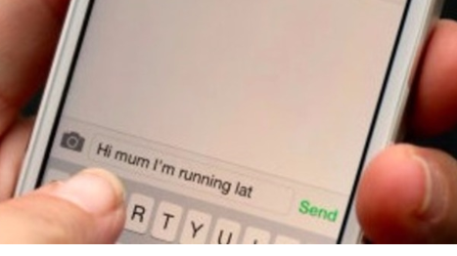
What might the warning signs be that a friend has been groomed as a drug mule?
Withdrawing from the family
Secretive behaviour
Blocking family and friends on social media
Unexplained injures
Not sticking to agreed times to come home when they go out
Going missing from home
New expensive clothes or other items
Large sums of money that can’t be accounted for
Aggressive or difficult behaviour
Arriving in taxis or unknown vehicles
New friends that you do not know
Truanting or long term absences from school
Showing a lack of respect towards peers and teachers

Slide 14
Daniel 15 years old
One 15-year-old boy, caught up in this dangerous world since the age of 13.
Daniel described how drug dealers groomed him, gave him gifts and made him feel part of their group.
“They’d pick me up around the corner from my house. They’d give me a lift to school and I’d get out and you just felt like you were important getting out of a nice big car."
“Anything I ever wanted I got given and I thought it was all for free,"
But he soon realised they wanted something in return. They asked him to deliver shoeboxes of class A drugs and bags of pills, often having to travel long distances from home.
But….are all these things free? What is the cost?

Slide 15
Help Lines
Crimestoppers
NSPCC
Childline
Kidscape

