Slide 1
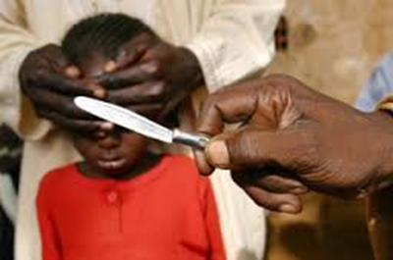
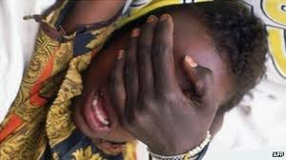
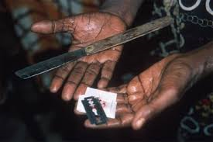
FGM
What am I?

Slide 2
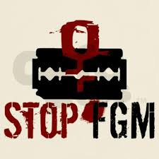
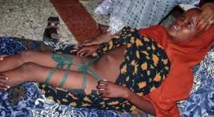
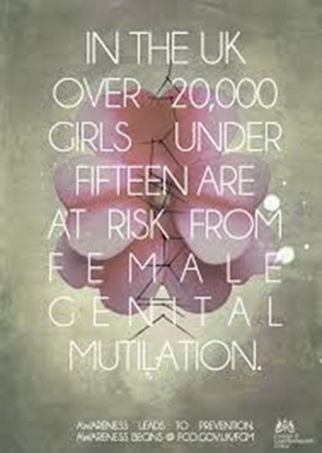
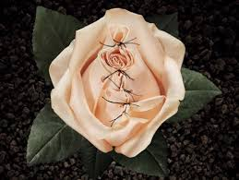

Slide 3
What is FGM
The term FGM covers all harmful procedures to the female genitalia for non-medical purposes. There are 4 types - all are illegal and have serious health risks.
FGM ranges from pricking or cauterizing the genital area, through partial or total removal of the clitoris, cutting the lips (the labia) and narrowing the vaginal opening.
Even partial removal or 'nipping' can risk serious health problems for girls and women.

Slide 4
Why?
Female genital cutting is a social norm. This means that it is held in place by the entire community. One individual acting alone cannot shift a social norm – the entire community must work together collectively.

Slide 5
Men and women often support FGM without question because it is a traditional practice that has existed in a community for generations. Many communities believe that a girl needs to be cut in order to marry well.

Slide 6
Despite the fact that it is harmful to women, FGM is sometimes seen as an issue that women confer onto other girls. Even if a mother does not want her daughter to be cut because of her own painful experience, she is unlikely to forego the practice because of the social sanctions in place.

Slide 7
In some communities, a girl who is not cut is seen as unclean and sexually promiscuous. On the other hand, the belief is that a girl who is cut will make a good marriage because she is thought to be cleaner, more fertile and will be a virgin until her wedding night.

Slide 8
So, what is a social norm?
A social norm is an expectation that influences people’s behaviour within a social group.
If someone questions this behaviour, they are likely to be punished through social sanctions. In the case of FGM, sanctions might be refusal of marriage or social rejection.
These ensure that individuals conform to the social norm that has been put into place, even if they are aware of the negative consequences.
https://www.youtube.com/watch?v=Nn_pKycgb38

Slide 9
Who is at risk
FGM is most commonly carried out when a girl is 5-8 years old. However it can happen at any age before a girl or woman is married or pregnant. Some girls are babies when FGM is carried out.
In the UK, girls from the Somali, Kenyan, Sudanese, Sierra Leonean, Egyptian, Nigerian, Eritrean, Yemeni, Kurdish and Indonesian communities are most at risk of FGM.

Slide 11
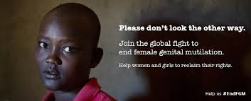
There are no medical reasons to carry out FGM. It doesn't enhance fertility and it doesn't make childbirth safer. It is used to control female sexuality and can cause severe and long-lasting damage to physical and emotional health.

Slide 12
How FGM happens
FGM is usually performed by someone with no medical training. Girls are given no anaesthetic, no antiseptic treatment and are often forcibly restrained.
The cutting is made using instruments such as a knife, pair of scissors, scalpel, glass or razor blade

Slide 13
The Home Affairs Committee into FGM has said there could be as many as 170,000 victims in the UK.

Slide 14
FGM can be extremely painful and dangerous It can cause:
severe pain
shock
bleeding
infection such as tetanus, HIV and hepatitis B and C
organ damage
Blood loss and infections can cause death in some cases.
FGM can cause ongoing health problems Girls and women who have had FGM may have problems that continue through adulthood, including difficulties urinating, incontinence, frequent infections and pain when having sex.

Slide 15
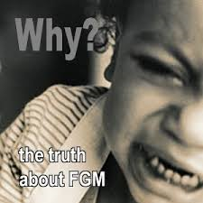
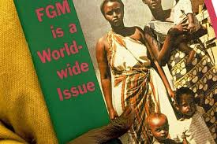

Slide 16
What to look for: signs of FGM
A girl or woman may:
have difficulty walking, sitting or standing
spend longer than normal in the bathroom or toilet
have unusual behaviour after an absence from school or college
be particularly reluctant to undergo normal medical examinations
ask for help, but may not be explicit about the problem due to embarrassment or fear.

Slide 17
FGM: UK police investigate 'dozens' of cases since 2011

Slide 18
Police forces have revealed there have been dozens of investigations into female genital mutilation (FGM) in the UK over the past three years.
West Midlands Police said they had investigated 49 suspected offences in the first six months of this year.
But others refused to give any figures on FGM-related investigations.
The NSPCC said it was "encouraging" more cases were being reported despite no convictions. Police said every case was "thoroughly investigated".

Slide 19
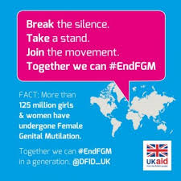
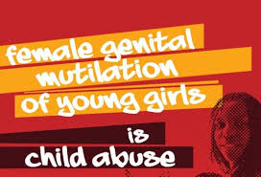
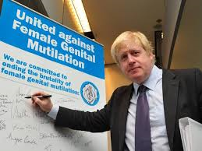
There were two arrests in 2012 but no charges were brought.
Avon and Somerset Police investigated 16 suspected FGM cases in 2013, compared with four in 2012 and six in 2011. It has also investigated six cases between January and June this year but did not provide information about arrests or charges.

Slide 20
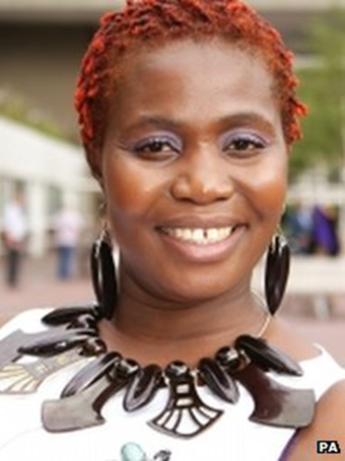
FGM victim Sarian Karim Kamara said awareness was growing…
Sarian Karim Kamara, who lives in Peckham, south west London and underwent FGM in Sierra Leone as an 11-year-old, said FGM remained a "secretive" act.
"For the police to be investigating these cases, it shows lots of people are aware now and people working with women and children are confident to ask questions," she added.
Prime Minister David Cameron used the recent Girl Summit to announce new measures to protect girls in England and Wales who were at risk.
As part of this, parents will face prosecution if they fail to stop their daughters undergoing FGM.
The domestic changes will not apply in Scotland or Northern Ireland, but governments there said they had their own plans to tackle the problem.

