Slide 1

Drug education
Keeping healthy
Year 1-2: Lesson 2

Slide 2
Using this PowerPoint
The slides in this presentation are divided into two sections:
Teacher slides (purple) – provide key information regarding lesson preparation.
Pupil slides – provide a visual focus point for pupils during the lesson and delivery notes for teachers about the activities. Click ‘notes’ to view these.
Ensure that you select ‘Use Presenter View’ under the ‘Slide Show’ tab – this will allow you to preview the teaching notes on your monitor while the main presentation is displayed on a screen/smartboard.

Slide 3


Support and challenge
The lesson includes suggestions for challenge and support activities, to help you differentiate appropriately for your class.
Support activities are adapted to be more accessible for those who need it.
Challenge activities deepen and extend learning for those who need more challenge or who finish the activity quickly.
Look for these icons on the pupil slides. See delivery notes for details of the activities.
Challenge
Support

Slide 4
Context
This is the second of three drug education lessons, for year 1-2. This lesson focuses on medicines; what they look like, how they are used and why people use them. It explores how medicines are used to treat illness in the short and long term, as well as how some medicines can help protect people from becoming ill in the future. Pupils also consider the role of other people in helping them and others to stay healthy and well, manage, or recover from, illness.

Slide 5
Developing subject knowledge
Key information on content related to these lessons can be found in the Year 1-2 Knowledge Organiser.
Advice on safe practice, dispelling common misconceptions, visitors to the classroom and other important information can be found in Teacher Guidance: Drug and alcohol education.
Data sources to inform your planning can be found within our document that outlines the approach of these lessons Evidence Review: Effective drug and alcohol education, along with advice regarding how to talk to young people about addiction, dependency and problematic substance use.

Slide 6
To learn about medicines, and the people who help someone to stay healthy.
identify what can make people feel better if not feeling well
explain that medicines come in different forms and are used in different ways
recognise that some medicines, such as vaccinations, can help prevent illness and disease and that some people need to take medicines every day to help them to stay healthy
identify who helps people to stay healthy and what they do

Slide 7
Box or envelope for questions
Resource 1: Feel better scenarios
[one set per pair]
Resource 1a: Support: Feel better scenarios
[one set per pupil or pair requiring support]
Resource 1b: Feel better scenarios [one set per pupil or pair requiring additional challenge]
Resource 2: Medicines cards [one set per class]
Resource 3: Different medicines chart
[one per pair]
Resource 4: Medicines case studies
[one set per class]
Resource 5: People who help us with health cards [one set per pupil or small group requiring support]
Optional:
Persona doll or puppet
Collection of empty, washed medicine and household product bottles, containers and packets
Notes:
Be aware that some pupils and their families may be affected by a health condition and may regularly need to take medicines in order to stay well. Some pupils may have experienced misuse of medicines. It is important they understand that a trusted adult is responsible for administering medicines. If safeguarding concerns arise, these should be reported to the Designated Safeguarding Lead.

Slide 8
Lesson summary
Activity | Description | Timing
Baseline assessment activity | To be completed before the lesson. Individually or as a whole class, pupils make a mind-map about what they already know about medicines. | 15 mins
Introduction | Re-introduce or reinforce ground rules. Introduce the learning objective and outcomes and provide a short explanation about medicines. | 5 mins
Helping someone to feel better | Pupils read the scenarios and suggest what will help the characters to feel better. | 15 mins
Different medicines | Pairs of pupils describe different types of medicine, what it looks like, how it is used, where on the body and why. | 15 mins
Keeping healthy | Pupils explore a case study about someone who needs to use medicine every day to stay healthy. | 10 mins
Give me 5! | Pupils think of people who help them stay healthy and well and what they do. | 5 mins
Signposting support | Highlight sources of support at home and at school and remind pupils that only a trusted adult should give them medicines. | 5 mins
Reflection and endpoint assessment | Pupils add to their baseline assessment activity, medicines mind-map, to demonstrate their new learning about medicines. | 5 mins

Slide 9

Keeping healthy
Lesson 2

Slide 10

What’s our starting point?
What do we know about medicines?
Notes:
Teacher notes - Baseline assessment (15 mins)
This allows time to look through the pupils’ work and gain a sense of their current understanding and experiences. Before setting this activity, ensure that ground rules for PSHE education lessons have been developed and shared with the class.
Before the lesson, ask pupils to respond to the question:
What do we know about medicines?
Pupils can draw or write their own response or make a whole class brainstorm or mind map.
As this is a baseline assessment, it is important to use neutral, non-guiding language and avoid giving any further information until the activity has been completed. Tell pupils that it does not matter if they don’t know or are unsure about something.

Slide 11
Notes:
Teacher notes – Introduction (5 mins, slides 11-13)
Re-introduce ground rules and reinforce any that may be particularly important for this lesson, such as ‘Although in this lesson we will be thinking about different kinds of medicines and when people use them, we are not going to name people we know. If we want to share a story about someone using a medicine, we will say “someone I know…” rather than use their name’.

Slide 12
To learn about medicines, and the people who help someone to stay healthy.
identify what can make people feel better if not feeling well
explain that medicines come in different forms and are used in different ways
recognise that some medicines, such as vaccinations, can help prevent illness and disease and that some people need to take medicines every day to help them to stay healthy
identify who helps people to stay healthy and what they do
Notes:
Teacher notes – Introduction (5 mins, slides 11-13)
Introduce the learning objective and outcomes, and explain that in this lesson pupils will be learning about some of the medicines and people that help us to stay healthy and well.

Slide 13
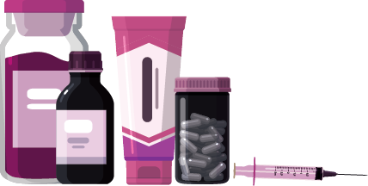
Introduction
Introduction
Some medicines help someone to recover (get better) from illness or injuries, such as antiseptic cream on a graze.
Some medicines protect the body, such as vaccinations which protect people against diseases, sun cream protecting the skin from burning, or mosquito spray protecting against bites.
Some medicines help people keep healthy and well and may need to be used every day or over a long period of time.
Notes:
Teacher notes – Introduction (5 mins, slides 11-13)
Explain that there are different types of medicines which are used in different ways and for lots of different reasons:
some medicines help someone to recover (get better) from illness or injuries, such as antiseptic cream on a graze
some medicines and other products protect the body, such as vaccinations which protect people against diseases (vaccinations might include injections or drops to swallow), sun cream protecting the skin from burning, or mosquito spray protecting against bites
some medicines help people keep healthy and well and may need to be used every day or over a long period of time

Slide 14
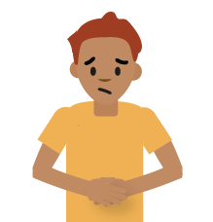
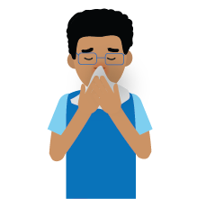
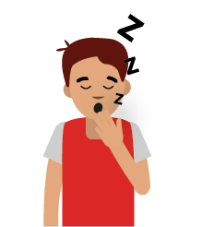
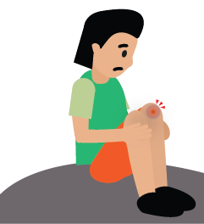
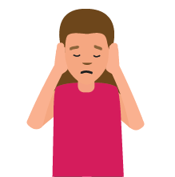
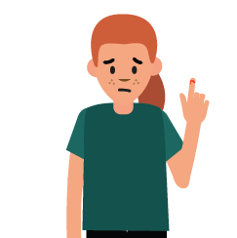


Helping someone to feel better
Think about a time you felt poorly and what helped you to feel better.
Now with your partner, read the scenarios. What might help the characters feel better and get well?
Notes:
Teacher notes – Helping someone to feel better (15 mins)
Ask pupils to think about a time when they felt poorly and what helped them to feel better. Pupils do not need to share, just reflect for themselves.
Introduce a character and explain that they are not feeling well. You might want to use a persona doll or puppet. Pupils discuss what might help them to feel better.
Working in pairs, ask pupils to read Resource 1: Feel better scenarios and suggest what might help the characters to feel better and get well.
Pupils may identify:
medical products such as: antiseptic cream, ear drops, nasal spray, tissues, plasters
soothing items or activities such as: cuddling a teddy, hugs, resting, watching TV, sleeping, drinking water, eating soup, rubbing the injury
Take feedback from the class. Draw out that medicines can be used to treat an illness or injury, but that other things such as hugs or having a hot drink can also help someone feel better.
Support: Using Resource 1a: Feel better scenarios – support, ask pupils to match up the symptoms to the remedies/things that might help them feel better.
Challenge: Using Resource 1b: Feel better scenarios – challenge, ask pupils to organise responses into things that go into/onto bodies and add other ideas.

Slide 15


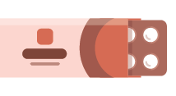
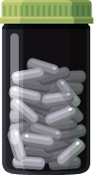


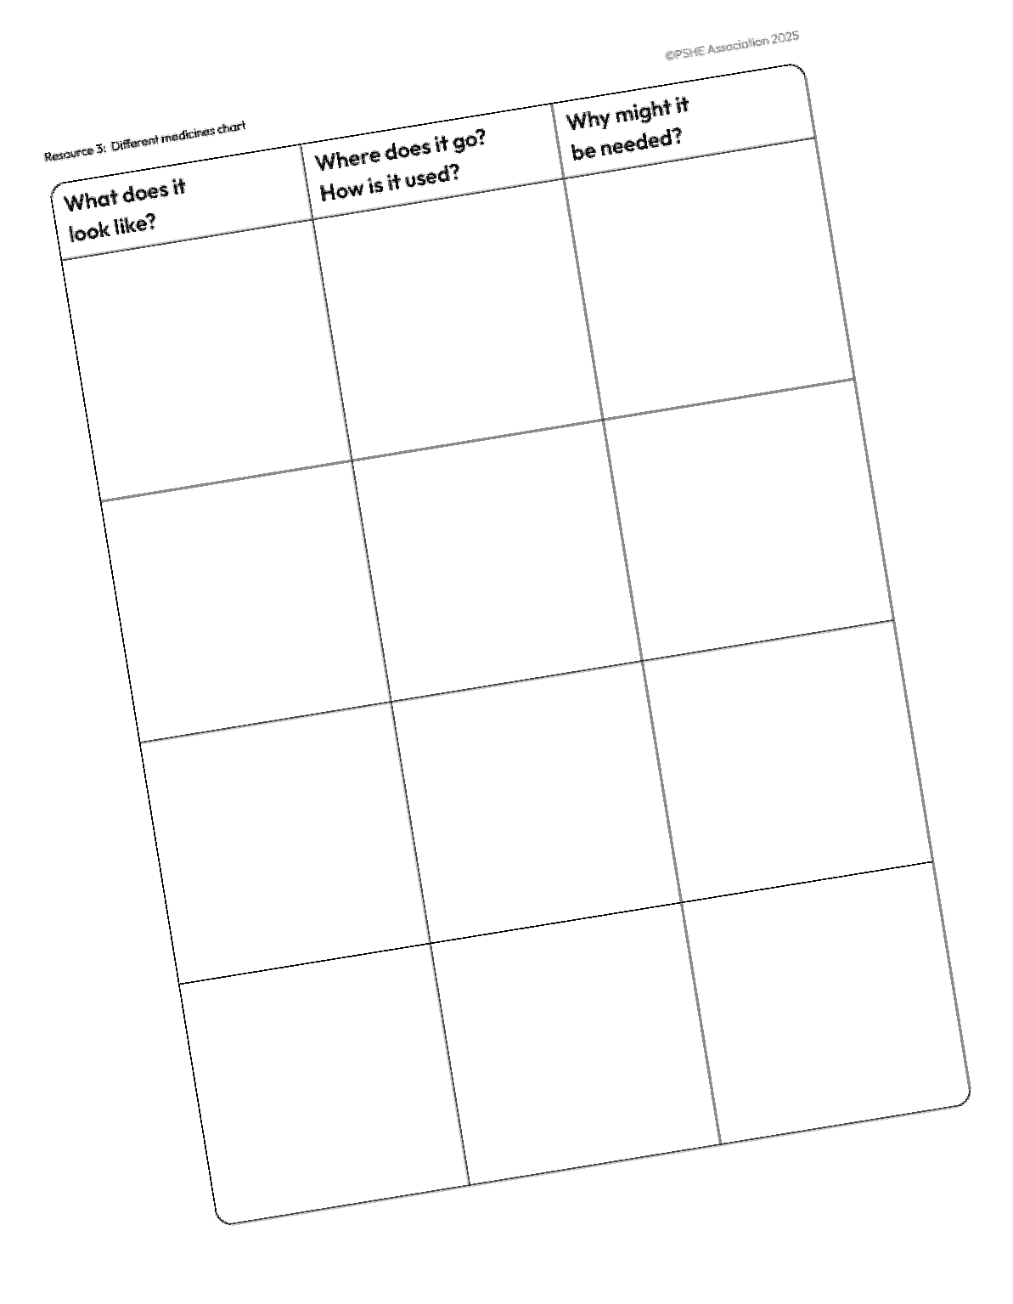






Different medicines
Think about a time you were given a medicine.
What did it look like?
Did it go into or onto the body?
How did it help?
With your partner, hunt for the Medicines cards. When you have found four, fill in the Different medicines chart.
Notes:
Teacher notes – Different medicines (15 mins)
Ask pupils to think about a time they were given medicine:
What did it look like?
Did it go into or onto their body?
How did it help?
Pupils do not need to share, just reflect for themselves. If they cannot remember a time they were given medicine, they can think about someone they know, such as a younger brother or sister.
Explain that medicines look different (come in many different forms); are used in different ways, and that it is important they are used correctly.
Display Resource 2: Medicines cards around the classroom. (Empty, washed bottles, and containers and empty medicine packets can also be used for the medicines hunt, if preferred.)
Ask pupils, in pairs, to hunt around the classroom for the cards, find four different types of medicine and complete Resource 3: Different medicines chart showing what the medicine looks like, where it might be used on the body, how it is used and why it might be needed.
Bring the class back together and discuss the different forms that medicines come in (e.g. drops, tablets, lozenges, liquids, creams) and explain that each medicine has a specific and individual use; they are all needed for different parts of the body and to relieve different ailments or illnesses.

Slide 16
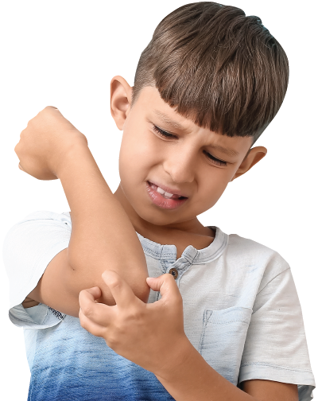
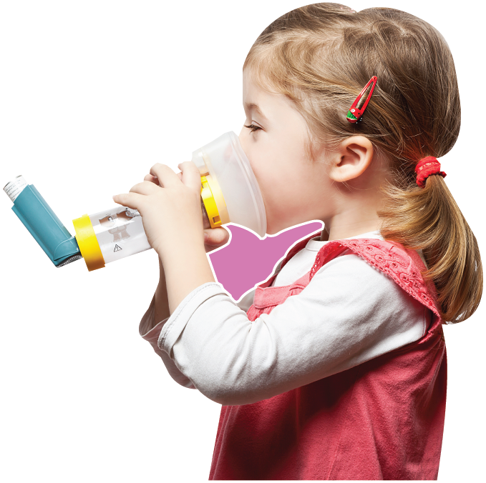
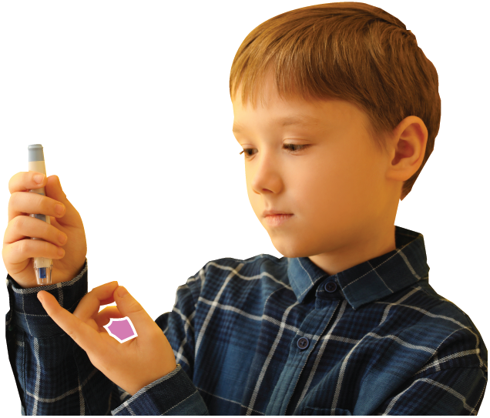
Keeping healthy
Listen to the case study.
Think about the questions and share your ideas.
Talk about the type of medicines used and how they help the person.
Notes:
Teacher notes – Keeping healthy (10 mins)
Explain that some medicines help to keep illnesses under control and are needed to help the person stay healthy – so that they can do all the things most other people can do.
Choose one or more of the medicines case studies to read to the class using Resource 4: Medicines case studies and encourage pupils to discuss the questions before sharing their ideas. Pupils can work as a whole class or in small groups. (You might prefer to read an information book on a similar theme. Be aware that pupils or members of their families may be living with a health condition. In most instances, it is best to select a case study that is not being experienced by a pupil in the class.)
Talk about the type of medicines used and how they help the person. Conclude that some people take medicines to recover from illness quickly and some need to take medicines every day or regularly, to help keep healthy and well over a longer period of time.

Slide 17


Give me 5!
Who can help?
Think of five people who help others to stay healthy and well.
Role
Talk about
their role and what they do.
Notes:
Teacher notes – Give me 5! (10 mins)
In pairs or small groups, ask pupils to think of at least five people who help others to stay healthy and well, discuss their roles and the kinds of things they do.
People might include: Parent/carer; doctor, pharmacist, nurse, paramedic, teacher, teaching assistant, midday assistant, dentist, counsellor, nutritionist, cleaner.
What they do might include: provide healthy food to eat, clean their clothes, keep the house/school clean, check-ups, listen to them, give them medicine.
Support: Use Resource 5: People who help us with health cards to identify the people’s roles, label their job title and what they do.
Challenge: Think of 10 different people.

Slide 18


Who can help?
If you feel unwell it is important to talk to a trusted adult – at home or school; and that only a trusted adult should give you medicines.
I need your help with something . . .
Something's worrying me,
can I talk to you?
I have something that’s been bothering me . . .
Notes:
Teacher notes – Signposting support (5 mins)
Remind pupils that if they feel unwell it is important that they talk to an adult they trust – at home or school; and that only a trusted adult should give them medicines. Young children should not take medicines without an adult helping them. If they are unsure about taking or using medicines of any kind, they should speak to their trusted adults first.

Slide 19


What have we learnt?
Now go back to your
mind-map.
Is there anything you would like to change?
Is there anything you would like to add?
Use a different colour pencil to add your ideas.
Share one thing that can help someone to feel better if they are unwell.
What do we know about
medicines?
Notes:
Teacher notes - Reflection and endpoint assessment (5 mins)
Ask pupils to return to their baseline assessment activity, medicines mind-map. Using a different colour pencil or pen, ask them to add to the mind-map to demonstrate their new learning about medicines and who and what helps people to feel better.
Ask each pupil to share one thing that can help someone feel better if they are unwell.

Slide 20
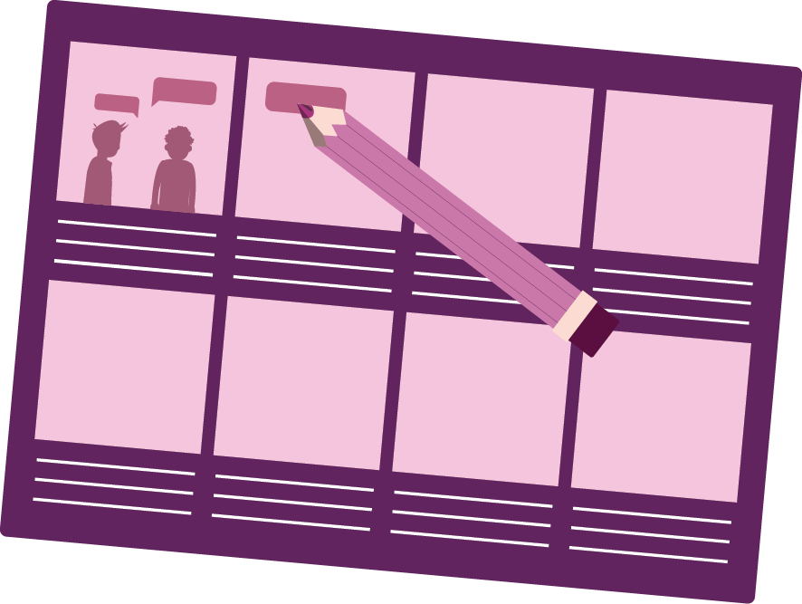
Writing a story
Writing a story
Write a story or create a storyboard about a character who isn’t feeling well.
Include:
what they do to feel better
who helps them
Notes:
Teacher notes – Extension activity
Ask pupils to write a story or create a storyboard about a character who isn’t feeling well and what they do to feel better. Pupils should write about who helped them and what they did.

