Slide 1
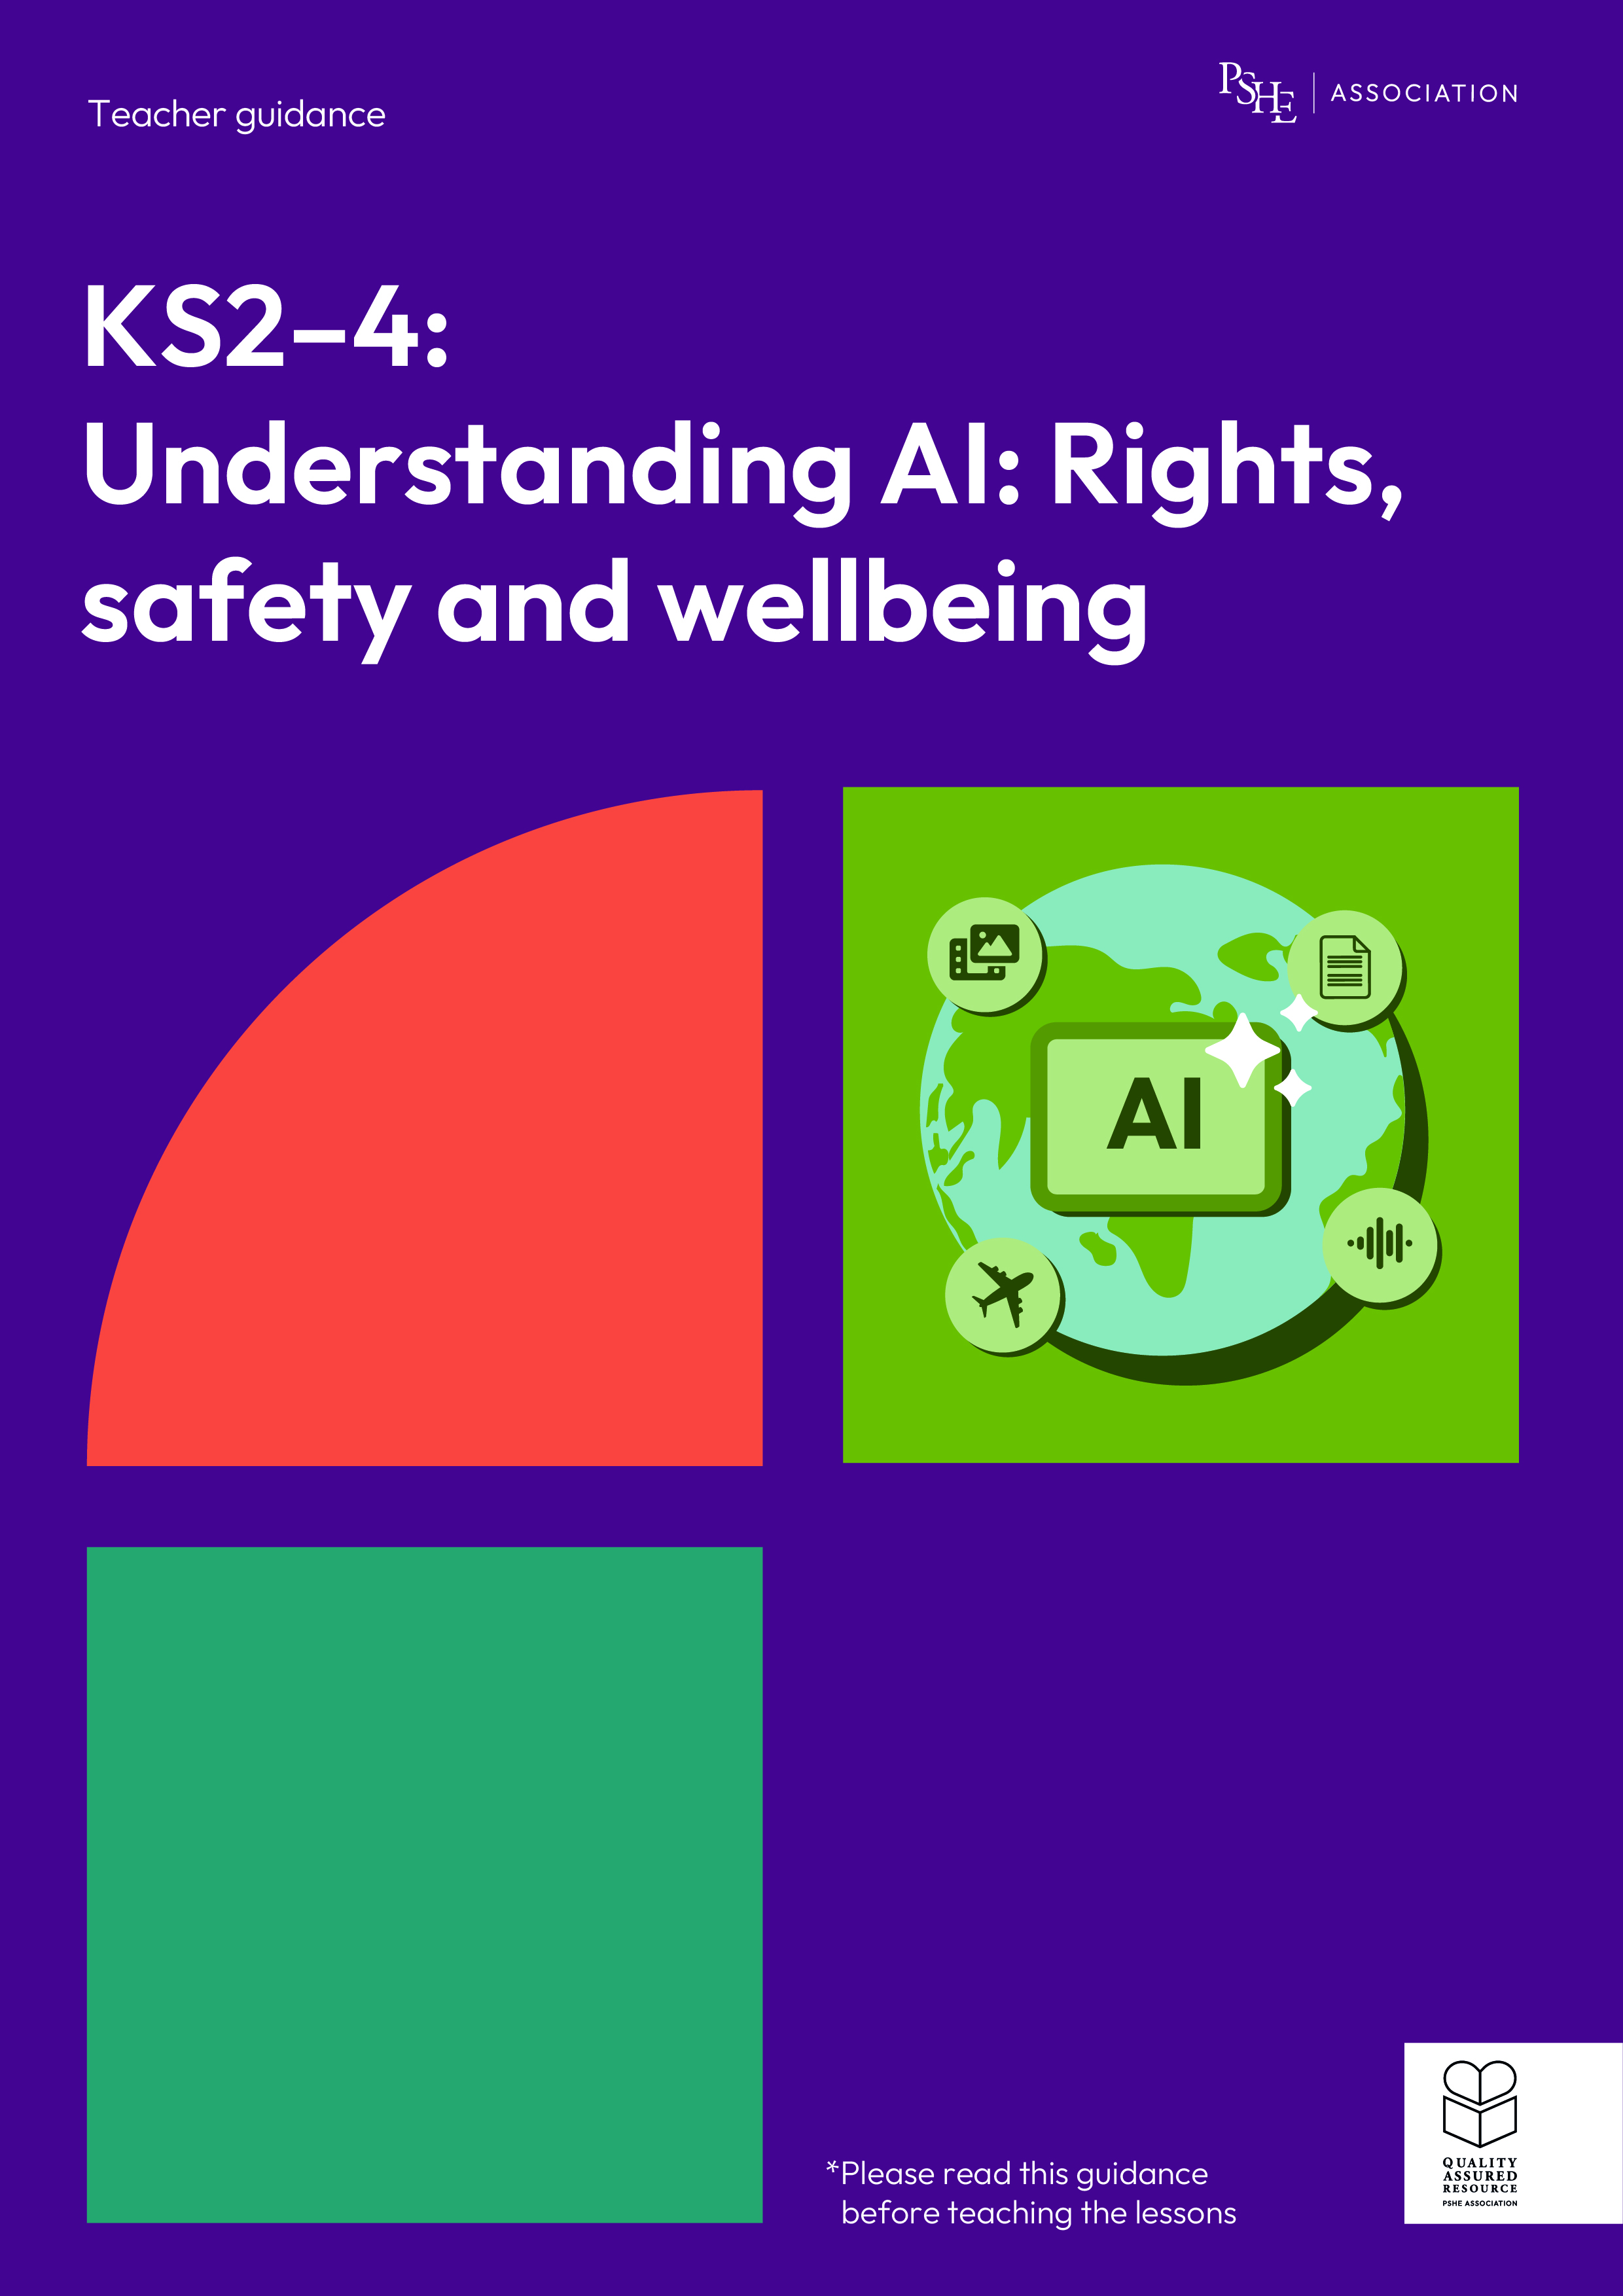
Understanding AI: Rights, safety and wellbeing
KS2, Lesson 1: What is AI?

Slide 2
Using this PowerPoint
The slides in this presentation are divided into two sections:
Teacher slides (purple) – provide key information regarding lesson preparation.
Pupil slides – provide a visual focus point for pupils during the lesson and delivery notes for teachers about the activities. Click ‘notes’ to view these.
Ensure that you select ‘Use Presenter View’ under the ‘Slide Show’ tab – this will allow you to preview the teaching notes on your monitor while the main presentation is displayed on a screen/smartboard.

Slide 3


Support and challenge
The lesson includes suggestions for challenge and support activities, to help you differentiate appropriately for your class.
Support activities are adapted to be more accessible for those who need it.
Challenge activities deepen and extend learning for those who need more challenge or who finish the activity quickly.
Look for these icons on the pupil slides. See delivery notes for details of the activities.
Challenge
Support

Slide 4
Context
This lesson pack for key stages 2–4 has been designed to support pupils’ AI literacy. This is the first of three lessons for years 5 and 6 and has been designed with the Alan Turing Institute. It introduces learning about artificial intelligence (AI), how it is used in daily life, and some of the benefits and challenges of using AI.
These lessons should not be taught in isolation, but always as part of a planned, developmental PSHE education programme. They are best used within the context of online safety or digital literacy.

Slide 5
To learn about what artificial intelligence (AI) is and how it is used in our daily lives.
Pupils will be able to:
identify what AI is and how it is used in daily life
explain how AI systems work and affect people’s lives
evaluate potential challenges of AI becoming part of daily life

Slide 6
Box or envelope for questions
Resource 1: Overheard conversation [1 per pair]
Resource 2: Challenges card sort
[1 per group]
Resource 2a: Benefits card sort
[as required, 1 per group]

Slide 7
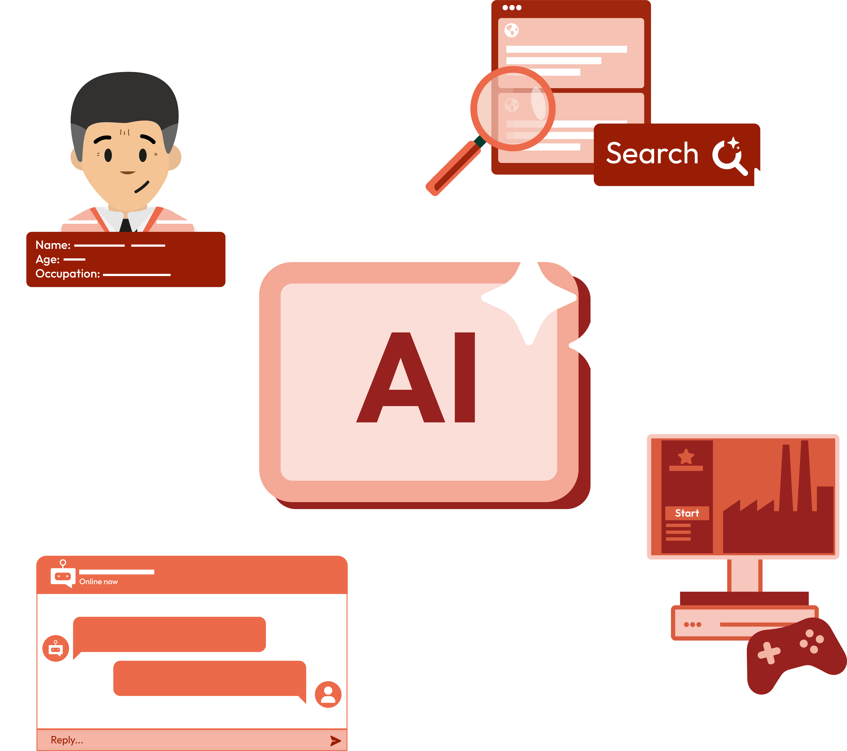
What is AI?
Lesson 1

Slide 8
Notes:
Teacher notes – Baseline assessment activity (10 mins, slides 8-9)
Revisit or establish ground rules with the class. Remind pupils of the question box, and that they can submit questions at any time throughout the lesson, either anonymously or with their name.

Slide 9




What’s our starting point?
Some pupils are talking about AI, and what they think AI means.
Is it something about social media and what you see online?
I heard it’s all about robots, isn’t it?
I think it means computers can think like humans.
Notes:
Teacher notes – Baseline assessment activity (10 mins, slides 8-9)
Explain that some children are talking about AI, and what they think AI means. Give pairs Resource 1: Overheard conversation and ask them to read the children’s different ideas. Together, they should discuss:
Do you agree with what any of the children are saying?
Have any of the children made a mistake?
What is AI and where is it used in our daily lives?
Ask them to leave the final bubble empty for now (as they will come back to this at the end of the lesson). Take feedback from pairs, noting existing knowledge and any gaps in understanding. Plan to address these throughout the lesson, for example by spending more time on specific activities or through tailored questioning.

Slide 10
To learn about what artificial intelligence (AI) is and how it is used in our daily lives.
Pupils will be able to:
identify what AI is and how it is used in daily life
explain how AI systems work and affect people’s lives
evaluate potential challenges of AI becoming part of daily life
Notes:
Teacher notes – Introduction (5 mins, slides 10-13)
Introduce the learning objective and outcomes. Explain that today’s lesson will help them understand what AI is, how it is used in our daily lives, and what this means for the future.

Slide 11


What is AI?
AI stands for ‘Artificial Intelligence’.
AI involves computers using information to do things that, in the past, only humans have been able to do.
For example, AI allows computer systems to be trained on data and predict patterns.
The word ‘intelligence’ is a bit misleading though, because AI doesn’t think for itself.
Did you know?
AI is already a part of many technologies we use everyday.
Notes:
Teacher notes – Introduction (5 mins, slides 10-13)
Use this slide to give a brief definition of artificial intelligence (AI). Explain that Artificial Intelligence allows computer systems to be trained on data and predict patterns. For example, AI systems could be trained on data about how many people visit certain shops each month. By finding patterns in this data, AI can predict which shops and areas will be busy. Emphasise that though AI does stand for ‘Artificial Intelligence’, the word intelligence is a bit misleading because AI does not think for itself.

Slide 12



AI needs data
This data could be lots of different types of information.
For example:
Numerical
(e.g. numbers and statistics)
Visual
(e.g. images, photographs
or videos)
Audio
(e.g. audio clips or call recordings)
Did you know?
A collection of data that can be used in an AI system is called a dataset!
Notes:
Teacher notes – Introduction (5 mins, slides 10-13)
Explain that AI needs data in order to work. Emphasise that some data is personal – this means it can be used to identify an individual (for example, name, date of birth or photograph).

Slide 13
What can AI do?
Prediction
AI can process lots of data and find patterns in it, to predict what might happen in future.
Classification
AI can be trained to find groups in information and to label things as belonging to different categories.
Generation
These types of AI models can be used to generate (or create) new content, using existing data. They are sometimes known as ‘GenAI’.
Recommendation
AI can process data about people’s behaviours, likes and interests – and make recommendations based on this data.
Notes:
Teacher notes – Introduction (5 mins, slides 10-13)
Briefly highlight some of the things that AI can do.

Slide 14

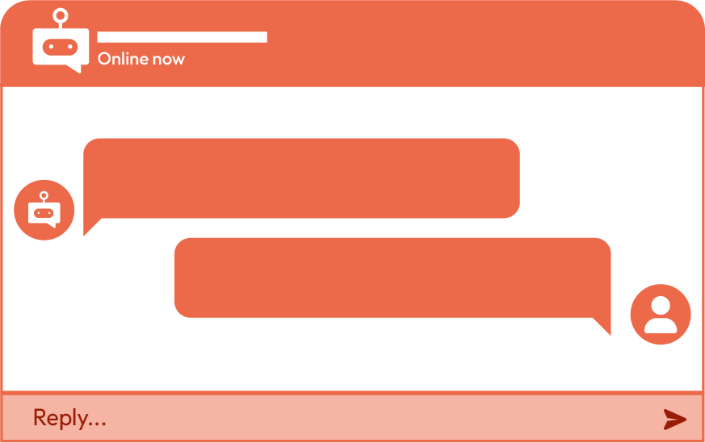


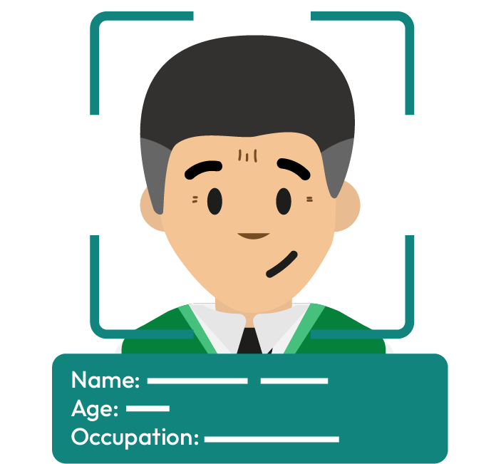




Everyday examples of AI
search engines
film recommendations
chat bots
Where is AI?
smart devices
facial recognition
computer games
Notes:
Teacher notes – Where is AI? (10 mins, slides 14-15)
In groups of four, ask pupils to mind-map examples of where AI is used in our daily lives. Challenge groups to try to name up to 10 different ways they might encounter AI. They could also try to identify different types of AI tools (for example, AI that makes predictions, classifications, generative AI etc).
Take feedback, identifying some of the common ways or places where AI might be encountered by children and young people, for example:
Film recommendations when viewing online (e.g. “If you watched this, you might like…”). Streaming services recommend what people might be interested in watching based on what they have viewed already
When using search engines on the internet – AI can answer questions and find information people search for
Chatbots on some websites or social media apps
Smart devices at home (e.g. a smart fridge, heating solutions or voice-automated assistants)
Autocorrect and predictive text programmes on phones or tablets
Some computer games, where AI might be used to make realistic characters and backgrounds
Facial recognition technology is a type of AI that is sometimes used for security to access a phone, device or app
Make sure you take this opportunity to challenge any misconceptions that pupils share on what AI is. However, be sure not to introduce these misconceptions and let them arise from pupils themselves. For example, pupils should recognise that AI is not just robots, and it is not the wires, hardware or tangible parts of a computer system. Some pupils may think that anything automated is AI - for example, ticket barriers at train stations - but automated technology is also not the same as AI.
Support: If groups are struggling to identify examples, click to show the animations on this slide, which give visual prompts of different places where children might experience AI.
Challenge: Encourage pupils to think about why AI has become part of our daily lives.
For example, pupils might say: it makes life easier, for fun, it saves humans time and effort, it makes technology function better.

Slide 15



Where else is AI used?
For example:
In healthcare – to find patterns in illnesses and to explore possible treatments
In the environment – AI is being used to monitor endangered species and predict extreme weather events
Notes:
Teacher notes – Where is AI? (10 mins, slides 14-15)
Next, use this slide to share some wider uses of AI. For example:
in health care – AI can be used to look at lots of information about different illnesses and find patterns to help understand why people become ill and what treatment might help them
in the environment – AI is being used to help monitor endangered species and predict extreme weather events

Slide 16
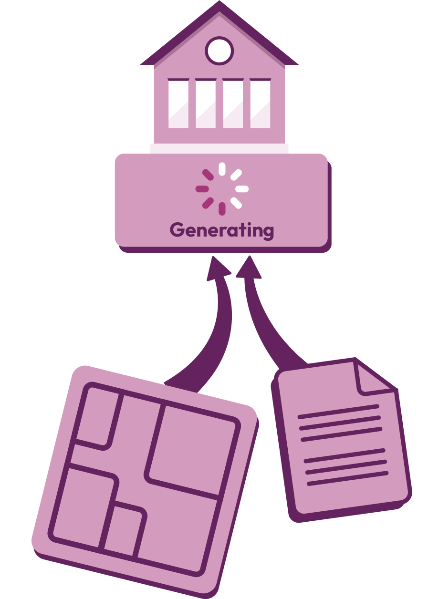
How does AI work?
Imagine an AI system is being used to help design a new school.
The AI system has been trained on data about what currently happens in schools all over the United Kingdom.
The AI system will use this data to make some recommendations about the design of the new school.
Notes:
Teacher notes – How does AI work? (10 mins, slides 16-20)
Ask pupils to imagine that an AI system that makes recommendations is going to be used to help design a new school. (Emphasise that making recommendations is just one of the things AI can do – and other AI systems might do different things, as discussed in the introduction). Explain that this AI research tool has been trained on data about what currently happens in schools all over the United Kingdom. The AI system will use this existing data to output a series of recommendations.

Slide 17

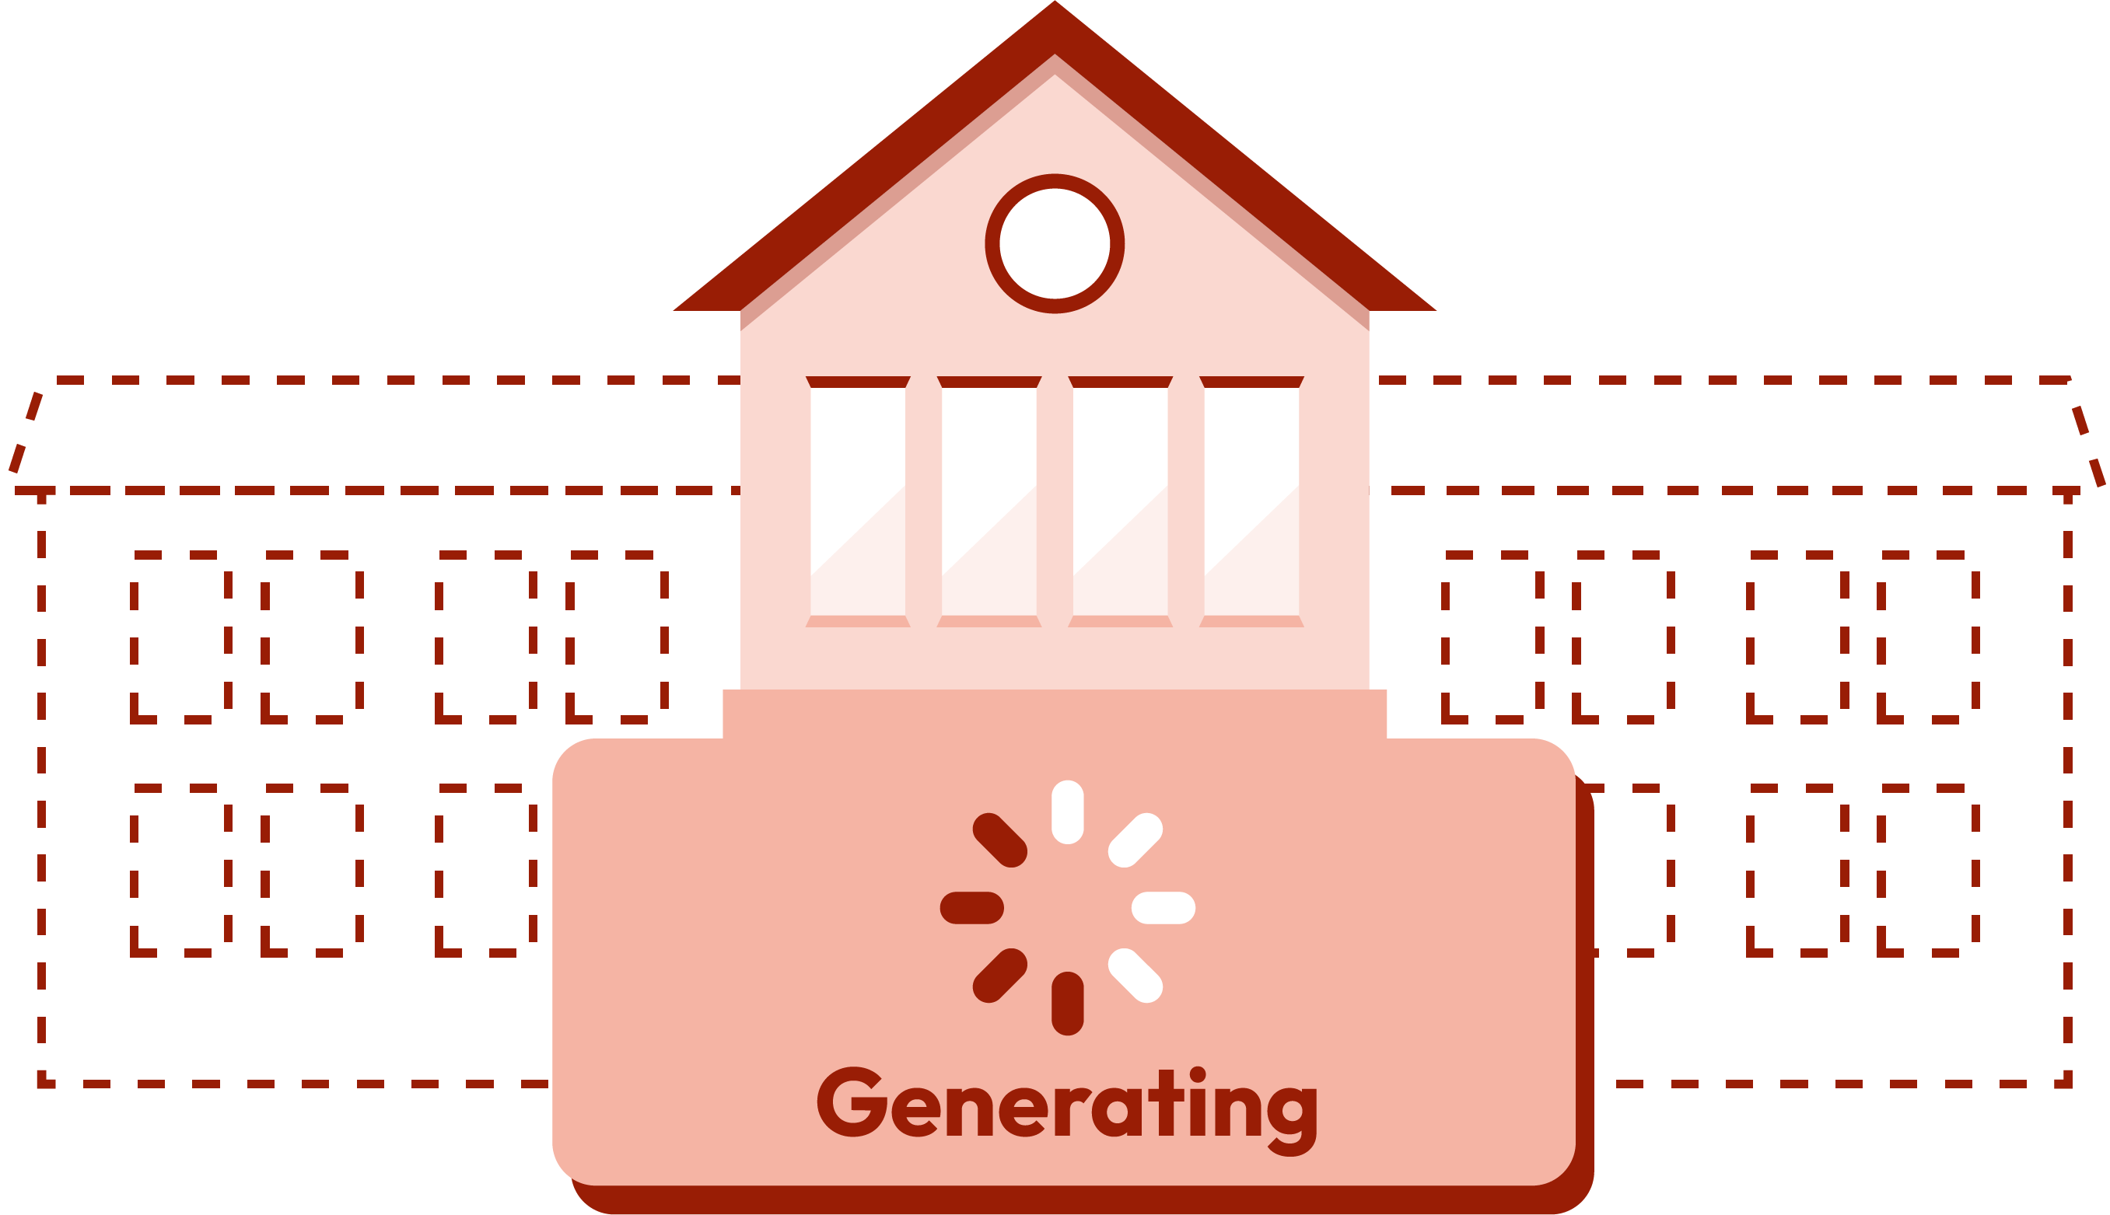
What should be in the playground?
What do you think?
What will the AI system most likely recommend based on the data?
Football field
Basketball court
Football field
Nature walk
2978
Basketball court
1860
Climbing frame
Nature walk
500
Climbing frame
2100
Notes:
Teacher notes – How does AI work? (10 mins, slides 16-20)
Show the slide and ask, “What should be in the playground?” give pupils a minute to discuss in pairs which of the options they would like the most.
Then click to reveal the data that AI has gathered and ask, “What will the AI system most likely recommend for the playground based on the data?” (pupils should identify this will be a football pitch).

Slide 18

What will be served for lunch?
What do you think?
What will the AI system most likely recommend based on the data?
Beef burger
Veggie hot dog
Beef burger
Pasta
3180
Veggie hot dog
1350
Fish and chips
Pasta
2590
Fish and chips
2080
Notes:
Teacher notes – How does AI work? (10 mins, slides 16-20)
Show the slide and ask, “What will be served for lunch in the new school?” give pupils a minute to discuss in pairs which of the options they would like the most.
Then click to reveal the data that AI has gathered and ask, “What will the AI system most likely recommend for lunch based on the data?” (pupils should identify that this will be beef burgers).

Slide 19

What lesson should be taught most?
What do you think?
What will the AI system most likely recommend based on the data?
French
Maths
Art
French
750
Maths
2000
History
Art
900
History
1450
Notes:
Teacher notes – How does AI work? (10 mins, slides 16-20)
Show the slide and ask, “What lesson should be taught the most?” give pupils a minute to discuss in pairs which of the options they would like the most.
Then click to reveal the data that AI has gathered and ask, “What will the AI system most likely recommend for lessons based on the data?” (pupils should identify this will be maths).

Slide 20

Let’s discuss
What do you think of the recommendations the AI tool made?
Why did the tool make these recommendations?
Do you think the recommendations were fair?
Notes:
Teacher notes – How does AI work? (10 mins, slides 16-20)
Ask pupils to reflect on this activity using the questions on the slide. This discussion should start to highlight that sometimes AI recommendations may not seem fair, or suit everyone, and are only based on data rather than human thinking, so may not always lead to the best result. For example, in recommending a lunch option the AI system did not take into account that pupils might have different dietary requirements, for instance because of their religion, or if they are vegetarian.

Slide 21


Benefits and challenges
How many benefits of AI can you list?
How many challenges of AI can you list?
These could be from the lesson, or from your prior knowledge.
You will have just
3 minutes!
Notes:
Teacher notes – What are the benefits and challenges? (10 mins, slides 21-22)
Building on the previous activity and still working in their pairs, tell pupils they have three minutes to list as many benefits and challenges of using AI as they can think of. These can be drawn from the previous activity, or any benefits and challenges they are aware of from their own knowledge of AI.
After three minutes, invite feedback from pairs and create a class list. Pupils might suggest:
Challenges: AI might be biased or make suggestions that aren’t always fair, it might take people’s jobs, it can make being online more confusing or hard to know what’s real, it can make human communication more challenging, it is sometimes based on bad information, it still needs humans to check the suggestions, AI collects lots of information about what people do online – and this can create issues around privacy, the technology used to power AI can use up lots of energy and cause harm to the environment.
Benefits: AI can make some work easier, it can help humans to think in new ways, it can summarise lots of information quickly, it can make online experiences more fun, it’s recommendations can be helpful, it can be used to help with important issues like healthcare, education and the environment.

Slide 22
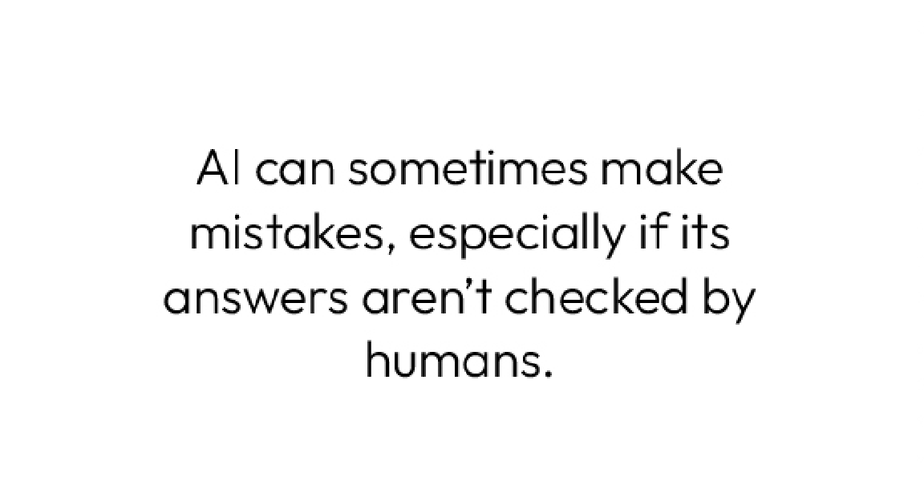
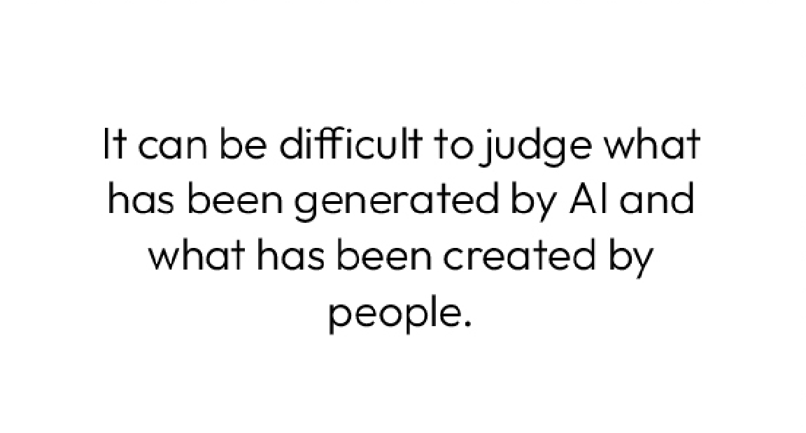
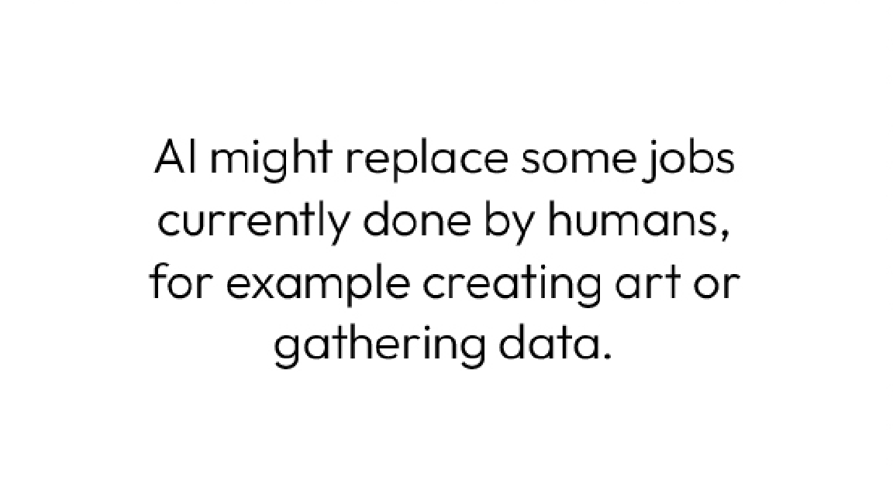
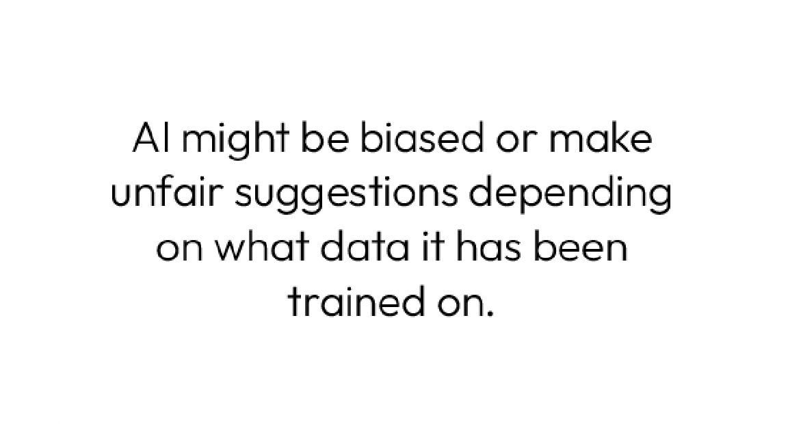

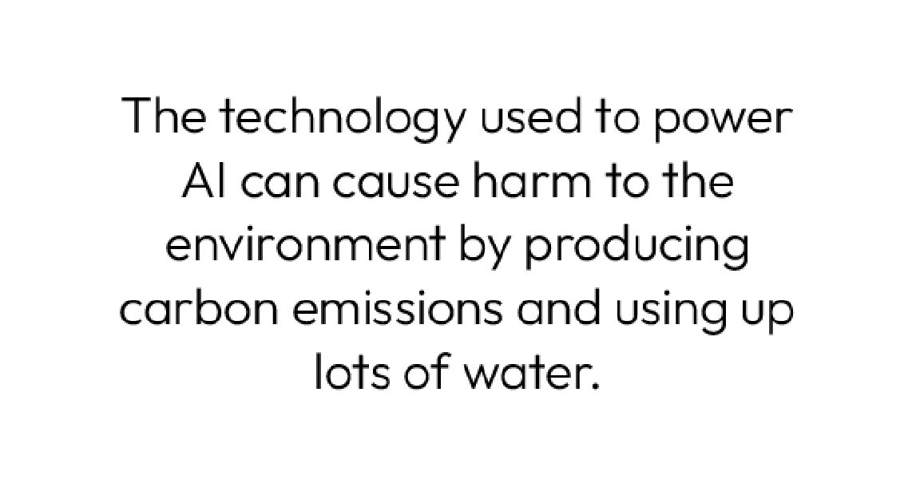
Benefits and challenges
Can you prioritise the challenges into a Diamond 5?
The challenge you think is most important should be at the top, and the one you think is least important should be at the bottom.
Most important challenge
Least important challenge
Notes:
Teacher notes – What are the benefits and challenges? (10 mins, slides 21-22)
Join pairs back into groups of four and give them Resource 2: Challenges card sort. Ask pupils to prioritise the cards into a Diamond 5, placing the challenge they think is the most important at the top, three challenges of mid-concern in the middle row, and the challenge they think is the least important at the bottom.
Circulate between groups as they complete this activity and take note of which challenges groups are most concerned about.
Challenge: Give groups Resource 2a: Benefits card sort and ask them to also prioritise five key benefits of AI, based on which they think are most helpful to society.

Slide 23


Sources of support
If you have worries about AI, or anything else you have seen online, you can speak to a trusted adult, at home or at school.
There are also organisations that can help, such as:
Childline: www.chidline.org.uk
CEOP:
www.ceopeducation.co.uk/8_10
I need your help with something . . .
Something's worrying me,
can I talk to you?
I have something that’s been bothering me . . .
Notes:
Teacher notes – Signposting support (2 mins)
Remind pupils that if they have any concerns about AI systems, or anything else they have encountered online, they can speak to a trusted adult, such as a parent or carer.
You can also direct pupils to the following websites for more advice and support:
www.childline.org.uk
www.ceopeducation.co.uk/8_10 - for pupils in KS2

Slide 24

Time to reflect
Without sharing, take a moment to consider:
How do you think AI could be used to help people and improve their lives?
Notes:
Teacher notes – Personal reflection (3 mins)
Invite pupils to quietly reflect on the question: How do you think AI could be used to help people and improve their lives?
As this is a personal reflection question, they do not need to share their ideas with anyone else.

Slide 25



What have we learnt?
Think back to the pupils from the start of the lesson.
Do you want to add to, or change your ideas?
Can you summarise what AI is?
Is it something about social media and what you see online?
I heard it’s all about robots, isn’t it?
I think it means computers can think like humans.
Notes:
Teacher notes – Endpoint assessment (5 mins)
To demonstrate progress and their learning in this lesson, ask pupils to revisit Resource 1: Overheard conversation from the start of the lesson. Ask them if they can add to or amend any of their initial ideas about the children’s views. Finally ask them to add their own sentence, in the final bubble, to summarise what AI is based on their understanding from today’s lesson.

Slide 26


Let’s get creative!
Video or audio pitch
What idea do you have for how AI could be used to do something truly amazing?
Create a video or audio explaining your idea.
An artwork
Can you use art to show what AI means to you or how you want AI to develop in future?
Notes:
Teacher notes – Extension activity
Ask pupils to either create a short video/audio recording of how AI could be used to do something great or create some artwork showing what AI means to them and how they want to see AI developed in the future.

