Slide 1
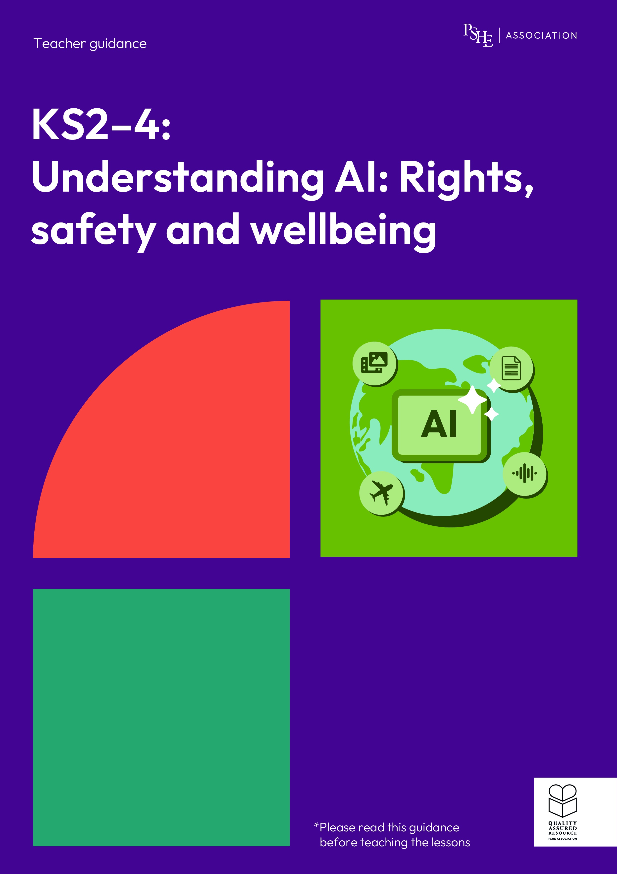
Understanding AI: Rights, safety and wellbeing
KS2, Lesson 2: How does AI affect our rights?

Slide 2
Using this PowerPoint
The slides in this presentation are divided into two sections:
Teacher slides (purple) – provide key information regarding lesson preparation.
Pupil slides – provide a visual focus point for pupils during the lesson and delivery notes for teachers about the activities. Click ‘notes’ to view these.
Ensure that you select ‘Use Presenter View’ under the ‘Slide Show’ tab – this will allow you to preview the teaching notes on your monitor while the main presentation is displayed on a screen/smartboard.

Slide 3


Support and challenge
The lesson includes suggestions for support and challenge activities, to help you differentiate appropriately for your class.
Support activities are adapted to be more accessible for those who need it.
Challenge activities deepen and extend learning for those who need more challenge or who finish the activity quickly.
Look for these icons on the pupil slides. See delivery notes for details of the activities.
Challenge
Support

Slide 4
Context
This lesson pack for key stages 2–4 has been designed to support pupils’ AI literacy. This is the second of three lessons for years 5 and 6. It focuses on children’s rights and how they can be impacted by AI technology.
These lessons should not be taught in isolation, but always as part of a planned, developmental PSHE education programme. They are best used within the context of online safety or digital literacy.

Slide 5
To learn about children’s rights and how they can be impacted by AI.
Pupils will be able to:
identify rights that children have, on and offline
explain how generative AI tools can impact children’s rights
describe ways to protect and uphold children’s rights when interacting with AI

Slide 6
Box or envelope for questions
Pupil whiteboards and pens
Resource 1: Children’s Rights [one per pair]
Resource 2: How can AI impact children’s rights? [one per pair]
Resource 2a: How can AI impact children’s rights? [support option, one per small group, printed on A3]
Resource 3: Keeping safe and protecting rights [one per pupil]

Slide 7
Lesson summary
Activity | Description | Timing
Baseline assessment | Set up a question box and establish or revisit ground rules. To demonstrate their starting point, pupils respond to questions about rights. | 10 mins
Introduction | Introduce the learning objective and outcomes, recap on prior learning and introduce key terms for this lesson. | 10 mins
Which right is impacted? | Pairs discuss some positive and negative impacts of generative AI on children’s rights, before identifying the rights being impacted in different scenarios. | 15 mins
Keeping safe and protecting rights | Pupils stand on a continuum to show how effective they think AI companies’ strategies would be at protecting children’s rights. Then they list strategies children can use to protect their rights, if using AI. | 10 mins
Endpoint assessment and reflection | Pupils give advice to a friend to help them protect their rights and keep safe, if using AI technology – and privately reflect on how they can keep safe if using AI. | 13 mins
Signposting support | Remind the class of adults and organisations who can help if they have questions or concerns. | 2 mins

Slide 8
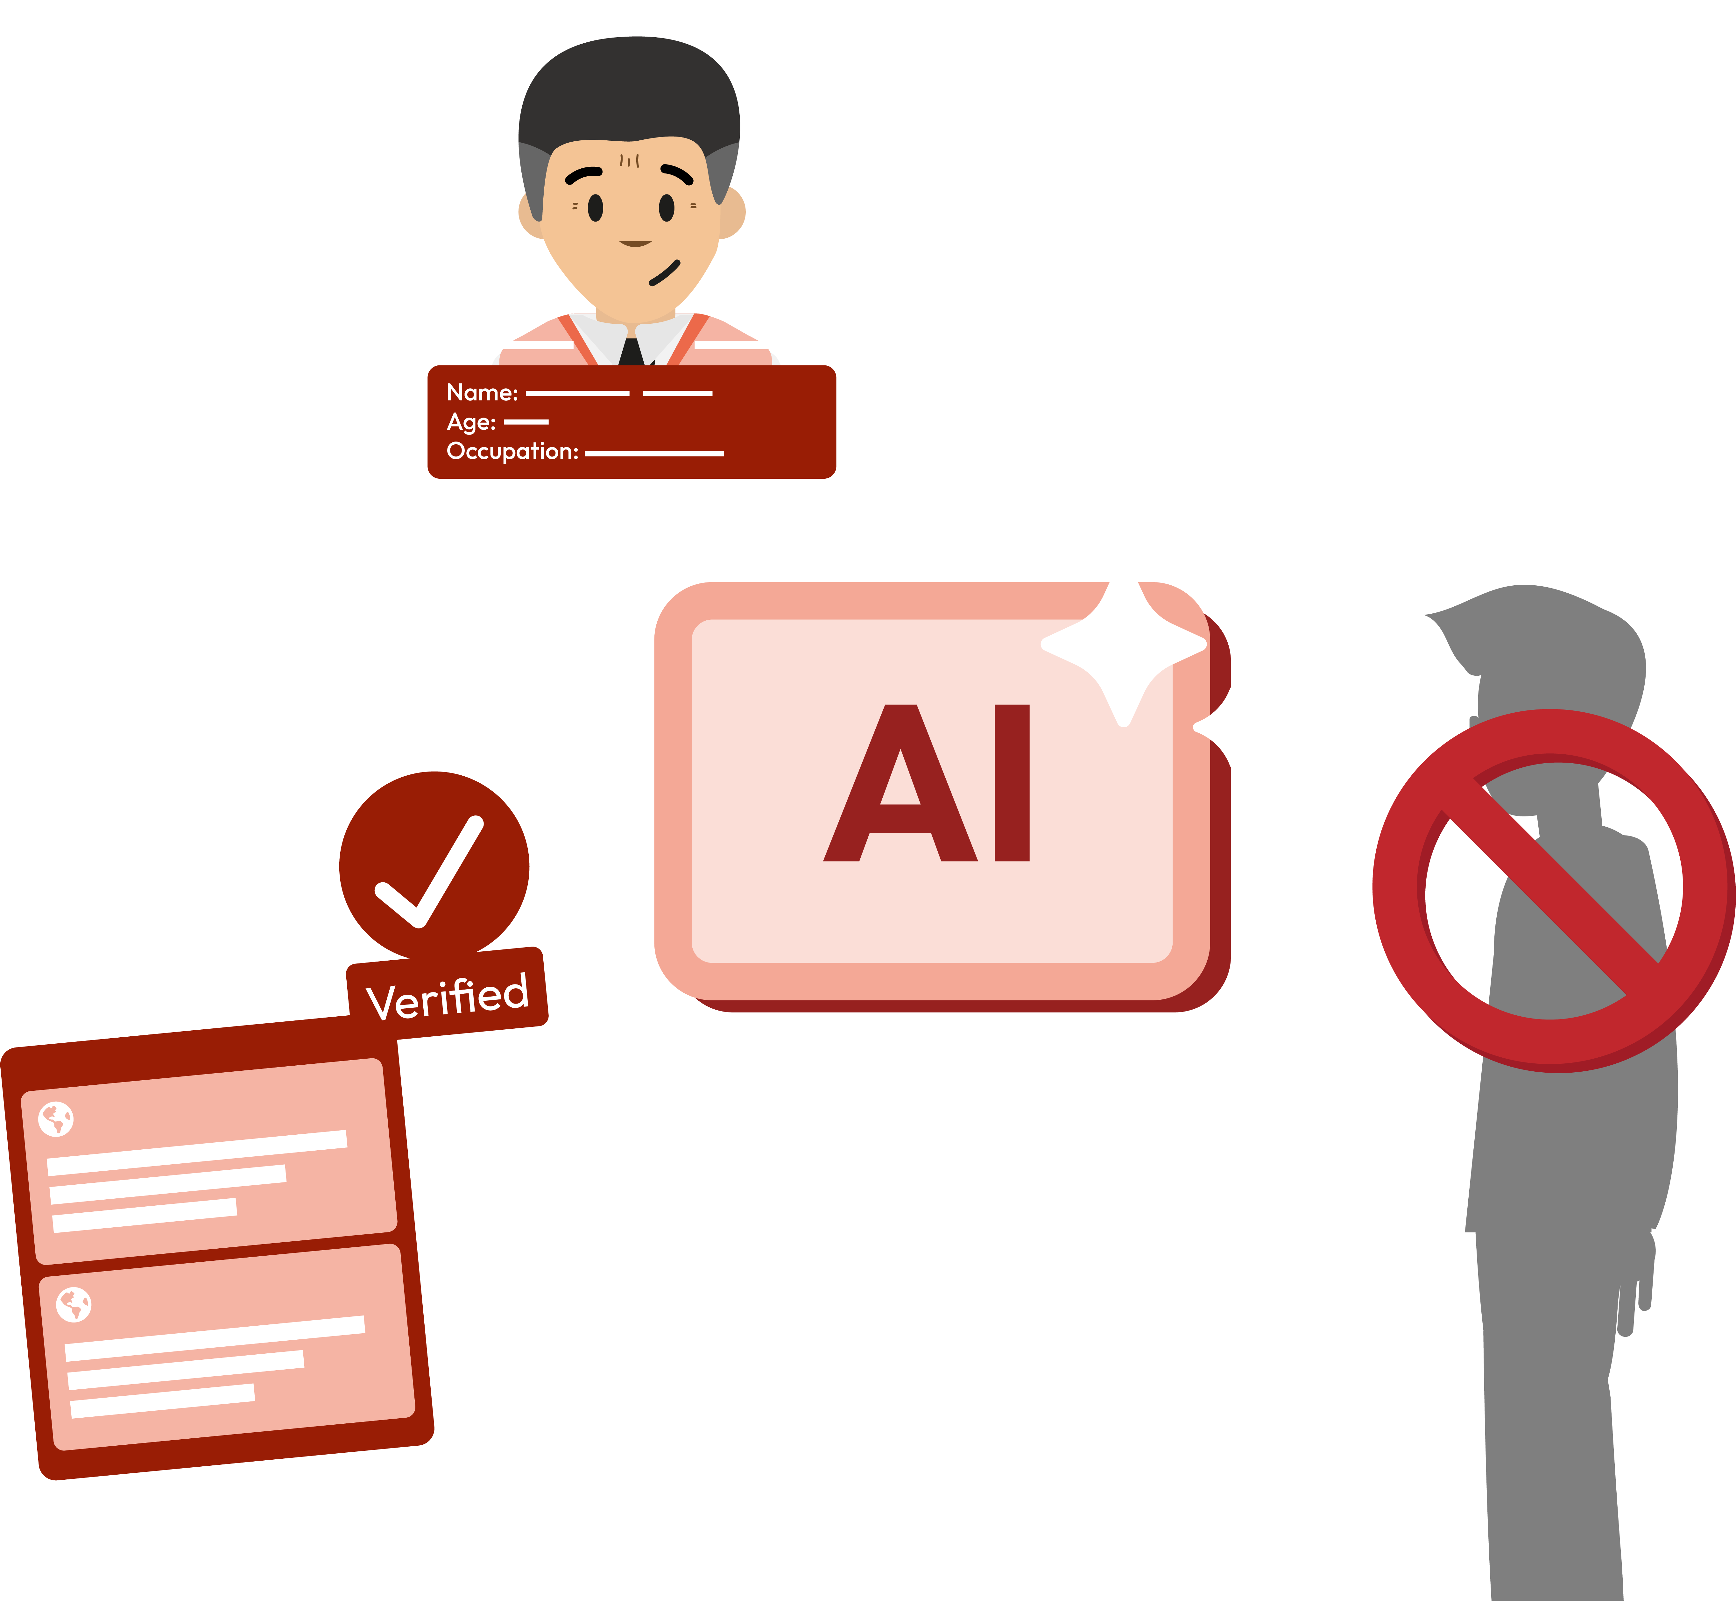
How does AI affect our rights?
Lesson 2

Slide 9
Notes:
Teacher notes – Baseline assessment activity (10 mins, slides 9-10)
Establish or revisit ground rules. Explain that if pupils have worries or questions during or after the lesson that they do not want to raise in front of the class, they can write their question on a piece of paper, anonymously or with their name, and put it in the question box.

Slide 10




What’s our starting point?
All children have rights – the basic things they need to live a happy and safe life.
Write down your thoughts:
What are some rights that children have?
How might children’s rights be affected by AI?
Can you explain one way someone could protect their rights and keep themselves safe when using AI?
Notes:
Teacher notes – Baseline assessment activity (10 mins, slides 9-10)
Introduce the baseline activity by sharing the character Talia’s explanation of rights. Then, in their books, ask pupils to respond to the three questions. Once they have noted their thoughts down, they should share them with a partner.
Circulate during the activity to establish pupils’ starting points and notice any common themes in their responses. Consider how the lesson may need adapting depending on any gaps or misconceptions. For example, if pupils are unable to identify ways in which people could keep themselves safe when using AI, you may wish to explore this in greater depth.

Slide 11
To learn about children’s rights and how they can be impacted by AI.
We will be able to:
identify rights that children have, on and offline
explain how generative AI tools can impact children’s rights
describe ways to protect and uphold children’s rights when interacting with AI
Notes:
Teacher notes - Introduction (10 mins, slides 11-17)
Introduce the learning objective and outcomes. Explain that today’s lesson will explore children’s rights and how AI technology can affect them.

Slide 12


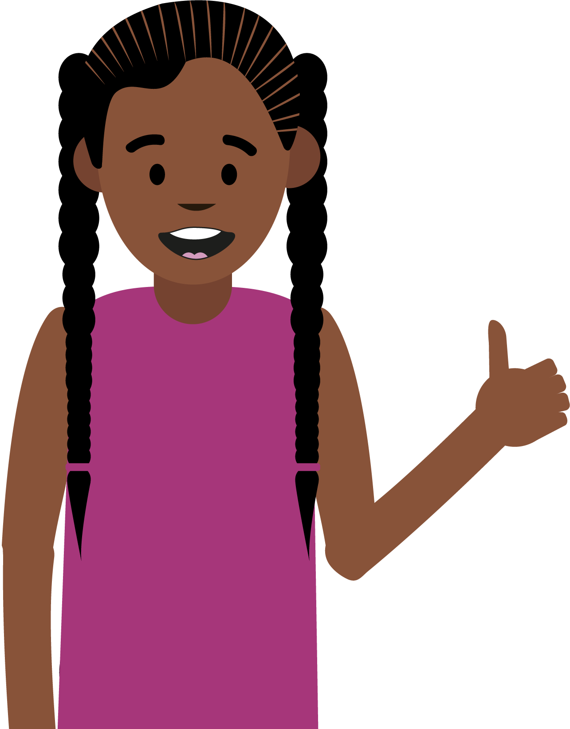



Can you remember what AI is?
Artificial Intelligence (AI) is a technology that lets computer systems do complex tasks, which in the past, only humans were able to do.
AI systems learn from data, detect patterns and improve performance over time.
Remember: The word ‘intelligence’ is misleading, because AI doesn’t think for itself.
Can you remember any everyday examples of AI?
That’s right!
AI stands for
‘Artificial Intelligence’.
Film recommendations
Search engines
Smart devices
Notes:
Teacher notes - Introduction (10 mins, slides 11-17)
Support pupils to recall from lesson 1 what AI is and some everyday examples.

Slide 13





What is generative AI?
Generative AI (GenAI) is a type of AI that can be used to generate (or create) new content, using existing data.
People might use generative AI to…
ask questions
create things like pictures, music or recipes
get ideas or inspiration
draft messages or text
analyse data
Notes:
Teacher notes - Introduction (10 mins, slides 11-17)
Remind pupils that generative AI (GenAI) is a type of AI that can be used to generate (or create) new content, using existing data.
Share examples of how some people might use generative AI.
Emphasise that generative AI was not built with children in mind. In fact, there are often age restrictions on the use of generative AI in the UK; usually 13 years old, and mostly with parental permission required.

Slide 14
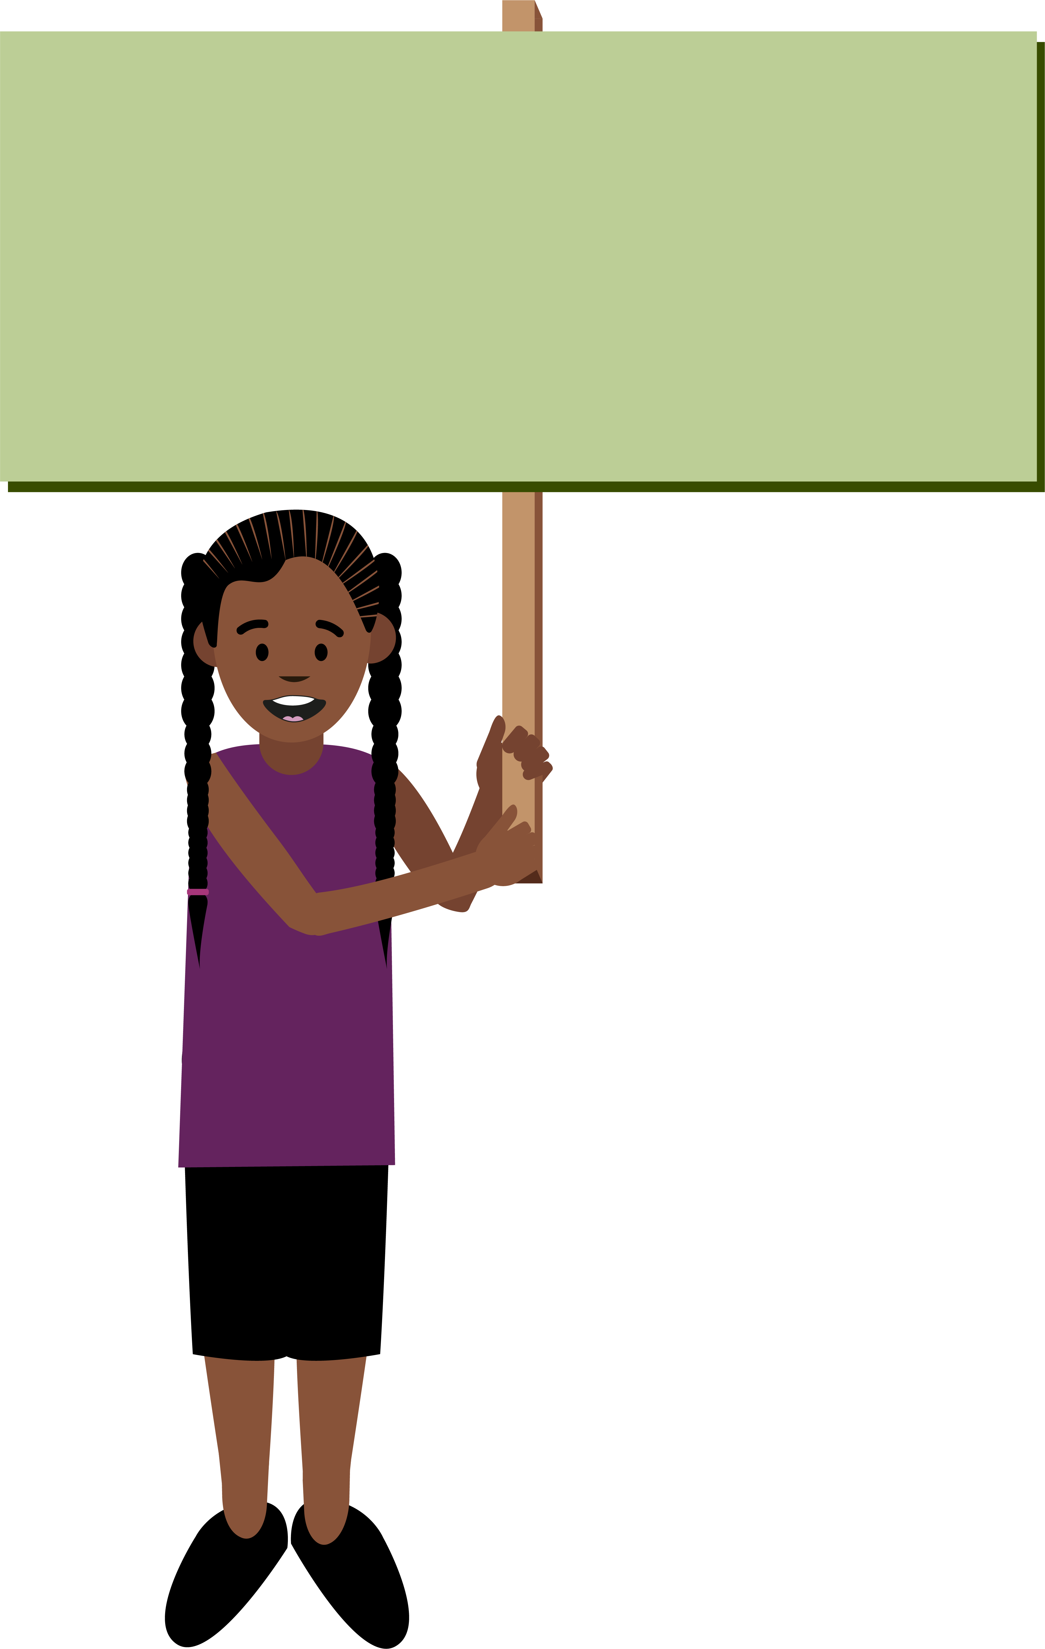
What is the UN Convention on the Rights of the Child (UNCRC)?
The UNCRC is an important agreement by countries who have promised to protect children’s rights.
It explains all the rights children have and the responsibilities of adults and governments to protect children’s rights.
All rights are connected, are equally important, and cannot be removed from children.
Notes:
Teacher notes - Introduction (10 mins, slides 11-17)
Introduce pupils to the UN Convention on the Rights of the Child (UNCRC).

Slide 15


What does ‘human dignity’ mean?
“It’s about being treated with respect, having your voice heard, and being valued as a human being – every day, in every space.”
(Children’s Parliament)
Notes:
Teacher notes - Introduction (10 mins, slides 11-17)
Tell pupils that ‘human dignity’ is at the heart of the UNCRC. Ask if anyone knows what ‘human dignity’ means?
Read aloud the definition on the slide and explain that human dignity means every person is important and deserves to be treated with care and respect simply because they are human. This is why children have rights – to uphold their dignity.

Slide 16

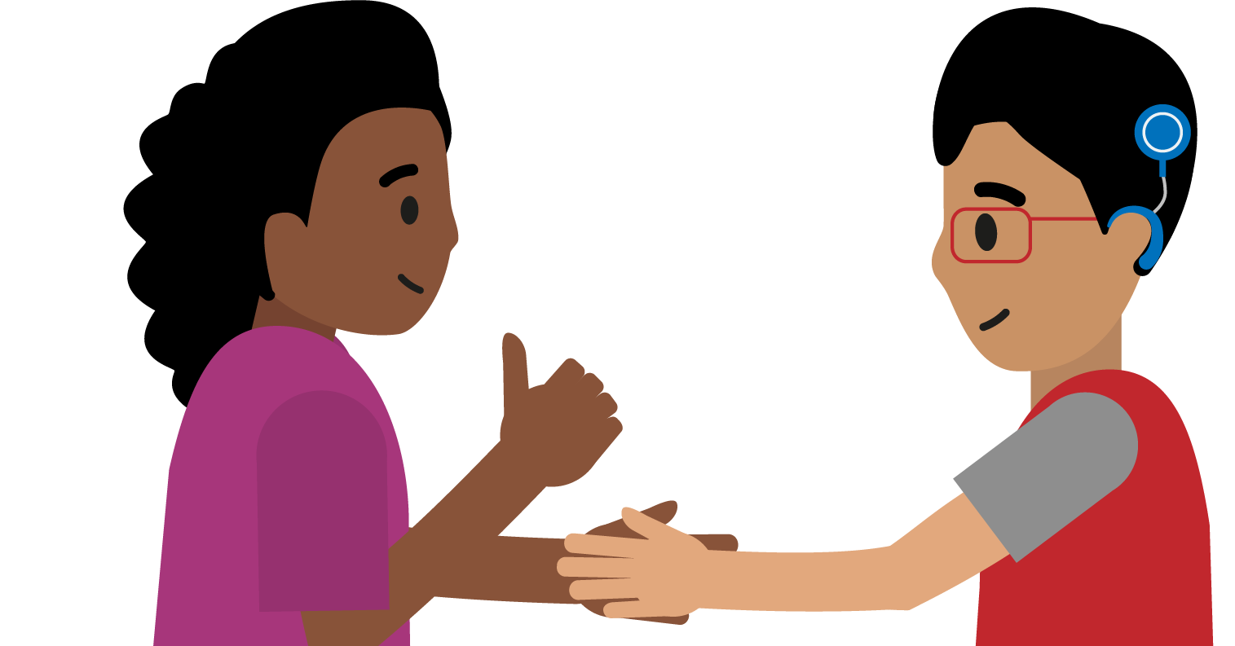
Rights that may be affected by generative AI use…
The right to non-discrimination
All children have the same rights no matter what their differences are, and no child should be treated unfairly for any reason, whatever their ethnicity, sex, religion, language, abilities, whatever they think or say, whatever their family background.
The right to privacy
Every child has the right to privacy. For example, every child has the right to make choices about who sees their personal information.
Notes:
Teacher notes - Introduction (10 mins, slides 11-17)
Use this slide and the next to share four key rights (articles) which may be affected by generative AI use:
The right to non-discrimination (Article 2) All children have the same rights no matter what their differences are, and no child should be treated unfairly for any reason, whatever their ethnicity, sex, religion, language, abilities or any other status, whatever they think or say, whatever their family background.
The right to privacy (Article 16) Every child has the right to privacy. For example, every child has the right to make choices about who sees their personal information.

Slide 17

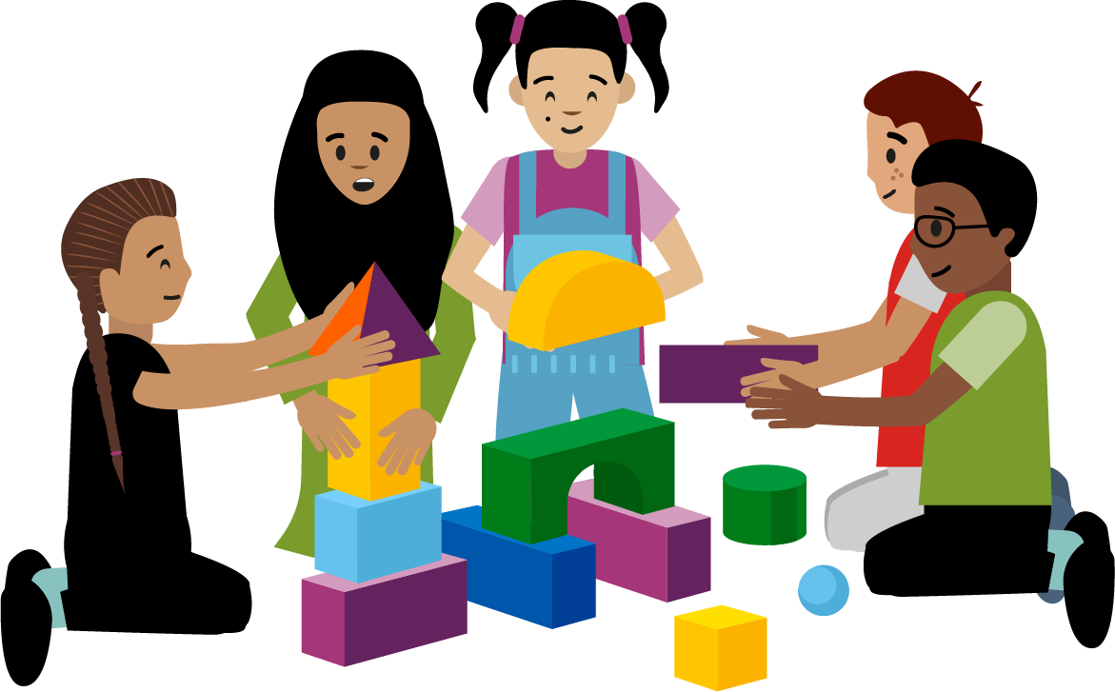
Rights that may be affected by generative AI use…
The right to access reliable information from the media
Every child has the right to reliable (trustworthy) information from different sources.
The right to leisure, play and culture
Every child has the right to relax, play and take part in a wide range of cultural and artistic activities.
Notes:
Teacher notes - Introduction (10 mins, slides 11-17)
Share the following key rights (articles) which may be affected by generative AI use:
The right to access reliable information from the media (Article 17) Every child has the right to reliable (i.e. trustworthy) information from a variety of sources. Governments must help protect children from materials that could harm them.
The right to leisure, play and culture (Article 31) Every child has the right to relax, play and take part in a wide range of cultural and artistic activities.

Slide 18
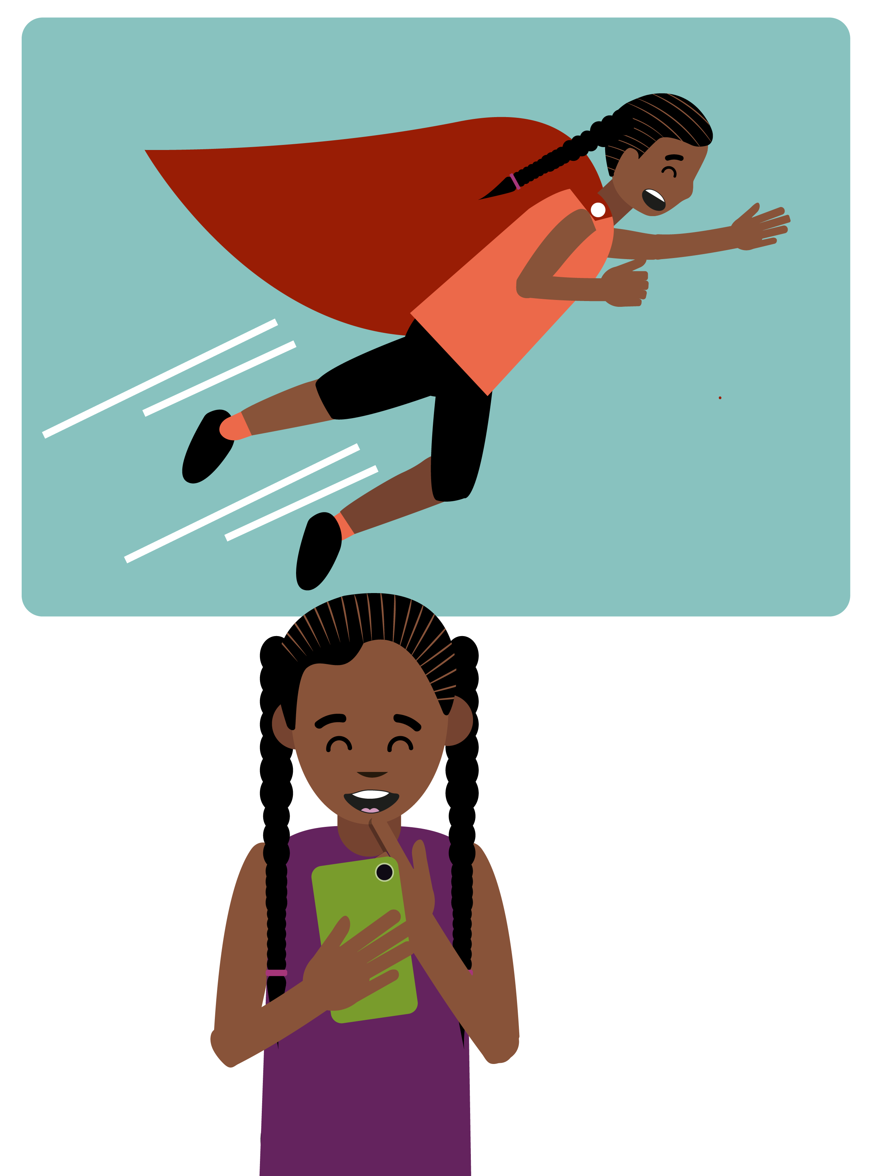
Which right is impacted?
Having asked her mum’s permission, Talia, a 13-year-old girl, used an AI game that lets people upload a photo and create a picture or video of themselves as a superhero.
She uploaded a photo of her face and AI made a video of her flying through the sky as a superhero!
Notes:
Teacher notes – Which right is impacted? (15 mins, slides 18-25)
Share the scenario. Emphasise that Talia is 13 years old and has her mum’s permission to use this generative AI game.

Slide 19

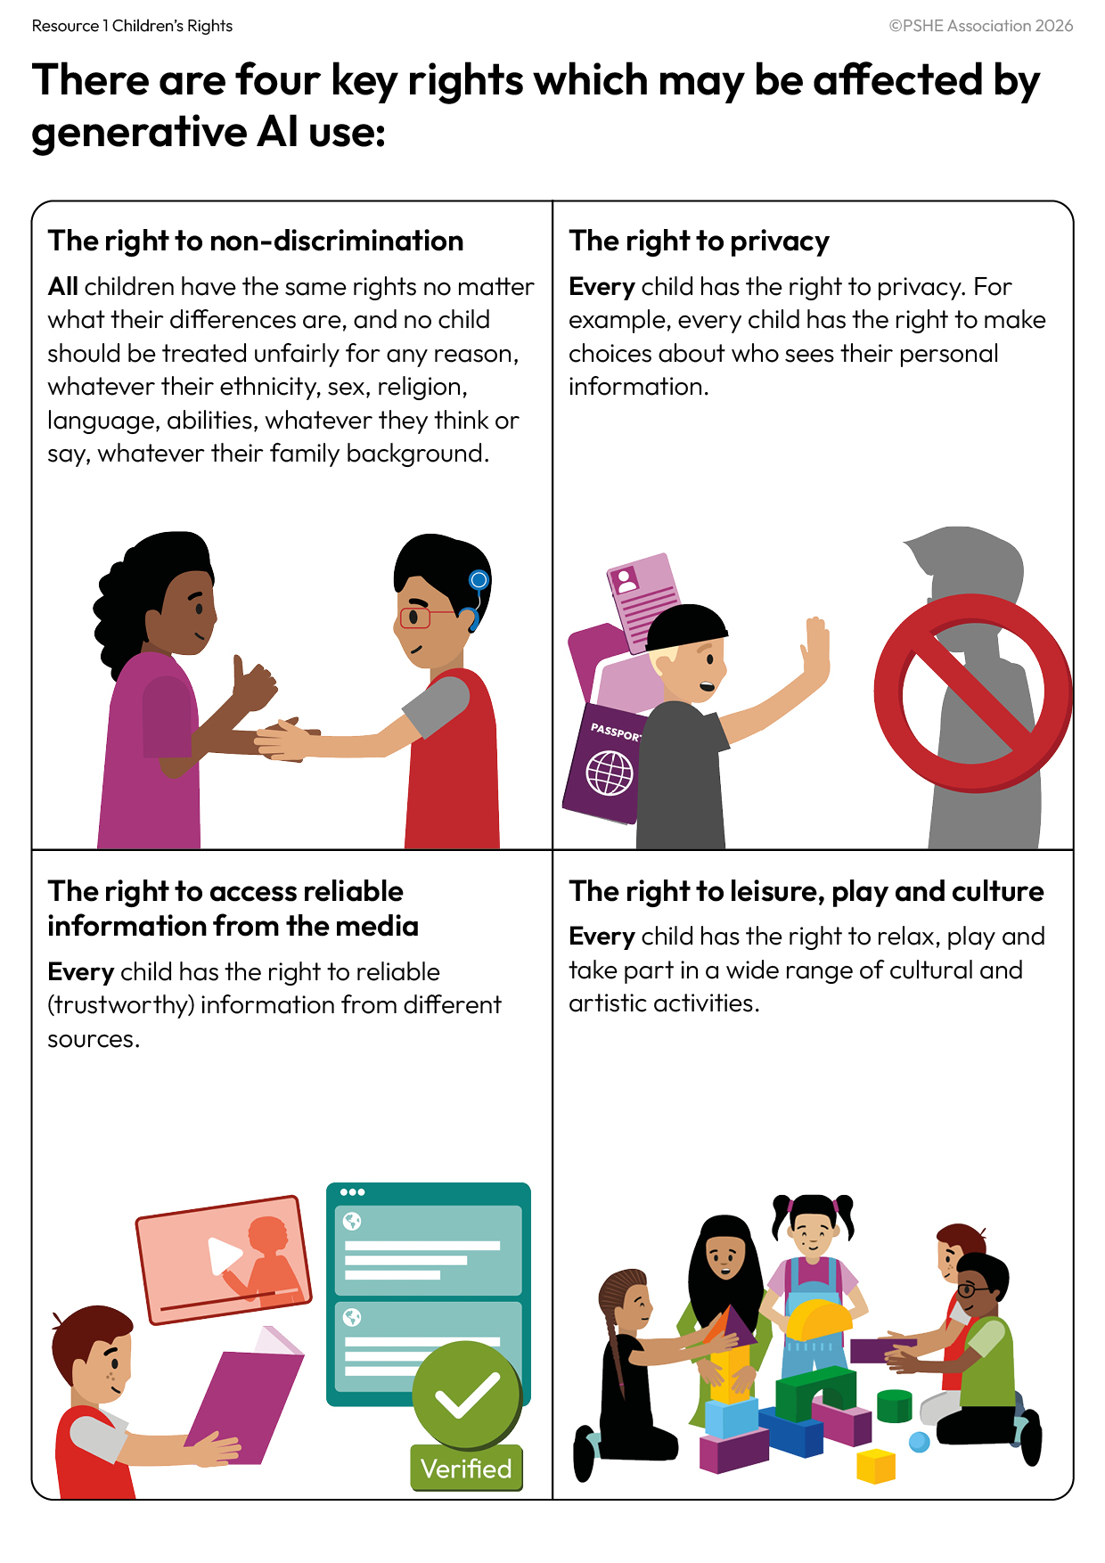
Which right is impacted?
Which right do you think is being positively impacted in this scenario?
This form of GenAI is helping me to play and be creative!
This form of generative AI use is impacting positively on the right to leisure, play and culture.
Notes:
Teacher notes – Which right is impacted? (15 mins, slides 18-25)
Give pupils Resource 1: Children’s Rights and ask them to discuss with a partner which right is being positively impacted in the scenario.
Take feedback and explain that this form of generative AI use is impacting positively on the right to leisure, play and culture (Article 31), as it’s helping Talia to play and be creative.

Slide 20

But what if…
…the app shared the superhero video online without asking her, or her parent’s permission?
…the game used AI systems designed to keep Talia playing as long as possible?
…the video changed Talia’s dark hair and skin tone to blond and fair?
Notes:
Teacher notes – Which right is impacted? (15 mins, slides 18-24)
Share three possibilities of what might happen next.

Slide 21
Which right is impacted?
But what if…
the app shared the superhero video online without asking her, or her parent’s permission?
This would impact Talia’s right to privacy.
What should have happened instead?
Apps should ask for the user’s permission before using, or sharing, their images and videos.
The app should have explained clearly what would happen with the video and given Talia the right to delete her data at any time.
Remember: Every child has the right to make choices about who sees their personal information.
Why would this be a problem?
Which right(s) would be impacted?
Notes:
Teacher notes – Which right is impacted? (15 mins, slides 18-24)
For each possibility on slides 21-23, discuss with the class their responses to:
Why would this be a problem?
Which right(s) would be impacted?
Reveal on each slide which right would be impacted. Ask pupils:
Does anyone have any thoughts on what should have happened instead?
Take feedback using the slides to discuss what should have happened instead to protect children’s rights.

Slide 22
Which right is impacted?
But what if…
the video generated changed Talia’s dark hair and skin tone to blond and fair?
This would impact Talia’s right to non-discrimination.
What should have happened instead?
The app should have reflected (and not altered) Talia’s appearance. Talia should be represented accurately, and her identity should be respected.
No child should be misrepresented or treated unfairly for any reason.
Why would this be a problem?
Which right(s) would be impacted?
Notes:
Teacher notes – Which right is impacted? (15 mins, slides 18-24)
For each possibility on slides 21-23, discuss with the class their responses to:
Why would this be a problem?
Which right(s) would be impacted?
Reveal on each slide which rights would be impacted by each of the possible outcomes.
Ask pupils:
Does anyone have any thoughts on what should have happened instead?
Take feedback using the slides to discuss what should have happened instead to protect children’s rights.

Slide 23
Which right is impacted?
But what if…
the game used AI systems designed to keep Talia playing as long as possible?
This would impact Talia’s right to leisure, play and culture.
What should have happened instead?
The game should be designed to make it easy for Talia to stop playing when she wants to get offline or do a different activity she enjoys.
Children have the right to play in a range of ways, including offline – and should be able to rest and relax.
Why would this be a problem?
Which right(s) would be impacted?
Notes:
Teacher notes – Which right is impacted? (15 mins, slides 18-25)
For each possibility on slides 21-23, discuss with the class their responses to:
Why would this be a problem?
Which right(s) would be impacted?
Reveal on each slide which rights would be impacted by each of the possible outcomes.
Ask pupils:
Does anyone have any thoughts on what should have happened instead?
Take feedback using the slides to discuss what should have happened instead to protect children’s rights.

Slide 24

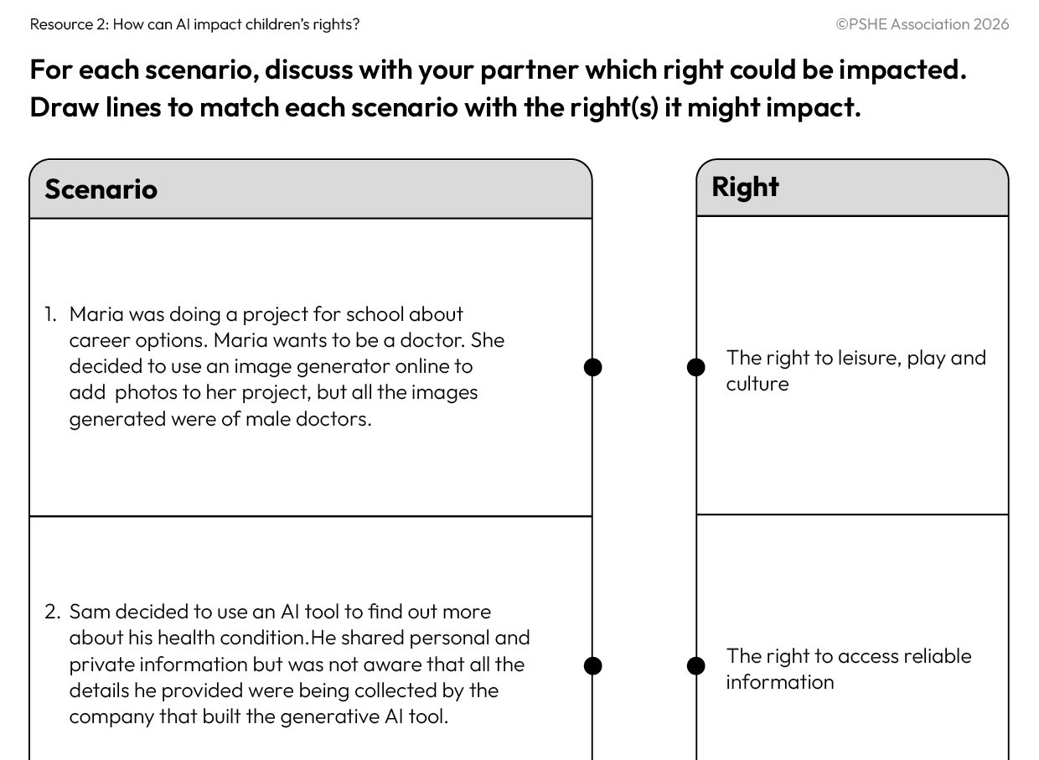


Which right is impacted?
Discuss the four scenarios and, for each, draw a line to match the generative AI example with the right it might impact.
Write a short explanation about how AI technology is affecting the child and their rights in each scenario.
A prompt is the input someone provides to an AI model to guide it to generate a specific response. It could be a question, command or statement.
An output is the result generated by an AI system after processing the prompt.
Notes:
Teacher notes – Which right is impacted? (15 mins, slides 18-24)
Using Resource 2: How can AI impact children’s rights?, ask pupils to work in pairs to discuss the four scenarios and consider how children’s rights might be impacted in each one. They should draw lines to match each generative AI example with the right it might impact.
To support pupils, share definitions of the terms ‘prompt’ and ‘output’.
Finally, pairs should write a short explanation about how AI technology is affecting the child and their rights in each scenario.
Support: Ask pupils to work in a small group on an A3 version of Resource 2a: How can AI impact children’s rights?. Once they have completed the matching, they should pick one scenario and explain to a partner how the child’s right is being affected.
Challenge: Ask pupils to discuss with a partner whether they think generative AI technology has more potential to positively or negatively impact children’s rights.

Slide 25
Which right is impacted?
Scenario 1
The right to non-discrimination
Scenario 2
The right to privacy
Scenario 3
The right to access to reliable information
Scenario 4
The right to leisure, play and culture
Notes:
Teacher notes – Which right is impacted? (15 mins, slides 18-24)
Take feedback and agree on which rights have been impacted. Draw out the following key learning for each scenario:
The data that AI draws from can be outdated, inaccurate, biased, or can reinforce stereotypes, so it’s important to always critically engage with AI outputs.
Personal information (e.g. name; address; school name; passwords; parent’s name or phone number; card or bank details) or information that someone wants to keep private – such as Sam’s health information - should never be shared with AI. Instead of turning to AI, Sam could speak to an adult to get help from trusted sources, such as health professionals.
While AI tools have the potential to positively impact children’s right to reliable information (for example, by summarising information or personalising learning) sometimes, the information AI generates is incorrect. This is particularly common if (like George) someone uses AI to find out about recent events, as AI may be trained on outdated data. It’s important to double-check AI’s outputs in other ways, such as cross-checking with trusted online sources, looking back at schoolwork, asking an adult, or checking in a book.
Generative AI can be helpful for some creative tasks – especially if it supports or inspires (rather than replacing) human creativity.

Slide 26


Keeping safe and protecting rights
AI companies and the government have a responsibility to make sure the online world and generative AI tools available to children are safe, accurate and helpful.
Lots of adults are thinking about this and working to put measures in place to protect children’s rights, if using AI.
Notes:
Teacher notes – Keeping safe and protecting rights (10 mins, slides 26-31)
Emphasise that AI companies and the government have a responsibility to make sure the online world and the generative AI tools available to children are safe, accurate and helpful.
Tell pupils that lots of adults are thinking about this and working to put measures in place to protect children’s rights if using AI.

Slide 27





What can companies do?
Read the quotes, then place yourself on the line to show how helpful (or effective) you think this company’s idea would be, for keeping children safe and protecting their rights.
Why have you chosen your position?
Not very helpful / ineffective
Helpful / effective
Notes:
Teacher notes – Keeping safe and protecting rights (10 mins, slides 26-31)
Share the quotes from fictional generative AI companies, on slides 28-30. For each quote, ask pupils to stand on a continuum across the classroom (with ‘helpful/effective’ at one end and ‘not very helpful/ineffective’ at the other), to show how effective they think this idea would be for keeping children safe and protecting their rights.
Once pupils are standing in place on the line, ask for a volunteer to explain why they have chosen their position.

Slide 28

What can companies do?
“We are thinking about introducing checks to make sure anyone who uses our generative AI games is old enough.”
(Gaming AI)
Why have you chosen your position?
Not very helpful / ineffective
Helpful / effective
Notes:
Teacher notes – Keeping safe and protecting rights (10 mins, slides 26-31)
Share the quotes from fictional generative AI companies, on slides 28-30. For each quote, ask pupils to stand on a continuum across the classroom (with ‘helpful/effective’ at one end and ‘not very helpful/ineffective’ at the other), to show how effective they think this idea would be for keeping children safe and protecting their rights.
Once pupils are standing in place on the line, ask for a volunteer to explain why they have chosen their position.

Slide 29
What can companies do?
“We want to be selective about the data we train our AI tools with, so we can make it less likely that our tools create biased outputs.”
(AI Aspire)
Why have you chosen your position?
Not very helpful / ineffective
Helpful / effective
Notes:
Teacher notes – Keeping safe and protecting rights (10 mins, slides 26-31)
Share the quotes from fictional generative AI companies, on slides 28-30. For each quote, ask pupils to stand on a continuum across the classroom (with ‘helpful/effective’ at one end and ‘not very helpful/ineffective’ at the other), to show how effective they think this idea would be for keeping children safe and protecting their rights.
Once pupils are standing in place on the line, ask for a volunteer to explain why they have chosen their position.

Slide 30
What can companies do?
“We’re going to add pop-up messages so whenever someone is using AI, they are reminded that it isn’t a human - just a computer, and that it can generate incorrect outputs too.”
(Ideal AI)
Why have you chosen your position?
Not very helpful / ineffective
Helpful / effective
Notes:
Teacher notes – Keeping safe and protecting rights (10 mins, slides 26-31)
Share the quotes from fictional generative AI companies, on slides 28-30. For each quote, ask pupils to stand on a continuum across the classroom (with ‘helpful/effective’ at one end and ‘not very helpful/ineffective’ at the other), to show how effective they think this idea would be for keeping children safe and protecting their rights.
Once pupils are standing in place on the line, ask for a volunteer to explain why they have chosen their position.
Once the class has responded to all the quotes, discuss:
Is there anything else AI companies or the government could do to help to keep children safe and uphold their rights, if they are using generative AI? (For example, provide child-friendly explanations of how AI works and uses data, so children can make informed decisions; involve children in the development of AI to make sure it reflects their needs)

Slide 31


What can children do?
​Remember there are usually age restrictions for using AI.
​Use AI with a trusted adult.
Avoid sharing personal information with generative AI.
Protect your privacy online.
Double check the outputs.
Tell a trusted adult if you’re worried about anything you’ve seen or heard.
​Be creative but remember AI is a tool – not a human!
Notes:
Teacher notes – Keeping safe and protecting rights (10 mins, slides 26-31)
Explain that there are also lots of things children can do to protect and uphold their rights if using generative AI. Reflecting on what they have learnt this lesson, ask pupils:
If using AI, what should children consider to help keep themselves safe and protect their rights?
Give pairs a few minutes to write two ideas on their whiteboards.
Ask pupils to show their whiteboards and pick out some examples to read aloud to the class.
Using the slide, add to pupils’ ideas with other ways in which people can keep safe and uphold their rights if using AI:
1. Remember there are usually age restrictions for using AI. This is often 13 years old, with the permission of a parent/carer.
2, Use AI with a trusted adult – it’s more fun and safer to explore new technology together. You can check things with them as well.
3. Avoid sharing personal information with generative AI – consider what to include and exclude from AI prompts and avoid sharing personal or sensitive information with AI, for example a home address.
4. Protect your privacy online – think about what you share online as it could be used by AI tools (AI models often scrape data from the web, so what you share publicly online may be used by an AI system).
5. Double check the outputs – AI can support with tasks but remember it can give incorrect, outdated or biased information so always double check with trusted adults, other reliable online sources or books.
6. Tell a trusted adult if you’re worried about anything you’ve seen or heard – AI outputs should never make someone feel uncomfortable or suggest that they do something wrong. If anything like that happens then tell a trusted adult right away.
7. Be creative but remember AI is a tool not a human!

Slide 32
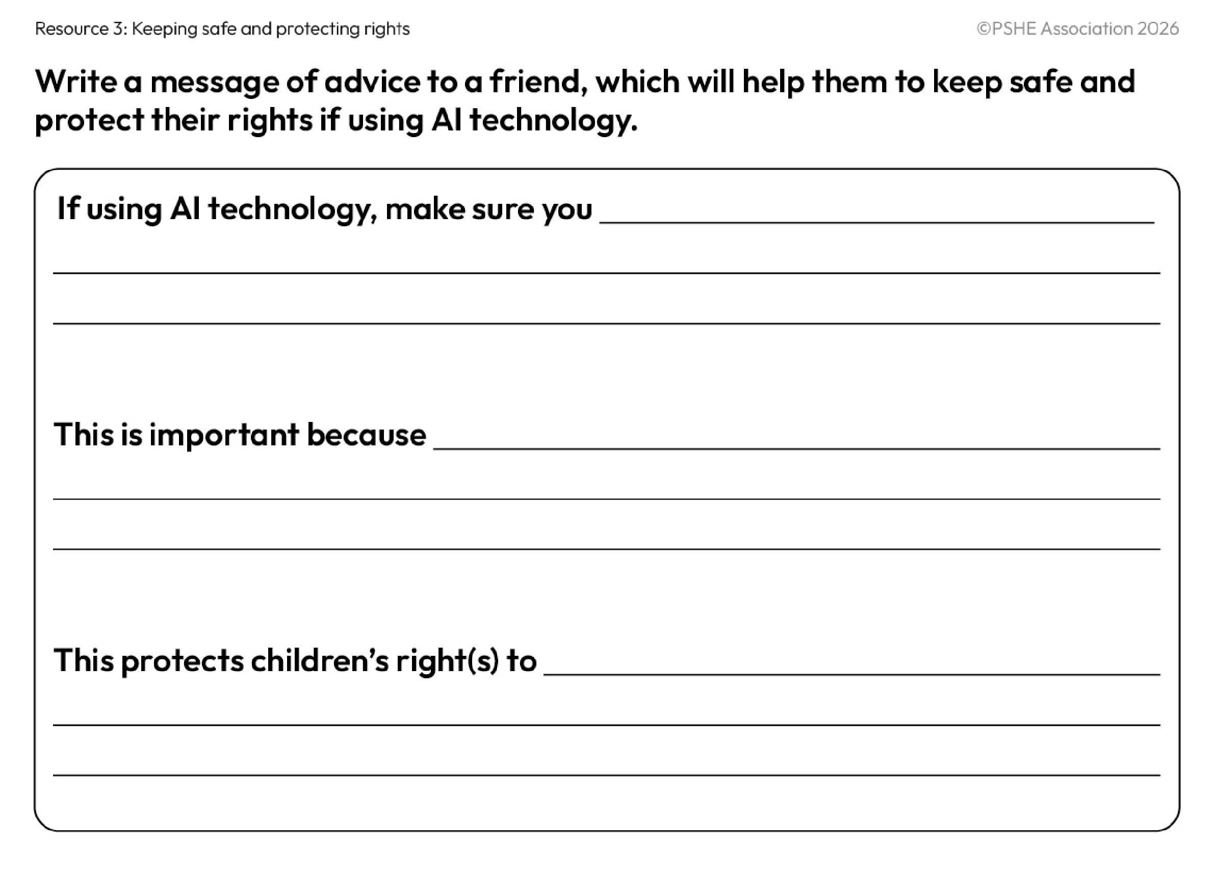
What have we learnt?
Write a message of advice to a friend to help them to protect their rights and keep safe, if using AI technology.
We will be able to:
identify rights that children have, on and offline
explain how AI (including generative AI) can impact children’s rights
describe ways to protect and uphold children’s rights when interacting with AI
Notes:
Teacher notes – Endpoint assessment and reflection (13 mins, slides 32-33)
Remind pupils of the learning outcomes.
Ask them to use Resource 3: Keeping safe and protecting rights to individually write a message of advice to a friend, to help them to protect their rights and keep safe if using AI technology.
Support: Ask pupils to explain the above to a trusted adult or, if appropriate, ask them to say it into a button recorder for you to listen to after the lesson.
Address any questions in the question box.

Slide 33

Reflection
How can I help to protect myself if using AI?
Notes:
Teacher notes – Endpoint assessment and reflection (13 mins, slides 32-33)
Ask pupils to reflect privately for a minute on the question, ‘How can I help to protect myself if using AI?’.

Slide 34


Who can help?
If concerned about AI systems, or anything else you have encountered online, you can speak to a trusted adult at home or at school.
Or find information and advice from:
www.childline.org.uk/kids
www.ceopeducation.co.uk/8_10
I need your help with something . . .
Something's worrying me,
can I talk to you?
I have something that’s been bothering me . . .
Notes:
Teacher notes – Signposting support (2 mins)
Remind pupils that if they have any concerns about AI systems, or anything else they have encountered online, they can speak to a trusted adult, such as a parent/carer or teacher.
You can also direct pupils to the following websites for more advice and support:
www.childline.org.uk/kids
www.ceopeducation.co.uk/8_10

Slide 35
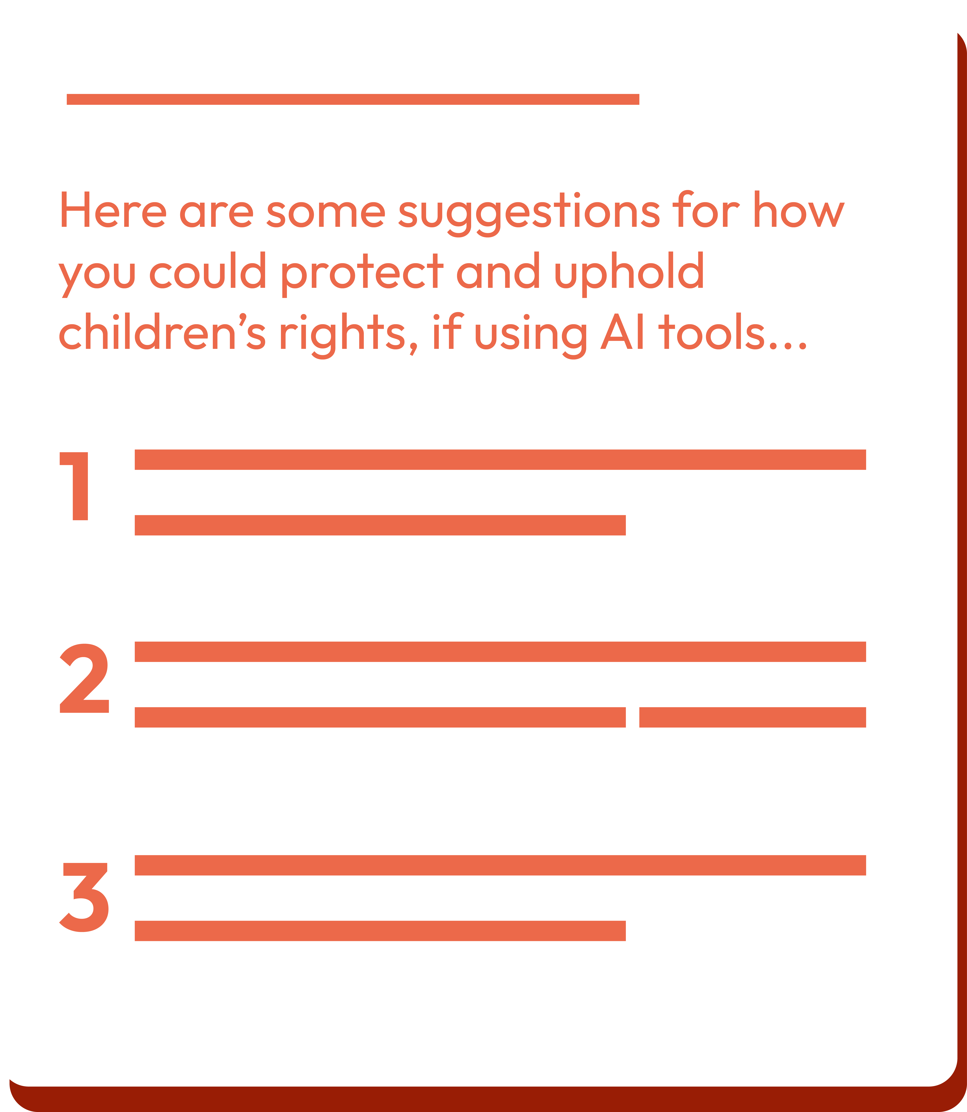
What could AI companies do?
Write a message to an AI company suggesting three things they could do to protect and uphold children’s rights, if using AI tools.
Notes:
Teacher notes – Extension activity
Ask pupils to write a message to an AI company suggesting three things they could do to protect and uphold children’s rights, if using AI tools.

