Slide 1
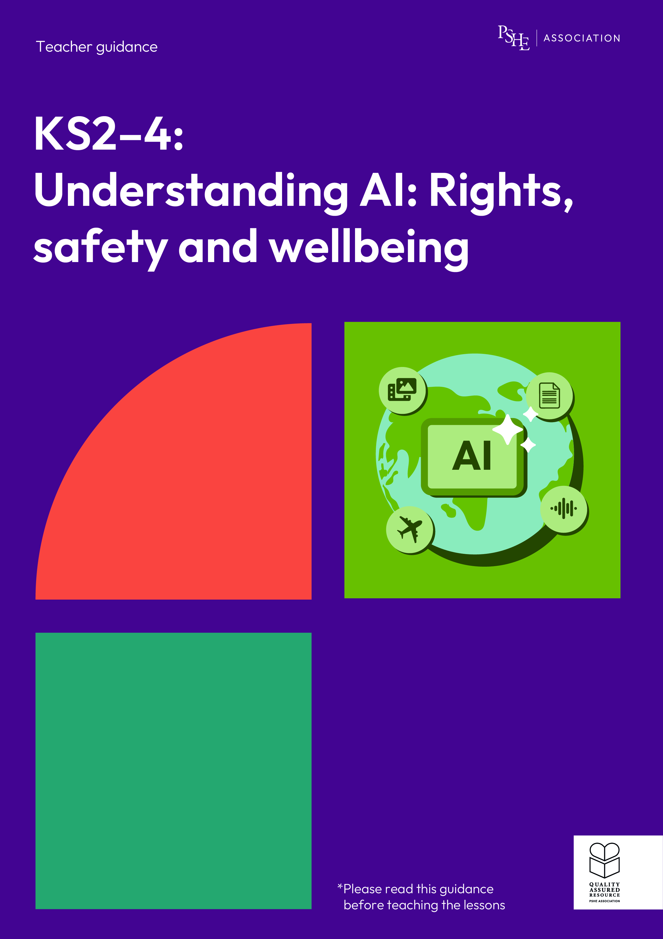
Understanding AI: Rights, safety and wellbeing
KS2, Lesson 3: What is an AI chatbot?

Slide 2
Using this PowerPoint
The slides in this presentation are divided into two sections:
Teacher slides (purple) – provide key information regarding lesson preparation.
Pupil slides – provide a visual focus point for pupils during the lesson and delivery notes for teachers about the activities. Click ‘notes’ to view these.
Ensure that you select ‘Use Presenter View’ under the ‘Slide Show’ tab – this will allow you to preview the teaching notes on your monitor while the main presentation is displayed on a screen/smartboard.

Slide 3


Support and challenge
The lesson includes suggestions for support and challenge activities, to help you differentiate appropriately for your class.
Support activities are adapted to be more accessible for those who need it.
Challenge activities deepen and extend learning for those who need more challenge or who finish the activity quickly.
Look for these icons on the pupil slides. See delivery notes for details of the activities.
Challenge
Support

Slide 4
Context
This lesson pack for key stages 2–4 has been designed to support pupils’ AI literacy. This is the third of three lessons for years 5 and 6. It focuses on AI chatbots and how they are different from humans.
These lessons should not be taught in isolation, but always as part of a planned, developmental PSHE education programme. They are best used within the context of online safety or digital literacy.

Slide 5
To learn about AI chatbots and how they are different from humans.
Pupils will be able to:
explain what AI chatbots are and why some people might use them
evaluate qualities of human friendship
identify factors to be aware of, if communicating with a chatbot
assess similarities and differences between communicating with chatbots and interacting with friends

Slide 6
Box or envelope for questions
Resource 1: AI chatbots [one per pupil]
Resource 2: Qualities of a good friend
[one per small group, cut up]
Resource 3: Support for Billy [one per pupil]
Resource 4: Venn diagram labels [one for activity, cut up)
2 hula hoops
Resource 5: Venn diagram card sort [one for activity, cut up]
Notes:
It is important to be sensitive to pupils’ different experiences and not to normalise the use of generative AI or chatbots for this age group, as some may have never used generative AI tools and most generative AI has an age restriction of 13 years old, with parental permission.

Slide 7
Lesson summary
Activity | Description | Timing
Baseline assessment | Set up the question box and establish or revisit ground rules. Pupils demonstrate their understanding by responding to four questions, in one colour. | 5 mins
Introduction | Introduce the learning objective and outcomes and explain what chatbots are and where/why they might be used. | 5 mins
Qualities of a good friend | Small groups create a diamond 9 to assess the qualities they believe are most important in a good friend. | 10 mins
Billy and the chatbot | Pupils explore a character’s interactions with an AI chatbot and decide if they are healthy, or if there’s something to consider. Next, they create three top tips to help the character safely communicate with an AI chatbot. | 15 mins
Similar or different? | The class sort qualities in a Venn diagram to show whether they apply to chatbots, human friends, or both. | 15 mins
Endpoint assessment and reflection | Pupils revisit the baseline activity and add new learning in a different colour before privately reflecting on the qualities they think are most important in a good friend. | 5 mins
Signposting support | Remind the class of adults and organisations who can help if they have questions or concerns. | 5 mins

Slide 8
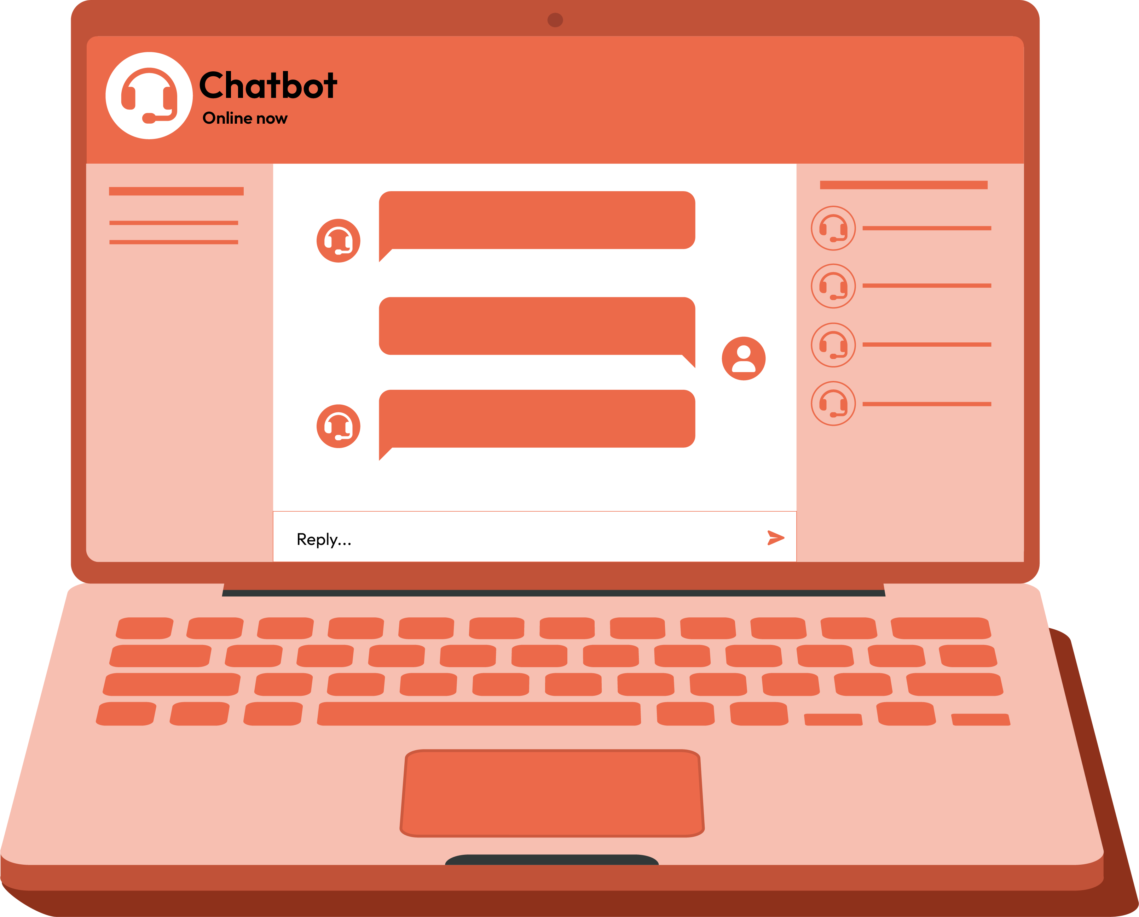
What is an AI chatbot?
Lesson 3

Slide 9
Notes:
Teacher notes – Baseline assessment activity (5 mins, slides 9-10)
Establish or revisit ground rules. Explain that if pupils have worries or questions during or after the lesson that they do not want to raise in front of the class, they can write their question on a piece of paper, anonymously or with their name, and put it in the question box.

Slide 10
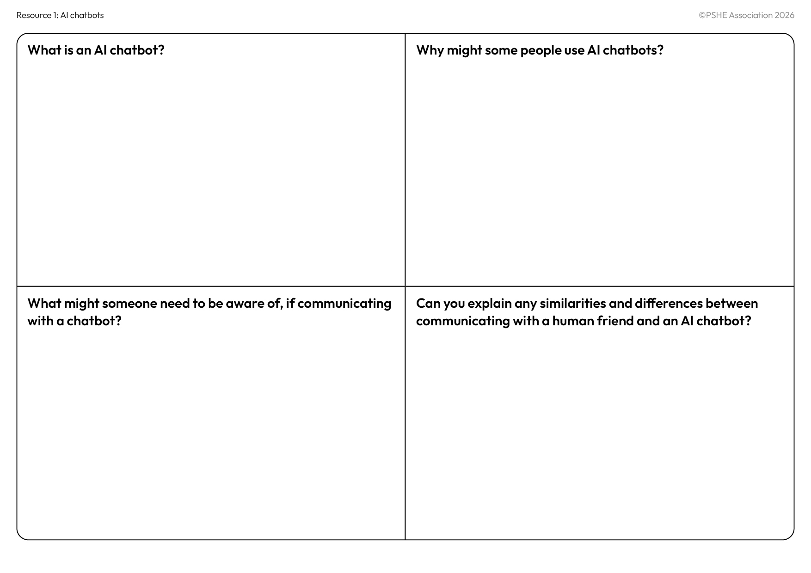

What’s our starting point?
Write your thoughts down under the four questions, in one colour only.
Don’t worry if you think you don’t know a lot! You’ll be learning more in today’s lesson.
Notes:
Teacher notes – Baseline assessment activity (5 mins, slides 9-10)
Ask pupils to complete Resource 1: AI chatbots on their own, in one colour pen.
Circulate during the activity to establish pupils’ starting points and notice any common themes in their work. Consider how the lesson may need adapting depending on any gaps or misconceptions. For example, more time may be needed for supporting pupils to understand what an AI chatbot is.

Slide 11
To learn about AI chatbots and how they are different from humans.
We will be able to:
explain what AI chatbots are and why some people might use them
evaluate qualities of human friendship
identify factors to be aware of, if communicating with a chatbot
assess similarities and differences between communicating with chatbots and interacting with friends
Notes:
Teacher notes - Introduction (5 mins, slides 11-14)
Introduce the learning objective and outcomes. Explain that today’s lesson will build on the learning in lessons 1 and 2, by exploring what AI chatbots are and how communicating with them might compare to interacting with human friends.

Slide 12


What are AI chatbots?
AI chatbots are computer programs that analyse what people type or say and are designed to respond like a human would.
Chatbots are trained by gathering data from lots of online conversations and learning patterns.
Chatbots are designed to mimic human communication, but they are not human!
What are AI chatbots?
How do AI chatbots work?
Notes:
Teacher notes - Introduction (5 mins, slides 11-14)
Introduce Billy, a 13-year-old boy (remind pupils that use of generative AI is usually restricted to 13 years and above in the United Kingdom). Explain that Billy has seen an advert for an AI chatbot, that is being marketed as a ‘friend’, but Billy wants to better understand how AI chatbots work and whether they can really provide quality friendship.
Ask the class what they think AI chatbots are. Explain that chatbots are computer programs that analyse what people type or say and are designed to respond like a human would. Chatbots are trained by gathering data from lots of online conversations and learning patterns. Emphasise that chatbots are designed to communicate similarly to a human, but chatbots are not human. Unlike a human, AI chatbots do not have emotions, beliefs or intentions, and do not ‘understand’ what is being said, but the tool is able to use patterns learned from the training data to mimic human interactions.

Slide 13


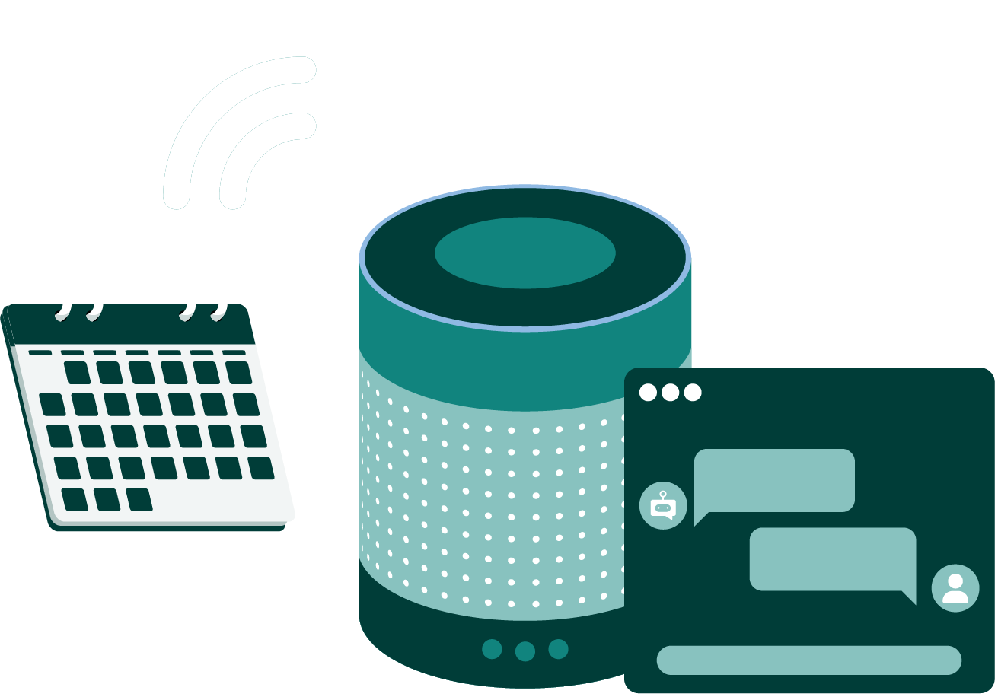

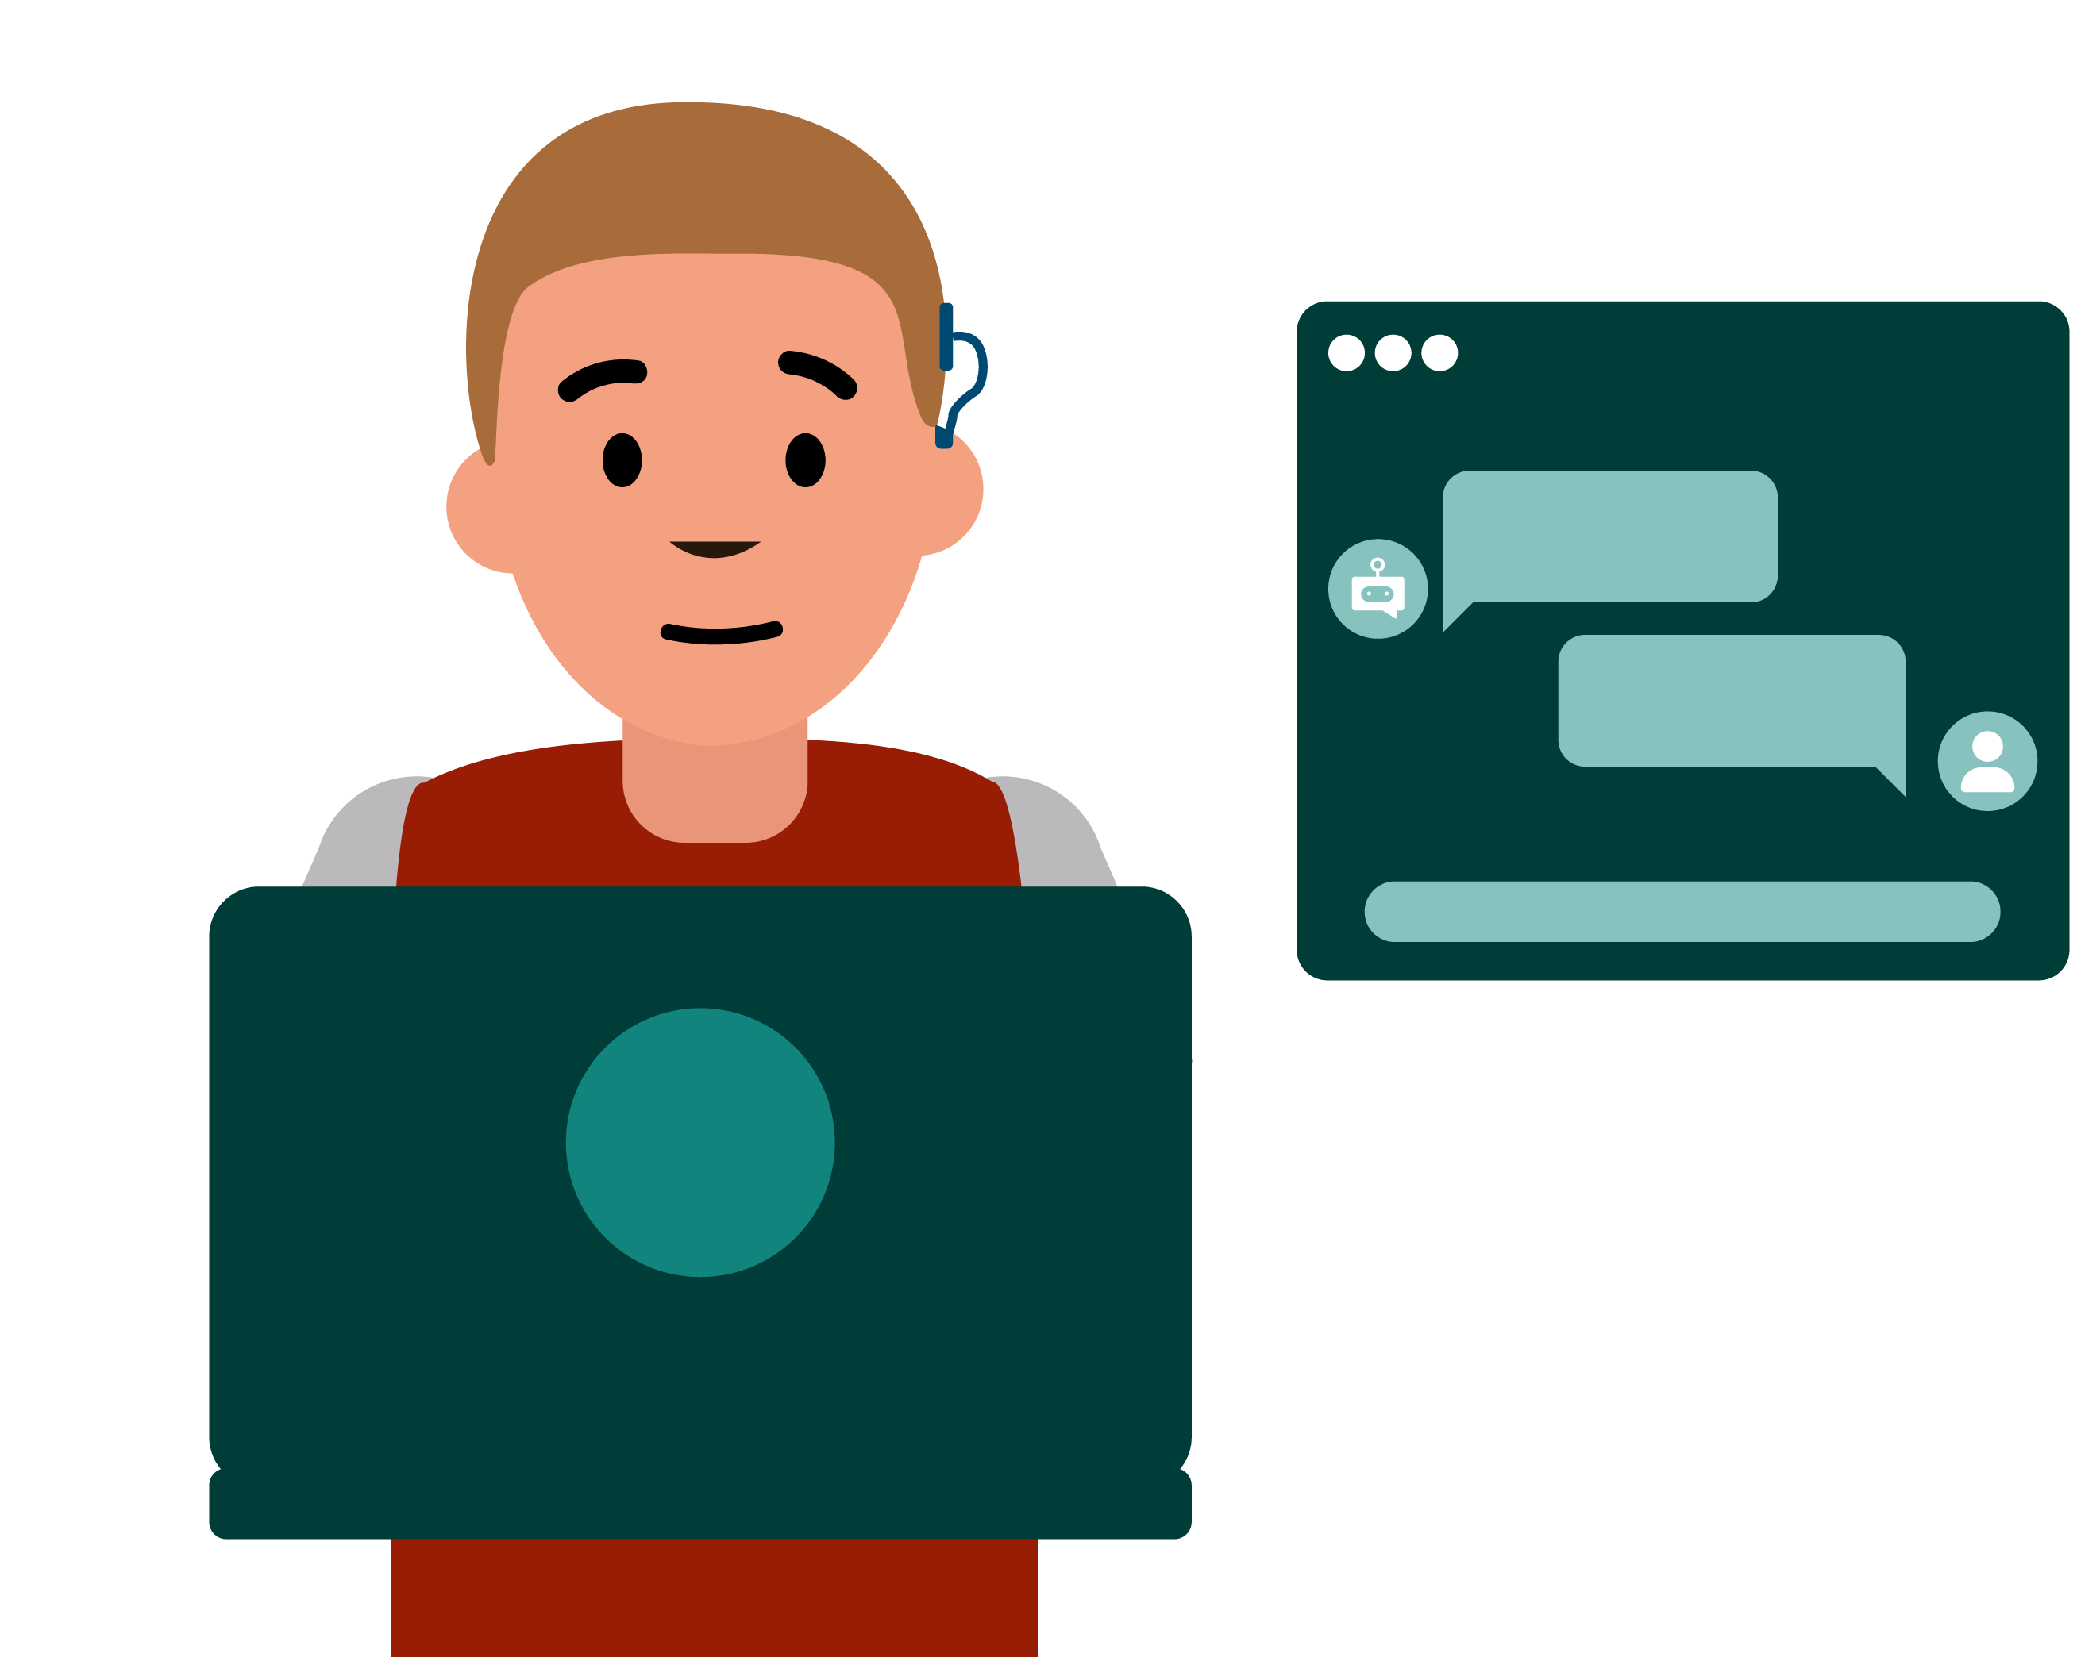
Where might someone come across an AI chatbot?
Customer service
Finding out information
Assistance and organisation
AI chatbot ‘friendship’ apps
Social media
Notes:
Teacher notes - Introduction (5 mins, slides 11-14)
Ask pupils:
Where might someone come across an AI chatbot?
Take feedback, drawing out that chatbots can be used in different contexts, including:
customer service, e.g. helping with online orders, handling inquiries, providing customer support, tracking orders, booking appointments
finding out information
assistance and organisation, e.g. voicebots like Alexa and Siri
social media
AI chatbot friendship apps, e.g. where an AI platform markets chatbots to people as ‘friends’, ‘avatars’, or ‘companions ’, but they are not real humans - they are chatbots

Slide 14

Why do people use AI chatbots?
For fun
Why might people use AI chatbots which are marketed as ‘friends’?
To practise conversations before having them in real life
To bounce ideas around
To interact with, when they
want company
To help with research
Notes:
Teacher notes - Introduction (5 mins, slides 11-14)
Ask pupils to ‘think-pair-share’ in response to the question:
Why do you think people might use AI chatbots which are marketed as ‘friends’?
Take feedback, using the ideas on the slide to support.
Explain that they are going to be thinking about what is important in friendships and how interacting with friends, such as school friends, compares with communicating with chatbots.

Slide 15


Qualities of a good friend
What qualities are important to me in a good friend?
Knows me well
Offers good advice
Trustworthy and doesn’t
share my private stories
Fun
Good listener
Good to have a meaningful/ personal conversation with
Would not knowingly cause me harm
Shares some similar hobbies/interests
Sometimes disagrees with me
Notes:
Teacher notes – Qualities of a good friend (10 mins, slides 15-16)
Explain that Billy has been thinking about his friends from school, Rani and River, and what qualities they have that are important to him. Go through Billy’s list with the class.

Slide 16
Qualities of a good friend
Most important
Create a diamond 9, ordering the qualities that are most important (top of the diamond) to least important (bottom of diamond).
Share your group’s top 3 qualities and reasons why they are important.
Least important
Notes:
Teacher notes – Qualities of a good friend (10 mins, slides 15-16)
Ask small groups to use Resource 2: Qualities of a good friend to create a diamond 9, ordering the qualities they believe are most important in a good friend (towards the top of their diamond) through to least important (towards the bottom of their diamond).
Take feedback by asking groups to share their top three qualities and reasons why these are important to them. Discuss with the class that good friends will often have these qualities, but everyone has strengths and weaknesses, and good days and more challenging days, which sometimes might affect how these qualities are demonstrated. This is what makes us human!

Slide 17

Billy and the chatbot
What do you notice?
Billy: Hey, do you think I’m good at everything?
AI chatbot: Yes – you are good at everything!
Is there anything Billy needs to consider?
Notes:
Teacher notes – Billy and the chatbot (15 mins, slides 17-21)
Tell the class that they are going to look at some of Billy’s interactions with an AI chatbot. Share the interactions on slides 17-20.
For each one, ask the class:
What do you notice?
Is there anything Billy needs to consider?
Take feedback, explaining the following:
Scenario 1 – The AI chatbot is agreeing that Billy is good at everything but the chatbot does not (and cannot) know Billy. Chatbots are also designed to agree with the user. This means that chatbots cannot be honest like school friends can, for example. Honesty helps friends build trust and grow together as individuals. Honesty can also help friends to work through disagreements or conflicts, which can even make relationships stronger.

Slide 18

Billy and the chatbot
What do you notice?
Billy: I’m feeling down today.
AI chatbot: I’m sorry, Billy – why is that?
Is there anything Billy needs to consider?
Billy: I don’t know. Should I be worried?
AI chatbot: Yes. I would recommend
this website: www.adultswhoareunhappy.com
Notes:
Teacher notes – Billy and the chatbot (15 mins, slides 17-21)
Tell the class that they are going to look at some of Billy’s interactions with an AI chatbot. Share the interactions on slides 17-20.
For each one, ask the class:
What do you notice?
Is there anything Billy needs to consider?
Take feedback, explaining the following:
Scenario 2 – Chatbots can make mistakes and may direct people to inappropriate support (like this website, which is for adults) or even into unsafe or risky situations. If this ever happens, Billy should speak to a trusted adult. If Billy feels sad or experiences other challenging emotions, he can talk to an adult at home or at school, who knows him and who he trusts – they will be able to give him advice and support, with his best interests at heart.
With statements like, ‘I’m sorry, Billy’ the chatbot is mimicking human conversation, but chatbots cannot have feelings. The chatbot is also ‘asking’ Billy questions; this feature of chatbot design aims to gather more data about the user to help tailor the chatbot’s responses.

Slide 19

Billy and the chatbot
What do you notice?
Billy: I found out which new school I am moving to!
AI chatbot: That’s great! ☺ Which one?
Is there anything Billy needs to consider?
Billy: Blackley Academy
AI chatbot: Where is that?
Billy: It’s in Blackley town in England.
Notes:
Teacher notes – Billy and the chatbot (15 mins, slides 17-21)
Tell the class that they are going to look at some of Billy’s interactions with an AI chatbot. Share the interactions on slides 17-20.
For each one, ask the class:
What do you notice?
Is there anything Billy needs to consider?
Take feedback, explaining the following:
Scenario 3 - The chatbot’s use of questions and human-like communication (e.g. emojis) is designed to gather data and encourage the user to keep engaging with the chatbot, so the chatbot companies make more money. Billy might trust his friends with his secrets, or some personal details, but he shouldn’t trust an AI chatbot with this information, as all text, photos and voice notes might be stored and used without his permission.

Slide 20

Billy and the chatbot
What do you notice?
Billy: Tell me a joke.
AI chatbot: Of course, Billy – you are going to be laughing your head off with this one…why did the bicycle fall over?
Is there anything Billy needs to consider?
Billy: I don’t know?
AI chatbot: It was two-tired!
Would you like to hear another?
Notes:
Teacher notes – Billy and the chatbot (15 mins, slides 17-21)
Tell the class that they are going to look at some of Billy’s interactions with an AI chatbot. Share the interactions on slides 17-20.
For each one, ask the class:
What do you notice?
Is there anything Billy needs to consider?
Take feedback, explaining the following:
Scenario 4 - AI can have positive uses. Here for example, Billy is using the chatbot for entertainment and fun. However, it is still important for Billy to consider that the chatbot is designed to keep him engaged (e.g. ‘Would you like to hear another?’). Billy will need to balance any time spent interacting with the chatbot with meaningful experiences with friends and family, and other offline activities.

Slide 21


What should Billy consider?
There are age restrictions in the UK for using generative AI. This is often 13 years old, with parental permission.
Include family, if interacting with a chatbot
Always get any advice from real, trusted adults or friends
Don’t share personal information
Do research beyond what AI generates and use critical thinking skills
Remember an AI chatbot is not human and cannot think about or understand what a human is saying - it is just predicting responses
Can you…
write a note to Billy explaining three important things he should think about if communicating with an AI chatbot?
Notes:
Teacher notes – Features of chatbot interactions: What should Billy consider? (15 mins, slides 17-21)
Explain that these interactions have shown some features and risks of using AI chatbots. So, what would Billy need to consider if interacting with an AI chatbot? Take feedback then share the ideas on the slide.
Then, in their books, ask pupils to write a note to Billy explaining three important things he should consider if communicating with an AI chatbot.
Finally, ask those pupils who completed the challenge activity to feedback their ideas to the rest of the class.
Support: Ask pupils to use Resource 3: Support for Billy to help with their note to Billy.
Challenge: Ask pairs to consider why they think AI chatbots are designed to always agree with the user. Draw out that this design feature aims to keep users engaged so they spend more time interacting with the chatbot, which helps chatbot companies make more money.

Slide 22

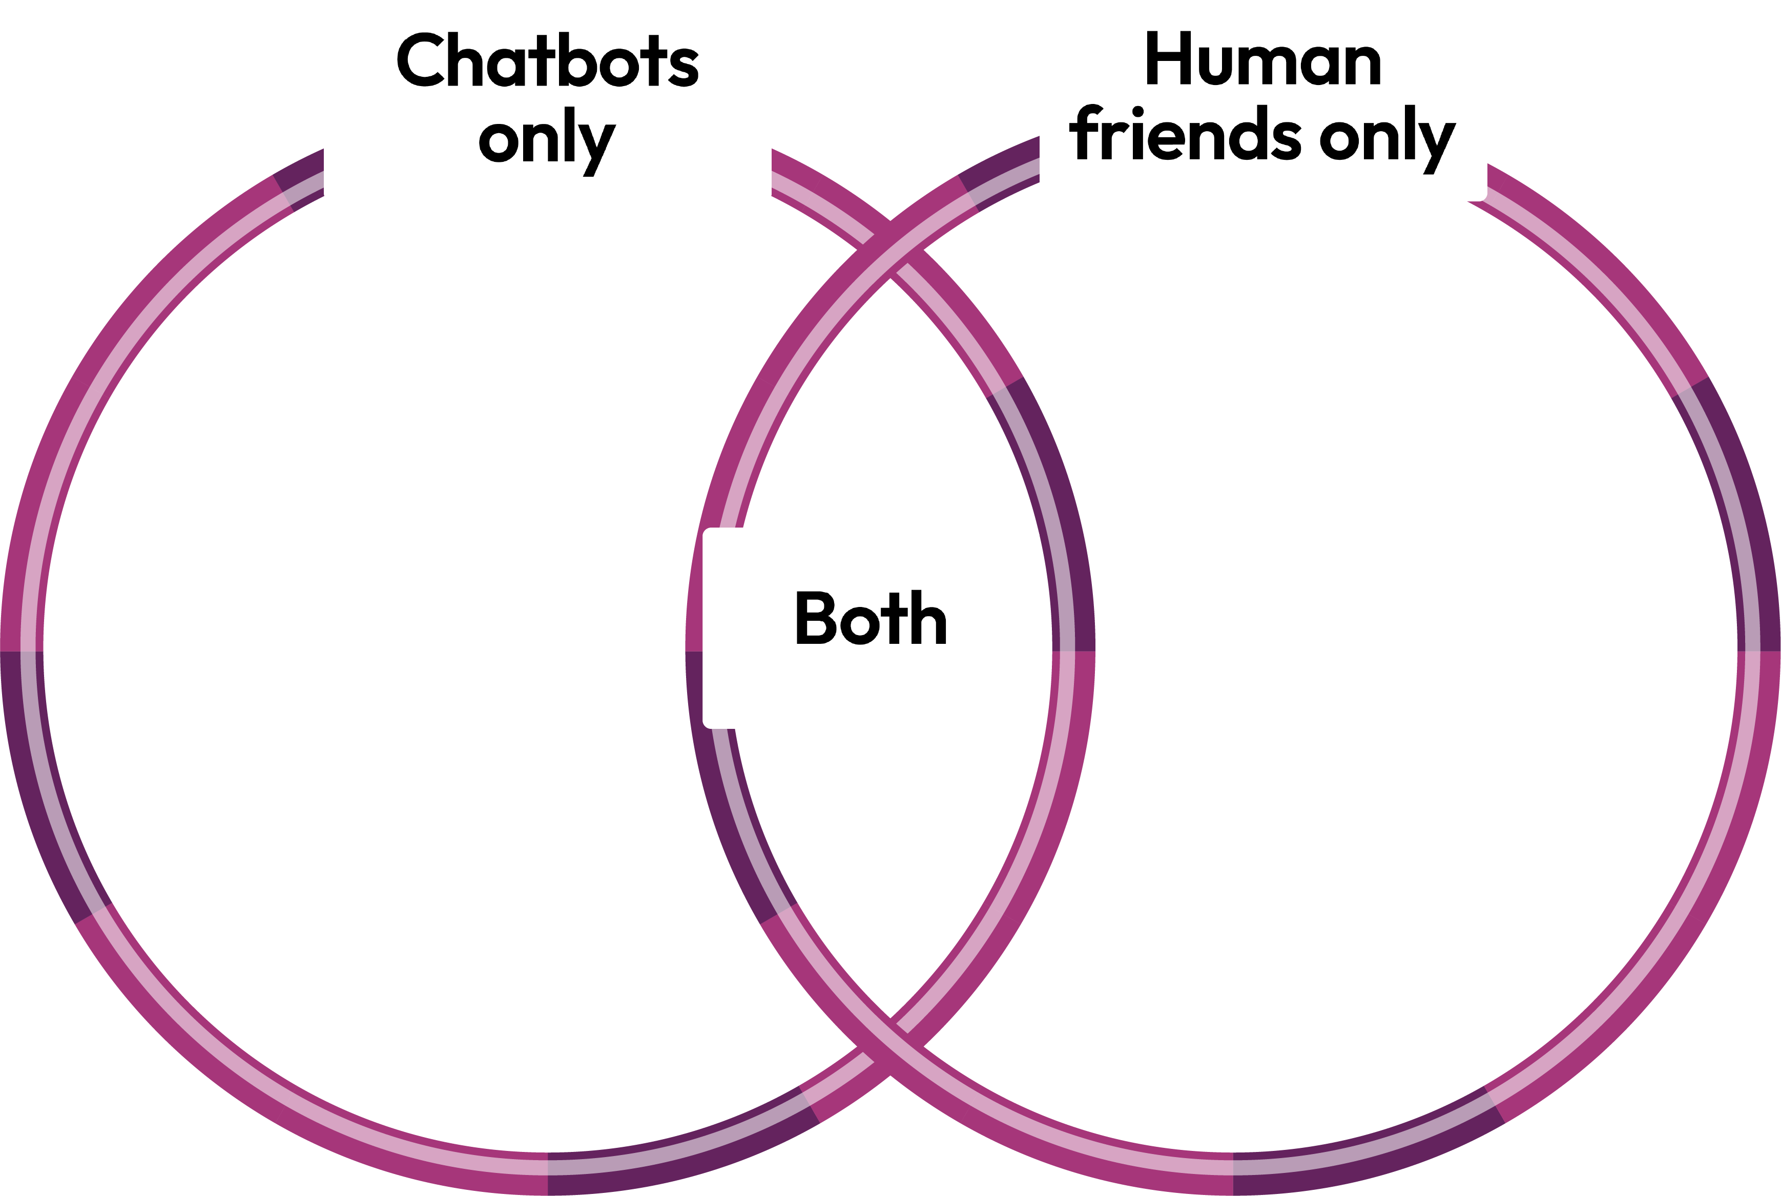


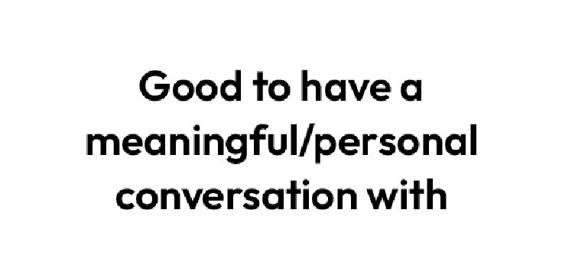



Similar or different?
Sometimes my interactions with the AI chatbot feel similar to those with my school friends and sometimes they feel different!
Please can you help me to think about this more?
For each card, consider whether it best applies to chatbots, human friends, or both.
Notes:
Teacher notes – Similar or different? (15 mins, slides 22-23)
Use the slide to explain that Billy is feeling confused; he thinks that sometimes his interactions with the AI chatbot are similar to those with his school friends, Rani and River, and sometimes he feels they are very different.
Explain that the class are now going to explore the similarities and differences between communicating with chatbots and communicating with human friends.
Tell the class to sit in a circle. In the middle of the circle, overlap two hula hoops so that they create a Venn diagram, labelled using Resource 4: Venn diagram labels. Spread out the cards from Resource 5: Venn diagram card sort and explain that for each card, pupils are going to consider whether it applies best to chatbots, human friends, or both. Take each card in turn and as a class decide on where it should be placed. If pupils are unsure of any card, this can be placed outside the hoops.
Using the guide below for support, draw out key learning:
Chatbots only:
Always available –human friends can’t always be available as they need to do things like sleeping and eating; and they have their own lives too. While always being available might seem like a positive, this could give people (like Billy) unrealistic expectations of human friends and how available they should be.
Human friends only:
Knows me well - chatbots can’t ‘know’ someone as they aren’t alive. All chatbots can do is store the information shared with them. Whereas human friends will know about their friend’s life, feelings, likes/dislikes and experiences.
Trustworthy and doesn’t share private stories – the information (including location data) someone provides to a chatbot may be shared elsewhere online which could lead to a person being unsafe. A good friend should be trustworthy.
Good to have a meaningful/personal conversation with – a positive aspect of a human friendship is sharing each other’s experiences and feelings, which leads to more meaningful interactions. Chatbots might “ask” lots of questions and store the responses but there’s little two-way discussion, so it isn’t as enjoyable or meaningful.
Would not knowingly cause me harm – chatbots can suggest unsafe or risky behaviours, whereas human friends wouldn’t want their friends to feel unsafe or be harmed.
Shares some similar hobbies/interests – human friends may have shared hobbies and interests; or have experiences and memories they have enjoyed together. This is not true of chatbots.
Sometimes disagrees with me - human friendships are built on honesty, trust, support. They might not always be available but when they are they will support their friend to make the right decisions for them and to own their mistakes, apologise for them and be a better person.
Can understand feelings – human friends can see expressions and body language and have empathy for others. Because they truly know their friend, they can understand why they might feel a certain way. Chatbots are not human so cannot understand feelings or empathise.
Both:
Fun – both human friends and chatbots can be fun to interact with.
Outside of hoops:
Remembers what I say – there may be times that both can’t recall details that have been shared with them.
Always offers good advice – the advice given by a human friend is based on knowing the person and being able to ask a trusted adult for support if needed. A chatbot may offer advice but it can contain mistakes, and it is unclear where the advice is sourced from.

Slide 23


Similar or different?
I feel much more knowledgeable about chatbots now, thank you!
Please could you help me with two last points?
How might interacting with a chatbot over time, impact someone’s human friendships?
What are three qualities that human friendships have (and chatbot interactions don’t)?
Notes:
Teacher notes – Similar or different? (15 mins, slides 22-23)
Using the slide, explain that Billy feels much more knowledgeable about chatbots now. He would just like some support with knowing a final few points, so that he can share them with his friends.
Ask pupils:
How might interacting with a chatbot over time impact someone’s human friendships? (For example, it could change their expectations of their human friendships as they might expect them to always be available or always agree with them.)
What are three qualities that human friendships have (and chatbot interactions don’t)? (For example, human friends can understand feelings, know their friends well, have shared experiences and memories together and may have similar hobbies and interests.)

Slide 24

What have we learnt?
Thinking about what you have learnt, revisit your baseline activity and add to, or amend it, using a different colour.
We will be able to:
explain what AI chatbots are and why some people might use AI chatbots
evaluate qualities of human friendship
identify factors to be aware of, if communicating with a chatbot
assess similarities and differences between communicating with chatbots and interacting with friends
Notes:
Teacher notes – Endpoint assessment activity and reflection (5 mins, slides 24-25)
Remind pupils of the learning outcomes. Ask them to revisit their baseline assessment activity and add to, or amend it, using a different colour.
This is an opportunity to measure progress, evidence learning, and inform your planning for future lessons.
Address any questions in the question box.

Slide 25

Reflection
Which qualities do I believe are important in a good friend?
Notes:
Teacher notes – Endpoint assessment activity and reflection (5 mins, slides 24-25)
Ask pupils to reflect privately on the question, ‘Which qualities do I believe are important in a good friend?’. They should not be asked to share this with others.

Slide 26


Who can help?
If concerned about friendships, AI chatbots, or anything else you have encountered online, you can speak to a trusted adult at home or at school.
Or find information and advice from:
www.childline.org.uk/kids
www.ceopeducation.co.uk/8_10
I need your help with something . . .
Something's worrying me,
can I talk to you?
I have something that’s been bothering me . . .
Notes:
Teacher notes – Signposting support (5 mins)
Remind pupils that if they have any concerns about friendships, AI chatbots, or anything else they have encountered online, they can speak to a trusted adult, such as a parent/carer or teacher.
You can also direct pupils to the following websites for more advice and support:
www.childline.org.uk/kids
www.ceopeducation.co.uk/8_10

Slide 27

What are AI chatbots?
Create a poster about AI chatbots.
It should explain:
what AI chatbots are
where people might come across AI chatbots
why interacting with a chatbot is not like communicating with a friend
two top tips for people to keep themselves safe, if interacting with AI chatbots
Notes:
Teacher notes – Extension activity
Create a poster on ‘What are AI chatbots?’. Include details to explain:
what AI chatbots are
where people might come across AI chatbots
some reasons why interacting with chatbots is not like communicating with a friend
two top tips for people to keep themselves safe, if interacting with AI chatbots

