Slide 1
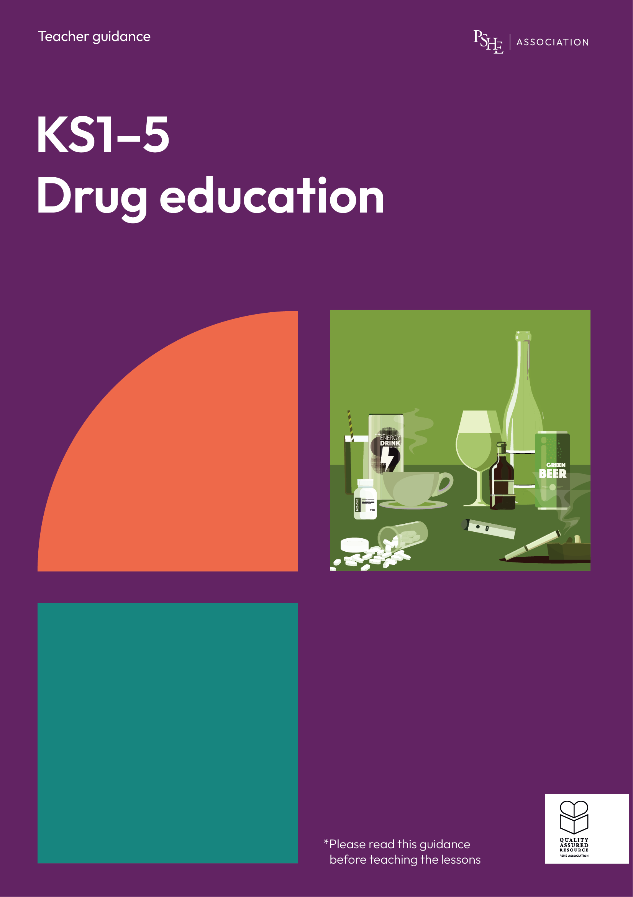
Drug education
Alcohol and risk
Year 7-8: Lesson 3

Slide 2
Using this PowerPoint
The slides in this presentation are divided into two sections:
Teacher slides (purple) – provide key information regarding lesson preparation.
Student slides – provide a visual focus point for students during the lesson and delivery notes for teachers about the activities. Click ‘notes’ to view these.
Ensure that you select ‘Use Presenter View’ under the ‘Slide Show’ tab – this will allow you to preview the teaching notes on your monitor while the main presentation is displayed on a screen/smartboard.

Slide 3
Support and challenge
The lesson includes suggestions for challenge and support activities, to help you differentiate appropriately for your class.
Support activities are adapted to be more accessible for those who need it.
Challenge activities deepen and extend learning for those who need more challenge or who finish the activity quickly.
Look for these icons on the pupil slides. See delivery notes for details of the activities.
Challenge
Support

Slide 4
Context
This is the third of three drug education lessons, for year 7-8. This lesson focuses on specific risks relating to alcohol use, and challenges some of the perceived social norms about drinking alcohol.

Slide 5
Developing subject knowledge
Key information on content related to these lessons can be found in the Year 7-8 Knowledge Organiser.
Advice on safe practice, dispelling common misconceptions, visitors to the classroom and other important information can be found in Teacher Guidance: Drug and alcohol education.
Data sources to inform your planning can be found within our document that outlines the approach of these lessons Evidence Review: Effective drug and alcohol education, along with advice regarding the effective use of positive social norms and how to talk to young people about alcohol.

Slide 6
To learn about the risks and consequences of alcohol use.
Students will be able to:
explain that most young people their age do not use alcohol and analyse the reasons why young people’s alcohol use is declining
describe the risks of alcohol use
describe strategies to manage influences on alcohol use
identify sources of support for alcohol misuse

Slide 7
Box or envelope for questions
Large sheets of paper and marker pens
Students’ ‘substance use draw and write’ baseline activity sheets from lesson 1
Resource 1: Short and long-term risks of alcohol [one per pair]
Resource 1a: Card sort of short and long-term risks of alcohol [support option, as required]
Resource 2: Diamond 9 card sort [one cut up set per pair/small group]

Slide 8
Lesson summary
Activity | Description | Timing
Introduction | Introduce learning objective and outcomes, and revisit ground rules. | 5 mins
Baseline assessment activity | Students estimate statistics relating to young people’s alcohol use. | 10 mins
Alcohol in decline | Students suggest reasons for a steady decline in young people’s alcohol use. | 5 mins
Short-term and long-term risks | In pairs, students identify a range of short-term and long-term risks of drinking alcohol. | 10 mins
Diamond 9 of influences | Students rank nine potential influences that may lead young people to drink alcohol. | 10 mins
Managing influences | Students suggest strategies for managing influences on drinking alcohol. | 10 mins
Reflection and endpoint assessment | Students re-visit the draw and write baseline activity from lesson 1. | 5 mins
Signposting support | Remind students how to access further advice, guidance and support related to substance use, including alcohol. | 5 mins

Slide 9
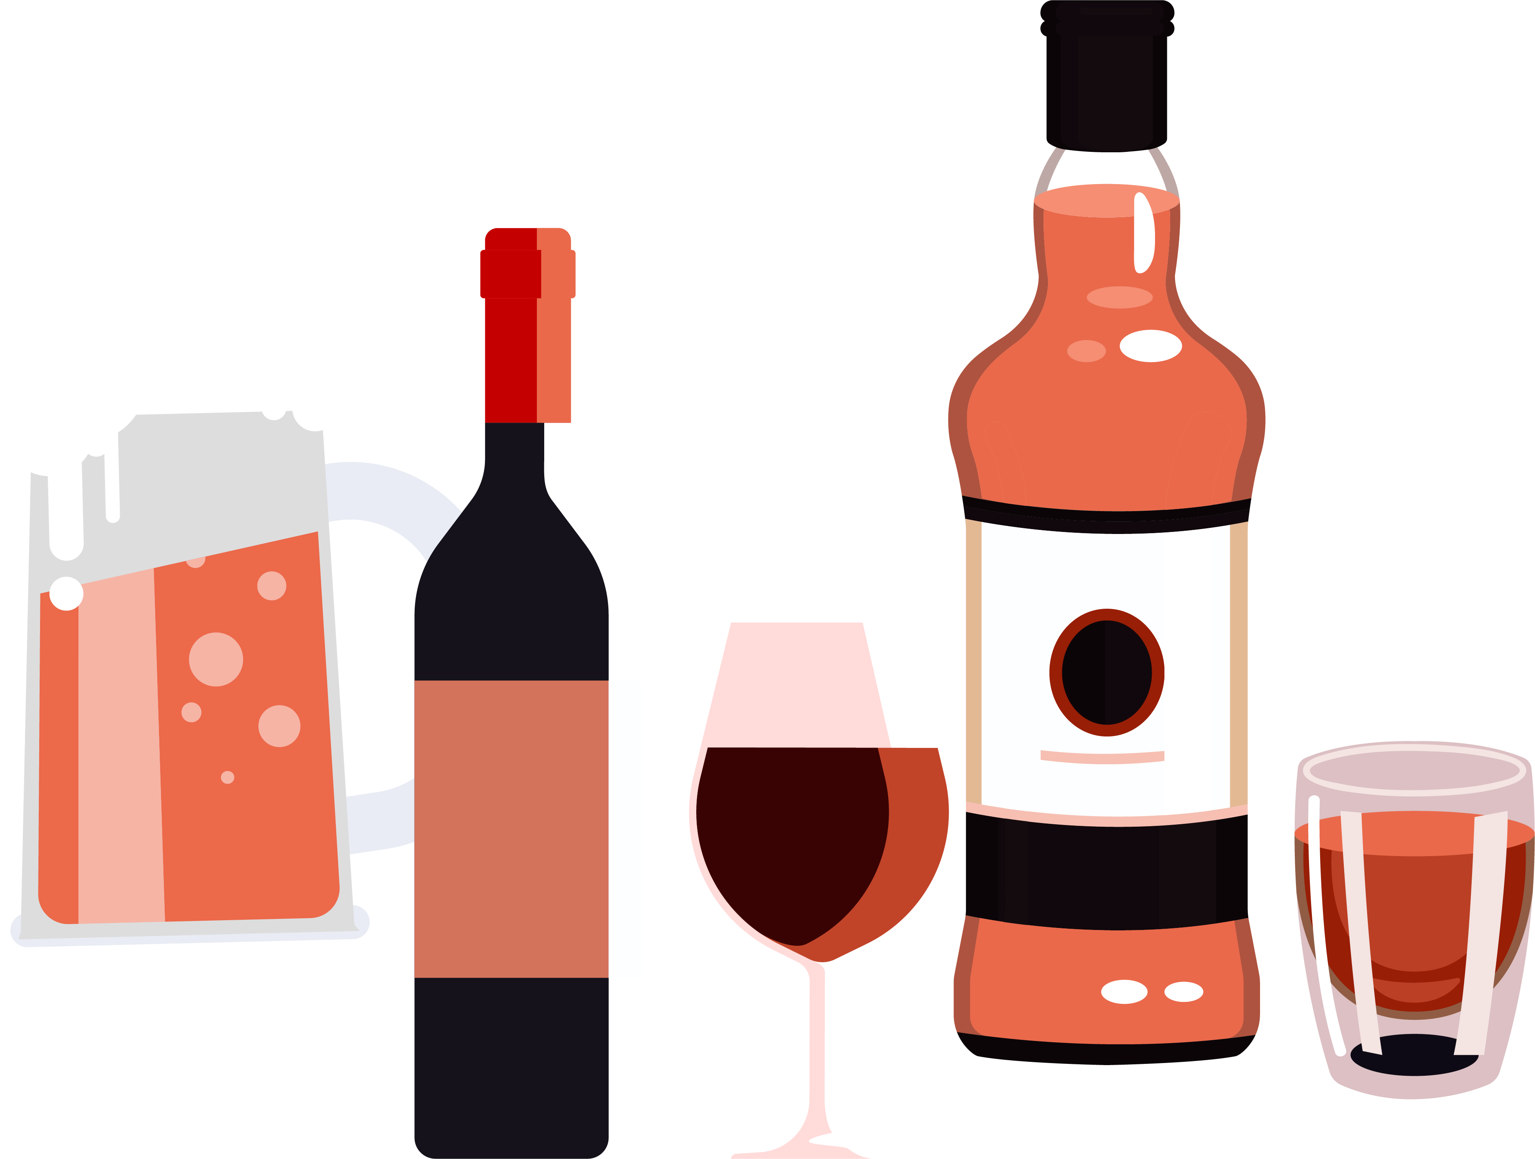
Alcohol and risk
Lesson 3
Notes:
Teacher notes – Lesson title

Slide 10
Notes:
Teacher notes – Introduction (5 mins, slides 10-11)
Ensure ground rules are established with the group before teaching this lesson and make students aware of the question box, which will be available throughout the lesson. Remind students that if they have worries or questions during or after the lesson, that they do not want to raise in front of the class, they can write their question on a piece of paper, anonymously or with their name, and put it in the question box.

Slide 11
To learn about the risks and consequences of alcohol use.
We will be able to:
explain that most young people their age do not use alcohol and analyse the reasons why young people’s alcohol use is declining
describe the risks of alcohol use
describe strategies to manage influences on alcohol use
identify sources of support for alcohol misuse
Notes:
Teacher notes – Introduction (5 mins, slides 10-11)
Introduce the learning objective and outcomes for the lesson, explaining to students that they will be exploring the risks relating to alcohol consumption and ways to manage the pressures on young people to drink alcohol, whilst also recognising the changes to young people’s use of alcohol over recent years.

Slide 12
75%
What’s our starting point?
What percentage of young people aged 11–13 said they have never tried alcohol?
What percentage of young people aged 11–13 said they have drunk alcohol in the last week?
77%
3%
What percentage of young people aged 11–13 said they usually drank alcohol at least once a month?
What percentage of young people aged 11–13 said they thought it was OK to drink alcohol once a week?
3%
8%
Were the actual answers different from your guesses? How?
Were there any answers that surprised you?
Notes:
Teacher notes – Baseline assessment activity (10 mins)
Indicate an imaginary line across the classroom with 0% at one end and 100% at the other. Read the questions below, one at a time, and ask students to stand along the line to indicate what they think the correct percentage is in each case. (An alternative approach would be for the class to direct you to stand on the line where they as a group estimate the correct answer to be.)
After you have asked all the questions, give the correct answers and ask students to note whether they had overestimated or underestimated the percentage (answers given in brackets):
In the Smoking, Drinking and Drug Use Survey in England (SDDU) 2023, what percentage of young people aged 11-13:
said they have never tried alcohol? [77%]
said they had drunk alcohol in the last week? [3% - so 97% had not]
said they usually drank alcohol at least once a month? [3% - so 97% do not]
said they thought it was OK to drink alcohol once a week? [8% - so 92% said it was not]
Then, ask them:
Were the actual answers different from your guesses? How?
Were there any answers that surprised you?
As in lesson 2 when considering smoking, students are likely to have overestimated their peers’ engagement in alcohol use due to media messaging, interactions with only a small section of society which skews perceptions, and some young people claiming to drink more alcohol than they actually do. Correcting this perception of their peers’ behaviour supports students to resist internal pressure to ‘fit in’. Refer to the evidence briefing paper for further guidance about using positive social norms with care.

Slide 13
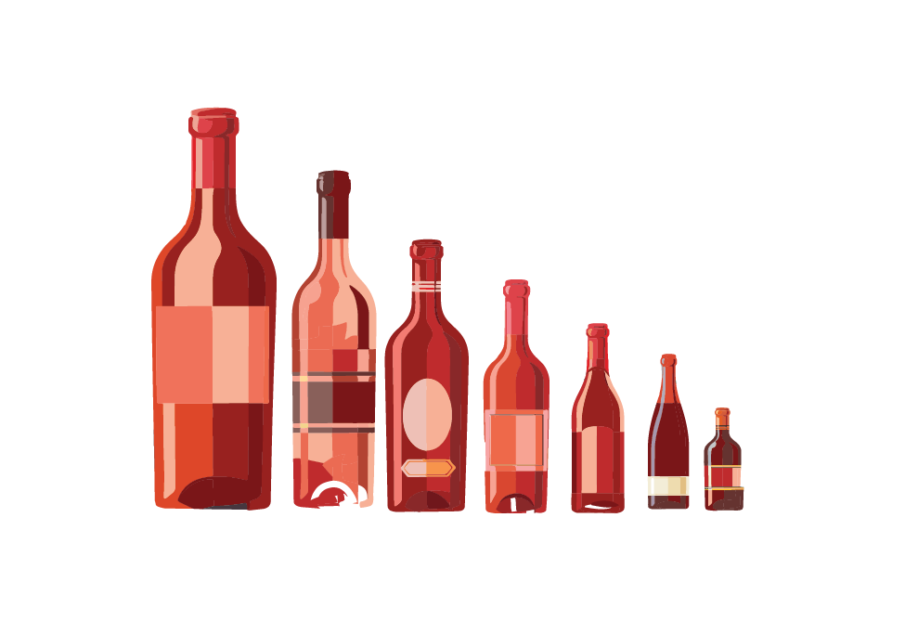
Alcohol in decline
In recent years there has been a steady decline in young people’s alcohol use generally.
Why do you think this is the case?
Notes:
Teacher notes – Alcohol in decline (5 mins)
Explain that some people will choose not to drink alcohol for religious or cultural reasons, but evidence from a number of surveys in recent years has shown a steady decline in young people’s alcohol use generally, across the population. In small groups, ask students to discuss why they think this is the case.
Take feedback. Explain that is difficult to be certain of the causes for this decline, but researchers have suggested that reasons might include:
Drinking less alcohol could be part of a positive change in attitudes and behaviour amongst young people, in which many are adopting a healthier lifestyle, abstaining from substance use, and becoming more environmentally conscious (which may influence food and drink choices).
Advances in digital technology and increased connectivity give young people alternative opportunities to socialise that do not involve alcohol, and that reduce the importance of pubs and clubs for meeting people and building social relationships and networks.
Social media and other online media, together with better health education, can also increase knowledge about alcohol-related harms. Social media can also raise the visibility of online communities that support, celebrate, and further normalise not drinking alcohol.
‘Dry months’ such as Dry January have become popular and increasingly familiar over recent years, normalising abstaining from alcohol as a positive lifestyle choice.
Changes to alcohol-related policies/laws e.g. on alcohol pricing, making cheap alcohol less available to young people, and requiring proof of age (challenge 25).
Economic factors can reduce the money young people have available to spend on alcohol.
Changes in exposure to alcohol advertising and marketing activities¹.
Changes in parental practice, such as parental modelling, monitoring of children’s behaviour, alcohol supply restriction (both in and out of the family home), and alcohol-specific rule setting. Studies have also demonstrated the importance of more general aspects of parenting on adolescent drinking, such as open communication between parents and children, general discipline, and parental support on adolescent drinking².
¹Vashishtha et al. (2019) https://www.tandfonline.com/doi/full/10.1080/16066359.2019.1663831
²Vashishtha et al. (2019) https://www.tandfonline.com/doi/full/10.1080/16066359.2019.1663831

Slide 14
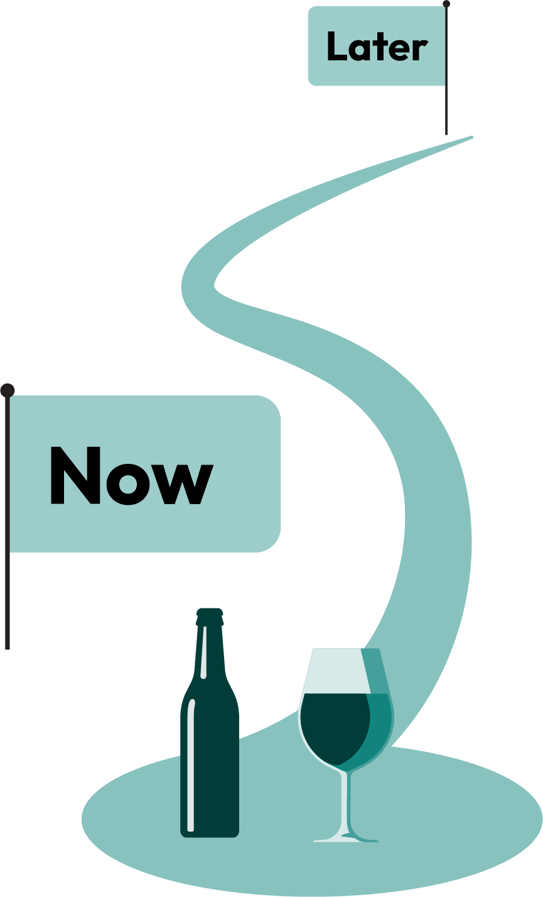
Short-term and long-term risks
What are possible short-term and long-term risks of alcohol use?
Notes:
Teacher notes – Short-term and long-term risks (10 mins)
Using Resource 1: Short and long-term risks of alcohol, ask students to work in pairs to suggest possible short-term and long-term risks of alcohol use. They should write the short-term risks in the box closest to the image and the long-term risks in the outer box.
Share answers as a class, ensuring students update their work with additional ideas.
Take feedback, drawing out key learning:
Short-term risks could include: dehydration, lack of inhibitions and feeling sociable – leading to ‘out of character’ behaviours, feeling sick, feeling drowsy, vomiting, headache, diarrhoea, dizziness and lack of coordination, loss of personal possessions, making poor decisions such as overspending, etc., being at greater risk in certain situations, accidents and injuries due to falling over, memory loss, a ‘hangover’ the following day, and alcohol poisoning.
It is against the law to buy alcohol under 18 years old. 16 or 17-year-olds accompanied by an adult can drink - but not buy - beer, wine or cider with a meal. Under 18s can be stopped, fined or arrested by police if caught drinking alcohol in public.
Long-term risks of alcohol use (which can take many years to develop) include health issues such as high blood pressure, stroke, cirrhosis/liver disease, effects on mood such as anxiety and depression, fertility issues, cancers including liver, bowel, breast and mouth; alcohol dependency; fallout from unwise actions while drunk including relationship changes and feelings of regret, and serious injuries. There are also sugar-related concerns including obesity, dental health issues and acne.
Support: Use Resource 1a: Card sort of short and long-term risks of alcohol to make labels that students can use to add to Resource 1.
Challenge: Ask students to give examples of how short-term effects of alcohol use can have long-term consequences. Students may identify: impaired decision-making, leading to an accident resulting in long-term injuries, or lack of inhibitions and impaired decision-making leading to unsafe sex, which in turn could lead to unplanned pregnancy or STIs.

Slide 15
Ranking influences
Complete the diamond 9 to rank the different influences on young people’s alcohol use.
Most significant
Least significant
Notes:
Teacher notes – Diamond 9 of influences (10 mins)
Ask students to work in pairs or small groups to sort the cards in Resource 2: Diamond 9 card sort, ranking the different influences on young people’s alcohol use into a diamond shape. The influence they think is the most significant should be at the top of the diamond and the least significant at the bottom of the diamond shape. Cards placed next to each other in a row are equally significant.
Explain that there are no right or wrong answers and that this activity allows them to assess their own opinions.
Share some of the answers as a class and ask those who did the challenge activity how answers might differ for adults and why.
Support: Students who need additional support can be given fewer cards to sort into a Diamond 5. Ensure the reasons provided are distinctly different.
Challenge: Ask students to rearrange the reasons to show which are most to least likely to influence adults to drink alcohol.

Slide 16
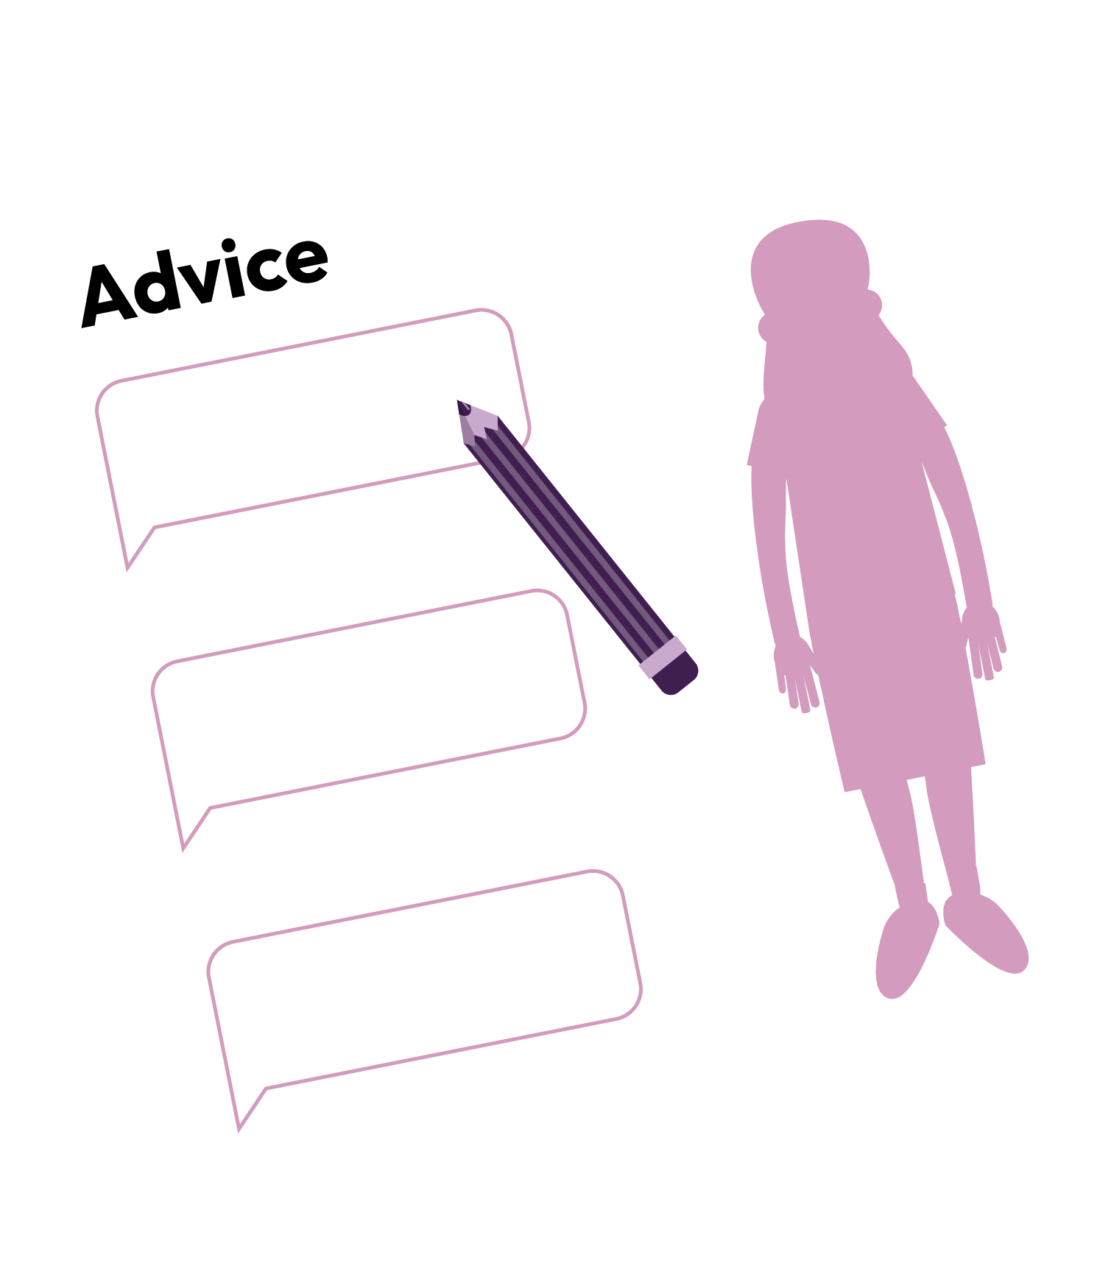
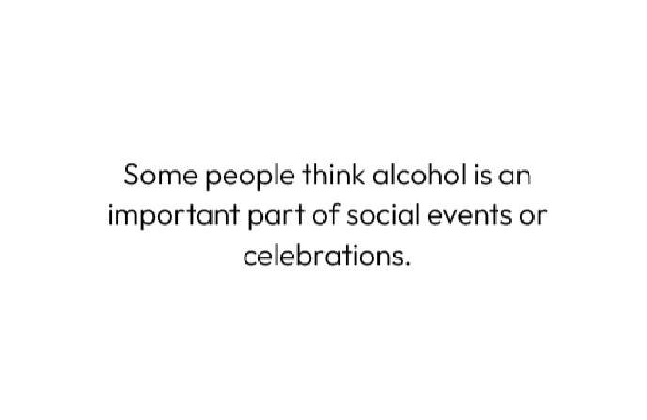
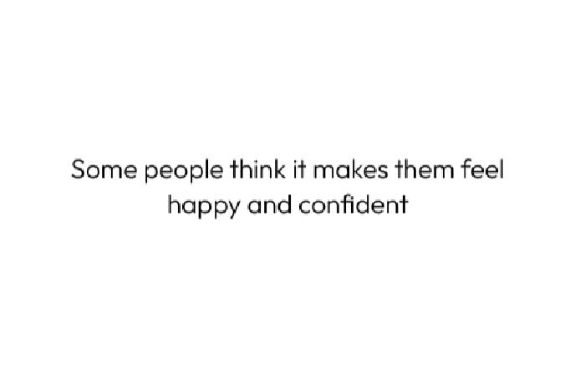
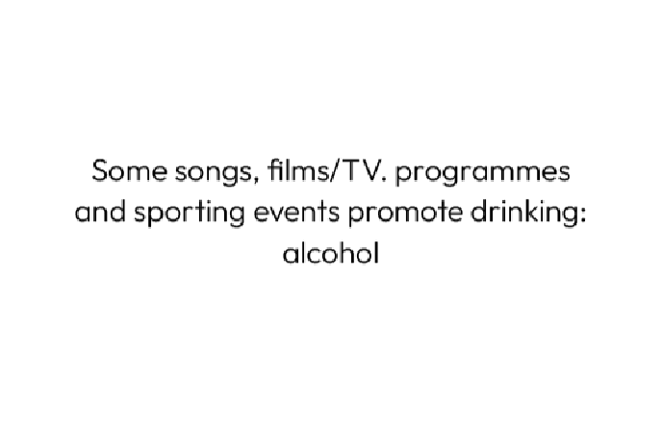
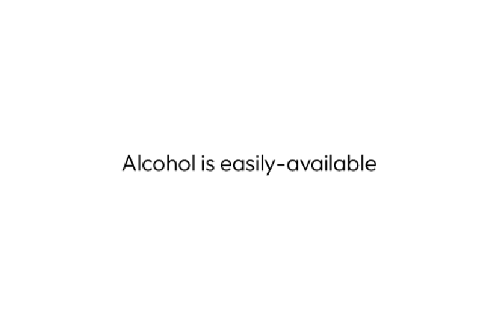
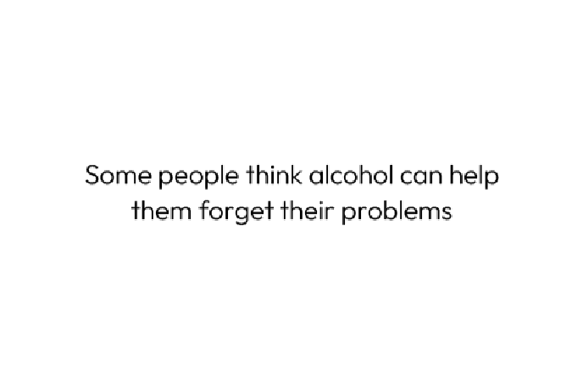
Managing influences
Imagine someone is being influenced in the way you have on your card. They would like some advice.
What advice can you give them?
Can you add any advice or sources of support to the other groups’ sheets?
Notes:
Teacher notes – Managing influences (10 mins)
From the feedback to the diamond 9 activity, choose six influence cards that students have tended to place highest in their diamonds. Divide the class into six groups and allocate one of the influences to each group.
Ask each group to imagine that someone who was being influenced in that way (e.g. someone who drinks alcohol to fit in with their peers, or to help with stress) had asked them their advice. Each group should discuss and then write their advice on a large sheet of paper.
Ask someone from each group to stick their sheet on the wall and invite the groups to visit each sheet to look at all the points, adding to the other groups’ ideas:
any additional advice they can think of
possible sources of support – people or organisations – they could go to for help
Ask students to summarise key pieces of advice.
Suggestions might include:
If you tell your friends you would prefer not to drink alcohol, some of them are likely to agree – they may only be drinking to ‘fit in’ too.
If you’re feeling stressed, alcohol could make things worse. It would be more helpful to talk to a trusted adult about any problems or worries.
It is much healthier and safer to find other activities that help you feel happy and confident e.g. a hobby, taking part in a sport, or organising social events that don’t involve alcohol.
There are lots of alcohol-free versions of popular drinks that taste much the same, so you can have the taste without the harmful effects. These are great for social events and celebrations too.

Slide 17
What have we learnt?
Think back over the last three lessons: what have you learnt?
In a different colour pen, edit your initial ideas on your draw and write, and add any new learning.
Notes:
Teacher notes – Reflection and endpoint assessment (5 mins)
Give students back the baseline assessment activity they completed at the start of lesson 1 (Lesson 1 Resource 1: Substance use draw and write baseline activity). Ask them to think back over the last three lessons and now re-visit this draw and write activity, editing their initial ideas and adding any additional information in a different colour pen, to demonstrate their learning over the scheme of work.
Their updated draw and write activity sheets can be used to inform future teaching and as evidence of progress over the three lessons.

Slide 18
Sources of support
To access further advice, guidance and support related to substance use, including alcohol, you can:
speak to a parent/carer, tutor, pastoral lead, or other trusted adult
contact Childline: www.childline.org.uk, 0800 1111
visit www.nhs.uk
visit www.talktofrank.com
Visit www.nacoa.org.uk/support-advice/for-children
I need your help with something . . .
Something's worrying me, can I talk to you?
I have something that’s been bothering me . . .
Notes:
Teacher notes – Signposting support (5 mins)
Summarise sources of support students identified in the Managing Influences activity above. Ensure that students know where they can seek help and advice, both now and in the future, if they are concerned about drug use. Students wishing to seek further guidance can:
speak to a parent/carer, tutor, pastoral lead, or other trusted adult
contact Childline www.childline.org.uk 0800 1111
visit www.nhs.uk
visit www.talktofrank.com
You may also wish to make them aware of the National Association for children of alcoholics

Slide 19
Public information campaign
Design a public information campaign to raise awareness about the statistics relating to young people’s alcohol use.
Share the message that most young people do not misuse or currently use alcohol, so young people should not feel pressurised to drink alcohol to be cool or fit in!
Notes:
Teacher notes – Extension activity
Ask students to design a public information campaign to raise awareness about the statistics relating to young people’s alcohol use. The aim is to get across the message that most young people do not misuse or currently use alcohol, so young people should not feel pressurised to drink alcohol to be cool or fit in.

