Slide 1
Drug education
Managing influence
Year 9: Lesson 5

Slide 2
Using this PowerPoint
The slides in this presentation are divided into two sections:
Teacher slides (purple) – provide key information regarding lesson preparation.
Student slides – provide a visual focus point for students during the lesson and delivery notes for teachers about the activities. Click ‘notes’ to view these.
Ensure that you select ‘Use Presenter View’ under the ‘Slide Show’ tab – this will allow you to preview the teaching notes on your monitor while the main presentation is displayed on a screen/smartboard.

Slide 3
Support and challenge
The lesson includes suggestions for challenge and support activities, to help you differentiate appropriately for your class.
Support activities are adapted to be more accessible for those who need it.
Challenge activities deepen and extend learning for those who need more challenge or who finish the activity quickly.
Look for these icons on the pupil slides. See delivery notes for details of the activities.
Challenge
Support

Slide 4
Context
This is the fifth of five drug education lessons, for year 9. This lesson focuses on developing skills and strategies to manage pressure and influence in relation to substances.

Slide 5
Developing subject knowledge
Key information on content related to these lessons can be found in the Year 9 Knowledge Organiser.
Advice on safe practice, dispelling common misconceptions, visitors to the classroom and other important information can be found in Teacher Guidance: Drug education.
Data sources to inform your planning can be found within our document that outlines the approach of these lessons Evidence Base: Drug education including advice regarding how to talk to young people about alcohol.

Slide 6
To learn how to manage peer and other influence in relation to substance use.
Students will be able to:
explain the physical, emotional and social consequences substance use might have on someone
demonstrate strategies they could use if someone offers them something that might be harmful or illegal
explain the potential impact of others’ views about drugs, alcohol and smoking on decision-making
explain what support is available to people who are concerned about substance use and how to access it for themselves or others

Slide 7
Box or envelope for questions
Students’ baseline mind-map activity from lesson 1
Resource 1: Types of influence [one per pair]
Resource 1a: Match the influences [support option, as required]
Resource 1b: Teacher answers [teacher copy]
Resource 2: Talking heads [one per pair]
Resource 3: Natasha’s story [one per pair]
Resource 4: Responding to influence [one per pair]

Slide 8
Lesson summary
Activity | Description | Timing
Introduction | Introduce the learning objective and outcomes, and revisit ground rules. | 5 mins
Baseline assessment activity | In pairs, students create a 60-second news bulletin summarising a topic of their choice from their learning so far. | 5 mins
Understanding influence | Students complete a matching activity identifying the different forms influence can take. | 5 mins
Talking heads | Students evaluate and rank different influences from a range of characters. | 10 mins
Natasha’s story | Students read and discuss key issues arising from a case study. | 10 mins
Responding to peer influence | Students suggest ways a person could respond if observing a pressured situation. | 10 mins
Reflections and endpoint assessment | Students revisit the mind-map baseline activity from lesson 1, adding new learning to demonstrate progress. | 10 mins
Signposting support | Remind students how to access further advice, guidance and support related to substance issues. | 5 mins

Slide 9
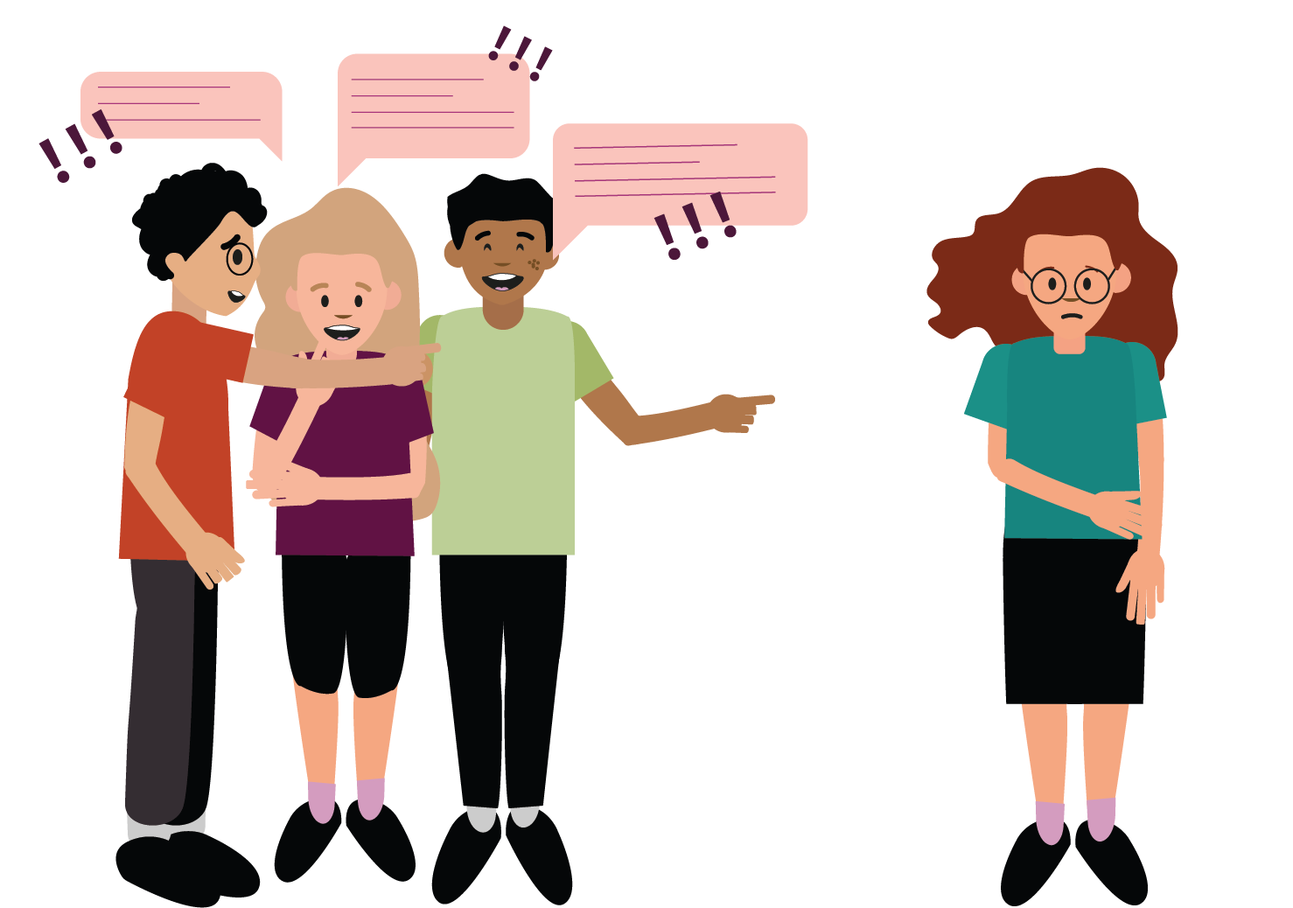
Managing influence
Lesson 5

Slide 10
Notes:
Teacher notes – Introduction (2 mins, slides 10-11)
Ensure ground rules are established with the group before teaching this lesson and make students aware of the question box, which will be available throughout the lesson. Remind students that if they have worries or questions during or after the lesson, that they do not want to raise in front of the class, they can write their question on a piece of paper, anonymously or with their name, and put it in the question box.

Slide 11
We will learn how to manage peer and other influence in relation to substance use.
We will be able to:
explain the physical, emotional and social consequences substance use might have on someone
demonstrate strategies they could use if someone offers them something that might be harmful or illegal
explain the potential impact of others’ views about drugs, alcohol and smoking on decision-making
explain what support is available to people who are concerned about substance use and how to access it for themselves or others
Notes:
Teacher notes – Introduction (2 mins, slides 10-11)
Introduce the learning objective and outcomes and explain that today’s lesson will focus on developing skills and strategies to manage influences relating to substance use.

Slide 12
What’s our starting point?
In pairs, choose a topic from the past three lessons and create a 60-second news bulletin to summarise what you have learnt about drugs.
60 seconds
Notes:
Teacher notes – Baseline assessment activity (8 mins)
In pairs, ask students to choose a topic from the previous three lessons and create a 60-second news bulletin to summarise what they have learnt about drugs. Encourage them to think about:
Statistics about young people’s drug use
Reasons why people may take illegal drugs (and why these reasons may be flawed)
The names, appearance and effects of common drugs
The law in relation to drugs
The consequences of a criminal conviction for drug use
How the police respond to drug-related incidents
Ask a selection of pairs to feedback their 60-second bulletins. Use this activity to gauge students’ starting point for the lesson, address any misconceptions or forgotten learning and adapt teaching as necessary.

Slide 13
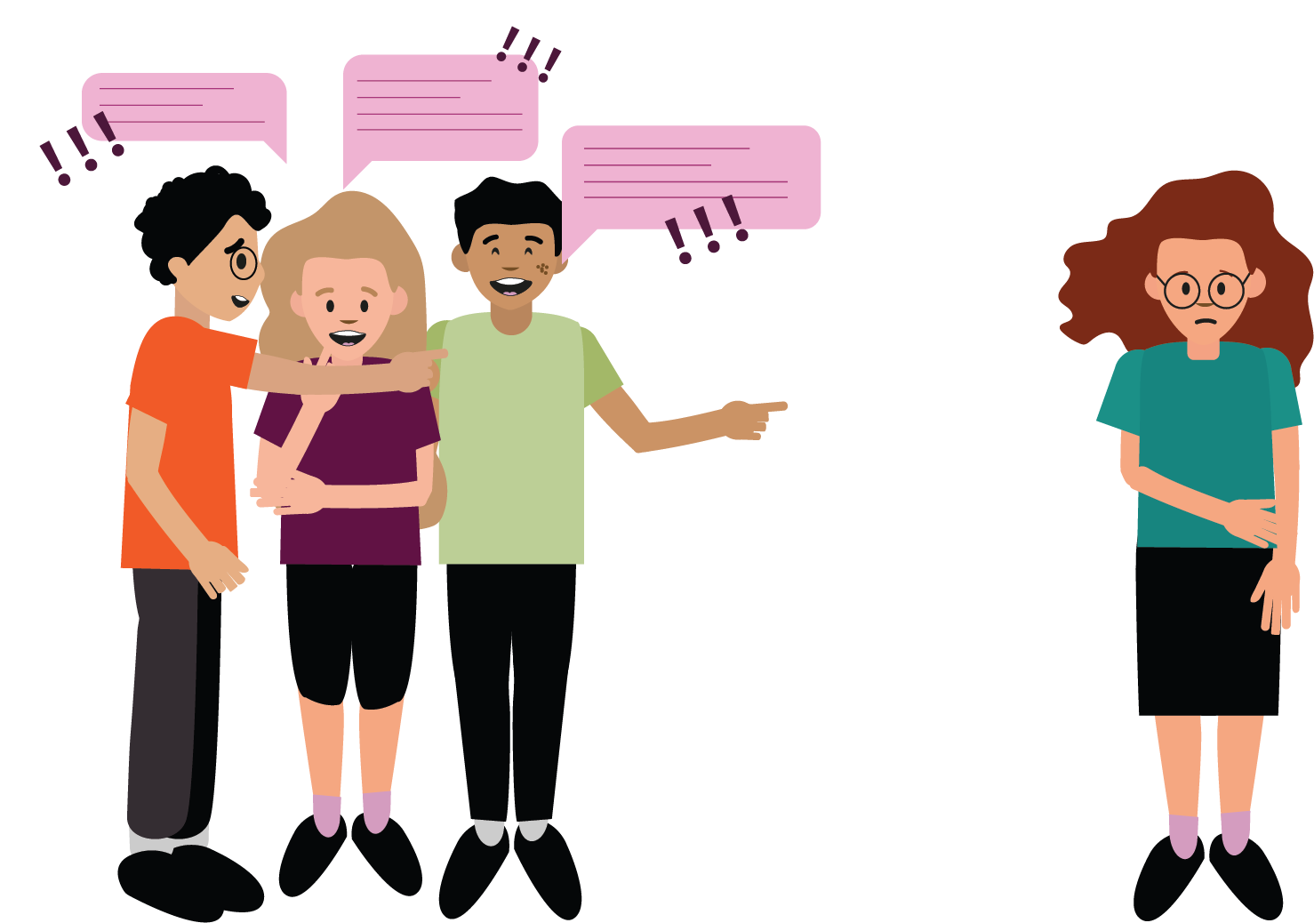
Understanding influence
There are many types of influence and pressure young people may experience from different places and in different forms.
On your sheet, match the type of influence to the description.
Notes:
Teacher notes – Understanding influence (5 mins)
Explain that there are many different types of influence and pressure on young people from many different places and in different forms. Give students Resource 1: Types of influence and ask them to match up the name with the description – they could do this through drawing lines to connect the answers, colour coding or numbering.
Take feedback and go through answers with the class, using Resource 1b: Teacher answers. When considering the influence of social media, you may wish to explore people trying to promote or sell goods, including illegal drugs, and how they may present a ‘successful’ image of themselves and those around them to help them to make sales. However, stress that this does not always reflect their real lives.
Support: Ask students to complete the activity using Resource 1a: Match the influences.
Challenge: Ask students to draw, write about, or script an example of each type of influence.

Slide 14
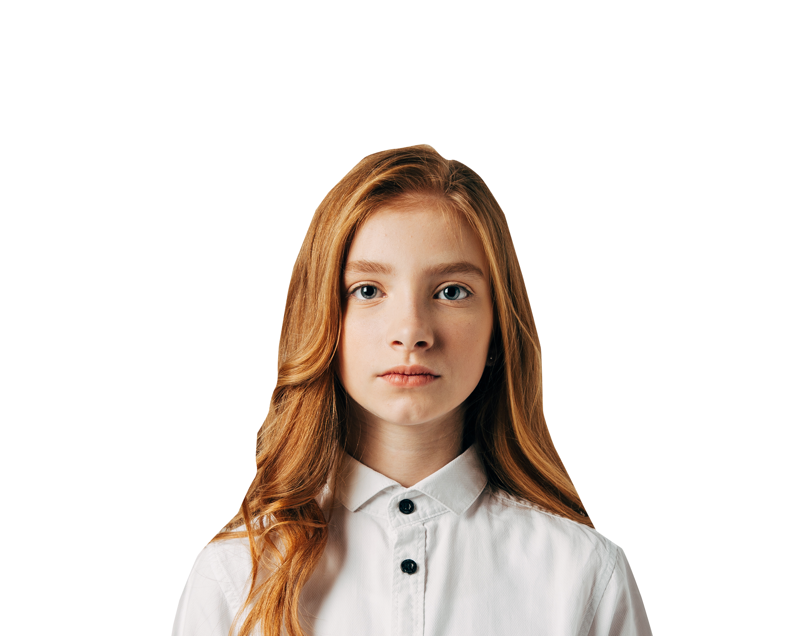
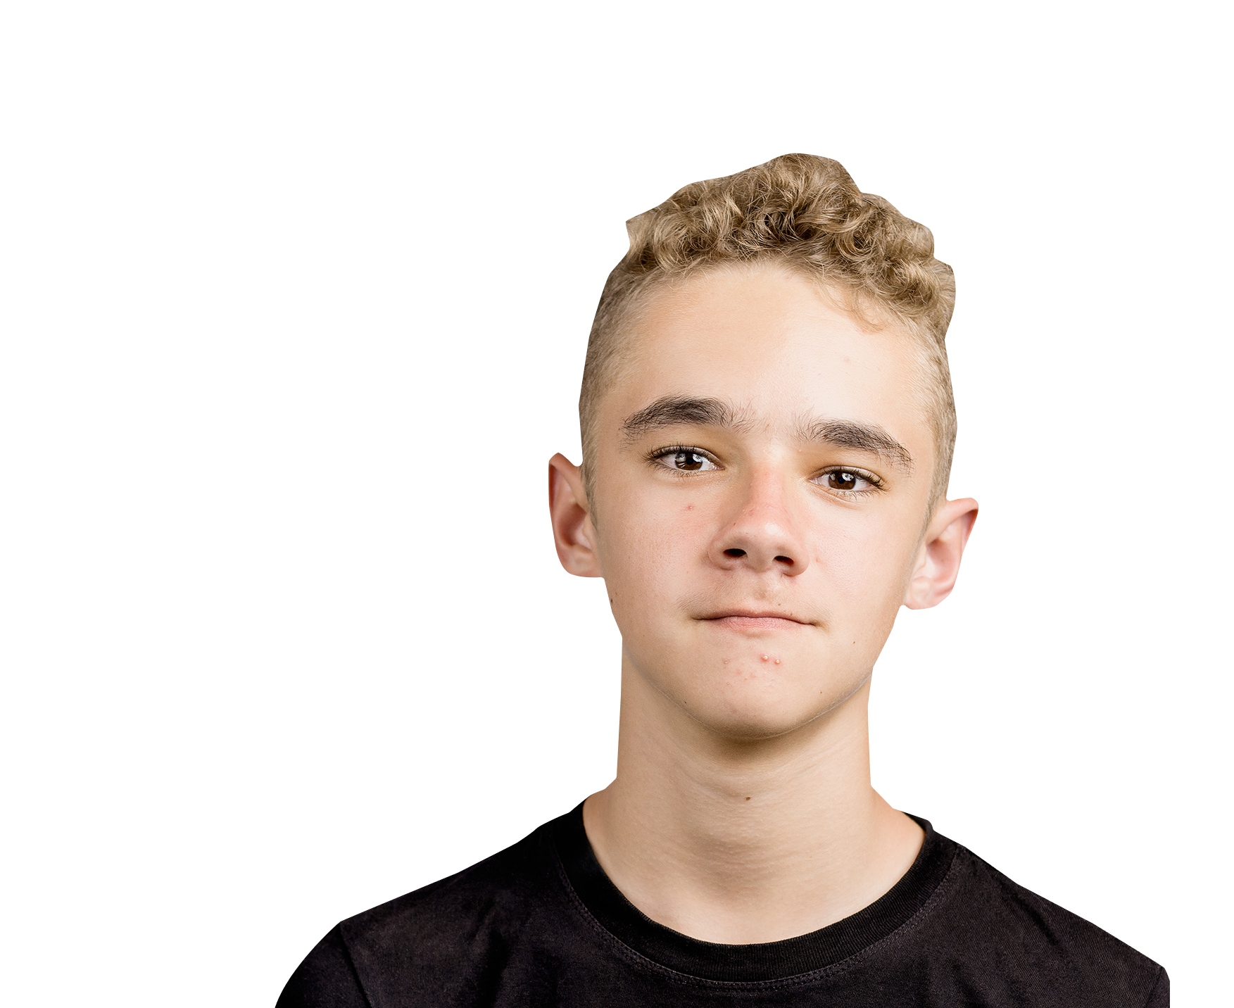
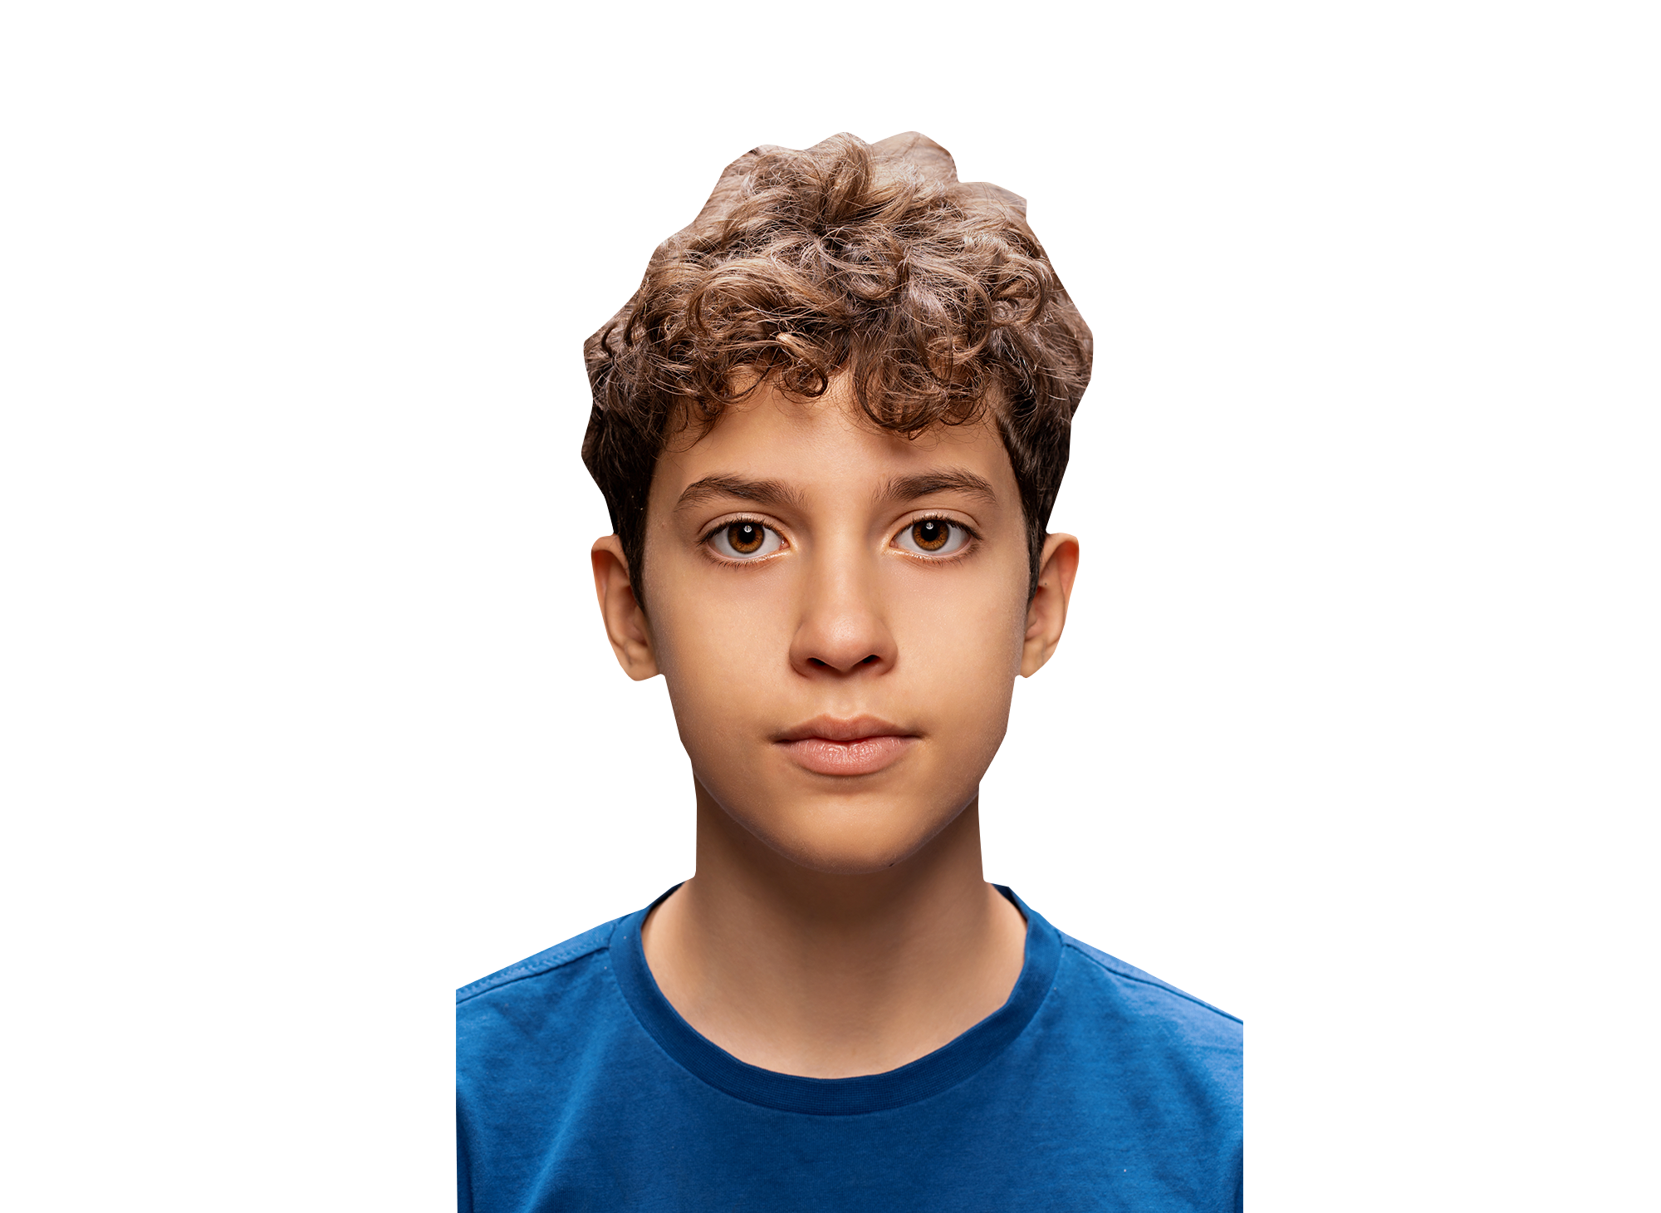
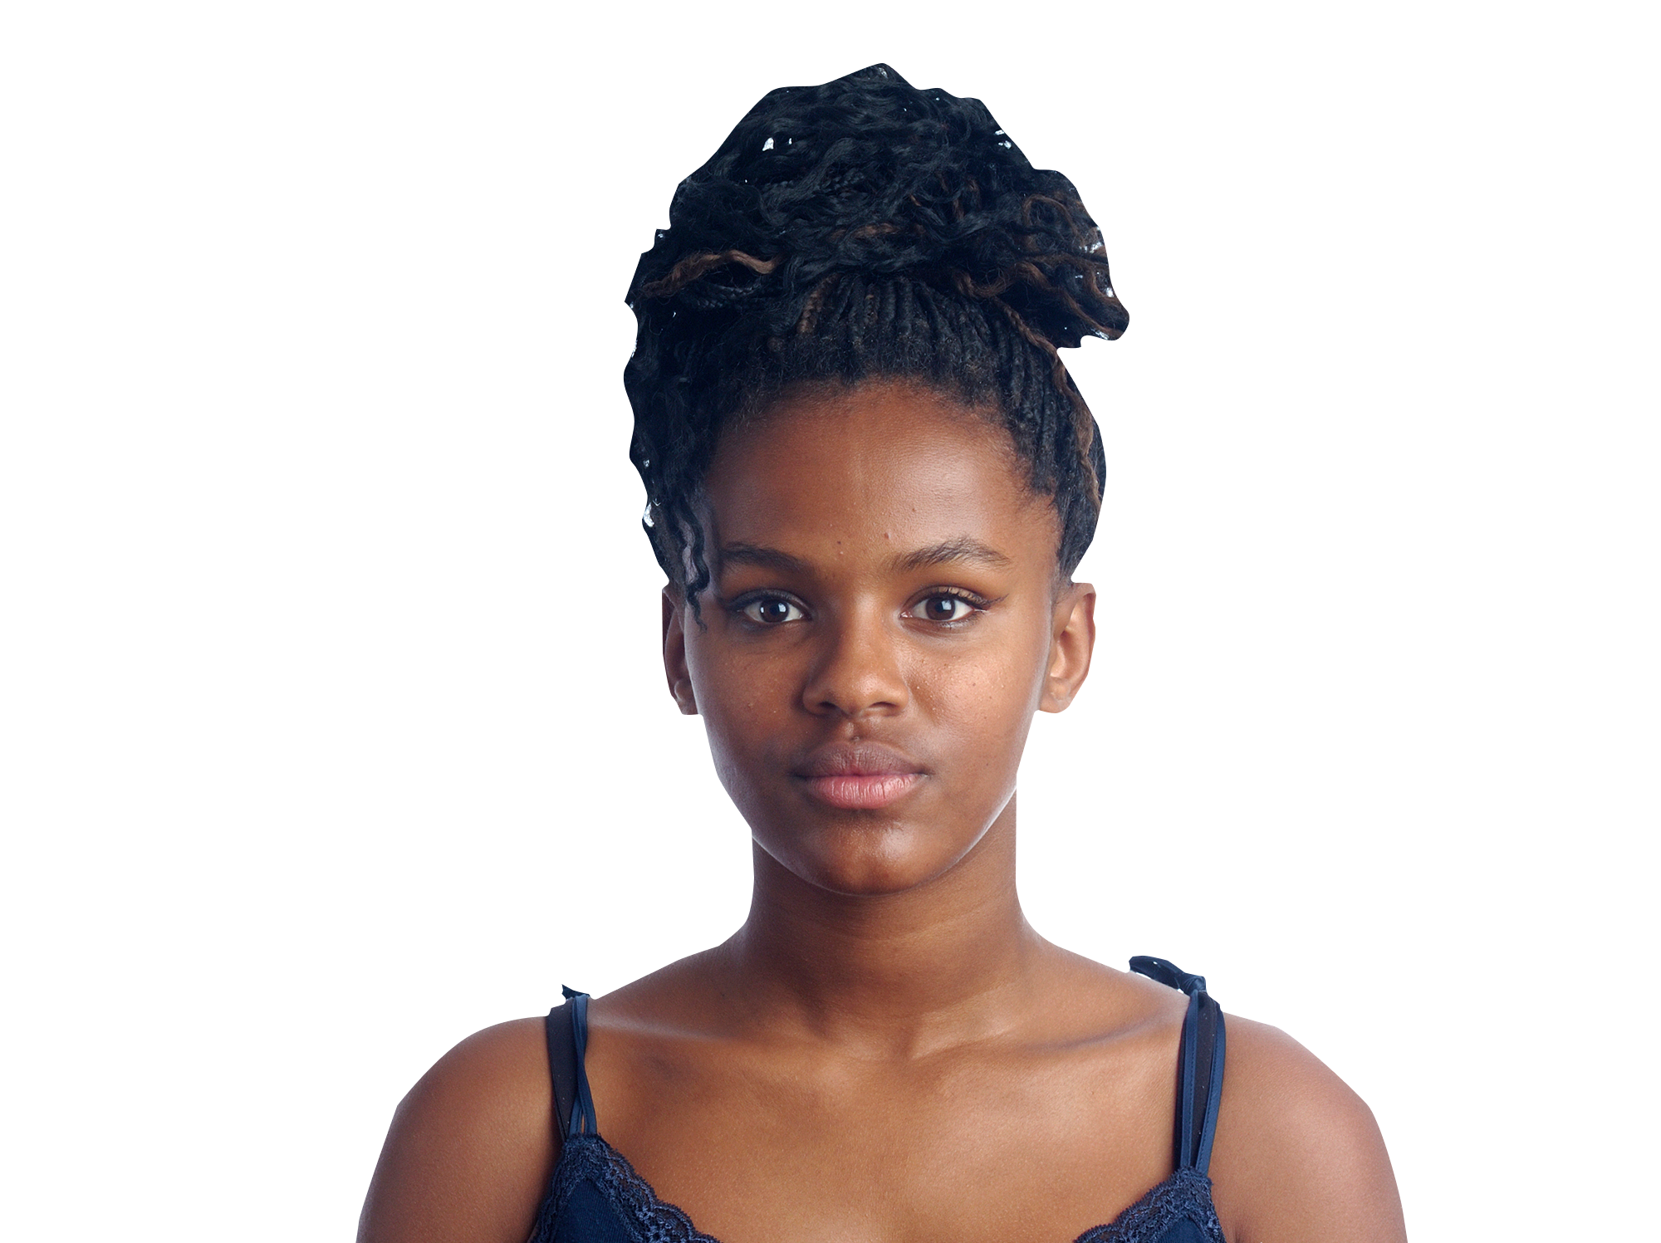
Talking heads
In pairs, discuss the following questions about the characters on your sheet:
What is influencing each character?
Personal reflection
Which of these influences are most likely to affect your own choices about drug use?
You don’t have to share this with the rest of the class.
Will these influences change over time as the character gets older?
How so?
Is there any support the character can put in place with others to help them if they feel under pressure?
14
Notes:
Teacher notes – Talking heads (10 mins)
Working in pairs, give students Resource 2: Talking heads and ask them to discuss the following questions:
What is influencing each character? Influences include: celebrities, parents, religion, siblings, sport/interests, social media, ambitions for the future.
Will these influences change over time as the character gets older? How so? The strength of each influence may change with age, for example: certain celebrities may become more or less important to the character over time or they may change their habits; their relationship with their parents may change, they may find that their opinion matters more or less to them; they may feel that they can or cannot expect support from their parents in relation to substances if they do use them.
Is there any support the character could put in place from friends, family or other sources, to help them if they feel pressure to use substances? Depending on the type of influence there may be a variety of ways that a young person could support themselves. For example: putting plans in place before they find themselves in a pressurised situation; talking to a trusted friend to let them know about their intention to not use substances; talking to their family to ask them if someone is able to pick them up if they decided that they wanted to come home.
Then, ask students to reflect for themselves and rank the influences these people describe, based on which they think are most likely to influence their own choices about drug use. As this is a personal reflection, students should not share their answers with the rest of the class.
Support: Ask students to focus on question 1 and identify the source of the influence.
Challenge: Ask students to choose a character to respond to and write a short response that a young person could give to support the character in continuing to resist pressure from the media, celebrities or friends.

Slide 15
Natasha’s story
Read Natasha’s story, then as a group discuss the following questions:
What might Natasha be thinking and feeling in this situation?
Are there any risks for Natasha in this situation? What are they?
What kind of influences might Natasha be experiencing in this situation?
What could Natasha do or say in this situation?
Notes:
Teacher notes – Natasha’s story (10 mins)
As a class, read Resource 3: Natasha’s story and then ask students to work in small groups to discuss the following questions:
What might Natasha be thinking and feeling in this situation?
Are there any risks for Natasha in this situation? What are they?
What kind of influences might Natasha be experiencing in this situation?
What could Natasha say or do in this situation?
Take feedback from different groups, drawing out key learning:
Natasha might be feeling nervous, excited, curious, she might be keen to impress these new people and eager to fit in with them. She might be worried about what they will think of her based on how she reacts.
If she chooses not to take the drug, Natasha might be worried she’s risking her reputation with these new people, possibly people thinking she is boring or not wanting to invite her to parties in the future. If she tries the drug, there is a wide range of risks which might be hard to predict. This includes not knowing how her body will react to the drug, the risks to her personal safety from being under the influence of a drug at a party where she doesn’t know many people (including getting home safely), and risks relating to ‘getting caught’ taking the drug, either from her parents or other people in authority (e.g. the police).
The types of influence most appropriate in this context are ‘internal’ and ‘friendly’. If Natasha says ‘no’ this might escalate to teasing or even ‘heavy’ pressure. This is predominantly influence from peers, although there may be other influences on Natasha’s decision making (such as thinking about her family, her ambitions, her interests, her moral values etc.).
Students might suggest various ideas. It is helpful to focus on statements that use effective exit strategies, for example: saying an assertive but friendly and polite ‘No thanks’; making an ‘excuse’ as to why she can’t take it; using humour to avoid the situation; clearly articulating the reasons why she wouldn’t take the drug; questions that aim to find out what it is and why others are taking it; a way to get out of the immediate situation (e.g. going to the kitchen for another drink, going to the toilet, saying she is going to find Josh, etc.). Natasha might choose to take the drug, which could have a range of physical, social, emotional and legal consequences.
Challenge: Ask students to write three or four example responses of things that Natasha could say to resist the pressure to use the substance. They should try to use a variety of the approaches listed in the key learning from question three.

Slide 16
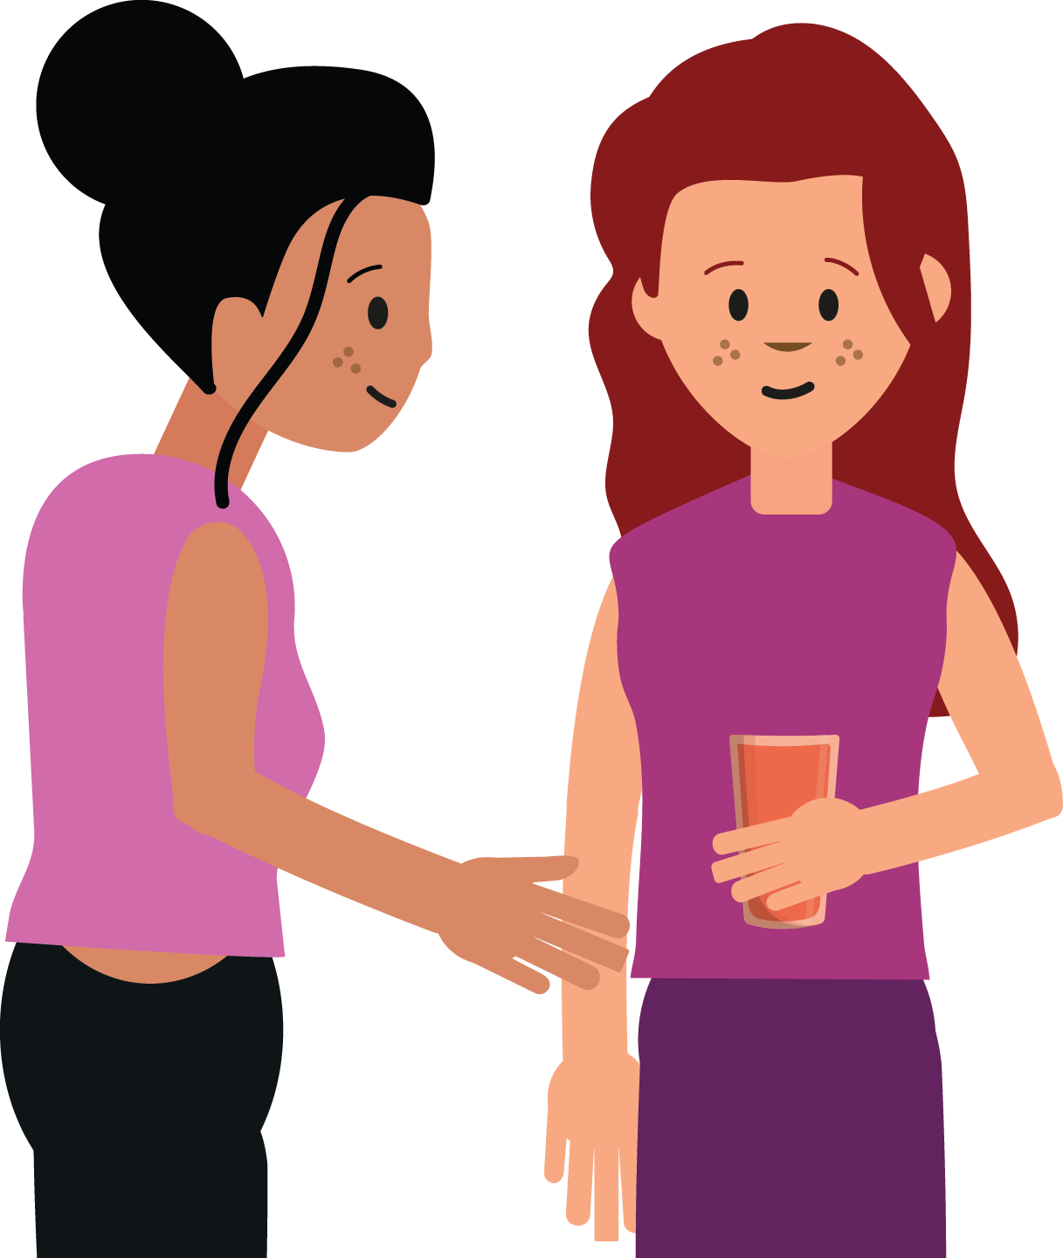
Responding to peer influence
Imagine there is another young person at the party who wants to help Natasha respond to the pressure she is under.
Working in pairs or small groups, add speech to the bubbles on your sheet.
You should show what a young person might say to:
Natasha to support her
others who are putting pressure on Natasha
a trusted adult
Notes:
Teacher notes – Responding to peer influence (10 mins)
Ask students to imagine there is another young person at the party who wants to help Natasha respond to the pressure she is under. Working in pairs or small groups, students should add speech to the bubbles in Resource 4: Responding to influence, to illustrate what a young person might say to Natasha to support her, to the others who are putting pressure on Natasha, and to a trusted adult either now or in the future, to seek help in managing these kinds of situations.
With these considerations, ask students to feedback the option they think would be most effective to support Natasha, and why they believe this would be the most useful option.
Key learning:
Showing support for Natasha might help her to feel more able to resist pressure from others.
The young person might want to consider removing themselves from the situation as well, for example by contacting an adult to be taken home.
The young person may want to seek help after the party from a trusted adult, for example if they are concerned that parties are featuring drugs and alcohol more frequently, they may wish to discuss this with a teacher or parent/carer, or to contact an outside agency such as Childline or Talk to Frank.
If time allows, students could rehearse these conversations in pairs or small groups. In debriefing them afterwards, you might wish to ask the following questions:
How might this change the situation? For example, does it persuade someone to act differently, or does it defuse tension?
What might a trusted adult say in response?

Slide 17
What have we learnt?
Look back at your mind map from lesson 1.
Is there anything you want to add or change, based on what you have learnt?
If so, do this in a different colour.
Notes:
Teacher notes – Reflection and endpoint assessment (10 mins)
Return students’ baseline mind-map activity from lesson 1. Ask them to now revisit their ideas, change anything they want to and add anything new they can, based on what they have learnt. Students should use a different coloured pen to do this, to demonstrate their progress over the series of lessons. These can be used to demonstrate progress and inform future teaching.

Slide 18
Sources of support
To access further advice, guidance and support related to substance use, you can:
Speak to a parent/carer or a member of staff in school such as your form tutor, head of year or school nurse.
Or contact:
Childline: www.childline.org.uk or 0800 11 11
FRANK: www.talktofrank.com/get-help
I need your help with something . . .
Something's worrying me, can I talk to you?
I have something that’s been bothering me . . .
Notes:
Teacher notes – Signposting support (5 mins)
Remind students that they can access support at home, and both in school (through their form tutor, pastoral lead, or school nurse) and out of school, through local and national organisations. Share the following websites and phone numbers with students:
Childline - www.childline.org.uk 0800 1111
Talk to Frank - www.talktofrank.com/get-help

Slide 19
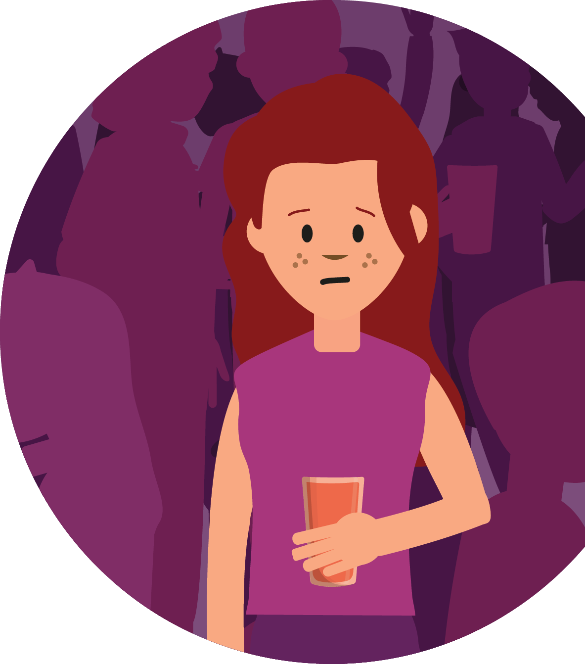
What have we learnt?
Imagine that Natasha does not want to take the drugs. Demonstrate what she could do to manage the situation and how the night might continue going forward.
You could show this through:
A short script
A role play
A storyboard
Notes:
Teacher notes – Extension activity
Ask students to create a short script, role play or storyboard. They should assume that in this instance Natasha does not want to take the drugs and demonstrate what she could do to manage the situation and how the night might continue going forward.

