Slide 1



KS 3-4 HOME LEARNING
Sharing information safely online
Play this slideshow from beginning

Slide 2



  We are learning about online fraud and staying safe online
Keywords for this session:
Fraud — illegal deception intended for financial or personal reward
Identity fraud — when a fraudster uses someone else’s identity (or creates a fake identity) to access a product or service so they don’t have to pay for it themselves
      We will be able to:
  describe what information should be kept private and what is safe to share online
  explain the risks of sharing personal information online
  analyse different strategies to ensure online safety

Slide 3
What makes up your identity?
Identity
Mind map all of the things that make up your identity.
E.g. your name, the school you go to, where you live etc..
Group these into ‘public’ and ‘private’ — what elements of your identity would you be willing to share with other people online and which elements would you only share with people you know and trust?

Slide 4
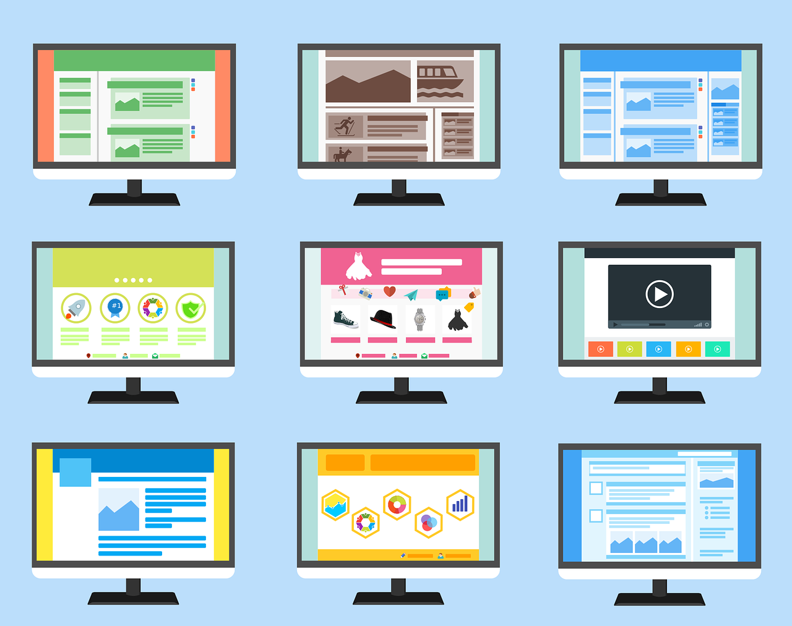
How much should be shared online?
How much of someone’s identity should they share online?
For each statement on Worksheet 1, state whether you think the action is:
Safe
Unsafe
It depends
Always think before posting and be prepared for anyone (family, teachers, online ‘friends’, a fraudster) to see what has been uploaded.
Be wary when using public computers or accessing public WiFi.
Recognise the risks of sharing too many distinguishing features, such as school logos, addresses, location, check-ins etc. as this might be used to build a picture of someone’s identity. This could be used by fraudsters or others who want to gain their trust, 'befriend’ them, or find out their location offline.
Click the image to reveal key learning points!
If you’ve answered ‘it depends’, note down in what circumstances the action might be safe or unsafe.

Slide 5
What might the consequences be of sharing personal information online?
Watch the Data To Go video which shows how a hacker or fraudster might be able to access personal information online.
  As you watch, answer the following questions:
  How did people react in this video when they were presented with their information?
  What parts of their identity were the team able to find out about them?
  What could these people have done to protect their information?
  What do you think a fraudster would use this information for?
  What might be the consequences of having this information publicly available?
Read about potential consequences on the next slide…
Notes:
https://www.youtube.com/watch?v=sq-0tjv4_BA

Slide 6
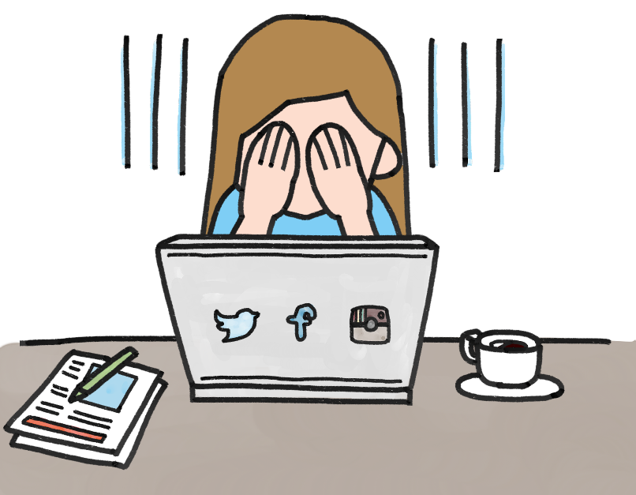
Potential consequences
Fraudsters and others will sometimes use information about a person’s interests and hobbies to befriend a target and trick them into giving over more information — the more information they have access to, the easier it may be for them to manipulate or exploit someone.
While in this video the personal information was only being accessed in order to demonstrate an important security point, a fraudster might use this type of information to apply for loans, credit cards, or to befriend and trick someone online into revealing even more about themselves.
Having this information publicly available could enable fraudsters to target people, which can lead to:
  long lasting reputational damage.
  problems with getting credit cards in the future.
  being unable to retrieve stolen money.

Slide 7
How can someone stay safe online?
Most important
1st
Complete the diamond 9 on ‘Worksheet 2: Diamond 9’ by putting the online safety tip you think is most important at the top, then the next two most important tips, down to the one you think is least important at the bottom.
2nd
2nd
3rd
3rd
3rd
4th
4th
Watch this clip…
If you could give the young person in this video one tip, what would it be?
5th
Least important
© PSHE Association 2020

Slide 8
What advice could be given?
Using what you now know about the consequences of sharing personal information online, and the different strategies that could be used to stay safe, write a short piece of advice to the three characters below (on Worksheet 3).
Afterwards click each box to reveal the answers: Does your advice include some of these key points?
Aaliyah
Aaliyah has been contacted on social media by someone she doesn’t know. They have sent her a message telling her a little bit about themselves and have asked her questions about herself in return. They seem to just want to be friends.
Austin
Austin has been sent an email, congratulating him on winning a competition. He can’t remember entering this particular one, but all he has to do to claim his prize is enter a few simple details. He’s excited to have won something!
Chidi
Chidi is worried about his friend Perry. Perry posts updates and pictures on social media regularly but lately this includes regular updates and photos about where they are and what they’re doing. He doesn’t want to upset or offend his friend, but is worried that Perry is sharing too much online!
Chidi could remind Perry that having personal information publicly available could make someone more likely to be targeted by fraudsters and others.
They could regularly check their privacy settings, especially after updates, to make sure only friends/friends-of-friends can see social media updates.
Aaliyah should be careful about what is shared, both publicly and with people she does not know face to face (even if they seem friendly).
She could change the privacy settings on her social media accounts so only friends, or friends of friends can follow or like posts.
Austin could check that he does not have his address, email or phone number on any profile pages that anyone could access and use to contact him.
Personal information or bank details should never be given out to an unknown source.

Slide 9

Personal reflection
Using what you have learnt today, write down three things that you will aim to do in future to increase your safety online.

Slide 10

Further support
If you’re worried about online fraud, or any aspect of online safety, you should always speak to your parent or carer or a teacher in school so they can help you.
Further information and support can be found at:
www.childline.org.uk
www.thinkuknow.co.uk
www.cifas.org.uk

Slide 11

More activities
Design your own television advert to warn people about the risks associated with sharing information online, and highlighting ways to keep personal information safe online.
Create a storyboard of images and text, showing what would be included in your advert.

