Slide 1
Drug education
Managing influence
Year 10-11: Lesson 2

Slide 2
Using this PowerPoint
The slides in this presentation are divided into two sections:
Teacher slides (purple) – provide key information regarding lesson preparation.
Student slides – provide a visual focus point for students during the lesson and delivery notes for teachers about the activities. Click ‘notes’ to view these.
Ensure that you select ‘Use Presenter View’ under the ‘Slide Show’ tab – this will allow you to preview the teaching notes on your monitor while the main presentation is displayed on a screen/smartboard.

Slide 3
Support and challenge
The lesson includes suggestions for challenge and support activities, to help you differentiate appropriately for your class.
Support activities are adapted to be more accessible for those who need it.
Challenge activities deepen and extend learning for those who need more challenge or who finish the activity quickly.
Look for these icons on the pupil slides. See delivery notes for details of the activities.
Challenge
Support

Slide 4
Context
This is the second of three drug education lessons, for year 10–11. This lesson explores how different sources of influence affect decision-making; strategies to manage peer influence; and ways to act as a positive influence on peers.

Slide 5
Developing subject knowledge
Key information on content related to these lessons can be found in the Year 10–11 Knowledge Organiser.
Advice on safe practice, dispelling common misconceptions, visitors to the classroom and other important information can be found in Teacher Guidance: Drug and alcohol education.
Data sources to inform your planning can be found within our document that outlines the approach of these lessons Evidence Review: Effective drug and alcohol education.

Slide 6
To learn how to manage influences in relation to alcohol and other drug use.
Students will be able to:
explain how different internal and external influences can affect decision making
describe strategies for managing peer influence in contexts where young people are increasingly independent
evaluate ways to be a positive influence on peers in relation to substance use

Slide 7
Box or envelope for questions
Resource 1: Influence chart [one per pair]
Resource 2: Influence cards [one cut-up set per pair]
Resource 3: Festival timeline [one per pair]
Resource 3a: Festival timeline – key moments [support option, as required]

Slide 8
Lesson summary
Activity | Description | Timing
Introduction | Introduce learning objective and outcomes and revisit ground rules. | 5 mins
Baseline assessment activity | Students sort different influence cards, assessing the type and level of influence for each. | 10 mins
Festival timeline | Pairs review a timeline of a music festival and examine the pressures and influences experienced at each stage. | 15 mins
Strategies for Max | Students identify strategies for how to be a positive influence. | 10 mins
What if..? | Groups consider how the timeline might differ without the influences identified in the previous activity. | 10 mins
Reflection and endpoint assessment | Students create top tips for a festival survival guide. | 10 mins
Signposting support | Remind students how to access further advice, guidance and support related to substance use. | 5 mins

Slide 9
Managing influence
Lesson 2

Slide 10
Notes:
Teacher notes – Introduction (5 mins, slides 10-11)
Ensure ground rules are established with the group before teaching this lesson and make students aware of the question box, which will be available throughout the lesson. Explain that if they have worries or questions during or after the lesson, that they do not want to raise in front of the class, they can write their question on a piece of paper, anonymously or with their name, and put it in the question box.

Slide 11
To learn how to manage influences in relation to alcohol and other drug use.
We will be able to:
explain how different internal and external influences can affect decision making
describe strategies for managing peer influence in contexts where young people are increasingly independent
evaluate ways to be a positive influence on peers in relation to substance use
Notes:
Teacher notes – Introduction (5 mins, slides 10-11)
Introduce the learning objective and outcomes and explain that today’s lesson explores how to manage influences in relation to substance use.

Slide 12
What’s our starting point?
Sort the influence cards onto the chart.
Are the influences internal or external influences?
How much impact will they have on a person’s behaviour?
Strong
(Level of influence)
Internal
Self-generated influence from thoughts and feelings
(Type of influence)
External
Influence from others or the environment (Type of influence)
Internal influence – relates to someone’s own thoughts, feelings, perceptions and attitudes etc.
Family
Self-worth
Peer group
External influence – relates to other aspects which affect someone’s ideas, such as those coming from others, the media, or the environment around them.
Weak
(Level of influence)
Celebrities
Desire to fit in
Media, including advertising
Mental health or wellbeing
Personal values and goals
Religion
Political opinions
School ethos
Social media
Notes:
Teacher notes – Baseline assessment activity (10 mins)
In pairs, ask students to sort the influence cards from Resource 2: Influence cards onto Resource 1: Influence chart, assessing whether they think each is an internal or external influence and how weak or strong the impact of the influence is likely to be on a person’s behaviour. Explain that internal influence relates to someone’s own thoughts, feelings, perceptions, attitudes etc., while external influence relates to other aspects which affect someone’s ideas, such as those coming from others, the media, or the environment around them.
Next, share their responses as a class. Draw out common ideas about influences and what influences they believe have the strongest impact on behaviour. Note that there may be considerable differences in how strong an impact individual students consider an influence will have on someone’s behaviour. Religion, for example, may be identified as a very strong influence for some but not at all for others. If time allows, ask students if there are any other types of influence that they think are common for young people that are not mentioned on the cards.
Use the discussions from this activity to gauge students’ understanding/perception of influences relating to the use of alcohol and other drugs. Use this to prioritise and adapt discussions in the lesson.

Slide 13
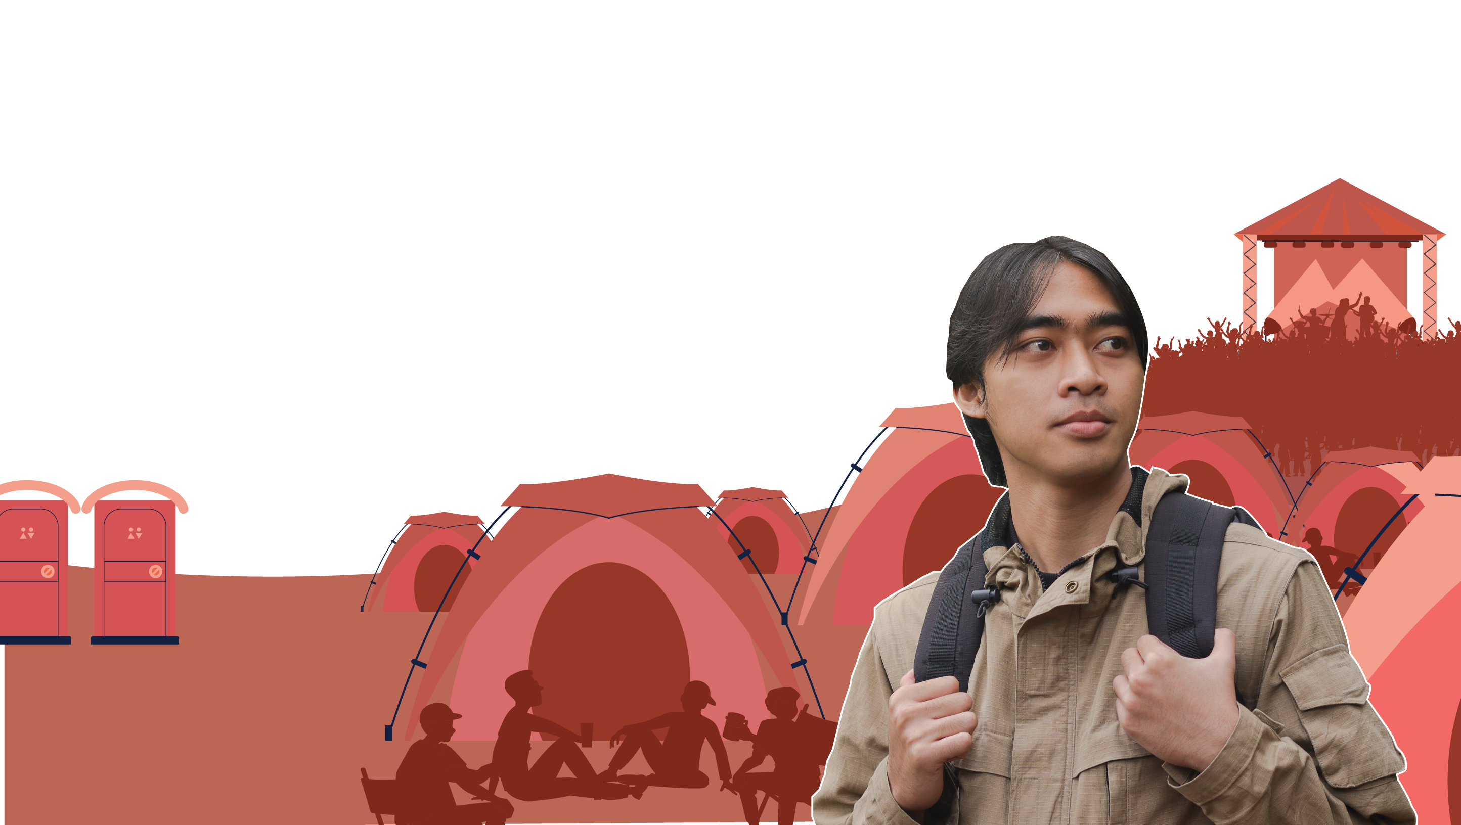
Festival timeline
Read the timeline of Max’s experience.
What are the potential influences on Max and the other characters at each stage of the timeline?
What would be the impact of acting based on these influences?
Are the influences on Max internal or external?
Notes:
Teacher notes – Festival timeline (15 mins)
As a class, read the timeline of Max’s experience of preparing for and going to a festival, in Resource 3: Festival timeline.
In pairs, ask students to identify the potential influences on Max and the other characters at each stage, and analyse the potential impact of acting based on these pressures and influences.
Finally, ask students to state whether the influences on Max at each stage are internal or external, i.e. are they coming from Max himself or from an outside source?
a
Take feedback, drawing out key learning:
At the start of the timeline, it is likely that Max is excited about going away with his friends, although he may start to feel external pressure to engage in alcohol/drug-taking activity when he receives the group messages about drugs and alcohol. While he may be going to the festival because he wants to (internal), the assumption of his friends might be that they will all be using drugs/alcohol (and Max may not want to).
At stage 2, Max may be feeling happy and relaxed and perhaps less obvious pressure to take drugs/alcohol, as there is a positive, relaxed vibe. He may feel internal influence to join in as the atmosphere is friendly and may feel safe, but external influence to join in from his friends and others attending the festival. This could be because he wants to “fit in” or feels that he is expected to.
Stage 3 of the timeline may begin with an excited and energetic mood, but Max may soon be feeling external pressure from friends and other festival goers to engage in drinking or drug-taking. They may also feel some external influence from musicians/celebrities. Max also thinks someone may have added something to (‘spiked’) his non-alcoholic drink without telling him. The people Max is with might be trying to pressure him to consume alcohol or other drugs, but spiking means that Max has not consented to consuming alcohol or other drugs. Spiking is illegal and can carry a sentence of up to ten years (this can be higher if the spiking is linked to further crimes against the person).
At stage 4, Max may be feeling pressure to ‘stay quiet’ in case he ruins the ‘good mood’ of the others – this might be internal or external. The use of nitrous oxide (identified in the story as ‘balloons’ but also known as ‘Noz’, ‘Nos’ or ‘laughing gas’) has become more prevalent amongst young people, but can be dangerous with heavy use or unsafe inhalation practices and result in effects such as headaches, breathing problems, nerve damage, unconsciousness. Nitrous oxide became a class C controlled substance in 2023. The Office for National Statistics reported 45 registered deaths involving nitrous oxide in England and Wales since 2010 (Office for National Statistics, 2022).
To sum up, explain that if a person can identify an influence as external, they may have a greater opportunity to evaluate whether it benefits them to act on it or not. If they recognise that the pressure is only coming from within themselves, then this can help them to resist the pressure and make more autonomous and authentic choices.
Support: Ask students to identify the influence at each stage and whether it is internal or external, using the timeline in Resource 3a: Festival timeline – key moments.
Challenge: Ask students to discuss what they think most often has the greatest impact: external or internal influence? Are there any contexts in which this balance changes?

Slide 14
Strategies for Max
What opportunities are there for Max to be a positive influence on others?
What strategies could he use?
Notes:
Teacher notes – Strategies for Max (10 mins)
Remind students that sometimes people might be going along with others because of the influences we have been considering, but it can just take one person to ‘break ranks’ for others to admit they feel the same about what is happening.
In their groups, ask students to identify opportunities for Max to be a positive influence on others in the timeline, and what strategy he could use e.g. could he encourage the friend to drink water between alcoholic drinks? Should he find help or a first aid tent at any point?
Then, ask for at least one strategy from each group. You may wish to collate these strategies on a whole class mind map.
Key learning:
In situations where they are increasingly independent, it is important that students know how to help keep themselves and others safe. For many students, festivals or similar weekends away will be the first time they feel independent, and this can be a very exciting time. It is easy for young people to get caught up ‘in the moment’, especially when with their peers and in a place where there is less direct adult supervision.
It is important that young people know that they have options and that using substances or drinking alcohol is not the norm, even if it feels like it is in environments such as music festivals.
Strategies might include: establishing expectations with friends before going to the festival; saying a polite but assertive ‘no thanks’ to offers of alcohol or other drugs; agreeing to respect others’ decisions not to use substances; drinking water between alcoholic drinks; arranging designated meeting points or meeting times in case they lose one another; finding appropriate help such as going to the first aid tent if needed; always staying in at least pairs throughout the weekend; not leaving drinks unattended; being aware of drug testing facilities which are present at some festivals (these tests may show the contents of a drug, and how frequently these are not the same as ‘advertised’, but do not remove the risks of taking the drug).
Challenge: Ask students to discuss if they think festival organisers should do more to keep young people safe and if so, how?

Slide 15
What if ..?
Rewrite your stage of the story, considering what decisions might have been made if the pressures/influences on the characters had been ignored or challenged.
STAGE 1
STAGE 2
STAGE 3
STAGE 4
Max’s story - STAGE 3
Notes:
Teacher notes – What if..? (10 mins)
Reflecting on who or what is influencing Max and his friends at each stage, assign groups a different part of the story each and ask them to rewrite that stage, considering what decisions might have been made if the pressures/influences (internal or external) had been ignored or challenged.
Ask each group to feedback their part of the story in order of the timeline.
Elements of the timeline that might have been different include:
The group deciding not to take alcohol or other drugs with them to the festival (e.g. if somebody spoke out against doing so at the start)
The group sticking together, returning together and creating a plan for the day together, without the use of drugs or alcohol
Telling others in the group how they are feeling about what is happening
Contacting a first aider if concerned about a friend

Slide 16
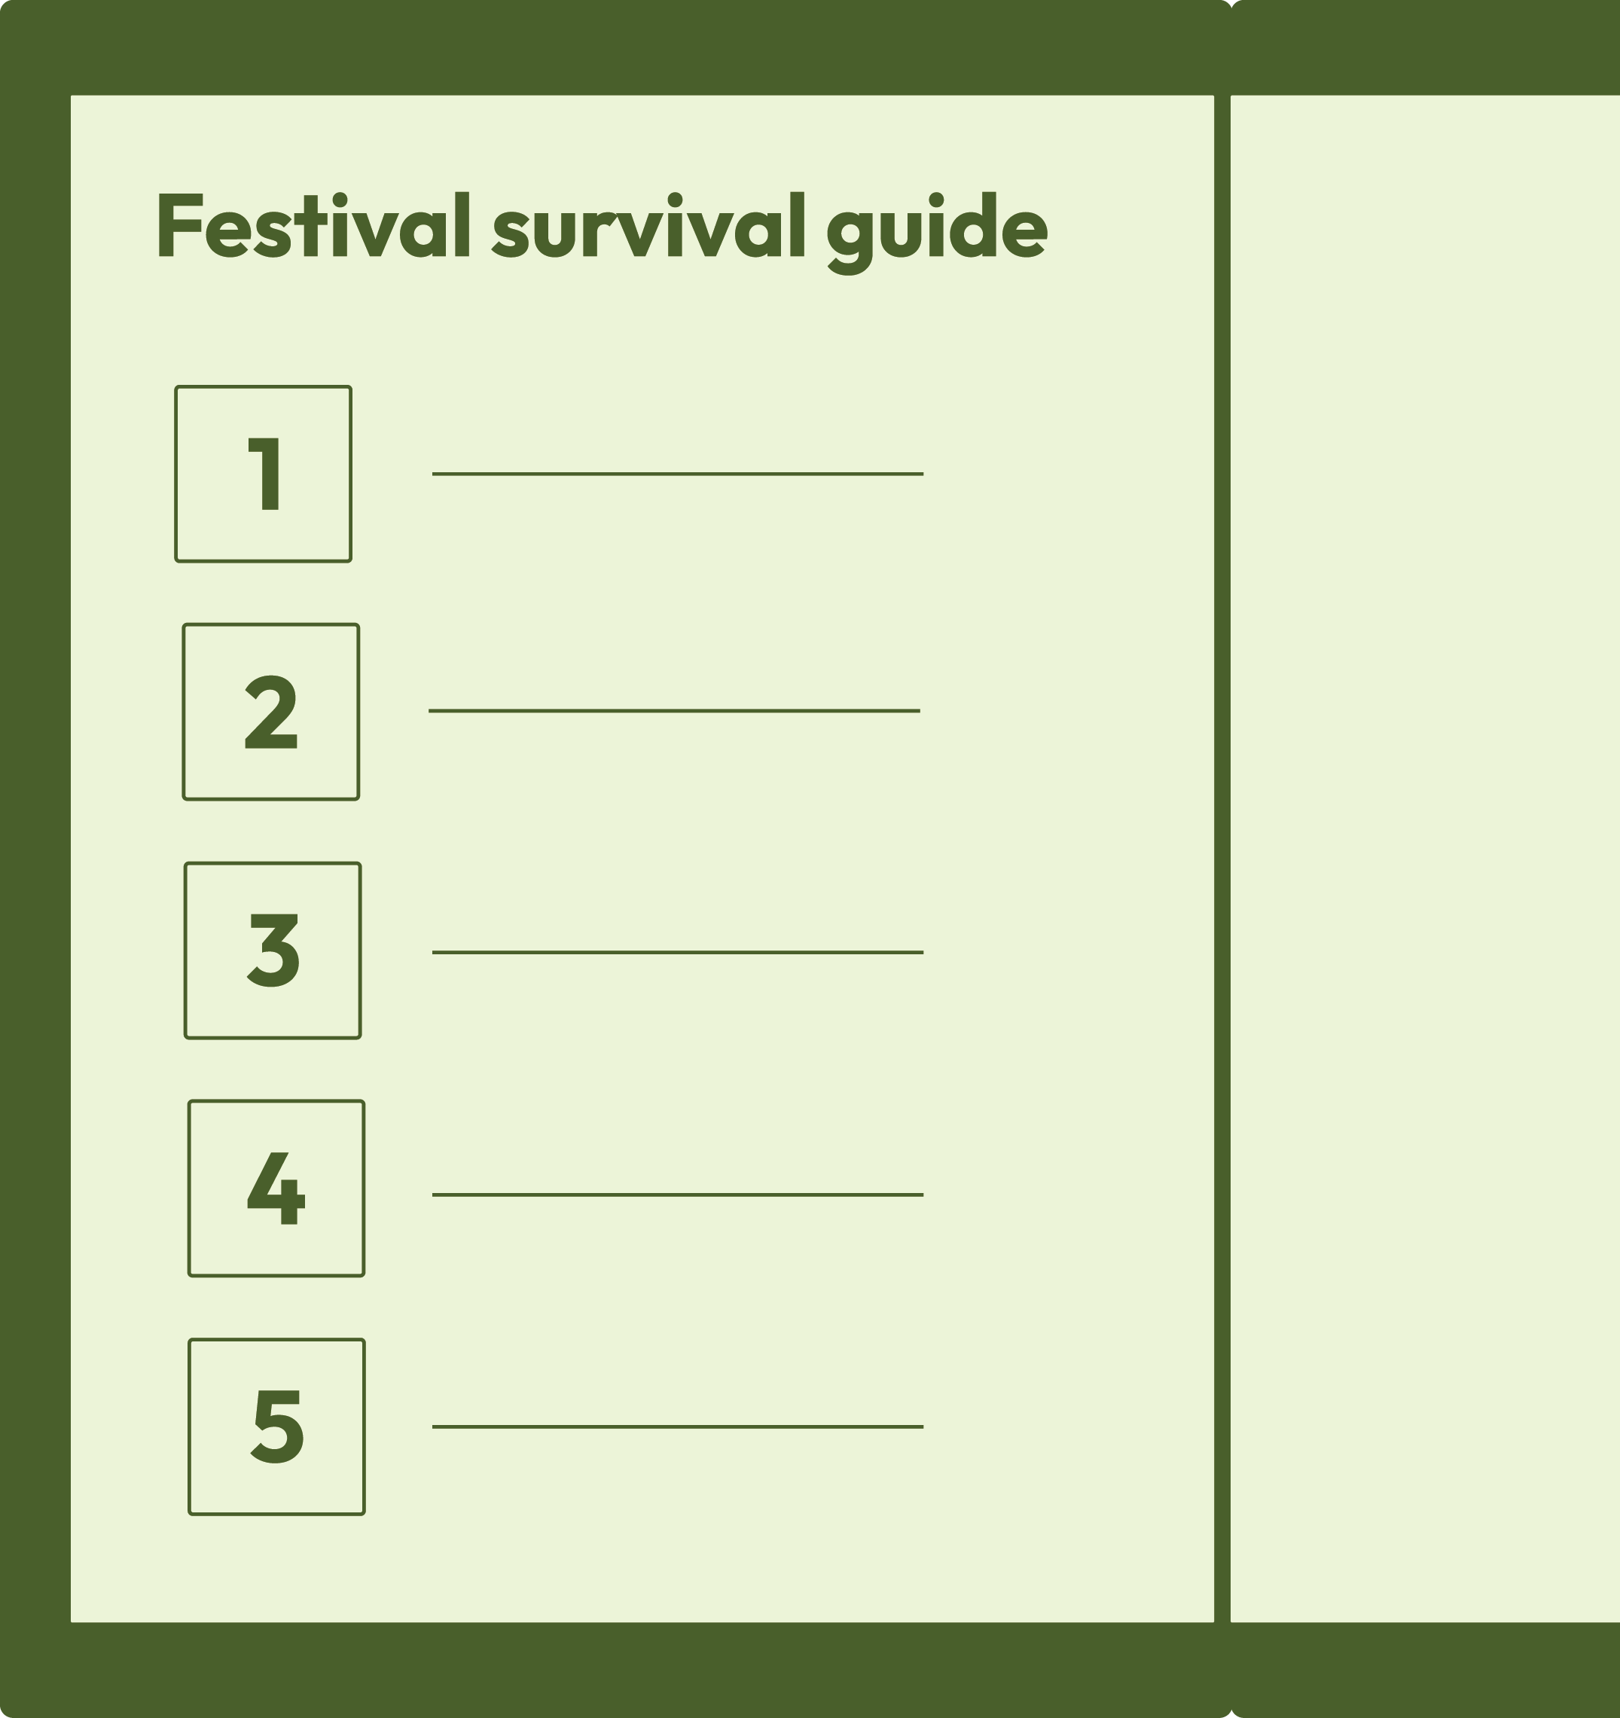
What have we learnt?
Write five top tips for a ‘festival survival guide’, about how to keep the experience enjoyable and safe for everyone.
Remember to include what you have learnt about:
the effects of different internal and external influences
strategies for managing peer influence
ways to be a positive influence on others in relation to substance use
Notes:
Teacher notes – Reflection and endpoint assessment (10 mins)
Ask students to come up with a list of at least five top tips for a ‘festival survival guide’ on a website about how to keep the experience enjoyable and safe for all, e.g. create a system to check on one another at various points in the day, aim to drink a certain amount of water to stay hydrated etc. They should include tips that show what they have learnt about the effects of different internal and external influences, strategies for managing peer influence and ways to be a positive influence on peers in relation to substance use.
Ask students to feedback what they think is their most important tip from their list. This is an opportunity for you to gather evidence of the learning that has taken place and to inform your planning for subsequent learning.

Slide 17
Sources of support
To access further advice, guidance and support related to substance use, including drugs and alcohol, or peer influence, you can:
speak to a tutor, pastoral lead, or other trusted adult
contact Childline: www.childline.org.uk, 0800 1111
visit www.talktofrank.com
I need your help with something . . .
Something's worrying me, can I talk to you?
I have something that’s been bothering me . . .
Notes:
Teacher notes – Signposting support (5 mins)
Ensure that students know where they can seek help and further advice, both now and in the future, if they are concerned about substance use, including drugs and alcohol, or peer influence. Students wishing to seek further guidance can:
Speak to a tutor, pastoral lead or other trusted member of staff in the school
Contact Childline www.childline.org.uk 0800 1111
Visit https://www.talktofrank.com

Slide 18
Script-writing
Choose a stage of the timeline and create a script or role-play, showing how someone could communicate their decision to challenge or ignore an influence.
Notes:
Teacher notes – Extension activity
Ask students to select a stage of the timeline and create a script/role-play, modelling how an individual could communicate their decision to challenge or ignore an influence.

