Slide 1
Drug education
Understanding risks and consequences
KS5/Post-16: Lesson 1

Slide 2
Using this PowerPoint
The slides in this presentation are divided into two sections:
Teacher slides (purple) – provide key information regarding lesson preparation.
Student slides – provide a visual focus point for students during the lesson and delivery notes for teachers about the activities. Click ‘notes’ to view these.
Ensure that you select ‘Use Presenter View’ under the ‘Slide Show’ tab – this will allow you to preview the teaching notes on your monitor while the main presentation is displayed on a screen/smartboard.

Slide 3
Support and challenge
The lesson includes suggestions for challenge and support activities, to help you differentiate appropriately for your class.
Support activities are adapted to be more accessible for those who need it.
Challenge activities deepen and extend learning for those who need more challenge or who finish the activity quickly.
Look for these icons on the student slides. See delivery notes for details of the activities.
Challenge
Support

Slide 4
Context
This is the first of five lessons for key stage 5 on understanding the risks and consequences of substance use; and making informed decisions about alcohol and other drugs.
This lesson explores the effects of illegal drugs, consequences for possessing or supplying illegal drugs, and the impact of drug supply chains on the wider community.

Slide 5
Developing subject knowledge
Key information on content related to these lessons can be found in the key stage 5 Knowledge Organiser.
Advice on safe practice, dispelling common misconceptions, visitors to the classroom and other important information can be found in Teacher Guidance: Drug and alcohol education.
Data sources to inform your planning can be found in our document that outlines the approach of these lessons: Evidence Review: Effective drug and alcohol education.

Slide 6
To learn about the risks and consequences of drug use.
Students will be able to:
identify illegal drugs and describe their associated risks
explain the consequences of possessing, using or supplying illegal drugs
analyse the impact of drug supply chains on communities at a local, national and international level

Slide 7
Box or envelope for questions
Flipchart paper and pens
Post-it notes
Resource 1: What I know now [1 per student]
Resource 2: Risks and effects [1 per pair]
Resource 2a: Risks and effects – alternative [support option, as required]
Resource 2b: Risks and effects – answers [1 copy for teacher reference]
Resource 3: Choices and consequences [1 per small group]
Resource 4: What’s the impact? [support option, as required]

Slide 8
Lesson summary
Activity | Description | Timing
Introduction | Introduce the learning objective and outcomes and revisit ground rules. | 2 mins
Baseline assessment | Students mind map their current knowledge and understanding of risks and consequences related to illegal drugs. | 10 mins
Understanding drugs and their risks | Pairs match types of drugs to their associated risks and identify examples of drugs for each category. | 10 mins
Exploring legal consequences | Groups review scenarios to explore the consequences of possession or supply of illegal drugs. | 15 mins
Considering the wider impact | Pairs discuss how the illegal drug trade can affect communities at a local, national and international level. | 10 mins
Reflection and endpoint assessment | Students return to the baseline assessment and add to, or correct their ideas, before reflecting on how the lesson has changed their thinking about illegal drugs. | 10 mins
Signpost support | Respond to student questions and remind students how to access further advice, guidance and support related to substance use. | 3 mins

Slide 9
Understanding risks and consequences
Lesson 1

Slide 10
To learn about the risks and consequences of drug use.
We will be able to:
identify illegal drugs and describe their associated risks
explain the consequences of possessing, using, or supplying illegal drugs
analyse the impact of drug supply chains on communities at a local, national and international level
Notes:
Teacher notes – Introduction (2 mins, slides 10-11)
Introduce the learning objective and outcomes. Explain that today’s lesson will explore the risks of using illegal drugs, including potential effects on mental and physical health, the consequences of possessing or supplying illegal drugs, and the impact of supplying drugs on the wider community.

Slide 11
Notes:
Teacher notes – Introduction (2 mins, slides 10-11)
Establish or revisit ground rules and explain that if students have worries or questions during or after the lesson that they do not want to raise in front of the class, they can write their question on a piece of paper, anonymously or with their name, and put it in the question box.

Slide 12
What I know now
What groups or ‘classes’ of drugs are defined by the law in the UK? Can you give examples of drugs that might be found in these classes?
What do these key terms mean?
Possession
Supply
Intent to supply
What are the potential risks of using illegal drugs on someone’s health and wellbeing?
What might the consequences be for buying, selling, or using illegal drugs? List any that you can, including for the people directly involved, or others around them.
Notes:
Teacher notes – Baseline assessment (10 mins)
Ask students to respond to the questions on Resource 1: What I know now, to demonstrate their prior learning from key stage 4. As this is a baseline assessment, they should complete it on their own, without any further prompting or discussion with others.
Circulate as students complete the activity, to gauge what they already know, especially regarding the law relating to alcohol and other drugs, and the effects of drug and alcohol use.
Use this activity to identify any gaps or misconceptions about alcohol and other drugs that students might have, and plan how to address these over the course of the lesson. For example, if students show less knowledge and understanding of the risks associated with a range of drugs, you may want to spend more time on the first core activity, using the teacher notes to address the gaps in their knowledge.

Slide 13
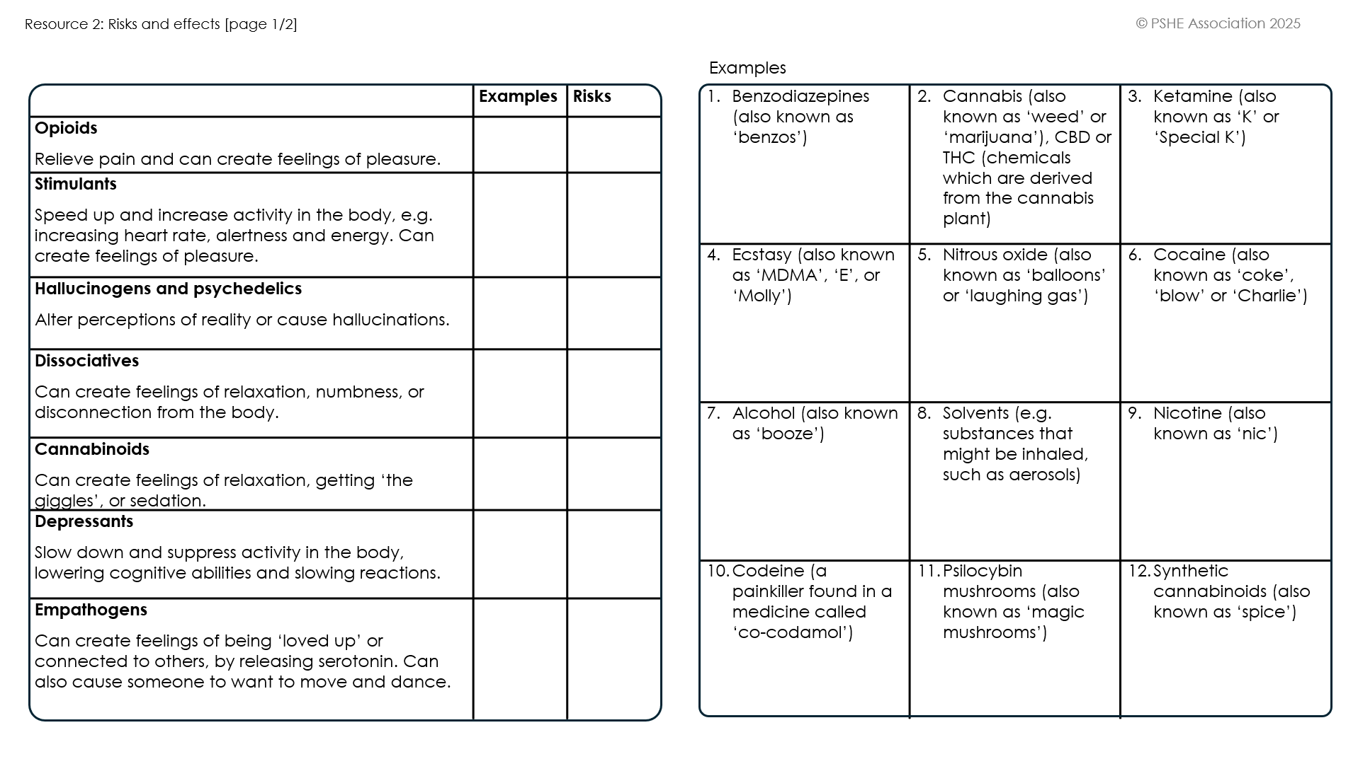
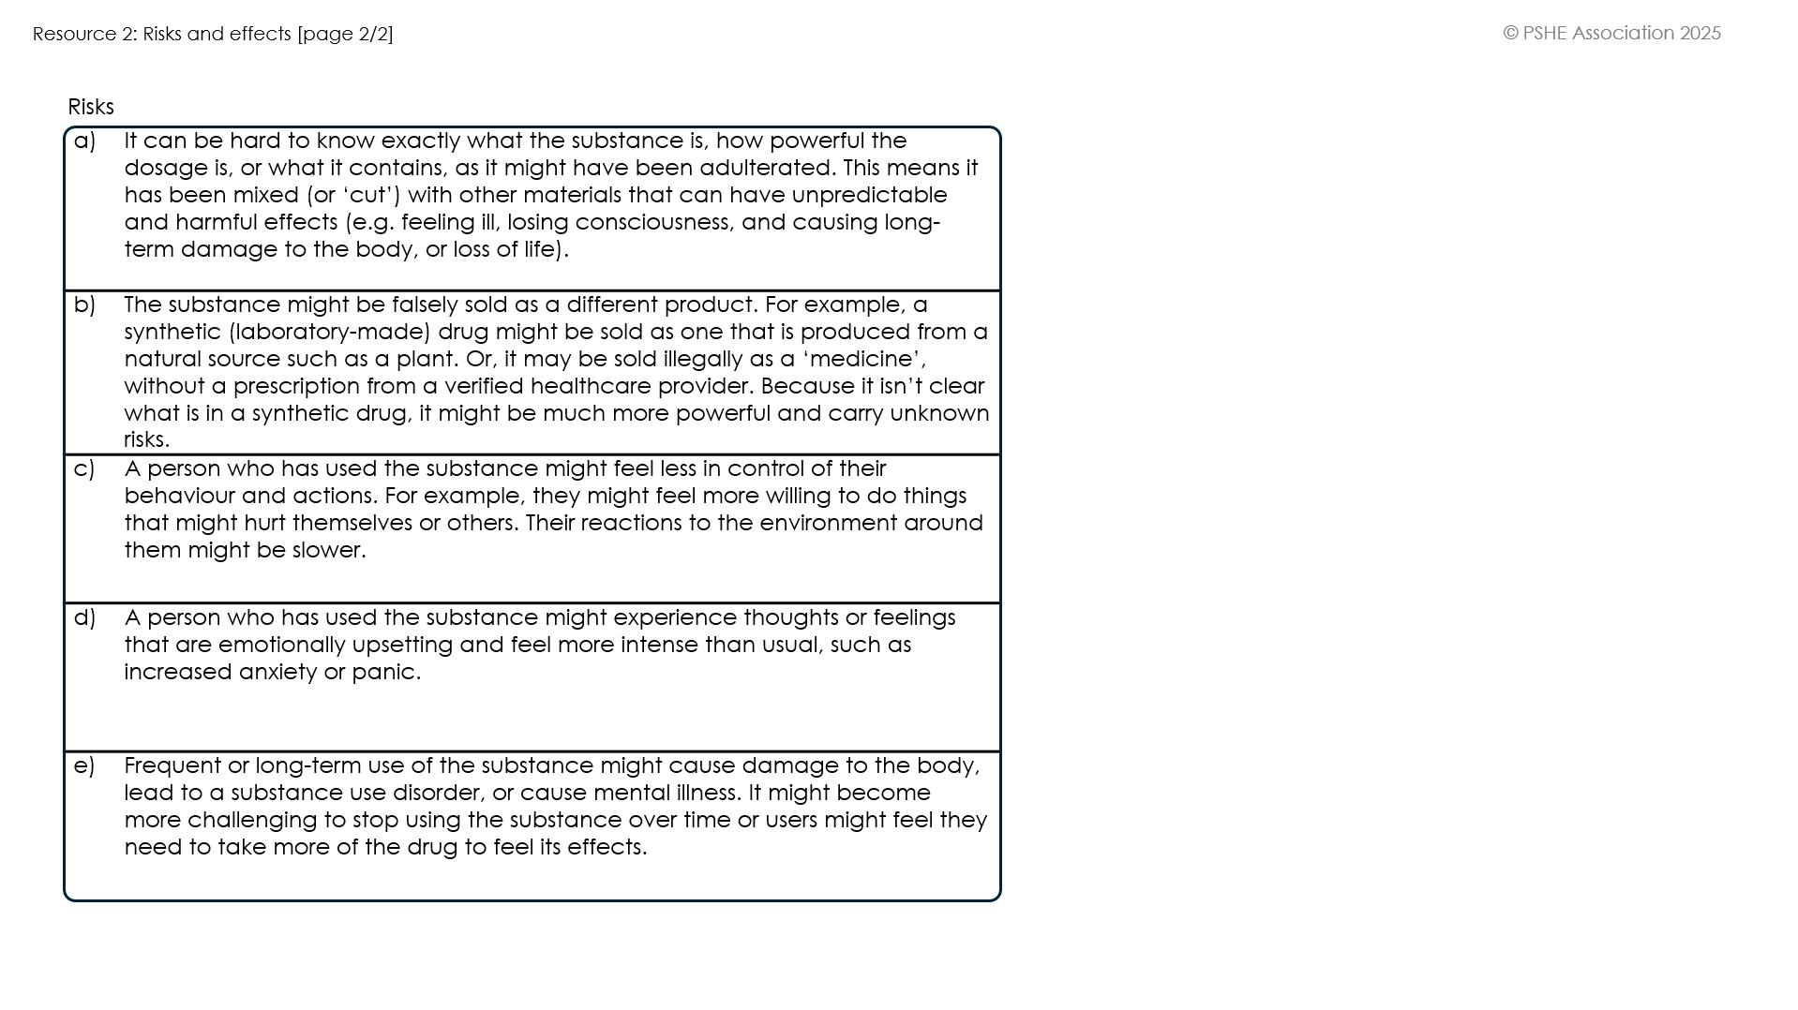
Risks and effects
Use the information to match the examples of drugs and their risks to the right category.
Notes:
Teacher notes – Understanding drugs and their risks (10 mins, slides 13-14)
In pairs, ask students to use Resource 2: Risks and effects to match examples of drugs to the correct type of drug by writing the corresponding numbers in the table. Then, ask them to identify the associated risks of those drugs by writing the corresponding letters into the correct row. Some letters may be used across multiple rows.
When students have completed the activity, ask volunteers to share their answers, as students self-assess their work. Use Resource 2b: Risks and effects – answers to guide feedback and answer any questions that students may have.

Slide 14
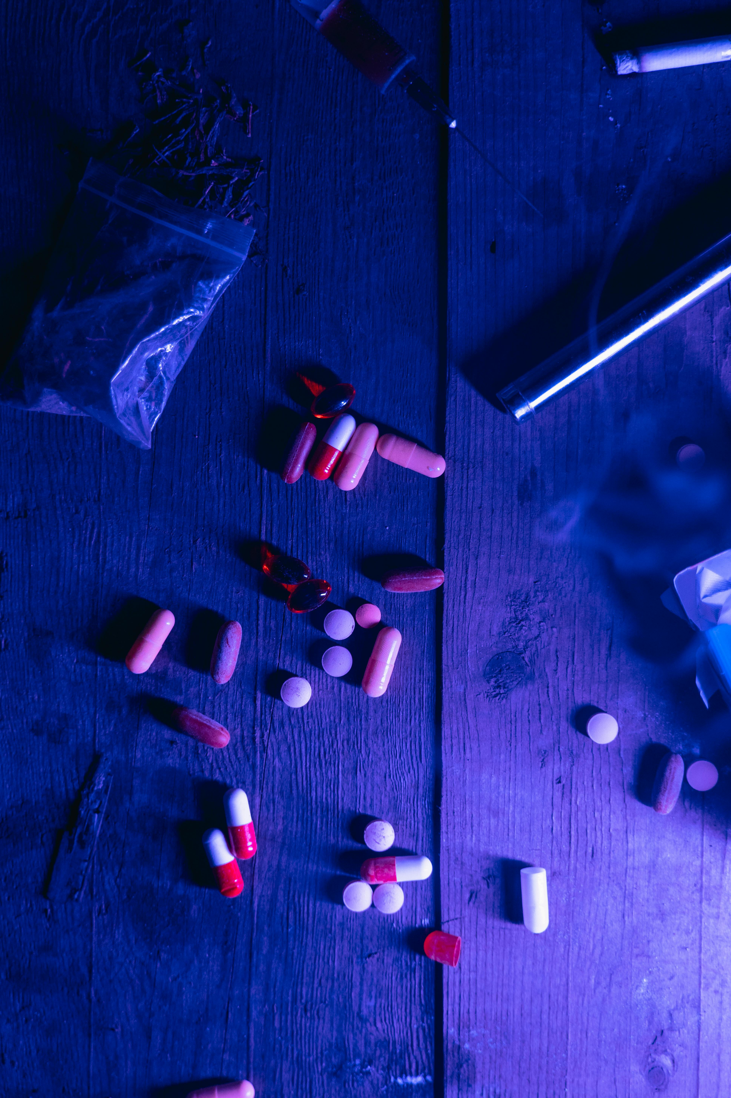
Risks and effects
It can be impossible to tell what is in an illegal substance.
Some may contain other harmful drugs and chemicals and not state this.
All drugs carry potential risks to health and wellbeing if they aren’t used for their intended purpose.
Notes:
Teacher notes – Understanding drugs and their risks (10 mins, slides 13-14)
Draw out key learning:
Although some drugs listed may be used legally (e.g. benzodiazepines when prescribed by a healthcare professional; alcohol, or nicotine for over 18s), all drugs carry risks to physical and mental health and wellbeing when used other than for their intended purpose.
As illegal drugs are unregulated, there is always an increased risk of harm, and it is often impossible to tell what is in a substance. Illegal drugs may be sold as different products, or in packaging designed to look like those which are prescribed by a healthcare professional. For example, a vape which is said to contain the substance THC may actually contain synthetic cannabinoids, while drugs sold illegally, under the guise of being medicines, may contain synthetic opioids.
Some drugs, such as nicotine, are restricted in their availability to young people due to the increased risk of developing dependence on the substance. For more information about challenging misconceptions related to the use of alcohol and other drugs, including dependence or ideas about ‘addiction’, see pages 6-8 of the Teacher guidance.
Support: Give Resource 2a: Risks and effects – alternative to any students who might need extra support and ask them to complete the missing information.
Challenge: Explain that the government has recently classified a wider group of synthetic opioids, known as ‘nitazenes’, as Class A drugs. Ask students to discuss what the positive impact of this classification might be, and what other measures might help people to understand the risks of using illegal drugs and seek support. Finally, ask students to consider why the government needs to keep classifying drugs.

Slide 15
Legal consequences
What does the “supply” of drugs mean?
Distributing or sharing drugs to others, whether in return for payment or a reward, as a gift, or for others to use.
[Adapted from cps.gov.uk]
Notes:
Teacher notes – Exploring legal consequences (15 mins, slides 15-16)
Ask students to ‘think-pair-share’ what is meant by the ‘supply’ of drugs.
Take feedback, drawing out that the ‘supply’ of illegal drugs includes selling to others as well as sharing them with family or friends, for example as a gift or reward. Sharing or selling controlled substances, such as prescription-only medicines including antibiotics or antidepressants, is also illegal.

Slide 16
Legal consequences
What legal consequences might the character face if they decide to buy or sell illegal drugs?
What might the consequences be for them in the short term?
What might the consequences be for them in the long term?
What differences are there between the consequences Joanna and Ivan might face?
Notes:
Teacher notes – Exploring legal consequences (15 mins, slides 15-16)
Then, working in small groups of three to four, give students one of the scenarios in Resource 3: Choices and consequences and ask them to use it to help them note down their answers to the questions on the slide, on flipchart paper.
After five minutes, ask groups to swap their flipchart paper with another group and look at the other scenario, adding any additional points they can think of.
Take feedback about both scenarios.
Students might suggest:
Joanna:
If Joanna decides to purchase the drugs, she is at risk of being found in possession of an illegal substance. The consequences she might face depend on what the substance is. For example, if the drugs contain substances such as ecstasy, cocaine, psilocybin mushrooms, or LSD, she would be in possession of a Class A drug. Joanna may face a fine or time in custody, depending on the amount of the substance that she possesses, or if she has an existing criminal record*.
Short-term consequences might include Joanna feeling embarrassed or worried if reprimanded by police in public or taken into custody. She might feel nervous or anxious about being found with illegal substances. She may become unwell if her body responds negatively to the substance, and her behaviour might change if she takes the substance, for example, becoming less aware of her surroundings, making decisions that lead to harm for herself or others, or doing something that might damage her relationships with others.
Long-term consequences might include Joanna receiving a criminal record if found with illegal substances. This might impact her employment, now or in future, if an employer asks Joanna if she has any criminal convictions (although explain to students that it is still very possible to find stable employment with a criminal conviction, depending on the severity of the offence). If Joanna is asked to share this information and chooses not to, this would be a further criminal offence. It could also affect factors such as her ability to travel, as some countries will restrict entry with a prior conviction.
Ivan:
If Ivan decides to speak to the friend about selling the ‘product’, and this involves him selling illegal drugs, he could face legal consequences for the supply of classified drugs, or for possession with intent to supply. These might include being referred to his local Youth Offending Team and being placed on a plan to prevent further offending (for example, attending regular meetings with a member of the team). Depending on the severity of Ivan’s actions, he could face time in custody, for example, if he is found in possession of a large quantity of classified drugs with intent to supply, or if he becomes involved in other related criminal activity.
Short-term consequences might include Ivan being placed in danger by the person arranging to have him supply illegal products. This is a form of child criminal exploitation, and Ivan may suffer from mental or physical harm.
Long-term consequences might include Ivan’s wellbeing being impacted if he experiences harm as a result of supplying illegal drugs. If he is found with illegal drugs, with intent to supply, he will face a criminal record. This might affect his current employment, where he could lose his job, or future employment, if he is asked to share this information. It could also impact his education, for example if he faces temporary or permanent exclusion from college.
Finally, ask the class to identify any differences between the consequences the two characters might face, and take feedback.
Students might suggest: Ivan and Joanna might face different consequences, such as Ivan facing a more serious penalty for the supply of drugs. As he is a minor, this would also be shared with his parent(s) or guardian(s). If taken into custody, Ivan’s legal identity as a minor would mean he might be kept in youth custody, rather than an institution for adults as Joanna would be. However, if he is convicted after his 18th birthday, he may face more serious consequences as an adult. As an adult, Joanna would likely have to declare that her conviction is ‘not spent’ (not yet finished) for a longer time period than Ivan.
Support: To help students identify consequences for each character, ask them to consider the following factors: education, employment, relationships, feelings.
Challenge: Ask students to identify any factors which might impact Joanna or Ivan’s decision to purchase or supply drugs. How might they overcome or turn away from any factors that influence them to make a decision that could be harmful or risky?
* In Scotland, someone found in possession of a class A, B, or C drug may receive a Recorded Police Warning. This is not the case in England or Wales, although possession of a controlled substance is still a criminal offence across the UK. (www.copfs.gov.uk/about-copfs/news/lord-advocate-statement-on-diversion-from-prosecution/ [Accessed 12.06.2024])

Slide 17
A wider impact
Going out sober last night felt so good! I’m not going to use anymore. It’s not even just that I feel better, I feel like I’ve actually done something good for the community.
A
I get what you’re saying about feeling good mentally, but how is not taking drugs good for the community? Isn’t that taking it a bit far?
B
I don’t think so… I used to think it was my choice, my life, only affecting me, but all our choices impact each other, don’t they?
Someone out there is supplying the drugs I buy, someone else is making them. And who knows how safe any of those people are? People must be in really dangerous situations. How many lives are being affected because of how I’m spending my money?
A
Notes:
Teacher notes – Considering the wider impact (10 mins, slides 17-19)
Ask students to read the conversation between two friends on this and the next slide.

Slide 18
A wider impact
I guess… but we’re the end of the chain. There are other people who have the power to stop it if it’s that bad. What we do isn’t really going to change that.
B
I think we’ve all got a part to play – we can’t just pretend that our actions don’t affect others…
A
Notes:
Teacher notes – Considering the wider impact (10 mins, slides 17-19)

Slide 19
Analysing the impact
How can the drug trade impact people and communities:
locally?
nationally?
internationally?
Notes:
Teacher notes – Considering the wider impact (10 mins, slides 17-19)
In pairs, ask them to discuss what the impact of the drug trade might be at the local, community level (e.g. direct impact on the area where drugs are traded); the national level (the impact on the UK); and the international level (the impact on different countries, or communities in different countries).
Take feedback, collating answers on the whiteboard or flipchart paper. Use the suggestions in Resource 4: What’s the impact? to help guide discussion.
Students might suggest:
At a local level, the drug trade might cause crime rates to rise in certain areas, making people feel unsafe. This may attract further crime, raise tensions in the area, or make community relations break down. This may also impact the local economy if an area is seen as at higher risk of violent crime. The drug trade can lead to worse health outcomes for the local population, for example if more people are hospitalised or face health complications due to using illegal substances, or if they have experienced harm as a result of exploitation and drug trafficking.
At a national level, the drug trade can lead to an escalation of policing against drug offences. This might increase tensions between different groups and the police, and lead to increased costs for the police and other emergency services. It may also lead to higher spending in the healthcare sector in response to drug-related illnesses or casualties.
At an international level, the drug trade can contribute to higher levels of violent crime in areas where there are high levels of drugs and human trafficking. These areas may also experience higher levels of poverty compared to areas where drugs are consumed, for example in countries with a higher gross national income. This economic inequality can be made worse by the exploitative nature of the drug trade.
The drug trade also has a significant and damaging environmental impact. For example, the harvesting, production and transportation of illegal substances create a significant carbon footprint and other harms, such as water and air pollution, and deforestation. Consuming illegal substances also produces high levels of waste pollution.
Support: Ask students to use Resource 4: What’s the impact? to sort the suggestions into the three categories, and then add their own ideas.
Challenge: Ask students to consider how Friend B’s thinking might be challenged by Friend A’s ideas. What factor might most impact their future decision about whether to buy or use illegal drugs?

Slide 20
Reviewing our learning
What can you add to your answers from the beginning of the lesson?
Do you need to correct anything?
Can you show you’ve met the learning outcomes?
Learning outcomes
We will be able to:
identify illegal drugs and describe their associated risks
explain the consequences of possessing, using or supplying illegal drugs
analyse the impact of drug supply chains on communities at a local, national and international level
Notes:
Teacher notes – Endpoint assessment and reflection (10 mins, slides 20-21)
Ask students to return to the questions from the baseline assessment. Remind them of the learning outcomes for the lesson, and using these to reflect on their learning, ask them to correct any misconceptions they may have written initially, or add any new learning (in a different coloured pen). Circulate as students complete the activity, to check student progress and identify if there are any remaining gaps in their understanding, or misconceptions, to address in future lessons.

Slide 21
Reflecting on our learning
What is one way this lesson has changed or challenged the way you think about drugs?
What is one question you still have about drugs?
Notes:
Teacher notes – Endpoint assessment and reflection (10 mins, slides 20-21)
Give each student a post-it note and ask them to write down either:
one way the lesson has changed or challenged the way they think about drugs
and/or:
one question they still have about drugs.
Ask them to write their answers anonymously and drop them in a box when they leave the lesson in a few minutes.

Slide 22
Sources of support
For further advice, guidance and support related to substance use, you can:
Speak to a member of staff such as your form tutor, head of year, school nurse, or a member of the safeguarding team
Speak to a trusted adult such as a parent/carer, family member or GP
Visit Childline - www.childline.org.uk; or phone on 0800 1111
Visit your GP or www.nhs.uk/live-well/quit-smoking/nhs-stop-smoking-services-help-you-quit/ for help quitting smoking
Visit FRANK at www.talktofrank.com/get-help/find-support-near-you to find local support services
Visit Release for confidential advice about drugs and the law www.release.org.uk/drugs-legal-advice
I need your help with something . . .
Something's worrying me, can I talk to you?
I have something that’s been bothering me . . .
Notes:
Teacher notes – Signposting support (3 mins)
If time allows, answer any questions from the question box that are appropriate to answer in front of the class. If students have written their names, keep the answers anonymous.
Remind students how they can access further advice, guidance and support related to substance use, including:
Speak to staff in school such as their form tutor, head of year, school nurse, or a member of the safeguarding team
Speak to another trusted adult such as a parent/carer, or family member, or visit their GP
Visit Childline, which can be contacted by young people under 19, at www.childline.org.uk; or by phone on 0800 1111
Visit their GP or www.nhs.uk/live-well/quit-smoking/nhs-stop-smoking-services-help-you-quit/ for help quitting smoking
Visit FRANK at www.talktofrank.com/get-help/find-support-near-you to find local support services
Visit Release, which provides a free, confidential and non-judgmental information and advice service in relation to drugs and drug laws, at www.release.org.uk/drugs-legal-advice, 0207 324 2989, or ask@release.org.uk

Slide 23
Blog post
Write a short article for the school or college’s student paper/website about either:
the social impact of using/buying illegal and harmful substances
or
the environmental impact of using/buying illegal and harmful substances.
Notes:
Teacher notes – Extension activity
Ask students to write a short article for the school or college’s student paper/website about the social or environmental impact of using or buying illegal and harmful substances.

