Slide 1

Drug education
Medicines and substances
KS5/Post-16: Lesson 2

Slide 2
Using this PowerPoint
The slides in this presentation are divided into two sections:
Teacher slides (purple) – provide key information regarding lesson preparation.
Student slides – provide a visual focus point for students during the lesson and delivery notes for teachers about the activities. Click ‘notes’ to view these.
Ensure that you select ‘Use Presenter View’ under the ‘Slide Show’ tab – this will allow you to preview the teaching notes on your monitor while the main presentation is displayed on a screen/smartboard.

Slide 3


Support and challenge
The lesson includes suggestions for challenge and support activities, to help you differentiate appropriately for your class.
Support activities are adapted to be more accessible for those who need it.
Challenge activities deepen and extend learning for those who need more challenge or who finish the activity quickly.
Look for these icons on the student slides. See delivery notes for details of the activities.
Challenge
Support

Slide 4
Context
This is the second of five lessons for key stage 5 on understanding the risks and consequences of substance use; and making informed decisions about alcohol and other drugs.
This lesson focuses on different types of substances, including prescription and ‘over-the-counter’ medicines, and how to safely access and seek reliable information about these.

Slide 5
Developing subject knowledge
Key information on content related to these lessons can be found in the key stage 5 Knowledge Organiser.
Advice on safe practice, dispelling common misconceptions, visitors to the classroom and other important information can be found in Teacher Guidance: Drug and alcohol education.
Data sources to inform your planning can be found in our document that outlines the approach of these lessons: Evidence Review: Effective drug and alcohol education.

Slide 6
To learn about different substances, including medicines, and how to seek reliable information about these.
Students will be able to:
describe differences between prescribed and over-the-counter medicines
identify risks of buying substances online and explain how to access prescription medicine safely
evaluate reliable sources of information about substances
explain how someone can seek support if they are concerned about substances that they, or others they know, have used

Slide 7
Box or envelope for questions
Post-it notes
Resource 1: Overheard conversation [1 per student]
Resource 2: All about medicines [1 per pair]
Resource 2a: All about medicines – key terms [support option, as required]
Resource 3: Getting help [1 per pair]
Resource 3a: Getting help – alternative [support option, as required]
Resource 3b: Getting help – answers [1 copy for teacher reference]
Resource 4: Accessing prescription medicine [1 per pair]

Slide 8
Lesson summary
Activity | Description | Timing
Baseline assessment | Students read an overheard conversation between two friends and respond to questions. | 5 mins
Introduction | Introduce the learning objective and outcomes and revisit ground rules. | 2 mins
All about medicines | Students respond to a series of FAQs from the perspective of a healthcare professional. | 15 mins
Getting help | Pairs explore why someone might access medicine online and evaluate the reliability of different sources of information about medicines. | 15 mins
Information relay | Groups summarise key facts about accessing medicines safely, and how to seek support for concerns relating to substances, including medicines. | 10 mins
Reflection and endpoint assessment | Students return to the baseline assessment and add new learning, before writing advice to a character about accessing medicines safely. | 10 mins
Signpost support | Respond to student questions and remind students how to access further advice, guidance and support related to medicines and substance use. | 3 mins

Slide 9

Medicines and substances
Lesson 2
DAE Title Image

Slide 10
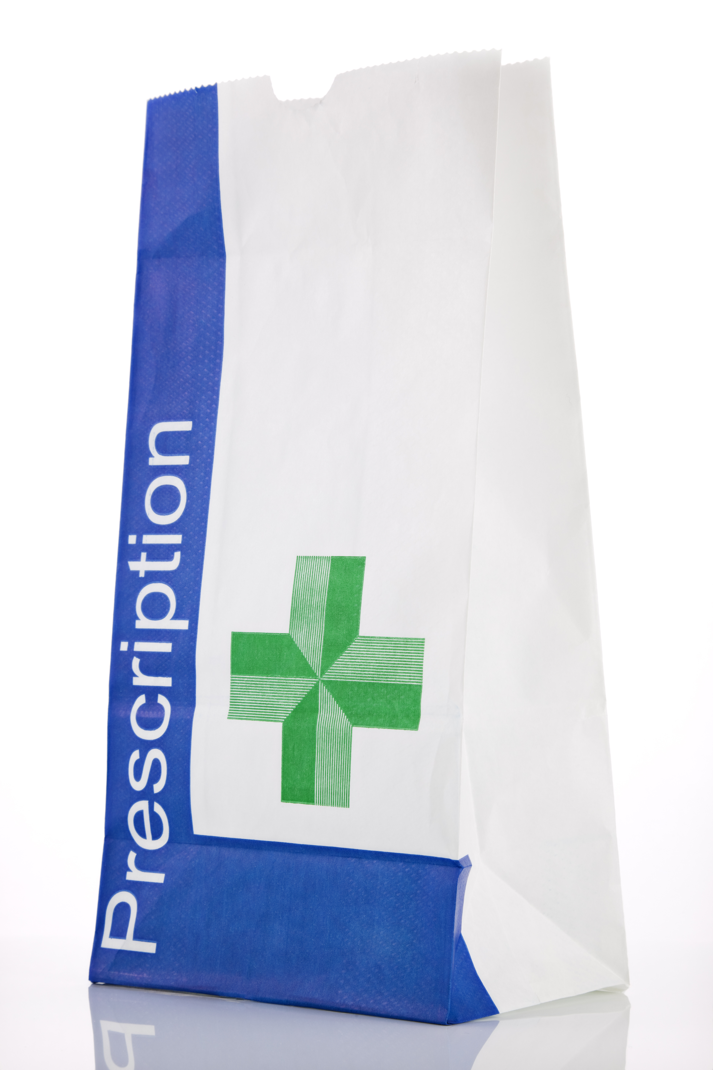
What’s our starting point?
What differences are there between prescription medicine and ‘over-the-counter’ medicine, that Lexi should be aware of?
If she needs to access prescription medicine, how can Lexi do this safely?
How can Lexi and Paddy be sure that the website advertising the substance is a reliable source of information?
If Paddy or Lexi have questions or concerns about substances, including medicines, what can they do?
Notes:
Teacher notes – Baseline assessment (5 mins)
Using Resource 1: Overheard conversation, share the snippet of a conversation between friends, Lexi and Paddy. Then, ask students to write down their responses to the questions on the slide.
As this is a baseline assessment, students should work on their own and avoid discussing their answers while they complete the activity.
When they have finished, take brief feedback from volunteers. Ask them not to add to their written answers at this point, as they will return to these at the end of the lesson. Take this opportunity to assess what students already know about different types of substances, and their understanding of how to safely access information about them. If students show a weaker understanding, for example of what is meant by prescription or ‘over-the-counter’ medicine, you may want to adapt the lesson by spending more time on core activities one and two, guiding students through the information on the resources provided, and answering their questions using the suggested key learning points.

Slide 11
To learn about different substances, including medicines, and how to seek reliable information about these.
We will be able to:
describe differences between prescribed and over-the-counter medicines
identify risks of buying substances online and explain how to access prescription medicine safely
evaluate reliable sources of information about substances
explain how someone can seek support if they are concerned about substances that they, or others they know, have used
Notes:
Teacher notes – Introduction (2 mins, slides 11-12)
Introduce the learning objective and outcomes. Explain that today’s lesson will explore different types of substances, including prescription and ‘over-the-counter’ medicines, how to find accurate and reliable information about these, and how to safely access medicines when needed.

Slide 12
Notes:
Teacher notes – Introduction (2 mins, slides 11-12)
Revisit ground rules for the lesson and remind students about the question box.

Slide 13

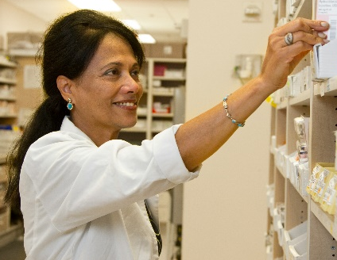
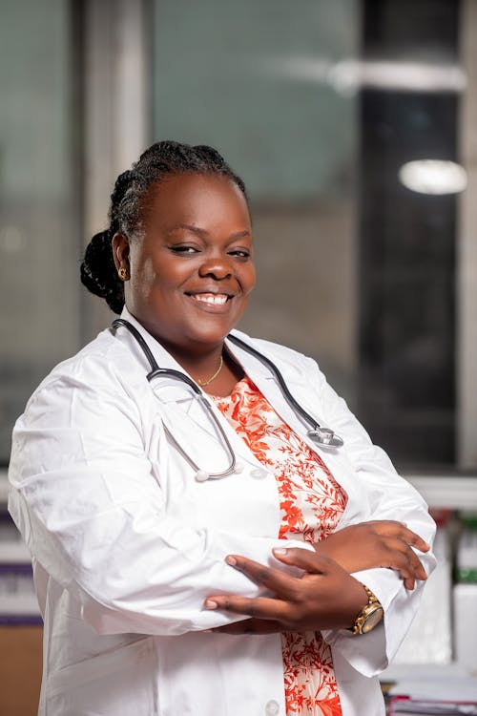
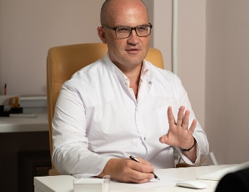


All about medicines
If I’m already taking medicine that my doctor prescribed, is it ok if I take another substance that someone recommended to me?
I’ve been suffering with bad hay fever for the last few months. If I go to the pharmacy, can I buy something to help me?
My mum has a prescription that she can’t pick up on her own. Can I pick it up for her?
I saw an advert for a tablet that said it was ‘over-the-counter’. Does that mean I need to speak to a pharmacist, and they get it from behind their counter?
Notes:
Teacher notes – All about medicines (15 mins, slides 13-17)
In pairs, ask students to read the information from healthcare professionals on Resource 2: All about medicines.
Then, using the frequently asked questions on the slide, ask pairs to take turns to play a young person asking each question, and a professional providing a response, swapping roles for each question.
Ask volunteers to share their responses, before sharing the key learning on slides 14-17.
Support: Ask students to use the key term bank on Resource 2a: All about medicines – key terms, to help them respond to the FAQs.

Slide 14
All about medicines
“If I’m already taking medicine that my doctor prescribed, is it ok if I take another substance that someone recommended to me?”
Don’t mix or combine medicines or other substances unless advised to by a healthcare professional, as they can react negatively with each other or give a harmful dose.
Always carefully follow instructions given by a medical professional when using prescribed medicine.
Tell medical professionals about any other substances being taken, including ‘over-the-counter’ medicines, herbal medicines, vitamins or supplements. Different substances can interact with each other, reducing how effective they are or causing a negative reaction.
Notes:
Teacher notes – All about medicines (15 mins, slides 13-17)

Slide 15
All about medicines
“I’ve been really suffering with bad hay fever for the last few months. If I go to the pharmacy, can I buy something to help me?”
Pharmacists can sometimes prescribe and give advice about medicines to treat certain conditions, for example, to help relieve severe allergies.
If someone has a condition that needs more serious treatment, or is long term, a pharmacist can advise them about who to speak to, for example, a GP.
Notes:
Teacher notes – All about medicines (15 mins, slides 13-17)

Slide 16
All about medicines
“My mum has a prescription that she can’t pick up on her own. Can I pick it up for her?”
If someone can’t collect their own prescription, they can arrange for someone to pick this up for them.
If a young carer needs to collect a prescription for a family member, they should check that the pharmacy will allow someone under the age of 18 to collect a prescription.
The pharmacist or GP surgery will ask questions to check that the prescription is going to the right person, or they might check for proof of ID if the medicine is a controlled substance (a more powerful drug).
A young person can collect their own prescriptions. Because of patient-doctor confidentiality, this doesn’t need to be shared with a parent/ carer.
Notes:
Teacher notes – All about medicines (15 mins, slides 13-17)

Slide 17
All about medicines
“I saw an advert for a tablet that said it was ‘over-the-counter’. Does that mean I need to speak to a pharmacist and they get it from behind their counter?”
‘Over-the-counter’ medicine refers to any medicine that can be bought legally (i.e. in a shop or supermarket), that does not need a prescription.
Some over-the-counter medicines, e.g. emergency contraception or travel sickness medicine, can be bought without a prescription, but only with a pharmacist’s supervision.
If someone buys this type of medicine through an online pharmacy, the pharmacist will need to call the person to make sure the medicine is being used safely.
It is always important to check the pharmacy is registered to the General Pharmaceutical Council.
Notes:
Teacher notes – All about medicines (15 mins, slides 13-17)

Slide 18



Getting help
Read the continued conversation between Paddy and Lexi with your partner and answer the questions that follow.
Notes:
Teacher notes – Getting help (15 mins, slides 18-19)
Reminding students of Lexi and Paddy from the baseline assessment, ask them to read the next part of their conversation on Resource 3: Getting help, in pairs, and answer the questions on the sheet.
Support: Ask students to look at the sources of information about medicines on Resource 3a: Getting help - alternative and rank them according to how reliable each source would be for gathering information about medicines and prescriptions, considering any potential risks of using these.
Challenge: Ask students to script the beginning of a conversation between Lexi and a healthcare professional, such as a GP or mental health nurse.

Slide 19
Getting help
If Lexi buys medicines from an unregulated shop online, it isn’t guaranteed that these will be effective or safe. If the contents of the substances aren’t known, her body might react negatively to them.
For Lexi to receive the help that she needs, she should contact a GP. She can do this online, on the phone, face-to-face, or with the help of a trusted adult.
The most reliable source of information about medicines is from a healthcare professional, which can include checking the NHS website.
Notes:
Teacher notes – Getting help (15 mins, slides 18-19)
Take feedback, using Resource 3b: Getting help – answers and the slide to guide discussion and draw out key learning.
During discussion, acknowledge that waiting lists for appointments with GPs and other specialists can prevent someone from getting the help they need straight away, but that it is still important to seek this support at the earliest opportunity. While waiting for an appointment, someone might access other support, such as by talking to a friend, as Lexi has, or from a local support service or charity specialising in mental health and wellbeing.
Support: Ask students to look at the sources of information about medicines on Resource 3a: Getting help - alternative and rank them according to how reliable each source would be for gathering information about medicines and prescriptions, considering any potential risks of using these. [For feedback and key learning on this, see Q5 on Resource 3b: Getting help – answers.]
Challenge: Ask students to script the beginning of a conversation between Lexi and a healthcare professional, such as a GP or mental health nurse.

Slide 20

Information relay!
Pair one: Take two minutes to read the information on the sheet.
Pair two: What clues can you take from the prompts below?
Why is it important to carefully follow instructions when taking medicine?
How can someone tell whether an online pharmacy is safe?
How can someone talk to a GP?
What other ways can someone access medical help?
Two minutes
Notes:
Teacher notes – Information relay (10 mins, slides 20-23)
Separate students into groups of four and explain that they are going to complete an ‘information relay’. In each group, ask one pair of students to take two minutes to read the information on Resource 4: Accessing prescription medicine, explaining how to safely access prescriptions or other medicines. [CLICK TO START ON-SCREEN TIMER]
The other pair should look at the prompts on the slide to help them prepare for what the information relayed to them next might be.

Slide 21
Information relay!
Pair one: Take two minutes to relay the information to pair two.
Pair two: Note down any key terms and phrases you think are important. Don’t look at the resource!
Two minutes
Notes:
Teacher notes – Information relay (10 mins, slides 20-23)
Once two minutes has passed, ask the first two students to explain the key ideas to the second pair in the group, taking two minutes to complete this step [CLICK TO START ON-SCREEN TIMER]. They can use the sheet to help them. The second pair should note down any key terms or phrases that help explain how to safely access prescription medicine, or how to seek support about using medicines or other substances, without looking at Resource 4.

Slide 22
Information relay!
Both pairs: Without looking at the information sheet or your notes, write down as many key points as you can remember about how someone can safely access medicine or seek support.
One minute
Notes:
Teacher notes – Information relay (10 mins, slides 20-23)
Then, ask students to put Resource 4 and their notes to the side and work in their groups of four to explain what someone can do to safely access medicine or seek support, by writing all they can remember on post-it notes. They should take no more than 60 seconds to do this [CLICK TO START ON-SCREEN TIMER].
Challenge: Ask students to organise the information into three to five top tips that a young person can remember when looking for help and support in relation to using medicines.

Slide 23
Information relay!
Share what information you can remember – be careful not to repeat what others have said!
Why is it important to carefully follow instructions when taking medicine?
How can someone tell whether an online pharmacy is safe?
How can someone talk to a GP?
What other ways can someone access medical help?
Notes:
Teacher notes – Information relay (10 mins, slides 20-23)
When they have finished, ask each group to feedback one key piece of information from their post-it notes to the class, eliminating any groups who repeat what another group has said. Continue to ask students to feed back until one group remains, or they have relayed all of their information.
Finally, ask students to use Resource 4 and their notes to check that they have not made any mistakes or missed any important information, such as how to check if a pharmacy is registered with the General Pharmaceutical Council, or calling 999 or 111 for medical assistance.
Challenge: Ask students to organise the information into three to five top tips that a young person can remember when looking for help and support in relation to using medicines.

Slide 24
Reviewing our learning
Add any new learning that you can to your answers from the beginning of the lesson.
Learning outcomes
We will be able to:
describe differences between prescribed and over-the-counter medicines
explain how to safely access prescription medicine
evaluate reliable sources of information about substances
explain how someone can seek support if they are concerned about substances that they, or others they know, have used
Notes:
Teacher notes – Endpoint assessment and reflection (10 mins, slides 24-26)
Remind students of the learning outcomes for the lesson and ask them to return to the baseline assessment and add any new learning, using these as a prompt.

Slide 25

Reviewing our learning
Write some advice to Lexi from a doctor’s perspective, making sure to include:
the difference between prescription and ‘over-the-counter’ medicine
why it is important to only use prescription medicine if it has been given by a healthcare professional
how to access safe and reliable information about substances, including medicines
how Lexi can get help and support
Notes:
Teacher notes – Endpoint assessment and reflection (10 mins, slides 24-26)
Then, ask them to imagine they are a doctor, writing advice to Lexi. Their advice should include:
the difference between prescription and ‘over-the-counter’ medicine
a clear explanation of why it is important to only use prescription medicine if it has been given by a healthcare professional
how to access safe and reliable information about substances, including medicines
how Lexi could get further help and support.

Slide 26

Reflecting on our learning
Choose one question to reflect on for today’s lesson:
If I need help or advice about medicines in the future, who can I go to for support?
If I’m experiencing difficulties or challenges with my health, what can I do?
Notes:
Teacher notes – Endpoint assessment and reflection (10 mins, slides 24-26)
Ask students to reflect on one of the following questions, either thinking to themselves or writing an answer:
If I need help or advice about medicines in the future, who can I go to for support?
If I’m experiencing difficulties or challenges with my health, what can I do?
As this is a personal reflection activity, students do not need to share their answers with anyone else.

Slide 27


Sources of support
For further advice, guidance and support related to substance use:
Speak to a member of staff in school such as your form tutor, head of year, school nurse, or a member of the safeguarding team
Visit your GP or www.111.nhs.uk, or phone 111
Visit Childline - www.childline.org.uk; or phone on 0800 1111
Visit FRANK at www.talktofrank.com/get-help/find-support-near-you to find local support services
Visit www.nhs.uk/conditions/medicines-information for information about medicines from the NHS
Check GPC-registered pharmacies in Britain using www.pharmacyregulation.org/registers
I need your help with something . . .
Something's worrying me,
can I talk to you?
I have something that’s been bothering me . . .
Notes:
Teacher notes – Signposting support (3 mins)
If time allows, answer any questions from the question box that are appropriate to answer in front of the class. If students have written their names, keep the answers anonymous.
Remind students how they can access further advice, guidance and support related to medicines or substance use, including:
Speak to staff in school such as their form tutor, head of year, school nurse, or a member of the safeguarding team
Visit their GP or www.111.nhs.uk, or phone 111
Visit Childline, which can be contacted by young people under 19, at www.childline.org.uk; or by phone on 0800 1111
Visit FRANK at www.talktofrank.com/get-help/find-support-near-you to find local support services
Visit www.nhs.uk/conditions/medicines-information for information about medicines from the NHS
Check GPC-registered pharmacies in Britain using www.pharmacyregulation.org/registers

Slide 28

Infobite
Create a short informative campaign, aimed at 16 to19 year-olds, about accessing medicines, or information about medicines, safely.
This might be through a recorded podcast extract, a mock-up of a social media post, or a short video.
Notes:
Teacher notes – Extension activity
Ask students to use the information from the final activity in the lesson to create a short informative campaign, aimed at 16 to19 year-olds, about accessing medicines, or information about medicines, safely. This might be through a recorded podcast extract, a mock-up of a social media post, or a short video.

