Slide 1
Drug education
Keeping safe
KS5/Post-16: Lesson 4

Slide 2
Using this PowerPoint
The slides in this presentation are divided into two sections:
Teacher slides (purple) – provide key information regarding lesson preparation.
Student slides – provide a visual focus point for students during the lesson and delivery notes for teachers about the activities. Click ‘notes’ to view these.
Ensure that you select ‘Use Presenter View’ under the ‘Slide Show’ tab – this will allow you to preview the teaching notes on your monitor while the main presentation is displayed on a screen/smartboard.

Slide 3
Support and challenge
The lesson includes suggestions for challenge and support activities, to help you differentiate appropriately for your class.
Support activities are adapted to be more accessible for those who need it.
Challenge activities deepen and extend learning for those who need more challenge or who finish the activity quickly.
Look for these icons on the student slides. See delivery notes for details of the activities.
Challenge
Support

Slide 4
Context
This is the fourth of five lessons for key stage 5 on understanding the risks and consequences of substance use and making informed decisions about alcohol and other drugs.
This lesson explores how to maintain personal safety in situations involving alcohol or other drugs, including how to help friends to stay safe and ask for help.

Slide 5
Developing subject knowledge
Key information on content related to these lessons can be found in the key stage 5 Knowledge Organiser.
Advice on safe practice, dispelling common misconceptions, visitors to the classroom and other important information can be found in Teacher Guidance: Drug and alcohol education.
Data sources to inform your planning can be found in our document that outlines the approach of these lessons: Evidence Review: Effective drug and alcohol education.

Slide 6
To learn how alcohol and other drugs can affect personal safety.
Students will be able to:
identify signs that someone’s personal safety may be at risk, in situations involving alcohol and other drugs
identify barriers to asking for help when personal safety is at risk, and explain how to overcome these
evaluate strategies to help stay safe when using alcohol or other drugs

Slide 7
Box or envelope for questions
Resource 1: Staying safe [1 per student]
Resource 2: House party [1 per pair]
Resource 2a: House party – hints [support option, as required]
Resource 2b: House party – answers [1 teacher copy]
Resource 3: Keeping friends safe [1 per pair]
Resource 4: A night out [1 per group]
Notes:
It is important to be vigilant to any potential victim blaming during student feedback in this lesson. Students should be challenged in a supportive way, and encouraged to consider the impact victim-blaming language can have on others. See page 4 in the teacher guidance document for more on challenging victim blaming.

Slide 8
Lesson summary
Activity | Description | Timing
Introduction | Introduce the learning objective and outcomes and revisit ground rules. | 2 mins
Baseline assessment | Students respond to questions about how someone can keep themselves or someone else safe. | 5 mins
Identifying a problem | Pairs identify potential risks or concerns relating to personal safety and suggest possible solutions. | 15 mins
Staying safe together | Pairs evaluate how a young person might encourage a friend to make safer decisions relating to alcohol and travel. | 10 mins
Safety strategies | Groups consider possible challenges a young person might face when asking for help related to personal safety and assess the benefits of speaking to a trusted adult. | 10 mins
Reflection and endpoint assessment | Students return to the baseline assessment and add new learning , before creating a plan that someone can use to keep themselves safe. | 15 mins
Signpost support | Respond to student questions and remind them how to access further advice, guidance and support, in relation to substance use. | 3 mins

Slide 9
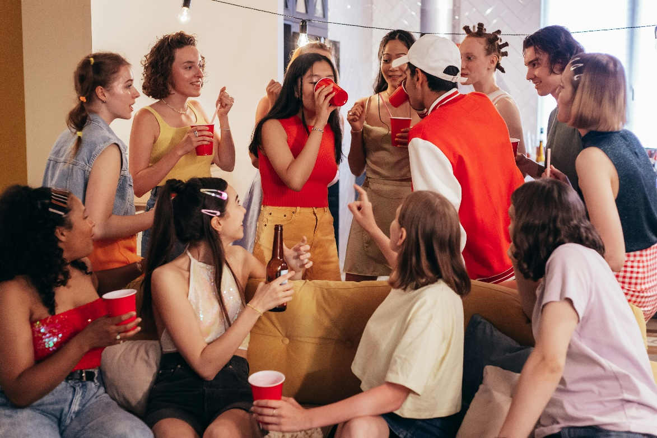
Keeping safe
Lesson 4

Slide 10
To learn how alcohol and other drugs can affect personal safety.
We will be able to:
identify signs that someone’s personal safety may be at risk, in situations involving alcohol and other drugs
identify barriers to asking for help when personal safety is at risk, and explain how to overcome these
evaluate strategies to help stay safe when using alcohol or other drugs
Notes:
Teacher notes – Introduction (2 mins, slides 10-11)
Introduce the learning objective and outcomes. Explain that today’s lesson will explore personal safety in situations involving alcohol or other drugs, including helping friends to stay safe, and how to ask for help.

Slide 11
Notes:
Teacher notes – Introduction (2 mins, slides 10-11)
Revisit ground rules for the lesson and remind students of the question box.

Slide 12
Staying safe
What signs or symptoms could others notice, that indicate that the person in the scenario doesn’t feel well, or isn’t safe?
If the person who is not feeling well is worried about asking for help, what could help them to do this safely?
What could someone do to help if the person became unwell after using alcohol or other drugs?
What could someone do to help the person to stay safe?
“I don’t feel great. I can’t see my friends anymore and everything is so loud. I really need to sit down, I’m so tired. This person keeps trying to get me a drink and I’m just not interested. How am I going to get out of here?”
Notes:
Teacher notes – Baseline assessment (5 mins)
Using Resource 1: Staying safe, ask students to read the speech bubble and consider the situation the character might be in, before responding to the questions below. As this is a baseline assessment, they should do this independently without discussing their answers with their peers.
While students complete the activity, circulate the classroom to assess their understanding of what someone might do to help themselves or others to stay safe in a situation involving alcohol or other drugs. If students show less confidence in answering the first two questions, you may want to spend more time on the first core activity, ensuring they understand signs that someone feels uncomfortable, unsafe, or unwell in a situation involving alcohol or other drugs, and how they can get help. If they show less confidence answering the last two questions, you may want to spend more time on the second and third core activities.
When students have completed the activity, ask them to put these to the side and explain that they will return to them at the end of the lesson.

Slide 13
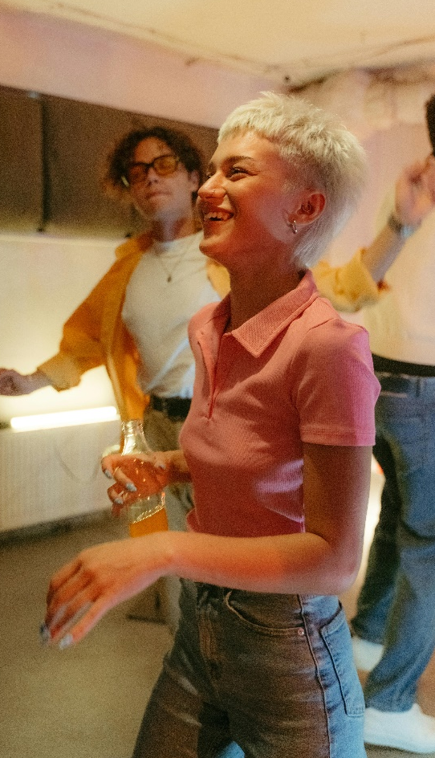
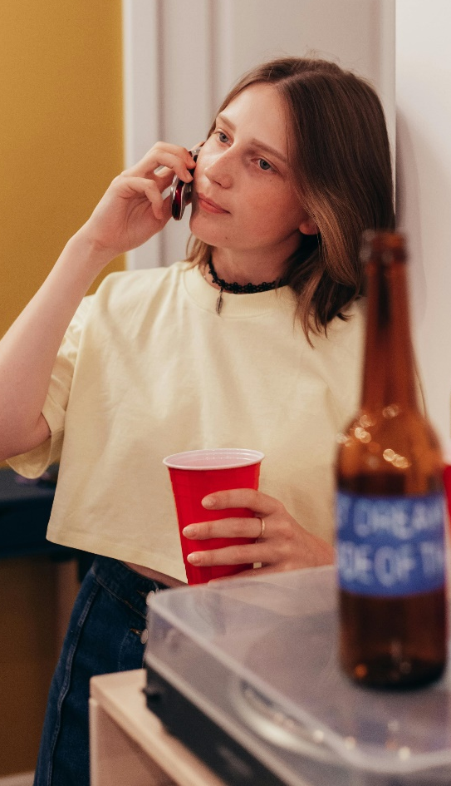
Identifying a problem
Notes:
Teacher notes – Identifying a problem (15 mins, slides 13-14)
Explain that these characters are at a party where there are alcohol or other drugs.
Using Resource 2: House party, ask them to work in pairs to complete the table. They should describe any signs that might show the characters are unwell, unsafe or uncomfortable, as well as identify any risks to the characters’ wellbeing and safety, before explaining what the characters, or their friends, could do to help.
Support: Ask students to use Resource 2a: House party – hints to match potential solutions to the different characters in the scenario, recommending strategies that each person might find most helpful.
Challenge: Ask students to write a short script for what one of the characters could say to ask someone for help or express they don’t feel comfortable, or what another person could say to help one of the characters.

Slide 14
Whatever I took earlier is making me feel weird. I’m so thirsty but I’ve had so much water!
If I finish this drink, I’m not going to keep it down… I want to go home.
I lost my phone. I don’t think I’ll hear it ringing over all the music…
Is this my drink? I think I picked up the right one.
I’ve tried to tell everyone to slow down, but no one’s listening to me. I don’t drink and this game is making me uncomfortable.
Notes:
Teacher notes – Identifying a problem (15 mins, slides 13-14)
Ask volunteers to share their ideas, using Resource 2b: House party – teacher notes to guide feedback. Ensure any victim blaming is challenged (see ‘Climate for learning’ above and p.4 of the teacher guidance document).
During feedback, explain that if a person has consumed alcohol or other drugs without their knowledge or consent (including if they have experienced pressure to do this), they are not at fault. It is important to use strategies that help to stay safe and vigilant, for example, those on Resource 2b, however, the act of ‘spiking’ is a criminal offence, where someone who causes another person to consume alcohol or other drugs without their knowledge or consent is fully responsible for this action.

Slide 15
Staying safe together
Use the ‘diamond 9’ to evaluate strategies that could help Kiran to keep Morgan safe.
Morgan
Kiran
Notes:
Teacher notes – Staying safe together (10 mins)
Explain that, building on the ways that people might help themselves or others to stay safe, they are now going to consider how someone might encourage or support others to make safe and responsible decisions.
Use the slide to introduce Kiran and Morgan, two more characters from the party. Towards the end of the night, Kiran sees his friend Morgan with car keys in her hand. Morgan said she wasn’t planning to have any alcohol, but he has seen her with a bottle at different points in the evening. Kiran isn’t sure how many drinks Morgan has had. She mentions that she will leave soon, as she needs to get the car back home.
Give pairs Resource 3: Keeping friends safe and ask them to decide what Kiran should do next, creating a ‘diamond 9’ with the strategies. The card at the top should be the strategy they think would be most effective, the cards in each middle row strategies that would be equally effective, and the card at the bottom the least effective. If students can identify their own strategies, they might add these too.
Take feedback, drawing out key learning:
If a friend is making a decision that could put themselves, or others, at risk of harm, it is important to take action to intervene to lessen the risks, such as challenging a friend who has drunk alcohol and intends to drive.
Asking others for support may help if challenging a friend is difficult. Using techniques such as humour, while remaining honest, can help to diffuse any tension in the situation.
Suggesting safe and responsible options, such as finding another way home, rather than focusing only on the risks of someone’s actions, can help to empower others to make a positive decision.
Support: Ask students to consider what might make it hard for Kiran to suggest to Morgan that she doesn’t drive home and use Resource 3: Keeping friends safe to pick one strategy Kiran can use to help him overcome this barrier.
Challenge: Ask students to consider another situation, where Kiran notices that Morgan’s behaviour has changed over the night, with her words and actions becoming slower or slurred. Morgan says that she wants to leave the party and walk home on her own. What might Kiran do to make sure that Morgan is safe?

Slide 16
A night out
“I don’t feel great. I can’t see my friends anymore and everything is so loud. I really need to sit down, I’m so tired. This person keeps trying to get me a drink and I’m just not interested. How am I going to get out of here?”
Notes:
Teacher notes – Safety strategies (10 mins, slides 16-18)
Remind students of the scenario from the baseline assessment, showing a scene at a nighttime venue. Explain that now they will be thinking about what others can do if someone is out, possibly in a less familiar setting, and needs help because they are feeling unwell, they are uncomfortable, or they feel someone is behaving inappropriately toward them.
In small groups, give students Resource 4: A night out, and explain that this shows four potential sources of support someone could turn to if they needed help (also on the next two slides).

Slide 17
A night out
It’s my job to make sure people are acting safely on the streets. If someone starts to feel unwell on their way home from a night out, it’s important they ask someone for help. An identifiable police officer can help make sure they get on their way safely, or get medical attention if they need it. If someone wants to check an officer’s identify, they can call 101 or asking to see their warrant card.
If my child is out and starts to feel unwell, they can call or message me to let me know where they are. I might be a little annoyed, but I would rather know they’re safe!
Notes:
Teacher notes – Safety strategies (10 mins, slides 16-18)
Ask groups to examine each of the sources of help and support. They should consider what challenges or barriers might stop a young person asking for help from each of them, and what the benefits of asking for help might be.
Ask groups to share points from their discussion.
Students might suggest:
Asking a police officer: A challenge might be that different people have varying levels of comfort approaching a police officer, or they might be worried if they have consumed illegal substances. A benefit might be that a police officer can help to make sure the young person doesn’t encounter any harm from others and can help to assess if they need medical help .
Asking a security guard (bouncer): A challenge might be that if the security guard is positioned outside, it might be harder to ask them for help if the young person is inside the venue. Some young people might feel too intimidated to approach a security guard. A benefit is that security guards can help to communicate with other members of bar staff if there is a problem, for example, if someone’s inappropriate behaviour means they need to be removed from the venue.
Asking a parent or trusted adult: A challenge might be that a young person may feel embarrassed to call a parent or another trusted adult, or they might want to avoid getting in trouble. However, a benefit is that a trusted adult can help to make sure that the young person gets home safely and help to care for them if they are feeling unwell. Before going out, the young person might plan a safe location to meet a trusted adult if they feel unsafe or uncomfortable. They might also research local ‘safe havens’ that a person can visit if they feel worried while out at night, where volunteers and staff are available to help.
Asking a member of staff: If the venue is busy, it might feel challenging to get the attention of a member of staff. Someone might feel unsure of what the member of staff can do. A benefit of talking to a member of staff at the bar is that many are trained to identify the signs or symptoms that someone has become unwell and can help to make sure that they don’t consume any further alcohol or other drugs. In venues that run schemes like ‘Ask for Angela’, staff are trained to make sure that if anyone feels concerned or worried that they are not safe, they can approach them safely (for example, by using a code phrase/word, rather than having to say explicitly what the problem is while they may still be at risk of harm from another person). Staff can then get them any help they need. They might also be able to help in other ways, for example by providing a phone charger, if someone can’t use their phone or doesn’t have a portable charger.
Ask students to ‘think-pair-share’ which of the sources of support they would recommend the character turn to and why, being ready to share their answers with the class. Take answers and draw out that whichever source of support the character turns to, asking for help or support or communicating that they feel safe or unwell is a safe and responsible decision to make.
Challenge: Encourage students to add any other sources of help and support the character could turn to, and explain how they might help.

Slide 18
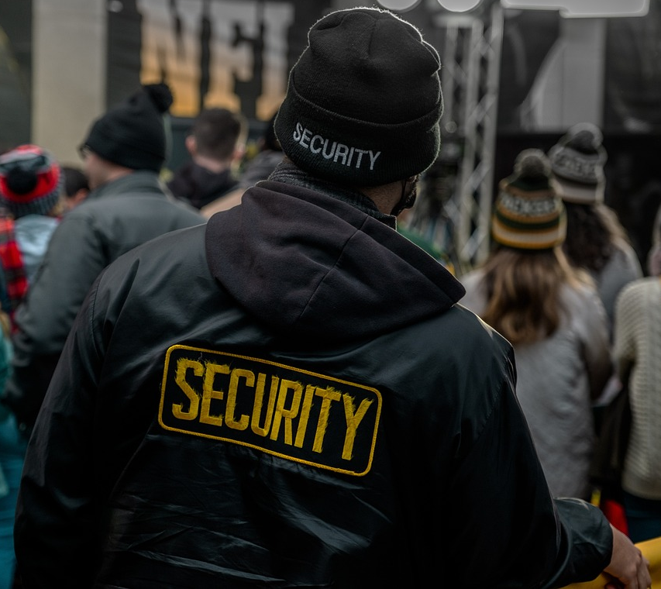
A night out
If someone thinks another person is behaving inappropriately, they can let me know and I’ll work with my colleagues to monitor the situation and take steps to maintain a safe environment.
If someone thinks they’re not safe, has drunk or taken something they aren’t sure about, or if someone is pressuring them, they can talk to someone at the bar. Lots of bars will have a code like ‘Ask for Angela’, which someone can use to let us know they feel unsafe and need our help.
Notes:
Teacher notes – Safety strategies (10 mins, slides 16-18)
Ask groups to examine each of the sources of help and support. They should consider what challenges or barriers might stop a young person asking for help from each of them, and what the benefits of asking for help might be.
Ask groups to share points from their discussion.
Students might suggest:
Asking a police officer: A challenge might be that different people have varying levels of comfort approaching a police officer, or they might be worried if they have consumed illegal substances. A benefit might be that a police officer can help to make sure the young person doesn’t encounter any harm from others and can help to assess if they need medical help .
Asking a security guard (bouncer): A challenge might be that if the security guard is positioned outside, it might be harder to ask them for help if the young person is inside the venue. Some young people might feel too intimidated to approach a security guard. A benefit is that security guards can help to communicate with other members of bar staff if there is a problem, for example, if someone’s inappropriate behaviour means they need to be removed from the venue.
Asking a parent or trusted adult: A challenge might be that a young person may feel embarrassed to call a parent or another trusted adult, or they might want to avoid getting in trouble. However, a benefit is that a trusted adult can help to make sure that the young person gets home safely and help to care for them if they are feeling unwell. Before going out, the young person might plan a safe location to meet a trusted adult if they feel unsafe or uncomfortable. They might also research local ‘safe havens’ that a person can visit if they feel worried while out at night, where volunteers and staff are available to help.
Asking a member of staff: If the venue is busy, it might feel challenging to get the attention of a member of staff. Someone might feel unsure of what the member of staff can do. A benefit of talking to a member of staff at the bar is that many are trained to identify the signs or symptoms that someone has become unwell and can help to make sure that they don’t consume any further alcohol or other drugs. In venues that run schemes like ‘Ask for Angela’, staff are trained to make sure that if anyone feels concerned or worried that they are not safe, they can approach them safely (for example, by using a code phrase/word, rather than having to say explicitly what the problem is while they may still be at risk of harm from another person). Staff can then get them any help they need. They might also be able to help in other ways, for example by providing a phone charger, if someone can’t use their phone or doesn’t have a portable charger.
Ask students to ‘think-pair-share’ which of the sources of support they would recommend the character turn to and why, being ready to share their answers with the class. Take answers and draw out that whichever source of support the character turns to, asking for help or support or communicating that they feel safe or unwell is a safe and responsible decision to make.
Challenge: Encourage students to add any other sources of help and support the character could turn to and explain how they might help.

Slide 19
Reviewing our learning
Look back at your answers from the beginning of the lesson.
Thinking about the learning outcomes for this lesson, in a different colour pen, add any new learning that you can, and correct any answers you need to.
Learning outcomes
We will be able to:
identify signs that someone’s personal safety may be at risk in situations involving alcohol and other drugs
identify barriers to asking for help when personal safety is at risk, and explain how to overcome these
evaluate strategies to help stay safe when using alcohol or other drugs
Notes:
Teacher notes – Endpoint assessment and reflection (15 mins, slides 19-22)
Ask students to return to the questions from Resource 1: Staying safe. Remind them of the learning outcomes, and reflecting on these, ask them to now add any new learning that they can, or correct any answers where they need to, using a different colour pen.

Slide 20
Reviewing our learning
Choose one character who we have looked at today, and create a plan they can follow to stay safe when out alone or with friends.
Including the following information:
Signs or symptoms that they might need to leave an unsafe situation, or need help or support
Who/where they can access help
Strategies they can use to ask for help or to reach a safe location
Notes:
Teacher notes – Endpoint assessment and reflection (15 mins, slides 19-22)
Then, ask students to choose one character from those they have looked at across the activities from the lesson, and using the prompts on the slide, write a short plan of action that the character can use to manage the situation safely, including which of the sources of support they could turn to, and what they might do to get home.

Slide 21
Top tips for staying safe
Stay hydrated – regularly drink water or non-alcoholic drinks, especially if drinking alcohol.
Don’t leave drinks unattended or accept drinks from others, without seeing the drink being prepared.
Support friends and help them stay safe, e.g. by helping them get home/putting them in the recovery position/getting help if they need medical attention.
Use exit strategies if feeling uncomfortable in a social situation involving alcohol or other drugs.
Plan routes and check these are running before returning home.
Notes:
Teacher notes – Endpoint assessment and reflection (15 mins, slides 19-22)
Take feedback from volunteers, using the slide to remind students of key learning from this lesson.

Slide 22
Reflecting on our learning
What is a plan of action that you could use in the future to keep you, or a friend, safe in a situation involving alcohol or other drugs?
Notes:
Teacher notes – Endpoint assessment and reflection (15 mins, slides 19-22)
Reflecting on this, ask students to then consider a plan of action they could use in future, to help to stay safe if they are in a situation involving alcohol or other drugs. Remind them that this might be for their own safety, or to help friends to stay safe. As this is a personal reflection activity, students do not need to share their answers.

Slide 23
Sources of support
For further advice, guidance and support related to substance use, you can:
Speak to a member of staff in school such as your form tutor, head of year, school nurse, or a member of the safeguarding team
Speak to a trusted adult such as a parent/carer, family member or GP
Visit Childline - www.childline.org.uk; or phone on 0800 1111
Visit your GP or www.nhs.uk/live-well/quit-smoking/nhs-stop-smoking-services-help-you-quit/ for help quitting smoking
Visit FRANK at www.talktofrank.com/get-help/find-support-near-you to find local support services
Visit www.talktofrank.com/get-help/what-to-do-in-an-emergency for information about managing situations where someone may need medical help
I need your help with something . . .
Something's worrying me, can I talk to you?
I have something that’s been bothering me . . .
Notes:
Teacher notes – Signposting support (3 mins)
Answer any questions from the question box that are appropriate to answer in front of the class. If students have written their names, keep the answers anonymous.
Remind students how they can access further advice, guidance and support related to substance use, including :
Speak to staff in school such as their form tutor, head of year, school nurse, or a member of the safeguarding team
Speak to another trusted adult such as a parent/carer, or family member, or visit their GP
Visit Childline, which can be contacted by young people under 19, at www.childline.org.uk; or by phone on 0800 1111
Visit their GP or www.nhs.uk/live-well/quit-smoking/nhs-stop-smoking-services-help-you-quit/ for help quitting smoking
Visit FRANK at www.talktofrank.com/get-help/find-support-near-you to find local support services
Visit www.talktofrank.com/get-help/what-to-do-in-an-emergency for information about managing situations where someone may need medical help

Slide 24
Personal safety plan
Write down your personal safety plan.
You could write it on a small card that can fit in a phone case.
You might include, for example:
emergency contacts
phone numbers of local taxi companies
night bus routes
details of a safe location where help is available.
Notes:
Teacher notes – Extension activity
Ask students to write down their personal safety plan that they considered during the reflection activity. This might be on a small card that can fit into a phone case, for example, with emergency contacts, phone numbers of local taxi companies, night bus routes, or a safe location where help is available.

