Slide 1
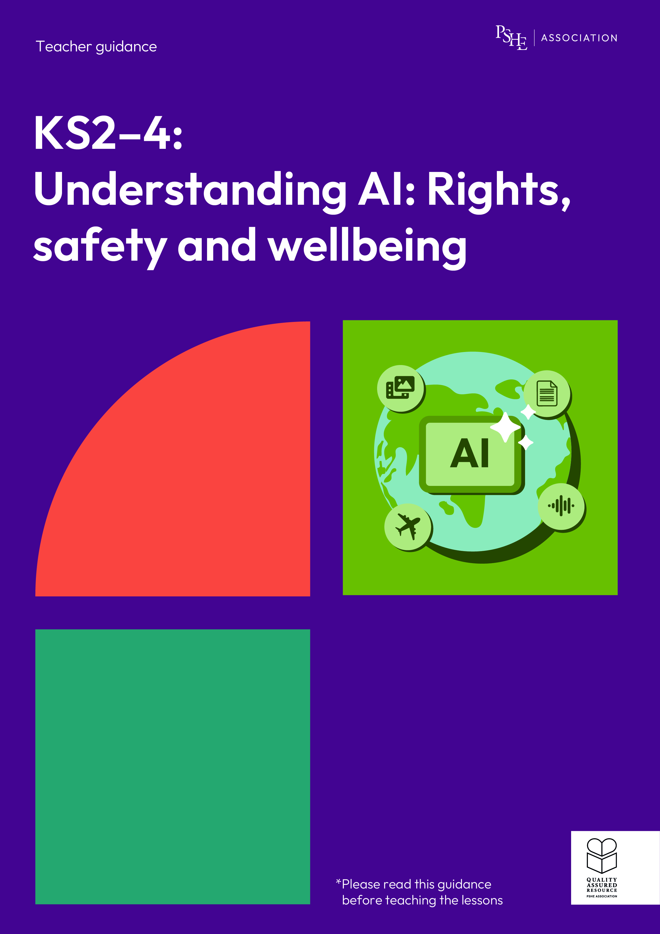
Understanding AI: Rights, safety and wellbeing
Year 9/10, Lesson 2: What are the limitations of generative AI?

Slide 2
Using this PowerPoint
The slides in this presentation are divided into two sections:
Teacher slides (purple) – provide key information regarding lesson preparation.
Student slides – provide a visual focus point for students during the lesson and delivery notes for teachers about the activities. Click ‘notes’ to view these.
Ensure that you select ‘Use Presenter View’ under the ‘Slide Show’ tab – this will allow you to preview the teaching notes on your monitor while the main presentation is displayed on a screen/smartboard.

Slide 3


Support and challenge
The lesson includes suggestions for support and challenge activities, to help you differentiate appropriately for your class.
Support activities are adapted to be more accessible for those who need it.
Challenge activities deepen and extend learning for those who need more challenge or who finish the activity quickly.
Look for these icons on the student slides. See delivery notes for details of the activities.
Challenge
Support

Slide 4
Context
This lesson pack for key stages 2–4 has been designed to support pupils’ AI literacy. This is the second of four lessons for students in years 9 and 10. It explores the limitations of using generative AI tools, including the impact they can have on young people’s rights.
These lessons should not be taught in isolation, but always as part of a planned, developmental PSHE education programme. They are best used within the context of online safety or digital literacy.

Slide 5
To learn about the challenges AI presents to people’s rights and experiences online.
Students will be able to:
identify the rights people have and apply these to decisions when using generative AI tools
explain how generative AI tools might put people’s rights at risk
describe individual and organisational strategies to manage the use of generative AI responsibly

Slide 6
Box or envelope for questions
Flipchart paper and pens
Resource 1: Children’s rights
[one cut-up set per class]
Resource 1a: Which right?
[support option as required]
Resource 2: Which right?
[support option as required]
Resource 3: Strategies
[one cut-up set per group]
Resource 3a: Helping Marta
[support option as required]

Slide 7
Lesson summary
Activity | Description | Timing
Introduction | Introduce the learning objective and outcomes, set up the question box and revisit ground rules. | 2 min
Baseline assessment activity | Students complete an attitude continuum considering how much they agree or disagree with four statements. | 10 min
Which rights? | Students consider how the use of generative AI might impact different rights. | 10 min
Rights at risk | Pairs identify which rights are put at risk using generative AI in different scenarios. | 10 min
Strategies for using AI | Groups categorise different strategies for using generative AI responsibly, before offering advice to a professional considering implementing the use of generative AI. | 15 min
Endpoint assessment and reflection | Students revisit their attitude continuum and explain any changes or information that has reinforced their previous answers. They also reflect on how they can reduce the impact on their own and others' rights when using generative AI. | 11 min
Signpost support | Answer students’ questions and signpost support. | 2 min

Slide 8
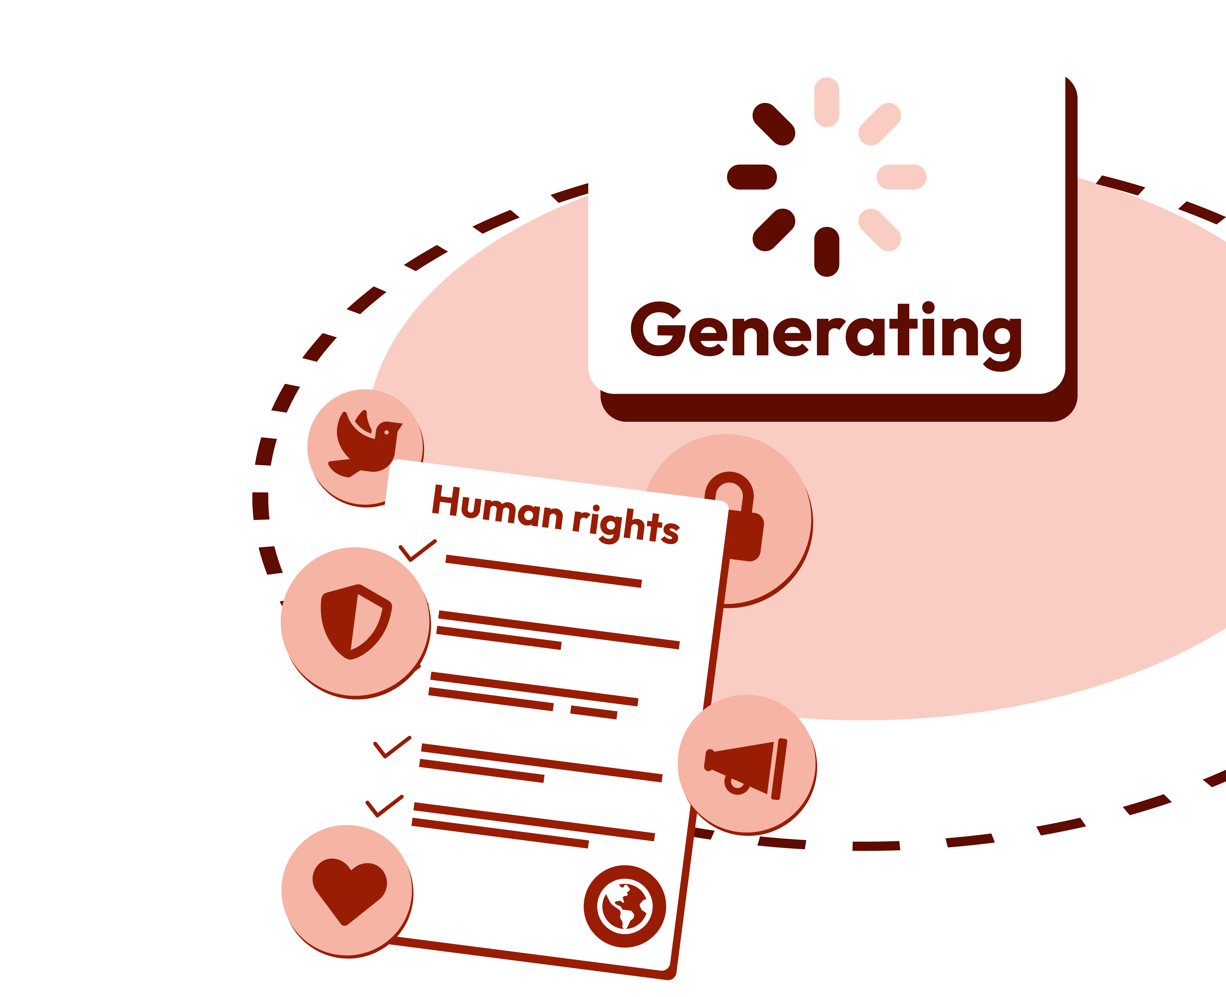
What are the limitations of generative AI?
Lesson 2

Slide 9
Notes:
Teacher notes – Introduction (2 mins, slides 8-10)
Establish or revisit ground rules using the slide. Explain that if students have worries or questions during or after the lesson that they do not want to raise in front of the class, they can write their question on a piece of paper, anonymously or with their name, and put it in the question box.

Slide 10
To learn about the challenges AI presents to people’s rights and experiences online.
We will be able to:
identify the rights people have and apply these to decisions when using generative AI tools
explain how generative AI tools might put people’s rights at risk
describe individual and organisational strategies to manage the use of generative AI responsibly
Notes:
Teacher notes – Introduction (2 mins, slides 8-10)
Introduce the learning objective and outcomes on the slide. Explain that today’s lesson will explore how the use of generative AI could put people’s rights at risk, and strategies to help manage this.

Slide 11

What’s out starting point?
Draw this in your book.
Human rights, such as privacy and freedom from discrimination, should be considered when using generative AI.
Agree
Disagree
Using generative AI could put someone’s rights at risk.
It is down to the developers of AI tools to ensure they are being used responsibly by individuals.
For each statement, decide where on the line you would put the statement to show how much you agree or disagree.
Give a brief reason for each.
Most generative AI tools have not been developed with young people’s rights in mind.
Notes:
Teacher notes – Baseline assessment activity (10 mins)
Using the slide, ask students to draw a line in their books, writing agree at one end and disagree at the other. For each statement, ask them to decide where on the line they would put the statement to show how much they agree or disagree. They should try to provide a brief reason for each.
Circulate during the activity to establish students’ starting points and notice any common themes in their responses. Consider how the lesson may need adapting depending on any gaps or misconceptions identified. For example, if students all disagree that the use of generative AI might put people’s rights at risk, you may want to spend more time exploring this in the second activity.

Slide 12
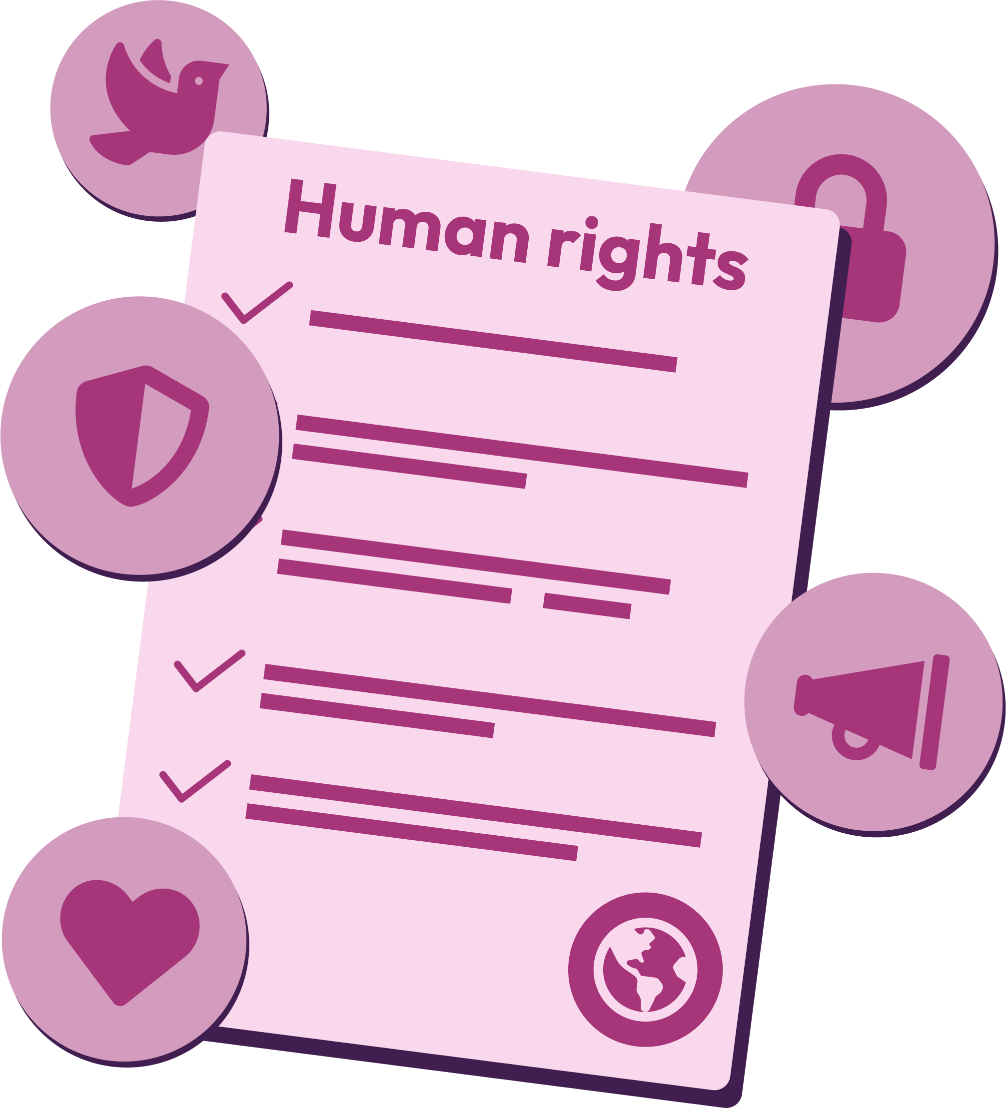
Which rights?
Human rights are the rights and freedoms of every person and are based on the principle of human dignity.
This is the belief that all people have worth and value because they are human. Examples of human rights include the right to life, freedom of expression, and the right to liberty and security. For anyone under 18 there are also specific children’s rights.
Notes:
Teacher notes – Which rights? (10 mins, slides 12-13)
Explain that human rights are the rights and freedoms of every person and are based on the principle of human dignity. This is the belief that all people have worth and value because they are human. Examples of human rights include the right to life, freedom of expression and the right to liberty and security. For anyone under 18 there are also specific children’s rights. The United Nations Convention on the Rights of the Child (UNCRC) contains additional rights for children and young people to protect them from harm, due to their increased vulnerability, and ensure their wellbeing and development. This lesson will focus on four of these:
Article 2 (the right to not be discriminated against)
Article 16 (the right to privacy)
Article 17 (the right of access to information from the media)
Article 28 (the right to education)

Slide 13
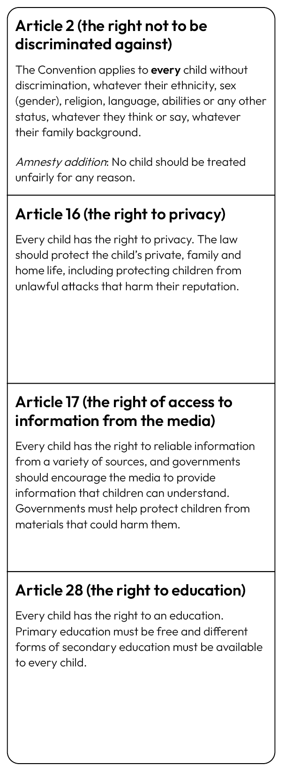



Which right?
Write ideas about how the use of generative AI might impact each right, either positively or negatively.
Article 2 (the right not to be discriminated against)
Article 16 (the right to privacy)
Article 17 (the right of access to information from the media)
Article 28 (the right to education)
Notes:
Teacher notes – Which right? (10 mins, slides 12-13)
Using Resource 1: Children’s rights, attach each of the four rights to a piece of flipchart paper and put them around the room. Ask students to write ideas about how the use of generative AI might impact each right, either positively or negatively.
Review students’ ideas as they add them to each right. When they have finished, summarise their ideas on each right, drawing out the key learning and making sure the following points are covered:
Article 2 (the right to not be discriminated against) – AI tools often include bias in the training data; materials that reinforce harmful views or stereotypes might be generated; AI might recommend choices or actions that discriminate against, or don’t consider the needs of, minority groups.
Article 16 (the right to privacy) - AI tools may collect or use personal data; users may not be aware how the data will be used; privacy breaches could lead to non-consensual content creation (fake images or videos); people might be encouraged to share more private information than they intended to when interacting with AI tools; some AI tools have been used to create content that might embarrass or harm another person’s reputation.
Article 17 (the right of access to information from the media) - AI tools could help summarise complex ideas; it can be difficult to know the difference between real news/images and AI generated ones; the information generated by AI is not always reliable but can appear accurate; AI tools can recreate/produce content that isn’t suitable for young people.
Article 28 (the right to education) – text could be adapted for different reading levels; could support personalised learning; not everyone has the same access to AI tools or electronic devices; they could generate incorrect information; relying on AI tools could impact skill development e.g. critical thinking.
Support: Give students Resource 1a: Which right? and ask them to match each statement to one of the rights around the room.
Challenge: Ask students to discuss which other rights might be affected by the use of generative AI.

Slide 14

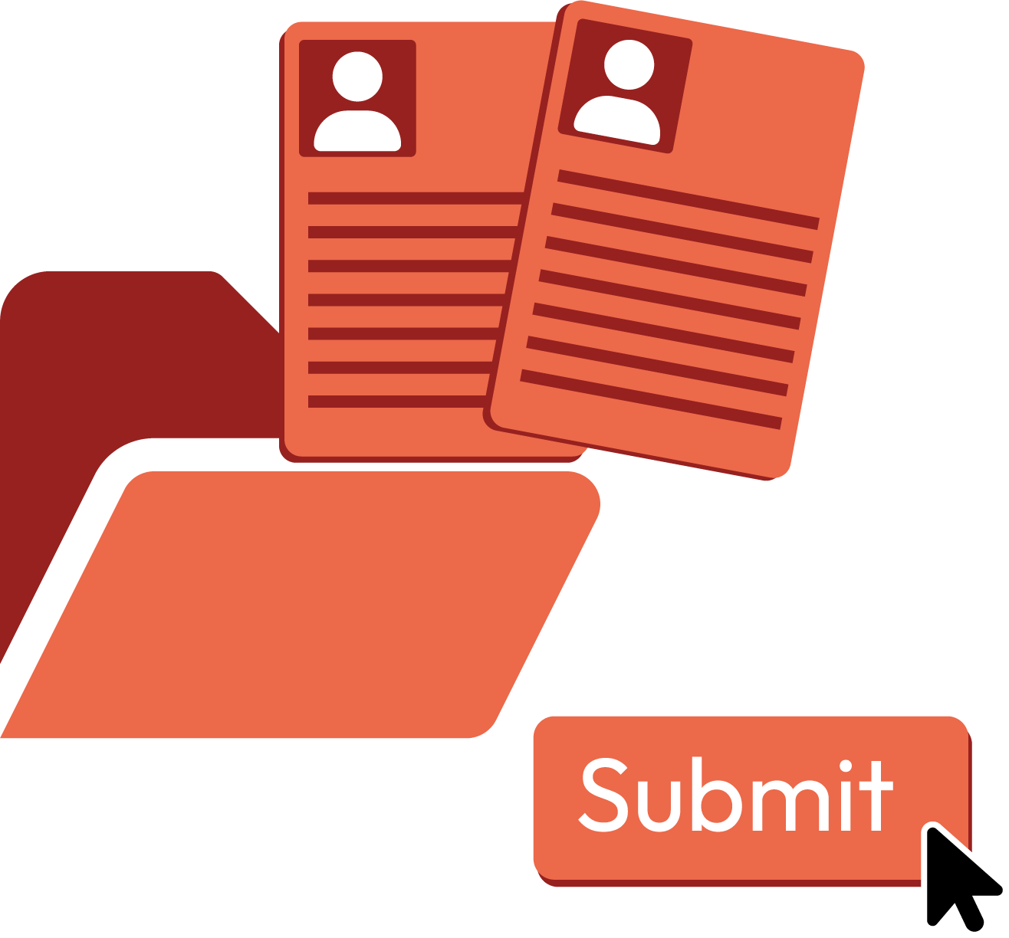




Rights at risk
For each scenario, identify which right could be put at risk and explain how.
A local youth centre uses a generative AI tool to design a new calm space for young people in the local community.
A year 10 student inputs some personal data when using a generative AI tool to get advice about a situation where their friends have broken the law.
A year 11 student struggles with how to start writing essays, so has been using a generative AI tool to write all their homework essays.
A year 9 student has joined the school environmental group and is using a generative AI tool to find out about a recent environmental issue in the local area.
Notes:
Teacher notes – Rights at risk (10 mins, slides 14-18)
Explain that when using generative AI tools, it is important for individuals to consider their own and others’ rights, especially when these tools are being used to make real-world decisions. Due to the nature of all the content on the internet, the type of data used to train generative AI tools, and how these tools are used, can put people’s rights at risk. Share the scenarios on the slide and ask pairs to identify, for each scenario, which right could be put at risk and explain how.
Support: Give students Resource 2: Rights at risk and ask them to match each scenario to the right that could be at risk, and the explanation.
Challenge: Ask students to suggest how the user could try and reduce the impact on people’s rights in each scenario.

Slide 15
Rights at risk
A local youth centre uses a generative AI tool to design a new calm space for young people in the local community.
The right not to be discriminated against.
Bias in the data may mean that specific needs have not been taken into account. For example, the needs of people with autism.
Notes:
Teacher notes – Rights at risk (10 mins, slides 14-18)
Take feedback, using slides 15-18 for support.

Slide 16
Rights at risk
A year 10 student uses a generative AI tool to get advice about a situation where their friends have broken the law.
The right to privacy.
It may not be clear how the information could be kept or used by the tool. Not everyone involved may consent to their information being shared with the tool.
Notes:
Teacher notes – Rights at risk (10 mins, slides 14-18)
Take feedback, using slides 15-18 for support.

Slide 17

Rights at risk
A year 11 student struggles with how to start writing essays, so has been using a generative AI tool to write all their homework essays.
Right to education.
Reliance on generative AI tools could mean the student is not able to develop their own skills and will always find essay writing hard.
Notes:
Teacher notes – Rights at risk (10 mins, slides 14-18)
Take feedback, using slides 15-18 for support.

Slide 18
Rights at risk
A year 9 student has joined the school environmental group and is using a generative AI tool to find out about a recent environmental issue in the local area.
Access to information from the media.
The information could be biased or influenced by local views that could be skewed by social media algorithms. Mis and disinformation are more common when researching recent events.
Notes:
Teacher notes – Rights at risk (10 mins, slides 14-18)
Take feedback, using slides 15-18 for support.

Slide 19
Strategies for using AI
To ensure generative AI is used responsibly, it is important for someone to consider:
Privacy
their own and others’ privacy
Honesty
honesty and transparency about when and how it’s used
Limitations
the limitations (bias, incorrect information, environmental impacts, harmful content)
Critical thinking
AI is a tool and not a replacement for learning or critical thinking
Creativity
it is not a replacement for creativity
Notes:
Teacher notes – Strategies for using AI (15 mins, slides 19-24)
Using the slide, explain that to ensure generative AI is used responsibly, someone should consider:
their own and others’ privacy
honesty and transparency about when and how it’s used
the limitations (bias/incorrect information/environmental impacts/harmful content)
it as a tool and not a replacement for learning, critical thinking, or creativity.
Give groups Resource 3: Strategies and explain that if someone decides to use generative AI, there are different strategies that can help them use it more responsibly.

Slide 20
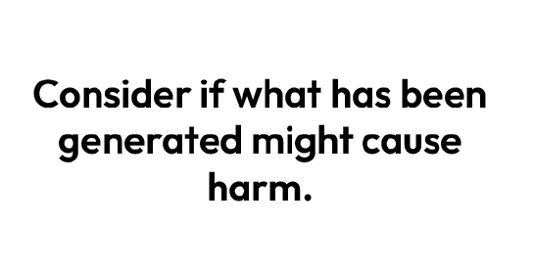
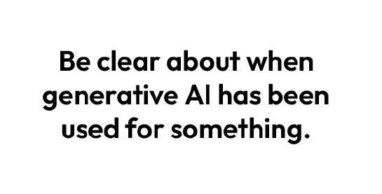
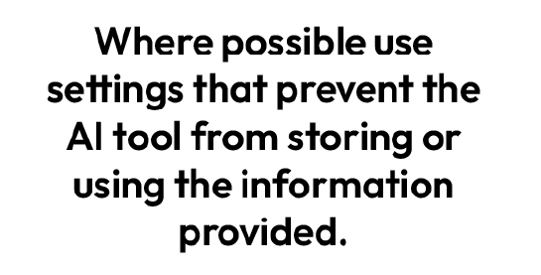
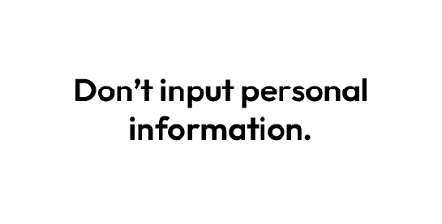
Strategies for using AI
Organise the strategies into the four categories:
Help protect privacy
Ensure honesty and integrity
Consider the limitations
Treat it as a tool
Notes:
Teacher notes – Strategies for using AI (15 mins, slides 19-24)
Show the slide and ask groups to organise the strategies into the four categories: help protect privacy, ensure honesty and integrity, consider the limitations, treat it as a tool.

Slide 21
Strategies for using AI
Consider the limitations
Help protect privacy
Check content for bias.
Don’t input personal information.
Consider if what has been generated might cause harm.
Where possible, use settings that prevent the AI tool from storing or using the information provided.
Users should understand how a generative AI tool works before using it.
Notes:
Teacher notes – Strategies for using AI (15 mins, slides 19-24)
Take feedback, using this and the next slide to support.

Slide 22
Strategies for using AI
Treat it as a tool
Ensure honesty and integrity
Critically review all content generated.
Be clear about when generative AI has been used for something.
Check facts using other reliable sources.
Users should consider if using generative AI is helping them to learn or limiting the development of their skills.
Notes:
Teacher notes – Strategies for using AI (15 mins, slides 19-24)

Slide 23


Strategies for using AI
Marta runs a local youth charity and wants to start using generative AI to help improve efficiency.
She is worried about the impact this might have on the young people they support and employees’ rights.
Notes:
Teacher notes – Strategies for using AI (15 mins, slides 19-24)
Next, explain that it is also important that any organisations that choose to use generative AI in their work also ensure responsible use. Share the scenario on the slide.

Slide 24
Strategies for using AI
Marta is hoping the tool might help with:
new activity ideas for the centre
creating surveys for young people and summarising results
writing grant applications and newsletters.
Advise Marta on what she needs to consider before using a generative AI tool.
How can I ensure I protect people’s privacy when using generative AI?
What can I do to reduce the impact
of bias?
How can I ensure transparency?
How can I ensure my staff and those I support are confident we can use generative AI responsibly as a charity?
Can I improve efficiency without using generative AI?
Notes:
Teacher notes – Strategies for using AI (15 mins, slides 19-24)
Ask students to answer the questions to advise Marta on what she should consider before using any new generative AI tool.
How can I ensure I protect people’s privacy when using generative AI?
What can I do to reduce the impact of bias?
How can I ensure transparency?
How can I ensure my staff and those I support are confident we can use generative AI responsibly as a charity?
Can I improve efficiency without using generative AI?
Take feedback, where students might suggest:
Marta shouldn’t use sensitive or personal information
tools that have been trained on diverse data sets should be used; staff need to be aware of bias; outputs should be reviewed to make sure they meet the diverse needs of the young people
Marta must be open about when and how generative AI is being used with staff and those using the youth centre; she could include when and how it can be used in policies
staff are trained before using generative AI tools; guidance documents on responsible use for staff could be created
templates for grant applications and newsletters could be used; multiple choice questions could be used in surveys to make data easier to review; Marta could gather feedback from staff and the youth centre users on ideas to improve efficiency.
Support: Give students Resource 3a: Helping Marta, with sentence starters to help structure their answers.
Challenge: Ask students to suggest any other strategies that could be used to help ensure generative AI tools are used responsibly.

Slide 25

Reflection
How will you reduce any negative impacts on your rights and the rights of others if you choose to use generative AI?
Notes:
Teacher notes – Reflection (3 mins)
Ask students to reflect on how they will reduce any negative impacts on their rights and the rights of others if they choose to use generative AI. As this is a personal reflection, students do not need to share their responses with the class.

Slide 26

What have we learnt?
Revisit the attitude continuum and consider if any of your previous answers have changed.
Explain any changes or add any new learning that has reinforced your original responses.
Human rights, such as privacy and freedom from discrimination, should be considered when using generative AI.
Using generative AI could put someone’s rights at risk.
It is down to the developers of AI tools to ensure they are being used responsibly by individuals.
Agree
Disagree
Most generative AI tools have not been developed with young people’s rights in mind.
Notes:
Teacher notes – Endpoint assessment (3 mins)
Remind students of the learning outcomes and ask them to revisit the attitude continuum and consider if any of their previous answers have changed. Then, ask them to explain any changes or add any new learning that has reinforced their original responses (using a different colour pen).
.
This is an opportunity for students to demonstrate progress through changes in attitudes or their ability to clearly articulate their opinions, using the lesson content to support them.

Slide 27


Sources of support
If concerned about the use of AI or how it might impact peoples' rights, speak to a trusted adult at home or at school (for example the head of year or form tutor).
Or find information and
advice from:
Childline - www.childline.org.uk; 0800 1111
I need your help with something . . .
Something's worrying me,
can I talk to you?
I have something that’s been bothering me . . .
Notes:
Teacher notes – Signposting support (2 mins)
Remind students that if they have concerns about the use of AI and how it might impact their rights it is important they speak to a trusted adult at home or at school (for example the head of year or form tutor). Students can also contact:
Childline - www.childline.org.uk; 0800 1111

Slide 28
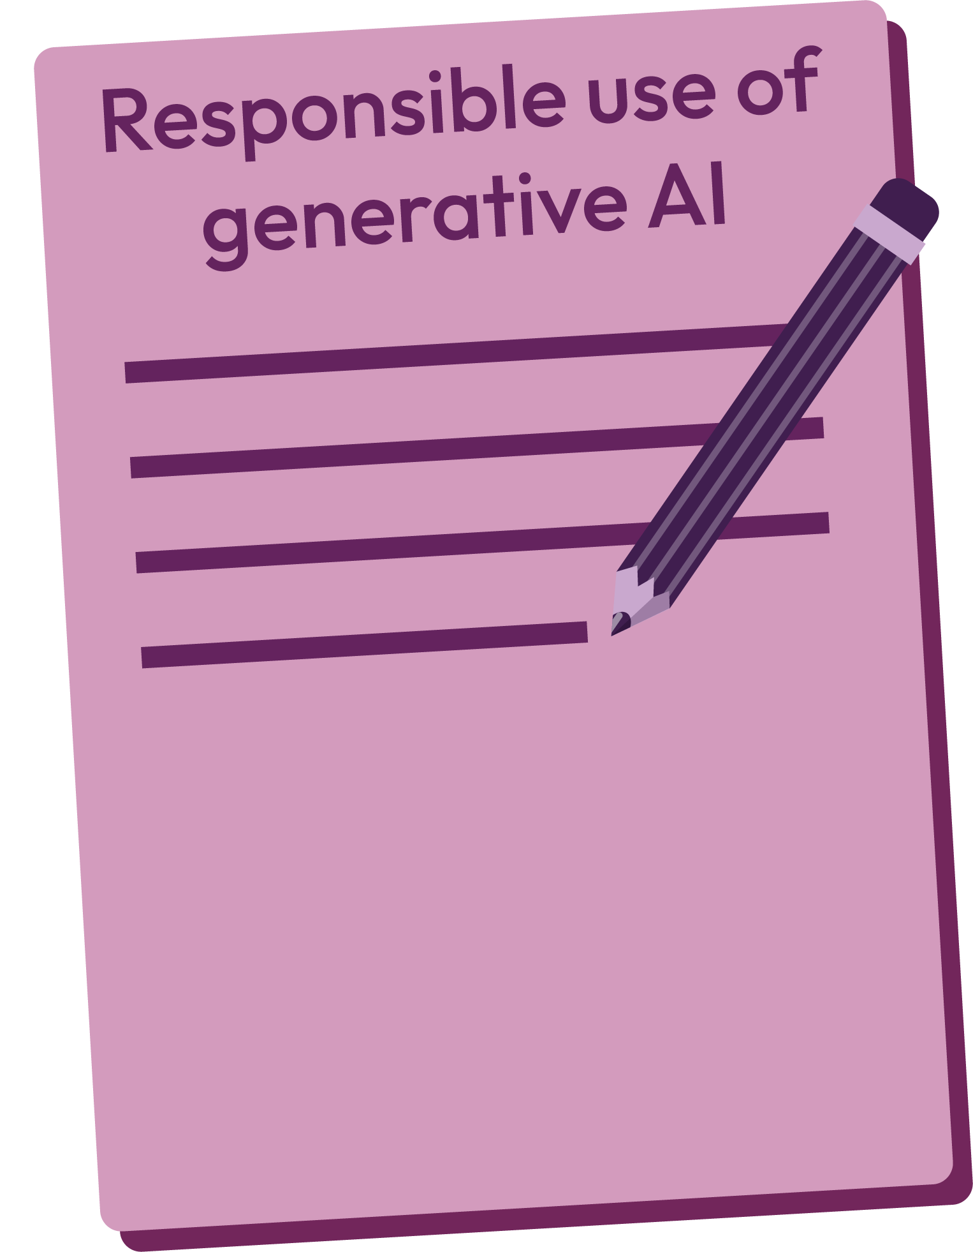
More activities
Create a school policy on the responsible use of generative AI for teachers and students, including:
information teachers and students should be aware of, to help make fully informed and responsible decisions about using generative AI
any rights that could be put at risk when using generative AI
strategies teachers and students could use to help reduce the impact on rights
Notes:
Teacher notes – Extension activity
Ask students to create a school policy on the responsible use of generative AI for teachers and students, including:
information teachers and students should be aware of, to help make fully informed and responsible decisions about using generative AI
any rights that could be put at risk when using generative AI
strategies teachers and students could use to help reduce the impact on rights

