Slide 1
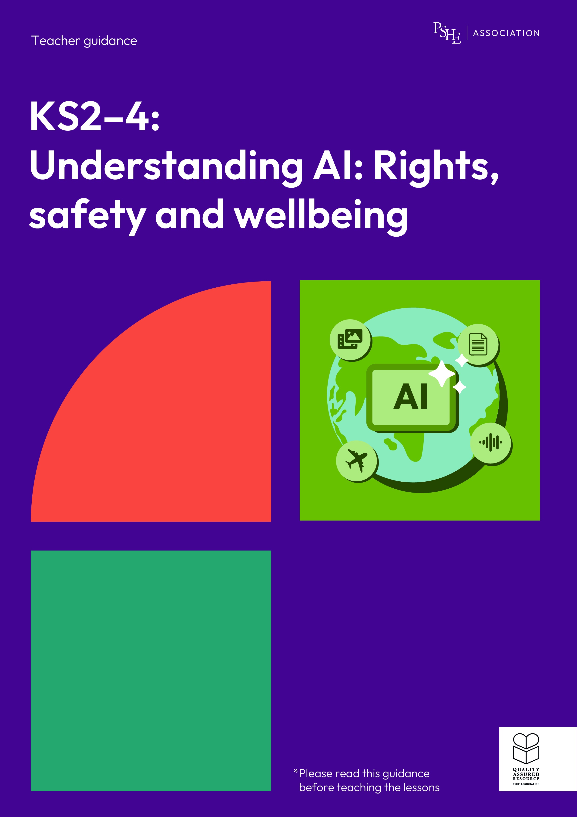
Understanding AI: Rights, safety and wellbeing
Year 9/10, Lesson 3: How does generative AI affect our understanding of the world?

Slide 2
Using this PowerPoint
The slides in this presentation are divided into two sections:
Teacher slides (purple) – provide key information regarding lesson preparation.
Student slides – provide a visual focus point for students during the lesson and delivery notes for teachers about the activities. Click ‘notes’ to view these.
Ensure that you select ‘Use Presenter View’ under the ‘Slide Show’ tab – this will allow you to preview the teaching notes on your monitor while the main presentation is displayed on a screen/smartboard.

Slide 3


Support and challenge
The lesson includes suggestions for support and challenge activities, to help you differentiate appropriately for your class.
Support activities are adapted to be more accessible for those who need it.
Challenge activities deepen and extend learning for those who need more challenge or who finish the activity quickly.
Look for these icons on the student slides. See delivery notes for details of the activities.
Challenge
Support

Slide 4
Context
This lesson pack for key stages 2–4 has been designed to support pupils’ AI literacy. This is the third of four lessons for students in years 9 and 10. It focuses on the role of generative AI in spreading mis- and disinformation online and strategies that can be used to help fact-check online content.
These lessons should not be taught in isolation, but always as part of a planned, developmental PSHE education programme. They are best used within the context of online safety or digital literacy.

Slide 5
To learn about generative AI and mis- and disinformation online.
Students will be able to:
explain how generative AI has increased the amount, and spread, of mis- and disinformation online
assess strategies for fact-checking content created by generative AI
describe the possible impacts of mis- and disinformation generated by AI

Slide 6
Box or envelope for questions
Resource 1: How does AI spread misinformation?
[support option, as required]
Resource 2: Source checking
[one cut-up set per group]
Resource 2a: Helping Poppy [support option, as required]
Resource 3: Mis- and disinformation [one per group]

Slide 7
Lesson summary
Activity | Description | Timing
Introduction | Introduce the learning objective and outcomes, set up the question box and revisit ground rules. | 3 min
Baseline assessment activity | Students consider a historical example of fake news and answer questions to demonstrate their understanding of mis- and disinformation. | 10 min
How does AI spread misinformation? | Pairs discuss how certain features of generative AI can lead to the spread of mis- and disinformation. | 10 min
Algorithms and fact checking | Groups complete a diamond 9, evaluating different fact-checking strategies, before explaining to a character why it is important to fact-check online information. | 12 min
What’s the impact? | Groups discuss the impact of spreading mis- and disinformation and then consider how this can be reduced. | 15 min
Endpoint assessment and reflection | Students answer questions related to an AI-generated example of fake news to demonstrate their progress and reflect strategies they could use for fact-checking. | 8 min
Signpost support | Answer students’ questions and signpost support. | 2 min

Slide 8
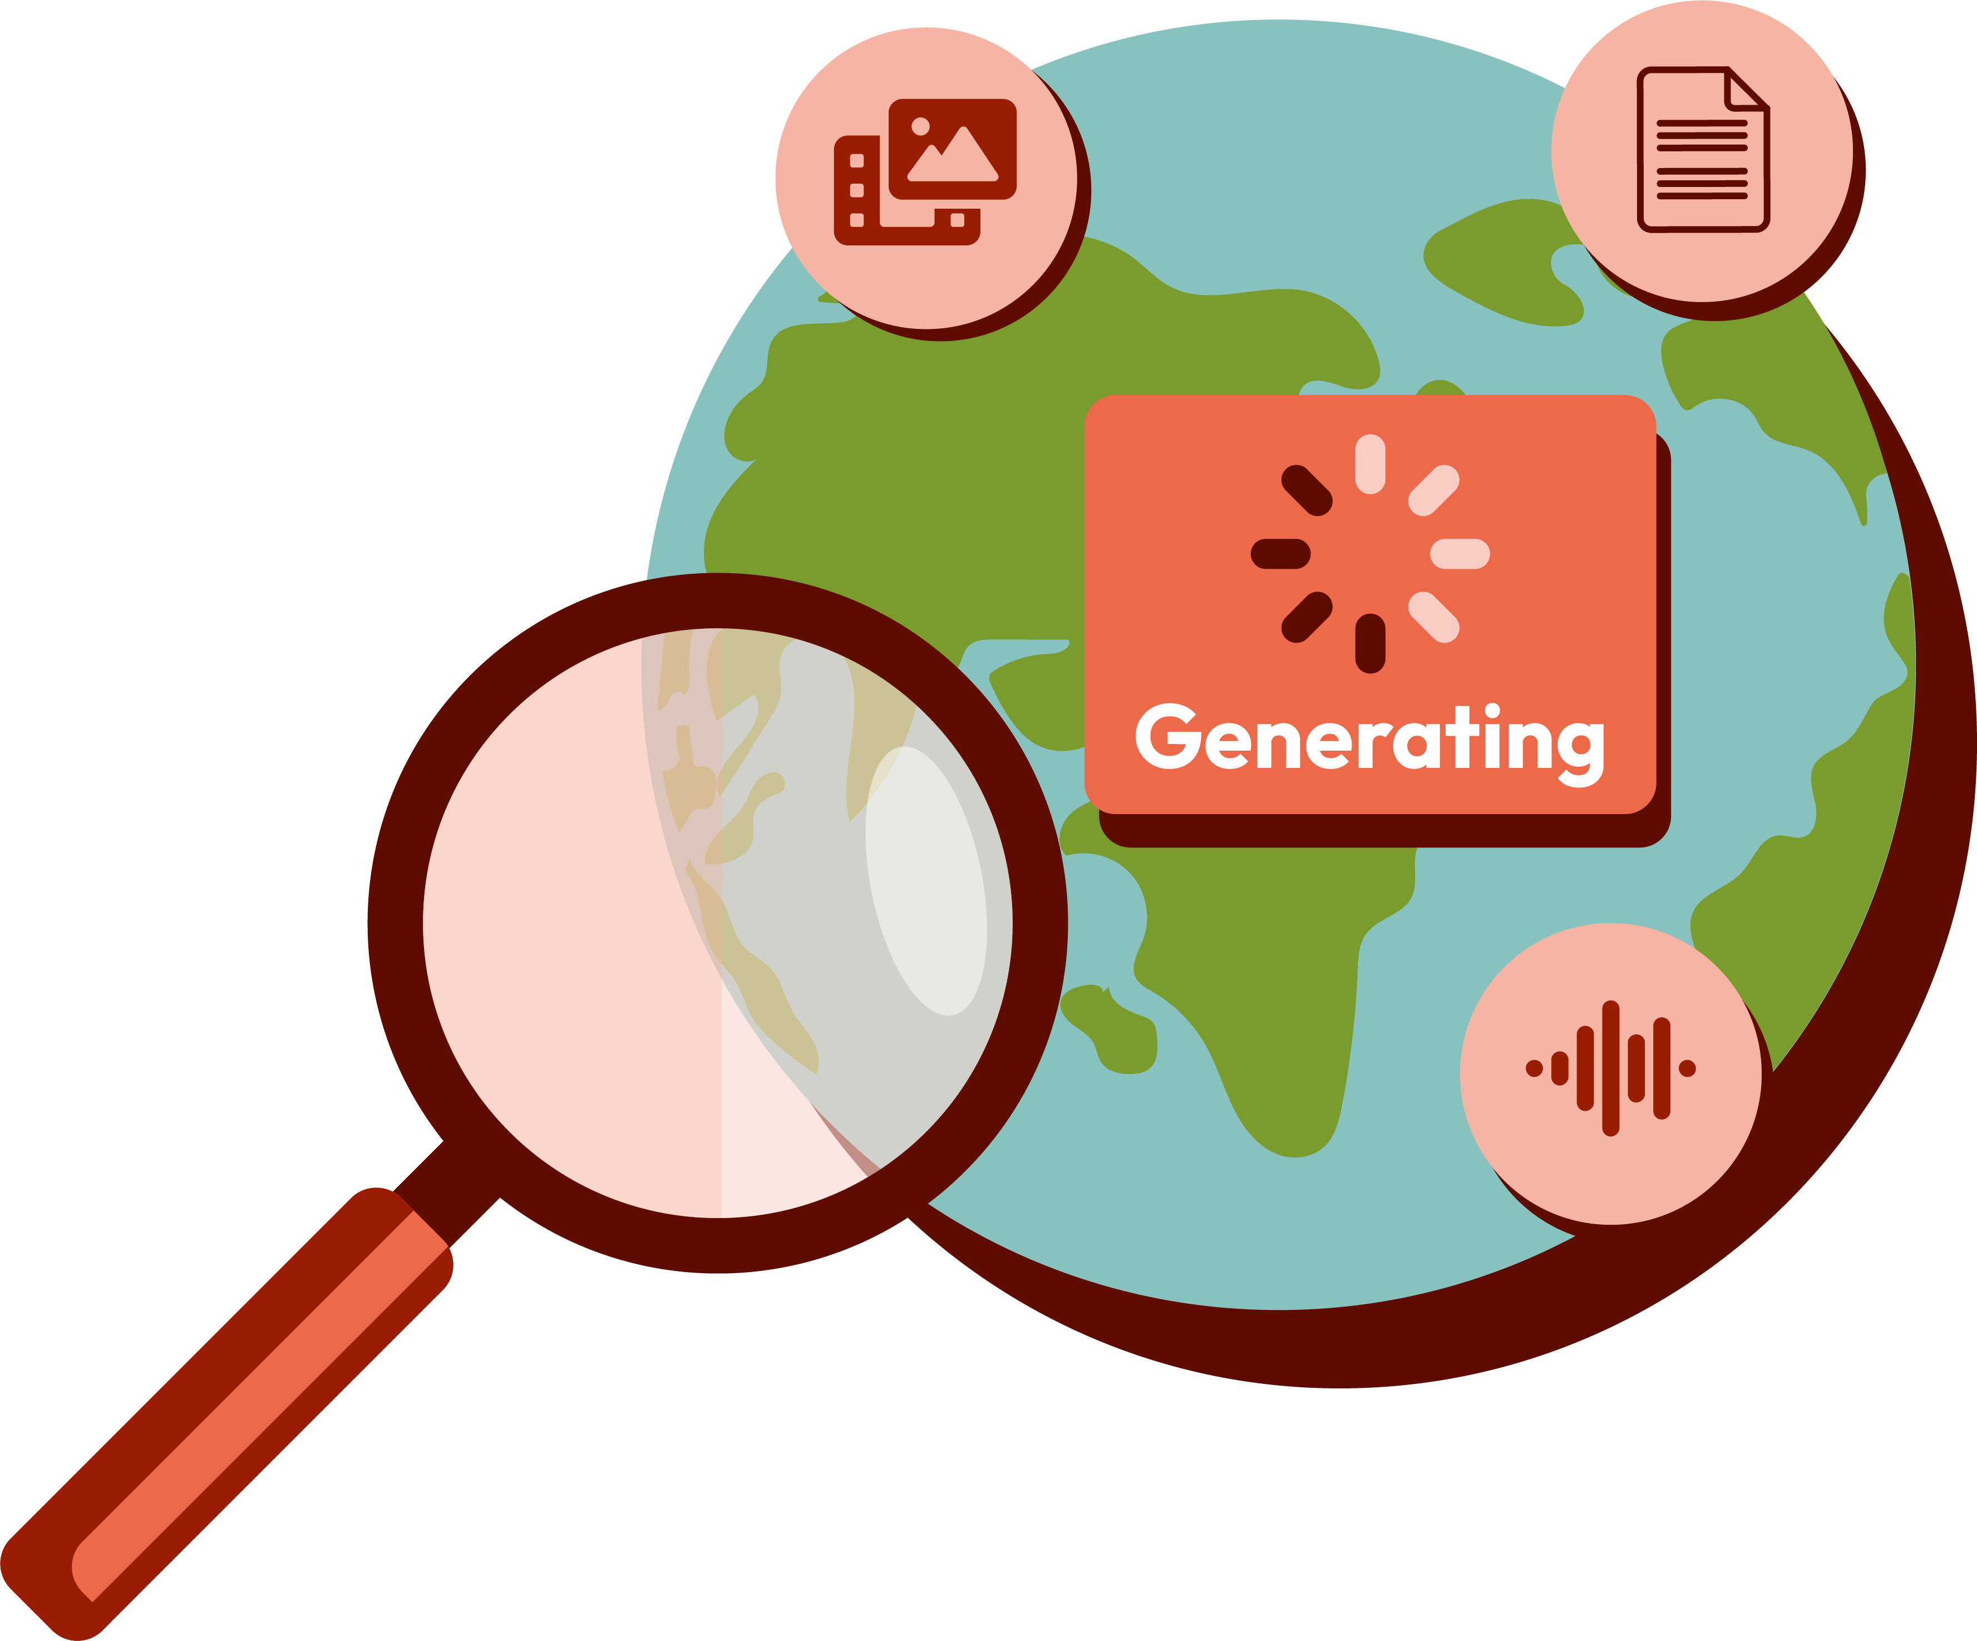
How does generative AI affect our understanding of the world?
Lesson 3

Slide 9
Notes:
Teacher notes – Introduction (3 mins, slides 8-10)
Establish or revisit ground rules using the slide. Explain that if students have worries or questions during or after the lesson that they do not want to raise in front of the class, they can write their question on a piece of paper, anonymously or with their name, and put it in the question box.

Slide 10
To learn about generative AI and mis- and disinformation online.
We will be able to:
explain how generative AI has increased the amount, and spread, of mis- and disinformation online
assess strategies for fact-checking content created by generative AI
describe the possible impacts of mis- and disinformation generated by AI
Notes:
Teacher notes – Introduction (3 mins, slides 8-10)
Introduce the learning objective and outcomes. Explain that today’s lesson will explore how generative AI is increasing the amount, and spread, of mis- and disinformation online, what the consequences of this might be and strategies that can help fact-check online information.

Slide 11

What’s our starting point?
A series of articles in The New York Sun claiming that a famous astronomer had discovered life on the Moon were published in 1835. These articles were intended to be a joke, but many believed the story, causing a huge increase in sales of the paper.
How has the way ‘fake news’ is spread, changed from the historical example?
How has the use of generative AI increased the amount, and spread, of ‘fake news’?
What can people do to help identify if something is fake?
Why is it important to fact-check information online?
Notes:
Teacher notes – Baseline assessment activity (10 mins)
Use the slide to share the historical example of ‘fake news’ and ask students to answer the questions. Take feedback from volunteers to establish students’ starting points and notice any common themes in their responses. Consider how the lesson may need adapting depending on any gaps or misconceptions identified. For example, if students are unable to identify how generative AI has increased the amount, and spread, of mis- and disinformation, you may want to spend more time exploring this in the first activity.

Slide 12
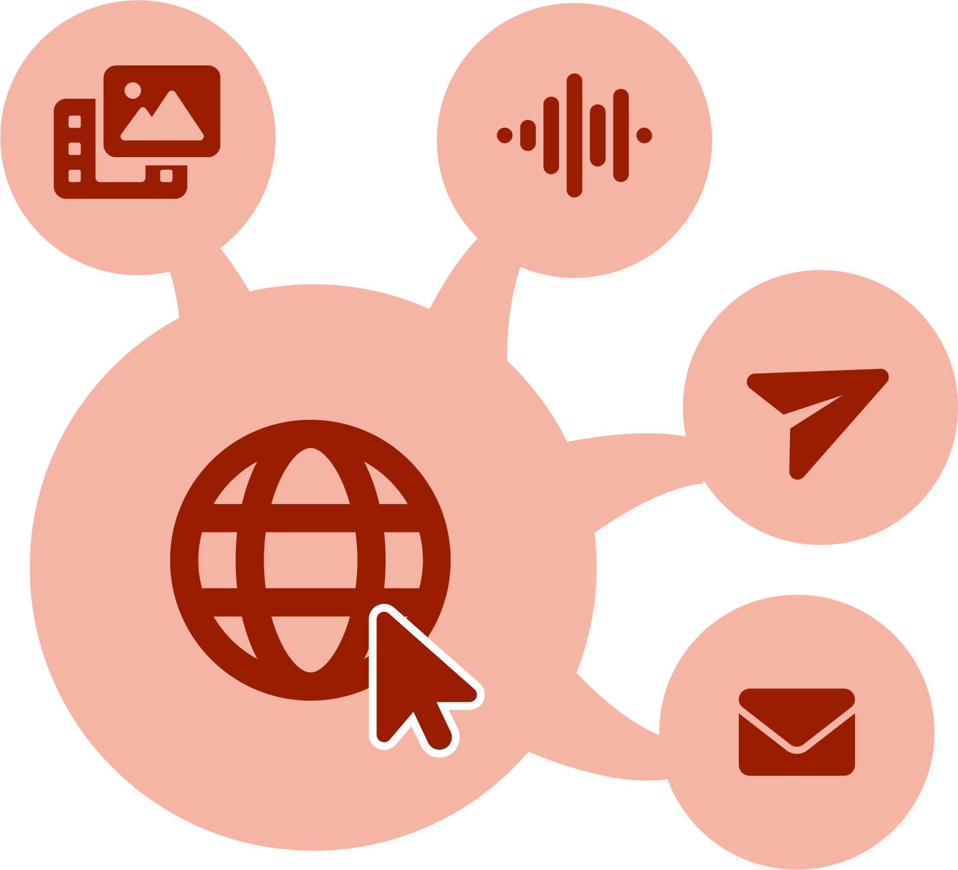
How does AI spread misinformation?
Creating and sharing content has become much easier since the introduction of the internet, social media and now generative AI tools.
What do the terms misinformation and disinformation mean?
Misinformation – fake or inaccurate information created and shared by mistake.
Disinformation – fake or inaccurate information created and shared deliberately, with the intent to deceive.
Notes:
Teacher notes – How does AI spread misinformation? (10 mins, slides 12-13)
Explain that creating and sharing content has become much easier since the introduction of the internet and social media. Now – with generative AI tools – stories, images and videos can be created to appear real, meaning the spread of mis- and disinformation is far more common and far reaching.
Ask the class what mis- and disinformation mean before sharing the definitions on the slide.

Slide 13


How does AI spread misinformation?
Discuss how each factor of generative AI could lead to the spread of misinformation and disinformation.
Generative AI doesn’t think or ‘know’ – it produces the most likely answer based on patterns in the training data.
Generative AI tools are trained on information that already exists, which is often drawn from the internet.
People might use generative AI to mislead others.
Because some people don’t know how AI works, they tend to trust the information provided.
Notes:
Teacher notes – How does AI spread misinformation? (10 mins, slides 12-13)
Next, share the statements on the slide, and ask pairs to discuss how each statement about generative AI could lead to the spread of mis- and disinformation.
Take feedback, highlighting key learning:
Generative AI tools can give answers that are based on the patterns in the training data but are actually incorrect (known as ‘hallucinations’) which can lead to the spreading of misinformation.
Generative AI tools are trained to produce the most likely outcome based on the user prompts. Because the information on the internet includes bias, stereotypes, conspiracy theories, incorrect information, fake news and outdated information, the outcome could reproduce inaccurate information. The more times a piece of information is repeated in the training data, which often draws on content from the internet, the more likely it is to be repeated via a generative AI tool.
People may use generative AI to create fake news, photos or videos or fake messages/posts to spread disinformation.
People might share stories or posts even if they don’t think they are real. Others may then think they are real, leading to further spreading of mis- and disinformation. People may be less critical of content generated by AI tools, meaning they are more likely to trust it – especially if they don’t have a good understanding of how generative AI tools work.
Support: Give students Resource 1: How does AI spread misinformation? and ask them to draw lines to match each statement to its possible outcome.
Challenge: Ask students to suggest reasons why people might be motivated to spread disinformation using generative AI.

Slide 14




Algorithms and fact-checking
Algorithms prioritise online content based on popularity, not accuracy.
This can lead to skewed facts when this content is used to train generative AI tools.
Where bias is present in the training data, the generative AI tool may learn and replicate these biases. This can lead to reinforced stereotypes and misinformation in the content generated.
Training data
Patterns identified
New content
Notes:
Teacher notes – Algorithms and fact checking (12 mins, slides 14-16)
Show the slide and explain that algorithms prioritise online content based on popularity not accuracy. This can lead to skewed facts when popular, but misleading or incorrect, content is included in the data used to train generative AI tools. Where bias is present in the training data, the generative AI tool may learn and replicate these biases. This can lead to reinforced stereotypes and misinformation in the content generated.

Slide 15
Algorithms and fact-checking
Most reliable
Organise the strategies for checking online information into a diamond 9, with those strategies that are most reliable at the top, and those that are least reliable at the bottom.
Least reliable
Notes:
Teacher notes – Algorithms and fact checking (12 mins, slides 14-16)
Give groups Resource 2: Source checking and ask students to organise the strategies for fact-checking online information into a diamond 9, with those strategies that are most reliable at the top, and least reliable at the bottom. Alternatively, students could number the cards from one to nine to reflect which they believe are the most to the least reliable.
Take feedback, highlighting key learning:
Checking against multiple sources, using reliable sources and using fact-checking tools are all reliable ways to fact-check online information, although can be time consuming.
Many generative AI videos are shorter than standard videos found on most social media platforms and have poor resolution (e.g. blurry edges). Although not foolproof, this can be useful as a quick sense check before using more reliable strategies such as checking against multiple sources.
Checking for spelling, grammar and tone and looking for continuity between the images and text can be slightly quicker ways to identify if content may not be genuine, however this method is not foolproof and should be supported by strategies such as checking reliable sources.
The effectiveness of discussing what has been seen online with friends or trusted adults, will depend on the individuals as well as the type of content.
The number of likes and shares does not reflect reliability – it only confirms how popular the content is, and this can often be skewed by algorithms.
Content labelled as AI generated does not confirm whether it includes mis- or disinformation.

Slide 16

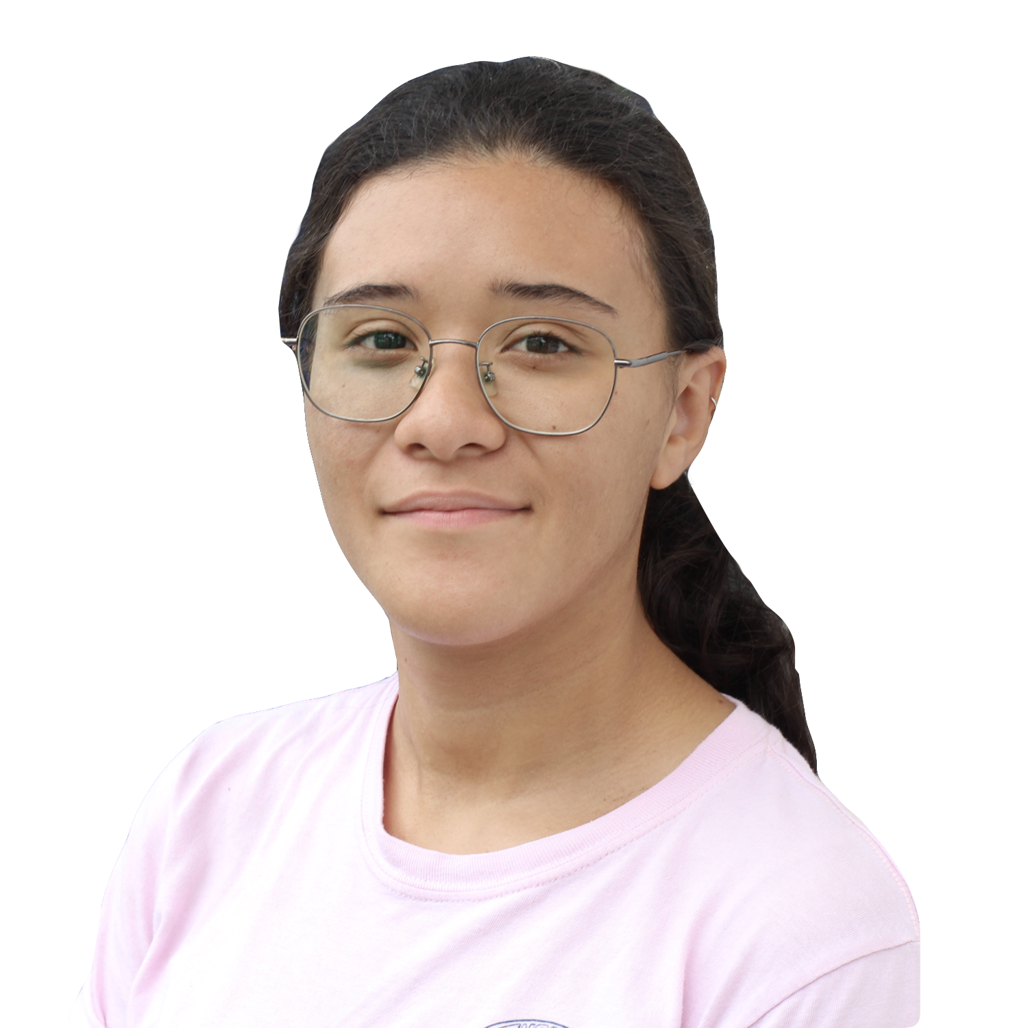
Algorithms and fact-checking
Poppy has noticed lots of the stories on social media are biased or seem like they are not real.
Write a response to Poppy explaining why it is important to fact-check, including:
the impact of algorithms
and bias
some strategies Poppy could use to fact-check
My social media seems full of fake news these days, it’s so biased too. How am I supposed to know what’s real?
Notes:
Teacher notes – Algorithms and fact checking (12 mins, slides 14-16)
Next, share the scenario on the slide, and explain that Poppy has noticed lots of the stories on social media are biased or seem like they are not real. Ask students to write a response to Poppy explaining why it is important to fact-check, including:
the impact of algorithms and bias
some strategies Poppy could use to fact-check
Circulate during the activity to check students’ understanding.
Support: Give students Resource 2a: Helping Poppy, to help structure their response.
Challenge: Explain that a possible consequence of mis- and disinformation is people mistrusting all online information. Ask students to discuss what the impact of this could be.

Slide 17
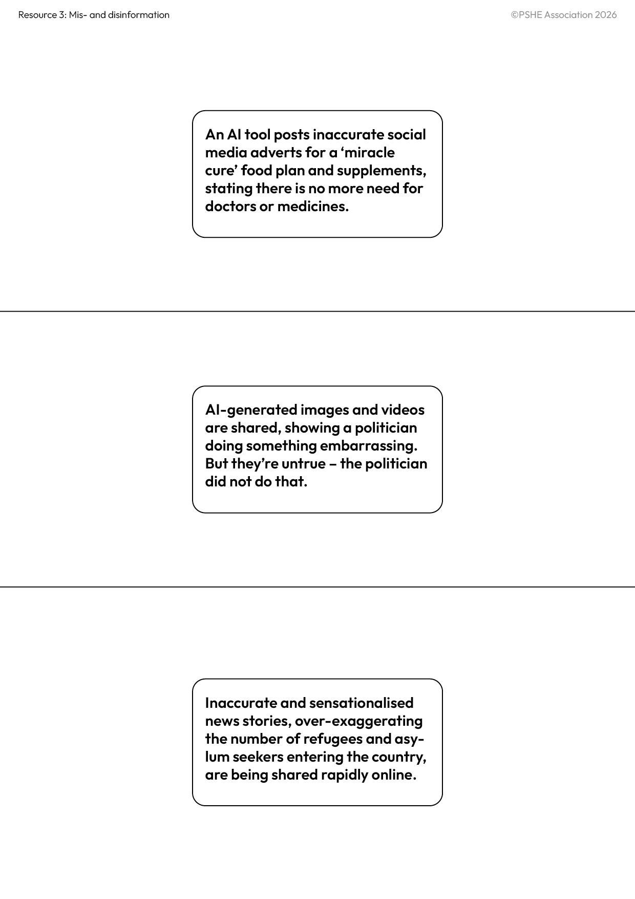

What’s the impact?
What could the possible impacts of spreading mis- and disinformation be?
Write the possible consequences of spreading this mis- and disinformation around each example on Resource 3.
Notes:
Teacher notes – What’s the impact? (15 mins, slides 17-18)
Explain that as well as being aware of how generative AI can increase the amount, and spread, of mis- and disinformation, we should also consider what the consequences of this might be. Show the slide and ask groups to discuss what the possible impacts of spreading mis- and disinformation could be.
Take feedback. Students might suggest:
It can spread untrue/harmful information; may be used to influence opinions; could lead to people unwittingly using/sharing incorrect information; disinformation can be spread to cause harm; used to promote hate speech or extremist views.
Next, give groups Resource 3: Mis- and disinformation, and ask them to write around each example the possible consequences of spreading this mis- and disinformation.
Take feedback, highlighting key learning:
Stigma related to health conditions; worsening of medical conditions; reduction in vaccination uptake; not seeking medical help when needed; undermining advice from medical professionals and reducing trust.
People being unfairly influenced in elections; loss of trust and not voting; used as an excuse by politicians to avoid accountability.
Increase in discrimination; divided communities; increase in hate speech or extremist views; reinforcing harmful stereotypes.

Slide 18


What’s the impact?
Using information from your discussion, write down three top pieces of information about generative AI that would be helpful for people to be aware of, to reduce the impact of mis- and disinformation.
Notes:
Teacher notes – What’s the impact? (15 mins, slides 17-18)
Finally, ask students to write down three top pieces of information about generative AI that would be helpful for people to be aware of, to reduce the impact of mis- and disinformation.
Students may suggest: awareness of how algorithms work; how generative AI is trained; that AI doesn’t think for itself; motivations behind spreading disinformation; how generative AI could be used to make disinformation appear real.
Challenge: Explain that a lot of mis- and disinformation online is related to health and politics. Ask students to discuss possible reasons for this.

Slide 19

Reflection
Which strategies will you find most useful for fact-checking information online?
Notes:
Teacher notes – Reflection (3 mins)
Ask students to reflect on which strategies they will find most useful for fact-checking information online. As this is a personal reflection, they do not need to share their responses with the class.

Slide 20
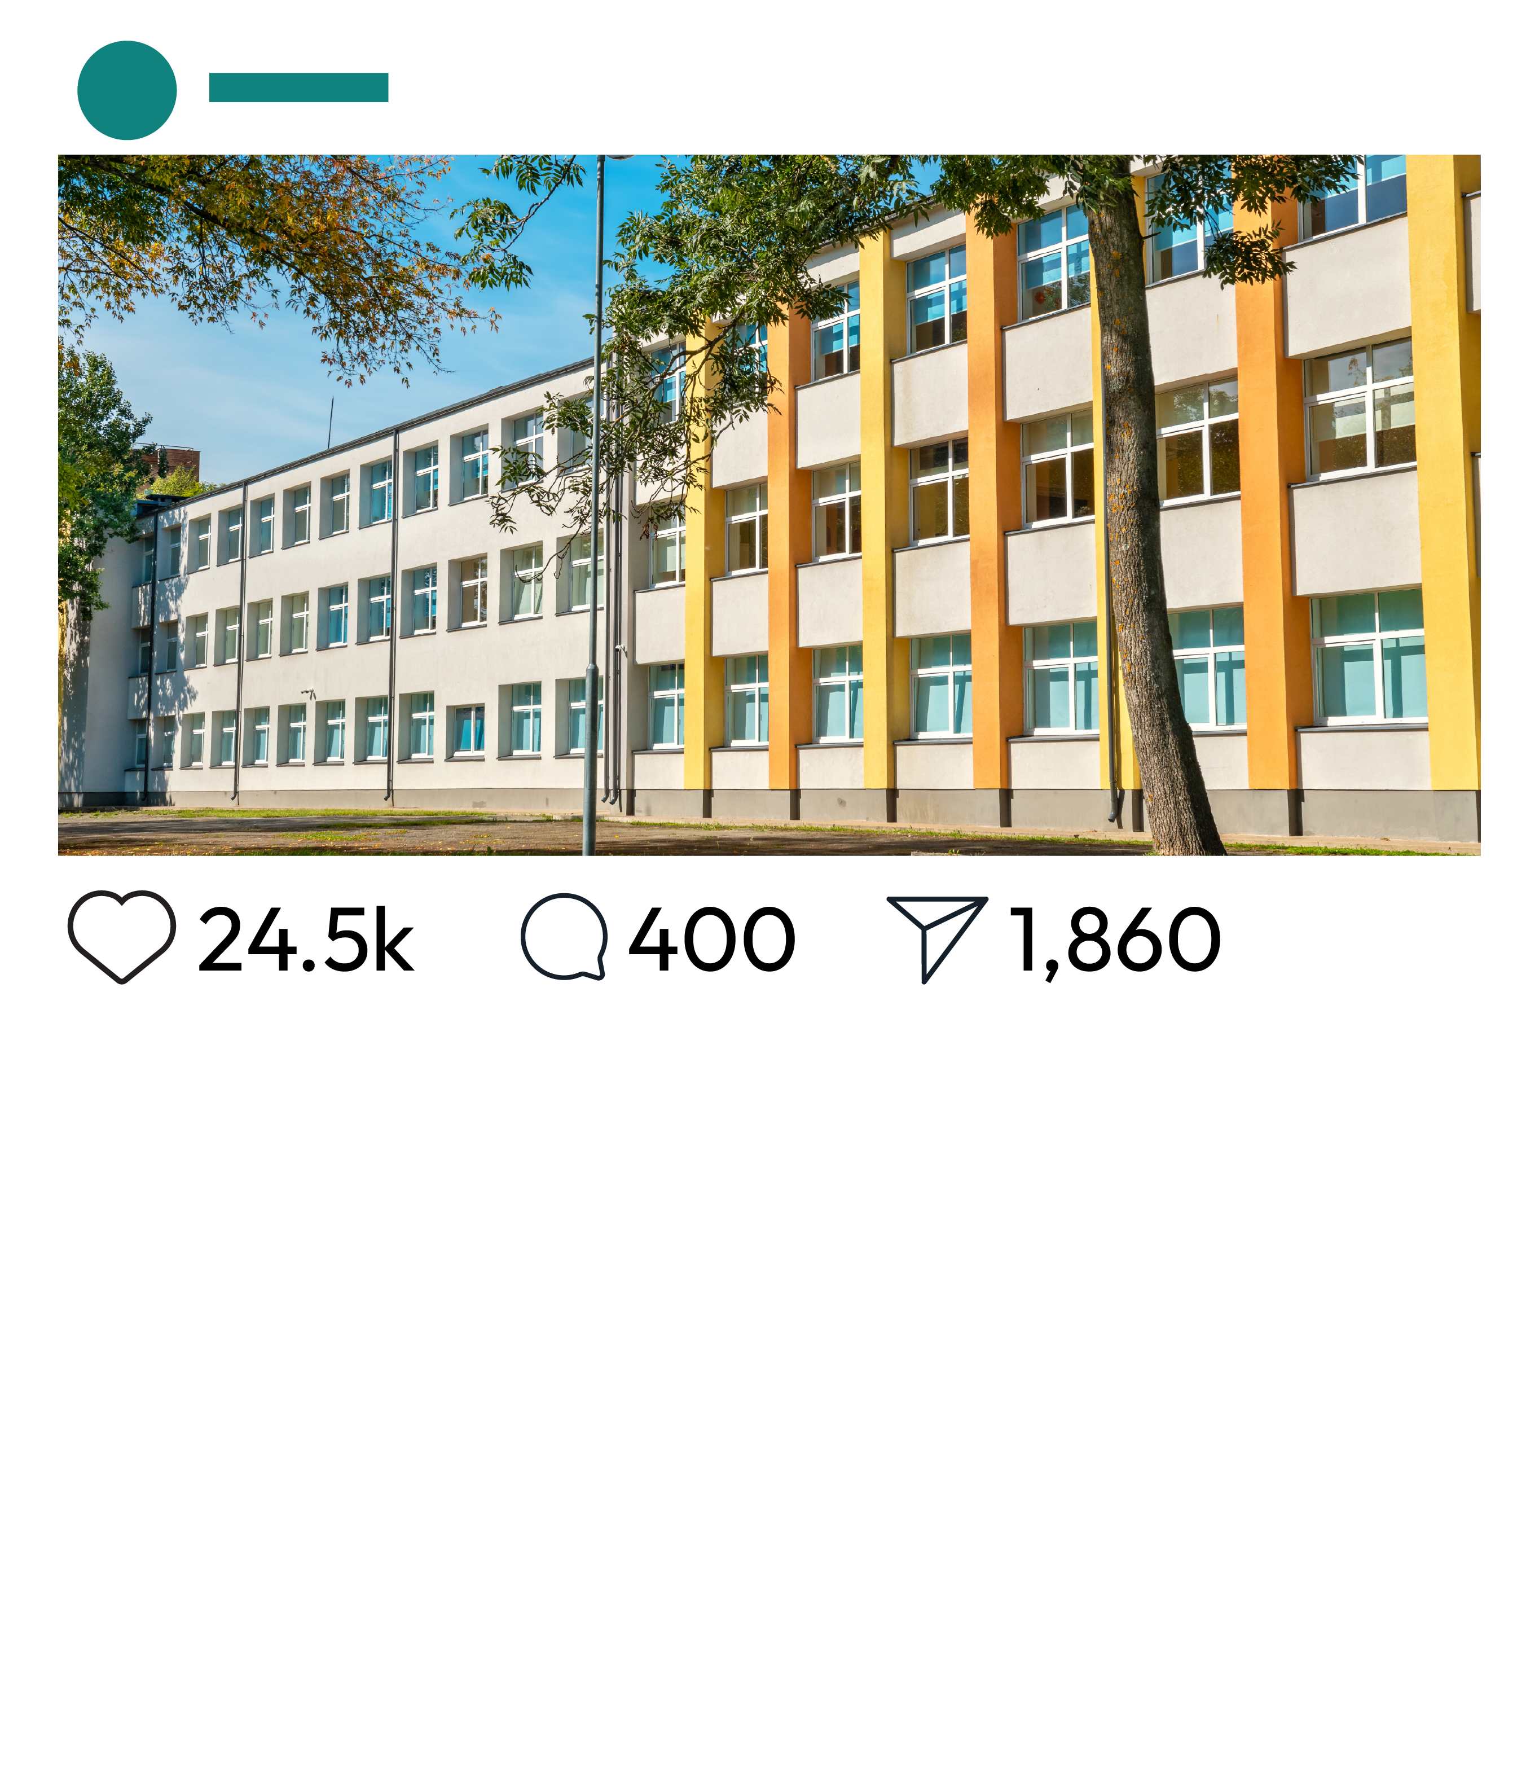
What have we learnt?
What clues are there that this story is fake news?
How has generative AI increased the amount, and spread, of fake stories like this?
What could someone do if they suspect it is mis- or disinformation?
What harm could be caused by fake stories like this?
Schools to replace all Teachers with AI Robots by next year, officials announce.
In a surprising announcement, several schools across the country are reportedly planning to replace all human teachers with generative AI robots by next year.
Notes:
Teacher notes – Endpoint assessment (5 mins)
Remind students of the learning outcomes and share the fake news story on the slide. This is an opportunity to check students’ understanding and identify any gaps that may need addressing in the following lessons. Review the question box and address any unanswered questions.

Slide 21


Sources of support
If concerned about the use of AI and mis- and disinformation, speak to a trusted adult at home or at school (for example the head of year or form tutor).
Or find information and advice from: Childline - www.childline.org.uk; 0800 1111
I need your help with something . . .
Something's worrying me,
can I talk to you?
I have something that’s been bothering me . . .
Notes:
Teacher notes – Signposting support (2 mins)
Remind students that if they have concerns about the use of generative AI and mis- and disinformation, it is important they speak to a trusted adult at home or at school (for example the head of year or form tutor). Students can also contact:
Childline - www.childline.org.uk; 0800 1111

Slide 22

More activities
Create a guide for spotting mis- and disinformation.
Include:
How generative AI increases the amount, and spread, of mis- and disinformation
Strategies that can be used to fact-check online information
How spreading mis- and disinformation can cause harm
Notes:
Teacher notes – Extension activity
Ask students to create a guide for spotting mis- and disinformation. They should include:
how generative AI increases the amount, and spread, of mis- and disinformation
strategies that can be used to fact-check online information
how spreading mis- and disinformation can cause harm

