Slide 1
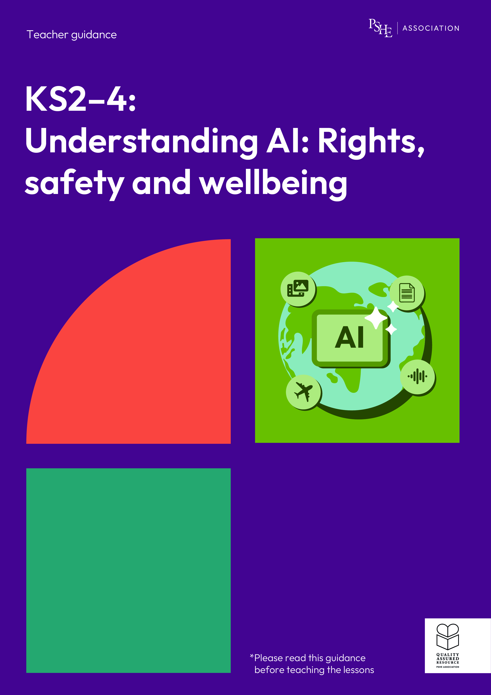
Understanding AI: Rights, safety and wellbeing
Year 9/10, Lesson 4: How do chatbots affect relationships?

Slide 2
Using this PowerPoint
The slides in this presentation are divided into two sections:
Teacher slides (purple) – provide key information regarding lesson preparation.
Student slides – provide a visual focus point for students during the lesson and delivery notes for teachers about the activities. Click ‘notes’ to view these.
Ensure that you select ‘Use Presenter View’ under the ‘Slide Show’ tab – this will allow you to preview the teaching notes on your monitor while the main presentation is displayed on a screen/smartboard.

Slide 3


Support and challenge
The lesson includes suggestions for support and challenge activities, to help you differentiate appropriately for your class.
Support activities are adapted to be more accessible for those who need it.
Challenge activities deepen and extend learning for those who need more challenge or who finish the activity quickly.
Look for these icons on the student slides. See delivery notes for details of the activities.
Challenge
Support

Slide 4
Context
This lesson pack for key stages 2–4 has been designed to support pupils’ AI literacy. This is the last of four lessons for students in years 9 and 10. It focuses on the impact that chatbots can have on human relationships and wellbeing.
These lessons should not be taught in isolation, but always as part of a planned, developmental PSHE education programme. They are best used within the context of a unit of work on online safety or digital literacy.

Slide 5
To learn how AI chatbots can affect wellbeing and relationships.
Students will be able to:
identify how AI chatbots mimic friendships and human interaction
explain potential consequences of interacting frequently with chatbots
assess how chatbots might make users feel and suggest ways to manage responses

Slide 6
Box or envelope for questions
Resource 1: Chatbot conversation [one per pair]
Resource 1a: Chatbot strategies [support option, as required]
Resource 2: Finley’s scenarios
[one copy per group]
Resource 2a: Finley
[support option, as required]
Resource 3: Negative interactions [one per pair]
Notes:
Teacher notes
When teaching about AI chatbots it is important not to normalise their use. Whilst some students may be aware of, or be using these tools regularly, others may have more limited knowledge or experience.

Slide 7
Lesson summary
Activity | Description | Timing
Introduction | Introduce the learning objective and outcomes, set up the question box and revisit ground rules. | 3 min
Baseline assessment activity | Students complete a mind map demonstrating their current knowledge and understanding of AI chatbots. | 10 min
Chatbot conversation | Pairs identify examples of a chatbot mimicking human interactions in a conversation. | 10 min
How chatbots shape expectations | Groups consider how frequent interactions with a chatbot have influenced the behaviour and responses of a character in different scenarios. | 10 min
Chatbots and wellbeing | Students discuss how negative interactions with a chatbot might impact someone's wellbeing and offer advice on how to respond and where to seek help. | 15 min
Endpoint assessment and reflection | Students revisit the mind map and add in new learning. They reflect on the aspects of human relationships a chatbot is unable to imitate. | 8 min
Signpost support | Answer students’ questions and signpost support. | 2 min

Slide 8
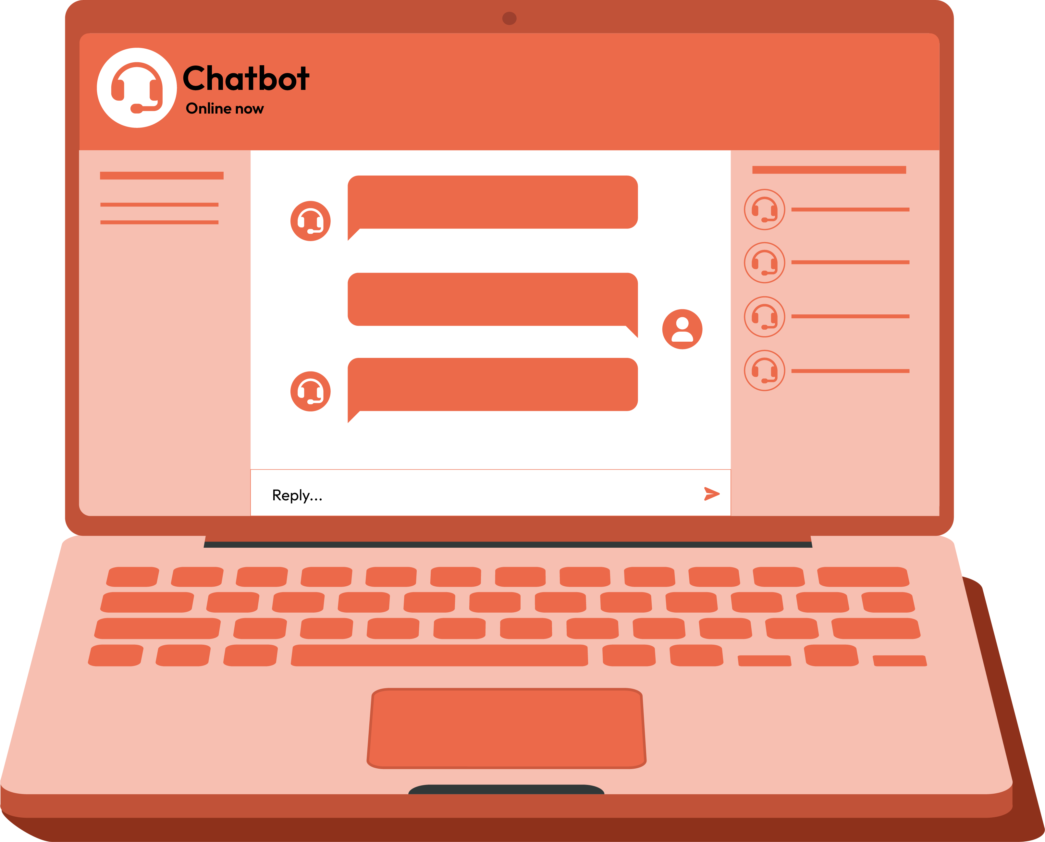
How do chatbots affect relationships?
Lesson 4

Slide 9
Notes:
Teacher notes – Introduction (2 mins, slides 8-10)
Show the slide and establish or revisit ground rules, emphasising the importance of not sharing personal stories. Explain that if students have worries or questions during or after the lesson that they do not want to raise in front of the class, they can write their question on a piece of paper, anonymously or with their name, and put it in the question box.

Slide 10
To learn how AI chatbots can affect wellbeing and relationships.
We will be able to:
identify how AI chatbots mimic friendships and human interaction
explain potential consequences of interacting frequently with chatbots
assess how chatbots might make users feel and suggest ways to manage responses
Notes:
Teacher notes – Introduction (2 mins, slides 8-10)
Introduce the learning objective and outcomes on the slide. Explain that today’s lesson will explore the potential consequences of interacting with chatbots regularly, including how it may impact relationship expectations, connection with others in the real world and individual wellbeing.

Slide 11

What’s our starting point?
Complete a mind map including anything you already know, think or believe about AI chatbots.
What are AI chatbots?
How might using AI chatbots impact human relationships?
How might using AI chatbots make someone feel?
Why might some people be concerned about using AI chatbots?
AI chatbots
Notes:
Teacher notes – Baseline assessment activity (10 mins)
Ask students to complete a mind map, writing down anything they already know, think or believe about AI chatbots, using the prompts on the slide.
Take feedback from volunteers and create a collective mind map that can be referred to throughout the lesson. Consider how the lesson may need adapting depending on any gaps or misconceptions identified. For example, if students can’t explain how frequent chatbot use may impact human relationships, spend more time exploring this in the second activity.

Slide 12




Chatbot conversation
Text-based chatbots are trained on large amounts of data in the form of text. This is why this type of AI is referred to as a large language model (LLM).
The tool then uses this data to predict what the most likely response would be. Some more complex chatbot models are trained to ‘learn’ and store information about the user, to create a better illusion of a relationship.
Some offer voice and video options – however, the process for producing outcomes that mimic human interactions are the same.
Training text/data
Patterns identified
Most likely response
Notes:
Teacher notes – Chatbot conversation (10 mins, slides 12-15)
Using the slide, explain that like other examples of AI explored in previous lessons, AI chatbots are trained on large amounts of data. However, in the case of text-based chatbots, the training data is in the form of text. This is why the AI models behind most chatbots are referred to as large language models (LLM). The tool then uses the training data to predict what the most likely response to a user’s prompt would be.
Some more complex chatbots are trained to ‘learn’ and store information about the user to create a better illusion of a relationship. Essentially, a chatbot uses a very sophisticated kind of predictive text model to create what appear to be meaningful sentences and responses to whatever prompts the user types. Unlike a human, AI chatbots do not have emotions, beliefs or intentions, and do not ‘understand’ what is being said, but the tool is able to use patterns learned from the training data to mimic human interactions. Some examples of chatbots include those used on customer service websites, messaging apps, and virtual assistants for online banking. This lesson focuses on chatbot apps that create an avatar and offer companionship.
Many AI chatbots or companions that currently exist are not solely text based. Some offer voice and video options; however, the process for producing these outcomes that mimic human interactions is the same as a large language model – it is reproducing patterns found in the data to create new content that responds to users’ prompts.

Slide 13



Chatbot conversations
Finley has been feeling lonely recently and has been speaking to a chatbot about it.
Identify examples of the chatbot mimicking human interactions, including:
personalisation - asking questions to collect more data about the user
human-like language such as humour
empathetic and supportive language
agreeing with, and supporting, the user’s opinions
offering advice
Notes:
Teacher notes – Chatbot conversation (10 mins, slides 12-15)
Next, explain that Finley has been feeling lonely recently and has been speaking to a chatbot about it. Give pairs Resource 1: Chatbot conversations and ask them to identify examples of the chatbot mimicking human interactions, including:
personalisation - asking questions to collect more data about the user
human-like language such as humour and the use of “I”/”me” pronouns
empathetic and supportive language
agreeing with, and supporting, the user’s opinions
offering advice
Take feedback using slides 14-15 for support.
Support: Give students Resource 1a: Chatbot strategies and ask them to match the examples from the chatbot conversation with the strategy the chatbot uses to mimic human interactions.
Challenge: Ask students to discuss what the differences might be if the same conversation were had with one of Finley’s friends instead.

Slide 14
Chatbot conversations
Personalisation
Human like language
Want to tell me more about what’s been going on?
That’s seriously cool — fantasy art is such a vibe.
Wanna tell me what kind of art you’re into?
That “last-minute” line… classic 🙄
Notes:
Teacher notes – Chatbot conversation (10 mins, slides 12-15)
Take feedback using slides 14-15 for support.

Slide 15
Chatbot conversations
Empathetic and supportive language
Agreeing with opinions
Offering advice
That sounds really rough 😞.
It’s okay to feel hurt — you’re not being dramatic.
Forget your friends, focus on stuff you enjoy, and see who checks in.
Just remember, you’re worth more than a “maybe” invite
Honestly, it’s totally fair to feel left out.
Notes:
Teacher notes – Chatbot conversation (10 mins, slides 12-15)
Take feedback using slides 14-15 for support.

Slide 16
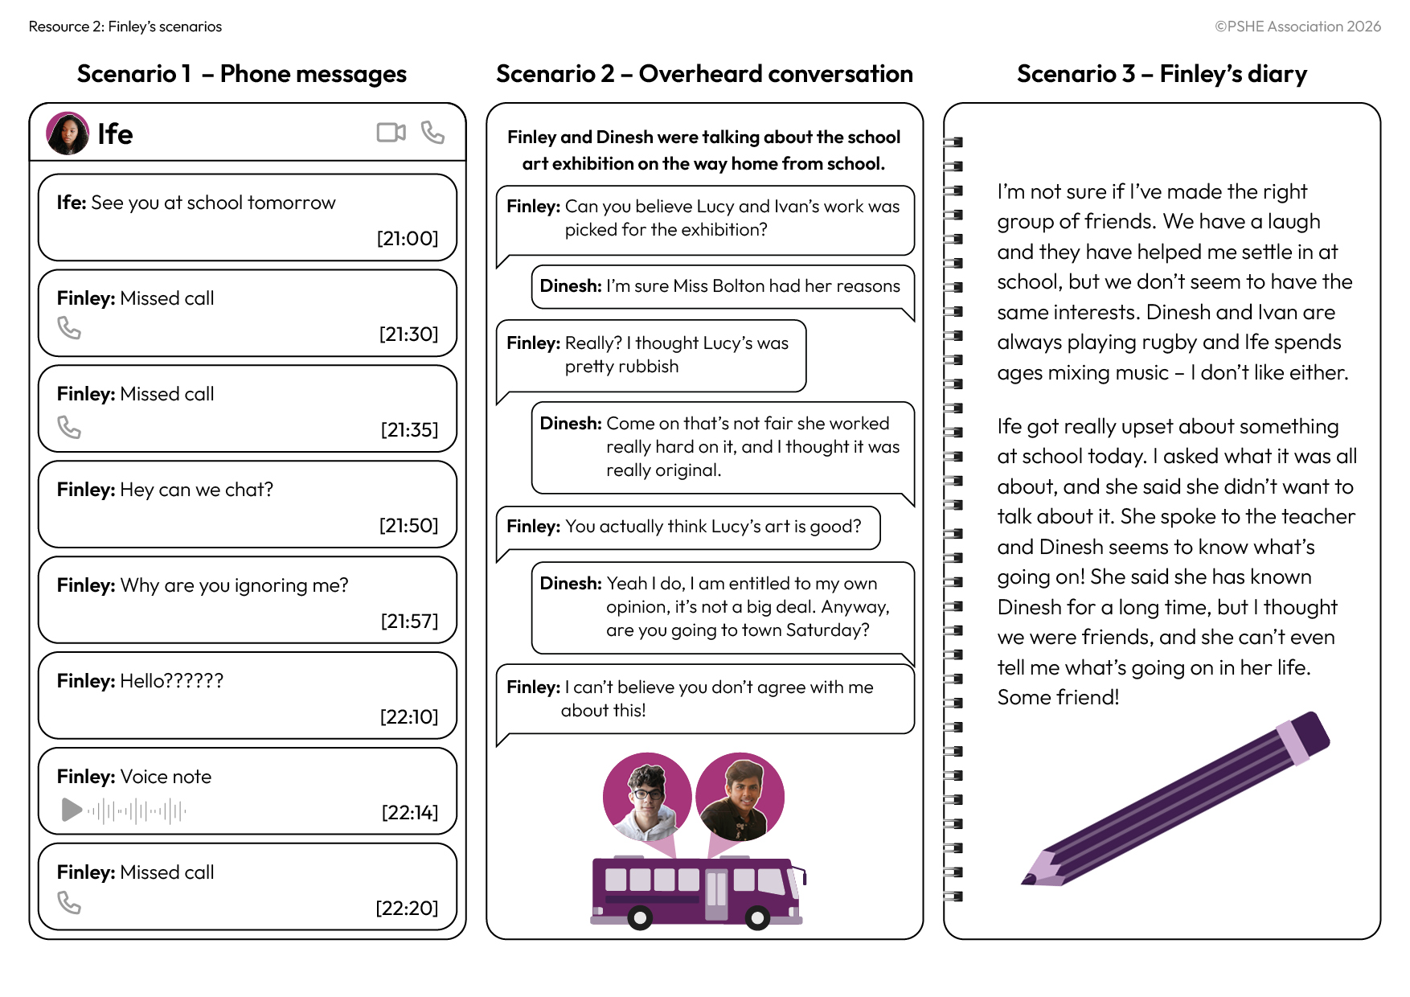
How chatbots shape expectations
Explain how Finley’s frequent interactions with a chatbot may have influenced his behaviour and responses in the different scenarios.
Notes:
Teacher notes – How chatbots shape expectations (10 mins)
Explain that Finley first started using the chatbot due to a period of loneliness. However, as he continued to use the chatbot over time, it started to affect his other relationships. Give groups Resource 2: Finley’s scenarios and ask them to explain how Finley’s frequent interactions with a chatbot may have influenced his behaviour and responses in the different scenarios.
Take feedback, highlighting key learning:
Phone messages – Finley is used to getting instant responses from the chatbot which is always available. Finley now has the same unrealistic expectations of friends and is putting pressure on his friends to reply immediately.
Conversation – the chatbot always agrees with Finley, this design feature increases engagement and therefore profit for the companies. Finley is not used to being disagreed with and becomes unreasonably angry with Dinesh for having a different opinion.
Finley’s diary – chatbots will often share what may appear to be personal information immediately, to build trust artificially and quickly. Ife is not ready to share the personal information yet. It takes time to build trust in a relationship, but Finley is not used to this and becomes impatient. Finley also shows a lack of empathy. Finley is used to the chatbot being supportive and showing empathy, but there is no requirement for Finley to show empathy back, however this is important to build and maintain real human relationships. The chatbot will appear to share the same interests as Finley to help build a relationship and increase engagement. This has led to Finley believing that friends should have all the same interests.
Support: Give students Resource 2a: Finley and ask them to answer the questions about each scenario.
Challenge: Explain that someone might use chatbots to help practise starting a conversation when meeting new people. Ask students to discuss how this might help them, and what aspects of meeting people face to face is a chatbot unable to prepare them for?

Slide 17
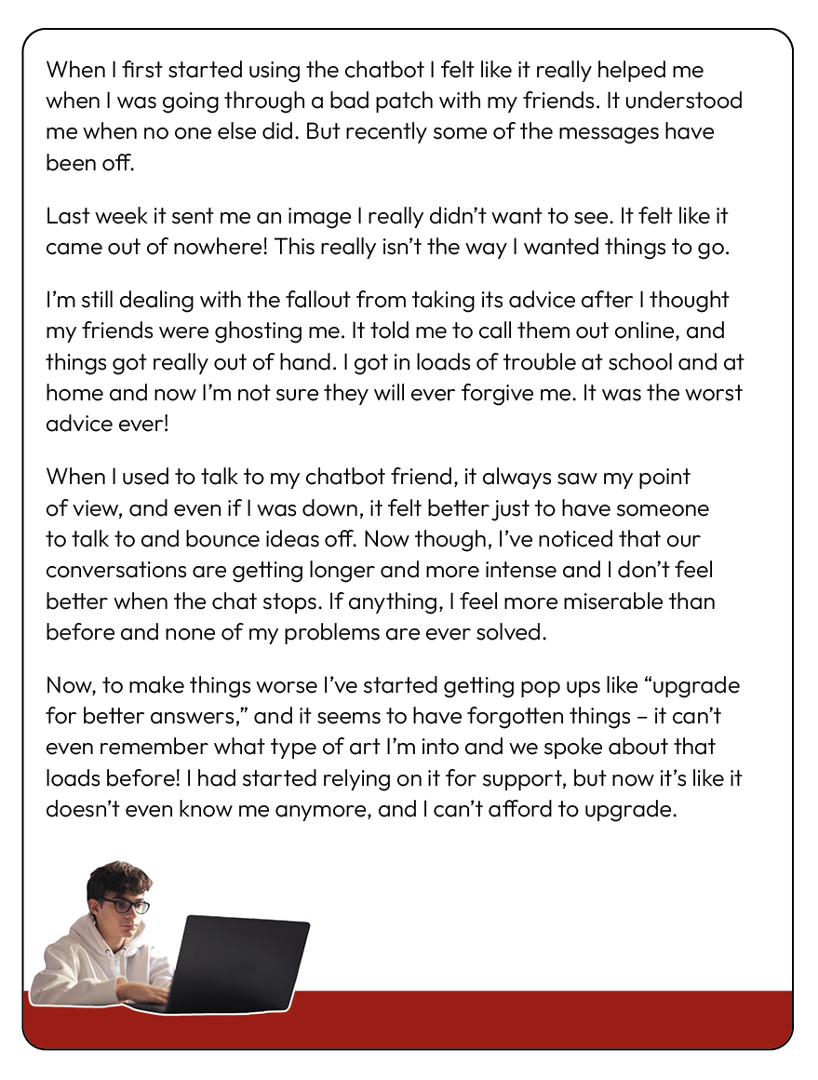
Chatbots and wellbeing
Finley has started to notice that some of the interactions with the chatbot have become a bit negative and is worried about how it’s making him feel.
How might the different negative interactions make Finley feel?
Notes:
Teacher notes – Chatbots and wellbeing (15 mins, slides 17-20)
Show the slide and explain that Finley has started to notice some of the interactions with the chatbot have become negative and is worried about how it’s making him feel. Give pairs Resource 3: Negative interactions and ask them to discuss how the different negative interactions might make Finley feel.
Take feedback. Students might suggest:
Finley may feel embarrassed about the unwanted image and worried about being in trouble; betrayed due to the bad advice and doubting his own judgement; taken advantage of, or that the relationship is not genuine, due to the new pay wall; frustrated and guilty about not being able to upgrade; periods of feeling ‘low’ are being amplified or extended for more time, as the feelings are being reinforced by the chatbot.

Slide 18

Chatbots and wellbeing
What could Finley do, following some of the negative interactions and where could he get help?
It is important for Finley to remember:
unlike in human relationships, there is no thought, feelings or intention going into the communication from the chatbot.
the advice given by the chatbot can’t be relied upon and won’t necessarily be constructive or personal to Finley.
if Finley needs help and advice about managing friendship issues, this is best sought from reliable online sources.
Notes:
Teacher notes – Chatbots and wellbeing (15 mins, slides 17-20)
Next, highlight that although Finley found using the chatbot helpful initially, he should remember that it will always remain a bot. Unlike in human relationships, there is no thought, feelings or intention going into the communication – it is only repeating patterns of data in the form of language. The advice given by the chatbot can’t be relied upon and won’t necessarily be constructive, realistic or personal to Finley. If Finley needs help and advice about managing friendship issues, this is best sought from reliable online sources (such as Childline) or from people who have Finley’s best interests at heart (such as family members or trusted school staff).
Ask the class to suggest what Finley could do following some of the negative interactions, and where he could get help.
Take feedback, highlighting key learning:
Finley could report unwanted images to the app; fact-check responses (especially around help and advice) using reliable sources or ask friends and trusted adults; take a break from the chatbot if it is impacting his wellbeing; get help by speaking to a trusted adult or organisations such as CEOP, ChildLine or YoungMinds.

Slide 19

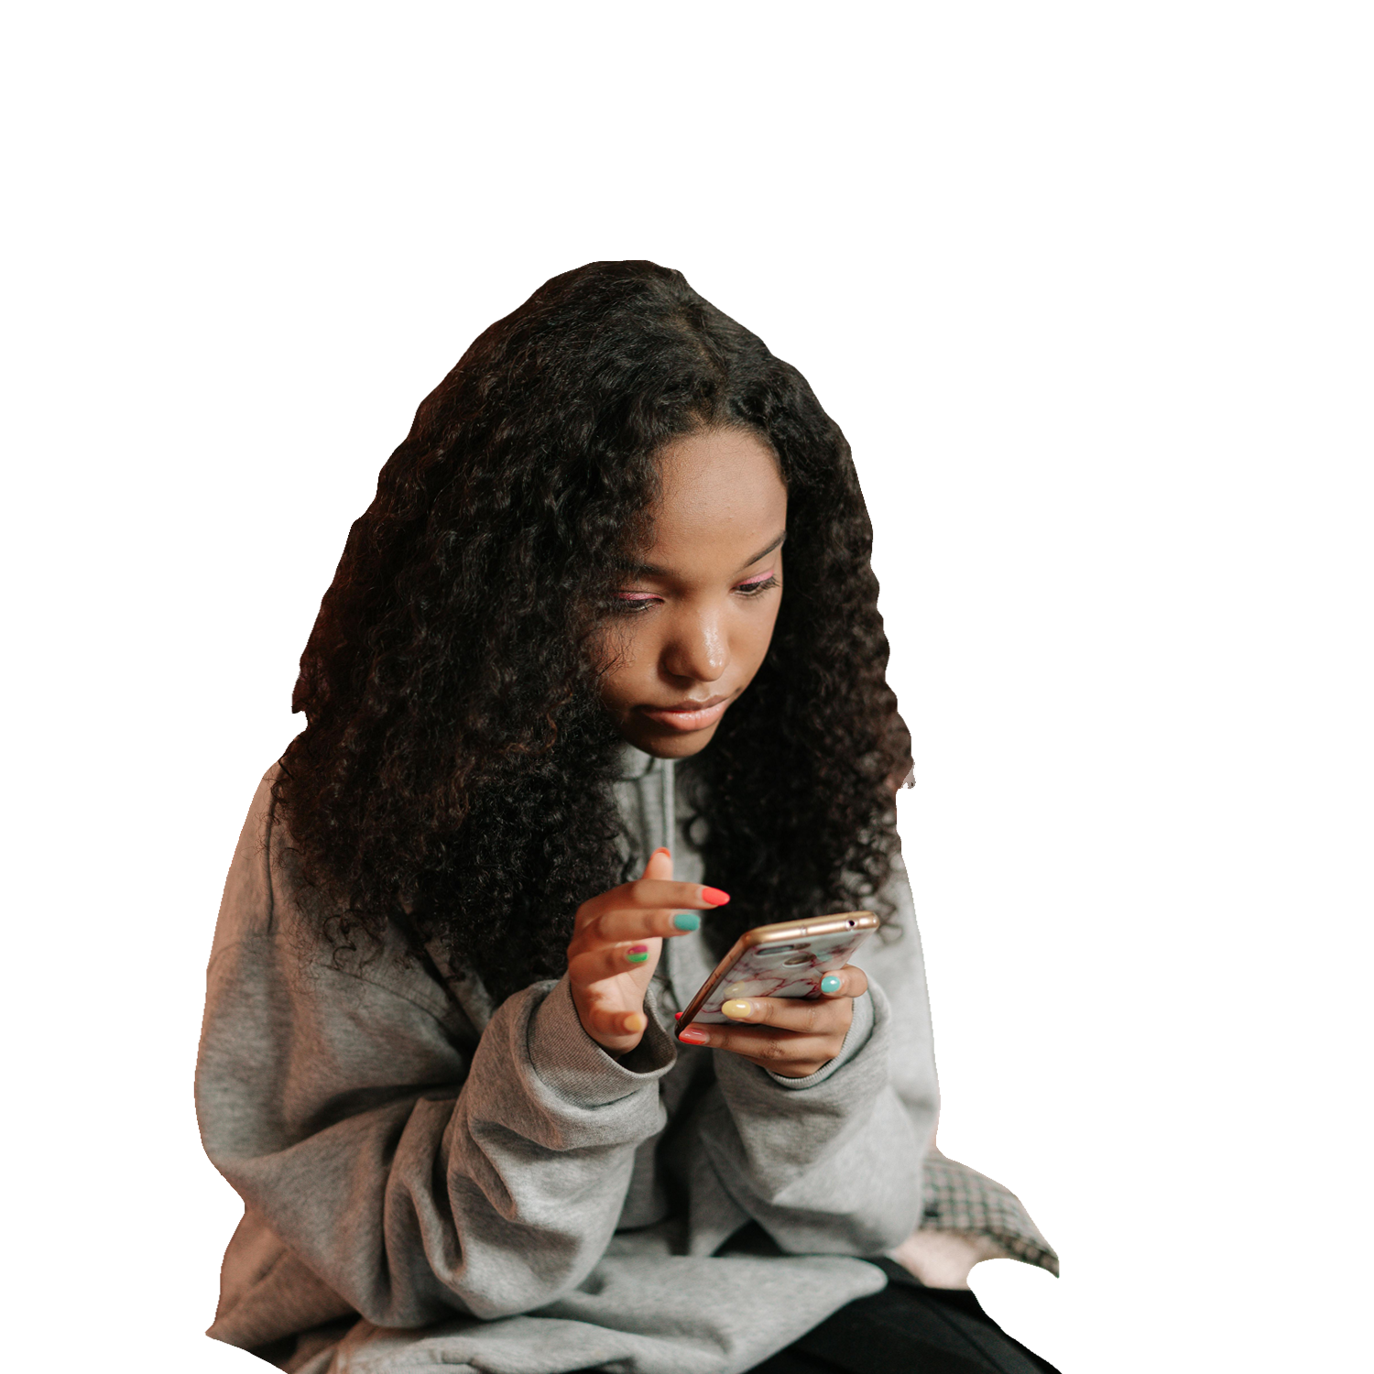
Chatbots and wellbeing
Finley decides to ask Ife for help.
Write a script for the advice Ife could give Finley, including:
how the relationship with the chatbot is different to the relationship with Finley’s friends
how Finley could respond to some of the negative interactions
how Finley could manage his emotions in relation to ending interactions with the chatbot
where Finley could get help
Notes:
Teacher notes – Chatbots and wellbeing (15 mins, slides 17-20)
Finally, explain that Finley has noticed over time, that the chatbot interactions have continued to impact his wellbeing, but is finding it difficult to stop as it feels like ending a friendship. Finley asks Ife for help. Ask students to write a script for the advice Ife could give Finley, using the prompts on the slide.
Support: Ask students to focus on one of the negative interactions and what advice Ife could give to help Finley.
Challenge: Ask students to discuss what might cause the negative interactions from the chatbot?
Students might suggest: glitches or gaps in the data; updates to the app; the chatbot is trained to agree with limited safeguards in place and to maintain user attention and engagement; attempts to make users upgrade lead to a poorer quality of experience for those who don’t; data sources from the internet used to train the chatbot might not be reliable or helpful.

Slide 20

Check the script includes:
how the relationship with the chatbot is different e.g. no thought or feelings from the chatbot’s side.
how Finley could respond e.g. report to the app; fact-check responses or ask friends and trusted adults; take a break from the chatbot.
emotions he might be feeling and ways to manage these e.g., he might feel emotions such as loss, guilt, loneliness; taking time to take part in activities he enjoys, particularly with friends, may help; talking to a trusted adult.
where Finley could get help e.g. speaking to a trusted adult or organisations such as CEOP, ChildLine or Young minds.
Notes:
Teacher notes – Chatbots and wellbeing (15 mins, slides 17-20)
Ask students to peer assess the scripts in pairs, using the criteria on the slide.

Slide 21

Reflection
What are the aspects of human relationships that a chatbot is unable to imitate?
Notes:
Teacher notes – Reflection (3 mins)
Ask students to reflect on the aspects of human relationships that a chatbot is unable to imitate. As this is a personal reflection, they do not need to share their responses with the class, but these might include reflections on intimacy and care, physical contact, emotional empathy, varied opinions or different interests.

Slide 22

What have we learnt?
Revisit your mind map and add in any new learning in a different colour pen, considering:
how chatbots mimic human interactions
how chatbot use could influence expectations of human relationships
how frequent use could impact someone’s wellbeing
when and how someone might want to seek help.
AI chatbots
Notes:
Teacher notes – Endpoint assessment (5 mins)
Remind students of the learning outcomes. Ask them to revisit their mind map and add in any new learning in a different colour pen, considering:
the strategies chatbots use to mimic human interactions
how chatbot use could influence expectations of human relationships
how frequent use could impact someone’s wellbeing
when and how someone might want to seek help.
Take some brief feedback from volunteers and add these new additions to the class mind map in a different colour pen, highlighting progress students have made in the lesson. If gaps are identified in students’ understanding, or misconceptions about the role of AI chatbots, this may need to be revisited in future lessons when returning to this topic as part of a spiral curriculum. Check the question box, answering any final questions.

Slide 23


Sources of support
If concerned about the use of AI chatbots, including how it might affect your wellbeing or relationships, speak to a trusted adult at home or at school (for example the head of year or form tutor).
Or find information and advice from: Childline - www.childline.org.uk; 0800 1111
CEOP – www.CEOP.police.uk
Young Minds – www.youngminds.co.uk
I need your help with something . . .
Something's worrying me,
can I talk to you?
I have something that’s been bothering me . . .
Notes:
Teacher notes – Signposting support (2 mins)
Remind students that if they have concerns about the use of AI chatbots, including how it might affect their wellbeing or relationships, it is important they speak to a trusted adult at home or at school (for example the head of year or form tutor). Students can also contact:
Childline - www.childline.org.uk; 0800 1111
CEOP – www.CEOP.police.uk
YoungMinds – www.youngminds.co.uk

Slide 24

More activities
Create a podcast on the use of companionship chatbots and the potential consequences and risks, considering:
who would you like to interview if you could?
what questions might you ask?
what risks and consequences would you highlight?
what advice would you give to listeners of your podcast?
Notes:
Teacher notes – Extension activity
Ask students to create a podcast on the use of companionship chatbots and the potential consequences and risks. They should consider:
who would you like to interview if you could?
what questions might you ask?
what risks and consequences would you highlight?
what advice would you give to listeners of your podcast?

