Slide 1
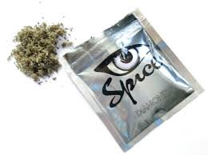
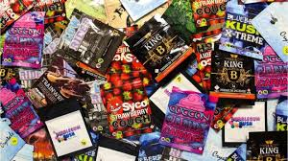
Psychoactive Substances ‘legal Highs’….

Slide 2
Myth one: Legal highs aren’t as strong as illegal drugs True or false?
FALSE
Nope. In fact, they’re potentially more potent than illegal drugs – hence their new found popularity. Illegal drugs such as cocaine or MDMA are usually mixed with all sorts of rubbish like caffeine pills and baking soda as they travel along the manufacturing line.
But reports suggest synthetic legal highs can be purer and more potent because they’re not cut with anything else. Even herbal highs pack a powerful punch.
https://spiceaddictionsupport.org/liquid-synthetic-marijuana-vaping/

Slide 3
Myth two: Legal highs are safer True or false?
FALSE
This is one of the biggest misconceptions about legal highs.
Just because they are technically legal, doesn’t mean they are safe. It just means the powers-that-be haven’t got round to legislating against the concoction of chemicals you’ve got clutched in your hand. New batches of legal highs are mixed up quickly to dodge new laws and haven’t been tested for human consumption. So you’re playing guinea pig. Not safe.
https://www.youtube.com/watch?v=C9bwZqAf7aI&feature=youtu.be

Slide 4
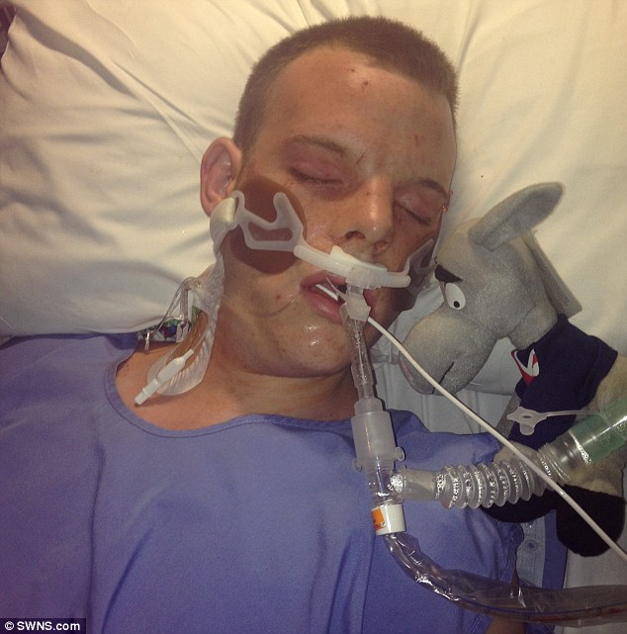
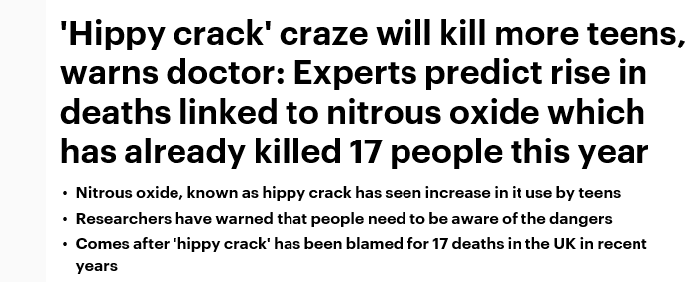

Slide 5
Myth three: Legal highs are legal True and false?
FALSE
“But they are called LEGAL highs,” surely legal is the key word here?
But think. Do you really know what’s in that packet? Have you done extensive laboratory tests on it? For all you know you’ve got an illegal substance there. Forensic tests on allegedly legal highs have shown some of them contain banned substances such as mephedrone.
So you might think you’re on the right side of the law, but ignorance isn’t an excuse for possession if you’re caught.
Not to mention that the new Psychoactive Substances Act means that it’s illegal to produce or supply legal highs.

Slide 6
These are substances designed to produce the same, or similar effects, to drugs such as cannabis, cocaine and ecstasy but are structurally different. We do not know the long term affects of these either.
Twenty-six people were convicted under "psychoactive substances" laws in the first six months since they were introduced.
It followed almost 500 arrests over the same period following a ban on new drugs like Spice.
http://www.bbc.co.uk/news/uk-england-41082868
https://www.theguardian.com/society/legal-highs

Slide 7
Myth four: Legal highs can kill you dead True or false?
TRUE
There is no way of telling how your body will respond to a substance. Plus mixing substances with medication, drugs or alcohol can be fatal.
http://www.dailymail.co.uk/news/article-3058299/Hippy-crack-craze-kill-teens-warns-doctor-Experts-predict-rise-deaths-linked-nitrous-oxide-killed-17-people-year.html
http://www.independent.co.uk/news/uk/home-news/teenager-collapses-and-dies-after-taking-laughing-gas-at-london-party-10416427.html

Slide 8
Myth five: You can mix legal highs with alcohol True or false?
FALSE
No. Don’t try. Here’s the science. Alcohol is a depressant. This means it slows down the nervous system which controls the heart and breathing rate.
Mixing alcohol with any drug, including legal ones, can seriously upset your body. Mixing alcohol with another legal depressant could shut you down altogether.

Slide 9
Myth six: Legal drugs come from a less dodgy source True or false?
TRUE
Most synthetic legal highs are made in China and sent legally into this country.
However, this doesn’t make legal high manufacturers candidates for outstanding citizen awards. They’re still rather shady business people with an interest in profit, not well-being. After all, they’re determinedly tweaking chemical formulas to dodge laws and mass-producing substances for human consumption without conducting any medical tests.
So it’s naive to assume the legal high industry is a clean one.

Slide 10
Myth seven: Legal highs are cheaper than illegal drugs True or false?
TRUE
The pricing of drugs works just like any other business. It’s all to do with supply and demand. Supplying illegal drugs can be tricky and involves risky manoeuvres, dodging police raids and getting people to stuff things up private orifices. All this pushes the price up. With legal highs the process is simpler. Therefore supply is easier, demand is lesser and the cost is lower.

Slide 11
Myth eight: Legal highs are purer True or false?
TRUE
It’s supply and demand again. Illegal drugs are scarcer, in demand, and therefore likely to be mixed with all sorts of nasties to stretch out the stock. So that rather expensive line may contain more caffeine than cocaine.
There’s less of a need to cut legal highs with so much rubbish.
Don’t assume this makes them safer. It makes them stronger. So if you’re snorting a ‘legal line’ or vaping a chemical like THC you might not need to take as much and you put yourself at risk of overloading your body.

Slide 12
Myth nine: It’s easier to get the dosage right with legal highs True or false?
FALSE
They’re not aspirins. They don’t come with a recommended dosage printed on the label. Plus, they’re largely unregulated and untested. What worked for a mate, might not work for you.
There is no way of telling how a legal high will affect you and how much to take. Plus, with the chemicals constantly changing, even re-trying a legal high is like trying it for the first time – a gamble with you health or your life!

Slide 13
Myth ten: With legal highs you know what you’re getting True or false?
FALSE
Drug legislation is constantly changing. Therefore crafty legal high traders are constantly adapting their products to keep the law on side. So your new legal purchase might look the same and be packaged the same as your last drug, but it could be completely different.
Legal highs are just as risky, or perhaps more so.

Slide 14
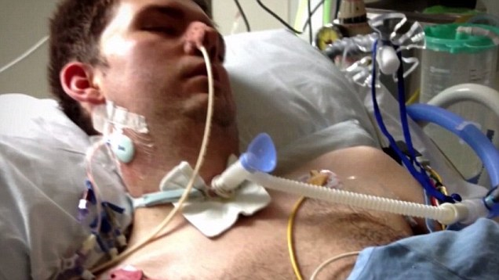
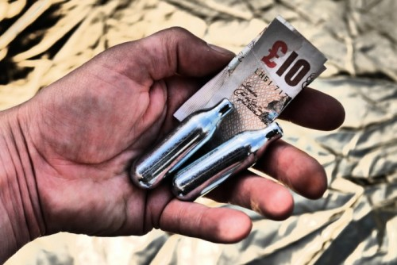
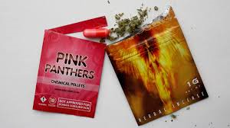
https://youtu.be/DEeSqirGi3Q
http://www.dailymail.co.uk/news/article-2470128/Horrific-cost-taking-legal-highs-Mother-releases-shocking-picture-dying-son-20-suffered-heart-attack-smoking-herbal-substance.html

