Slide 1
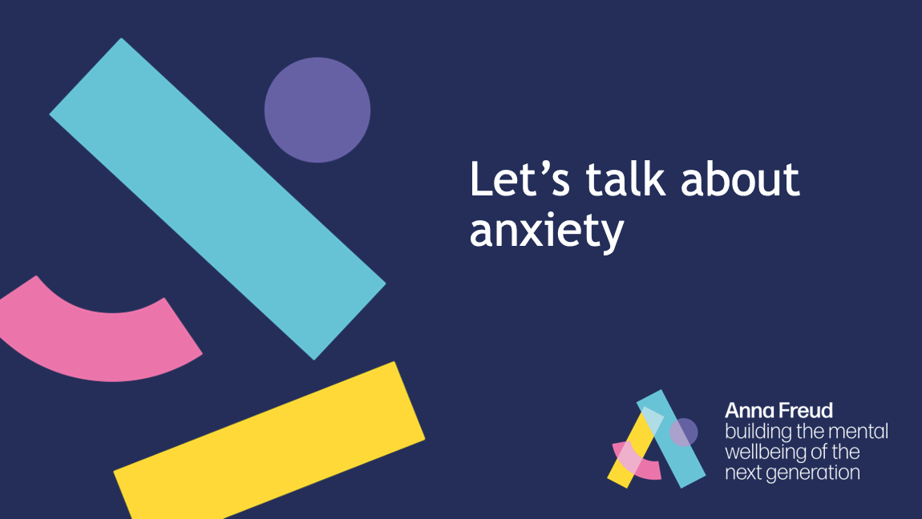
Notes:
Introduce the topic and show students the definition of anxiety.
Explain that you are going to look at this in two parts.

Slide 2
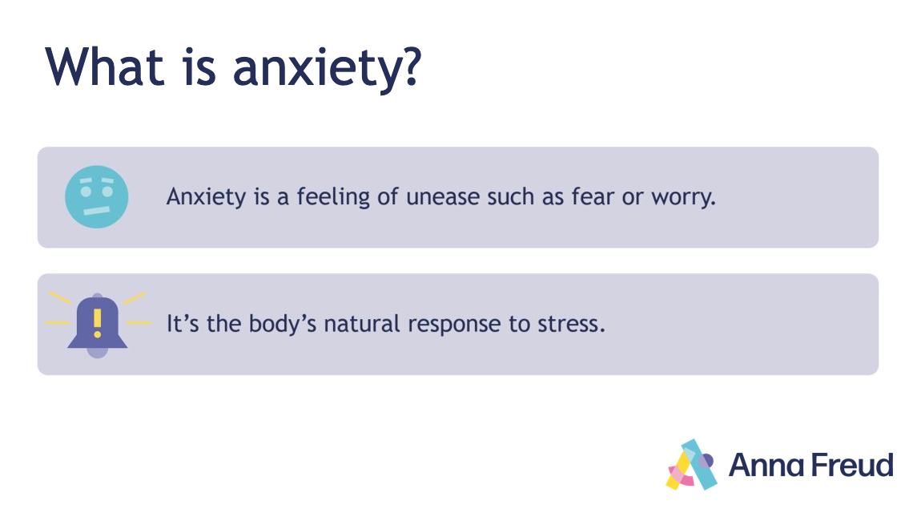
Notes:
Introduce the topic and show students the definition of anxiety.
Explain that you are going to look at this in two parts.

Slide 3
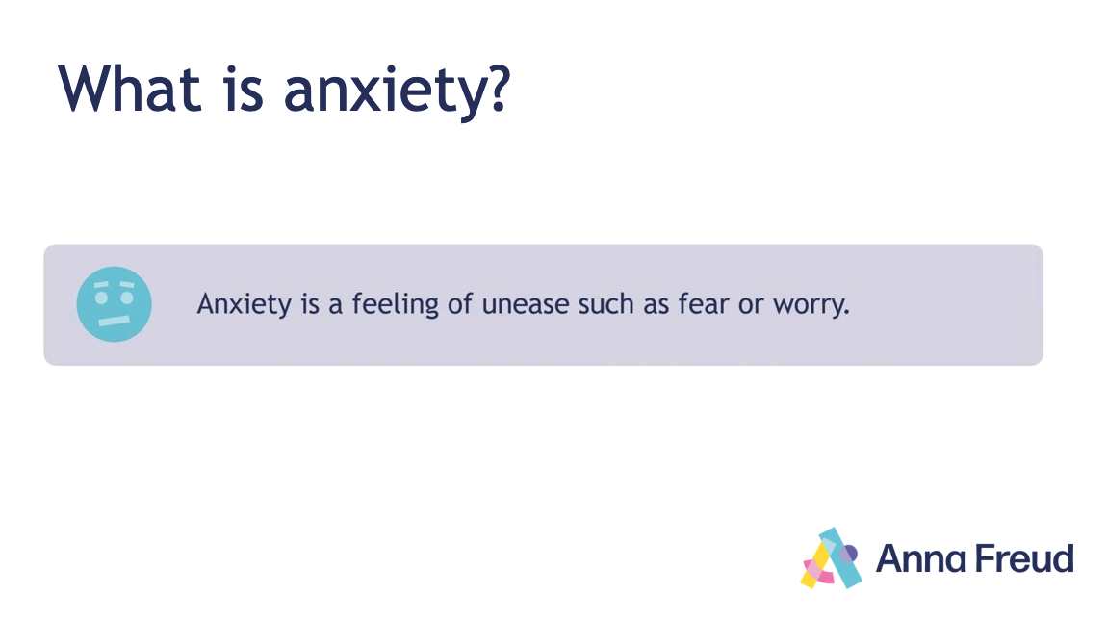
Notes:
Thinking about this definition, ask students for a couple of examples of when someone might feel anxious.
Draw students’ attention to ‘unease’, ‘fear’ and ‘worry’. Explain that you're going to think about some similar feelings.

Slide 4
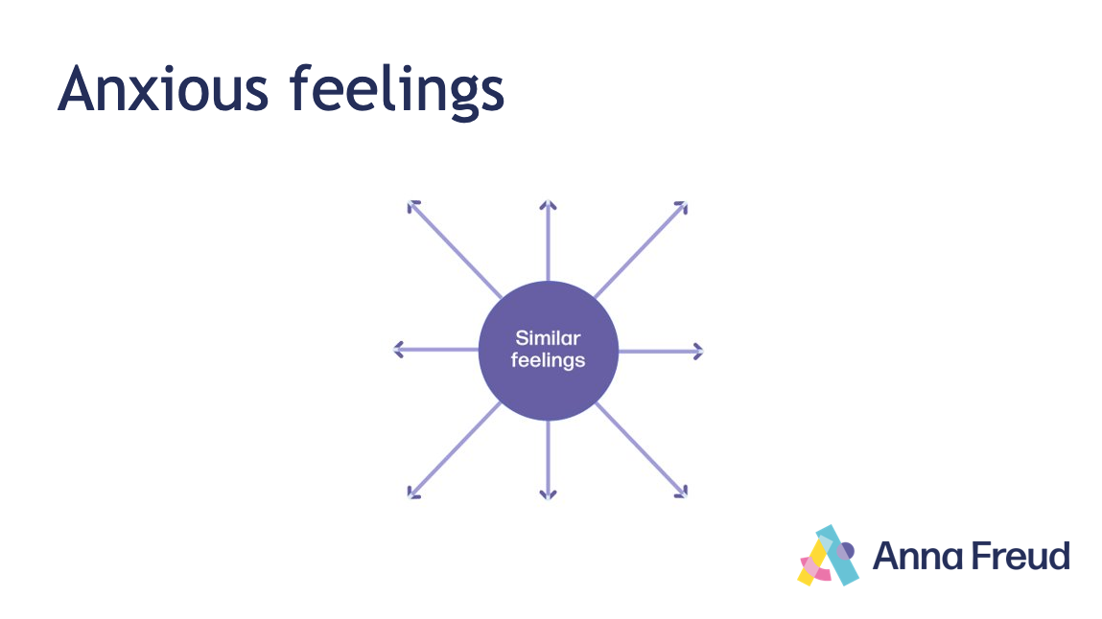
Notes:
Ask students to name some similar feelings.
Give students two minutes to fill in their spider diagrams on their worksheets, and then gather their ideas to fill in the spider diagram on the PowerPoint. (e.g., stressed, worried, scared, worked-up, panicky, nervous, uneasy, afraid, excited, terrified, bothered, concerned, distressed).
Use these words to gather three to four example sentences from your students (e.g., “I’m really worried about my exam”, “I’m super-stressed about my performance tomorrow”).
Use these examples to help students reflect on the meanings and usages of the different feeling words. Make comparisons between the different feelings and situations.
Encourage students to reflect on the meaning and appropriateness of different words (e.g., the distinction between “I’m nervous about my presentation” and “I’m terrified of going to school”).
Ask students: What’s the difference between [word] and [word]? How might it be different? Is one stronger than the other? When else might someone feel it?
Explain that naming anxious feelings accurately can help us to understand how we feel and think about how best to respond in an appropriate way.

Slide 5
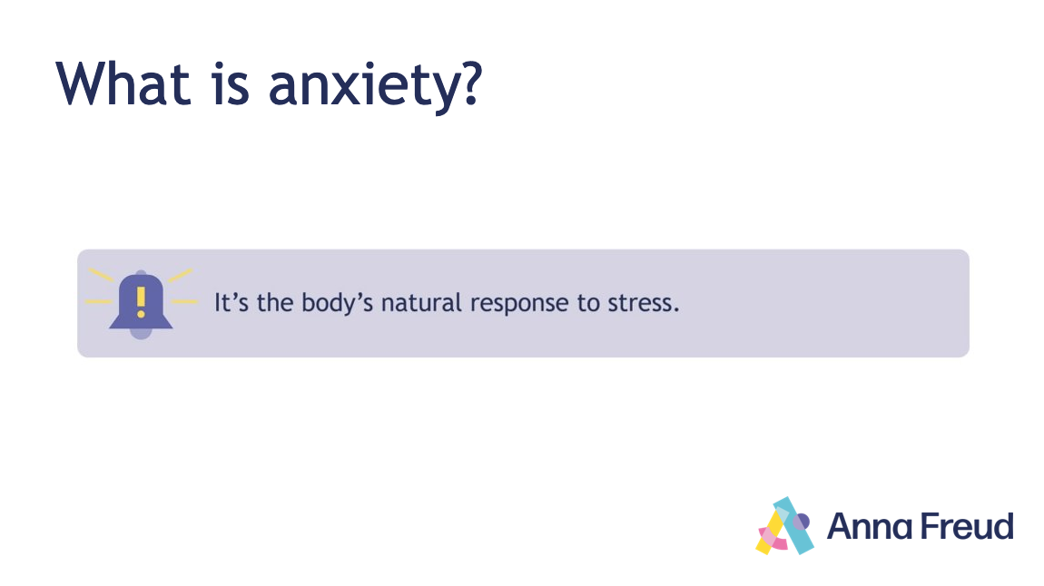
Notes:
Explain that anxiety is a normal and useful emotion. It helps to protect us from danger.

Slide 6
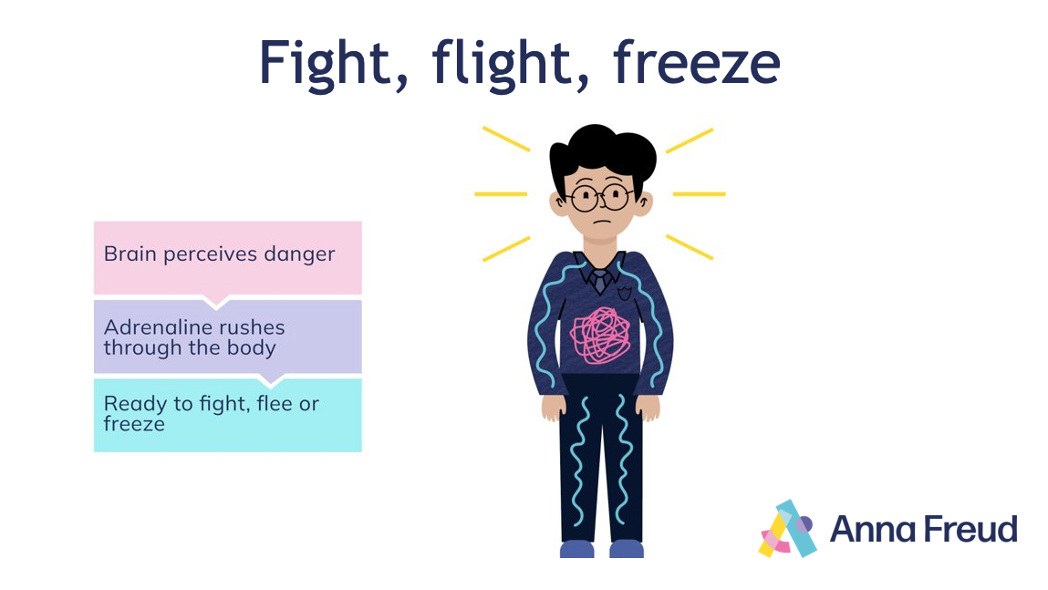
Notes:
When your brain thinks you're in danger, it activates the fight-flight-freeze response to help protect you. Adrenaline and cortisol (the stress hormone) rush through your body, and put it on high alert.
This means that the body is ready to fight, escape or freeze when it thinks that there's a threat. This response helps us to act without thinking and keep safe.
Ask students: Can you think of some examples of when anxiety might protect us from danger? (e.g. when a fire alarm goes off, when crossing the road, when threatened by a dangerous animal).

Slide 7
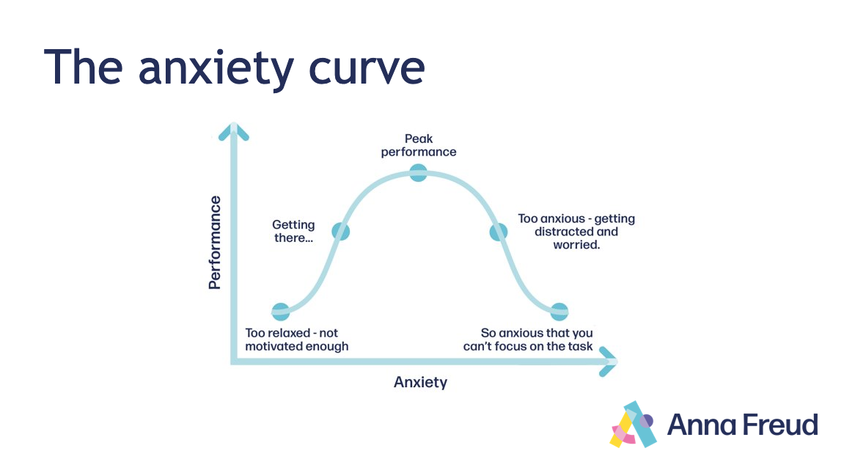
Notes:
Explain that some level of anxiety can also be helpful. Just as anxiety can help to protect us, some level of anxiety can help us to focus, deal with difficult situations and perform better.
Ask students: Can you think of times when some level of anxiety can be helpful? (e.g. exams, sports games, performances, presentations).

Slide 8
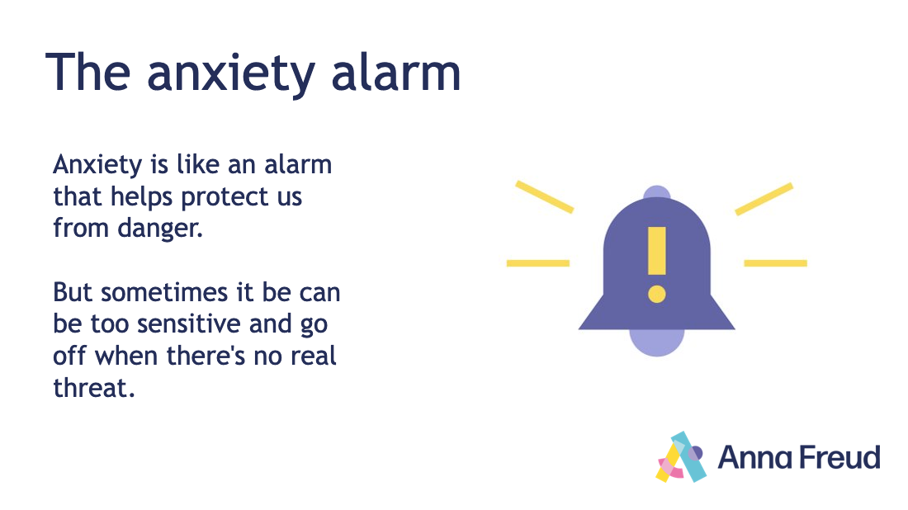
Notes:
Explain that sometimes we might think that something is more dangerous than it is – or we might think there’s a threat when there isn’t one. This is when anxiety can be a problem. We can think of this as a ‘false alarm’.
Explain the alarm metaphor to the class:
Anxiety is like an alarm that helps protect us from danger - but sometimes it can be too sensitive and go off when there's no real threat (e.g. an over-sensitive car alarm that goes off when the wind blows, or when someone walks past).

Slide 9
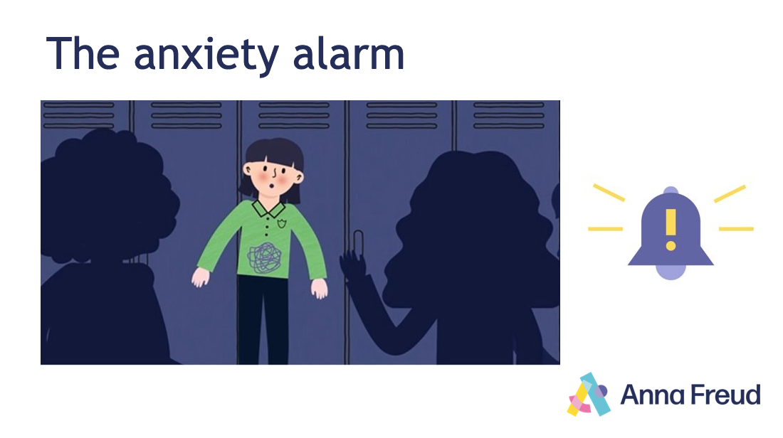
Notes:
Ask the class: What might be setting off the girl’s anxiety alarm? What might be going on in her mind? How might it affect her body?
Explain that these responses are normal – and that there are some skills and techniques we can learn and practise to help manage anxious feelings.

Slide 10
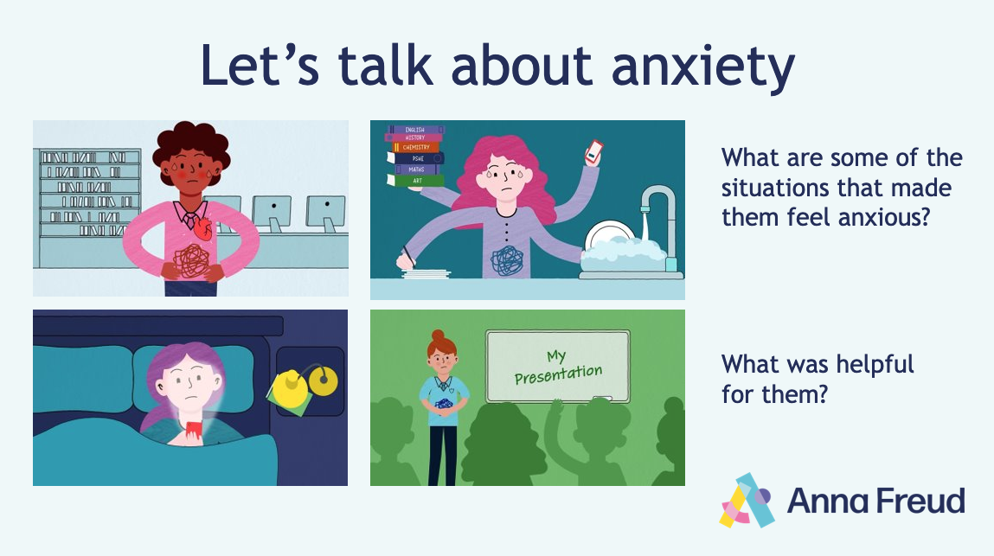

Notes:
Animation link: https://www.youtube.com/watch?v=dknTQktH5Z0
Alternative link: https://vimeo.com/825490584/15cc14f9bc
Introduce the Let’s talk about anxiety animation. Ask students to look out for the characters on the slide, and to think about the following as they watch:
What are some of the situations that made them feel anxious?
What things were helpful for them?
After you have watched the animation, give students one minute to discuss these questions in pairs and fill in their worksheets. Then use the slides to guide a whole class discussion of the content of the animation in more detail.

Slide 11
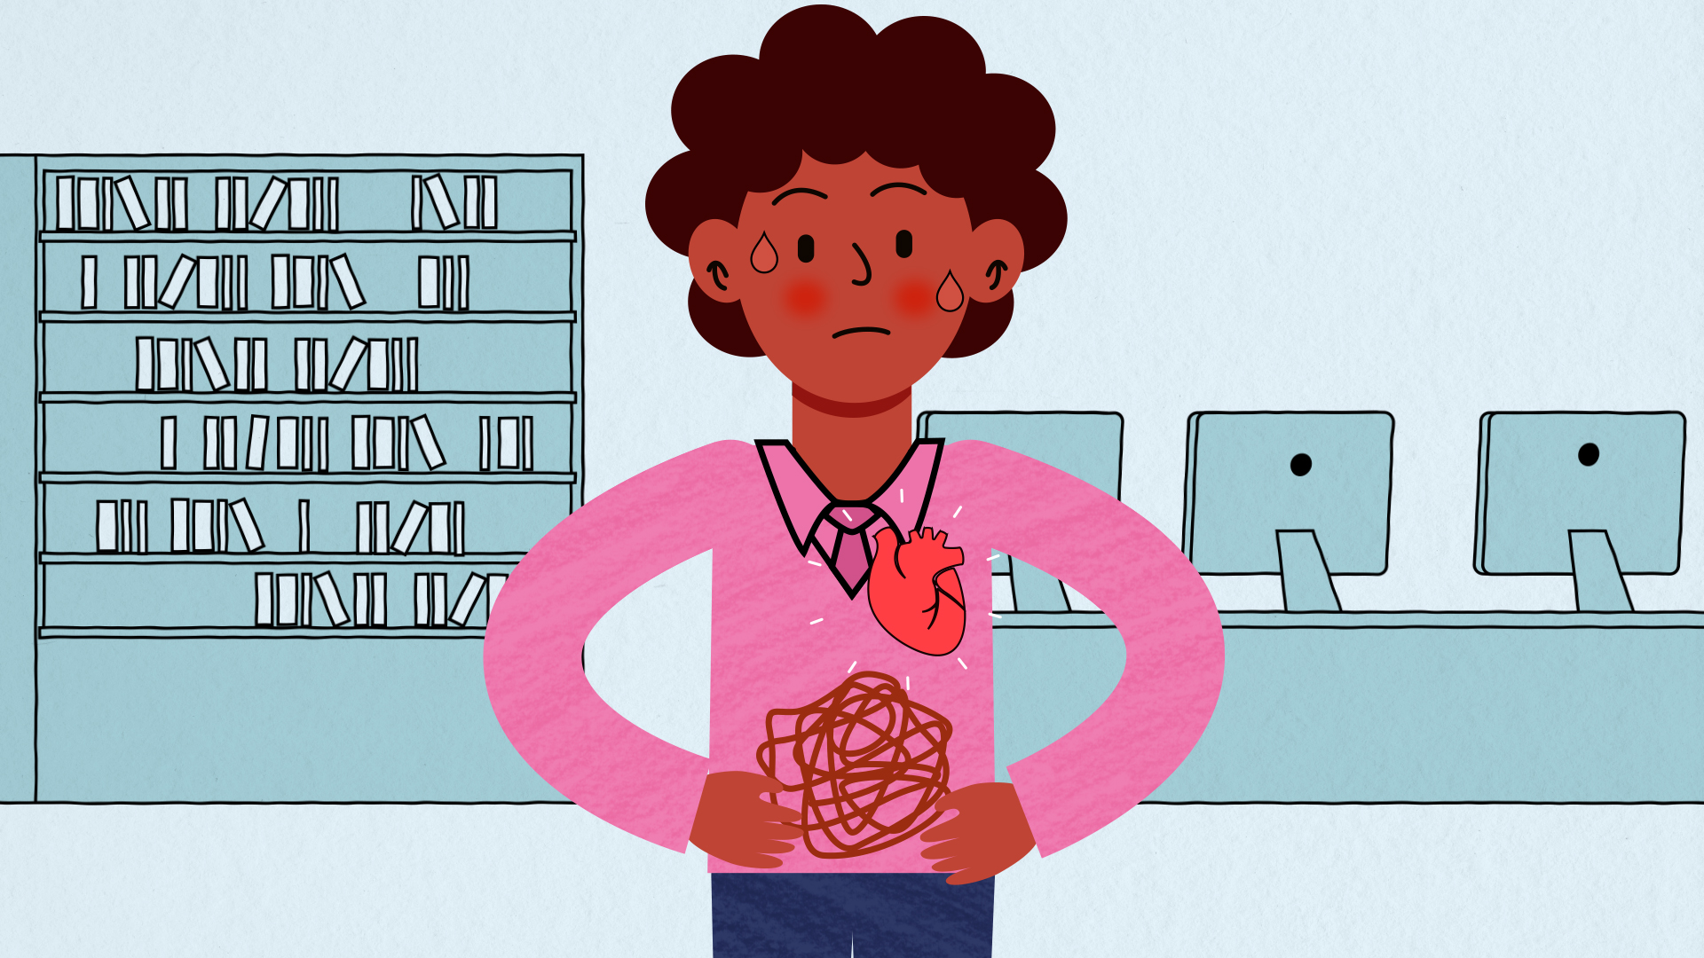
Notes:
What did we find out about how anxiety can affect our bodies? (e.g. sweating, heart racing, butterflies in stomach, feeling dizzy, fidgety, etc.)
How might it affect our thoughts, feelings and actions? (e.g. negative thoughts, acting impulsively, avoiding difficult situations).

Slide 12
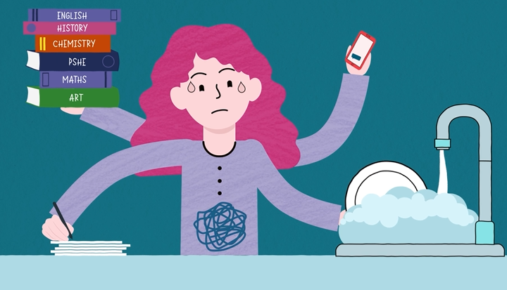
Notes:
What kinds of thoughts might be going through this character’s mind? (e.g. “I don’t have enough time”; “I’m going to fail my exam”; “My mum will be mad if I don’t finish my chores and do my homework”).
What could they try to manage better? (e.g. ask for help; create a schedule; stick to a routine; make time for self-care)

Slide 13
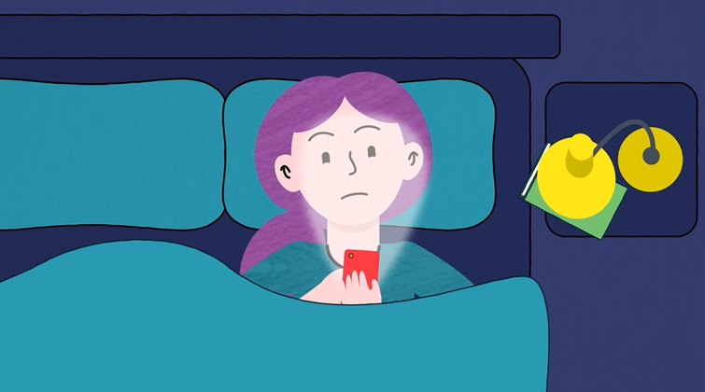
Notes:
What might this character be looking at on their phone? How might this affect them?
What could a healthy evening routine look like for them? (e.g. stop using phone 30 mins before bed; set phone to ‘night mode’; try not to use laptop and phone in bed; have a regular bedtime; listen to relaxing music, read, etc.)

Slide 14
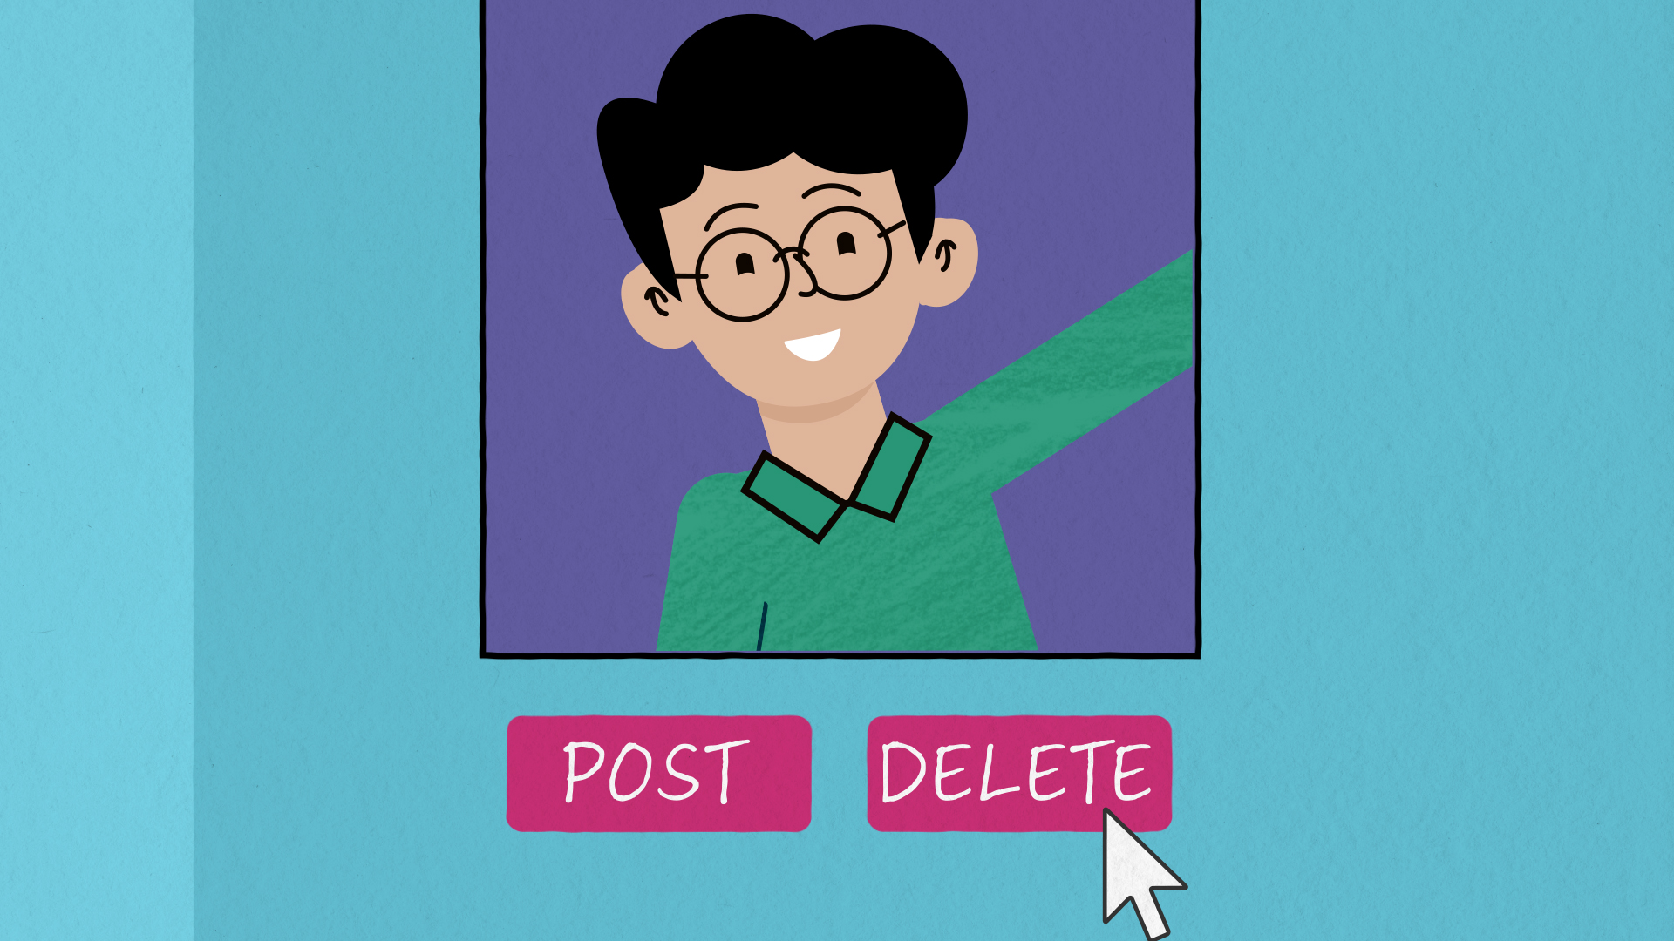
Notes:
What do you think this character was worried about? How could they use their phone in a more positive way?
(e.g. contact friends and family; set limits on using certain apps; use apps to pursue their interests or learn something new, such as a language or skill).

Slide 15
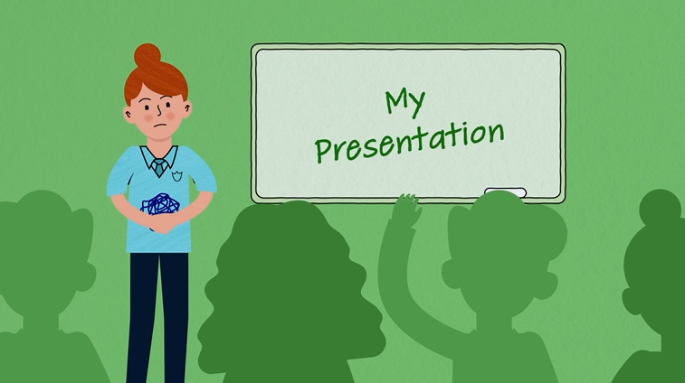
Notes:
What might this character be thinking or imagining? (e.g. “I don’t know what I’m talking about”; “I’m not ready”; “Everyone will laugh at me”; “I’ll go red”).
Explain that one thing they might try is ‘positive self-talk'. This is when we talk to ourselves in a kinder and more helpful way. (e.g. rather than thinking “There’s no way I can do this,” we might think “I’ve done it before, I’ll try my best”).
How could this character use positive self-talk to ‘talk back’ to her anxious thoughts?

Slide 16
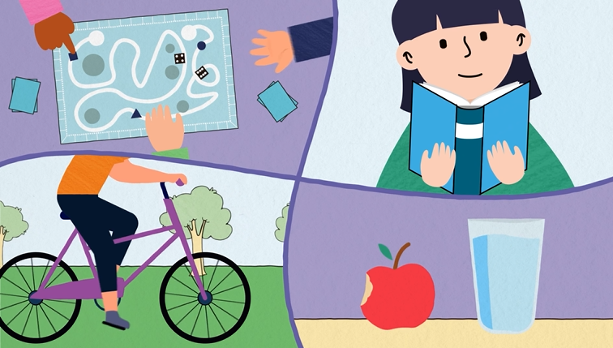
Notes:
What are some other skills and coping strategies that we can work on to help manage anxious feelings?

Slide 17
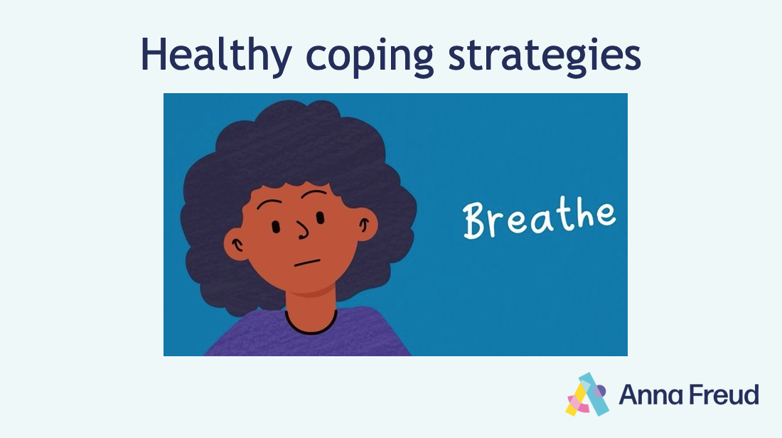
Notes:
Explain that you’re going to learn some more skills that can help you to manage anxiety.
Remind students of the earlier discussion of anxiety and the body.
How might breathing help to regulate our bodies? How might this affect our thoughts and feelings?

Slide 18
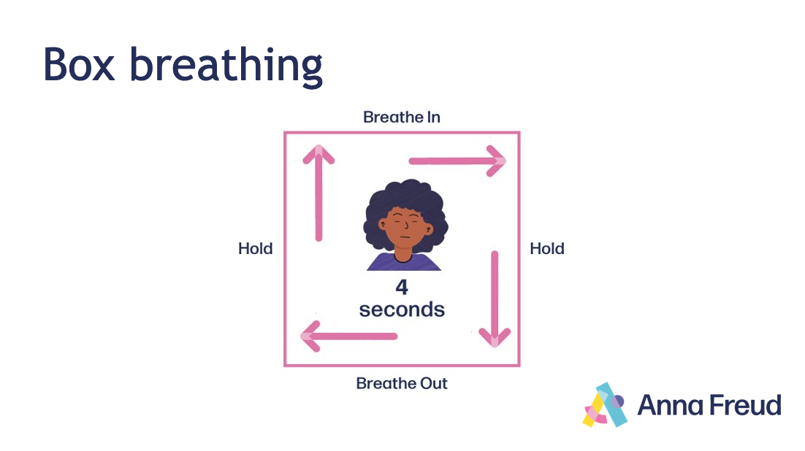
Notes:
Breathe in through your nose for 4 seconds.
Hold your breath for 4 more seconds. Feel the air fill your lungs.
Breathe out through your mouth for 4 seconds.
Hold for 4 seconds.
Repeat this several times.
Ask students:
What effect did it have on your thoughts, feelings and body?
How would you describe how you feel right now?

Slide 19
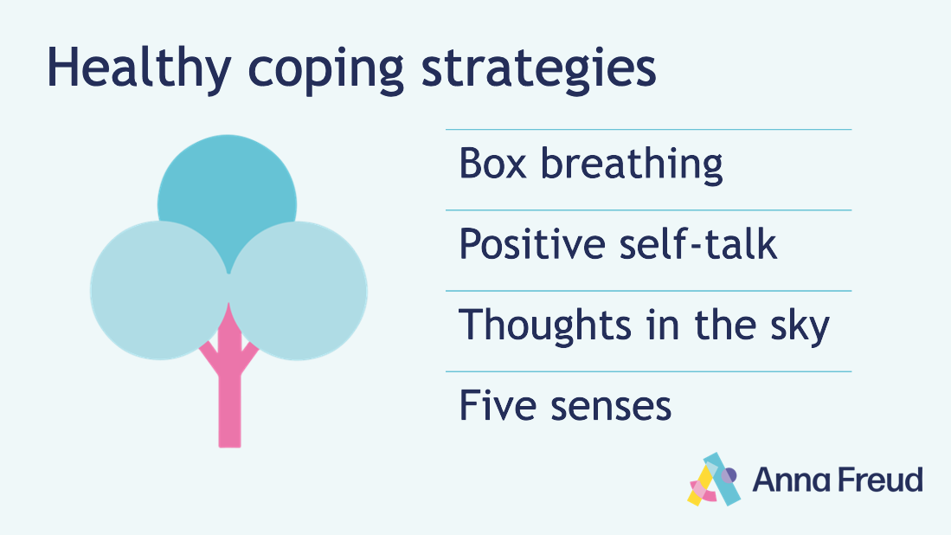
Notes:
Explain that students are going to teach each other, practise and reflect on these different skills.
Distribute the healthy coping skills cards among the class. Divide the class into pairs. One student is the teacher and the other is the learner.
Explain that each learner should imagine that they are one of the characters from the animation.
Give the students two to three minutes to teach and practise one of the skills, before swapping roles and skills.
At the end of the exercise, ask students to reflect on the following:
What effect did the different skills have on your thoughts, feelings, and body?
When might someone use them? Are there times when it wouldn’t be helpful or possible to use them?
What other skills or techniques might someone use when they feel anxious?

Slide 20
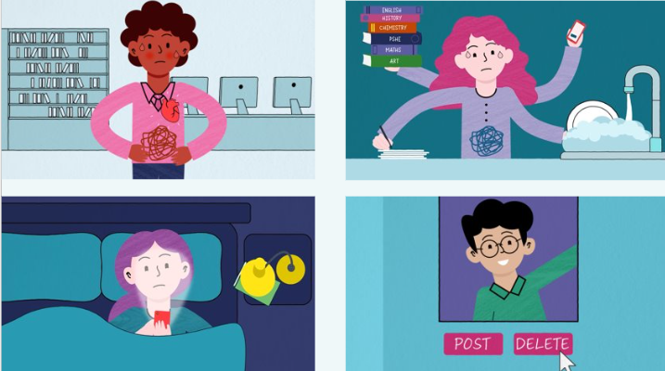
Notes:
Explain that students are going to teach each other, practise and reflect on these different skills.
Distribute the healthy coping skills cards among the class. Divide the class into pairs. One student is the teacher and the other is the learner.
Explain that each learner should imagine that they are one of the characters from the animation. Use one of the worries that the character has (e.g., "I've got too much to do", "I'll never be able to sleep tonight") and try the healthy coping skills to see if they can help.
Give the students two to three minutes to teach and practise one of the skills, before swapping roles and skills.
At the end of the exercise, ask students to reflect on the following:
What effect did the different skills have on your thoughts, feelings, and body?
When might someone use them? Are there times when it wouldn’t be helpful or possible to use them?
What other skills or techniques might someone use when they feel anxious?

Slide 21
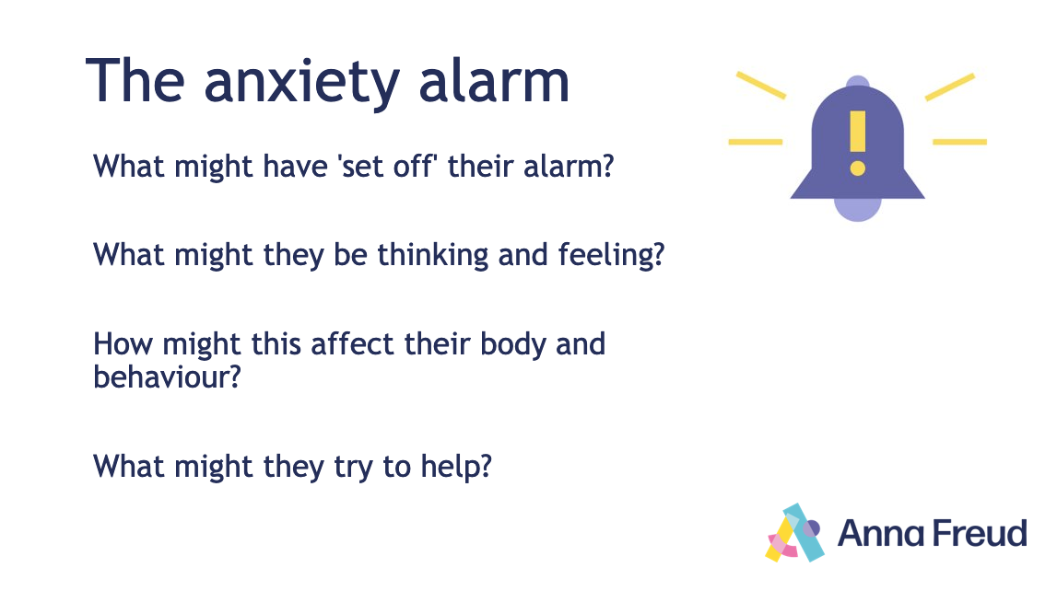
Notes:
Note: There are six scenarios for this activity in the PowerPoint. Depending on available time and the needs of your students, you may wish to focus on two to three of these scenarios and discuss those that are most relevant to your class.
Remind students of the anxiety alarm metaphor. Explain that they are going to consider some different scenarios in which people feel anxious.
They should apply what they have learned to think about how the characters feel and how they might respond.
As they read the scenario, ask students to think about:
what might have ‘set off’ their alarm?
what might they be thinking and feeling?
how might this affect their body and behaviour?
what might they try to help?

Slide 22
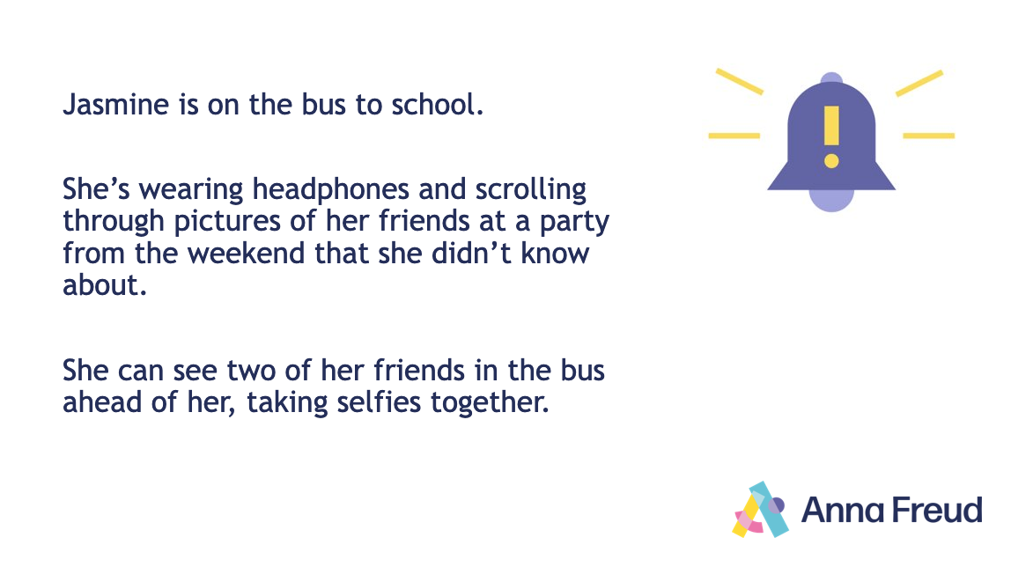
Notes:
What might have 'set off' their alarm?
What might they be thinking and feeling?
How might this affect their body and behaviour?
What might they try to help?
Give students two minutes to discuss this in pairs and make notes, before coming together as a class to discuss.
During the discussion, encourage students to consider the practicality and effectiveness of different coping strategies in specific situations, while emphasising that different things will work for different people.

Slide 23
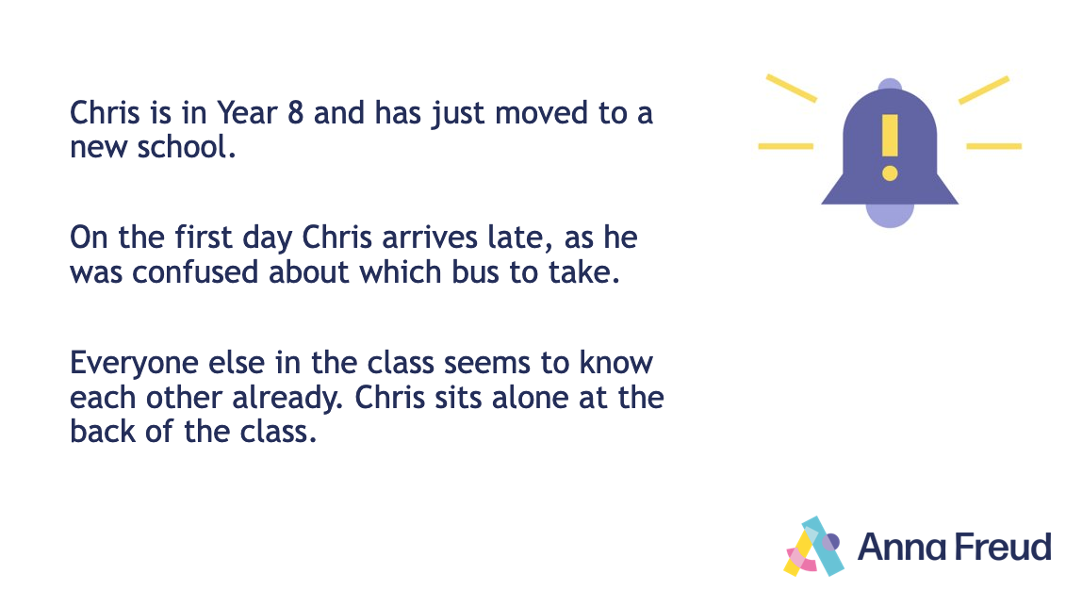
Notes:
What might have 'set off' their alarm?
What might they be thinking and feeling?
How might this affect their body and behaviour?
What might they try to help?

Slide 24
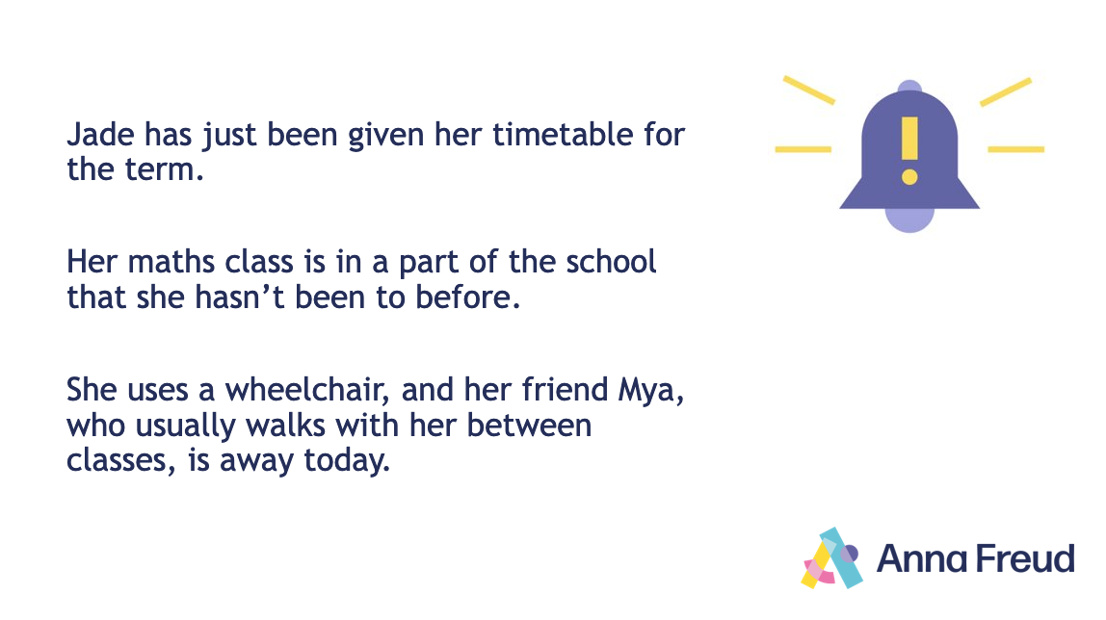
Notes:
What might have 'set off' their alarm?
What might they be thinking and feeling?
How might this affect their body and behaviour?
What might they try to help?

Slide 25
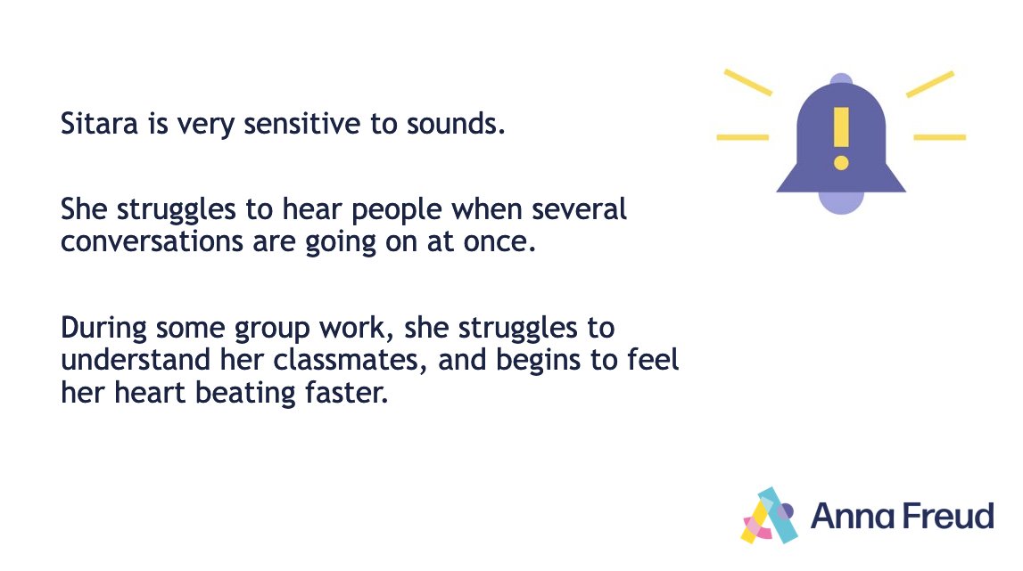
Notes:
What might have 'set off' their alarm?
What might they be thinking and feeling?
How might this affect their body and behaviour?
What might they try to help?

Slide 26
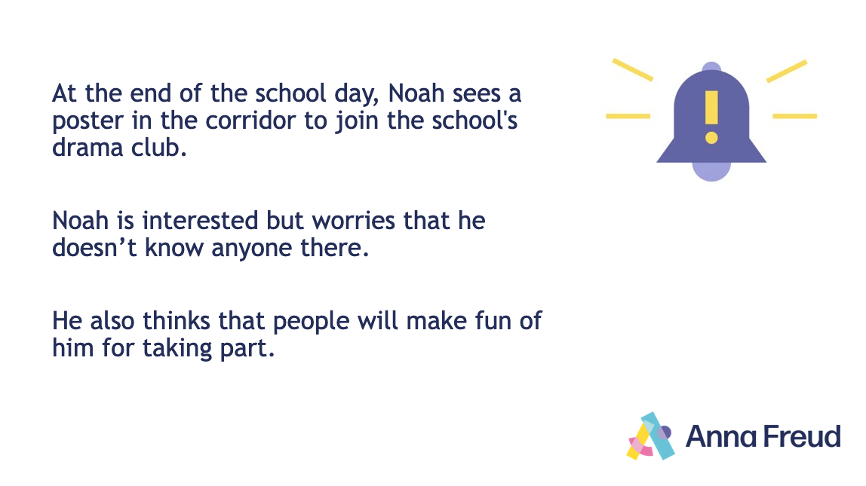
Notes:
What might have 'set off' their alarm?
What might they be thinking and feeling?
How might this affect their body and behaviour?
What might they try to help?

Slide 27
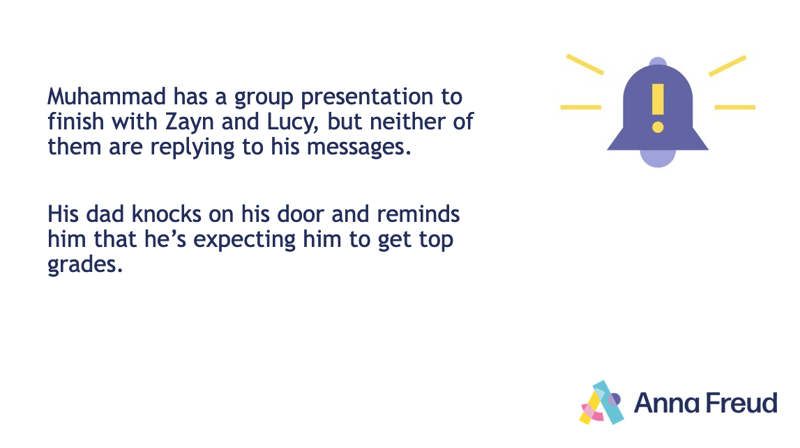
Notes:
What might have 'set off' their alarm?
What might they be thinking and feeling?
How might this affect their bodiy and behaviour?
What might they try to help?

Slide 28
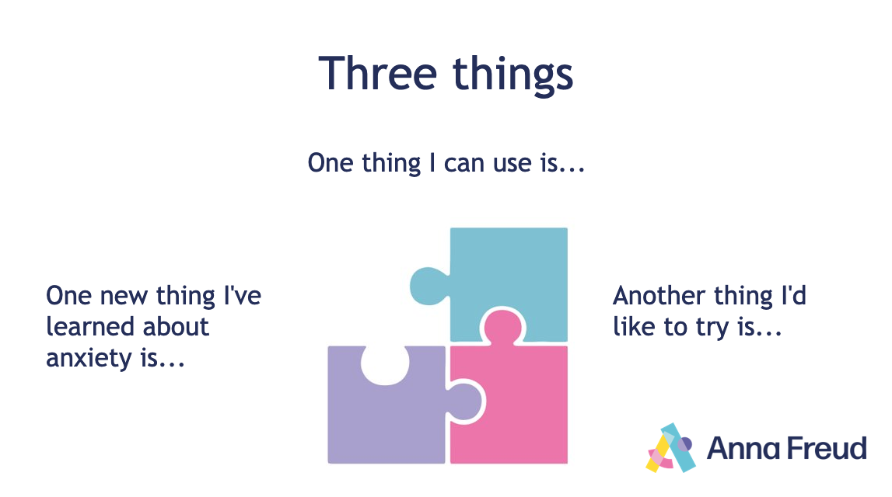
Notes:
Ask students to reflect on what they’ve learned, and to complete the following prompts:
Something new I’ve learned about anxiety is...
Something I can use is...
Another I’d like to try is...
On a separate card, encourage students to write any questions they might have and to put them in the listening box.

Slide 29

Further support
Here’s where you can find further support if you need it:
Speak to your teacher
-
-
-
-
Notes:
Fill this slide with information about where students can find further support in your setting.
Close the lesson by emphasising that anxiety is a normal emotion, and that it’s important to try and find out what works for you.
Remind students that if they’re worried, they should speak to a trusted adult, and possibly seek specialist help (e.g., speak to your GP).
Remind students about the support available at school. Make yourself available to any students who want to speak further.

Slide 30
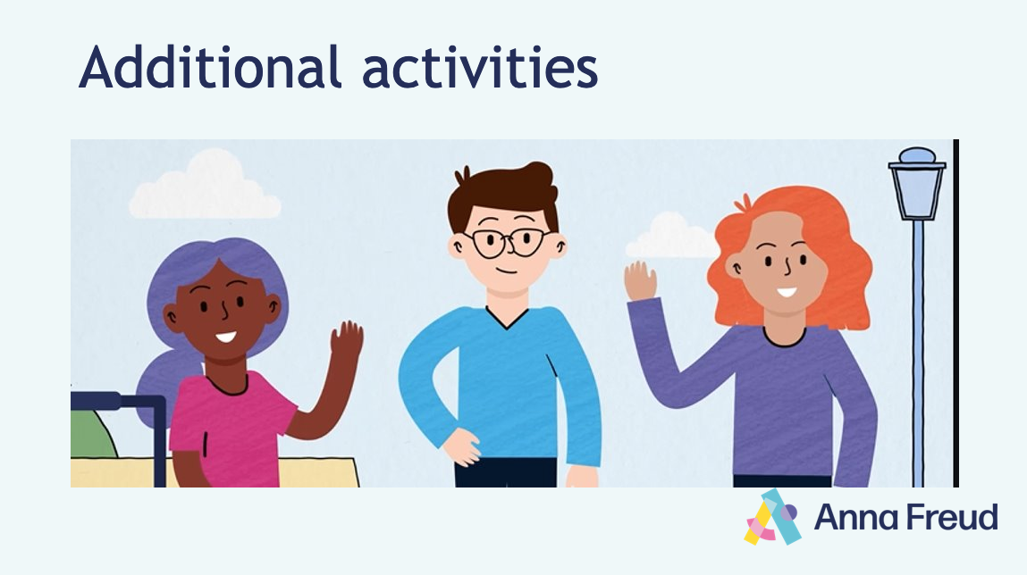
Notes:
These activities can be used as extensions to the Let’s talk about anxiety lesson, or to revisit the topic in later lessons as part of a fully planned PSHE curriculum. Shorter activities may also be used in tutor time.
If you are using these activities to return to the topic later in the academic year, you may wish to rewatch the animation and revise previous material as necessary.
The content for delivering these activities can be found in the notes for each slide. You may also wish to print the Additional activities document to assist delivery.

Slide 31
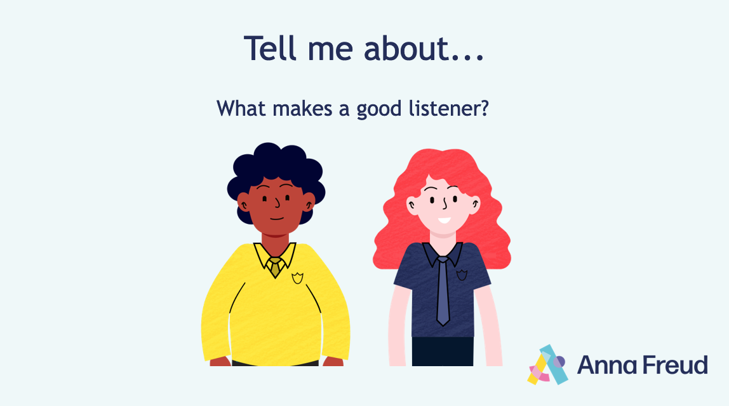
Notes:
Explain that you are going to think about how you can support others who are feeling anxious. One thing that can help is listening to people, and being there to support them.
Ask the class: what makes a good listener? (e.g., paying close attention; showing interest and asking relevant questions; not interrupting, etc.).
Explain that in pairs you’re going to practise listening to each other by learning another coping skill. In this case, you can use the skill to support others.

Slide 32
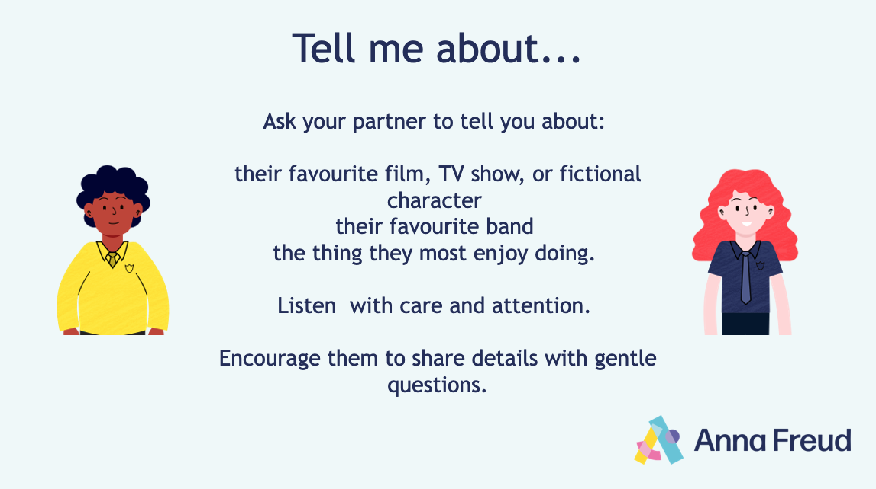
Notes:
Introduce the ‘Tell me about’ technique. Explain that this technique can help to calm someone who is having anxious thoughts by taking their mind off their worries, and by helping them feel listened to.
Ask students to practise this in pairs. Each partner should speak for one – two minutes while the other listens, before swapping roles.

Slide 33
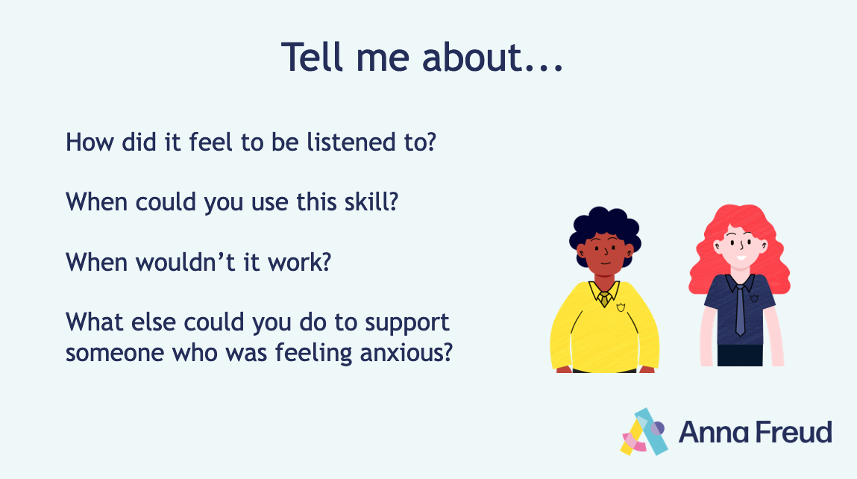
Notes:
Ask students to reflect: how did it feel to be listened to? When could you use this skill? When wouldn’t it work?
What else could you do to support someone who was feeling anxious?
(e.g., make yourself available to support them; offer to go with them if they’re worried about going somewhere or trying something new; offer to practice healthy coping skill with them; help them to make a plan; suggest they talk to a trusted adult).

Slide 34
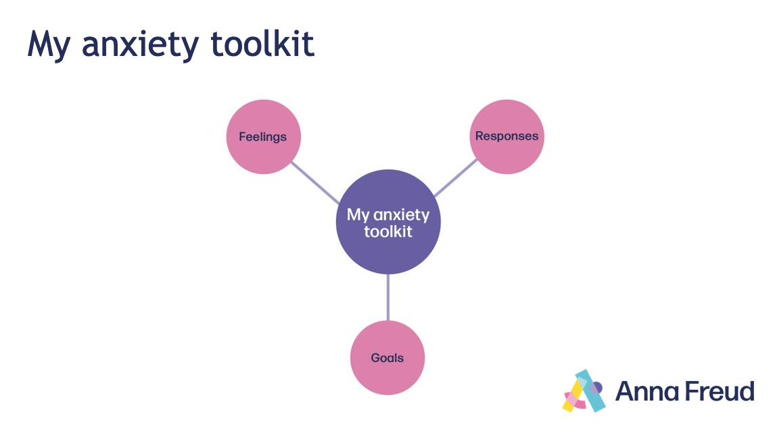
Notes:
Explain to students that they will design their own toolkit to help them when they’re feeling anxious. This is for their own use – they can keep it completely private or share it with others if it will help to support them.
Run through the different sections of the worksheet and ask students for some examples of what someone might put in their toolkit. You may wish to initially refer to characters from the animation to assist with this.
Give students 10 – 15 minutes to fill in the different sections of the worksheet in whichever way is most useful to them. You may play some relaxing music to support this.
Invite any students who wish to do so to share anything. It may also be helpful to create your own toolkit and share it with your class.
Explain to students that they can keep their toolkit in their exercise books, bags, at home or at school.
If they wish, they can also discuss it with their friends, parents and carers, or school staff, to make them aware of any ways in which they might support them.

Slide 35
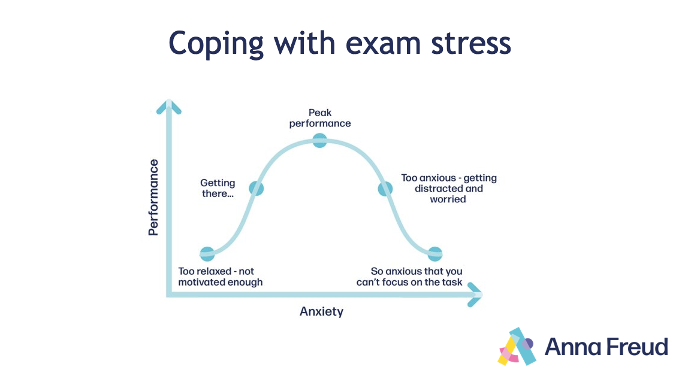
Notes:
Remind students of the anxiety curve. Explain that some level anxiety is normal in challenging situations, and can even be beneficial: it can help us to perform better in challenging situations.
Explain that it’s common to feel worried during exam periods.
Draw a spider diagram on the board and ask students: what are some common worries around exams?
(e.g., feeling overwhelmed by pressure; getting bad results; not having enough time to revise; having too much to learn; thinking you’ll forget everything on the day; difficulty concentrating when studying; obsessing over what you forgot after an exam, etc.).
How might these worries affect someone’s behaviour? Where would they be on the anxiety curve? (e.g., a student with no motivation might be on the bottom left; a student unable to sleep because they’re so worried about revision might be on the bottom right).
Explain that we can use what we’ve learned about managing anxiety to help during exam periods, and ensure we are in the ‘Peak performance’ section of the anxiety curve.
Divide the class into groups of two - four. Ask them to take three examples of common worries from the spider diagram, or to come up with their own.
Give each group five minutes to come up with three tips for responding to these worries. Remind them of the healthy coping skills, encourage them to think about what would be useful at different times (e.g., a month, week, or day before an exam) and encourage them to consider practical solutions (e.g., study schedules).
Bring the class back together. Discuss and write down these suggestions on the board.
(e.g., create a study schedule; use the Pomodoro Technique to break up your study; organize a study group with your friends; take breaks, exercise, and make time for things you enjoy; practice the healthy coping skills; visualise success; talk to someone).
At the end of the discussion, give students two minutes to reflect, and to write down three tips on the index cards that would work for them.
Remind students that some level of anxiety around exams is normal and even helpful – but that if they’re struggling, they should speak to someone and seek further support. Remind them of the support available in your setting.

Slide 36
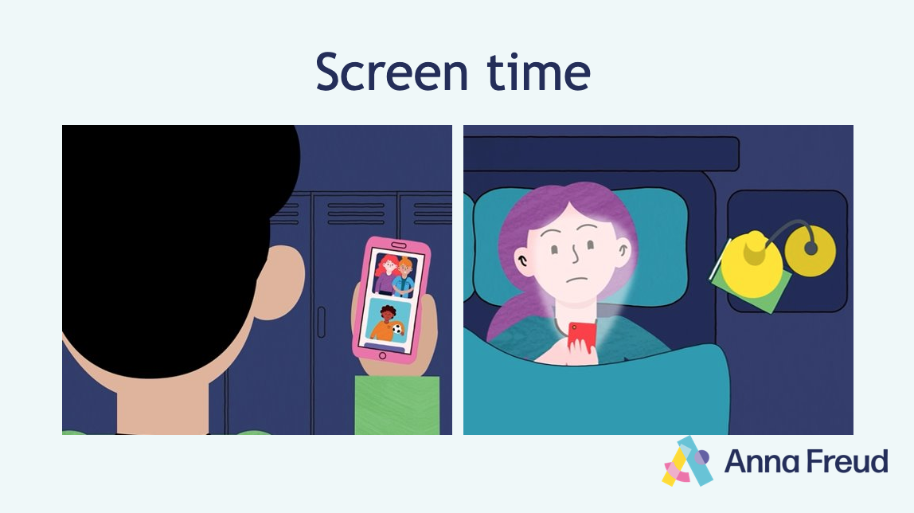
Notes:
Ask students: how might the characters be feeling? What might they be doing on their phone to make them feel this way? (e.g., scrolling through pictures; trying to contact friends; refreshing to see if someone has replied to them or commented on a video; reading negative articles; comparing themselves to someone else, etc.).
Explain that you’re going to think about how to use your phone in ways that make you feel less anxious, and come up with tips for using technology more positively.

Slide 37
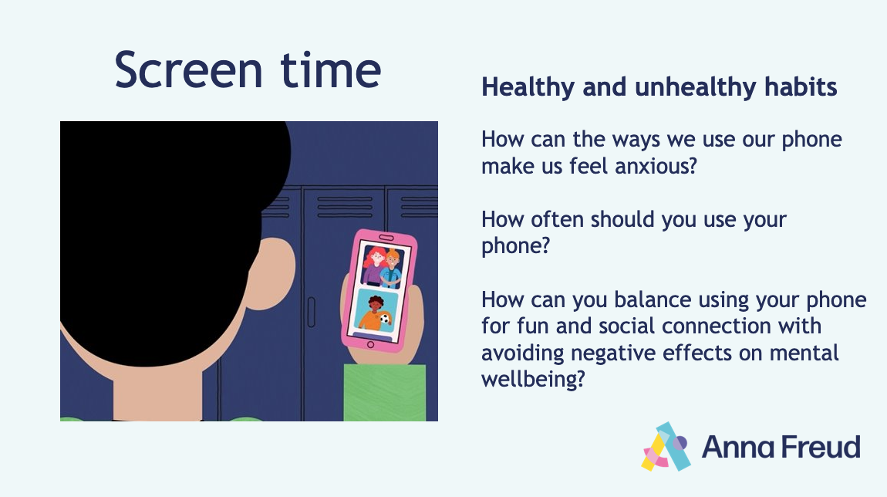
Notes:
Divide the class into two. In small groups, one half of the class will brainstorm some unhealthy phone usage habits (e.g., constantly scrolling through images that make you feel bad) while the other will brainstorm some ways in which you might use your phone in healthier ways (e.g., using an app to learn something new).
Ask students to think about the questions on the slide as they discuss ideas.
After five minutes, come back together as a class and discuss different healthy and unhealthy habits. Use this discussion to write a list of tips on the board for how students might use their phones more positively. Consider:
limiting phone and social media use to specific times of day
unfollowing or muting accounts that make you feel anxious
taking breaks from your phone
switching your phone to ‘night mode’ in the evening, and not using your phone up to 30 mins before you go to sleep
engaging with positive and inspiring content
using your phone to help you learn something new (e.g., a language or skill) and connect with others.
After the discussion, ask students to write down three tips that they think would be most helpful for them. Suggest that they can keep this card with them as a reminder for when they’re struggling with their phone and social media usage.

