Slide 1
LESSON 2
Nicotine and Vaping

Slide 2
Ground rules…
It’s great to be open and honest but we should avoid discussing our own, or other people’s personal or private lives.
It’s fine for us to disagree with another person’s opinion but being respectful means that we will not judge or put down the person.
It’s great to take part in PSHE lessons but we have the right to pass on answering a question or participating in an activity if we don’t feel comfortable.
It’s great to ask questions. However, we do not ask personal questions, or anything intended to deliberately try to embarrass someone.
We know that we can find further help and advice, both in school and in our community. We will encourage friends to seek help if we think they need it.
Notes:
3 minutes: Revisit ground rules for PSHE lessons.
*Remind the children that you as a teacher cannot promise confidentiality. If you are concerned that a pupil is at risk, you would follow the school’s safeguarding policy.

Slide 3
“The ______________ epidemic is one of the biggest public health threats the world has ever faced…”
The World Health Organisation
Notes:
Answer: Tobacco.
Extra information: Smoking prematurely kills 96,000 people a year in the UK… more than obesity, alcohol, road accidents, drug use and HIV combined.
Smokers lose on average 10 years between the age of 73-83.

Slide 4
Harms of tobacco smoking
Watch the video and answer questions on worksheet:
Notes:
Harms of Tobacco 7 minutes:
Pupils should watch the video and note down any harms of tobacco.

Slide 5
Task: True or False?
What do we know about the effects of consuming tobacco today?
Look at the statements on your worksheet and in pairs decide whether you think it is true or false.
Notes:
True or False: 6 minutes
Pupils to work in pairs to decide whether each statement is true or false.
Teacher go through each one after 3-5 minutes (see teacher answer sheet)

Slide 6
What is vaping?
To breathe in nicotine or another drug as vapour rather than as smoke, especially using an e-cigarette.
See if you can create a more detailed definition for what vaping is using these words:
E-cigarettes
Flavourings
Nicotine
Vapour
Lungs
Tobacco
Finish your definition with this sentence: …therefore, vapes do not produce tar and carbon monoxide, two of the most harmful elements in tobacco smoke. There are however significant harms associated with vaping.
Notes:
Definition: 5 minutes
Pupils to use boldened words to complete a detailed definition of vaping. A possible answer is on the next slide.

Slide 7
Write this down
Vapes, otherwise known as e-cigarettes are devices that work by heating a liquid that contains flavourings, other chemicals and sometimes the drug nicotine. When heated, the device produces a vapour which is then inhaled into the lungs. Vapes, unlike cigarettes, heat nicotine that has been extracted from the tobacco plant rather than burning the entire tobacco leaf.
Therefore, vapes do not produce tar and carbon monoxide, two of the most harmful elements in tobacco smoke. There are however significant harms associated with vaping.
Notes:
Teacher can read out this definition or print it out for the pupils (there is a fill in the blanks activity later in the lesson that uses this definition)

Slide 8
Based on what you already know about vaping, should we worry about it?
YES
NO
Notes:
5 minutes: What do you think?
Ask people to move to one side of the classroom or the other depending on their viewpoint. Ask volunteers why their think this.
Say: In today’s lesson we are going to look at the evidence that underpins people’s thinking about vaping.

Slide 9
Do you know the law when it comes to vaping?
Anyone who sells cigarettes or vapes to under-18s, or buys them on behalf of anyone under 18, is breaking the law.
There is potential for users to become addicted to nicotine-containing vapes, and the long-term effects of vaping on health are unknown therefore vapes are an age-restricted product.
Notes:
The Law: 1 minute
Read out the law (also on their worksheets)

Slide 10
How do vapes* work?
Try and explain how vapes work using the information given.
*Vape design is changing rapidly but these are the common features of most vapes
Notes:
How do vapes work? 5 minutes
See if the children can work out how a vape might work then click to reveal answers.
Extra information for the teacher:
Propylene Glycol: a viscous, colourless liquid, which is nearly odourless but possesses a faintly sweet taste. This acts as a base for the e-liquid.
Vegetable Glycerin: creating thicker vapour clouds while also providing a smoother vape experience
https://en.wikipedia.org/wiki/Electronic_cigarette#:~:text=Instead%20of%20smoke%2C%20the%20user,puff%20or%20pressing%20a%20button.

Slide 11
How do vapes* work?
Try and explain how vapes work using the information given.
Mouth piece
Heating element
Cartridge (liquid and nicotine storage area)
Battery
*Vape design is changing rapidly but these are the common features of most vapes
Notes:
Extra information for the teacher:
Propylene Glycol: a viscous, colourless liquid, which is nearly odourless but possesses a faintly sweet taste. This acts as a base for the e-liquid.
Vegetable Glycerin: creating thicker vapour clouds while also providing a smoother vape experience
https://en.wikipedia.org/wiki/Electronic_cigarette#:~:text=Instead%20of%20smoke%2C%20the%20user,puff%20or%20pressing%20a%20button.

Slide 12
How do vapes* work?
Mouth piece
Try and explain how vapes work using the information given.
Vapour containing nicotine is released here. When the user inhales, a flow sensor activates the heating element that atomizes the liquid solution.
Heating element
Cartridge (liquid and nicotine storage area)
Battery
The battery powers the device
This liquid contains Propylene Glycol (a base for the e-liquid, that can have the flavourings added to it), Vegetable Glycerin (used to create vapour clouds), water, flavourings and the drug nicotine.
*Vape design is changing rapidly but these are the common features of most vapes
Notes:
Extra information for the teacher:
Propylene Glycol: a viscous, colourless liquid, which is nearly odourless but possesses a faintly sweet taste. This acts as a base for the e-liquid.
Vegetable Glycerin: creating thicker vapour clouds while also providing a smoother vape experience
https://en.wikipedia.org/wiki/Electronic_cigarette#:~:text=Instead%20of%20smoke%2C%20the%20user,puff%20or%20pressing%20a%20button.

Slide 13
What do vapes contain?
Watch the video and answer questions on worksheet:
Notes:
Video: 5 minutes
Pupils to watch video and jot down notes on what vapes contain.
The nicotine in e-liquids is readily absorbed from the lungs into the bloodstream when a person vapes an e-cigarette. Upon entering the blood, nicotine stimulates the adrenal glands to release the hormone epinephrine (adrenaline). Epinephrine stimulates the central nervous system and increases blood pressure, breathing, and heart rate. As with most addictive substances, nicotine activates the brain’s reward circuits and also increases levels of a chemical messenger in the brain called dopamine, which reinforces rewarding behaviors. Pleasure caused by nicotine’s interaction with the reward circuit motivates some people to use nicotine again and again, despite risks to their health and well-being.

Slide 14
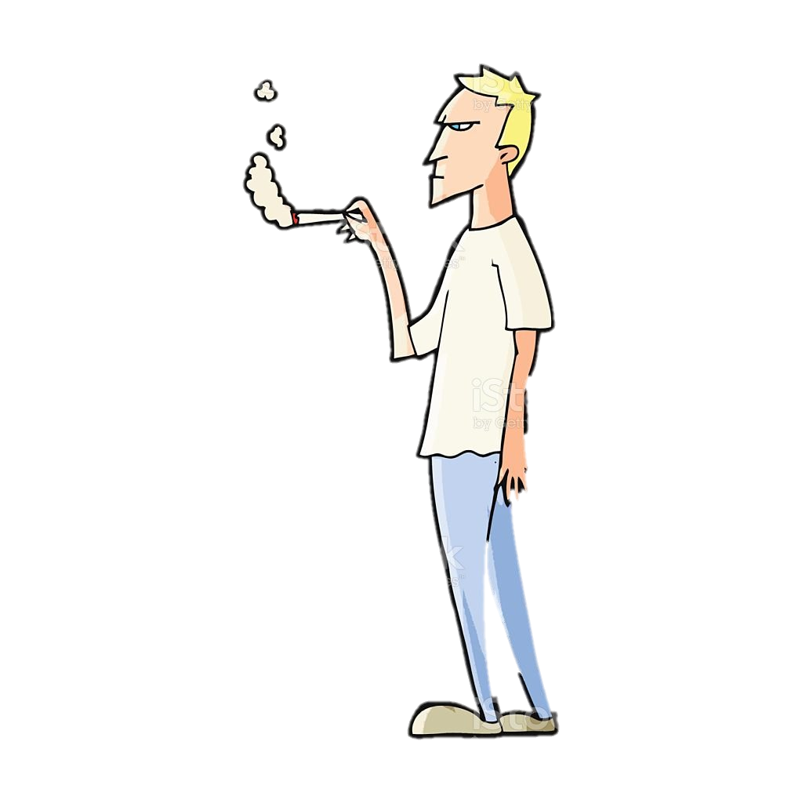
Task: Let’s look at the evidence*!
Your group will be given one of the following profiles:
25-year-old smoker
14-year-old non-smoker
Government minister
Each group will use the same information to decide the pros and cons of vaping from their perspective.
*Because vaping is a fairly new phenomenon, there is no conclusive long-term evidence yet
Notes:
Let’s look at the evidence: 15 minutes
Pupils should research the evidence around vaping using the scientific information found on the A3 sheets. Pupils to jot down their findings on the worksheet.

Slide 15
Task: Let’s look at the evidence*!
25-year-old smoker
14-year-old non-smoker
Government minister
Jonny thinks smoking is expensive but is unsure whether to quit smoking as he’s heard that vaping is just as bad, and he feels addicted to cigarettes.
Aisha loves playing sport but recently she has felt intrigued about trying a vape because it feels like everyone around her is vaping, she loves the smell of the flavours, and she wonders whether it might help her feel less stressed.
The government minister is keen to reduce the harms of smoking in the population but is also worried about more young people trying vapes.
Notes:
Let’s look at the evidence: 15 minutes
Pupils should research the evidence around vaping using the scientific information found on the A3 sheets. Pupils to jot down their findings on the worksheet.

Slide 16
What did you find?
Recently, Professor Sir Chris Whitty said in a Times article:
“If you smoke, vaping is much safer; if you don’t smoke, don’t vape.”
Notes:
Teacher to ask someone from each profile to give their perspective on vaping.
After all three profiles have spoken, ask the class what the national challenge is when it comes to vaping. Summarise with Chris Whitty’s quotation…

Slide 17
Plenary A
Plenary B - Fill in the blanks
Vapes, otherwise known as ______________ are devices that work by heating a liquid that contains _________________, other chemicals and sometimes the drug _____________. When heated, the device produces a _______________ which is then inhaled into the _________. Vapes, unlike cigarettes, heat nicotine that has been extracted from the tobacco plant rather than burning the entire _________________ leaf. Therefore, vapes do not produce tar and carbon monoxide, two of the most harmful elements in tobacco smoke. There are however significant harms associated with vaping.
Design a message that is between 10-15 words in length that could be put on the packets of e-cigarettes that would discourage non-smokers but encourage smokers to use them as an alternative to smoking.
THIS PRODUCT CONTAINS NICOTINE WHICH IS A HIGHLY ADDICTIVE SUBSTANCE
Current messaging
If you have time, do both!
Notes:
Plenary A or B: 5 minutes
For plenary A, perhaps something like: ‘use of this product is far less harmful than smoking.’
Answer to plenary B on slide 19.

Slide 18
Suggestions for Plenary A
Lynne Dawkins and her team developed and tested 20 different messages. They found that this message on vapes did indeed increase smokers’ intentions to purchase a vape but did not increase intentions to purchase in non-smokers.
USE OF THIS PRODUCT IS MUCH LESS HARMFUL THAN SMOKING
Why do you think this message worked so well?
Notes:
Why do you think this message worked so well?
Perhaps because it’s making the comparison to smoking and therefore is more noticeable/relevant for smokers.
Studies:
Development and testing of relative risk-based health messages for electronic cigarette products | Harm Reduction Journal | Full Text (biomedcentral.com)
Communicating the relative health risks of E-cigarettes: An online experimental study exploring the effects of a comparative health message versus the EU nicotine addiction warnings on smokers’ and non-smokers’ risk perceptions and behavioural intentions – ScienceDirect

Slide 19
Answer to Plenary B
Vapes, otherwise known as e-cigarettes are devices that work by heating a liquid that contains flavourings, other chemicals and sometimes the drug nicotine. When heated, the device produces a vapour which is then inhaled into the lungs. Vapes, unlike cigarettes, heat nicotine that has been extracted from the tobacco plant rather than burning the entire tobacco leaf.
Therefore, vapes do not produce tar and carbon monoxide, two of the most harmful elements in tobacco smoke. There are however significant harms associated with vaping.

Slide 20
Quitting vaping…
Many people who vape will want to quit vaping, and many smokers who have used vapes as a form of nicotine replacement therapy, will ultimately want to go nicotine free.
Can you think of any reasons why a person might want to quit vaping?
Notes:
3 minutes: Think, pair, share: Can you think if any reasons why a person might want to quit vaping?
Possible answers:
- Uncertain health impacts
- to save money
- so that they are not reliant on a substance
- so that they have a clear mind

Slide 21
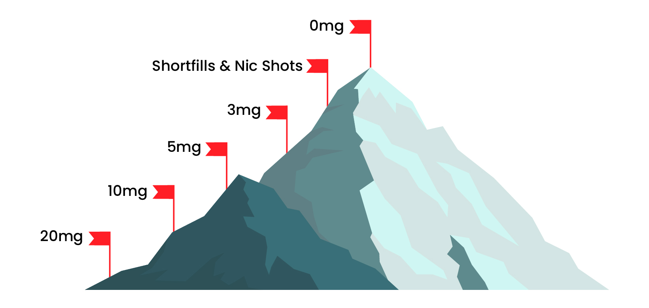
How to quit vaping…
The advice from the NHS is to quit vaping gradually.
A person can do this in several ways:
gradually reduce the strength of nicotine in their e-liquid (if they are using a disposable vape, they could switch to a refillable device to do this)
extend the time between vaping
set rules about where and where not to vape, for example only outside of the home or only on breaks at work
Notes:
Read advice

Slide 22
Find out more…
If you would like to learn more about nicotine or you are concerned about yourself or another person’s nicotine use:
ash.org.uk
drugscience.org.uk
Click on the image above to find your nearest stop smoking services
Scan here for the NHS quit smoking page where you find advice and download the quit smoking app

