Slide 1




Lumi Nova Club
Discussion Slides

Slide 2
Useful information for teacher/member of staff running the club:
Discussion points can be…
used at the start of each session
used to foster a collaborative and holistic culture.
used as a means of gauging children’s feelings for the day and their opinions on different topics.
done as a group, with a partner or used as a writing exercise.

Slide 3

Lumi Nova Club
Week 1
What is
Wellbeing?

Slide 4
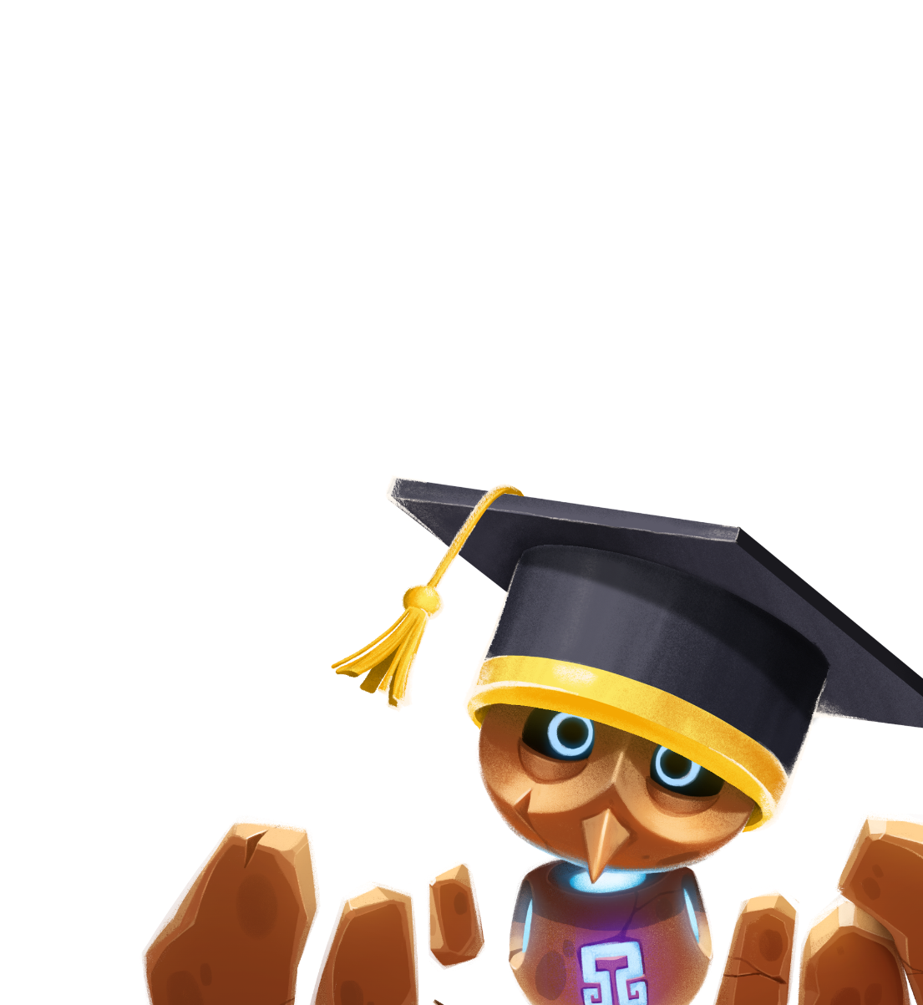
Talking Points:
1.
2.
3.
What do you think wellbeing means?
How do you feel when you’re looking after yourself?
Can you think of one thing that helps you feel happy or calm?
4.
Imagine you are a Luminaut that has crash landed on a strange planet. You meet an inhabitant and they don’t know or understand what a worry is. How would you explain what a worry is to them?

Slide 5
Lumi Nova Club
Week 2
Feelings and Emotions

Slide 6

Talking Points:
How do you feel today?
Can you name some different feelings?
What can we do when we feel sad, angry, or frustrated?
How can we help a friend who feels upset?

Slide 7
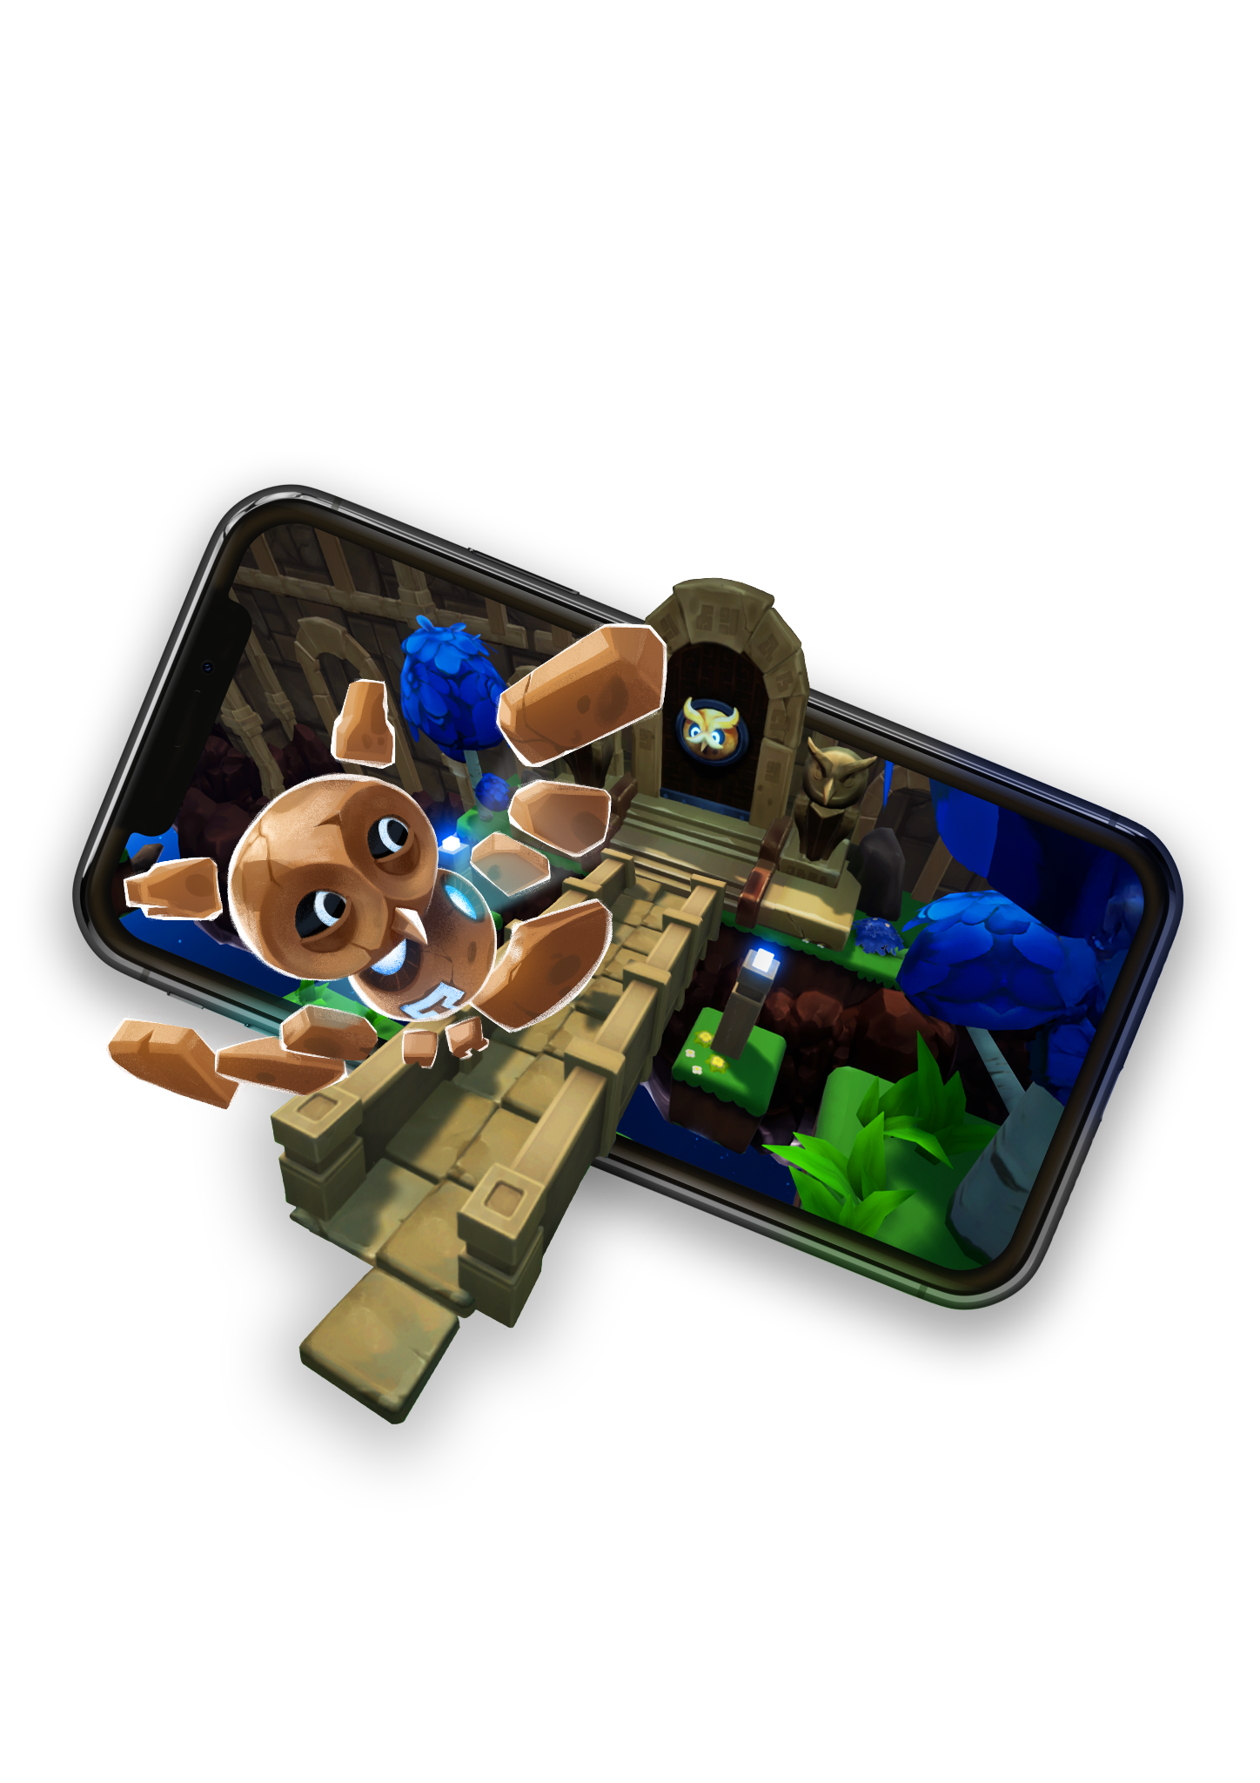
Lumi Nova Club
Week 3
Being Kind to Ourselves

Slide 8

Talking Points:
What do you like about yourself?
How do we look after ourselves when we're feeling tired or overwhelmed?
Why is it important to say kind things to ourselves?
How do you show kindness to yourself and others?

Slide 9
Lumi Nova Club
Week 4
Healthy Habits and Choices

Slide 10
Talking Points:
What do you think makes a healthy choice?
Why is it important to eat healthy food, exercise, and get enough sleep?
Can you name one healthy habit you’d like to try this week?
How do you feel when you make healthy choices?

Slide 11
Lumi Nova Club
Week 5
Friendship and Kindness

Slide 12
Week 5: Friendship and Kindness
Discussion Prompt:
  What makes someone a good friend?
  How can we show kindness to others?
  What do you do when a friend is feeling sad?
  How can you be a good friend today?
Talking Points:
What makes someone a good friend?
How can we show kindness to others?
What do you do when a friend is feeling sad?
How can you be a good friend today?

Slide 13
Lumi Nova Club
Week 6
Gratitude and Positive Thinking

Slide 14
Talking Points:
What are three things you're grateful for today?
How does it feel to focus on the good things in your life?
What is something nice someone has done for you recently?
How can we remind ourselves to think positively?

Slide 15
Other Talking Points

Slide 16
Additional Discussion Points
Talking Points Bank
Why do you think it’s important to talk about our feelings with others?
(How does it help to express how you’re feeling when something is bothering you?)
What makes you feel calm or relaxed?
(Is it listening to music, drawing, playing outside, or something else?)

Slide 17
Additional Discussion Points
What are the things that make you feel happy or excited?
(Can you think of activities or places that make you feel joyful?)
Why do you think it’s important to tackle challenges with resilience and bravery?
(What would you tell someone if they were worried about something?)
What do you do when you feel nervous or worried?
(Are there any activities or ideas that help you feel better when you have those feelings?)

