Slide 1
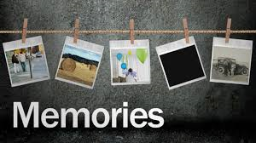
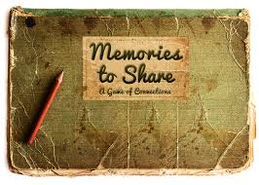
Memory Boxes
Group Challenge

Slide 2
Memory
What do we need to create memories?
Vision
Touch
Taste
Smell
Hear
All of our senses help up to create memories.

Slide 3
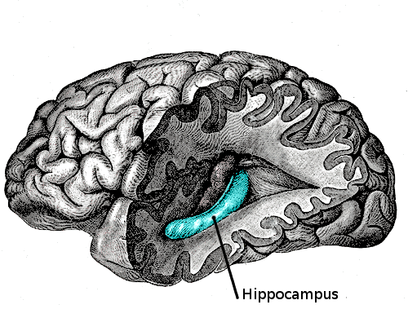
Hippocampus
The hippocampus is associated mainly with memory, in particular long-term memory.
Think of this as our ‘click and save’ button!
Dementia often prevents our ‘click and save’
from working.

Slide 4
The ‘click and save’ button can stop working as early as when someone is in their 40’s who is later to be diagnosed with dementia – but a person won’t know this until they are diagnosed a long time down the line.
All of the memories after this point won’t be saved.
The memories we make between the ages of 12 and 27 are usually particularly strong memories.

Slide 5
Memory Triggers
How can we trigger memories from our past?
Photos
Things to smell
Things to tastes
Sounds
Objects to touch
Think of some example of objects for each of these categories.
Think of different eras and what objects you might use?

Slide 6
Group Challenge…
To create a memory box full of different objects that will help families and friends trigger meaningful conversations with people with dementia.
You might find – if you ask older relatives if they have objects they could donate – it gets you talking to them!
The next few slide shows some examples of what you might put in your memory box.

Slide 7
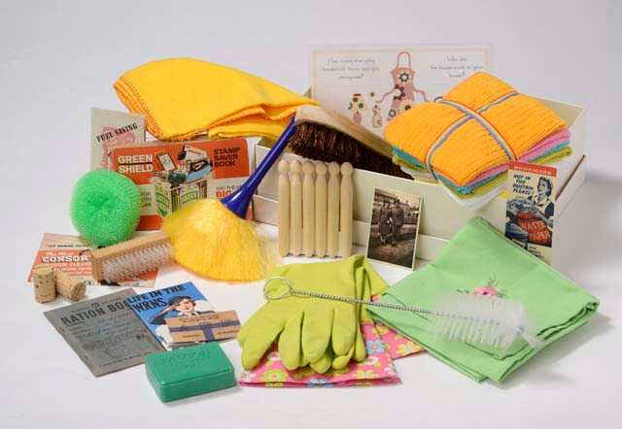
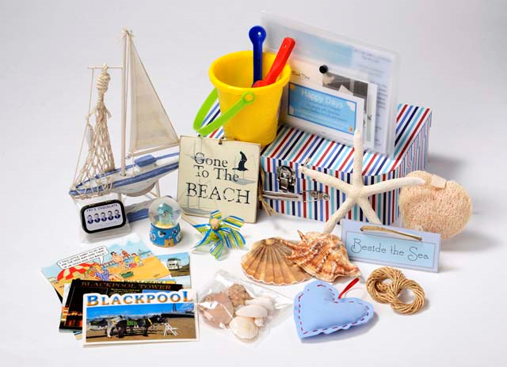

Slide 8
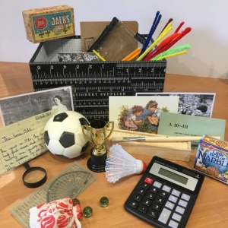
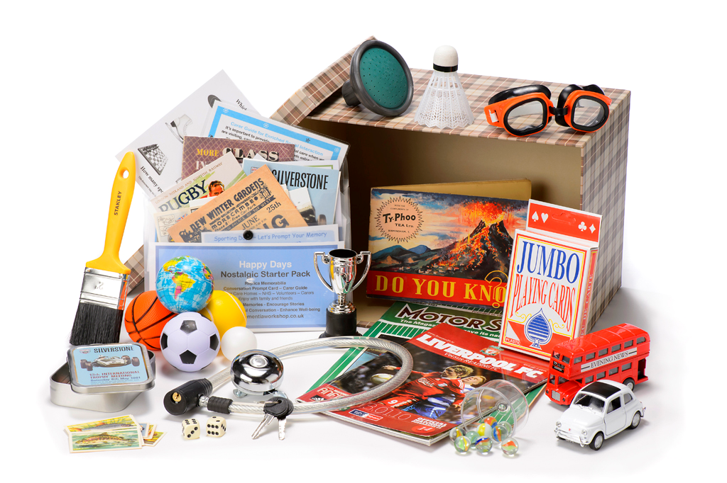

Slide 9
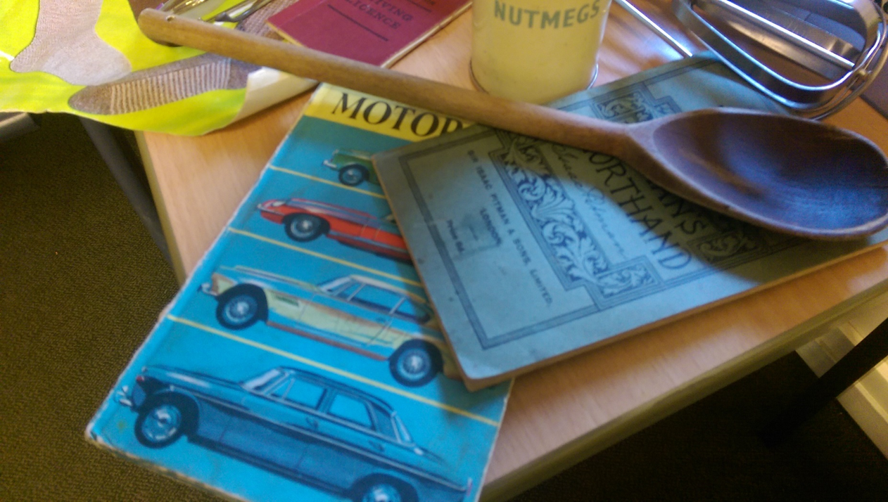
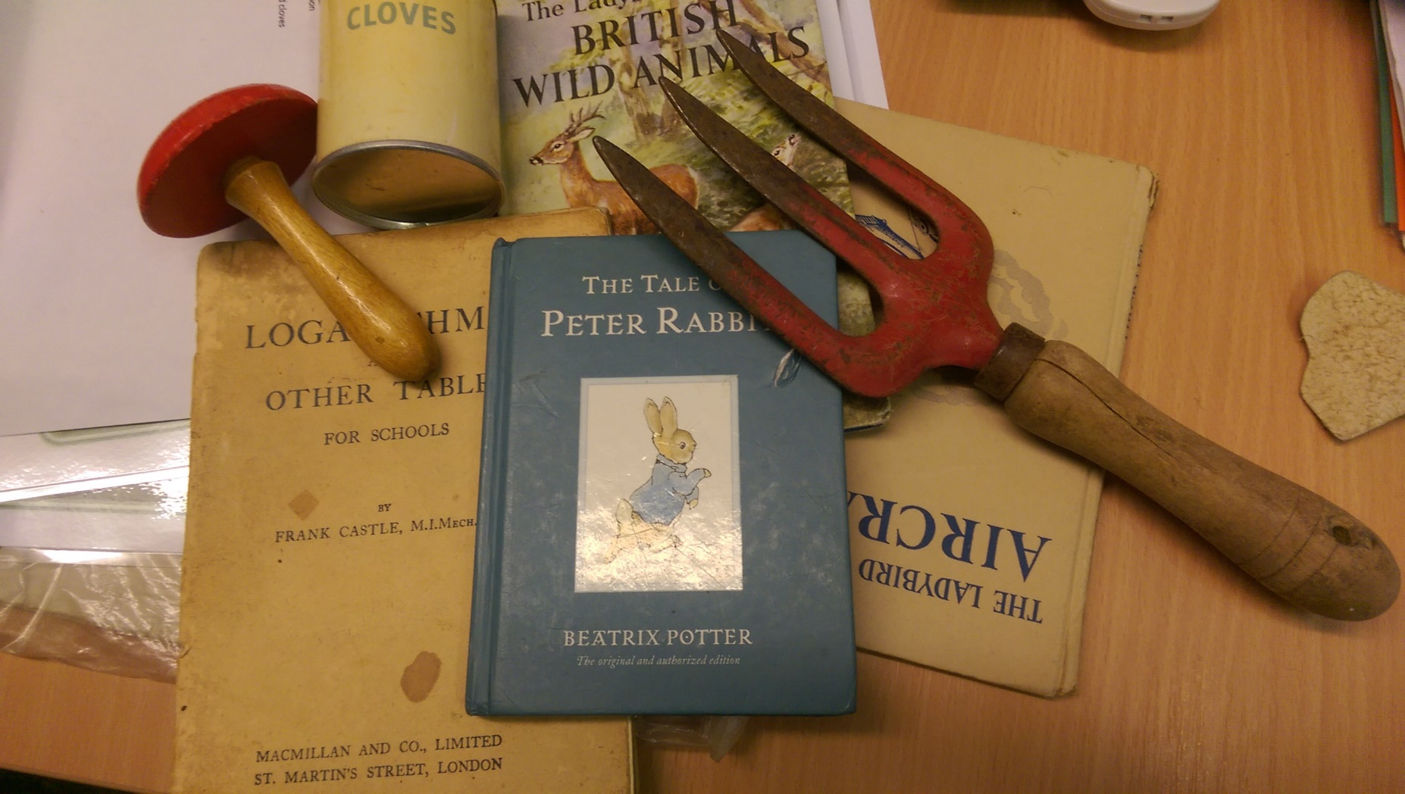

Slide 10
What happens next….
We will take our memory boxes
To the library
Care home…
………………………
…………………………..
………………………
So that families and friends can borrow them and use them to help trigger meaningful conversations with family members and friends who have dementia.

