Slide 1


Notes:
Understanding the Child in Me: (2) Understanding the Child in Me | By Ceri Walker - YouTube

Slide 2
Notes:
Title: Understanding the Impact of Parental Alcoholism
Objective: By the end of this lesson, you will gain an understanding alcoholism of Nacoa (The National Association for Children of Alcoholics), how to access support, and the impact of parental alcoholism on children and families.
Create a safe place for students, you can say:
“Hello everyone, before we start today's lesson, I'd like to talk about creating a safe and supportive environment for all of us.
First and foremost, this is a safe space.
We also want to be sensitive to the fact that some of you may have personal experiences with the topic we're discussing today, like having a family member affected by alcoholism. It's crucial for us to support students who might be affected by the lesson content but don't want to be identified as a child of an alcoholic.
Here are some strategies to make sure everyone feels comfortable:
You can express your thoughts and feelings without fear of judgment.
I want you to know that it's okay to take a step back if, at any point, the content we cover becomes upsetting for you. You don't need to explain why you need a break – just take one if you feel it's necessary.
We provide a non-judgmental space where you can talk openly about sensitive topics.
We use inclusive language, like 'some people' or 'families affected by alcoholism,' to avoid making assumptions about anyone's background.
If you ever want to discuss your concerns or feelings privately, you can talk to myself or another teacher or Nacoa. You don't have to share in the group if you're not comfortable.
You are not obligated to share personal experiences. It's entirely up to you what you want to disclose, and we respect your boundaries.
Finally, we'll give a heads-up about any sensitive content before we dive into it. If at any point you feel uncomfortable, you can choose not to participate in that particular discussion or activity.
Our goal is to make sure this is a space where everyone feels safe, heard, and respected. If you have any questions or concerns, please don't hesitate to let us know.
Let's get started with our lesson.”

Slide 3
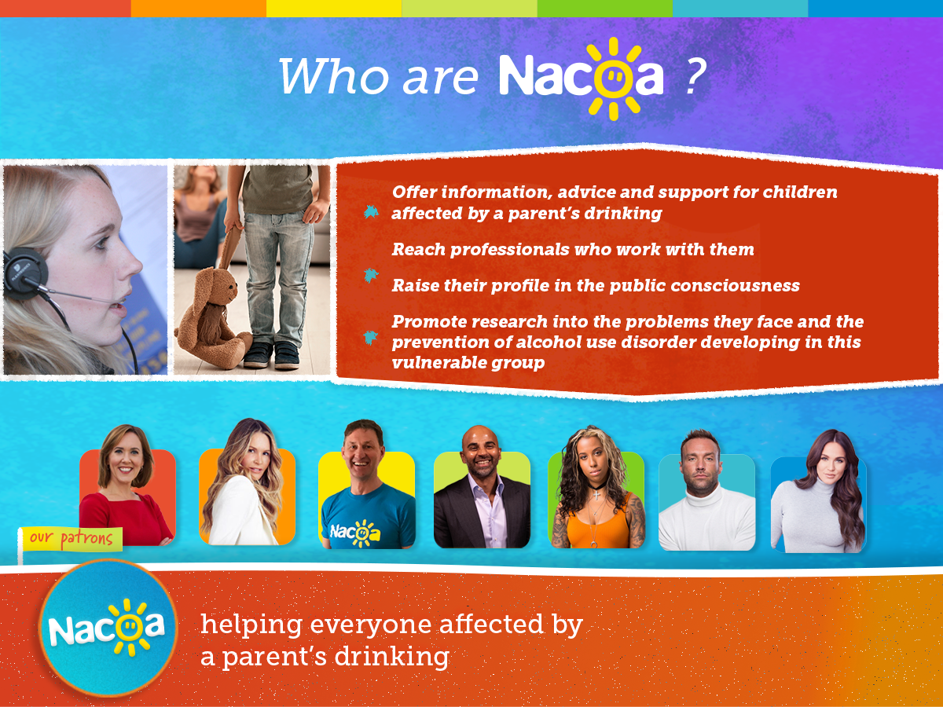
Notes:
Nacoa (The National Association for Children of Alcoholics) was founded in 1990 to address the needs of children affected by a parent’s drinking or similar addictive problem.
This national charity aims to …
To offer information, advice and support for children affected by a parent’s drinking
To reach professionals working with them.
To raise awareness of the problems they face and how to help
To promote research into their problems and prevention of alcohol problems developing in this vulnerable group

Slide 4
Nacoa Resources
Free Helpline by telephone and email
Social Media and YouTube Chanel
Website:
Instant chat
Online Message Boards
Personal experiences
Publications
FAQs, help and advice
Videos, books and media
Latest news and research
Notes:
Nacoa’s work includes a free helpline by telephone, email and letter
Nacoa has received over: 370,000 helpline calls
Confidential, non-judgemental help and support for everyone affected by a parent’s drinking
Some children and young people contact once, others many times over weeks, months or years
They signpost to local services if you wish and they will still remain available
The Nacoa website has received over 1 million visits. It includes personal experiences, ways to help, FAQs, videos, publications and research. All publications are available and printable from our Nacoa website. Instant chat with the helpline is currently available on Thursday but will extend to more days in the future.
Nacoa Social Media Platforms Instagram, Facebook, Twitter, Tiktok as well as Linked in. They have received over 220,000 contacts
Nacoa has Publications for children, young people, adults and professionals
Nacoa takes part and produces research to identify problems and prevent alcohol dependency developing
Nacoa’s Media and Speaker panels take part in interviews and other media activities to spread awareness of the issues faced by children of alcohol dependents and how alcohol dependency can affect the family. Aiming to reduce stigma and make listeners aware of the support available to them and help them feel less alone.

Slide 5

Nacoa model of care
Alcohol dependency is a family illness
1 in 5 children in the UK live with a parent who drinks hazardously
Previous research suggests that children affected are:
6 times more likely to witness domestic violence
5 times more likely to develop an eating problem
3 times more likely to consider suicide
2 times more likely to experience difficulties at school
2 times more likely to develop alcohol dependency or addiction
2 times more likely to be in trouble with the police
Nacoa has a Person-centred Approach, which means we want children to have the help and support they need, even if their parent continues to drink’
Notes:
Nacoa offers a simple, non-judgemental approach understanding that everyone has a different relationship with alcohol:
Alcohol dependency is a family illness, even if only one or two people drink, it can affect the whole family.
For some people, alcohol isn’t an issue and is used in a responsible way. For others it can cause problems, distress and upset within the family.
People suffering with alcoholism organise their lives around alcohol, alcohol often becomes their main focus. It’s not about a lack of love, but as the person drinking organises their life around alcohol.
Alcohol dependency is like an illness and can affect people of all ages and from all walks of life. People with alcohol problems have lost control over their drinking and usually need help in order to stop. Sometimes people may continue to drink despite negative effects on their lives, their health, and those around them.
families may have ongoing problems, conflicts, or difficulties that affect the well-being and happiness of its members. These problems might include frequent arguments, lack of communication, or issues related to addiction, abuse, or mental health. In a dysfunctional family, the relationships between family members may not be as supportive or healthy as they should be, which can make it challenging for everyone to thrive and be their best selves.
Living with someone who drinks too much can be chaotic and lead to other problems. Parents may have money worries, argue, become violent or withdraw from family life, suffering with anxiety, depression and mood swings. What’s OK one day may not be the next. Children often feel confused, frightened, anxious, lonely, guilty and ashamed. Home can be a very frightening place to be.
A child of an alcoholic can be 1 or 101. Whatever their age, it doesn't change the fact that their parent, step-parent or carer is, or has been, dependent on alcohol, along with the problems this brings.
Many families keep alcohol problems a secret, so sometimes for people affected, it can feel like they are the only one. However, 1 in 5 children in the UK live with a parent who drinks hazardously.
Rarely is alcoholism is an isolated problem. [Read research paragraph].
Hidden harm – about 81% of parents that drink too much are not receiving any treatment
Person-centred approach:
Nacoa helps anyone affected by this to break the silence, develop healthy coping strategies and identify who can help in their family and friends. Nacoa Provide ongoing support with daily challenges and in crisis situations, but can also celebrate their triumphs with them (as some children have no one to do this with).

Slide 6
Alcohol: The Family Illness
Parents don't intentionally become dysfunctional, but they change how they act to deal with alcohol problems and the stigma that can come with it. Families may develop certain ways of handling these:
Feelings of guilt and shame — feeling like they are to blame
Developing unhealthy defences to deal with emotional pain
Being unable to identify or express feelings or trust
Find close and personal relationships difficult
Deny and/or minimise past and current problems
Notes:
1.[Read the first paragraph on the slide]
2. [Go through the following bullet points]:
Feelings of guilt and shame — feeling like they are to blame
It is common for these children to feel that they have somehow caused the problem.
Developing unhealthy defences to deal with emotional pain
Attempting to control fear, anger, hurt shame and blame rather than dealing with problems as they arise.
Being unable to identify or express feelings
Children keep quiet about problems, do not develop trust in others and eventually suppress their feelings
Find making and maintaining healthy relationships difficult
Growing up with crisis is the norm, thus similar relationships will be sought because they are familiar. There may be a fear of abandonment.
Denial and/or minimisation of past and current problems
This might include an ability to normalise trauma and crisis as it is familiar and justify situations or behaviours.

Slide 7
What can I do?
You cannot change or control your parent’s drinking, but you can, with help, find ways to feel better.
It’s OK to talk about how you feel, talking is not being disloyal to your parents.
Remember:
You are not alone.
You are not responsible for your parent’s drinking.
You did not cause it and you can’t control it.
There are people who can help.
It’s OK to talk about how you are feeling.
Do things you enjoy
Notes:
1.[Read the first paragraph on the slide]
You are not alone - there are millions of people in the UK who have been affected by a parent’s drinking.
You are not responsible for your parent’s drinking - whatever is said, it isn't your fault and you are not to blame.
You did not cause their drinking and can’t control it - support is available for people who need help to stop drinking. However, they have to accept they have a problem and want to stop.
There are people who can help – You can talk to who understands the problem or someone you trust. This could be a family member, teacher, counsellor, or organisation like Nacoa. At Nacoa you can speak to trained volunteer helpline counsellors, who understand what it can be like when a parent has an alcohol problem. They listen without judging and can help you to find new ways to cope.
It’s OK to talk about how you are feeling - talking about how you feel is not being disloyal to your family and can help you feel less alone. Sharing your thoughts and feelings can help you understand that it is not your fault and help you feel better.
Do things you enjoy - which take you out of the situation and your worries for a while. You are important too.

Slide 8
Activity!
Discuss in groups how you could help a friend whose parent drinks too much.
Notes:
Divide students into small groups and ask them to discuss how they would support a friend dealing with parental alcoholism.
Have each group share their ideas with the class, or create a poster in groups
Options to help a friend:
Listen
Be there for them - simply being there and acknowledging what they are saying can make a difference
Let them know they're not alone and there is help. Encourage them to talk to Nacoa or the school to find out about available support
Let them know it is okay to talk - this isn’t being disloyal to their family
Encourage them to do things they enjoy
Make them laugh
Invite to hang out - they may not always be able to go out to the green to play football or over to friends houses for a sleepover but don’t stop asking because one day they might say yes.
Do hobbies and sports together

Slide 9


More Information
Read our website nacoa.org.uk
Real life stories
Help & advice
Publications
Facts & figures
Message boards
Check out social Media
@NacoaUK
Email us
helpline@nacoa.org.uk
Call us
0800 358 3456
Notes:
Encourage students to reflect on what they've learned and how they can raise awareness about the issue of parental alcoholism
Remind them if they would like to talk they can
Optional to include homework assignment
Give out Information for Some Mums and Dads leaflet

