Slide 1

New students induction
Personal, Social, Health & Economic Education
Core Theme 2: Relationships

Slide 2
1 Getting to know each other
Learning Objective:
To develop the skills and knowledge required to manage the transition to, and the expectations of, secondary education
Success Criteria:
Students engage with each other and their form tutors to get to know each other
Students can communicate effectively and listen to others

Slide 3

Starter
Sit in a circle
Starting with the personal tutor, introduce yourself by saying your name and surname and one thing you like
After everyone has spoken, go round the circle again and re-introduce the person on your left including the characteristic that that person shared, for example, ‘This is Jane Smith
and she likes horse riding’

Slide 4
Who’s who?
Each person writes their name on a piece of card and hands it in to the personal tutor/lecturer
The cards are shuffled and given out face down in front of each student
The first person in the circle looks at the card they have and goes to find the owner
They then sit in the owner’s seat and whoever this person is then looks at their own card and goes in search of the name on that card and so on

Slide 5

People Search
Find the ‘People Search’ grid in
your booklet
The aim is to get 9 different names
(to include surnames) in response to
each of the items on the sheet
You cannot ask someone a question if someone else is speaking to them and can only ask someone one question at a time
When you have completed all the boxes shout ‘finished’ and sit down in your seat
The search is over when everyone completes the sheet and returns to their seat

Slide 6
Plenary
My Tutor Group
In your booklets write 3 or 4 sentences about their first impressions of the class

Slide 7
2 Changing Schools
Learning Objective:
To develop the skills and knowledge required to manage the transition to, and the expectations of, secondary education
Success Criteria:
Students take part in a discussion about how they felt about moving schools and to talk about their concerns in a positive way
Students express their emotions clearly and openly

Slide 8
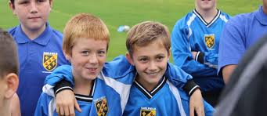
Starter
For most people, starting at Hartpury College was probably quite nerve racking
For some people it will have been their first change of school
Hands up survey (Record the results in your booklet):
How many people have never changed schools previously?
How many have changed schools once?
How many have changed schools twice?
How many have changed schools more than twice?

Slide 9
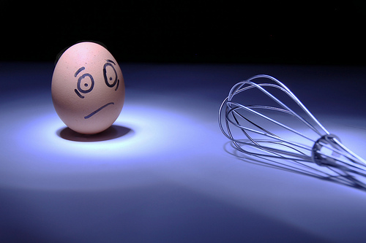
What are you worried about?
Question: What were you most worried about starting at Hartpury?
Let’s write all the responses on the board, e.g. leaving previous school behind, getting lost, making friends, being bullied, fear of older
students, fear of lecturers,
not being able to do the work,
forgetting books etc.
In pairs discuss your concerns
and put them in order with the
one that you dreaded the most
at the top of the list

Slide 10
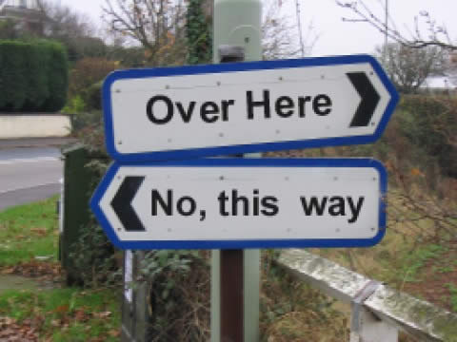
Is it just me?
Taking each of the concerns in turn hands up if this was your biggest worry
Different people will
have very different
worries and what may
be a problem for somebody,
such as organisation,
may not be a problem for somebody else

Slide 11

Solutions
Let’s go through each concern in turn
What advice can we give each other on how to deal with each area?
Jot down any points that will help
you in your booklet
E.g. If organisation is your problem
colour code your time table to help

Slide 12
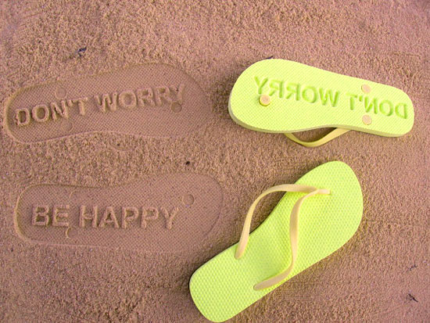
Plenary
In 2-3 sentences in your booklet, write down what you had worried about the most and how you will deal with it now

Slide 13
3 Being a Newcomer
What happens if….?
Learning Objective:
To develop the skills and knowledge required to manage the transition to, and the expectations of, further education
How to identify and access appropriate advice and support
Success Criteria:
Students know where they should go or what to do in a range of situations
Students are aware of feelings of anyone who is still finding it difficult to settle in and have discussed ways to support each other

Slide 14
What to do if…..?
In pairs discuss each potential problem before giving some feedback to the class

Slide 15
You have been sent to deliver a message but cannot find the person for whom the message has been intended

Slide 16
You have fallen walking to your next lecture and hurt your wrist. It is not swollen, but is very painful

Slide 17
You have lost your new jacket at lunch; it has your name in it but nobody has seen it

Slide 18
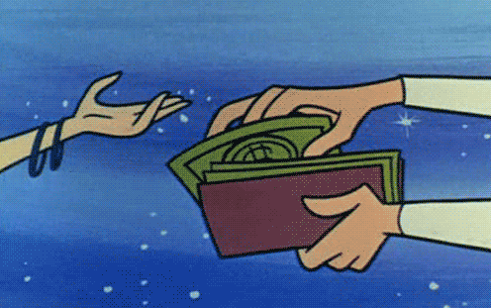
You have been asked for £1 by another student. He asks you everyday but has not threatened you at all

Slide 19
You have been kicking a ball around at break time and running around on the field with your friends. Suddenly you hear a rip, your friends laugh and you realise you have split your trousers.

Slide 20
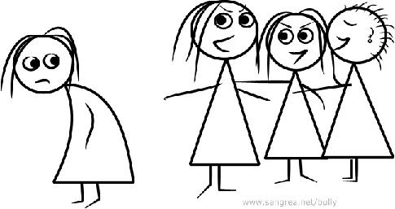
You have noticed that a friend is being called names by a group of other students. Your friend is upset but is frightened to tell anyone

Slide 21
Your bus was late, it wasn’t your fault. Registration has finished. What do you do to get your mark?

Slide 22

You have forgotten your lunch money / card lost

Slide 23

Who can I turn to for help?
Progress Coordinator: Mr C Sumner
Guidance Office
Guidance Manager: Miss K Ankiah
Guidance Office
Welfare Manager: Julie Blyde N2
Mentor & Counsellor: Denver Jones N2
Safeguarding Lead: Jawandha G9
Learning Support Assistants
Form Tutor
Peer Mentor
Student Reception

Slide 24
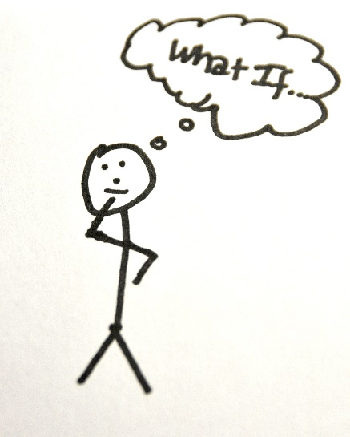
Extra Activity
Design a ‘What to do if……’ poster on A4 paper for display
Make it humorous and based on any of the situations used in the first activity (or anything else you have thought of)
Plenary
Think of three ways you could make
a newcomer feel welcome
– share with the class

Slide 25
4 This is me!
Learning Objective:
To develop the skills and knowledge required to manage the transition to, and the expectations of, secondary education
To introduce yourself to your form group
Success Criteria:
Students evaluate the sort of person they are and to gain confidence in talking about themselves
Students recognise that they are a unique individual and think about themselves on many different levels

Slide 26

Starter
Respond quickly and honestly to these statements as they appear:
thumbs up – total agreement thumbs down – disagree fold arms – not sure, don’t know
1. Who enjoys watching TV?
2. Who plays a musical instrument, no matter how badly?
3. How many feel they get enough sleep at night?
4. Who cares about the way they look?
5. Who is an only child?
6. Who has a friend of another race?
7. Who finds it difficult to get up in the morning?
8. Who can say they feel they eat too much?
9. How many people enjoy school most of the time?
10. Who thinks teachers are generally pleasant?!
11. Who would like to experience parachuting from a plane?
12. Who thinks cheating is always wrong?
13. Who cries easily?
14. Who enjoys a good argument?
15. How many feel they have difficulty controlling their temper?
Everyone is unique and differ in all sorts of things including behaviour, interests and circumstances!

Slide 27

All About Me Rosette
This is your opportunity to introduce yourself to your group
Use the rosette template in your booklet to tell us all about you!
Likes and dislikes on the tails
What is important to me in the middle
Name and form around the frill
Be as creative and colourful as you like!
Note to tutors – Use the booklet template to plan your design then print the templates off again and produce the rosettes for your form notice board. Students could bring in materials to make a collage e.g photographs / ribbons / keepsakes (Use the rest of this weeks sessions for your display)

Slide 28
Plenary
Pair up with a partner
Show each others rosettes to the class – introduce your partner

Slide 29
5 Yourself as others see you
Learning Objective:
How to develop and maintain a variety of healthy relationships within a range of social/cultural contexts
Success criteria:
For pupils to investigate their own view of themselves and compare this with how others see them
To help pupils recognise when they should feel pleased with, and proud of themselves, and to learn to accept praise from others

Slide 30

Starter
Alphabet game: What adjectives can we use to describe people? Can we get through the whole alphabet?
I’ll start
A….. Adventurous

Slide 31
Adjective Rating List
Complete the left hand column of the ‘Adjective Rating List’ individually without anyone else seeing, using the following: always, often, occasionally and never
When you have completed it fold under the left hand column so it can’t be seen and exchange the paper with someone you know very well
The partner now fills in the right hand column using the same descriptions - always, often, occasionally and never – being as honest as possible
When completed, hand the sheets back and look at the responses and discuss with each other.
Plenary: How accurately did you see yourselves and was it as others did?

Slide 32

Compliments!
Now that we know each other better…
In your PSHE booklet write down everyone’s name in the room and next to it write one NICE thing about them
Let’s go round the room each person at a time - Put your hand up if you would like to share what you have written about that person – I will choose one volunteer to offer their compliment
No shouting out – hands up only

Slide 33
Plenary
Write down a quality that you have heard given to another person that you wish you had
How could you develop that quality?
What do you need to work on to be more that way?

Slide 34
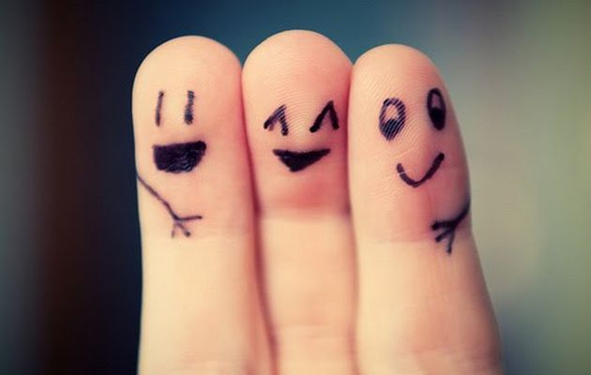
6 Friendships
Learning objective
Success criteria
All must identify the qualities of a good friend
Most should describe how friendships can change over time
Some could offer advice to their peers on how to cope with changing friendships
To explore how friendships can change and develop or end

Slide 35
Starter Activity – Circle of Friends
In the circles list all your friends
In the closest circle to the centre put your best friends
Work your way outwards with other friends, people in your class you get on with to acquaintances
Discuss – how have your friendships changed since you have started at Shelfield?
Has this been easy or hard?

Slide 36
Circle of Friends

Slide 37
Friendship quiz
Mostly a’s:
You are so concerned about what your friends think of you that you will do almost anything to keep in with them. You’re allowing them to influence you so much that you’ve stopped thinking for yourself. You need to listen far more to what your instincts and conscience tell you about how to behave than to think about what will most impress your friends. You must start asserting yourself and acting according to your beliefs rather than just doing things to please others.

Slide 38
Friendship quiz
Mostly b’s:
You hesitate before saying or doing things that you don’t believe in, and sometimes you allow yourself to do things that you don’t want to do in order not to upset your friends. When faced with an awkward situation you tend to look for the easy way out. You need to start trusting your own judgement more and to be more prepared to speak out and do things that might set you apart from the crowd.

Slide 39
Friendship quiz
Mostly c’s:
You have a healthy disregard for what others think of you and are prepared to stand up for yourself and do what you believe is right. Sometimes it will cause difficulties with friends, but you understand that it is more important to stick to your principles rather than to do things just to curry favour. Your actions give you self-respect because you don’t allow people to pressurise you, and those people who are your friends know where they stand with you and can rely on you to speak your mind.

Slide 40
Friendship quiz
What are the outcomes of the quiz?
Discuss your results with your partner
Would your answers change if you were thinking about a different set of friends? Why would they? How can different friends make you act in a different way?

Slide 41
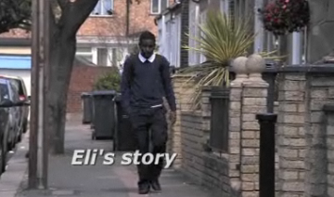
Watch the following clip
http://www.bbc.co.uk/learningzone/clips/l8r-youngers-2-balancing-new-and-longstanding-relationships/13219.html
How do you think Eli feels?
What about Joe?
Has anything like this happened to you?
How can you deal with this in a positive way?

Slide 42
Create a mind map of friendship – use these questions to create your mind map
What qualities do you look for in a friend?
Are friends more important to you now than they were in primary school? Why?
What's the difference between a friend and an acquaintance?
How do you tell the difference between true friends and false friends?
What is a "best friend?" Is it possible to have more than one "best friend" at the same time?
In what ways does friendship change as you get older?
Is there a difference between popularity and friendship? Can you be popular and not be a good friend? What is more important, being popular, or being a good friend?
Describe the groups or cliques that people you know associate with. Are the relationships within these groups real friendships? What's the difference between friendship and group membership?

Slide 43
Extra Activity: Role play
Get into groups of four
Each group is going to be given a scenario where you will create a role play of how you should and shouldn’t react in these circumstances. Make sure that you work as a team in order to ensure that everyone has a role within the play
  Group 1 – A fallout within a group of friends
  Group 2 – A friend calls you chicken because you won’t join in
  Group 3 – A friend keeps making excuses when you ask them to come around
  Group 4 – A friend is jealous of your success
  Group 5 – A friend from primary has made some new friends – they don’t include you in their new friendship

Slide 44

Is it ok to change friends?
Discuss this as a class
What do you think? What things do you need to be able to do to make changing friendships less stressful for each other? How can you look after each other?

Slide 45
Plenary – What makes a good friend?
List the qualities that you think you would like in a good friend in the thought bubble

Slide 46
Extension: A Good Friend is…
Advertise yourself announcing your qualities as a potential friend
Your advert can contain drawings, phrases or anything else to get the message across about the personal qualities you can offer in friendship
The content can contain the sort of person you are as well as hobbies and interests
Can you come up with a slogan to sum you up – ask a friend for ideas

Slide 47

7 Relationships
Learning Objective:
To recognise different types of relationships, including those within families, friendships, romantic or intimate relationships and the factors that can affect these (including age, gender, power and interests)
To recognise the qualities and behaviours they should expect and exhibit in a wide variety of positive relationships (including teams, class, friendships etc.)
To explore the range of positive qualities people bring to relationships
Success criteria:
Students will take part in a series of discussion activities reflecting on a range of different relationships
Student offer suggestions the good things about relationships and what can be difficult about relationships

Slide 48

Starter - There are lots of different types of Relationships
Examples….Relationships with friends
        Relationships with parents
In pairs, write down as many different types of
relationships that you can have with other people
that you can think of

Slide 49
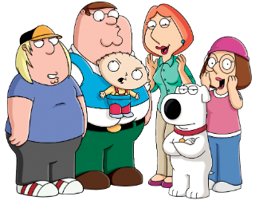
How many of these did you think of?
Friends
Families
Neighbours
Boyfriends/girlfriends
Parents
Teachers
Sisters/brothers
Aunts/uncles
Doctors/dentists
Librarians
Shopkeeper
Postman
Lollipop man
Local policeman
Social worker
Youth group leader
scouts/guides leader
Sports coach
Pets
Did you have any others ?

Slide 50



Task 1 - Different types of relationships
Is there a difference between a relationship and a friendship?
What are the differences?

Slide 51
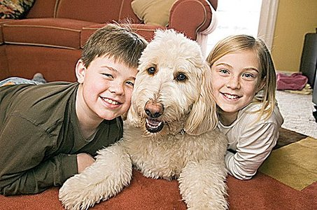
Easy Relationships
Can you think of someone who you get on really well with and you enjoy having a relationship with them
What kind of things makes it an ‘easy’ relationship

Slide 52
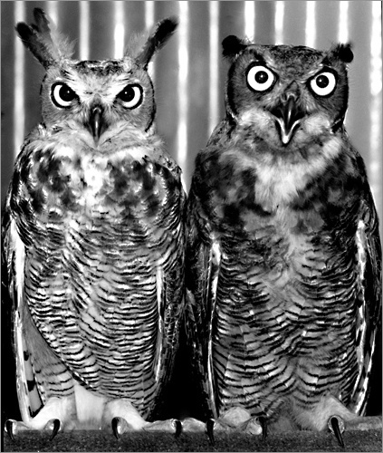
Difficult Relationships
Can you think of someone who you don’t get on well with and you don’t enjoy their company.
What kind of things make it difficult?

Slide 53
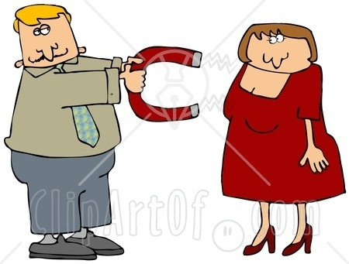
Romantic Relationships
Can you think of someone who you are ‘attracted’ to
What kind of things attracts you to that person?

Slide 54

Romantic Relationships
Why do you think we need these kinds of relationship?
What do we get out of these types of relationship?
(note your ideas down in your booklets)

Slide 55
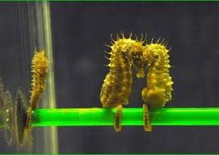
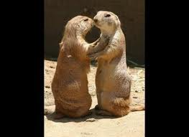
For love and affection

Slide 56
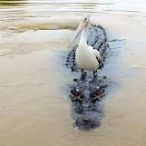
For support

Slide 57
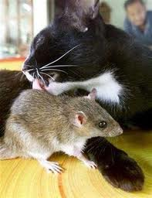
For acceptance

Slide 58
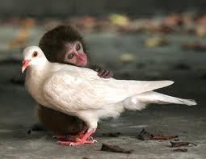
For emotional closeness

Slide 59
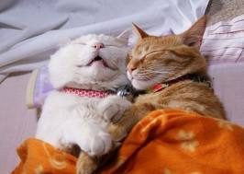
For physical closeness

Slide 60
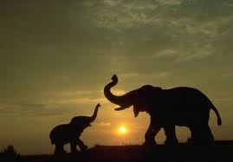
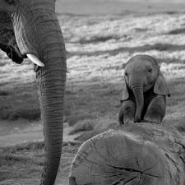
For making babies

Slide 61
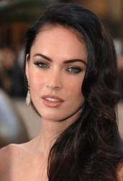
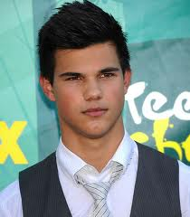

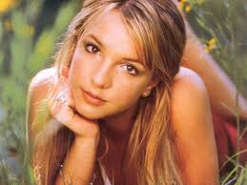
Task 2 -What do you look for in a partner?
Try to think of think of things other than looks....the novelty of looks can soon ware off if you have nothing in common etc

Slide 62

What do you look for in a partner?
Perhaps some of these traits.....
Note down 9 traits that you
would like a partner to have.
brave
thoughtful
confident
funny
affectionate

Slide 63
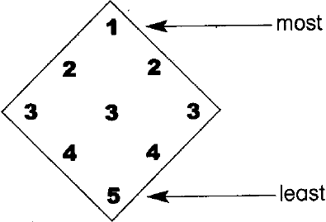
Rank your chosen traits in the following order of importance.

Slide 64
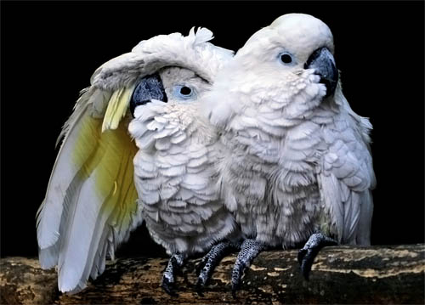
Task 3 - Class discussion
Why are close relationships important?
What can make close relationships difficult at times?
Why is good communication important within a relationship?
How important do you think commitment and fidelity is in a serious relationship.

Slide 65

Plenary - Relationship jigsaw
Write key words or statements that you think describe what a good relationship would have.
e.g. Good communication, fun, etc.
Think of it as a relationship recipe!

Slide 66
8 You and Your Family
Learning Objective:
To consider the roles and responsibilities of parents, carers and children in families
To see the world from other people’s points of view
Success Criteria:
Students can describe and understand some common sources of conflict in families
Students can suggest ways to improve relationships at home

Slide 67

Starter
Brainstorm all the things that cause arguments at home – have we all thought of the same things?
Is it getting worse as you are
almost teenagers?
Why might this be?

Slide 68

I need my own space!
Read the letter from Laura
Think about Laura’s problem in pairs
What advice would you offer her?
How are her parents likely to be feeling?
Maybe their behaviour is no different to usual but now that Laura is growing up it’s her that’s changing not them. How do they deal with this?
Read the advice letter do you agree?
Talking is always important and once you put up a wall between you and the adults in your life it can be more difficult and lead to even more problems in the future

Slide 69
Extension Activity
What causes arguments in families? Do you think that your parents try to control your lives too much? Consider the following:
Why are there often quarrels about clothes?
Why do parents and carers want to know where you are going and who are you going with?
Parents often say you must be in at a certain time. Why do you think they set deadlines?
Choose one of these issues or any other that causes conflict between adults and children and role play an argument about it between a parent and a child – one in which the argument develops into a row because the child’s behaviour is either angry, sulky or cheeky, and another in which the disagreement is settled because the child remains calm and a compromise is agreed. Note the part that body language plays in these rows as many pupils think if they do not say anything rude or horrid they have done nothing wrong.

Slide 70
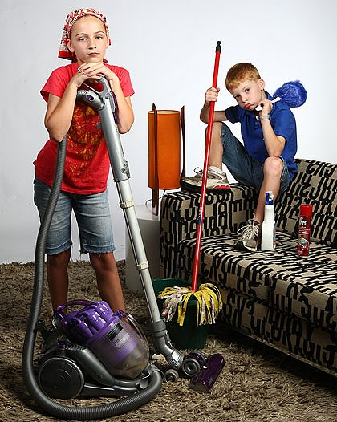
Do you help at home?
Many arguments between children and parents are about the way you behave at home. Many adults feel that everyone living in the family group should do their fair share of the household chores. What do you think?
How often do you help with the following activities: a) daily, b) two or three times a week, c) once a week, d) once a month, e) hardly ever, f) never.
Cooking
Hoovering
Dusting
Cleaning
Making beds
Washing up/loading the dishwasher
Washing clothes
Ironing
Shopping
Setting the table
Clearing away
Cooking
Cleaning the car
Gardening
What else do you help with that isn’t on the list?

Slide 71
Paired Discussion
Team up with a partner to compare your lists. How much do you help at home compared to your partner?
Discuss how much you think you should be expected to help out
Should you get paid for helping out?
Consider the lives of the adults you live with – How much do they have to do in a day?

Slide 72

Plenary
Write a short statement of the reasons why children should/should not be expected to help with household chores

Slide 73

Getting on better with Adults
Think back to our last few sessions
Make a poster or charter for display, entitled ‘Top ten tips on how to get on better with the adults in your life’
Plenary
Decide on one piece of advice you
have written or discussed and decide
on one thing that you are going to
make more effort with at home
from TODAY!

