Slide 1
Positive Playtime Practice
Class:
Notes:
Go through each person and see who we are, where we are from. Be able to adapt talk for each school attending. What would this look like for you? Who we are. What we do – GHLL and in school.
What are we seeing in school? Link between H&W and attainment document 2016 – isolation?

Slide 2
Part 1:
Tell me about…
Break times and
lunch times at your school!
Notes:
Have a think. Pair it. Then share it. What do we notice? Isolated pupils, needy pupils needing that daily boost, those that attach themselves to you, those that are bored, find competition difficult.

Slide 4
Health and well-being
What do you know?
4
3
2
1
The human bar chart
Notes:
Play human bar chart with teachers about their understanding of Mental Health and their playtime practice. Share what we saw at Berry Hill and Coalway Juniors. Use BH sheets.

Slide 5
The 5 ways to Well-being – They make you feel happier!
If we know that doing any of these has a positive effect on our mental health…
Notes:
Before we talk through each one, let’s have a g at a game that will give us a wellbeing boost. Then, talk through each one. Share the launch with the pupils in their hall, with staff. How it links in with current pots of funding – Sports Premium and Awards for All funding – Share examples of these – Parton manor Infants and Lakers Sec/St Johns Primary.

Slide 6
Part 2:
It’s time to action plan with a team of 10 pupils!

Slide 7
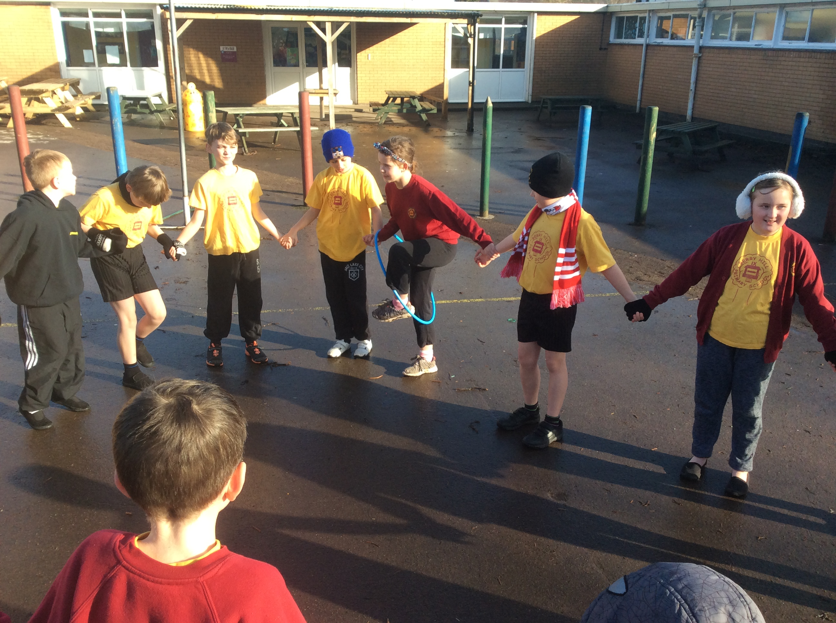
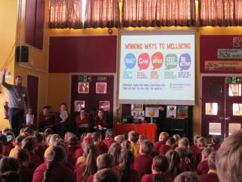
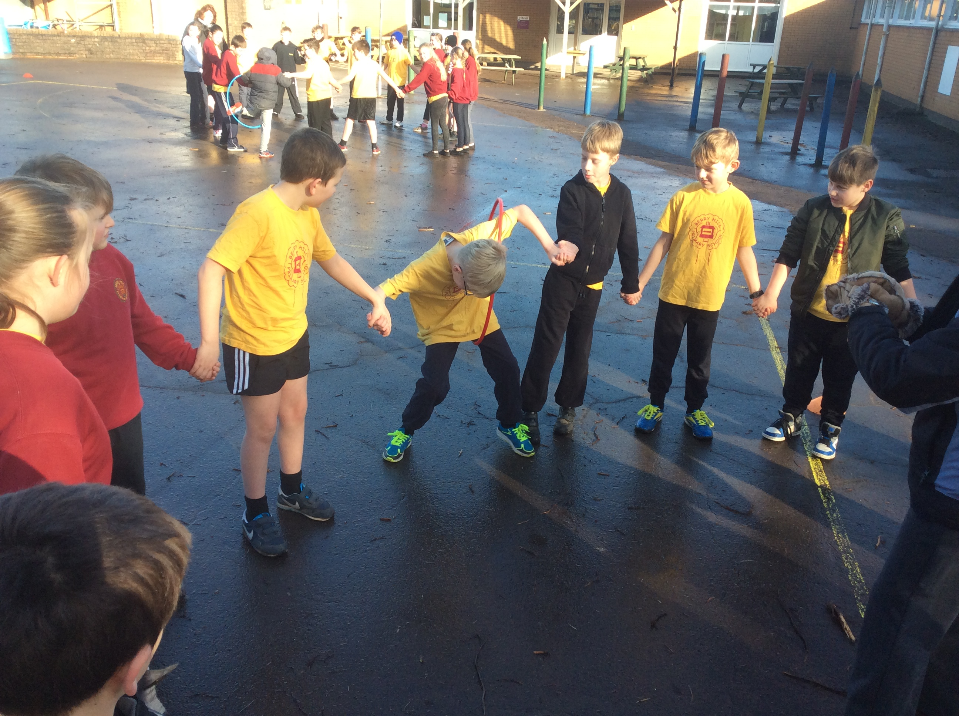
Berry Hill Primary School
Notes:
A couple of weeks after the initial meeting, I got the children back together again and asked for their ideas for how each zone should look. They came up with a brilliant set of ideas (share some of these).
Giving children ownership of this has meant that they have been keen to get it all going. Two Y6 girls offered to put together a rota for each zone and they did a great job of this, matching children together and then typing it all up. There has also been a launch assembly where 5 of the children introduced the concept to the rest of the school.

Slide 8
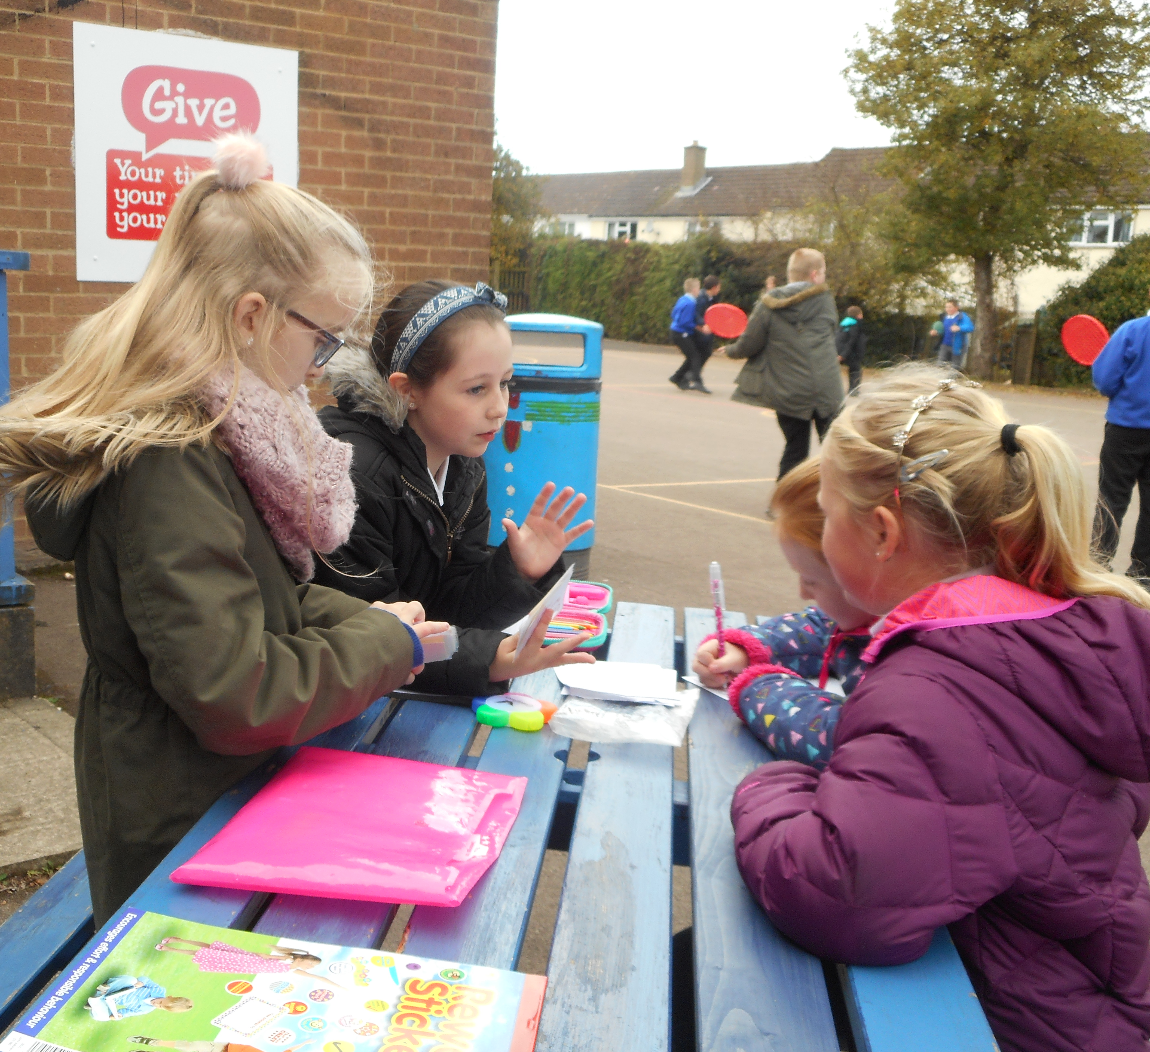
Signs for the playground:
craig@chiswellcreative.co.uk

Slide 9
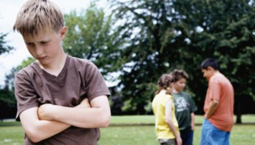
Part 3:
Meeting with MDSV (45 mins)
Who are we going to target and how?

Slide 10
Contact details for future support:
Chris Powell
GHLL Lead Teacher
chris.powell@ghll.org.uk

