Slide 1
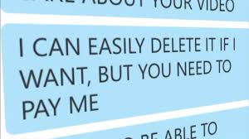

Sextortion
Webcam blackmail
http://www.nationalcrimeagency.gov.uk/crime-threats/kidnap-and-extortion/sextortion

Slide 2
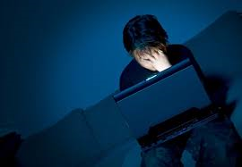
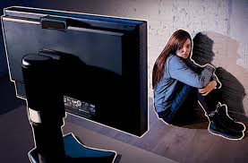
Sextortion…
Refers to a form of blackmail in which sexual information or images are used to extort sexual favours from the victim.
Social media and text messages are often the source of the sexual material and the threatened means of sharing it with others.

Slide 3
Sextortion is a crime rapidly on the increase.
Also known as ‘webcam blackmail’, it refers to criminals deceiving webcam users into unclothing and performing sexual acts.
This footage is recorded and then used to blackmail victims for money.
It is an international, organised crime, making it difficult for the police to capture the criminals responsible.

Slide 4
Discussion….
Why might a young person share indecent image of themselves?
How do you know the person you are sharing the image with is who they say they are?
Even if you know the person, can you totally trust them not to exploit you?
What might be the consequence of sextortion in the long and short term?

Slide 5
British police believe the crime is growing but that the true numbers involved could be far higher than those reported due to the embarrassment that can be caused meaning victims are often reluctant to come forward.
The worse cases can be fatal – 17-year-old Daniel Perry from Dunfermline, took his own life in 2013, only an hour after being targeted.

Slide 6

Who is behind this crime?
Organised crime groups – mostly based overseas.
For them it's a low risk way to make money and they can reach many victims easily online.

Slide 7
Video clip
https://www.irishtimes.com/news/ireland/irish-news/garda-warn-of-online-sextortion-of-teenagers-and-children-1.3126638

Slide 8
What were the main messages from this video?
There were two stories running parallel, Anna’s story and George’s story, how were they different?
What should they have done differently?
What might be the short and long term consequences of their actions?

Slide 9
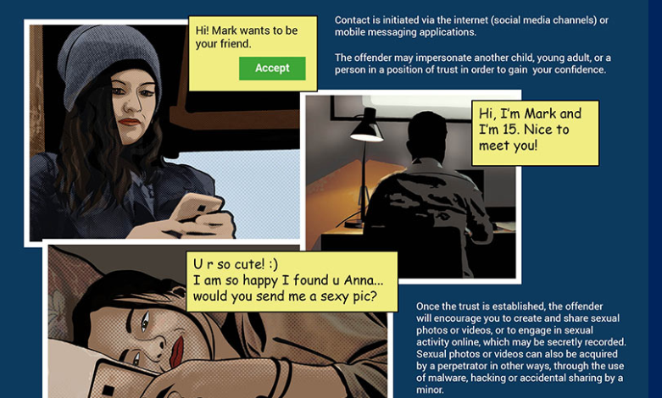

Slide 10
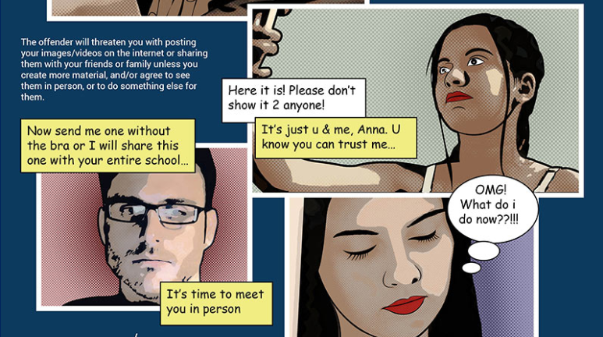

Slide 11
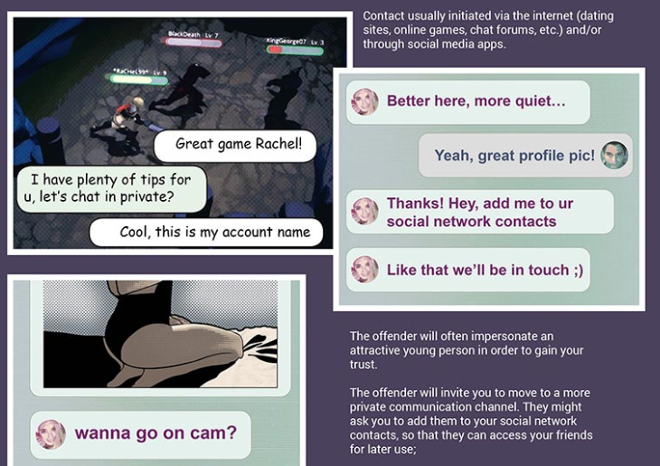

Slide 12
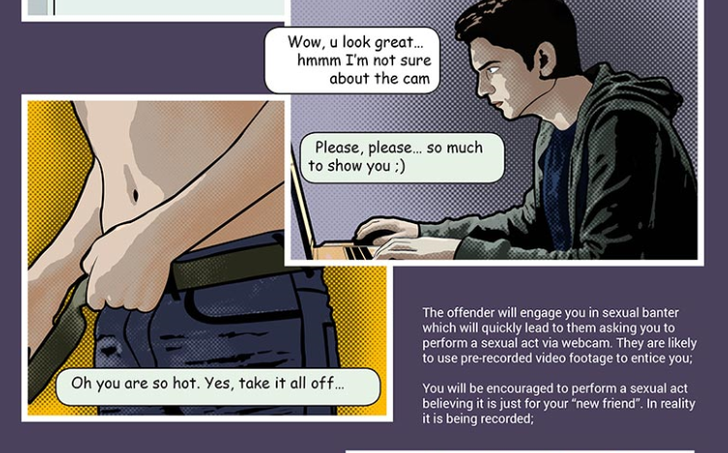

Slide 13
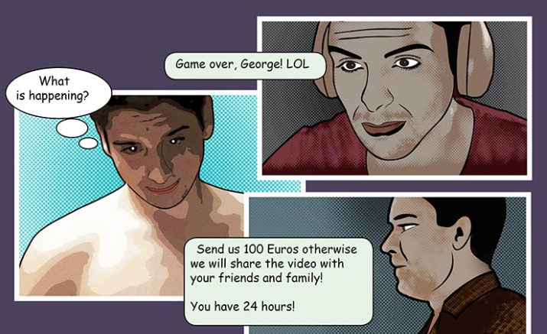

Slide 14
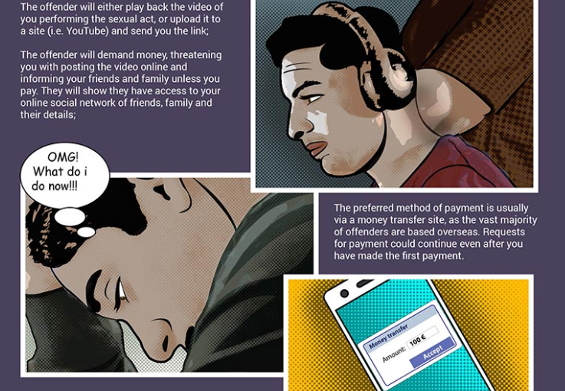

Slide 15
Sextortion in the public eye
http://www.bbc.co.uk/news/uk-38150313
http://english.cctv.com/2016/12/01/VIDEfJhi5unB1ZzaDt3fsZ2r161201.shtml
http://www.mirror.co.uk/news/uk-news/cyber-sex-gangs-blackmail-30-9972341

Slide 16
What to do if you're a victim of sextortion
Don’t panic!
Contact your local police and internet service provider immediately.
The police will take your case seriously and will deal with it in confidence. They will not judge you for being in this situation.
Don't communicate further with the criminals. Take screen shots of all your communication.
Suspend your Facebook account (but don’t delete it) and use the online reporting process to report the matter to Skype, YouTube etc. to have any video blocked and to set up an alert in case the video resurfaces.
Deactivating the Facebook account temporarily rather than shutting it down will mean the data is preserved and will help police to collect evidence.
Also, keep an eye on all the accounts which you might have linked in case the criminals try to contact you via one of those.

Slide 17
Don't pay. Many victims who have paid have continued to get more demands for higher amounts of money. In some cases, even when the demands have been met the offenders will still go on to post the explicit videos.
If you have already paid, check to see if the money has been collected. If it has, and if you are able, then make a note of where it was collected from. If it hasn't, then you can cancel the payment - and the sooner you do that the better.

Slide 18
Preserve evidence. Make a note of all details provided by the offenders, for example; the Skype name (particularly the Skype ID), the Facebook URL; any photos/videos that were sent, etc.
Be aware that the scammer's Skype name is different to their Skype ID, and it's the ID details that police will need.
To get that, right click on their profile, select ‘View Profile’ and then look for the name shown in blue rather than the one above it in black. It'll be next to the word ’Skype’ and will have no spaces in it. DO NOT DELETE ANY CORRESPONDENCE.

Slide 19
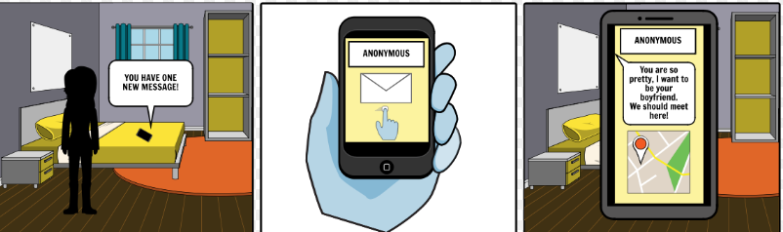
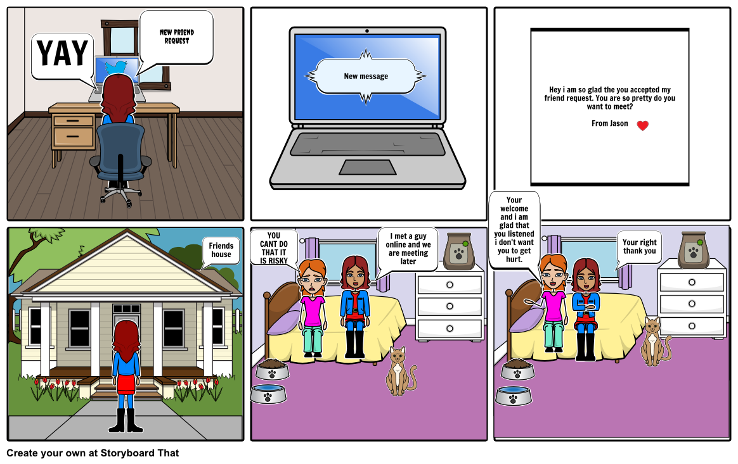
Activity
Create a story board where a young person is approached online –
Give your story a positive ending.
Remember – What should a victim do if they are blackmailed?
What precautions should a young person take online?

Slide 20
Help organisations - talk to a trusted adult…
PAPYRUS provides confidential advice and support and works to prevent young suicide in the UK.
Samaritans to talk any time you like in your own way and off the record
Childline
Get Safe Online
Revenge Porn Helpline
Skype advice on protecting yourself from blackmail
Thinkuknow

