Slide 1

CELEBRATING DIFFERENCE AND CHALLENGING HOMOPHOBIA, BIPHOBIA AND TRANSPHOBIA IN GLOUCESTERSHIRE SECONDARY SCHOOLS
Sarah Rose
Senior Account Manager

Slide 2
Terminology
Task:
In groups, match up the 18 terms with their definitions. You have 10 minutes.
Don’t worry if you don’t know all of them!
Notes:
P17 of the Training Partner Manual. After groups have spent 10 minutes on the exercise, discuss how they found it and terms they were unsure about.
Some of the definitions can vary, for many there’s no ‘one perfect answer’ but are ones here are good-practice that have been developed by Stonewall and Gendered Intelligence, a trans youth organisation.

Slide 3
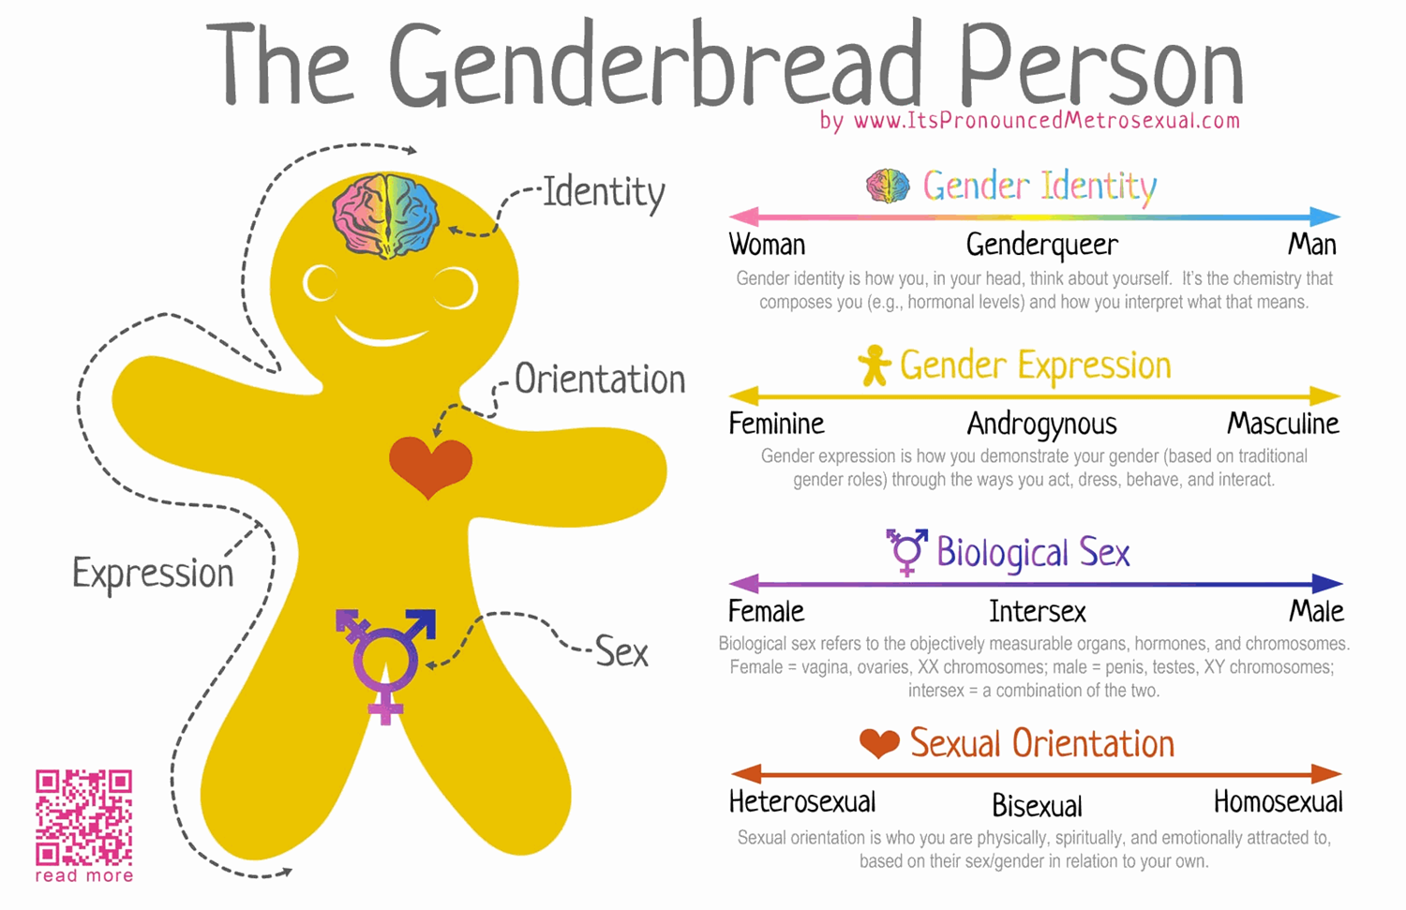

STONEWALL HEADING

Slide 4
Quiz
Notes:
P17 of the Training Partner Manual. After groups have spent 10 minutes on the exercise, discuss how they found it and terms they were unsure about.
Some of the definitions can vary, for many there’s no ‘one perfect answer’ but are ones here are good-practice that have been developed by Stonewall and Gendered Intelligence, a trans youth organisation.

Slide 5
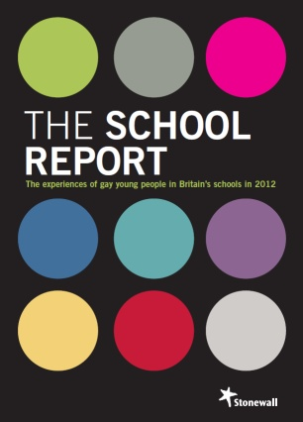
Homophobic, biphobic and transphobic bullying in schools
55 per cent of lesbian, gay and bisexual young people have experienced homophobic bullying
99 per cent of lesbian, gay and bisexual young people hear the phrases ‘that’s so gay’ or ‘you’re so gay’ in school
60 per cent of lesbian, gay and bisexual young people say teachers who witness homophobic bullying never intervene
53 per cent of lesbian, gay and bisexual pupils have never been taught about lesbian and gay people or seen lesbian and gay issues addressed in class.
Notes:
In 2012 Stonewall commissioned the University of Cambridge to survey 1614 lesbian, gay and bisexual young people aged between 11 – 18. Some of the key results are here.
Read out each stat in turn and ask participants if it surprises them or matches with their experience.

Slide 6
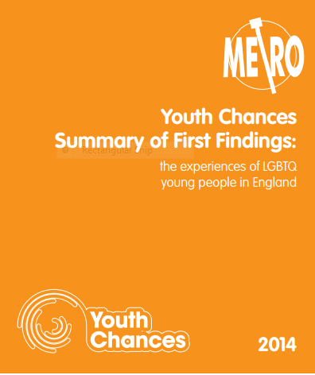
Homophobic, biphobic and transphobic bullying in schools
65 per cent of LGBT young people say teachers and staff do not speak up against homophobia, biphobia and transphobia
83 per cent of trans young people say they’ve experienced name-calling and 35 per cent physical abuse, even higher than for LGB young people
89 per cent of LGBT young people said they have never learned about bisexuality and 94 per cent said they have never learned about transgender issues
Notes:
Metro Youth Chances surveyed more than 7000 young people, most of whom identified at lesbian, gay, bisexual or trans. Similarly to Stonewall’s research the report shows that most LGBT young people do not believe school staff are supportive, with two thirds saying they don’t speak up against homophobia, biphobia and transphobia.
The report also surveyed trans young people (956 respondents identified as trans), unlike The School Report. It shows that, though bullying and discrimination is bad for LGB young people, it can be ever worse for trans young people, with three quarters experiencing name-calling and 28 per cent physical abuse. Ask participants why they think this might be, and whether they have had any experience of supporting trans young people in their schools.
The School Report showed that most LGB young people have never learned about LGB issues, but even fewer say they learn about bisexuality or trans issues.

Slide 7
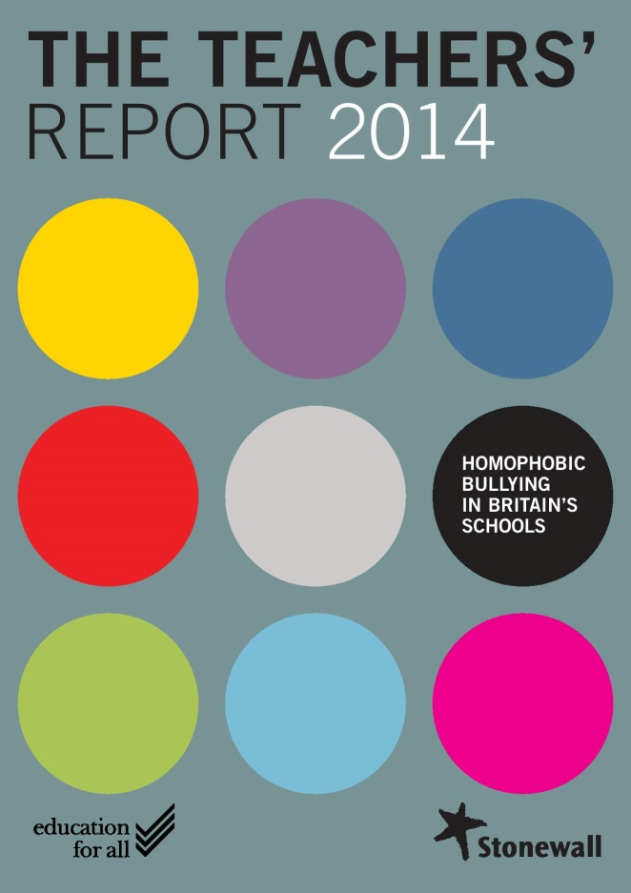
Homophobic, biphobic and transphobic bullying in schools
89 per cent of secondary school teachers say young people regardless of their sexual orientation experience homophobic bullying
29 per cent of teachers don’t know if they’re allowed to teach about lesbian, gay and bisexual issues
80 per cent of teachers have not had any specific training on how to tackle it
Notes:
In the summer of 2014, Stonewall launched The Teachers’ Report 2014, a survey by YouGov of 1000 primary and 1000 secondary school teachers, asking their experiences of homophobic bullying in school. Here are some of the key headline results. Read each one is turn and ask participants if it surprises them or matches up with their experiences.

Slide 8
Who experiences homophobic and biphobic bullying?
Data from The Teachers’ Report (2014)
Notes:
Ask participants what strikes them about this. Explore the fact that rates for boys are higher for girls and that the rate for ‘pupils who are suspected…’ is higher than ‘pupils who are openly…’ – why might each be? Bring the importance of gender stereotypes and how interlinked H, B and T bullying are in secondary schools.

Slide 9
What does it look like?
Data from The School Report (2012)
Notes:
Flag not trans but similarities and differences. In Metro Youth Chances 18% of LGBTQ young people had experienced physical abuse, 28% for just trans young people.

Slide 10
What does it look like?
‘It’s incredibly widespread – 90 per cent of more of students refer to anything broken defected or unwanted as ‘gay’. The most common insult is to call someone else ‘queer’ ‘faggot’ or ‘gay’’
Connor, 17 secondary school (South East)
‘They wouldn’t let me in the girls’ changing rooms for a year or two so I changed for PE in the loos’
Gillian, 18, secondary school (South West)
‘People were calling me names and laughing at how short my hair is and gossiping to the friend next to them about me’
Caitlin, 11, single-sex secondary school (London)
‘I’ve had a death threat sent to me saying how someone wanted to ‘ shove a knife up my arse and in my throat…’ because I’m gay’
David, 17, secondary school, (East of England)
Notes:
Ask participants to read these and then ask which they’ve encountered or is most common in their contexts.

Slide 11
What’s the impact?
60 per cent of pupils who experience homophobic bullying state that this has had an impact on their school work
32 per cent of pupils say that they’ve changed their future educational plans because of homophobic bullying
18 per cent of LGB young people and 32 per cent of trans young people say they’ve missed lessons due to discrimination or fear of discrimination
Notes:
First two stats from The School Report, the last two from Metro Youth Chances. Talk about how these stats can be used to persuade senior leadership.

Slide 12
What’s the impact?
23 per cent of lesbian, gay and bisexual young people have tried to take their own life at some point
27 per cent of trans young people have tried to kill themselves, with 62 per cent having thought about committing suicide
53 per cent of LGBTQ young people have deliberately harmed themselves
Notes:
HBT bullying is having a devastating impact on young LGBT people’s mental health. The Samaritans say that 7% of young people have tried to kill themselves, so being LGBT makes you more than three times more likely.

Slide 13
What’s the impact?
‘I didn’t make friends in college. I tended to stay away from people. There was a bunch of people from my old secondary school who made me feel unsafe. It felt safer to not know anyone at all. At that time I was quite vulnerable and there were people who had it in for me. By the end of college I was so isolated and depressed that I was finding it hard to keep caring. There was no social interaction at college. I stopped enjoying the lessons and I wasn’t confident to do well in exams. When I was younger I always had 100% attendance but it was difficult to attend college. I was usually late. Days would go by and the only words I would say were ‘sorry I’m late’
Capturing Journeys, Gendered Intelligence (2011)

Slide 14
What the law says
Education and Inspections Act 2006 - Legal duty on schools to safeguard and promote the wellbeing of children. Schools must identify and implement measures to promote good behaviour and respect for others and prevent all forms of bullying.
Notes:
Ask participants if they have heard of Section 28. Explain briefly that Section 28 was a piece of legislation from the 1980s that Stonewall was founded to campaign against. It banned the promotion of homosexuality and ‘pretended family relationships’ in schools, but was repealed in 2003.
Now, the legal context is extremely different, but lots of staff don’t know this, so it’s important to make this clear.
The Education and Inspections Act 2006 places a duty on schools to promote the safety and wellbeing of the children and young people in their care. This enshrines a child-centred approach in law and is important to bear in mind when we think of examples like the six year-old earlier.
The Equality Act places a duty on schools to have ‘due regard’ for three things: eradicating discrimination and prejudice (which includes prejudice-based bullying like HBT bullying), advancing equality of opportunity and fostering good relations between people of different ‘protected characteristics’ such as age, sexual orientation, race etc. As part of this schools are supposed to set and publish equality objectives every four years, saying things like ‘we’re going to halve the number of homophobic incidents over the next two years’ . In Stonewall’s experience not that many schools know about this and are doing it, but increasing numbers of schools are.
Tackling homophobic, biphobic and transphobic bullying is also a government priority now. The government has recently given a number of organisations including Stonewall funding to do this, and indeed this training is part of a government-funded programme.
A key consequence of this is a new Ofsted framework, which has focused increasing on tackling HBT bullying since 2012. We’re going to give out a handout now of the last time Ofsted issued specific guidance for schools on tackling HBT bullying, in April 2014. This is what Ofsted have told Stonewall inspectors are trained with, though the current inspection handbook doesn’t go into as much detail as this.
Give the group 30 secs to read the guidance and ask what they think of it.

Slide 15
What the law says
Equality Act 2010 - public duty requires public bodies, including schools, to:
  eliminate discrimination
  advance equality of opportunity
  foster good relations
Gender reassignment applies to anyone who is undergoing, has undergone or is proposing to undergo a process of reassigning their sex. For this to apply, a pupil does not have to be undergoing a medical procedure to change their sex, but must be taking active steps to live in the opposite gender or proposing to do so.
Notes:
Ask participants if they have heard of Section 28. Explain briefly that Section 28 was a piece of legislation from the 1980s that Stonewall was founded to campaign against. It banned the promotion of homosexuality and ‘pretended family relationships’ in schools, but was repealed in 2003.
Now, the legal context is extremely different, but lots of staff don’t know this, so it’s important to make this clear.
The Education and Inspections Act 2006 places a duty on schools to promote the safety and wellbeing of the children and young people in their care. This enshrines a child-centred approach in law and is important to bear in mind when we think of examples like the six year-old earlier.
The Equality Act places a duty on schools to have ‘due regard’ for three things: eradicating discrimination and prejudice (which includes prejudice-based bullying like HBT bullying), advancing equality of opportunity and fostering good relations between people of different ‘protected characteristics’ such as age, sexual orientation, race etc. As part of this schools are supposed to set and publish equality objectives every four years, saying things like ‘we’re going to halve the number of homophobic incidents over the next two years’ . In Stonewall’s experience not that many schools know about this and are doing it, but increasing numbers of schools are.
Tackling homophobic, biphobic and transphobic bullying is also a government priority now. The government has recently given a number of organisations including Stonewall funding to do this, and indeed this training is part of a government-funded programme.
A key consequence of this is a new Ofsted framework, which has focused increasing on tackling HBT bullying since 2012. We’re going to give out a handout now of the last time Ofsted issued specific guidance for schools on tackling HBT bullying, in April 2014. This is what Ofsted have told Stonewall inspectors are trained with, though the current inspection handbook doesn’t go into as much detail as this.
Give the group 30 secs to read the guidance and ask what they think of it.

Slide 16
Key government priority
“Homophobic, biphobic and transphobic bullying affects everyone, not just young people who may identify as LGBT. Any child who is different can find themselves subjected to distressing and intimidating homophobic abuse.”
Nicky Morgan MP, Secretary of State for Education
Notes:
Ask participants if they have heard of Section 28. Explain briefly that Section 28 was a piece of legislation from the 1980s that Stonewall was founded to campaign against. It banned the promotion of homosexuality and ‘pretended family relationships’ in schools, but was repealed in 2003.
Now, the legal context is extremely different, but lots of staff don’t know this, so it’s important to make this clear.
The Education and Inspections Act 2006 places a duty on schools to promote the safety and wellbeing of the children and young people in their care. This enshrines a child-centred approach in law and is important to bear in mind when we think of examples like the six year-old earlier.
The Equality Act places a duty on schools to have ‘due regard’ for three things: eradicating discrimination and prejudice (which includes prejudice-based bullying like HBT bullying), advancing equality of opportunity and fostering good relations between people of different ‘protected characteristics’ such as age, sexual orientation, race etc. As part of this schools are supposed to set and publish equality objectives every four years, saying things like ‘we’re going to halve the number of homophobic incidents over the next two years’ . In Stonewall’s experience not that many schools know about this and are doing it, but increasing numbers of schools are.
Tackling homophobic, biphobic and transphobic bullying is also a government priority now. The government has recently given a number of organisations including Stonewall funding to do this, and indeed this training is part of a government-funded programme.
A key consequence of this is a new Ofsted framework, which has focused increasing on tackling HBT bullying since 2012. We’re going to give out a handout now of the last time Ofsted issued specific guidance for schools on tackling HBT bullying, in April 2014. This is what Ofsted have told Stonewall inspectors are trained with, though the current inspection handbook doesn’t go into as much detail as this.
Give the group 30 secs to read the guidance and ask what they think of it.

Slide 17
Ofsted – School Inspection Handbook 09/15
At the start of the inspections, inspectors will request:
records and analysis of bullying, discriminatory and prejudicial behaviour, either directly or indirectly, including racist, disability and homophobic bullying, use of derogatory language and racist incidents
Notes:
Ask participants if they have heard of Section 28. Explain briefly that Section 28 was a piece of legislation from the 1980s that Stonewall was founded to campaign against. It banned the promotion of homosexuality and ‘pretended family relationships’ in schools, but was repealed in 2003.
Now, the legal context is extremely different, but lots of staff don’t know this, so it’s important to make this clear.
The Education and Inspections Act 2006 places a duty on schools to promote the safety and wellbeing of the children and young people in their care. This enshrines a child-centred approach in law and is important to bear in mind when we think of examples like the six year-old earlier.
The Equality Act places a duty on schools to have ‘due regard’ for three things: eradicating discrimination and prejudice (which includes prejudice-based bullying like HBT bullying), advancing equality of opportunity and fostering good relations between people of different ‘protected characteristics’ such as age, sexual orientation, race etc. As part of this schools are supposed to set and publish equality objectives every four years, saying things like ‘we’re going to halve the number of homophobic incidents over the next two years’ . In Stonewall’s experience not that many schools know about this and are doing it, but increasing numbers of schools are.
Tackling homophobic, biphobic and transphobic bullying is also a government priority now. The government has recently given a number of organisations including Stonewall funding to do this, and indeed this training is part of a government-funded programme.
A key consequence of this is a new Ofsted framework, which has focused increasing on tackling HBT bullying since 2012. We’re going to give out a handout now of the last time Ofsted issued specific guidance for schools on tackling HBT bullying, in April 2014. This is what Ofsted have told Stonewall inspectors are trained with, though the current inspection handbook doesn’t go into as much detail as this.
Give the group 30 secs to read the guidance and ask what they think of it.

Slide 18
Ofsted – SMSC and British Values
In their judgements of overall effectiveness, inspectors must evaluate the provision for pupils’ SMSC. For example, the cultural development of pupils is shown by their:
interest in exploring, improving understanding of and showing respect for different faiths and cultural diversity and the extent to which they understand, accept, respect and celebrate diversity
Key part of SMSC is an acceptance of and engagement with the fundamental British values:
democracy
the rule of law
individual liberty
mutual respect and tolerance of others
Notes:
Ask participants if they have heard of Section 28. Explain briefly that Section 28 was a piece of legislation from the 1980s that Stonewall was founded to campaign against. It banned the promotion of homosexuality and ‘pretended family relationships’ in schools, but was repealed in 2003.
Now, the legal context is extremely different, but lots of staff don’t know this, so it’s important to make this clear.
The Education and Inspections Act 2006 places a duty on schools to promote the safety and wellbeing of the children and young people in their care. This enshrines a child-centred approach in law and is important to bear in mind when we think of examples like the six year-old earlier.
The Equality Act places a duty on schools to have ‘due regard’ for three things: eradicating discrimination and prejudice (which includes prejudice-based bullying like HBT bullying), advancing equality of opportunity and fostering good relations between people of different ‘protected characteristics’ such as age, sexual orientation, race etc. As part of this schools are supposed to set and publish equality objectives every four years, saying things like ‘we’re going to halve the number of homophobic incidents over the next two years’ . In Stonewall’s experience not that many schools know about this and are doing it, but increasing numbers of schools are.
Tackling homophobic, biphobic and transphobic bullying is also a government priority now. The government has recently given a number of organisations including Stonewall funding to do this, and indeed this training is part of a government-funded programme.
A key consequence of this is a new Ofsted framework, which has focused increasing on tackling HBT bullying since 2012. We’re going to give out a handout now of the last time Ofsted issued specific guidance for schools on tackling HBT bullying, in April 2014. This is what Ofsted have told Stonewall inspectors are trained with, though the current inspection handbook doesn’t go into as much detail as this.
Give the group 30 secs to read the guidance and ask what they think of it.

Slide 19
Ofsted – CIF 09/15
Effectiveness of leadership and management
Inspectors will evaluate the extent to which leaders, managers and governors:
actively promote equality and diversity, tackle bullying and discrimination and narrow any gaps in achievement between different groups of children and learners
Notes:
Ask participants if they have heard of Section 28. Explain briefly that Section 28 was a piece of legislation from the 1980s that Stonewall was founded to campaign against. It banned the promotion of homosexuality and ‘pretended family relationships’ in schools, but was repealed in 2003.
Now, the legal context is extremely different, but lots of staff don’t know this, so it’s important to make this clear.
The Education and Inspections Act 2006 places a duty on schools to promote the safety and wellbeing of the children and young people in their care. This enshrines a child-centred approach in law and is important to bear in mind when we think of examples like the six year-old earlier.
The Equality Act places a duty on schools to have ‘due regard’ for three things: eradicating discrimination and prejudice (which includes prejudice-based bullying like HBT bullying), advancing equality of opportunity and fostering good relations between people of different ‘protected characteristics’ such as age, sexual orientation, race etc. As part of this schools are supposed to set and publish equality objectives every four years, saying things like ‘we’re going to halve the number of homophobic incidents over the next two years’ . In Stonewall’s experience not that many schools know about this and are doing it, but increasing numbers of schools are.
Tackling homophobic, biphobic and transphobic bullying is also a government priority now. The government has recently given a number of organisations including Stonewall funding to do this, and indeed this training is part of a government-funded programme.
A key consequence of this is a new Ofsted framework, which has focused increasing on tackling HBT bullying since 2012. We’re going to give out a handout now of the last time Ofsted issued specific guidance for schools on tackling HBT bullying, in April 2014. This is what Ofsted have told Stonewall inspectors are trained with, though the current inspection handbook doesn’t go into as much detail as this.
Give the group 30 secs to read the guidance and ask what they think of it.

Slide 20
Ofsted – CIF 09/15
Quality of teaching, learning and assessment
Inspectors will evaluate the extent to which:
equality of opportunity and recognition of diversity are promoted through teaching and learning
Notes:
Ask participants if they have heard of Section 28. Explain briefly that Section 28 was a piece of legislation from the 1980s that Stonewall was founded to campaign against. It banned the promotion of homosexuality and ‘pretended family relationships’ in schools, but was repealed in 2003.
Now, the legal context is extremely different, but lots of staff don’t know this, so it’s important to make this clear.
The Education and Inspections Act 2006 places a duty on schools to promote the safety and wellbeing of the children and young people in their care. This enshrines a child-centred approach in law and is important to bear in mind when we think of examples like the six year-old earlier.
The Equality Act places a duty on schools to have ‘due regard’ for three things: eradicating discrimination and prejudice (which includes prejudice-based bullying like HBT bullying), advancing equality of opportunity and fostering good relations between people of different ‘protected characteristics’ such as age, sexual orientation, race etc. As part of this schools are supposed to set and publish equality objectives every four years, saying things like ‘we’re going to halve the number of homophobic incidents over the next two years’ . In Stonewall’s experience not that many schools know about this and are doing it, but increasing numbers of schools are.
Tackling homophobic, biphobic and transphobic bullying is also a government priority now. The government has recently given a number of organisations including Stonewall funding to do this, and indeed this training is part of a government-funded programme.
A key consequence of this is a new Ofsted framework, which has focused increasing on tackling HBT bullying since 2012. We’re going to give out a handout now of the last time Ofsted issued specific guidance for schools on tackling HBT bullying, in April 2014. This is what Ofsted have told Stonewall inspectors are trained with, though the current inspection handbook doesn’t go into as much detail as this.
Give the group 30 secs to read the guidance and ask what they think of it.

Slide 21
Ofsted – CIF 09/15
Personal development, behaviour and welfare
Inspectors will evaluate the extent to which the provision is successfully promoting and supporting children’s and other learners’:
following of any guidelines for behaviour and conduct
understanding of how to keep themselves safe from relevant risks (all forms of bullying, derogatory language)
personal development, so that they are well prepared to respect others and contribute to wider society and life in Britain
Notes:
Ask participants if they have heard of Section 28. Explain briefly that Section 28 was a piece of legislation from the 1980s that Stonewall was founded to campaign against. It banned the promotion of homosexuality and ‘pretended family relationships’ in schools, but was repealed in 2003.
Now, the legal context is extremely different, but lots of staff don’t know this, so it’s important to make this clear.
The Education and Inspections Act 2006 places a duty on schools to promote the safety and wellbeing of the children and young people in their care. This enshrines a child-centred approach in law and is important to bear in mind when we think of examples like the six year-old earlier.
The Equality Act places a duty on schools to have ‘due regard’ for three things: eradicating discrimination and prejudice (which includes prejudice-based bullying like HBT bullying), advancing equality of opportunity and fostering good relations between people of different ‘protected characteristics’ such as age, sexual orientation, race etc. As part of this schools are supposed to set and publish equality objectives every four years, saying things like ‘we’re going to halve the number of homophobic incidents over the next two years’ . In Stonewall’s experience not that many schools know about this and are doing it, but increasing numbers of schools are.
Tackling homophobic, biphobic and transphobic bullying is also a government priority now. The government has recently given a number of organisations including Stonewall funding to do this, and indeed this training is part of a government-funded programme.
A key consequence of this is a new Ofsted framework, which has focused increasing on tackling HBT bullying since 2012. We’re going to give out a handout now of the last time Ofsted issued specific guidance for schools on tackling HBT bullying, in April 2014. This is what Ofsted have told Stonewall inspectors are trained with, though the current inspection handbook doesn’t go into as much detail as this.
Give the group 30 secs to read the guidance and ask what they think of it.

Slide 22
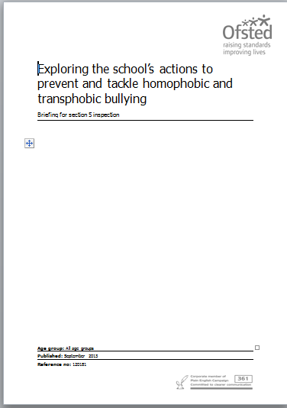
Ofsted – Exploring school’s actions to prevent and tackle homophobic and transphobic bullying
Notes:
Ask participants if they have heard of Section 28. Explain briefly that Section 28 was a piece of legislation from the 1980s that Stonewall was founded to campaign against. It banned the promotion of homosexuality and ‘pretended family relationships’ in schools, but was repealed in 2003.
Now, the legal context is extremely different, but lots of staff don’t know this, so it’s important to make this clear.
The Education and Inspections Act 2006 places a duty on schools to promote the safety and wellbeing of the children and young people in their care. This enshrines a child-centred approach in law and is important to bear in mind when we think of examples like the six year-old earlier.
The Equality Act places a duty on schools to have ‘due regard’ for three things: eradicating discrimination and prejudice (which includes prejudice-based bullying like HBT bullying), advancing equality of opportunity and fostering good relations between people of different ‘protected characteristics’ such as age, sexual orientation, race etc. As part of this schools are supposed to set and publish equality objectives every four years, saying things like ‘we’re going to halve the number of homophobic incidents over the next two years’ . In Stonewall’s experience not that many schools know about this and are doing it, but increasing numbers of schools are.
Tackling homophobic, biphobic and transphobic bullying is also a government priority now. The government has recently given a number of organisations including Stonewall funding to do this, and indeed this training is part of a government-funded programme.
A key consequence of this is a new Ofsted framework, which has focused increasing on tackling HBT bullying since 2012. We’re going to give out a handout now of the last time Ofsted issued specific guidance for schools on tackling HBT bullying, in April 2014. This is what Ofsted have told Stonewall inspectors are trained with, though the current inspection handbook doesn’t go into as much detail as this.
Give the group 30 secs to read the guidance and ask what they think of it.

Slide 23
Safeguarding
There are no issues under child protection or safeguarding law or practice specific to lesbian, gay, bisexual or trans children and young people aside from what is in place to keep all children and young people safe
Notes:
Ask participants if they have heard of Section 28. Explain briefly that Section 28 was a piece of legislation from the 1980s that Stonewall was founded to campaign against. It banned the promotion of homosexuality and ‘pretended family relationships’ in schools, but was repealed in 2003.
Now, the legal context is extremely different, but lots of staff don’t know this, so it’s important to make this clear.
The Education and Inspections Act 2006 places a duty on schools to promote the safety and wellbeing of the children and young people in their care. This enshrines a child-centred approach in law and is important to bear in mind when we think of examples like the six year-old earlier.
The Equality Act places a duty on schools to have ‘due regard’ for three things: eradicating discrimination and prejudice (which includes prejudice-based bullying like HBT bullying), advancing equality of opportunity and fostering good relations between people of different ‘protected characteristics’ such as age, sexual orientation, race etc. As part of this schools are supposed to set and publish equality objectives every four years, saying things like ‘we’re going to halve the number of homophobic incidents over the next two years’ . In Stonewall’s experience not that many schools know about this and are doing it, but increasing numbers of schools are.
Tackling homophobic, biphobic and transphobic bullying is also a government priority now. The government has recently given a number of organisations including Stonewall funding to do this, and indeed this training is part of a government-funded programme.
A key consequence of this is a new Ofsted framework, which has focused increasing on tackling HBT bullying since 2012. We’re going to give out a handout now of the last time Ofsted issued specific guidance for schools on tackling HBT bullying, in April 2014. This is what Ofsted have told Stonewall inspectors are trained with, though the current inspection handbook doesn’t go into as much detail as this.
Give the group 30 secs to read the guidance and ask what they think of it.

Slide 24
Ofsted – Inspecting safeguarding in Early Years, Education and Skills
Safeguarding action may be needed to protect children and learners from:
  bullying, including online bullying and prejudice-based bullying
  racist, disabilist and homophobic and transphobic abuse
Notes:
Ask participants if they have heard of Section 28. Explain briefly that Section 28 was a piece of legislation from the 1980s that Stonewall was founded to campaign against. It banned the promotion of homosexuality and ‘pretended family relationships’ in schools, but was repealed in 2003.
Now, the legal context is extremely different, but lots of staff don’t know this, so it’s important to make this clear.
The Education and Inspections Act 2006 places a duty on schools to promote the safety and wellbeing of the children and young people in their care. This enshrines a child-centred approach in law and is important to bear in mind when we think of examples like the six year-old earlier.
The Equality Act places a duty on schools to have ‘due regard’ for three things: eradicating discrimination and prejudice (which includes prejudice-based bullying like HBT bullying), advancing equality of opportunity and fostering good relations between people of different ‘protected characteristics’ such as age, sexual orientation, race etc. As part of this schools are supposed to set and publish equality objectives every four years, saying things like ‘we’re going to halve the number of homophobic incidents over the next two years’ . In Stonewall’s experience not that many schools know about this and are doing it, but increasing numbers of schools are.
Tackling homophobic, biphobic and transphobic bullying is also a government priority now. The government has recently given a number of organisations including Stonewall funding to do this, and indeed this training is part of a government-funded programme.
A key consequence of this is a new Ofsted framework, which has focused increasing on tackling HBT bullying since 2012. We’re going to give out a handout now of the last time Ofsted issued specific guidance for schools on tackling HBT bullying, in April 2014. This is what Ofsted have told Stonewall inspectors are trained with, though the current inspection handbook doesn’t go into as much detail as this.
Give the group 30 secs to read the guidance and ask what they think of it.

Slide 25
HBT language
Homophobic: ‘This homework’s so gay’
Biphobic: ‘Make your mind up, you can’t like boys and girls’
Transphobic: ‘That hair makes you look like a right tranny’
…..: ‘Stop being such a girl’

Slide 26

Confidence ruler
NOT AT ALL
VERY
How confident do you feel challenging homophobic, biphobic and transphobic language?
Notes:
Use this slide to briefly discuss the Confidence Ruler as an exercise and how it might be adapted in staff training your participants will conduct.

Slide 27
Confidence ruler
NOT AT ALL
VERY
How confident do you feel teachers at your school are at challenging homophobic, biphobic and transphobic language?
Notes:
Use this slide to briefly discuss the Confidence Ruler as an exercise and how it might be adapted in staff training your participants will conduct.

Slide 28
Confidence ruler
NOT AT ALL
VERY
How confident do you feel that the whole staff at your school are at challenging homophobic, biphobic and transphobic language?
Notes:
Use this slide to briefly discuss the Confidence Ruler as an exercise and how it might be adapted in staff training your participants will conduct.

Slide 29
Developing a script of responses
Institutional response
In our school we always try to be kind to each other and when you use ‘gay’ like that it is unkind.
Question
What do you think that word means?
Confront
Language like that is not acceptable.
Personal response
I’m not happy with what you said.

Slide 30
Case studies
For each case study, think about:
Is the response correct?
What should the appropriate response be?
What steps could be taken to prevent this from happening again?
What steps could be taken to prevent this problem arising in your school?

Slide 31
Case study 1
Aliyah is 17. She works hard at school and tends not to mix with the other girls very much. The other students have taken to calling her a lesbian every time they see or talk about her. Aliyah doesn’t know if she is a lesbian, but she thinks she probably isn’t. She feels uncomfortable and embarrassed be the taunt. She knows that her teachers have overheard but haven’t intervened. Aliyah thinks this is because her teachers think she is a lesbian too. She is worried that the teachers might say something to her parents, and will stop thinking she is good at her work. Aliyah becomes increasingly withdrawn and her work suffers as a result.

Slide 32
Case study 2
A student walks in late and shouts, ‘This subject’s so gay, I don’t see why we have to be here!’ Another student replies, ‘You’re so gay Tom, I wish you weren’t here.’ The teacher tries to deal with the situation by saying, ‘Let’s have some quiet please so I can get on with the lesson.’ When the teacher says Tom’s name, members of the class whisper ‘Gay boy.’ This is met with silence from the teacher.

Slide 33
Case study 3
Adam is openly gay and has a boyfriend from another school. At the end of the day, his boyfriend meets him outside. Other students see this and make remarks that the couple can overhear. When asked to work in groups the next day, Adam’s fellow students start telling homophobic jokes and team up without him. The teacher overhears the remarks but does not react because he thinks Adam should have been more discreet about his sexual orientation and he should have anticipated these reactions. When it comes to assessment, the teacher realises that Adam’s results are below average.

Slide 34

Show NoBystanders video
Notes:
Show NoBystanders and ask participants whether they’d use it and if so how. Make clear that this resource, like others, is an ‘offer’ – it doesn’t have to be used, but is there for participants to adapt if helpful.

Slide 35
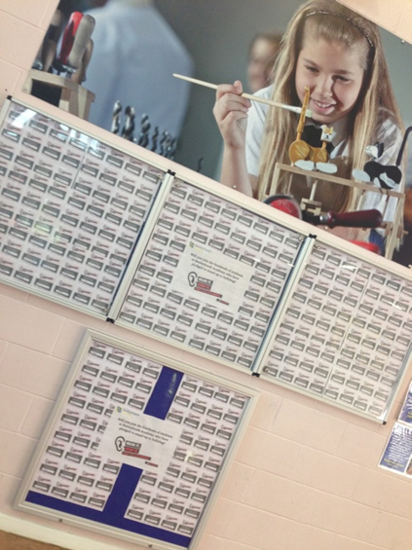
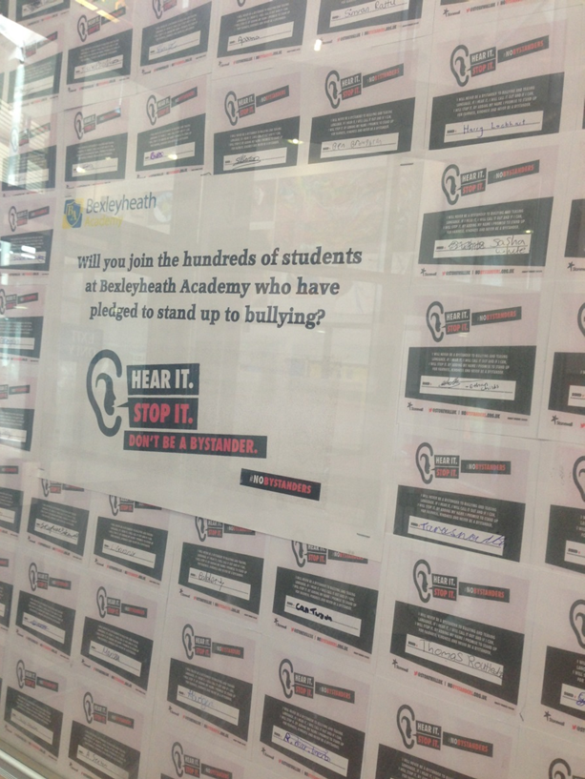
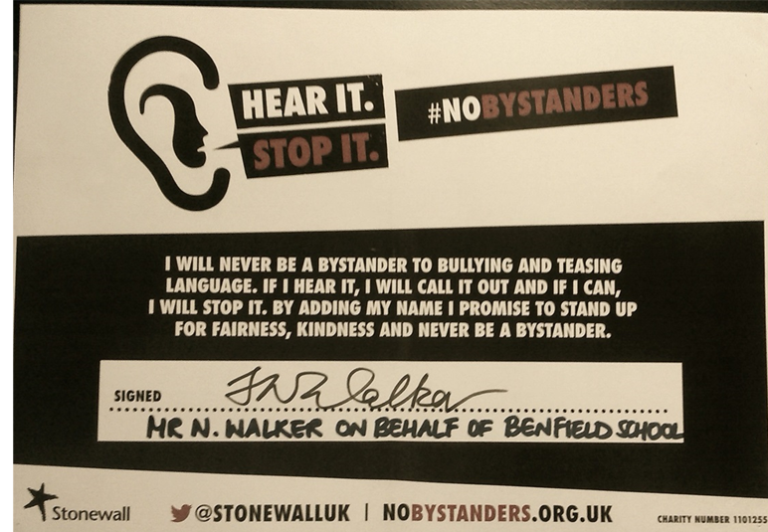
In practice

Slide 36






Secondary resources

Slide 37





Resources to tackle homophobic language

Slide 38




Dealing with tough issues

Slide 39


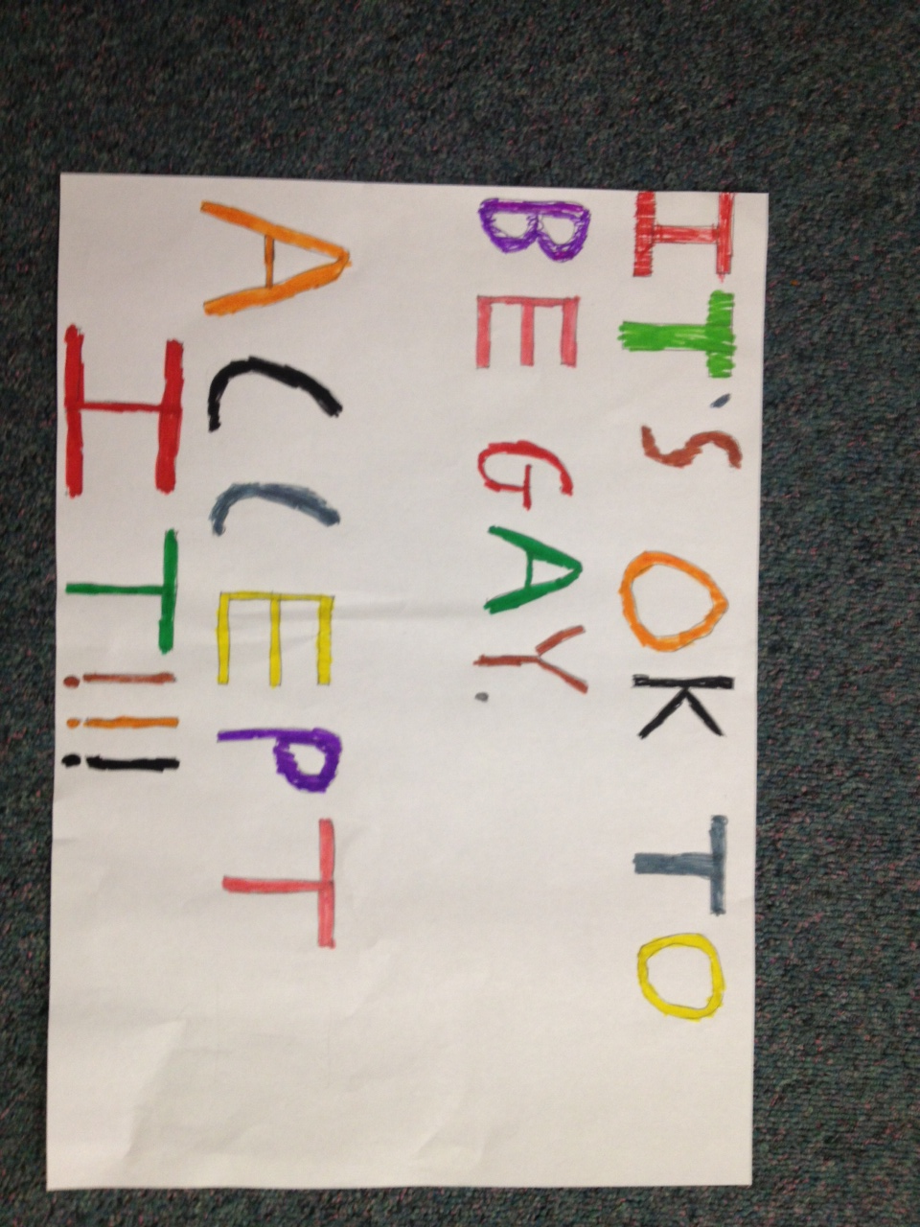
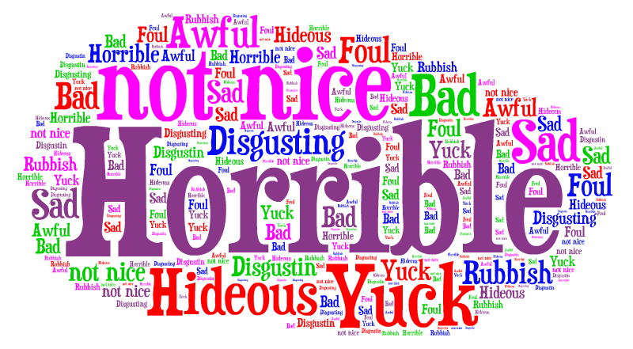
In practice

Slide 40
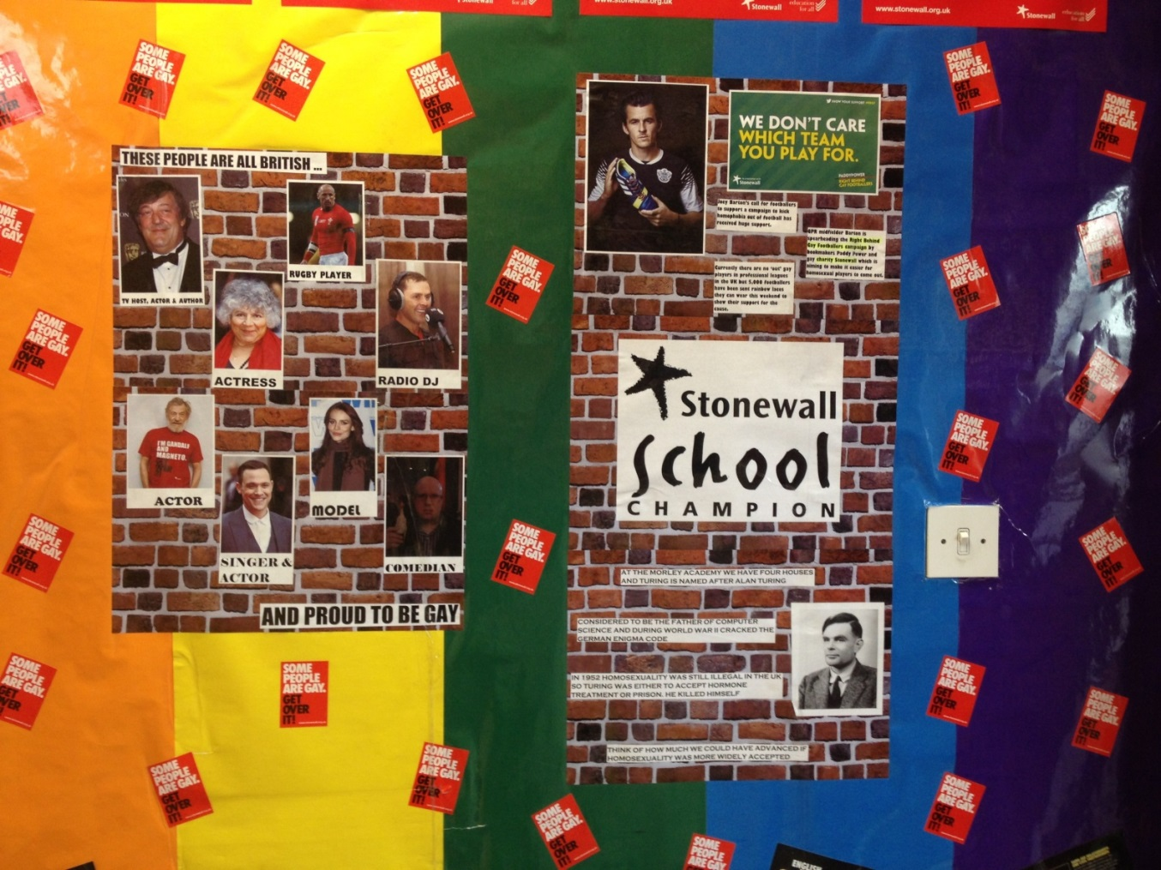
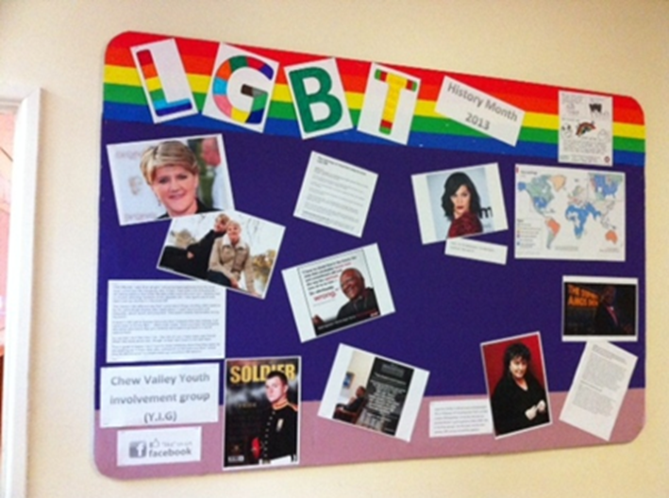
Showcasing LGBT role models
Notes:
Refer to pp19-22 of the Training Partner Manual.

Slide 41
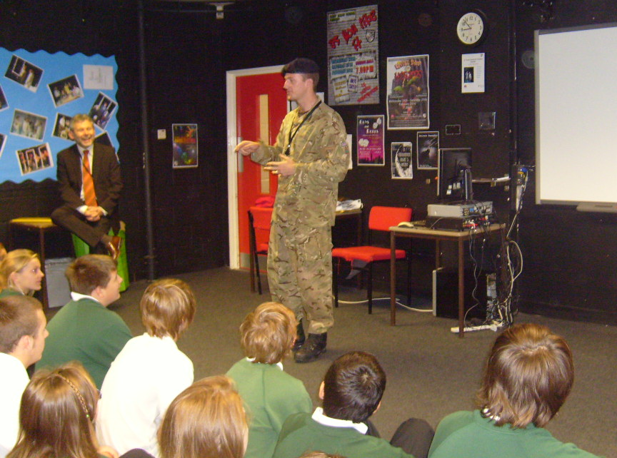
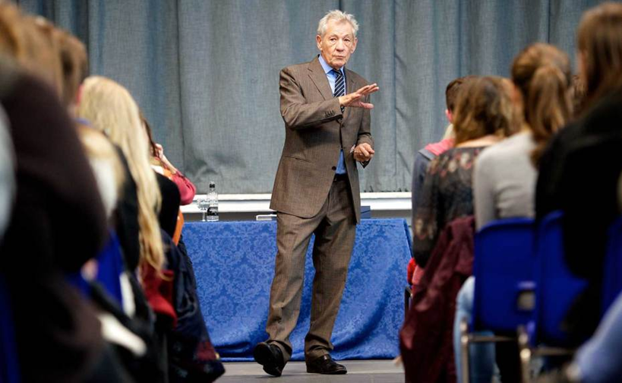
Stonewall role models
Notes:
Refer to pp19-22 of the Training Partner Manual.

Slide 42
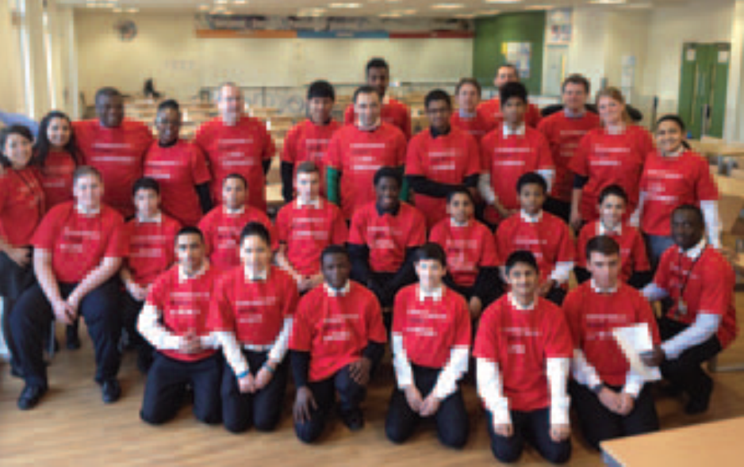

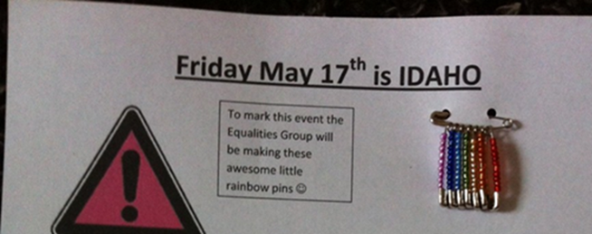
Student-led initiatives
Notes:
Refer to pp19-22 of the Training Partner Manual.

Slide 43
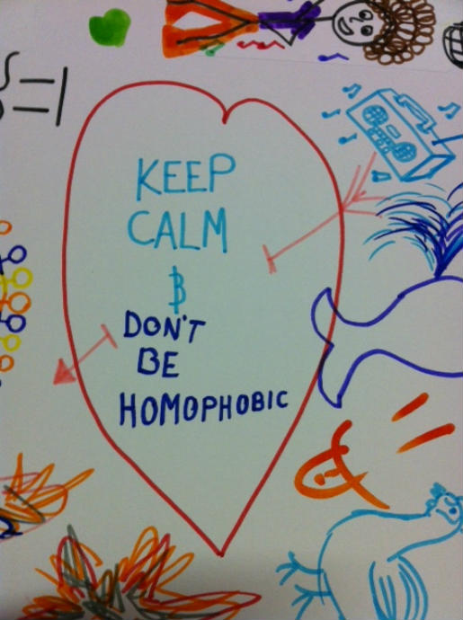
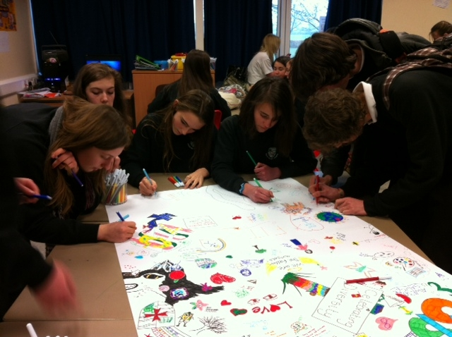
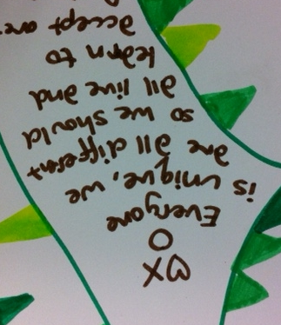
Student-led initiatives
Doodle for Diversity

Slide 44
FIT

Slide 45






Can we tell if someone is gay?
Name: Isaac
Age: 18
Hobbies: Rollerblading, Playstation, collecting baseball caps, street dance, hip hop and ragga music
Name: Lee
Age: 17
Hobbies: Basketball, street dance, graffiti art, Joelly D the pop star, karaoke
Name: Ryan
Age: 18
Hobbies: Football, martial arts, RnB, singing, Playstation,
Sci-fi, street dance
Name: Jordan
Age: 17
Hobbies: football, MCing, street
dance, boxing
Name: Karmel
Age: 17
Hobbies: fashion, shopping, beauty,
drama, street dance
Name: Tegs
Age: 17
Hobbies: Reading, online gaming, indie music, street dance, tap dancing

Slide 46
What each chapter covers
Lee - gender stereotyping, friendship
Karmel - coming out, impact of homophobic language
Tegs - difference and different forms of bullying
Jordan - homophobia in sport and perceptions of gay people
Ryan - friendship, secrecy, denial and violence
Isaac - prejudice, discrimination and homophobia
Notes:
Refer to pp19-22 of the Training Partner Manual.

Slide 47

The Wall
What barriers exist in your school to celebrating difference and preventing and tackling homophobia, biphobia and transphobia?
Notes:
Refer to pp19-22 of the Training Partner Manual.

Slide 48
QUESTIONS?
Contact details:
sarah.rose@stonewall.org.uk
Website:
www.stonewall.org.uk

