Slide 1


Assembly kit for Anti-Bullying Week 2017
LGBT – Transphobia and Transphobic bullying.
Suggested age range: 11-18
This assembly explores some of the differences that exist within the LGBT community, specifically some the differences between the experiences of LGB and trans people. This assembly draws on what we know of young trans people’s experiences in schools in the UK today, as shown in our 2017 School Report, and seeks to empower secondary schools to tackle this type of bullying head on. It also aims to dispel common myths or misconceptions about trans people and encourage alliances in recognition of the challenges young trans people may face.
Please note This presentation focuses on trans issues in schools, including being a trans young person. It also references bullying and self-harm statistics (on slide 6) as well as a range of mental health issues (slide 10) – please alert students that if they need any support around any of the issues raised in this presentation that they can talk to school staff or contact ChildLine.
Learning Objectives
Learners will
Consider what it means to be trans by exploring a definition and a real-life story
Develop an understanding of the challenges trans young people might face
Reflect on their own identity, feelings and how they respond to and treat others who may be different to them
Explore the responsibilities they have in upholding the equality of everyone in the school community

Slide 2


ANTI-BULLYING WEEK
LGBT – Transphobia and Transphobic bullying
13 – 17 November 2017
ALL DIFFERENT, ALL EQUAL
Notes:
General introduction to the assembly and the week-long initiative. The anti-bullying alliance can be referenced and the week can be explained/put in to context.
The theme this year is “All different, all equal”.

Slide 3

WHAT DOES LGBT STAND FOR?
Notes:
Ask students for hands up if they know what LGBT stands for.
Alternatively you could talk through each of the letters in the acronym and offer definitions. Go through the definitions to LGB – T will be explained more thoroughly in the coming slides. Here are Stonewall’s definitions for you to use:
Lesbian: refers to a woman who has an emotional, romantic and/or sexual orientation towards women
Gay: refers to a man who has an emotional, romantic and/or sexual orientation towards men. Also a generic term for lesbian and gay sexuality –some women deﬁne themselves as gay rather than lesbian
Bisexual: refers to a person who has an emotional, romantic and/or sexual orientation towards more than one gender

Slide 4
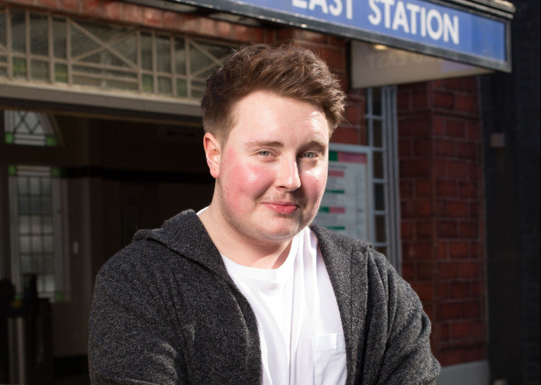


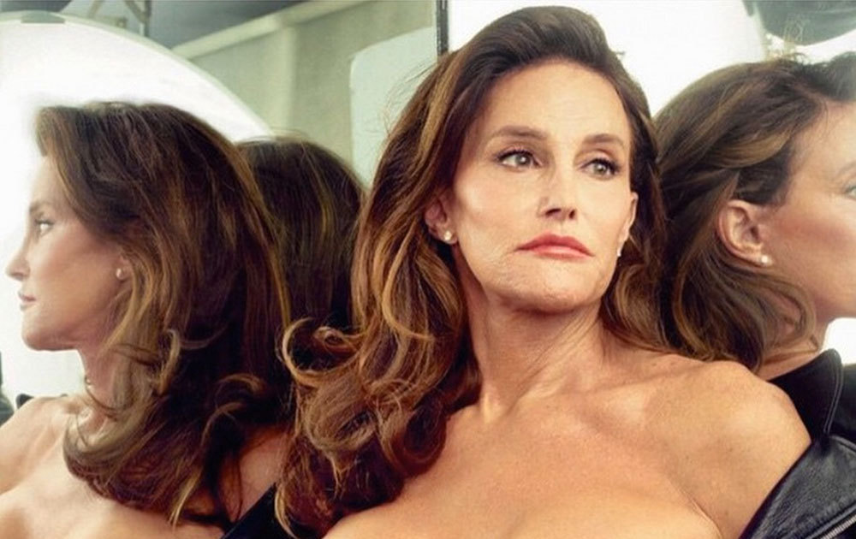
WHAT ABOUT THE ‘T’ IN LGBT?
WHO OR WHAT DO YOU THINK OF?
Notes:
Ask students to think about the ‘T’ in LGBT. Who or what do they think of? You can take student responses.
Some names that might be mentioned are Laverne Cox, Caitlyn Jenner, Riley Carter Millington (The first trans actor in Eastenders) and the Trans Pride flag (which is different to the pride flag)

Slide 5
WHAT DOES TRANS MEAN?
Trans is an umbrella term to describe people whose gender is not the same as, or does not sit comfortably with, the sex they were assigned at birth.
Trans people may describe themselves using one or more of a wide variety of terms, including (but not limited to) transgender, cross dresser, non-binary and/or gender queer.
Notes:
Go through the definition of what being ‘trans’ means. This is Stonewall’s definition.

Slide 6
SO, WHAT ABOUT LGBT AND BULLYING?
The Stonewall School Report 2017 found that:
Nearly half of all LGB young people face bullying at school for being LGB. More than 60% of trans young people have experienced bullying for being trans.
While there has been some improvement in tackling homophobic, biphobic and transphobic bullying there is still work to be done:
  More than 4 in 5 trans young people have thought about or have hurt themselves in some way. This is compared to 3 in 5 LGB young people who do not identify as trans
Notes:
This is an opportunity to talk about why there is a focus on the ‘T’ in ‘LGBT’. This is our suggestion.
The Stonewall School Report provides evidence that trans young people are more likely to experience bullying at school when compared to their non trans peers, even if those peers identify as LGB. There has been a reduction in homophobic and biphobic bullying in schools but the figure still remains at nearly 50%. However, worse still is the figure for trans people. More than 60% of trans school students surveyed stated that they had been the victim of bullying due to their identity as a trans person. More than 60% of trans school students have been or are being bullied simply because of who they are. For some trans young people these negative experiences have had such an impact that they have harmed themselves in some way or have thought about doing this. This is not a consequence of being trans. This is a consequence of being bullied for being trans. And this has to stop.

Slide 7
WHAT KINDS OF CHALLENGES MIGHT TRANS
YOUNG PEOPLE FACE?
“I knew that something wasn’t quite right,
but I didn’t know what”
Matt
Notes:
Introduce that trans people face challenges in their daily lives.
We all face challenges, of course we do. But trans people will face challenges that non trans people will not have to face, simply because they’re trans.
The following short film outlines the experiences and story of Matt, a young trans person.
Ask the students to listen to and watch his story and see if they can identify some specific challenges that Matt faces or has faced in his life.

Slide 8
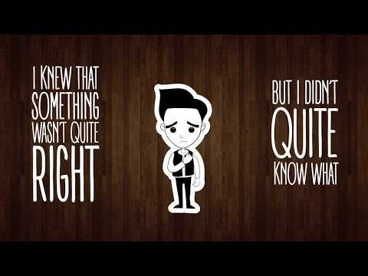
https://www.youtube.com/watch?v=B57Orj-JJhQ
Notes:
Play film - https://www.youtube.com/watch?v=B57Orj-JJhQ
Interactive board/projector and sound needed.

Slide 9
WHAT KIND OF CHALLENGES DID YOU SPOT
IN THE FILM?
Experiencing name-calling and transphobic language
Clothing and uniform codes
Toilets – Which to use? Will someone make a comment?
Changing rooms
Being misgendered - “You don’t look like a girl!” or, “You don’t look like a boy!”
Feeling the need to conform to gender stereotypes
A change in pronouns – “he” or, “she”?
People not understanding that trans people exist and having to defend themselves and their existence
Having to explain why some trans people don’t feel comfortable with the label “boy” or, “girl” and that for them, gender is not binary (only male or female)
Notes:
Ask students for feedback.
What challenges did they spot in the film?
Once a few responses have been taken you can move on to talk through this list.
Here is a little more information on each of the bullet points should you wish to expand on some or all of them.
Experiencing name-calling and transphobic language
Sometimes trans people will experience bullying in the form of name calling or transphobic language. Transphobic language can be words or phrases that express a fear or dislike of people who are trans. Transphobic phrases could be, “But you look so much prettier as a girl” and examples of transphobic languages could be calling a trans person a “tranny” or a “gender bender”.
Clothing and uniform codes
Sometimes it can be difficult for trans people to express themselves through what they wear, especially if they are expected to wear a particular uniform either at school or at work. Think about how important your clothes are to you and how they make you feel about yourself.
Toilets – Which to use? Will someone make a comment?
Trans people might encounter problems when using public toilets. They might not feel as though they can use the facilities that match their gender identity for fear of being accused of using the wrong toilet. Additionally, some trans people who are non-binary and do not feel comfortable with the labels ‘man’ and/or ‘woman’ might not have a gender neutral toilet to use. Lack of a gender neutral toilet might also prevent a trans person from using the toilet that matches their gender identity without ‘outing’ themselves as trans.
Changing rooms
As above. These bullet points could be explained together as the issue is similar.
Being misgendered - “You don’t look like a girl!” or, “You don’t look like a boy!”
Some trans people face being misgendered. This means that when they meet people for the first time or give information about themselves they are accused of not being the gender with which they identify. Some examples might be, “You don’t look/sound like a boy/girl”.
Feeling the need to conform to gender stereotypes
Some trans people might feel that in order to prove themselves to society and be accepted as the gender with which they identify they have to conform to stereotypes that exist about that gender. For example, Matt felt the need to exercise and lift weights. Other people might feel as though they should wear make-up or wear a particular colour or style of clothing.
A change in pronouns – “he” or, “she”?
Trans people might choose to change their pronoun. This means that they want to be known as ‘he’ rather than ‘she’ or vice versa. Some might experience difficulties as friends and teachers don’t always get it right.
People not understanding that trans people exist and having to defend themselves and their existence and Having to explain why some trans people don’t feel comfortable with the label “boy” or, “girl” and that for them, gender is not binary (only male or female)
Some people suggest that being trans is a choice or that a trans person is simply craving attention. A trans person might have to defend their existence and the validity of their identity in a way that a person who isn’t trans will not have to, however some people who don’t identify as trans but who question their gender might have to too. All of these people exist. All of these people are different. All of these people are equal. Why should a person’s internal sense of self need validation or justification?

Slide 10
WHAT CAN THE IMPACT OF BULLYING BE?
Low self confidence
Not wanting to come to school and feeling demotivated in school work
Underachievement
Not wanting to take part in school-life such as extra curricular clubs or activities
Stress and anxiety
Low mood or in some cases depression
Notes:
Go through this list with students.
This is by no means exhaustive but it captures some of the known consequences of bullying.
It must be stressed that these are not the consequence of being LGB or Trans; these are the consequences of being bullied and all of these consequences are avoidable.

Slide 11
WHY DOES THIS MATTER IN OUR SCHOOL?
Every person has the right to be who they are – the rights of trans people are protected in the Equality Act 2010 and transphobic bullying can be treated as a hate crime and is therefore a criminal offence
Young people report experiencing homophobic, biphobic and transphobic bullying even when they do not identify as LGBT
Every person deserves to fulfil their potential and achieve their best at school and in every aspect of their life, no matter what. Mutual Respect and Individual Liberty are fundamental British values.
Every person is different, but all people are equal
Every person has many parts to their identity, being LGBT is just one of many layers
Notes:
Transphobic bullying matters to all schools, whether they have pupils who are trans or not. Here’s a suggestion for how you could explain this easily.
The Stonewall School Report 2017 found that young people report experiencing transphobic bullying and language even when they themselves are not trans. Students, no matter how they identify, can be the victim of HBT bullying and can experience gender stereotyping that infringes on their ability to be themselves. When people cannot be their true selves they are denied the opportunities they deserve and have a right to. All people, no matter how they identify and no matter how different they may be, deserve respect and equal treatment. Remember, no person is JUST LGB or T. This is just one of many layers to a person’s overall identity. Think about how many layers you might have to yours.

Slide 12
WHAT CAN WE ALL DO?
Hear, don’t just listen to what people say and tell you
Respect every persons right to privacy
Ask how a person would like to be referred to and follow their wishes
Think about what you’re saying, if you think it’s offensive, don’t say it!
Don’t ask too many questions, especially not personal ones
Report incidents of bullying, even if they didn’t happen to you
Notes:
This final slide is a call to action – What can we all do to make the experiences of trans young people better? Here are a few suggestions with explanations.
We all have a responsibility to ensure all people are protected and treated equally in our school community. Here are some practical ways to help support people who might be different to you. Some of these people might be trans, some might not. These practical suggestions can help us all to support LGBT people more effectively and be there for everyone in our community.
Firstly, hear don’t just listen; take the time to process what a person is saying to you and take it on board, don’t just let it go in one ear and out of the other.
Secondly, respect every person’s right to privacy. Just because they’ve told you something doesn’t mean they want everyone to know.
Thirdly, if you do meet a trans person, ask how they would like to be known and respect their wishes. Try and get it right, if you slip up, apologize.
Fourthly, think about what you’re saying. It’s likely that you’ll know something is offensive before you say it but if in doubt, don’t say it.
Additionally, don’t ask too many questions. People will come to you when they’re ready and they may or not share information with you that is personal to them. Don’t be offended if they don’t, just be patient and be led by what the people around you want.

Slide 13
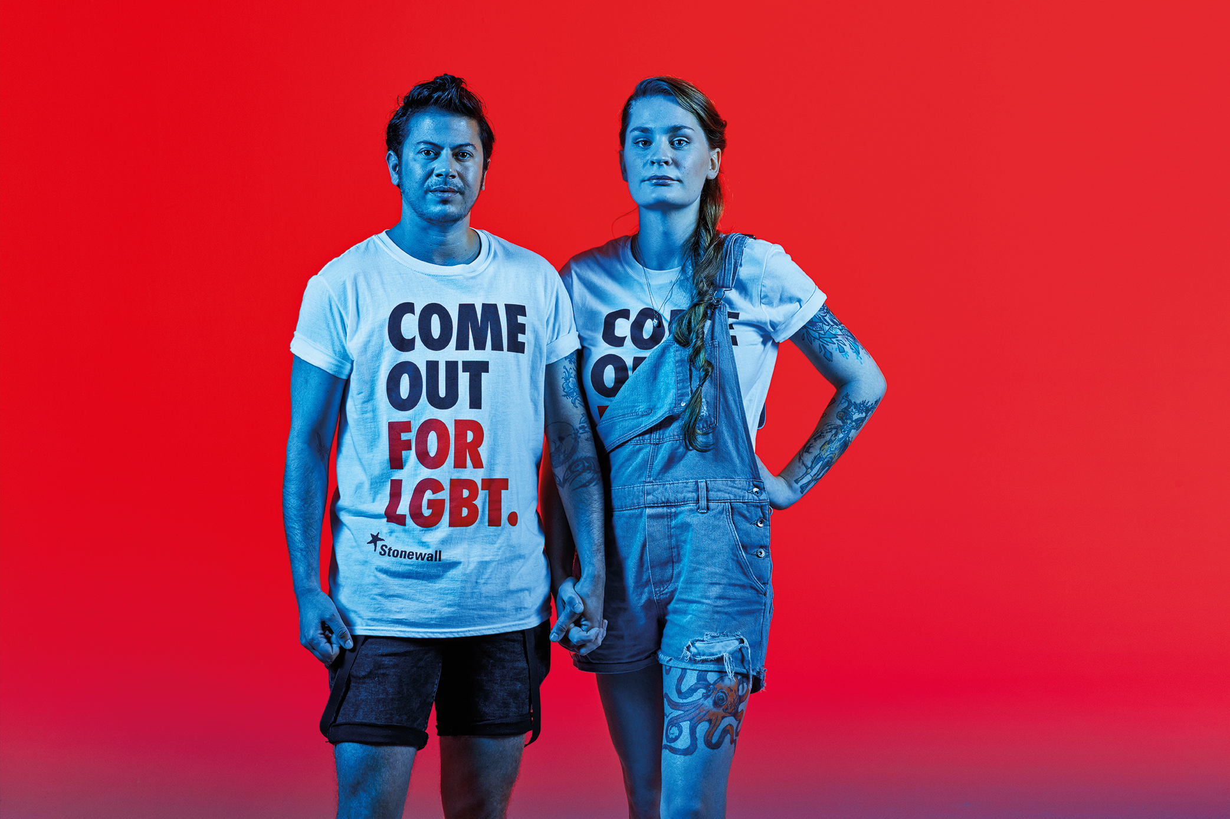
Finally, Be an ally –
#comeoutforlgbt
“I hope people realise that standing up for rights – not just LGBT rights but human rights in general – is just common sense, part of common decency.
It’s not enough that just one group gets what they need. Equality can’t leave anyone behind”.
Owl Fisher
(right of image)
Notes:
Finally, be an ally. This means being prepared to stand side by side LGBT people, even if you don’t identify as LGBT yourself. This could involve reporting an incident of bullying, even if it didn’t happen to you, or supporting the victim so they feel able to report it to someone who can help. Alternatively it could involve taking part in events and campaigns such as Stonewall’s #nobystanders or the brand new #comeoutforlgbt campaign. This could be both in and out of school and both provide opportunities to celebrate LGBT people and to stand by their sides. You could commit to working as part of the schools LGBT group or Equality and Diversity Team. We all have a part to play in making the world a fairer place for all people. As Owl says, “…standing up for rights – not just LGBT rights but human rights in general – is just common sense, part of common decency. It’s not enough that just one group gets what they need. Equality can’t leave anyone behind”.
No matter how different we are, we are all equal.
Thank you for listening.

