Slide 1
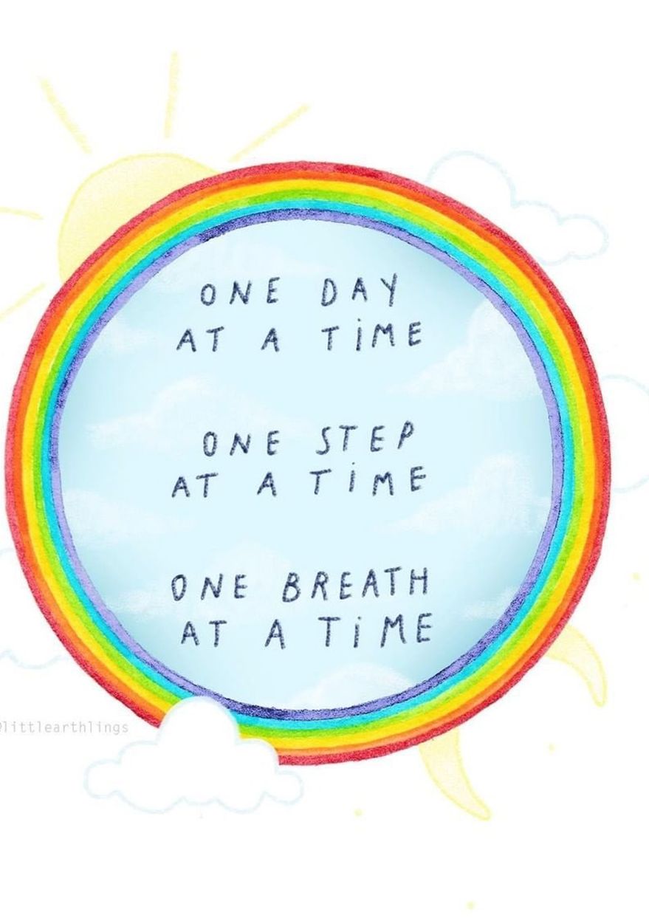

Slide 2
Session 2 Change is Challenging
Charles Darwin has been described as one of the most influential figures in human history. Though there is still some debate as to the actual originator, for many years he has been credited with the following quote:
‘It is not the strongest nor the most intelligent of the species that survives. It is the one that is most adaptable to change.’
Think back to lock down – what were the 2 hardest changes for you to deal with?
How did you adapt? Can you think of any thing you did that helped?
Notes:
Adapting – try to draw out the positives that resulted from the changes – that may even be ‘being still’ and appreciating what we have –
Might be worth playing this short
youtube video – Lockdown fairy tale
https://youtu.be/x3BJrOHrrTE

Slide 3
We thrive on the predictability and our daily routines. We get used to people, places and favourite activities.
Changes require us to expend a lot of effort, not only physically, but emotionally, socially, and cognitively.
The Coronavirus crisis has meant that we have had to quickly come to terms with huge changes in our lives.
This sudden change can be very difficult, are there are times you can recall where you have surprised yourself and been able to adapt in a positive way?
How do you think this learning to adapt quickly might you in the future?

Slide 4
It’s much easier for us to navigate change if:
We are provided with advanced warning and have time to process and prepare for the change.
We can maintain routines as much as possible, keeping as much the same as possible, for example getting up the usual time, following a timetable, completing school work.
We understand our emotions will be a bit –’up’ and ‘down’, and that it is normal.
We understand this change will create instability, vulnerability, worries, stress and anxiety and a fear of the unknown – all of which are normal
We anticipating the grieving process we may go through as we try to deal with the loss of routines or what was normality.

Slide 5
What do we mean by the term ‘resilience’?
Dictionary Definition: the capacity to recover quickly from difficulties
Resilience explains how two people can experience the same event but cope with it entirely differently.
Where one person may stay calm and look for a rational response; to problem solve and find solutions, the other may panic and over-react and respond with little thought.
One child might give up and the other will push on through the same barrier, obstacle or setback regardless.
What do you think enables people to become more able to deal with the ‘ups’ and ‘downs’?
So, are we born more resilient?
Notes:
Resilience is the ability to bounce back from stress, challenge, tragedy, trauma or adversity.
When children are resilient, they are braver and more curious, which means they will go looking for new opportunities, new possibilities, which of course will mean transitioning from a place of comfort to a place of uncertainty. Resilient children are more adaptable, and more flexible so have greater ability to bend and not break. Adaptability and flexibility are important skills to have when dealing with transitions and change.
One of the traits of a child who lacks resilience is a tendency to behave like a victim.
Now of course, there are genuine victims in life. Daily we are aware of people falling victim to the Coronavirus. However, when we talk about behaving like a victim when we teach SUMO, we are referring to those children who refuse to accept responsibility for their own actions. For example, where two children are equally affected by the Coronavirus, but one takes responsibility for maintaining a positive outlook and to keep active and busy, the other adopts a victim mentality and seeks to blame the virus or others and find excuses rather than take some positive action.

Slide 6
So, is a resilient person someone who…
Gives in
Is a bad loser
Sees the best in things
Tries again
Sees the positive in themselves
Understands why they feel as they do
Accepts a challenge
Bounces back
Accepts or asks for help
Understands the that the teenage brain is still developing emotionally
Gets upset if something doesn’t go right for them
Which of the above, do you believe are true for some for someone who shows resilience?
Notes:
Most children thrive on the predictability of daily routines. They get used to people, places and favourite activities and change requires them to expend a lot of effort, not only physically, but emotionally, socially, and cognitively. The Coronavirus crisis has meant they have had to quickly come to terms with huge changes to their lives.
Even children who are usually able to deal comfortably with change are likely to be experiencing some challenges given the scale and speed of the changes in their lives.
Change can improve our resilience – change we have little control over means we have to find ways to adapt….this in turn helps create resilience now and in the future. It may a bit of a ‘bumpy – ride’ at first – as change can be difficulty.
The positive characteristics shown here – show the ability for a person to adapt…see failure as a chance to learn – to work at something – to work through the problem….

Slide 7
Are people born resilient or can you learn it?
So what is it that makes someone resilient?
Psychologists believe that although we may be born with a certain amount of resilience, we can do certain things to improve our resilience.
Look at the following people.

Slide 8
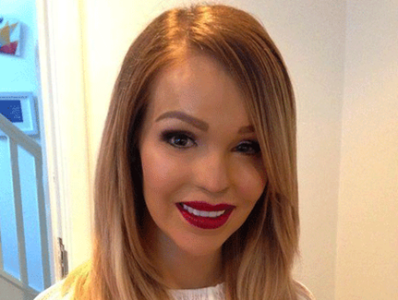
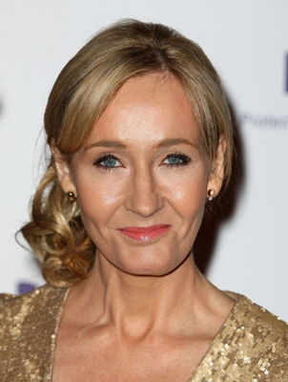
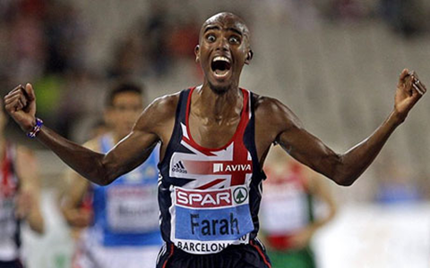
What do you think helps these people to be more resilient?

Slide 9
What do you think helps these people to be more resilient?
Katie Piper born 12 October 1983
An English philanthropist, television presenter and former model. Piper had hoped to have a full-time career in the media, but in March 2008 sulphuric acid was thrown in her face. The attack, which blinded Piper in one eye, was arranged by Piper's ex-boyfriend and carried out by an accomplice; both men were arrested and are serving life sentences in prison for their crimes
In 2009, Piper chose to give up her anonymity in order to increase awareness about burn victims.
She has been through over 100 medical operations since the acid attack. Katie uses her experience to educate others about burns and raise awareness of different treatments used in treating such problems. She also uses her experiences to challenge attitudes towards beauty and cosmetic surgery.
Notes:
Think about the way she has found a way to use her awful experience and disfigurement as a way to promote good and influence others. Think about how much we are obsessed by looks – how people see us – could you do what she has done?
That shows amazing resilience.

Slide 10
J K Rowling born 31 July 1965
A British novelist best known as the author of the Harry Potter fantasy series.
Born in Yate, Gloucestershire, Rowling was working as a researcher and bilingual secretary for Amnesty International when she conceived the idea for the Harry Potter series .The seven-year period that followed saw the death of her mother, divorce from her first husband and relative poverty until Rowling finished the first novel in the series, Harry Potter and the Philosopher's Stone in 1997.
Rowling used many of her life experiences to shape the characters in her books, the death of her mother informed the way she wrote about Harry’s sense of loss for his dead parents, a period of clinical depression inspired the soul sucking Dementors and Rowling also said that she based the character of Hermione Granger on herself when she was eleven.
Rowling has led a "rags to riches" life story, in which she progressed from living on state benefits to multi-millionaire status within five years.
In October 2010, Rowling was named the "Most Influential Woman in Britain" by leading magazine editors. She has supported charities including Comic Relief, One Parent Families, Multiple Sclerosis Society of Great Britain and Lumos (formerly the Children's High Level Group).
Notes:
J K Rowling overcame extreme personal hardship…..and now is a wealthy, influential woman.

Slide 11
Ellie Simmonds born 11 November 1994
A British Paralympian swimmer competing in S6 events.
Simmonds, who has achondroplasia, became interested in swimming at the age of five.
She swam in Sutton Coldfield, under Head Coach Ashley Cox, but she and her mother moved to Swansea when Simmonds was 11 to take advantage of the city's world-class swimming pool.
At the age of 13, Simmonds was the youngest British athlete at the 2008 Summer Paralympics in Beijing, competing in the 50m, 100m and 400m freestyle, 50m butterfly, and 200m Individual Medley. She won gold medals in the 100m and 400m freestyle events.
On 1 September 2012, Simmonds repeated her gold performance to win the 400m freestyle at the 2012 Summer Paralympics in London, in which she took five seconds off the World Record time. Two days later, on the evening of 3 September, she took Gold in the 200m Individual Medley, breaking the World Record that she had set in the qualifying round that morning.

Slide 12
Mo Farah born 23 March 1983
A Somali-born British long-distance and middle-distance runner. He is the current Olympic, World and European champion in the 5000 metres to 10,000 metres
Farah's first major title was at 5000 metres at the European Athletics Junior Championship in 2001.
In May 2008, Farah ran 10,000 m events, claiming the fastest UK men's time for almost eight years. However, he was knocked out before the 5000 m final at the 2008 Olympics in Beijing.
At the London 2012 Olympics, on 4 August, Farah won the 10,000 m gold in a time of 27:30.42. This was Great Britain's first Olympic gold medal in the 10,000 m, and came after two other gold medals for the country in the same athletics session.
Notes:
Mo Farah – came as an immigrant – no money – no job…..now a multiple gold medal winner –

Slide 13
What do you believe are key characteristics of resilient people?
What characteristics do You have that show resilience?
Do you think you the pandemic has enabled you to improve your ability to be resilient?
Look at the following slide – what do you see?
What characteristics do I have?

Slide 14
1-4-9
1x1 = 1
2x2=4
3x3=9
4x4=15
What do you see?

Slide 15
Discussion
Did you focus on the 3 that were right?
Or the one that was wrong?
Is it important to focus on the positives to help maintain and
develop resilience?
Challenge yourself to see a 1 – 4 – 9 every day!
Notes:
Remind them of the social norm discussion and the news – how we focus on the bad – try to see the positive in things.
Resilient peolpe see failure as a way to improve – a learning mechanism.

Slide 16
Remember:
"LIFE is not about how fast you run or how high you climb but how well you bounce." Tigger.

