Slide 1

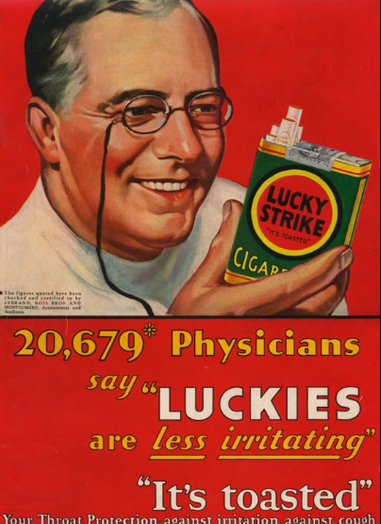
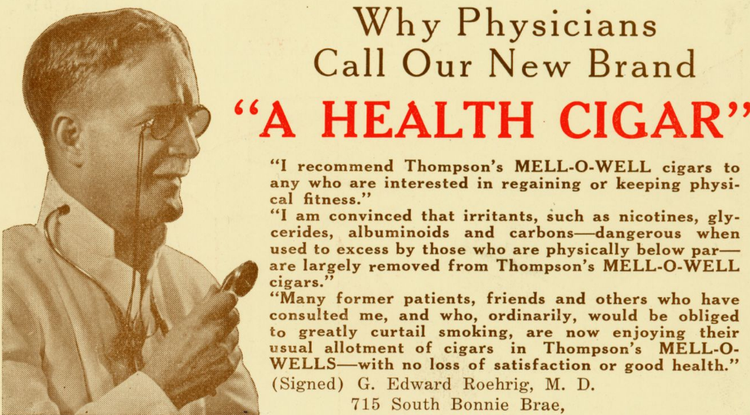
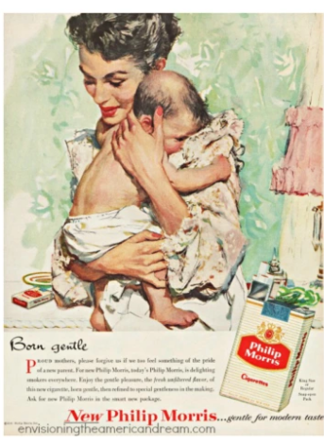
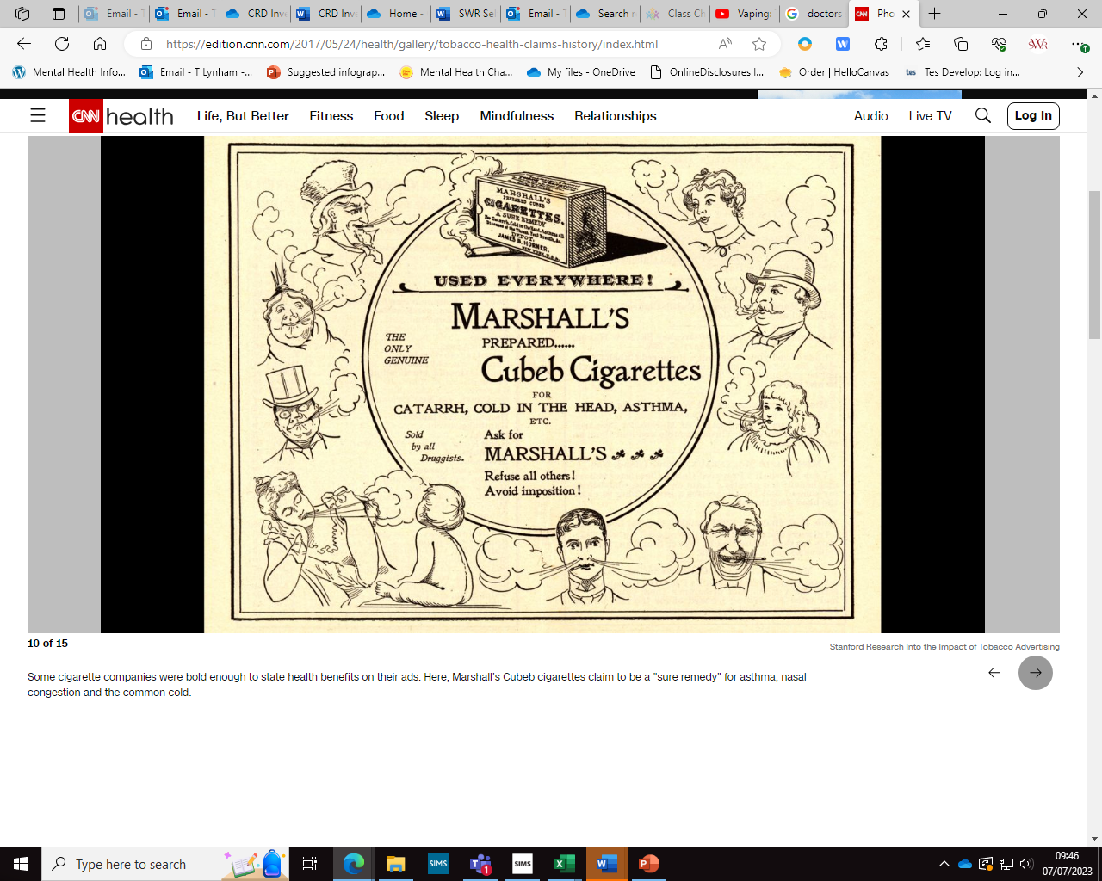
Are you their target audience?
You Explore – Starter:
We’re going to take a closer look at the following adverts for cigarettes from the past.
Whilst looking at them what are they suggesting?
Why wouldn’t we see these adverts today?
Signpost: School Nurse, Safeguarding Team, Talktofrank.com
Notes:
Explore who there is! Through this lesson resources their – tobacco companies.

Slide 2
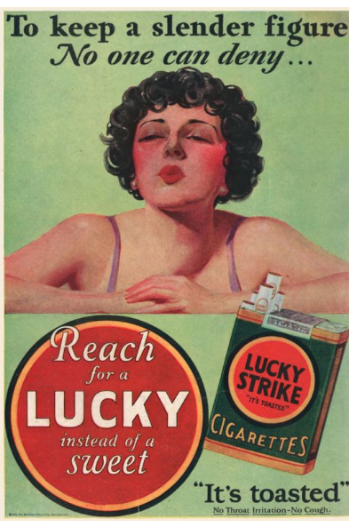
Signpost: School Nurse, Safeguarding Team, Talktofrank.com
Notes:
Some adverts focused on women – cigarettes can reduce appetite and therefore focused on women suggesting that women should be a certain size and were part of a weight control!

Slide 3
Signpost: School Nurse, Safeguarding Team, Talktofrank.com
Notes:
A real doctor in Chicago and Los Angeles promoting supposedly healthy cigars. Later died of lung cancer.

Slide 4
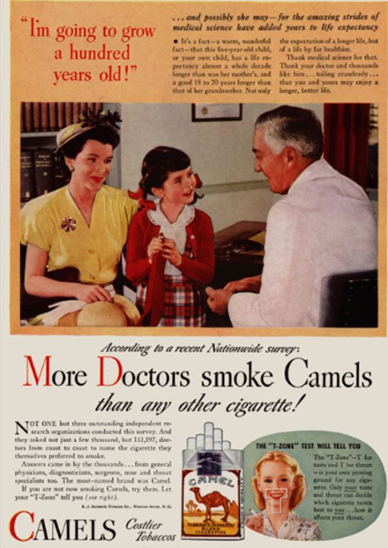
Signpost: School Nurse, Safeguarding Team, Talktofrank.com
Notes:
By today's standards, the ads were shocking. In one ad, a "doctor" describes how a little girl could live to 100 -- years longer than her mother -- while promoting the virtues of smoking.
"The none-too-subtle message was that if the doctor, with all of his expertise, chose to smoke a particular brand, then it must be safe," SRITA said. Tobacco ads using images of health professionals like doctors, nurses and dentists ran from about 1935 through the early '60s

Slide 5
Signpost: School Nurse, Safeguarding Team, Talktofrank.com
Notes:
Some cigarette companies were bold enough to state health benefits on their ads. Here, Marshall's Cubeb cigarettes claim to be a "sure remedy" for asthma, nasal congestion and the common cold.

Slide 6
What are the messages these adverts trying to convey?
Signpost: School Nurse, Safeguarding Team, Talktofrank.com

Slide 7
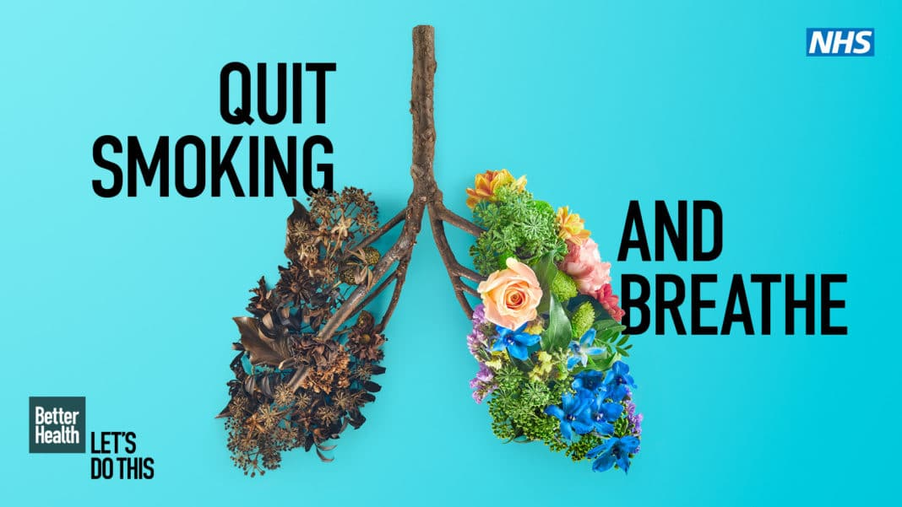
How do cigarettes affect the body? - Krishna Sudhir - YouTube
Signpost: School Nurse, Safeguarding Team, Talktofrank.com
Notes:
See the video to explore smoking

Slide 8


Advertising tobacco in the UK …
There is a clear, established relationship between tobacco advertising and consumption
As a result, advertising in the UK is banned in line with FCTC guidelines
Standardised packaging for these products has been required since 2016 ....
Laws
Signpost: School Nurse, Safeguarding Team, Talktofrank.com

Slide 9
So how do tobacco companies make a profit now with sales on tobacco falling in the UK …
Signpost: School Nurse, Safeguarding Team, Talktofrank.com

Slide 10
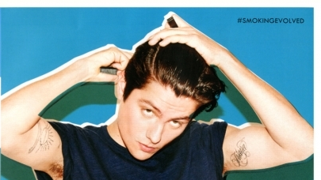
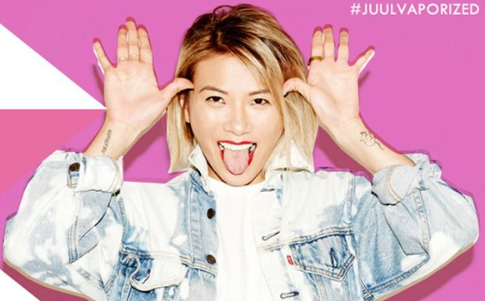



Who’s the target audience of this advertising campaign?
Signpost: School Nurse, Safeguarding Team, Talktofrank.com
Notes:
Discuss the fact that they’re young people.
Bright colours
Fashionable
Attractive
Teens/Young People

Slide 11
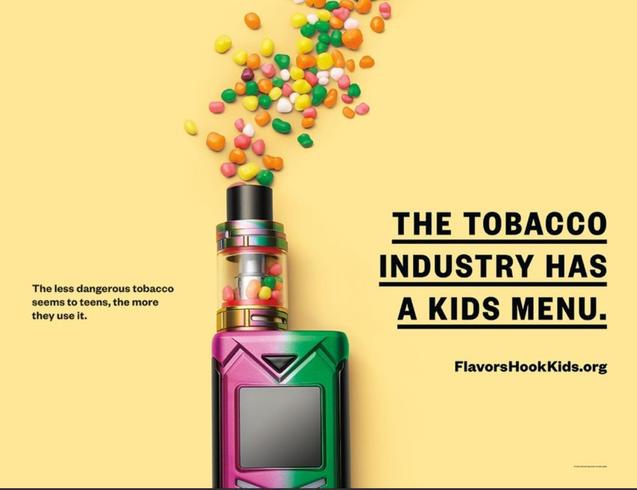
Signpost: School Nurse, Safeguarding Team, Talktofrank.com
Notes:
Young People

Slide 12
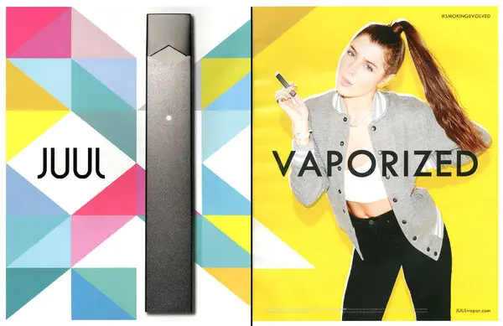
Signpost: School Nurse, Safeguarding Team, Talktofrank.com

Slide 13
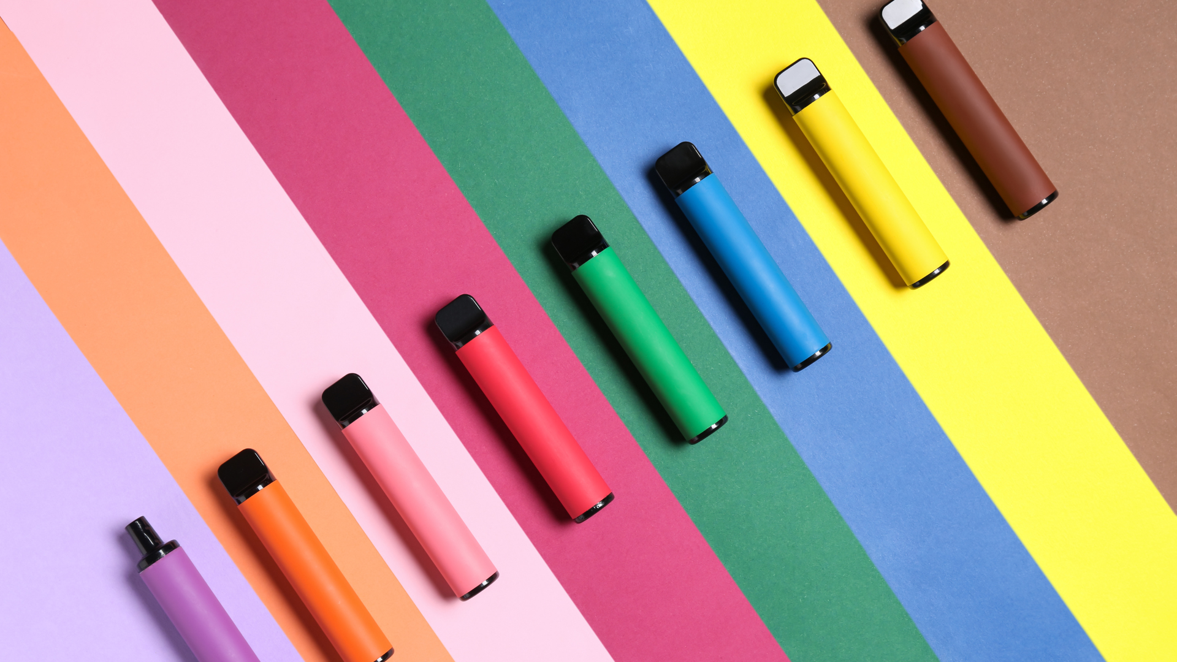
Signpost: School Nurse, Safeguarding Team, Talktofrank.com

Slide 14

Unpick the picture
Take a look at this photograph.
What do you think this picture is suggesting?
What do you already know about vaping?
What would you like to know about vaping?
Notes:
Unpick the picture
Students have already explored the idea of media and images and what they depict regarding tobacco and vaping.
You may want to have a class discussion around this picture and use the questions as a prompt.
Or you may want to print a copy of this picture, glue it into their books/booklets. Use the questions to annotate the picture or draw bubbles around the picture or different colour pens to answer the questions. It’s a great way to establish what students already know.

Slide 15

Are you being duped?
Video compiled by Sheffield County Council.
Notes:
https://www.youtube.com/watch?v=rod4d4yFeaE

Slide 16

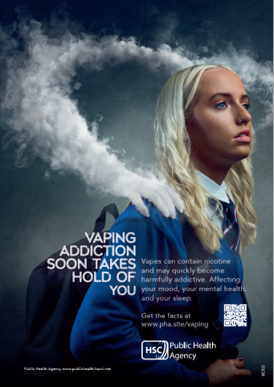
Mixed Messages? Let’s be clear:
Vapes help to stop adults smoking
Legal vaping devices don’t allow the user to inhale tar and carbon monoxide
There are short term effects, we don’t know long term effects
Single use vapes have an impact on the environment and the government are currently trying to abolish these in the UK.
Notes:
If you glued the picture into the books students could start to respond to any of the questions they may have.

Slide 17
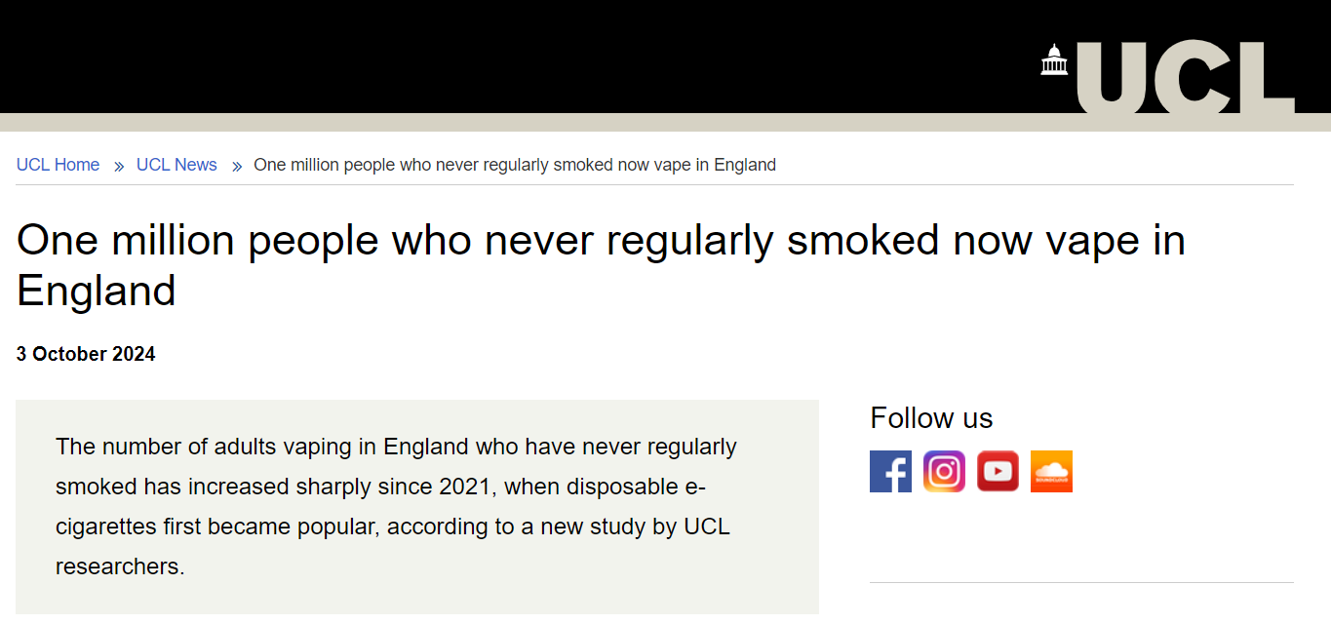
However
Reality of what the medical journal The Lancet found.
Notes:
The study, published in Lancet Public Health and funded by Cancer Research UK, estimated that, as of April 2024, about one million adults who had never regularly smoked now vaped in England, a sevenfold increase since 2021, with most of them vaping daily and over a sustained period.

Slide 18
Risks/Impacts of vaping
Your turn:
In pairs which do you think is the biggest deterrent and which is the smallest deterrent for teenagers thinking about vaping for the first time.
Sharing a vape
with someone else carries the risk of picking up illnesses
Chemicals are released into the lungs which could be harmful
The long-term impact
of vaping on health
is not yet known
Nicotine is an addictive substance that can be hard to stop using
once you've started
Financial impact
(it’s expensive)
Nicotine can increase levels of stress
and anxiety
Environmental impact (vapes end up
in landfill)
Signpost: School Nurse, Safeguarding Team, Talktofrank.com
Notes:
Ask students in pairs to look at some of the main impacts of vaping on the slide and order them from which might be the biggest deterrent (something that puts them off) to the smallest deterrent for young people thinking about vaping for the first time. A diamond 7 can work well with this activity.
Hold a class discussion on the impact of vaping and which factors they think could be the main deterrents. For less popular factors, why do they think this impact factor might not stop young people vaping?
Share with the class that vaping is much less harmful than smoking as you don't inhale the toxic tar and carbon monoxide you get from tobacco smoke. But vapes aren't harmless and are especially risky for teenagers' developing brains and lungs. Nicotine also has an impact on mental health and can lead to increased anxiety and stress and poorer concentration.
The period while the lungs are growing is important. We know smoking from an early age is especially damaging – the lungs don’t develop as they should, so lung function never reaches the peak it should have. Although the effects of vaping will be lower than smoking, those effects will still be more marked in teenagers.
The environmental impact of vapes can be higher than cigarettes. Both vapes and disposable vapes can be recycled, but often they end up in landfill and incorrect disposal can potentially release hazardous chemical waste.

Slide 19
Risks/Impacts of vaping – Progress check
True or False
Can a vape? – Choose which statements you think are true
A teenagers brain is developing fast.
Nicotine can mimic your brain chemicals that make you feel good.
Nicotine changes your brain chemistry.
Nicotine makes your brain want more of it and is highly addictive.
A lack of nicotine can make you feel anxious.
A lack of nicotine can make it difficult to concentrate in things.
Signpost: School Nurse, Safeguarding Team, Talktofrank.com
Notes:
Suggest using mini whiteboard with true on one side and false on the other.
Or heads down thumbs up or down for True / False

Slide 20
Risks/Impacts of vaping – Progress check
ALL TRUE
Can a vape? – Choose which statements you think are true
A teenagers brain is developing fast.
Nicotine can mimic your brain chemicals that make you feel good.
Nicotine changes your brain chemistry.
Nicotine makes your brain want more of it and is highly addictive.
A lack of nicotine can make you feel anxious.
A lack of nicotine can make it difficult to concentrate in things.
Why might these 2 be a particular problem as a teenager?
Signpost: School Nurse, Safeguarding Team, Talktofrank.com

Slide 21

Prevalence of Vaping
Teacher note – 2 activities to explore the prevalence.
Quiz
Figures from memory
See the notes section
Notes:
In an attempt to support our SEND students in the classroom and the importance of movement – both of these activities incorporate some element of movement.
Quiz – Stand up, sit down. A quick quiz which explores a range of different statistics. Click through the slides where the answer will be displayed on the second click. The data is in the notes section so feel free to discuss / unpack.
Figures from memory – print 2 copies of the figures slide (slide x). Put the students into groups of 4. Give each child a number. Between them they will need a piece of plain paper.
At the front of the class, turned over you will have the 2 printed slides.
All students will come up for 30 seconds. They will be called by their numbers – e.g. All number 1’s come up – you have 30 seconds to memorise the content/figures/icons. They can’t write anything down until they have returned to their group and the cannot shout it across the room. All number 1s return o group after 30 seconds. They have 30 seconds ‘memory dump’ time to get down on their paper what they can remember. Then all number 2’s come up and so on. For example – the cherry (11% of young people vape because they like the flavours – their favourite flavour is fruity).
At the end of the activity, this is an opportunity to have a whole class discussion around the data and unpacking what the icons might mean.

Slide 22
Quick Quiz - Prevalence of Vaping
Let’s get moving – stand up for A, sit down for B.
Question | A (stand up) | B (sit down)
1) What percentage of 11-18 year olds vape (nationally) | 38% | 18%
2) What percentage of young people have been exposed to advertising of vaping? | 72% | 52%
3) Where was the most common place young people were exposed to this advertising? | Shops | Online
4) Across the UK, how many 11-14 year olds have tried vaping? | 34% | 14%
5) What was the most common reason why young people tried vaping? | Peer pressure | Wanted to try it
Notes:
National Data has been taken from the 2024 Ash Report who surveyed 11-18 year olds.
18% of young people have tried vaping nationally, that equates to 980,000
72% of those surveyed had been exposed to advertising – main source being shops at 55%, followed by 29% online advertisements – through the platforms of TikTok Youtube and Instagram.
14% of 11-14 year olds have tried vaping, compared to 28% of 16-17 year olds
7.2% of our young people regularly vape, compared to 5.1% who regularly smoke. Vaping overtook smoking back in 2021. However, smoking rates are back up to pre pandemic levels.
Reasons Why:
51% said it was just to give it a try, 18% said that other people did it and they wanted to join in, 11% liked the flavours and 10% said to manage stress and mental health.

Slide 23
Quick Quiz - Prevalence of Vaping
Let’s get moving – stand up for A, sit down for B.
Question | A (stand up) | B (sit down)
1) What percentage of 11-18 year olds vape (nationally) | 38% | 18%
2) What percentage of young people have been exposed to advertising of vaping? | 72% | 52%
3) Where was the most common place young people were exposed to this advertising? | Shops | Online
4) Across the UK, how many 11-14 year olds have tried vaping? | 34% | 14%
5) What was the most common reason why young people tried vaping? | Peer pressure | Wanted to try it
Notes:
National Data has been taken from the 2024 Ash Report who surveyed 11-18 year olds.
18% of young people have tried vaping nationally, that equates to 980,000
72% of those surveyed had been exposed to advertising – main source being shops at 55%, followed by 29% online advertisements – through the platforms of TikTok Youtube and Instagram.
14% of 11-14 year olds have tried vaping, compared to 28% of 16-17 year olds
7.2% of our young people regularly vape, compared to 5.1% who regularly smoke. Vaping overtook smoking back in 2021. However, smoking rates are back up to pre pandemic levels.
Reasons Why:
51% said it was just to give it a try, 18% said that other people did it and they wanted to join in, 11% liked the flavours and 10% said to manage stress and mental health.

Slide 24
Quick Quiz - Prevalence of Vaping
Let’s get moving – stand up for A, sit down for B.
Question | A (stand up) | B (sit down)
1) What percentage of 11-18 year olds vape (nationally) | 38% | 18%
2) What percentage of young people have been exposed to advertising of vaping? | 72% | 52%
3) Where was the most common place young people were exposed to this advertising? | Shops | Online
4) Across the UK, how many 11-14 year olds have tried vaping? | 34% | 14%
5) What was the most common reason why young people tried vaping? | Peer pressure | Wanted to try it
Notes:
National Data has been taken from the 2024 Ash Report who surveyed 11-18 year olds.
18% of young people have tried vaping nationally, that equates to 980,000
72% of those surveyed had been exposed to advertising – main source being shops at 55%, followed by 29% online advertisements – through the platforms of TikTok Youtube and Instagram.
14% of 11-14 year olds have tried vaping, compared to 28% of 16-17 year olds
7.2% of our young people regularly vape, compared to 5.1% who regularly smoke. Vaping overtook smoking back in 2021. However, smoking rates are back up to pre pandemic levels.
Reasons Why:
51% said it was just to give it a try, 18% said that other people did it and they wanted to join in, 11% liked the flavours and 10% said to manage stress and mental health.

Slide 25
Quick Quiz - Prevalence of Vaping
Let’s get moving – stand up for A, sit down for B.
Question | A (stand up) | B (sit down)
1) What percentage of 11-18 year olds vape (nationally) | 38% | 18%
2) What percentage of young people have been exposed to advertising of vaping? | 72% | 52%
3) Where was the most common place young people were exposed to this advertising? | Shops | Online
4) Across the UK, how many 11-14 year olds have tried vaping? | 34% | 14%
5) What was the most common reason why young people tried vaping? | Peer pressure | Wanted to try it
Notes:
National Data has been taken from the 2024 Ash Report who surveyed 11-18 year olds.
18% of young people have tried vaping nationally, that equates to 980,000
72% of those surveyed had been exposed to advertising – main source being shops at 55%, followed by 29% online advertisements – through the platforms of TikTok Youtube and Instagram.
14% of 11-14 year olds have tried vaping, compared to 28% of 16-17 year olds
7.2% of our young people regularly vape, compared to 5.1% who regularly smoke. Vaping overtook smoking back in 2021. However, smoking rates are back up to pre pandemic levels.
Reasons Why:
51% said it was just to give it a try, 18% said that other people did it and they wanted to join in, 11% liked the flavours and 10% said to manage stress and mental health.

Slide 26
Quick Quiz - Prevalence of Vaping
Let’s get moving – stand up for A, sit down for B.
Question | A (stand up) | B (sit down)
1) What percentage of 11-18 year olds vape (nationally) | 38% | 18%
2) What percentage of young people have been exposed to advertising of vaping? | 72% | 52%
3) Where was the most common place young people were exposed to this advertising? | Shops | Online
4) Across the UK, how many 11-14 year olds have tried vaping? | 34% | 14%
5) What was the most common reason why young people tried vaping? | Peer pressure | Wanted to try it
Notes:
National Data has been taken from the 2024 Ash Report who surveyed 11-18 year olds.
18% of young people have tried vaping nationally, that equates to 980,000
72% of those surveyed had been exposed to advertising – main source being shops at 55%, followed by 29% online advertisements – through the platforms of TikTok Youtube and Instagram.
14% of 11-14 year olds have tried vaping, compared to 28% of 16-17 year olds
7.2% of our young people regularly vape, compared to 5.1% who regularly smoke. Vaping overtook smoking back in 2021. However, smoking rates are back up to pre pandemic levels.
Reasons Why:
51% said it was just to give it a try, 18% said that other people did it and they wanted to join in, 11% liked the flavours and 10% said to manage stress and mental health.

Slide 27
Quick Quiz - Prevalence of Vaping
Let’s get moving – stand up for A, sit down for B.
Question | A (stand up) | B (sit down)
1) What percentage of 11-18 year olds vape (nationally) | 38% | 18%
2) What percentage of young people have been exposed to advertising of vaping? | 72% | 52%
3) Where was the most common place young people were exposed to this advertising? | Shops | Online
4) Across the UK, how many 11-14 year olds have tried vaping? | 34% | 14%
5) What was the most common reason why young people tried vaping? | Peer pressure | Wanted to try it
Notes:
National Data has been taken from the 2024 Ash Report who surveyed 11-18 year olds.
18% of young people have tried vaping nationally, that equates to 980,000
72% of those surveyed had been exposed to advertising – main source being shops at 55%, followed by 29% online advertisements – through the platforms of TikTok Youtube and Instagram.
14% of 11-14 year olds have tried vaping, compared to 28% of 16-17 year olds
7.2% of our young people regularly vape, compared to 5.1% who regularly smoke. Vaping overtook smoking back in 2021. However, smoking rates are back up to pre pandemic levels.
Reasons Why:
51% said it was just to give it a try, 18% said that other people did it and they wanted to join in, 11% liked the flavours and 10% said to manage stress and mental health.

Slide 28
Quick Quiz - Prevalence of Vaping
Let’s get moving – stand up for A, sit down for B.
Question | A (stand up) | B (sit down)
1) What percentage of 11-18 year olds vape (nationally) | 38% | 18%
2) What percentage of young people have been exposed to advertising of vaping? | 72% | 52%
3) Where was the most common place young people were exposed to this advertising? | Shops | Online
4) Across the UK, how many 11-14 year olds have tried vaping? | 34% | 14%
5) What was the most common reason why young people tried vaping? | Peer pressure | Wanted to try it
Notes:
National Data has been taken from the 2024 Ash Report who surveyed 11-18 year olds.
18% of young people have tried vaping nationally, that equates to 980,000
72% of those surveyed had been exposed to advertising – main source being shops at 55%, followed by 29% online advertisements – through the platforms of TikTok Youtube and Instagram.
14% of 11-14 year olds have tried vaping, compared to 28% of 16-17 year olds
7.2% of our young people regularly vape, compared to 5.1% who regularly smoke. Vaping overtook smoking back in 2021. However, smoking rates are back up to pre pandemic levels.
Reasons Why:
51% said it was just to give it a try, 18% said that other people did it and they wanted to join in, 11% liked the flavours and 10% said to manage stress and mental health.

Slide 29
Quick Quiz - Prevalence of Vaping
Let’s get moving – stand up for A, sit down for B.
Question | A (stand up) | B (sit down)
1) What percentage of 11-18 year olds vape (nationally) | 38% | 18%
2) What percentage of young people have been exposed to advertising of vaping? | 72% | 52%
3) Where was the most common place young people were exposed to this advertising? | Shops | Online
4) Across the UK, how many 11-14 year olds have tried vaping? | 34% | 14%
5) What was the most common reason why young people tried vaping? | Peer pressure | Wanted to try it
Notes:
National Data has been taken from the 2024 Ash Report who surveyed 11-18 year olds.
18% of young people have tried vaping nationally, that equates to 980,000
72% of those surveyed had been exposed to advertising – main source being shops at 55%, followed by 29% online advertisements – through the platforms of TikTok Youtube and Instagram.
14% of 11-14 year olds have tried vaping, compared to 28% of 16-17 year olds
7.2% of our young people regularly vape, compared to 5.1% who regularly smoke. Vaping overtook smoking back in 2021. However, smoking rates are back up to pre pandemic levels.
Reasons Why:
51% said it was just to give it a try, 18% said that other people did it and they wanted to join in, 11% liked the flavours and 10% said to manage stress and mental health.

Slide 30
Quick Quiz - Prevalence of Vaping
Let’s get moving – stand up for A, sit down for B.
Question | A (stand up) | B (sit down)
1) What percentage of 11-18 year olds vape (nationally) | 38% | 18%
2) What percentage of young people have been exposed to advertising of vaping? | 72% | 52%
3) Where was the most common place young people were exposed to this advertising? | Shops | Online
4) Across the UK, how many 11-14 year olds have tried vaping? | 34% | 14%
5) What was the most common reason why young people tried vaping? | Peer pressure | Wanted to try it
Notes:
National Data has been taken from the 2024 Ash Report who surveyed 11-18 year olds.
18% of young people have tried vaping nationally, that equates to 980,000
72% of those surveyed had been exposed to advertising – main source being shops at 55%, followed by 29% online advertisements – through the platforms of TikTok Youtube and Instagram.
14% of 11-14 year olds have tried vaping, compared to 28% of 16-17 year olds
7.2% of our young people regularly vape, compared to 5.1% who regularly smoke. Vaping overtook smoking back in 2021. However, smoking rates are back up to pre pandemic levels.
Reasons Why:
51% said it was just to give it a try, 18% said that other people did it and they wanted to join in, 11% liked the flavours and 10% said to manage stress and mental health.

Slide 31
Quick Quiz - Prevalence of Vaping
Let’s get moving – stand up for A, sit down for B.
Question | A (stand up) | B (sit down)
1) What percentage of 11-18 year olds vape (nationally) | 38% | 18%
2) What percentage of young people have been exposed to advertising of vaping? | 72% | 52%
3) Where was the most common place young people were exposed to this advertising? | Shops | Online
4) Across the UK, how many 11-14 year olds have tried vaping? | 34% | 14%
5) What was the most common reason why young people tried vaping? | Peer pressure | Wanted to try it
Notes:
National Data has been taken from the 2024 Ash Report who surveyed 11-18 year olds.
18% of young people have tried vaping nationally, that equates to 980,000
72% of those surveyed had been exposed to advertising – main source being shops at 55%, followed by 29% online advertisements – through the platforms of TikTok Youtube and Instagram.
14% of 11-14 year olds have tried vaping, compared to 28% of 16-17 year olds
7.2% of our young people regularly vape, compared to 5.1% who regularly smoke. Vaping overtook smoking back in 2021. However, smoking rates are back up to pre pandemic levels.
Reasons Why:
51% said it was just to give it a try, 18% said that other people did it and they wanted to join in, 11% liked the flavours and 10% said to manage stress and mental health.

Slide 32
Quick Quiz - Prevalence of Vaping
Let’s get moving – stand up for A, sit down for B.
Question | A (stand up) | B (sit down)
1) What percentage of 11-18 year olds vape (nationally) | 38% | 18%
2) What percentage of young people have been exposed to advertising of vaping? | 72% | 52%
3) Where was the most common place young people were exposed to this advertising? | Shops | Online
4) Across the UK, how many 11-14 year olds have tried vaping? | 34% | 14%
5) What was the most common reason why young people tried vaping? | Peer pressure | Wanted to try it
Notes:
National Data has been taken from the 2024 Ash Report who surveyed 11-18 year olds.
18% of young people have tried vaping nationally, that equates to 980,000
72% of those surveyed had been exposed to advertising – main source being shops at 55%, followed by 29% online advertisements – through the platforms of TikTok Youtube and Instagram.
14% of 11-14 year olds have tried vaping, compared to 28% of 16-17 year olds
7.2% of our young people regularly vape, compared to 5.1% who regularly smoke. Vaping overtook smoking back in 2021. However, smoking rates are back up to pre pandemic levels.
Reasons Why:
51% said it was just to give it a try, 18% said that other people did it and they wanted to join in, 11% liked the flavours and 10% said to manage stress and mental health.

Slide 33







Prevalence of Vaping
18%
72%
14%
11-14 years olds
7.2% 5.1%
28%
vs
16-17 years olds
51%
18%
11%
10%
Notes:
National Data has been taken from the 2024 Ash Report who surveyed 11-18 year olds.
18% of young people have tried vaping nationally, that equates to 980,000
72% of those surveyed had been exposed to advertising – main source being shops at 55%, followed by 29% online advertisements – through the platforms of TikTok Youtube and Instagram.
14% of 11-14 year olds have tried vaping, compared to 28% of 16-17 year olds
7.2% of our young people regularly vape, compared to 5.1% who regularly smoke. Vaping overtook smoking back in 2021. However, smoking rates are back up to pre pandemic levels.
Reasons Why:
51% said it was just to give it a try, 18% said that other people did it and they wanted to join in, 11% liked the flavours and 10% said to manage stress and mental health.

Slide 34
Prevalence of Vaping
Discussion Point:
Any surprises?
18%
72%
14%
11-14 years olds
7.2% 5.1%
28%
vs
16-17 years olds
51%
18%
11%
10%
Notes:
National Data has been taken from the 2024 Ash Report who surveyed 11-18 year olds.
18% of young people have tried vaping nationally, that equates to 980,000
72% of those surveyed had been exposed to advertising – main source being shops at 55%, followed by 29% online advertisements – through the platforms of TikTok Youtube and Instagram.
14% of 11-14 year olds have tried vaping, compared to 28% of 16-17 year olds
7.2% of our young people regularly vape, compared to 5.1% who regularly smoke. Vaping overtook smoking back in 2021. However, smoking rates are back up to pre pandemic levels.
Reasons Why:
51% said it was just to give it a try, 18% said that other people did it and they wanted to join in, 11% liked the flavours and 10% said to manage stress and mental health.

Slide 35
Laws around Vaping
Laws
Pitch it up:
If you were in charge of the Government committee in charge of looking at laws around vaping who would you involve in your consultation? More importantly – what perspectives do you think they would offer you?
One of our British Values is the
Rule of Law.
What laws do you think there are around vaping?
Are the laws the same for adults and children?
How are those laws enforced?

Slide 36
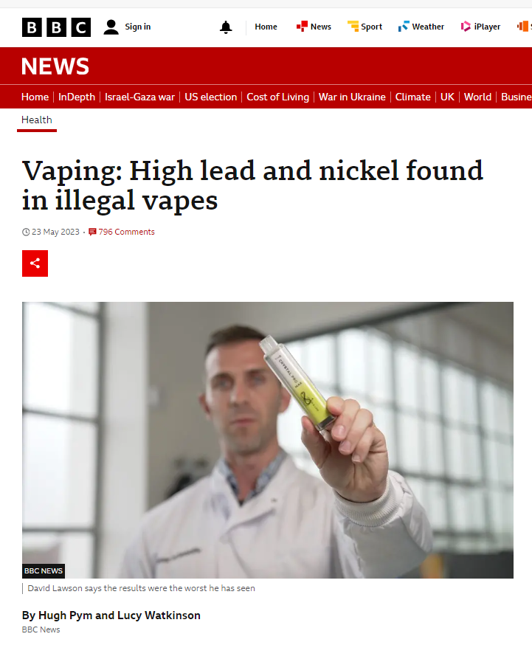
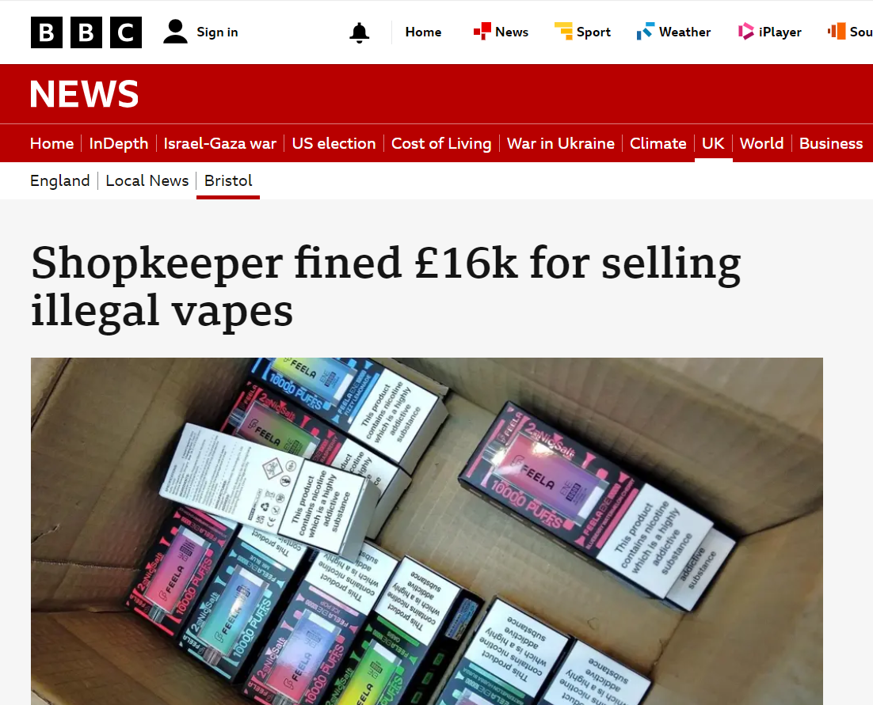
Laws
Notes:
However, we are starting to see law enforcement agencies taking crimes linked to vaping seriously – with trading standards working to identify which shop owners are selling illegal vapes and cigarettes, and those that are selling them to children.
However further worries come in what could be inside the vapes:
Vapes confiscated from school pupils contain high levels of lead, nickel and chromium,
The results showed children using them could be inhaling more than twice the daily safe amount of lead, and nine times the safe amount of nickel.
Some vapes also contained harmful chemicals like those in cigarette smoke.
The Inter Scientific laboratory, in Liverpool, which works with vape manufacturers to ensure regulatory standards are met, analysed 18 vapes.
Most were illegal and had not gone through any kind of testing before being sold in the UK.
In "highlighter vapes" - designed with bright colours to look like highlighter pens - the amounts of the metals found were:
lead - 12 micrograms per gram, 2.4 times the stipulated safe exposure level
nickel - 9.6 times safe levels
chromium - 6.6 times safe levels

Slide 37

Laws
Selling nicotine vapes to children is illegal.
BUT
But it is not illegal to vape underage.
1) What percentage of all vapes were bought in shops?
2) What percentage of vapes bought were disposable?
3) In what year does the government hope to ban disposable vapes?

Slide 38



Laws
Selling nicotine vapes to children is illegal.
BUT
But it is not illegal to vape underage.
48%
54%
2025
BUT
Free
24% 12%
Over
2.9%
Sale and supply of single-use vapes to be banned in UK
Notes:
Current laws and guidance on vaping
It is illegal to sell vapes from children. Despite this 48% of all vapes are bought from shops.
Whilst 27% are bought informally through friends/contacts.
54% of what they are buying are disposable – most popular one being an ElfBar
However, by 2025 single use vapes will be banned.
But – it is not illegal to give them to children free as a promotion by a company. 2.9% children reported that was how they first got into vaping.
In terms of legal and recommended amount of nicotine found in vapes used by young people – 24% were at the top adults recommended limit, whilst 12% were over the recommended limit.

Slide 39
Laws
But with new laws coming in their profits are at risk!
So....

Slide 40
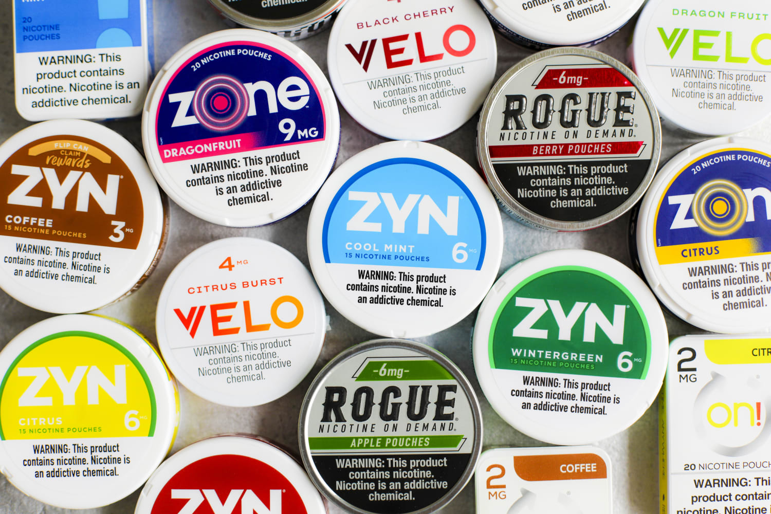
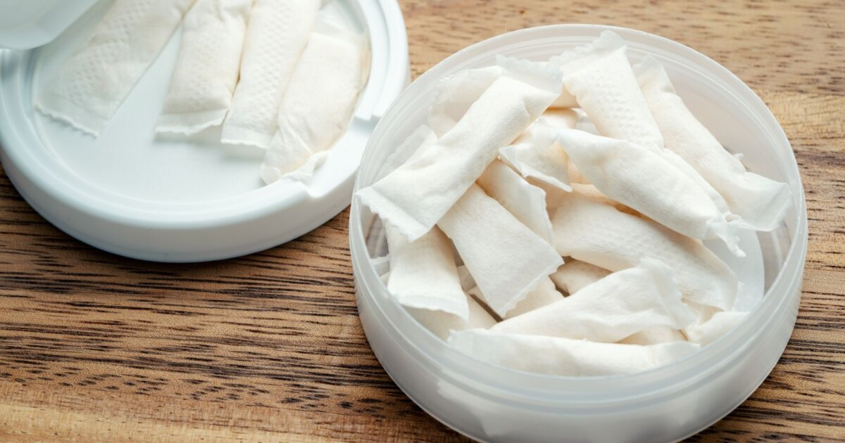
Law – Tobacco Industry
Harder to detect
No laws yet
History of being adept …. so it's new highly addictive product is nicotine pouches.
High quantities of nicotine
Introducing Nicotine Pouches
Notes:
But nicotine addiction is also very big business. The tobacco industry has not quietly faded into the background, but instead is manufacturing and marketing a whole new generation of products aimed primarily at young people. Including the latest novel product development: nicotine pouches.
Nicotine pouches are typically sold in small, round, plastic containers that fit easily into a pocket or purse. The pouches themselves look like miniature teabags and are filled with plant fibres that act as a filler, sugars, flavours, and of course nicotine.
The small pouches are placed between the lip and the gum so that users can absorb the nicotine in their mouths. Once all the nicotine has all been absorbed, users simply remove the pouch and replace it with another one. Pouches are very discreet, smell pleasant
This lack of regulation means that pouches, unlike cigarettes, can be legally sold to people under the age of 18 in the UK.
We do know that using pouches results in exposure to toxic nicotine, which can lead to nicotine addiction and may also encourage and facilitate the use of other products like vapes or cigarettes.
In addition to addiction, nicotine has negative effects on adolescent brain development, including on learning outcomes. In high doses, nicotine may cause dizziness, headache, nausea and abdominal cramps, especially among people who have never been exposed to nicotine before.
The tobacco industry has proven itself highly adept at marketing harmful and addictive products to young people, and with so few limits on the promotion and sale of pouches, there is a real danger that pouch use, and nicotine addiction, could rapidly increase among young people.

Slide 41

Round up
Getting Help
What would your advice be?
‘I find I keep reaching
for my vape when I feel stressed out, but I know it’s not good for me and I really want to stop.’

Slide 42
Round up – Responding to our big question.
Are you their target audience?
Taking today’s big question, respond to it with 6-8 sentences.
Need a hand up: Sentence starters
Many years ago the tobacco industry targeted their advertising ……
However, there are now much stricter laws, so they ….
18% of young people vape because …
But, vaping can be risky….
Young people are legally not allowed to but vapes ….
Sadly …..
Pitch it up: Imagine you’re a lawyer, you are tasked to take the company’s who make vapes to the international court with regard to their advertising campaigns. What would be your 6 core arguments (remember to make them persuasive).

