Slide 1
Title: Vaping
Do Now - 6 minutes:
Do you know what vaping is? If so, explain.
Is it illegal or legal?
Do you think it is bad for you? Why or why not?
Expectations:
In silence
No shouting out
Hands up for questions
Random students will be asked for feedback
Respect each others feedback
Challenge Question:
Do you know the difference between cigarettes and vaping?

Slide 2
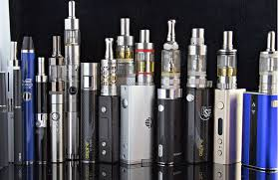
What is Vaping?
Vaping is the inhaling of a vapor created by an electronic cigarette (e-cigarette) or other vaping device.
Vaping hasn't been around long enough for us to know how it affects the body over time. But health experts are reporting serious lung damage in people who vape, including some deaths.
Expectations:
Listening quietly
Eyes this way
Nothing in hands
Hands up for questions
Notes:
Students watch the video and then answer the question.

Slide 3
What is Vaping?
Disposable: Throw away after use
Nicotine: Addictive substance found in tobacco

Slide 4
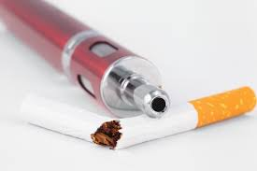
What is the Difference Between Cigarettes and Vaping?
The difference between smoking and vaping is that smoking delivers nicotine by burning tobacco, which can cause smoking-related illnesses, and vaping can deliver nicotine by heating a liquid.
Expectations:
Listening quietly
Eyes this way
Nothing in hands
Hands up for questions
Notes:
Students watch the video and then answer the question.

Slide 5
MISCONCEPTION
Vaping is not ‘healthy’.
Vaping has a lot of negative side effects.
Expectations:
Listening quietly
Eyes this way
Nothing in hands
Hands up for questions
Notes:
Students watch the video and then answer the question.

Slide 6
Checkpoint Quiz
Vaping is also known as:
Tobacco
An E Cigarette
A Cigarette
Vaping delivers something to the body called:
Nicotine
Juice
Tobacco
True or False: Vaping has a lot of negative side effects.
True
False
Expectations:
In silence, think about the questions for 90 seconds..
I will randomly ask students for the answer.
Notes:
Students watch the video and then answer the question.

Slide 7
Answers
Vaping is also known as:
Tobacco
An E Cigarette
A Cigarette
Vaping delivers something to the body called:
Nicotine
Juice
Tobacco
True or False: Vaping has a lot of negative side effects.
True
False
Notes:
Students watch the video and then answer the question.

Slide 8
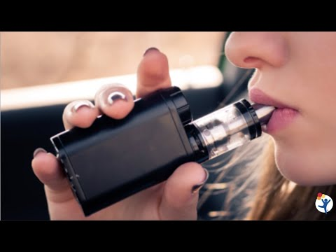
The Dangers of Vaping
Expectations
Listening quietly to the video - 8 minutes.
Eyes this way
Nothing in hands
Hands up for questions
Key Terms:
Paraphernalia: Traps.
Notes:
Students watch the video and then answer the question.

Slide 9
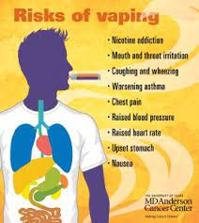
The Dangers of Vaping
Nicotine itself is harmful
The chemicals in the aerosol are harmful
Risk of progressing to cigarette smoking
Dual use – both vaping and smoking – is common
Risk of addiction
Link to other substance use and addiction
Link to mental health disorders
Recent spate of illnesses and deaths
Expectations
Listening quietly
Eyes this way
Nothing in hands
Hands up for questions
Notes:
Students watch the video and then answer the question.

Slide 10
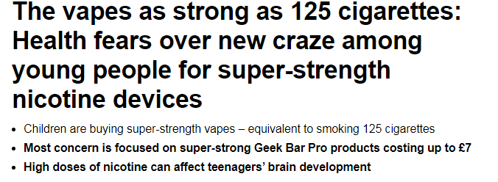
Vaping is illegal if you are under 18
Notes:
Article from The Daily Mail:
https://www.dailymail.co.uk/news/article-9961055/Health-fears-new-craze-young-people-super-strength-nicotine-devices.html#:~:text=teenagers'%20brain%20development-,Children%20are%20buying%20super%2Dstrength%20vapes%20%E2%80%93%20equivalent%20to%20smoking%20125,chest%20pains%20and%20dizzy%20spells.

Slide 11
Checkpoint on Dangers of Vaping
A younger sibling has asked you what vaping is. You need to explain to them 5 negative effects it can have.
1.
2.
3.
4.
5.
Expectations:
In silence
Independent task
I will ask for volunteers to comment afterwards
5 minutes

Slide 12
Article Task
I am going to model read this article
I may stop at times and ask questions or ask others to read.
Therefore, you must follow the reading.
Literacy explained from the article:
Geek Bars = Vape Brand
Consumption = Using the product
Regulations = Rules
Expectations
Following the reading.
Eyes this way
Nothing in hands
Hands up for questions
Notes:
Students watch the video and then answer the question.

Slide 13
Checkpoint on the Article
Answer the following questions in your book:
How many cigarettes is a super strength vape the equivalent of?
A high dose of nicotine can affect what in teenagers?
Geekbar Vapes has more than the legal limit of nicotine - true or false?
What did Deborah Arnott say?
Some vape products were hidden in what chocolate?
Expectations:
You may discuss this in pairs
Only talk about the work
Write the answers down afterwards
I will ask random students for feedback
Notes:
Students watch the video and then answer the question.

Slide 14
Checkpoint on the Article Answers
How many cigarettes is a super strength vape the equivalent of?
125.
A high dose of nicotine can affect what in teenagers?
Brain development .
Geekbar Vapes has more than the legal limit of nicotine - true or false?
True.
Notes:
Students watch the video and then answer the question.

Slide 15
Checkpoint on the Article Answers
4. What did Deborah Arnott say?
Action is needed now to get these products out of shops.
5. Some vape products were hidden in what chocolate?
A Kinder Egg.
Notes:
Students watch the video and then answer the question.

Slide 16
Task
Design a poster or campaign encouraging people not to vape.
What to include:
Include misconceptions about vaping
Negatives of vaping
The cost of vaping
Emphasise the side effects of vaping
You can make this colourful and presentable.
Expectations:
Minimal noise
Work to the best of your ability
No shouting out
Notes:
Students watch the video and then answer the question.

Slide 17
Exit Task
What is vaping?
Is nicotine addictive?
Name a danger of vaping.
List 3 health side effects of vaping.
Note one other point of learning from today.
Expectations:
In silence
Write down the answers
Random students for feedback
4 minutes

Slide 18
If you finish any work early
Challenge Tasks
If you were in government, what would you do about the vaping issues society faces?
What could schools do more of to stop vaping among young people?

