Slide 1

What do you think is meant by the term ‘Wellbeing’?
Discuss in pairs, then write your ideas on a ‘post-it’ note ready to share with the group.

Slide 2
“A good or satisfactory condition of existence; a state characterized by health, happiness, and prosperity; welfare: to influence the well-being of the nation and its people.”
“Feelings of wellbeing are fundamental to the overall health of an individual, enabling them to successfully overcome difficulties and achieve what they want out of life”.

Slide 3
Own wellbeing
The best way to really improve wellbeing is through understanding that
Wellbeing is important for me
There are things that I can do to improve my wellbeing
The best chance of being able to stay happy throughout life is to learn how to take responsibility for our own wellbeing

Slide 4

The Five Ways to Wellbeing
The Five Ways to Wellbeing Framework was developed by the New Economics Foundation as a set of five evidence based actions that promote wellbeing. Based on the latest scientific evidence the simple
actions, if taken regularly, can improve wellbeing and enhance quality of life.

Slide 5
The Five Ways to Wellbeing are
Connect – connecting with others
Give – giving – looking outward as well as inward
Be active – doing something active
Take Notice – taking notice of the world around you
Keep Learning – learning new things

Slide 6
Five Ways Activity
Think about one of the Five Ways to Wellbeing actions you have done recently,
think about:
the emotion you felt when doing the activity.
how often you do this sort of activity.
whether you have thought about the activity as helping to improve their wellbeing.
Notes:
Emotions could be – happy – fulfilled – warm inside – positive – chilled….

Slide 7
The Five Ways to Wellbeing may help you…
Make the most of opportunities and deal with stressful situations by taking time out and learning
Learn how to cope when things get tough
Increase your interpersonal skills, empathy and communication skills through giving and seeing yourself as part of the wider community
Increase your chances of employability and self-worth by taking notice of what you are good at and what you have to offer others.

Slide 8
Think of at least 4 ideas, for each of the Five Ways to Wellbeing:-
Connect
Be Active
Take Notice
Keep Learning
Give

Slide 9
Some ways to Connect:
With family – share your day and ask about theirs
At school - speak to someone new. Smile and speak to someone as you pass them in the corridor
Ask a friend about their weekend and pay attention and listen when they tell you
Talk to someone in person or on the phone instead of messaging or social media
Make contact with someone you used to hang out with
Don’t use your phone for a day (or at least for a few hours!)
Take your headphones off when in a shop
Ask your parents or carer about their childhood
Don’t use the self-checkout in a shop and talk to the shop assistant
Write a letter or send a postcard to someone
Smile at a person on the street and say hello
Share a random or inspirational photo with your friends
Set up a social network group with a new group of friends

Slide 10
Some ways to be Active:
Play your favourite song and dance to it
Go for a walk at lunchtime
Walk to school
Get off the bus one stop earlier and walk the final part of your journey
Go to your local park
Stretch and move your limbs in the morning, midday and evening
Join a new sports club or team
Walk the dog or a neighbours dog
Do some gardening
Make bread – it’s hard work!
Climb a tree
Go to PE – no excuses!
Try out a new exercise class like yoga or zumba
Learn how to swim or ride a bike
Create a five a side football team
Try crazy golf or bowling with your mates
Walk to see friends instead of going in the car
Have a Wii fit competition
Learn to be a lifeguard
Help coach a school sports team

Slide 11
Some ways to Take Notice:
Take a different, more beautiful route to or from school
Stop and really take in your surroundings
Reflect on the positives, what can you be grateful for – there is always something
Take notice of what you are thinking. Not to judge or be hard on yourself, but just to be more aware of what you are thinking
Really savour every mouthful of your lunch, noticing the texture, flavour, how the food feels, tastes
Consider your strengths and how you make the most of them.
Think about who inspires you and why
Notice your neighbours and people around you
Notice wild flowers and where they grow
Watch animals and birds outside
Think about what your parents do for you
Pretend you are someone else and reflect on what they would think about you
Plan for the future and where you’d like to be in 5 years time
Do some people watching in the middle of town or in the park
Try a new food and then notice how different it tastes and feels

Slide 12
Some ways to keep learning:
Research something you’ve always wondered about
Discover something new, find out more about something you’re interested in
Read the news or a book
Use a conversation as a way to learn new things, be curious
Sign up for a class or group outside of school
Learn a new word
Visit your local library
Learn something new about yourself
Go to a quiz or host one among your friends
Learn an inspirational quote
Download a random fact app
Go to a museum
Learn a new hobby or a new language
Learn a new dance routine or the words to a new song
Learn a new route home
Find out more about something your friends or family are interested in
Learn more about your family history
If you hear something you don’t understand, google it straight away
Use a dictionary for words you don’t know
Think about how others are feeling and work out why

Slide 13
Ways to give:
Smile and be willing to give your time to a conversation
Check up on a friend
Do something to help without being asked
Say thank you to someone who has helped you. Send a text, or message or write them a letter to
show how much it meant to you
Give unwanted items to a local charity shop
Donate your time to do something for someone else; help out a neighbour; carry shopping or offer to baby-sit
Offer to help your parents or people you live with round the house
Bake a cake and give it to someone
Do some volunteering
Give some food to a food bank
Give someone a hug
Raise money for charity
Help an elderly neighbour
Learn how to put someone in the Recovery Position
Give your pocket money to someone who needs it more than you
Give yourself some time to relax
Pick up litter in the park or at school
Notes:
Any acts of kindness, whether small or large can make you feel happier and more satisfied about life.
Seeing yourself, and your happiness, linked to the wider community can be incredibly rewarding and
creates connections with the people around you.

Slide 14
Can you focus on a time when you felt good?
What were you doing, who were you with?
Can you link this to one or more of the Five Ways to Wellbeing actions.
Notes:
It’s important to remember that thinking of good things can be a lot harder to do than thinking of difficult things. If they are struggling to come up with anything good then explain that it’s normal to find
it hard. Generally we human beings have a tendency to focus on the negative more easily, it’s in our nature!
We have to work a lot harder to think of good things – think of it as how our brains are wired. We
have to push our brains to pay attention to the good things, but when we do most people can find they
think of things that have happened, however and despite how difficult life can be. Help prompt them
using examples of small good things that happen; for example someone smiling at them, listening to a
new song or laughing with friends.

Slide 15
Remember …
Wellbeing (feeling good and functioning well) is important for everyone.
Developing habits for wellbeing is best done when you are feeling ok rather than waiting until things are difficult.
Taking these five actions regularly will help improve wellbeing.
Finding ways to include the Five Ways to Wellbeing actions as part of everyday routines is the best way to improve your wellbeing.
Notes:
Explain that one way to improve wellbeing is to start to notice how many of the Five Ways to
Wellbeing actions they are doing already, and also to notice the ones they are not.

Slide 16
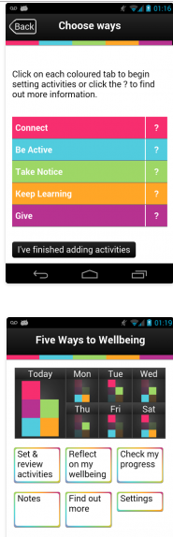
Five Ways to Wellbeing app’
Can be downloaded for free from Google
Set yourself activities to complete throughout the week
Keep track of how many activities you’ve completed and earn trophies as you go!
Reflect on how well you connect, be active, take notice, keep learning and give and track how well you think you’re doing
Set reminders to reflect so each week you can keep learning
Learn about wellbeing and how the Five Ways can help you
Find out how other people have used the Five Ways in the personal stories section
Get a quote a day to help you keep working on your wellbeing
https://mentalhealthpartnerships.com/resource/five-ways-to-wellbeing-app/

Slide 17
Five Ways to Wellbeing Pledge
I pledge to take ownership of my own wellbeing.
I will do this by regularly doing as many of the Five Ways to Wellbeing actions as I can, and helping my friends to do the same.
Name
.........................................................................................
Signed
.........................................................................................
Pledge partners
.....................................................................................................................................................................................................................................
................................................................................................................................................................................................................................
Date

Slide 18
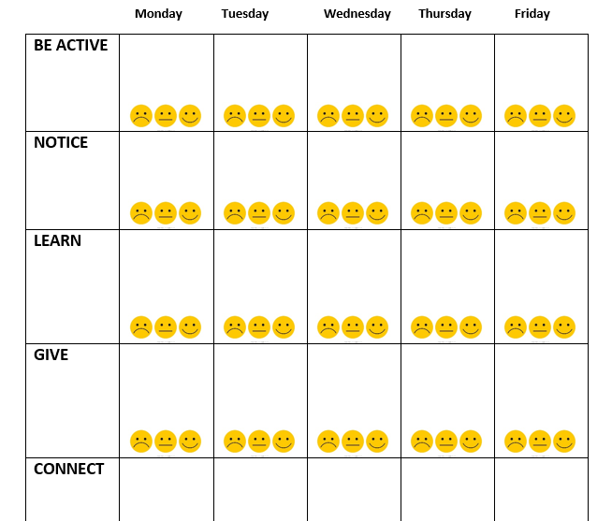
Logging your Five Ways to Wellbeing
In each box write down what activity you did e.g. football. And then circle the smiley face to show how it made you feel.

