Slide 1
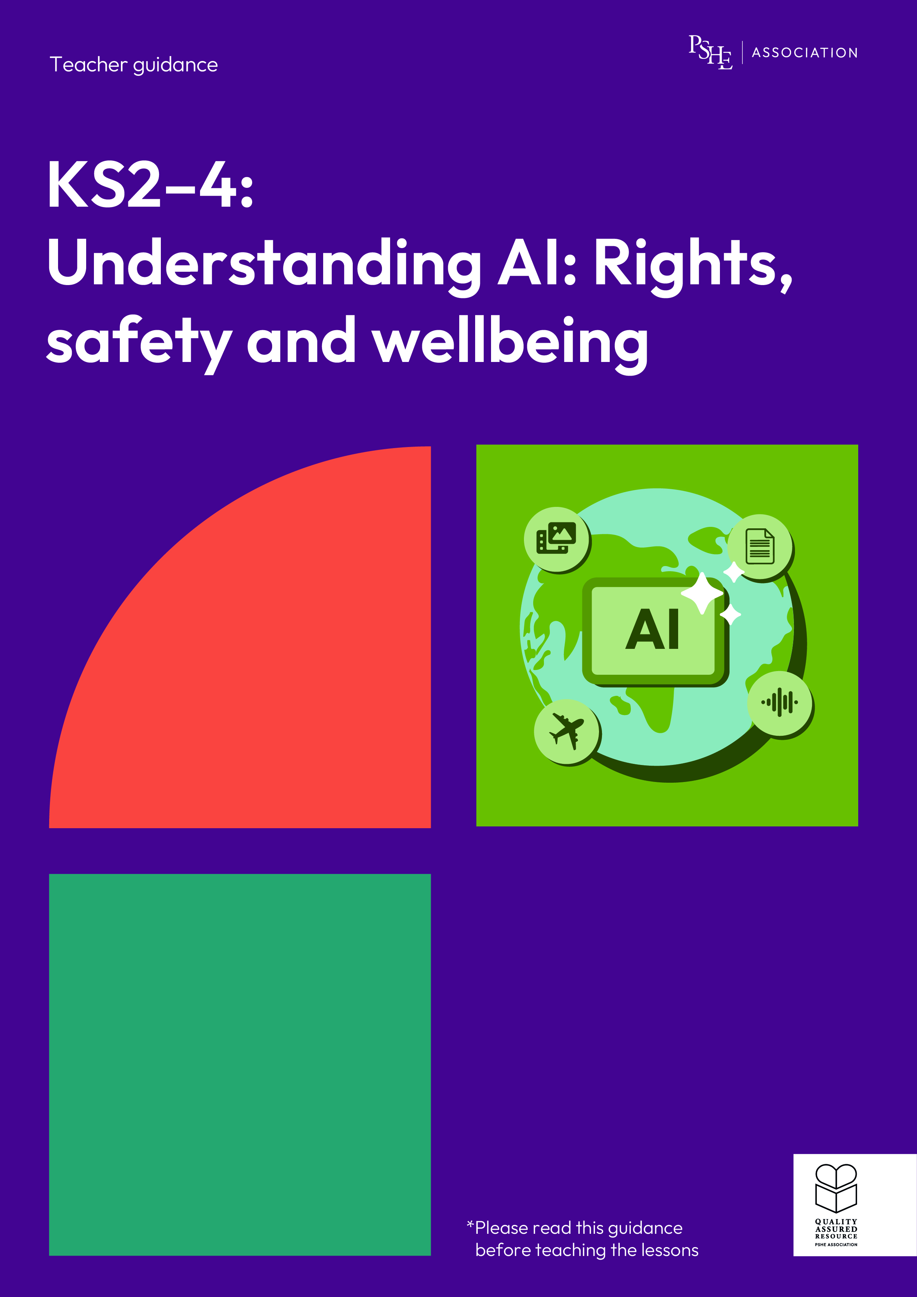
Understanding AI: Rights, safety and wellbeing
Year 9/10, Lesson 1: How does AI affect our daily lives?

Slide 2
Using this PowerPoint
The slides in this presentation are divided into two sections:
Teacher slides (purple) – provide key information regarding lesson preparation.
Student slides – provide a visual focus point for students during the lesson and delivery notes for teachers about the activities. Click ‘notes’ to view these.
Ensure that you select ‘Use Presenter View’ under the ‘Slide Show’ tab – this will allow you to preview the teaching notes on your monitor while the main presentation is displayed on a screen/smartboard.

Slide 3


Support and challenge
The lesson includes suggestions for support and challenge activities, to help you differentiate appropriately for your class.
Support activities are adapted to be more accessible for those who need it.
Challenge activities deepen and extend learning for those who need more challenge or who finish the activity quickly.
Look for these icons on the student slides. See delivery notes for details of the activities.
Challenge
Support

Slide 4
Context
This lesson pack for key stages 2–4 has been designed to support pupils’ AI literacy. This is the first of four lessons for students in years 9 and 10. It focuses on the different forms of artificial intelligence (AI) that people may come across, and how to manage the ethical considerations of using generative AI.
These lessons should not be taught in isolation, but always as part of a planned, developmental PSHE education programme. They are best used within the context of online safety or digital literacy.

Slide 5
To learn how different forms of AI affect our daily lives and work.
Students will be able to:
describe different forms of AI and how they can support work in different industries
identify how generative AI works and where people might encounter it in their daily lives
evaluate how professionals are managing some of the ethical concerns about generative AI

Slide 6
Box or envelope for questions
Resource 1: Types of AI
[one cut-up set per group]
Resource 2: Jax’s week
[one per pair]
Resource 2a: Jax’s diary
[support option as required]
Resource 3: Fact sheet
[one per pair]
Resource 3a: Ethical decisions
[support option as required]

Slide 7
Lesson summary
Activity | Description | Timing
Introduction | Introduce the learning objective and outcomes, set up the question box and revisit ground rules. | 2 min
Baseline assessment activity | Students complete an AI mind map demonstrating their current understanding. | 10 min
AI in industry | Groups categorise different types of AI and discuss how AI is used to support work in different industries. | 15 min
A week in the life of Jax | Pairs identify different types of generative AI people might come across in daily life. | 10 min
Career considerations | In pairs, students explore the factors that need to be considered to ensure ethical use of generative AI. | 12 min
Endpoint assessment and reflection | Students revisit their baseline and add in new learning. They reflect on factors that might impact their decision to use generative AI. | 8 min
Signpost support | Answer students’ questions and signpost support. | 3 min

Slide 8

How does AI affect our daily lives?
Lesson 1

Slide 9
Notes:
Teacher notes – Introduction (2 mins, slides 9-10)
Establish or revisit ground rules using the slide. Explain that if students have worries or questions during or after the lesson that they do not want to raise in front of the class, they can write their question on a piece of paper, anonymously or with their name, and put it in the question box.

Slide 10
To learn how different forms of AI affect our daily lives and work.
We will be able to:
describe different forms of AI and how they can support work in different industries
identify how generative AI works and where people might encounter it in their daily lives
evaluate how professionals are managing some of the ethical concerns about generative AI
Notes:
Teacher notes – Introduction (2 mins, slides 9-10)
Introduce the learning objective and outcomes. Explain that today’s lesson will explore different types of AI and how professionals are managing the ethical considerations about using generative AI.

Slide 11

What’s our starting point?
Complete an AI mind map considering:
what is AI?
where might someone come across AI in
daily life?
how might people
use AI at work?
what might someone want to consider before using AI?
What is AI?
What to consider?
AI
AI in
daily life
AI at work
Notes:
Teacher notes – Baseline assessment activity (10 mins)
Ask students to work on their own to complete an AI mind map considering:
what is AI?
where might someone come across AI in daily life?
how might people use AI at work?
what might someone want to consider before using AI?
Take feedback from volunteers to establish students’ starting points and notice any common themes in their work. Consider how the lesson may need adapting depending on any gaps or misconceptions. For example, if students can’t identify what someone might consider before using AI, spend more time evaluating how professionals manage ethical considerations of AI use in the third activity.

Slide 12
AI in industry
AI stands for ‘Artificial Intelligence’
A technology that allows computer systems to carry out complex tasks, which previously required human-like intelligence. AI systems are trained using data, detect patterns, and improve performance over time.
What is the definition of AI?
Notes:
Teacher notes – AI in industry (15 mins, slides 12-17)
Ask the class for a definition of AI before sharing the answer on the slide. Explain that AI involves computers using information to do things that, in the past, only humans have been able to do. Highlight that the word ‘intelligence’ can be misleading, because AI doesn’t think for itself, but instead uses data to predict patterns.

Slide 13




AI in industry
Organise the examples of AI into the four different categories.
Generation
These types of AI models can be used to generate (or create) new content, using existing data. They are sometimes known as ‘GenAI’.
Classification
AI can be trained to find groups in information and to label things as belonging to different categories.
Prediction
AI can process lots of data and find patterns in it, to predict what might happen in the future.
Recommendation
AI can process data about people’s behaviours, likes and interests – and make recommendations based on
this data.
Notes:
Teacher notes – AI in industry (15 mins, slides 12-17)
In groups, give students Resource 1: Types of AI and ask them to organise the examples of AI into four different categories:
Prediction
Classification
Generation
Recommendation

Slide 14
AI in industry
Generation
Image generator tools
Game level generation
Classification
Spam detection (email filters)
Image recognition
Medical diagnosis
(e.g. analysing X-rays)
Prediction
Weather forecasting
Disease progression mapping
Recommendation
Targeted ads on social media
‘Watch next’ video recommendations
Notes:
Teacher notes – AI in industry (15 mins, slides 12-17)
Take feedback using the slide for support.

Slide 15



AI in industry
AI is used to support work in different industries. For example, in education AI tools might sometimes be used to:
adapt content based on student strengths or areas to improve
mark work and generate feedback
identify patterns in data and predict student outcomes
translate text
create content e.g. quizzes and text summaries.
Notes:
Teacher notes – AI in industry (15 mins, slides 12-17)
Next, explain that AI is used to support work in different industries and share the example of education on the slide.

Slide 16









AI in industry
Discuss how AI could be used to support work in one of these industries.
Healthcare
Manufacturing
Finance and banking
Environmental science
Retail
Travel
Gaming
Notes:
Teacher notes – AI in industry (15 mins, slides 12-17)
Give each group one of the following industries: healthcare, finance and banking, retail, manufacturing, travel, gaming, or environmental science. Ask them to discuss how AI might be used to support work in that industry.
Take feedback, drawing out key learning:
Healthcare – analysis of medical images (e.g. CT scans, MRI, X-ray), predicting risk of developing medical conditions from patient history (e.g. diabetes and heart disease), personalised treatment plans, virtual assistants to answer medical questions and schedule appointments, robotic surgery, wearable devices (e.g. detecting irregular heart rate).
Finance and banking – fraud detection, credit scoring, trading, customer service virtual assistants, tailored budgeting tips on banking apps, predicting market trends to support investment decisions.
Retail – product recommendations, customer service virtual assistants, sales forecasting to manage stock levels, virtual ‘try on’ for online shopping, Al cameras to monitor suspicious behaviour around high value items.
Manufacturing – monitoring equipment for maintenance, product defect detection, process optimisation (reducing waste/increasing efficiency), robotics and automation, product design.
Travel – personalised travel plans, dynamic pricing (i.e. adjusting prices in real-time based on demand, supply, competitor prices, time, or customer behaviour), translation tools, facial recognition and other biometrics (e.g. voice recognition and iris scanning).
Gaming – non-player character behaviours, content generation (maps, characters, quests), game testing, enhancing graphics (generating realistic character movements or facial expressions), dynamic storylines.
Environmental science – climate modelling and weather prediction, environmental monitoring, tracking animal populations and movements through image recognition, disaster management and early warning systems, optimising the use of renewable energy by predicting supply and demand.
Challenge: Ask students to identify and discuss how AI from each of the four different categories can be used to support work in that industry.
Support: Give students the gaming industry and share the prompt questions on slide 17.

Slide 17

AI in industry
How might AI be used to check the quality of a game before it is launched?
How might AI be used to improve the graphics in
a game?
How might AI be used to give the gamer a more personalised gaming experience?
Gaming
Notes:
Teacher notes – AI in industry (15 mins, slides 12-17)
Share these prompt questions to support students, if required.

Slide 18


Generative AI
Generative AI tools can create new content. This often leads to the misconception that AI
can think.
Generative AI is trained on huge amounts of data. This allows patterns to be identified which are then used to create new content, based on prompts provided by the user.
Training data
Patterns
identified
New content
Image credits : David Man & Tristan Ferne / https://betterimagesofai.org / https://creativecommons.org/licenses/by/4.0/
Notes:
Teacher notes – A week in the life of Jax (10 mins, slides 18-21)
Explain that as well as at work, people come across AI in their daily lives, and this is often in the form of generative AI. Use the slide to highlight that as generative AI tools can create new content, this often leads to the misconception that AI can think. However, generative AI is trained on huge amounts of data – this allows patterns to be identified which are then used to create new content, based on prompts provided by the user.

Slide 19
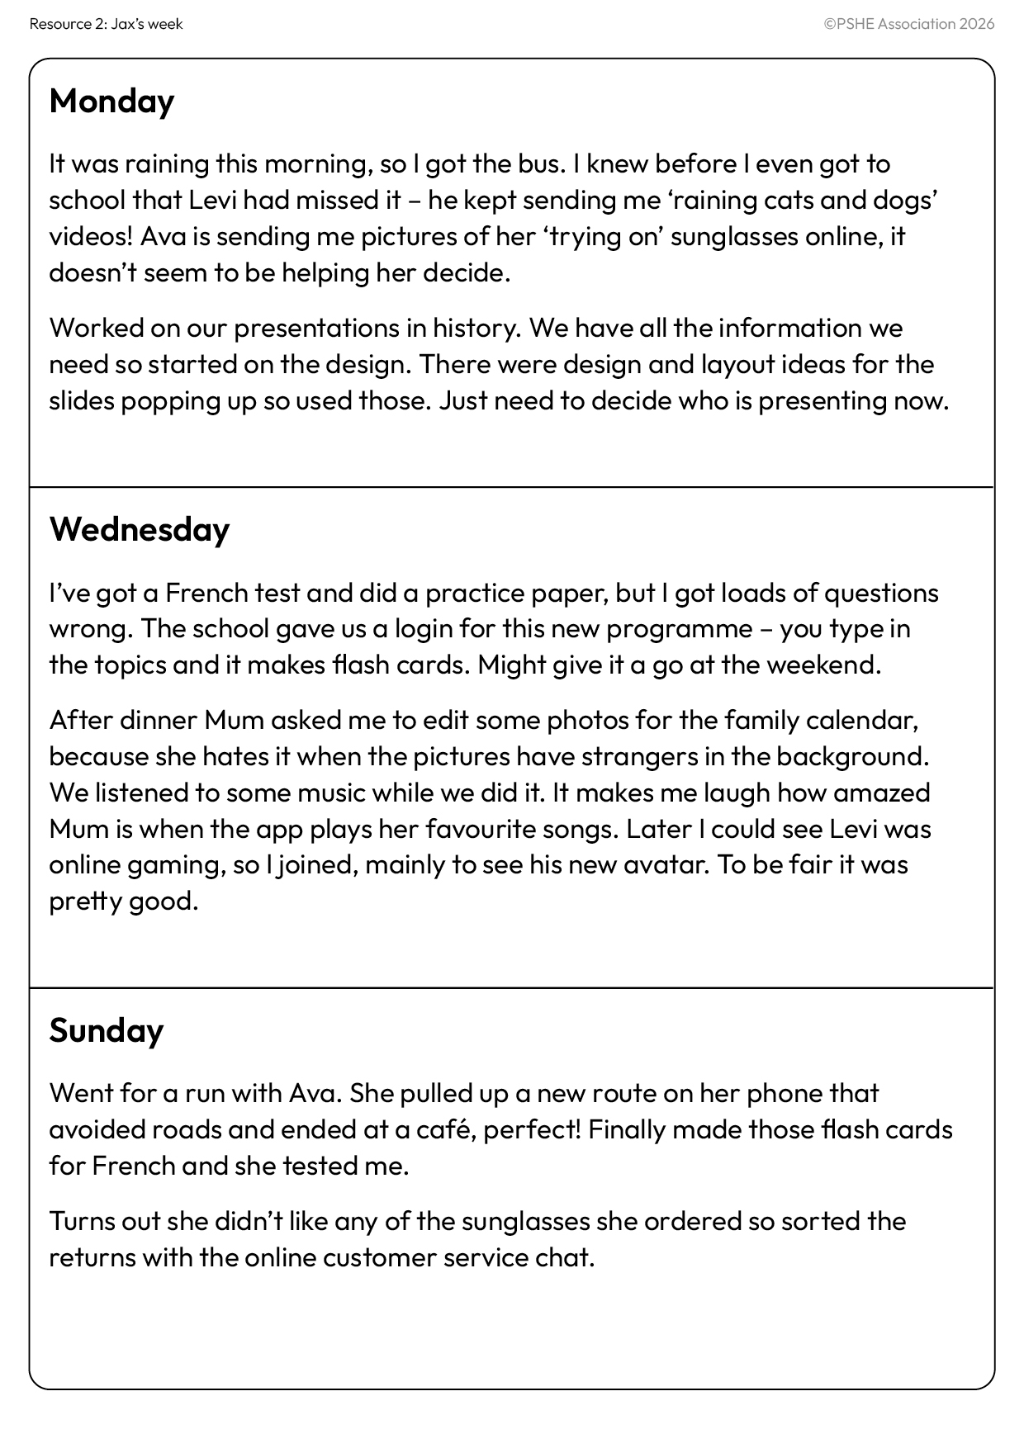
A week in the life of Jax
Highlight or circle all the examples of generative AI described in Jax’s diary.
Notes:
Teacher notes – A week in the life of Jax (10 mins, slides 18-21)
Give pairs Resource 2: Jax’s week and ask them to highlight/circle all the examples of generative AI described in Jax’s diary.
Support: Give students Resource 2a: Jax’s diary and ask them to identify which character used each example of generative AI in the diary entry.
Challenge: Ask students to discuss how the way someone uses generative AI at work might differ from using it in their personal life?

Slide 20
A week in the life of Jax
Monday
It was raining this morning, so I got the bus. I knew before I even got to school that Levi had missed it – he kept sending me ‘raining cats and dogs’ videos! Ava is sending me pictures of her ‘trying on’ sunglasses online, it doesn’t seem to be helping her decide.
Worked on our presentations in history. We have all the information we need, so started on the design. There were design and layout ideas for the slides popping up so used those. Just need to decide who is presenting now.
Notes:
Teacher notes – A week in the life of Jax (10 mins, slides 18-22)
Take feedback, using this and the next two slides.

Slide 21
A week in the life of Jax
Wednesday
I’ve got a French test and did a practice paper, but I got loads of questions wrong. The school gave us a login for this new programme – you type in the topics and it makes flash cards. Might give it a go at the weekend.
After dinner Mum asked me to edit some photos for the family calendar, because she hates it when the pictures have strangers in the background. We listened to some music while we did it. It makes me laugh how amazed Mum is when the app plays her favourite songs. Later I could see Levi was online gaming, so I joined, mainly to see his new avatar. To be fair it was pretty good.
Notes:
Teacher notes – A week in the life of Jax (10 mins, slides 18-22)
Take feedback, using this and the next slide.

Slide 22
A week in the life of Jax
Sunday
Went for a run with Ava. She pulled up a new route on her phone that avoided roads and ended at a café – perfect! Finally made those flash cards for French and she tested me.
Turns out she didn’t like any of the sunglasses she ordered, so sorted the returns with the online customer service chat.
Notes:
Teacher notes – A week in the life of Jax (10 mins, slides 18-22)
Finish taking feedback.

Slide 23



Workplace considerations
People often need to ensure ethical use of generative AI as part of their job.
To make an informed decision, users will need to consider factors such as bias, data privacy and environmental impacts.
Data privacy
Bias
Environmental impacts
Notes:
Teacher notes – Workplace considerations (12 mins, slides 23-25)
Explain that although generative AI has some benefits, such as saving time, there are things to consider when making decisions about whether to use it. This is particularly important for people who need to ensure ethical use of generative AI as part of their job. To make an informed decision, users will need to consider factors such as data privacy, bias, and environmental impacts. Give pairs Resource 3: Factsheet and give them a few minutes to read through the information.

Slide 24



Career considerations
A headteacher at a secondary school has been thinking about buying a generative
AI programme to help mark students work and provide personalised feedback.
Notes:
Teacher notes – Career considerations (12 mins, slides 23-25)
Explain that a headteacher at a secondary school has been thinking about buying a generative AI programme to help mark students’ work and provide personalised feedback.

Slide 25
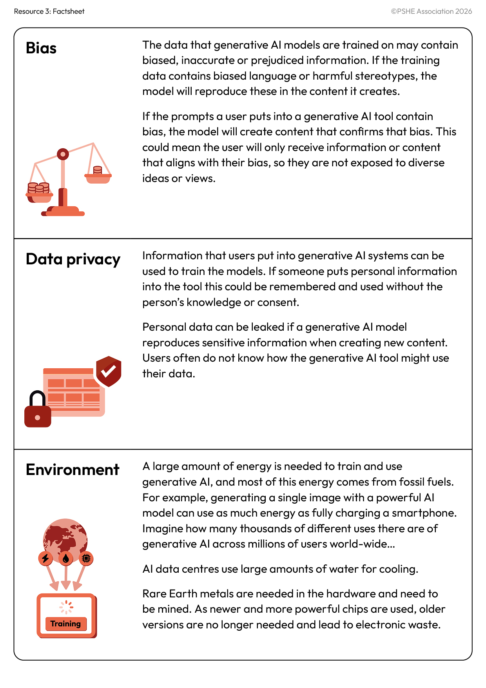

Career considerations
Use the information from Resource 3 to help answer the headteacher’s questions.
What are the benefits of using generative AI in this case?
What must be considered in relation to data privacy/security and what could be done to reduce these risks?
How might bias impact the student feedback? What could be done to reduce the impact?
What are the environmental implications of using generative AI? What could be done to reduce the impact?
How might using the feedback tool impact the relationship between teachers and their students?
Notes:
Teacher notes – Career considerations (12 mins, slides 23-25)
In pairs, ask them to use the information from Resource 3 to help answer the headteacher’s questions on the slide.
Take feedback, drawing out key learning:
Benefits may include saving teachers time, and possibly more detailed, targeted feedback for students.
Teachers would need to be aware of the privacy settings of the tool and how any data that is input would be used, no personal information such as students’ names, school or class should be input.
Feedback may not consider specific needs of the student; feedback may include biased content or reinforce stereotypes. Teachers would need to review and adapt the feedback.
Teachers should be aware that using the generative AI tool may increase the school’s environmental impact. They could look at ways the school could reduce energy use in other ways to offset the use of the tool. They could limit the use to a specific number of assessments each year.
Students knowing that the teacher has not read their work may impact their relationship with the teacher. Teachers will have less understanding of the student’s ability and progress.
Finally, explain that the headteacher will need to decide if the benefits of using generative AI will outweigh the negatives, and if they can put enough safeguards in place to ensure any negative impacts are minimised. Highlight that this is a dilemma many different industries and professionals are now having to consider.
Support: Give students Resource 3a: Ethical decisions and ask them to circle the statement that helps answer each of the head teacher’s questions.

Slide 26

Reflection
How might factors like data privacy, bias and environmental impact, affect the decisions you make related to the use of generative AI?
Notes:
Teacher notes – Reflection (3 mins)
Ask students to reflect on how factors like data privacy, bias and environmental impact might affect the decisions they make related to the use of generative AI. As this is a personal reflection, students do not need to share their responses with the class.

Slide 27
What have we learnt?
Revisit the concept map and add in new learning in a different colour.
Consider:
how different types of AI are used to support different industries
where someone might come across generative AI
what needs to be considered for AI tools to be used ethically and responsibly
We will be able to:
describe different forms of AI and how they can support work in different industries
identify how generative AI works and where people might encounter it in their daily lives
evaluate how professionals are managing some of the ethical concerns about generative AI
What is AI?
Ethics and responsibility
Generative AI
What to consider ?
AI
AI in
daily life
AI in industries
AI at work
Notes:
Teacher notes – Endpoint assessment (5 mins)
Remind students of the learning outcomes and ask them to revisit the baseline activity, adding new learning in a different colour, considering:
how different types of AI are used to support different industries
where someone might come across generative AI
what needs to be considered for AI tools to be used ethically and responsibly
This is an opportunity to assess students’ progress and identify any gaps in their understanding that may need addressing in the following lessons. Check the question box and respond to any questions you can answer immediately. Consider how you might address others in subsequent lessons in this series.

Slide 28


Sources of support
If concerned about the use of AI, speak to a trusted adult at home or at school (for example the head of year or form tutor).
Or find information and advice from: Childline - www.childline.org.uk; 0800 1111
I need your help with something . . .
Something's worrying me,
can I talk to you?
I have something that’s been bothering me . . .
Notes:
Teacher notes – Signposting support (3 mins)
Remind students that if they have concerns about the use of AI, it is important they speak to a trusted adult at home or at school (for example the head of year or form tutor). Students can also contact:
Childline - www.childline.org.uk; 0800 111

Slide 29


More activities
Ethical use of generative AI
Write a set of guidelines, or a checklist of questions, to help promote the ethical use of generative AI.
The guidelines should include information that will help someone consider:
the impact of bias
environmental considerations
data privacy
whether using AI for a task is the most appropriate solution
Notes:
Teacher notes – Extension activity (3 mins)
Ask students to write a set of guidelines, or a checklist of questions, to help promote the ethical use of generative AI. The guidelines should include information
that will help someone consider:
the impact of bias
environmental considerations
data privacy
whether using AI for a task is the most appropriate solution

