Slide 1
RSE and Parental Consultation
What schools should know

Slide 2
The Guidance States That Schools:
Must…
Provide RHE as part of the basic curriculum, and integrated within a broad and balanced curriculum
Have a school policy for Relationships Education, or Relationships and Sex Education
Provide parental ‘opt out’ from sex education
Consult parents
Be accessible for all pupils
Comply with the Equalities Act
Should…
Involve pupils in determining the curriculum & policy
Cover the learning set out in the ‘pupils should know by the end of primary’ tables
Be resourced, staffed and timetabled in a way that ensures the school can fulfil its legal obligations
Sex Ed Forum guidance

Slide 3
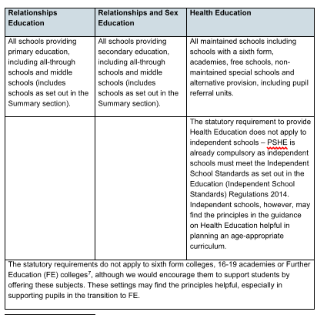
What is RSE?
Relationships and Sex Education
DfE Guidance
Relationships and sex education (RSE) is learning about the emotional, social and physical aspects of growing up, relationships, sex, human sexuality and sexual health.
It should equip children and young people with the information, skills and positive values to have safe, fulfilling relationships, to enjoy their sexuality and to take responsibility for their sexual health and wellbeing.
The importance of this has been recognised and is now a compulsory subject along with Health Education in both Primary and Secondary settings.

Slide 4
DfE Guidance for ‘Parental Engagement with Relationships Education’
Engagement means schools providing the opportunity for parents to feed in their views on the school’s proposed Relationships Education policy and includes considering whether any strongly held views of their parent body should lead the school to adapt when and how they approach certain topics with their pupils.
Schools should consider those views and balance them with their views on the needs of the pupils and school. Ultimately it is for schools to decide their curriculum, having taken these views on board.
Both parties should engage in open, constructive and respectful dialogue at all times.
Engagement works best when everyone involved enters into it with an open mind.
https://www.gov.uk/government/publications/engaging-parents-with-relationships-education-policy

Slide 5
DfE Guidance for Parents
We are clear that parents and carers are the prime educators for children on many of these matters. Schools complement and reinforce this role and have told us that they see building on what pupils learn at home as an important part of delivering a good education.
DfE Guidance
Parent information leaflets have been produced for both primary and secondary. They are available to download from the DfE website
https://assets.publishing.service.gov.uk/government/uploads/system/uploads/attachment_data/file/907638/RSE_primary_schools_guide_for_parents.pdf

Slide 6
Parent Involvement Model

Slide 7
Forms of Parental Engagement
It is important that parents are involved in the development of the RSE curriculum including discussions around when lessons are delivered. Most schools share topic coverage with parents as part of everyday practice for all curriculum areas. Engagement could be carried out in the following ways:
Questionnaires (confidential but not anonymous so that discussions can be had with individuals if necessary.)
Open questions e.g. What do you think are the most important things your child needs to learn?
Face to face discussion (when possible)
Use the channels of communication already established in school, e.g., newsletters, topic letters, school website, information evenings, etc
The Sex Education forum suggests the following steps:
Share the facts Invite suggestions Share new policy and plans Give regular information about what is taught/when

Slide 8
Dealing with Parental Concerns
Some parents will have anxieties about the teaching of RSE and this needs to be taken into consideration. The curriculum must be led by the guidance, but every setting and their community will be different. If there are strongly held parental views, the school needs to work with them to look at the possible approaches or adaptations to the teaching.
DfE Guidance states ‘Engagement means schools providing the opportunity for parents to feed in their views on the school’s proposed Relationships Education policy and includes considering whether any strongly held views of their parent body should lead the school to adapt when and how they approach certain topics with their pupils.’
However, the guidance also states that ‘We do not think that head teachers should spend disproportionate amounts of time engaging parents or that this engagement should go on in perpetuity’
Therefore, it is important to remember that we will not always be able to meet individual needs and need to think of the whole school community.
These are good discussion points which could be used with parents :
What was you RSE teaching like and what would you like it to be like for your children?
What do you value? Which values do we have in common? How do these build on the ethos of our school?
Which topics do you want more help with at home? Which topics are high priority?
Are there any beliefs or practices relevant to puberty, relationships and sex education that are important in your culture/faith which we might not be aware of?
(Sex Ed Forum)

Slide 9
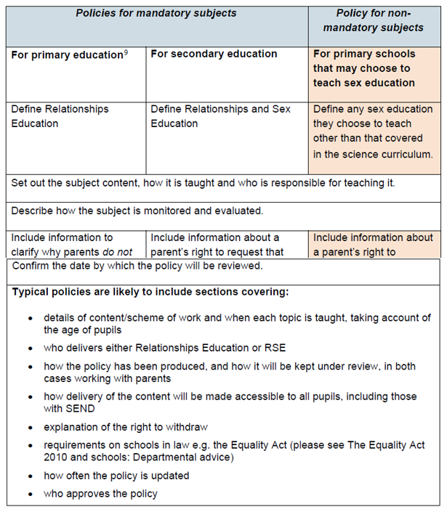
RSE Policy
Using the DfE Guidance you will need to ensure a school RSE policy is in place. GHLL has produced policies they are happy to share
This will need to be published and shared with parents

Slide 10
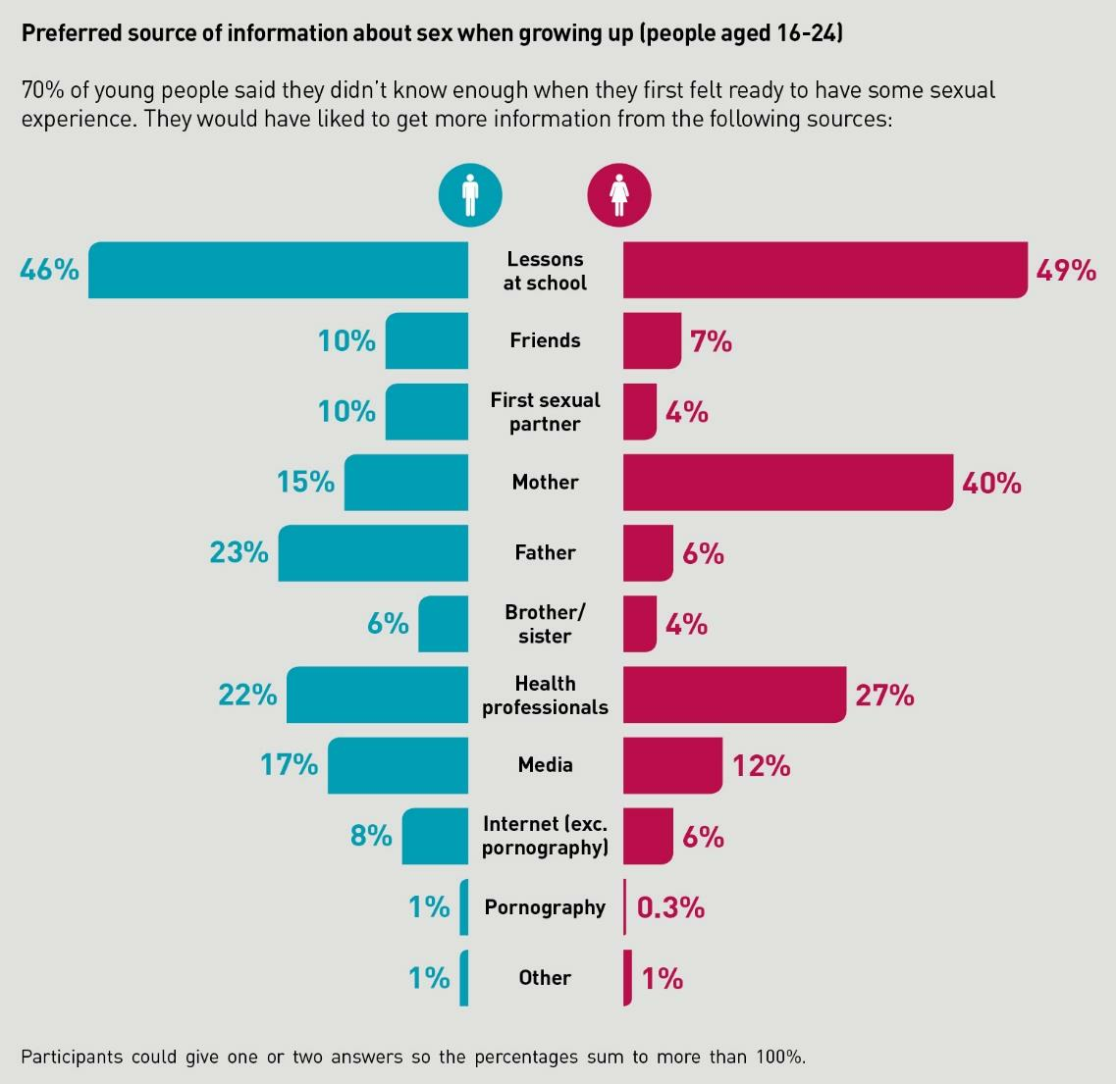
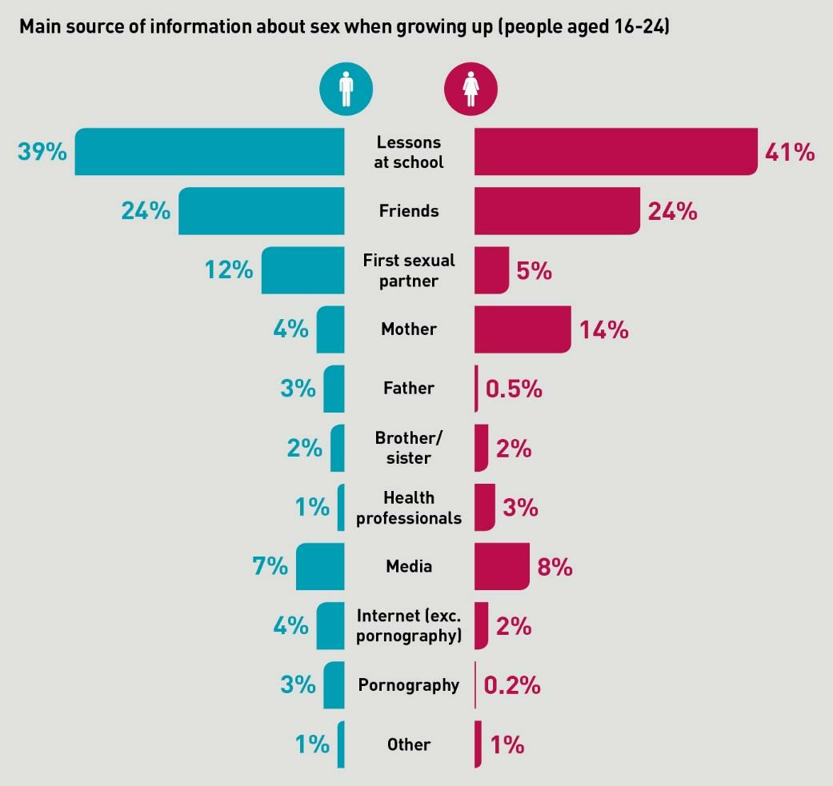
Parents as Educators
1
2
It isimportant that we empower parents to be able to support their children with RSE. By sharing information, such as when topics are covered, parents can then be part of the learning process. Children are saying that they want advice from their parents. Chart I shows where young people would like to get information from. However, Chart 2 shows where they are currently getting information from. (from mrc.ukri.org research)

Slide 11
Suggestions for Resources to Share with Parents
If there are any resources linked to the topic you are teaching, it is good practice to share with parents to help them support their children. Questions may be raised at home, and this will ensure parents are confident to deal with them. It will consolidate their learning in school.
BBC resources: KS1 KS1 PSHE, Relationships Education, and Health Education - BBC Teach
KS2 Relationships and Sex Education (RSE) - Teaching Resources - BBC Teach
NSPCC https://learning.nspcc.org.uk/research-resources/schools/relationships-health-and-sex-education-resources
Educating Eve https://eveappeal.org.uk/blog/educating-eve
Big Talk Education https://www.bigtalkeducation.co.uk/parents
FPA: A simple guide for parents: Parents Guide to Relationships & Sex Education in Primary School (fpa.org.uk)
Sex Education Forum sexeducationforum.org.uk | Working together for quality relationships and sex education

