Slide 1

Emotional Health
To understand what emotional health is, and how it may vary over time (knowledge).
To be able to identify and put into practice protective factors that will help to maintain balance in our personal emotional health (skills).
To challenge the stigma associated with poor emotional health, and to be able to discuss ways of maintaining good emotional health (attitudes/values).

Slide 2

Working with a talk partner
Think of as many words as you can associated with emotional health
Using your words, come up with a definition for Emotional Health.

Slide 3
What is an emotion?
FEELING
BEHAVIOUR
PHYSIOLOGICAL
RESPONSE

Slide 4
How do we know what emotions people may be feeling?
Facial Expressions

Slide 5
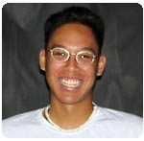
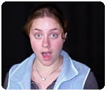
How do we know what emotions people may be feeling?

Slide 6
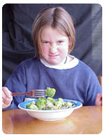
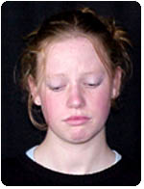
How do we know what emotions people may be feeling?

Slide 7
How do we know what emotions people may be feeling?
Body Language

Slide 8
Is good emotional health…..
Being Happy all the time?
What do you think good emotional health looks like?

Slide 9
Emotional Health Time Line Graph
Good
Thin about how you have felt over the past few weeks.
What ups and downs have you had?
Bad
Time

Slide 10
Balance Line
Bad
Good

Slide 11
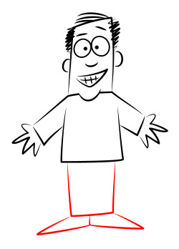
We all fall on this continuum somewhere. We move along the line depending on how we're feeling.
Most of the time we're balanced somewhere in the middle.
Bad
Good
We all face challenges in our lives, and the stress or pressure of these can push
us towards the negative end.
When something really good happens
we're at the positive.

Slide 12
Emotional health is about finding positive ways to cope with challenges in our life and keeping our emotional balance.

Slide 13
What knocks people off balance?
Negative
Positive
worrying about schoolwork,
missing out on a social activity,
getting a poor mark for work,
feeling ill,
being bullied
sport,
relaxing in front of the telly,
getting homework done,
socialising,
A favourite lesson (PSHE ☺),
weekends,
being with family,
sharing a problem with someone else,
finishing some revision,

Slide 14
What helps people to recover and keep their balance?
Write your suggestions down.

Slide 15


Slide 16
Reflect.
Do you know where to go for help either in school or out of school if you want to talk further about any issues raised?
What would you like to learn more about on the topic of emotional and mental health?

Slide 17
So…
Are people born with good or bad emotional health?

Slide 18
Copy this in to your books…
People are not born with good or poor emotional health. It depends on the circumstances they grow up in, as well as the knowledge and skills and experience they collect throughout their life, and of course, the way they use them.

Slide 19
How come some people have lots of difficulties in their lives but still manage to achieve?

Slide 20
Copy This in to your book…
Resilience
The ability to recover quickly from illness, change, or misfortune

Slide 21
Overcoming a Challenge….
Video

Slide 22
“Positive coping strategies”
Use a safe website to look at how other young people are feeling
Confiding in friend and family
Counselling
Thinking about the advice you would give a friend in the same situation
Asking for help, advice or support
Making a list of good things about yourself/life
Talking about worries or problems
Burning off stress and thinking things through by exercising
Finding out about local services
Writing feelings down
Doing something you enjoy
Using a helpline

Slide 23
Remember the little things you do every day help you keep the balance – as well as the big things.
And… remember, life is full of ups and downs, it’s how we deal with them that matters.

Slide 24
http://www.hrmvideo.com/catalog/stronger-tougher-smarter

Slide 25
Explain WHY it is important to deal with varied emotions (what is the impact of bottling things up?)
Explain HOW we can be emotionally resilient (When face with a challenge what can you DO to help cope? E.g. look for the positives, talk to people about worries/fears, make time for yourself, try new things etc)
Choice of format – either:
a. An information poster
b. A newspaper article
c. A storyboard for a TV advert campaign

Slide 26
Homework Task
Interview 2 people in your family and find out how they deal with stress or worries in their everyday lives.

