Slide 2
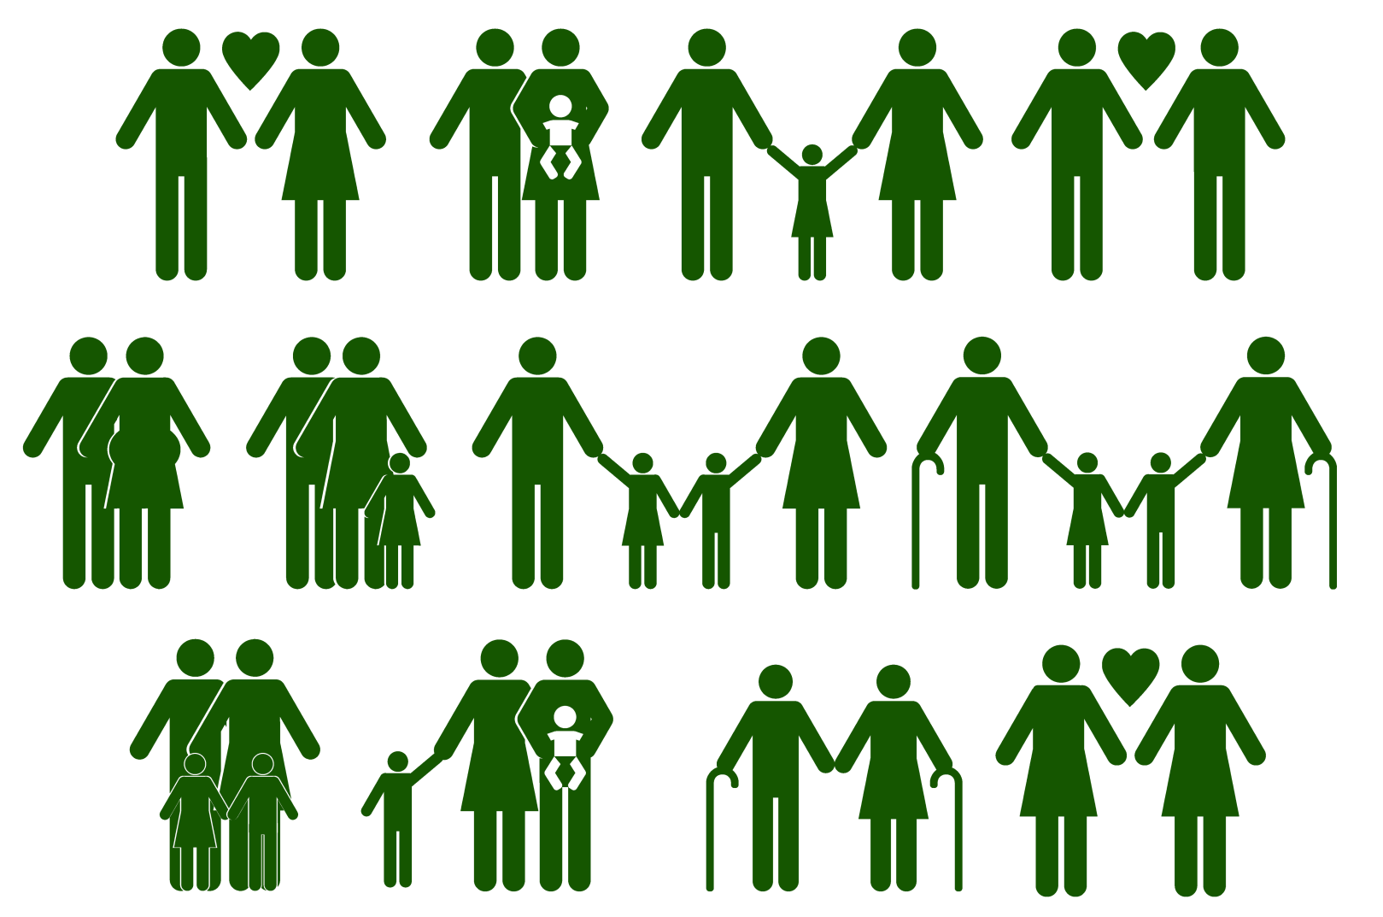
Family

Slide 3
Family
What is a family?
There is no fixed recipe for a family; just a group of people who love and care for one another.
Love and care are the most important ingredients!
Think of the things that family members can do to care for each other.

Slide 4
Christmas Challenge…
Feel Good Five
1. Connect – talk with someone in your family and really listen to what they have to say, perhaps ask about something that happened at work, at a club or perhaps how he or she is feeling today and why that is.

Slide 5
2. Be active – do something active with your family like going for a walk or playing a game that gets you moving.

Slide 6
3. Take notice – take a bit of time to notice things around you, perhaps have a mindful moment, notice what you can see, hear, smell, feel. Perhaps notice what the people around you are up to, how they are feeling or acting.

Slide 7
4. Learn – We’re learning new things all the time, see if you can find out something new, an interesting fact, perhaps learn a new skill, you could write fact files about your family’s favourite things.

Slide 8
5. Give – Think of an opportunity to show kindness to someone else. Being kind to others actually makes you feel good so it’s a kindness for you as much as the person on the receiving end! Try doing something to help out around the house, maybe an opportunity to share with someone, maybe just holding open a door for someone or saying something kind.

Slide 9
Your Challenge!
It would be fabulous if you could do the Feel Good Five every day but for this challenge, we’re only asking you to do them just three times over the Christmas holiday – how easy is that!?

Slide 10
We’ll send you home with a sheet like this to complete, but you can record your challenge in any way you like. Just remember to include your name, a picture of your family and complete the statements with the happiness scale before and after the challenge.
Do this first!
Do this last!

Slide 11
That’s it. Now you just need to go and share the Feel Good Five with everyone you know!
OAKS – One Act of Kindness Shared
Complete over the Christmas holidays….
Return to your PSHE teacher the first lesson back.

