Slide 1







Reconnecting & Returning
XXXX School
8th March 2021
Notes:
Just change the photos and details to create your own ready-made PowerPoint to be shared with pupils on the return. Feel free to adapt to meet the school’s needs

Slide 2

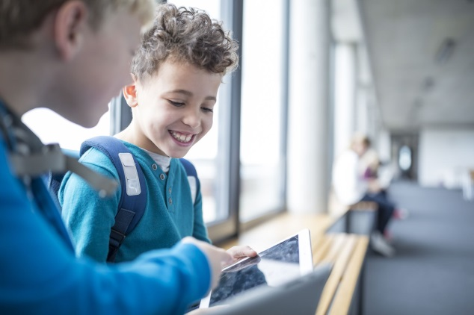



XXXX School are pleased to have you all in school together
Welcomes to new pupils/returning pupils
Changes to groups
Sharing updates & good news e.g. successes of pupils and staff during the period of ‘lockdown’
Notes:
This slide is to give a chance for the staff delivering this to welcome the children back together and to share some

Slide 3
Information for you to know
Things which are different
Things which are the same as before
Classrooms are the same for pupils
Same use of toilets
New playground area for KS1
Different entrances to come in from
One way system in lunch hall
Notes:
This slide allows the staff to share routines which are the same and new ones or changes to help them to know what is happening and feel secure. Here are some examples to share

Slide 4

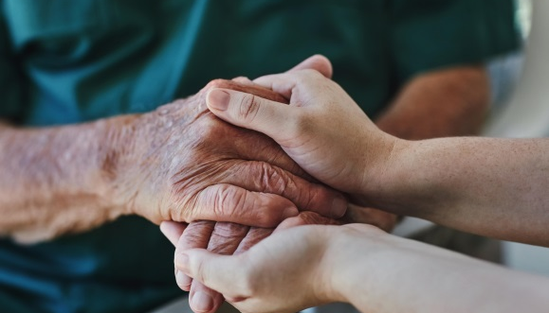
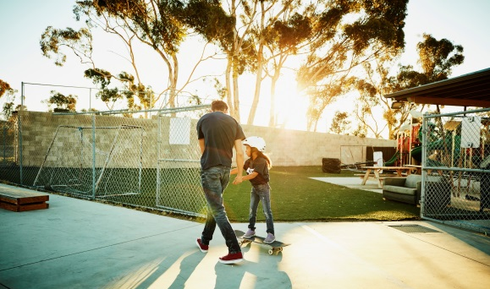
School values/key beliefs
Supportive – we like to work together to help each other
Thoughtful – at xxx school, we think of others and care for each other
Kind – we are kind to our friends and families
Polite – we treat others as we want to be treated
Persevere – we always try hard and do our best, even when things are hard
Notes:
This could be the school ethos or values as part of the school values which can be shared and reiterated with examples of how pupils and staff have continued this/will continue this to share expectations and remind pupils of lots of the lovely behaviours we see from them at school

Slide 5


Reconnecting
There will be time for us to come together to build our friendships and relationships:
Extra tutor time/circle time
Time to focus on friendships and relationships with key adults
More group tasks and activities to encourage working together
Assemblies and whole school groups using technology
Having time to talk about your feelings about coming back – excitement and worries
Notes:
These are some examples of ways for the school to connect and build relationships, using the approach of every ‘interaction is an intervention’

Slide 6

Sharing together
Remember you can use the ‘worry box’ / ‘question box’ or tell yout teacher/teaching partner if you want to ask questions about coming back to school
Each class will be doing some tasks together to tell their partner/group 2 good things they have done during ‘lockdown’ either at school or while home-schooling
Your teacher and key adults will be spending some time which all of you to help you to feel safe and happy at school. You can tell them if you need help or are worried
Notes:
It will be useful for staff to be able to detail when and how pupils will be able to communicate with adults or with each other about their experiences if they want to, to let them know it is okay to talk if they want to or not if they don’t however there are opportunities to discuss or be supported by adults

Slide 7
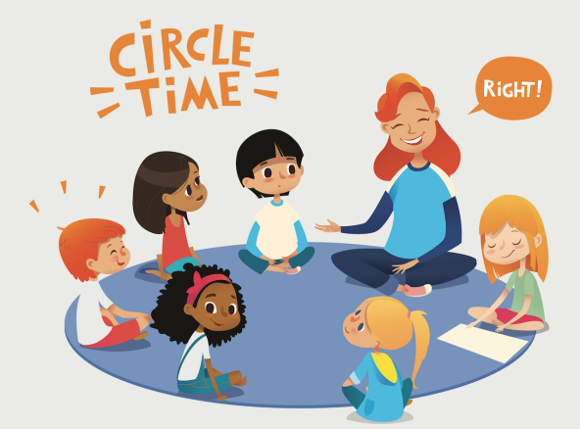



Who Can Help?
Your parent(s)/carers/grandparent or other trusted adult
Ask your class teacher in your school
<insert name of Wellbeing lead > which room they are located in?
Tic+ Helpline for children age 9years up - CALL: 0300 303 8080
free and confidential
Child line - Call 0800 1111

